Slide 1
Wealth Creation in Disrupting Times
ACAE CAPITAL MARKETS SUMMIT, FEB 2019, KOLKATA

Slide 2
What is ‘Disruption’?
‘disruption’ (noun):
Disturbance or problems which interrupt an event, activity or process
(Synonyms):
disturbance / disordering / disarrangement / upsetting / unsettling / confusing)

Slide 3
What is ‘Disruption’?
‘disrupt’ (verb):
..to prevent something, especially a system, process, or event, from continuing as usual or as expected

Slide 4
What is ‘Disruption’?
Business Definition:
..to change the traditional way that an industry operates, especially in a new and effective way!

Slide 5
Examples of ‘Disruption’?

Slide 6
What is ‘Disruption’?
Disruption v/s Innovation
Both are used interchangeably
Can get mixed up
Outcomes are what differentiates the two

Slide 7
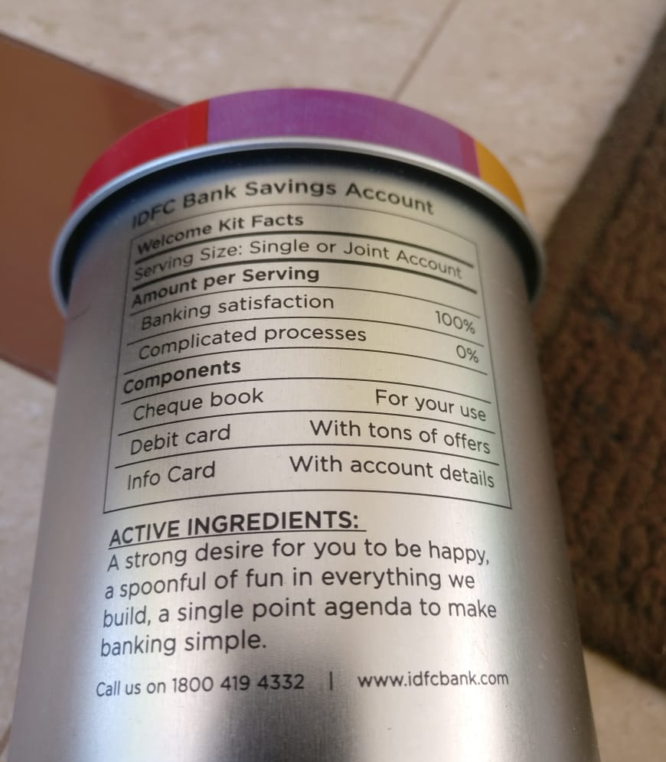
Disruption or Innovation?

Slide 8
Disruption or Innovation?

Slide 9
Why Disruption happens?
Disruption has its origin in anticipating unstated or future needs of customers
It most likely starts by either satisfying the less-demanding customer or creating a market where none existed before
Facebook’s guiding principle is “If we don’t invent the thing that will kill Facebook, someone else will”

Slide 10
Investors just cannot ignore Disruption Time taken to grow is shrinking!

Slide 11
Investors just cannot ignore Disruption The reaction time is shrinking!

Slide 12
Investors just cannot ignore Disruption The impact is too fast, once it starts!

Slide 13
Investors just cannot ignore Disruption Its happening usually too quietly!

Slide 14
Challenges with spotting Disruption
Disruption can take lots of time to make an impact and test your patience
Biz models can look completely different than what’s already there, so that makes it difficult to identify in the early stages
Successful disruptions start off as very normal businesses – there are not bells that ring!

Slide 15
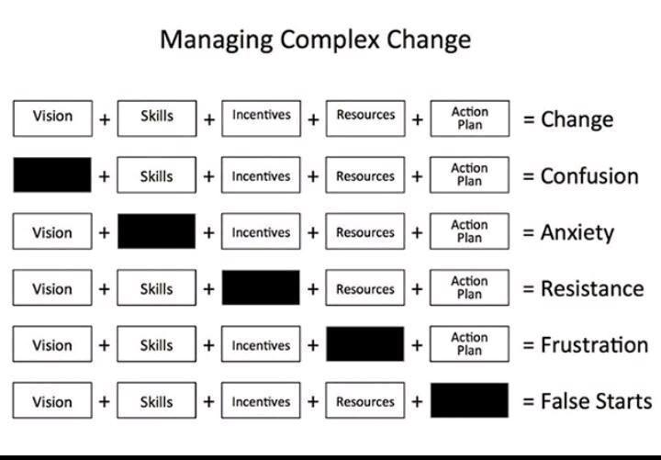
How to evaluate disruptors?

Slide 16
4 Simple Ways to make the most of Investing in Disruption
1
Invest in the Disruptor themselves
- Binary outcomes : Hero v/s Zero

Slide 17
4 Simple Ways to make the most of Investing in Disruption
2
Invest in the beneficiary of the new technology or change
- Companies that are agile enough to embrace and integrate helpful innovations
(eg. MARUTI ~ UBER)

Slide 18
4 Simple Ways to make the most of Investing in Disruption
3
Avoid the disrupted
- Narrowing moats of businesses are a red flag
(eg. CAMERA Cos/ CASTROL/ EVEREADY)

Slide 19
4 Simple Ways to make the most of Investing in Disruption
4
Look for opportunities from overreactions
- Hype v/s Reality is a paradigm that always exists in markets
(eg. EV ecosystem)

Slide 20
Where to look for Opportunities to Invest
Businesses where margins & growth have plateaued
Sectors where competition is getting complacent
Oligopolies that are getting challenged by new entrants
Capital allocation is being made into innovation
New consumer segments are appearing

Slide 21
Is Disruption good for Investors?
It could be a FRIEND, if we are ready to….
Anticipate
Accept
Assimilate
Act
It could end up being a FOE, if we chose to….
Refuse to recognise
Reject
Resist
Repent

Slide 22
Should we be worried of Disruption?
No amount of
ARTIFICIAL INTELLIGENCE
can replace
NATURAL STUPIDITY!

Slide 23
Happy Investing!
We always overestimate the change that will occur in the next two years and underestimate the change that will occur in the next ten. Don't let yourself be lulled into inaction.
-Bill Gates

