Slide 1
Unique Document Identification Number (UDIN)
A Way to Secure Documents

Slide 2
ABOUT UDIN
What is the need of UDIN
What is Unique about UDIN
What is the schedule for mandating UDIN
Is UDIN Secure
Is any document required to be uploaded on UDIN
Is there any fee for UDIN
Can UDIN be generated on later date of signing / certifying Document/ Reports/ Financial Statements

Slide 3
Why UDIN?
It has been noticed by the Institute that financial documents/certificates attested by third person misrepresenting themselves as CA members are misleading the authorities and stakeholders
Forged Signature are used for getting Bank Loans/to sign Financial Statements for Regulators
Surrogated Firms are being created with forged Signature to bid for tenders with the connivance of authorities
Contd..

Slide 4
Why UDIN?
Fake Signature of one Partner by another Partner of the same firm without his knowledge
Non Existent Partners are being added in Firms in the absence of proper KYC of Members at ICAI
Forged Signatures are rampant in Certificates by Part-time COP Holders/Non CAs

Slide 5
What is Unique about UDIN?
Only Members with Full time Certificate of Practice (CoP) can register
No limit on the number of generation of UDIN
Only Singing Partner can generate UDIN
Regulators and Banks can verify the credentials of documents certified by CAs
No fee for registration/generation of UDIN

Slide 6
UDIN being made mandatory
As per Council decision UDIN is being made mandatory as per following phases:
For all Certifications w.e.f. 1st Feb., 2019
For all GST & Tax Audit Reports w.e.f. 1st April, 2019
For all other Assurance / Attest functions w.e.f. 1st July, 2019.

Slide 7
Is UDIN Secure?
OTP & UDIN is shared only on registered Mobile & Email of the Members
No Client Name is required to be disclosed anywhere
No document is required to be uploaded

Slide 8
When can UDIN be Generated?
UDIN is to be generated at the time of signing the Certificate/ Document. However, the same can be generated within 15 days of the signing Certificate/ Document, in case of an emergency.

Slide 9
ALGORITHM OF UDIN
The UDIN is system generated random 18 digit number
Wherein;
First 2 Digits are the last 2 digits of the Current Year
Next 6 Digits are ICAI’s Membership No.
Next 10 Digits are Alpha-numeric generated randomly by the system

Slide 10
MEANING OF CERTIFICATES?
With effect from 1st Feb., 2019, it is mandatory to obtain UDIN for all Certificates* issued where the financial information/related contents is certified as True and Fair / True and Correct.
It should also be noted that for certificates, detailed Guidance note have been issued by AASB of ICAI as Guidance Note on Reports or Certificates for Special Purposes (Revised 2016) with illustrative formats, to be followed by the Practicing Chartered Accountants.
*Certificates includes Reports issued in lieu of a certificate in terms of Guidance Note on Reports or Certificates for Special Purposes (Revised 2016)

Slide 11
An illustrative dropdown list of certificates is appearing on the Portal. In case, the type of certificate being certified is not appearing in the said list, Members are advised to select “others” and mention the nomenclature of the certificate in Document Description.

Slide 12
What will not be covered under Certificates
Non-applicability of UDIN can be listed out but the list is not exhaustive. Like in the 1st phase, requirement of obtaining UDIN is Not Applicable for :
Auditor's Opinion/Reports issued by the Practicing Chartered Accountant under any Statute w.r.t. any entity or any person (e.g.: Transfer Price Audit, Company Audit, Trust Audit, Society Audit, etc.)

Slide 14
FLOW OF UDIN SYSTEM
Portal available on https://udin.icai.org
Member Sign up for Ist time register
Generation of UDIN
Print UDIN as watermarked/handwritten
Member Login by Six digit Membership Number and Password

Slide 15
PROCESS OF REGISTRATION AT UDIN PORTAL
Visit www.udin.icai.org

Slide 16
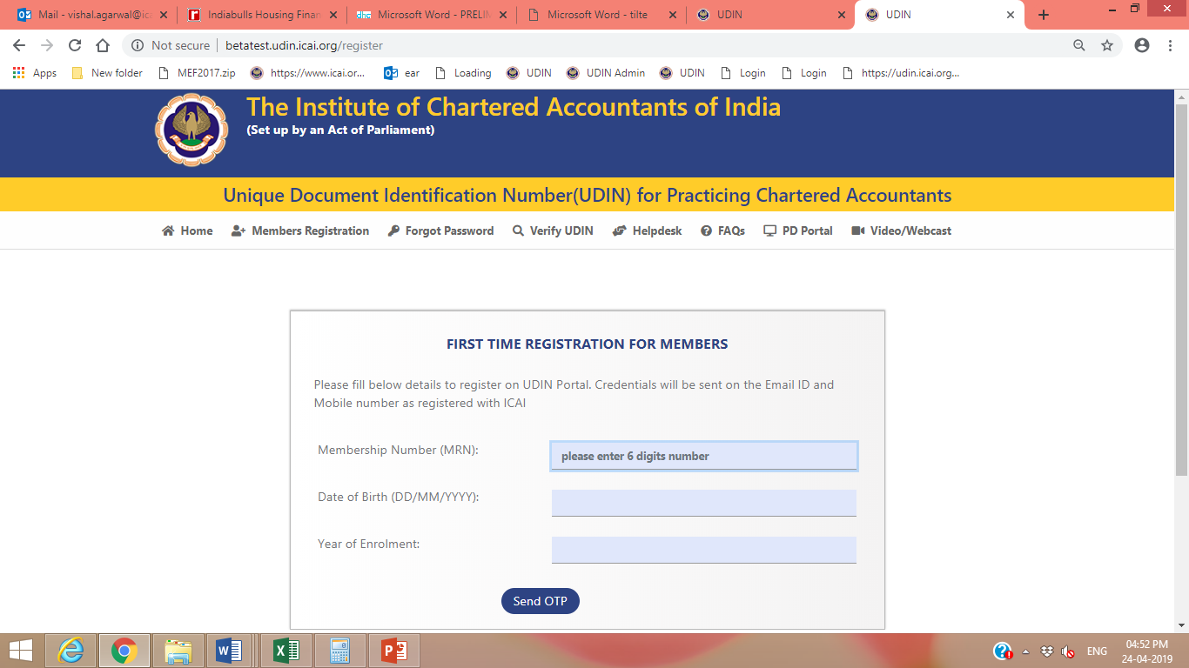
MEMBER REGISTRATION

Slide 17
REGISTRATION OF MEMBER ON UDIN
Step 1: Click “Member Registration” Tab or click at “For first time sign up, click here” under Member’s Login
Step 2: Registration window will be opened. After entering Six-digits Membership No., Date of Birth and Year of Enrolment please click “Send OTP”. An OTP will be sent to the Mobile and Email of the Member as registered with ICAI.
On confirmation of OTP as received, a Username and Password will be sent to the registered Email and Mobile No.
Note:- It is only one-time exercise

Slide 18
CHANGE PASSWORD
The password generated by the system is encrypted to ensure the appropriate safety. However, interested Members may change the password at any time through “Change Password” button.

Slide 19
FORGOT PASSWORD

Slide 20
FORGOT PASSWORD
Forgot Password” form will be opened, enter six-digit Membership No., Date of Birth and Year of Enrolment and click “Send OTP”. An OTP will be sent on registered mobile and email.
On confirmation OTP as received, a Username and password will be sent to the registered email and Mobile No.

Slide 21
GENERATION Of UDIN
Step 1: Member Login
Login by entering the Username as 6 digits Membership Number and password under Member’s Login

Slide 22
GENERATION Of UDIN
Step 2: After login, window for “Generate UDIN” will open

Slide 23
GENERATION Of UDIN
Membership Registration Number, Member Name and Email id are pre-filled fields
Please select Document type- Certificates/ GST & Tax Audits (presently Other Attest Functions is inactive as is not mandatory as of now)
Select the “Type of Certificate”- in case of Certificates and “Particulars of Section/ Form under which report issued” – in case of GST & Tax Audit Reports from the dropdown list. The list is illustrative and in case the type of the certificate / section / form being certified / issued is not appearing in the said list, please select others and mention the nomenclature of the certificate in Document Description
Enter the date of signing/certifying the document in “Date of Signing Document”
Enter the KEY FIELDS*
Under “Document Description” enter the description / details / text from Certificate / Document. If others has been selected for Type of Certificate/ Section, then mention the description. Then Click the button “Send OTP”.

Slide 24
GENERATION Of UDIN- For Certificates
KEY FIELDS
Enter Financial Figures i.e. any Financial Figures from the document being certified such as Turnover/Net worth etc.
Enter Particulars of the Figure i.e. Turnover/ Net worth etc. to be filled in 10 to 40 characters.
Two Financial Figures are mandatory out of 3 (three) given fields. In case, there is no Financial Figure in the Certificate, Zero (0) is to be mentioned in Financial Figure and in its Particulars mention “There is no Financial Figure in Certificate”.

Slide 25
GENERATION Of UDIN

Slide 26
GENERATION Of UDIN- For GST & Tax Audit
Key fields under “Figures / Values/Description” in Tax Audits
Under Section 44AB, the following 5 key fields are mandatory:
Total Turnover as per Form 3CD
Net Profit/ Turnover as per Form 3CD
WDV of Fixed Assets as per Form 3CD
Assessment Year
Firm Registration Number (FRN)
In case where there is no figure/value available in the report related to above key fields from Sl. No. 1 to 3, mention “0”. The Assessment Year at Sl. No. 4 is to be filled in YYYY-YYYY format. In case, there is no FRN at Sl. No. 5 mention “Not Applicable/NA” and proceed.
Apart from above, one additional key field of PAN is there which is optional.

Slide 27
GENERATION Of UDIN- For GST & Tax Audit
Key fields under “Figures / Values/Description” for Other Tax Audit Reports other than Section 44AB, following 3 key fields are mandatory:
Assessment Year
Firm Registration Number (FRN)
Any Figure/Value from the Report
The Assessment Year is to be filled in YYYY-YYYY format. In case, there is no FRN at Sl. No. 2 mention “Not Applicable/NA” and proceed. For 3rd Mandatory field some Figure/Value from report has to be mentioned. In case, there is no figure/value available in the report related to key fields at Sl. No. 3, mention “0” and proceed.
Apart from these, there are 3 additional key fields including PAN of the Assessee which are optional.

Slide 28
GENERATION Of UDIN- For GST & Tax Audit
Key fields under “Figures / Values/Description” for Section 35(5) of CGST Act, 2017 - Form GST 9C, the mandatory key fields are as under:
Turnover (incld. exports) as per Audited Financial Statements under Clause 5 (A) of Form 9C
Turnover as declared in Annual Return (GSTR 9) under Clause 5 (Q) of Form 9C
Assessment Year
Firm Registration Number (FRN)
In case where there is no figure available in the form related to above mandatory key fields from Sl. No. 1 to 2, mention “0”. The Assessment Year at Sl. No. 3 is to be filled in YYYY-YYYY format. In case, there is no FRN as at Sl. No. 4, mention “Not Applicable/NA” and proceed.
Apart from the above, there are 2 more key fields including GSTIN of the Assessee which are optional.

Slide 29
GENERATION Of UDIN- For GST & Tax Audit
For Section 66(1) of CGST Act, 2017 -Form ADT-04, the mandatory key fields are as under:
Short payment of Tax as per Form ADT-04
Any other amount as per Form ADT-04
Assessment Year
Firm Registration Number (FRN)
In case where there is no figure available in the form related to above mandatory key fields from Sl. No. 1 to 2, mention “0”. The Assessment Year at Sl. No. 3 is to be filled in YYYY-YYYY format. In case, there is no FRN as at Sl. No. 4 mention “Not Applicable/NA” and proceed.
Apart from the above, there are 2 more key fields including GSTIN of the Assessee which are optional.

Slide 30
GENERATION Of UDIN
After this an OTP will be sent on registered Mobile and Email of the Member.
Then enter OTP as received and click “Preview”. In Preview, details so entered for generating the UDIN will be displayed. If there is any change/error in the content, click “Edit” button or else click “Submit”.
A notification – SMS and Email would be sent to Members after generation of UDIN.

Slide 31
On confirmation of OTP, 18 Digit UDIN will be generated and displayed. The generated UDIN can be used for mentioning on the Certificate/ Document/ Reprt for which it has been generated either by printing (watermarked) or it can be handwritten.
GENERATION Of UDIN

Slide 32
DISPLAY OF UDIN ON CERTIFICATE
UDIN that generated can be as watermarked on document(s) else the UDIN can also be mentioned on the document(s) by using a pen.

Slide 33
SEARCH UDIN
UDIN generated by the members can be tracked through “Search” and List UDIN menu from your UDIN account

Slide 34
List UDIN

Slide 35
REVOKE / CANCEL UDIN

Slide 36
REVOKE / CANCEL UDIN
In case, due to any error Member wants to cancel the UDIN generated can do so through Revoke facility
To revoke Member has to mention reason of revocation/cancellation .
If any Regulator/ Bank verify for this UDIN, appropriate narration indicated by Member with the date of revoke will be displayed for reference.

Slide 37
VERIFY UDIN by Authorities/Regulators /Banks/others
The Authorities/Regulators /Banks/others can Go to the link https://udin.icai.org .
Click on verify UDIN

Slide 38
VERIFY UDIN by Authorities/Regulators /Banks/others
At Verify UDIN option, mention the UDIN number & some details like authorities name, mobile, email, details of the document will appear.

Slide 39
VERIFY UDIN by Authorities/Regulators /Banks/others
In case document is revoked, System generated email/SMS will be sent to the Regulators and third parties who have already viewed the documents so that they can be aware about the revocation of documents.

Slide 40
HELPDESK FACILITY

Slide 41
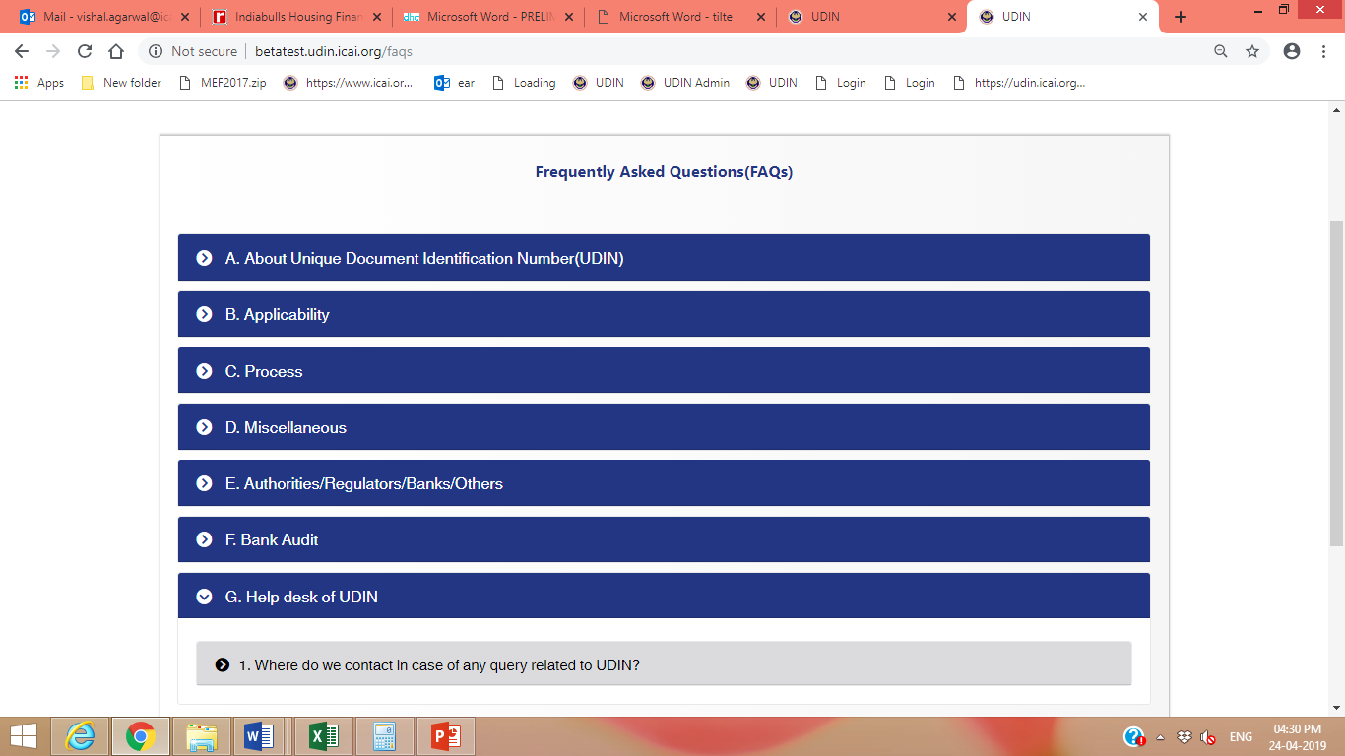
FREQUENTLY ASKED QUESTIONS ON UDIN

Slide 42
Important Issues in UDIN
1.SAE 3400 Examine/report on Prospective Financial Information.
Second Schedule, Part I, Clause 3- Estimate on Future Earning
100th meeting held on 22nd through 24th July 1982, a chartered accountant can participate in the preparation of profit or financial forecasts and can review them, provided he indicates clearly in his report the sources of information, the basis of forecasts and also the major assumptions made in arriving at the forecasts and so long as he does not vouch for the accuracy of the forecasts.

Slide 43
Non Compliance of UDIN
Clause (1) of Part II of Second Schedule of CA Act
“A Member shall be guilty of Professional misconduct if he contravenes any of the provisions of the Act, Regulations or Guidelines issued by the Council”

Slide 44
Advantages of UDIN
Elimination of Fake/Forged CA Certificates
Elimination of Fake/Forged CAs
Check on the No of Audit Reports certified by CAs as per Laws
Check on remittances of money as per FCRA/FEMA Act
Check/Control on the attest function done by Practising CAs
Check on Money Laundering/Benami Transactions if CA Certificates
Check on the Tax Avoidances Measures on Income Tax and GST as every transactions is supported by UDIN enabled Certificates
Check on all Certificates/Audit of All Govt Sponsored Schemes

Slide 45
THANK YOU
CA Ranjeet Kumar Agarwal
Convenor, UDIN Monitoring Group
9830140211/rka.icai@gmail.com

