Slide 1
Simplified New Returns & Amended GSTR 9 & 9C
CA Vikash Kumar Banka
ACAE CA Study Circle-EIRC
11.12.2019

Slide 2
Contents
Sahaj, Sugam & Normal Return
GSTR 9- Form Level Discussion
GSTR 9C-Form Level Discussion
Technical Glitches and Probable Solutions

Slide 3
New GST Returns

Slide 4
New GST Returns
Jul 2018 – 28th GST Council meeting approves concept of new simplified returns.
Nov 2019 – Prototype introduced.
Apr 2020 - To be implemented.

Slide 5
TYPE OF RETURN
Taxpayer Turnover
< Rs. 5 crore
Ret-1 (Normal)
Ret- 2 (Sahaj)
>= Rs. 5 crore
Ret – 1 (Normal)
Ret – 3 (Sugam)

Slide 6
Comparison
 | Monthly | Quarterly
Parameters | RET-1 | RET-1 | Sahaj (RET-2) | Sugam (RET-3)
Applicability | Aggregate T.O. >= Rs. 5 crores | Aggregate T.O. < Rs. 5 crores | Aggregate T.O. < Rs. 5 crores B2C | Aggregate T.O. < Rs. 5 crores B2B and B2C
Input Tax Credit for missing invoices | Allowed | Allowed | Not Allowed | Not Allowed
Applicability for e-commerce operators | Allowed | Allowed | Not Allowed | Not Allowed

Slide 7
Annexures to Returns
Anx-1
Outward
Anx-2
Inward
Annex to returns
Manual Fill-up
Auto Generated

Slide 8
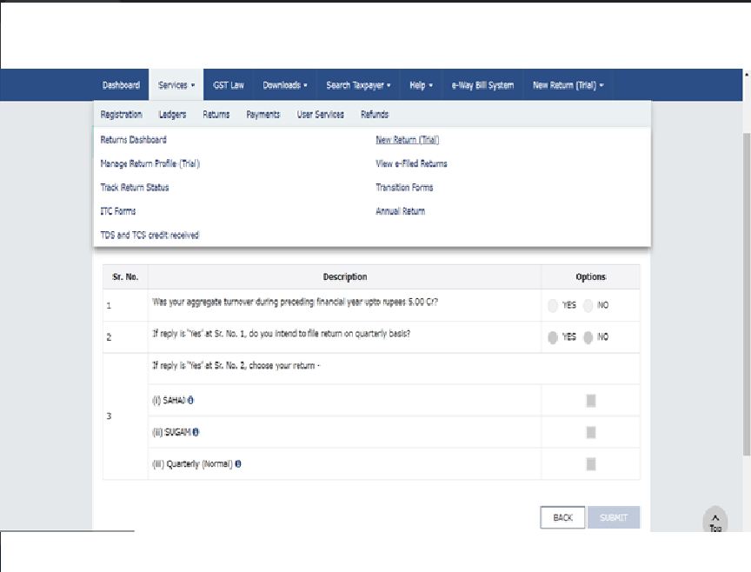

Slide 9
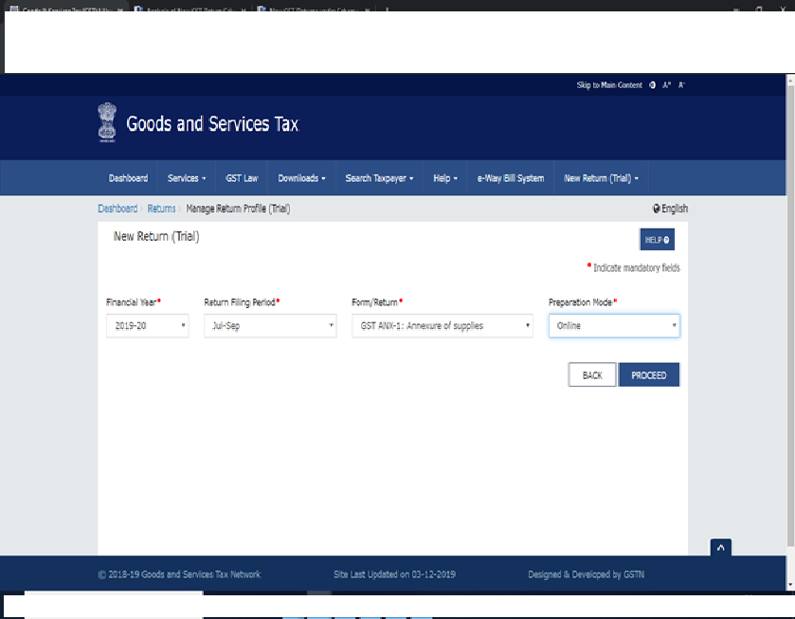
SAHAJ PROTOTYPE

Slide 10
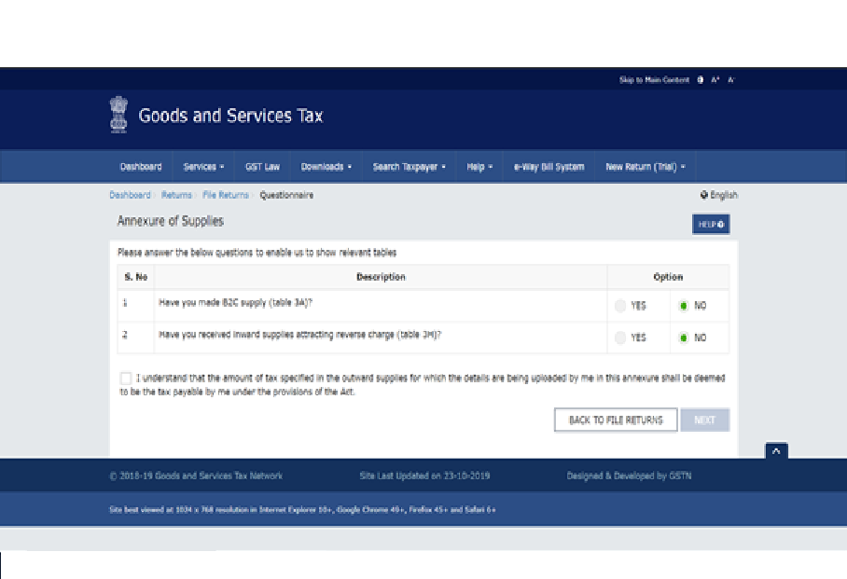

Slide 11
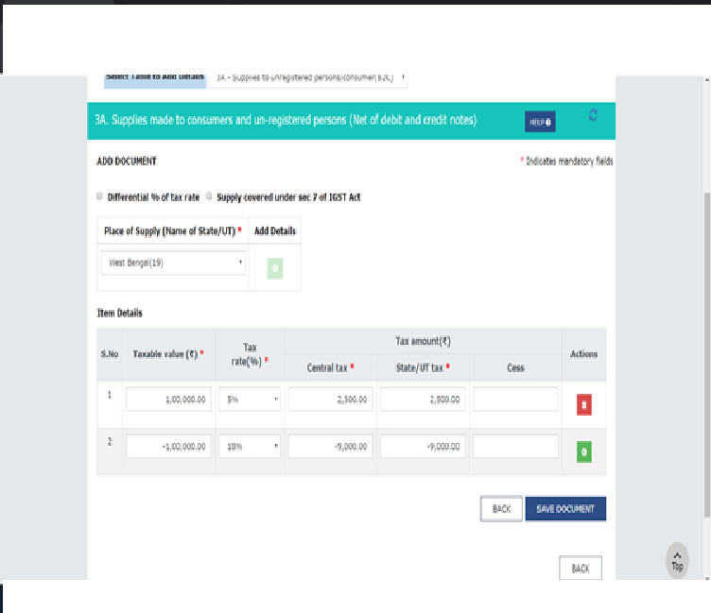

Slide 12
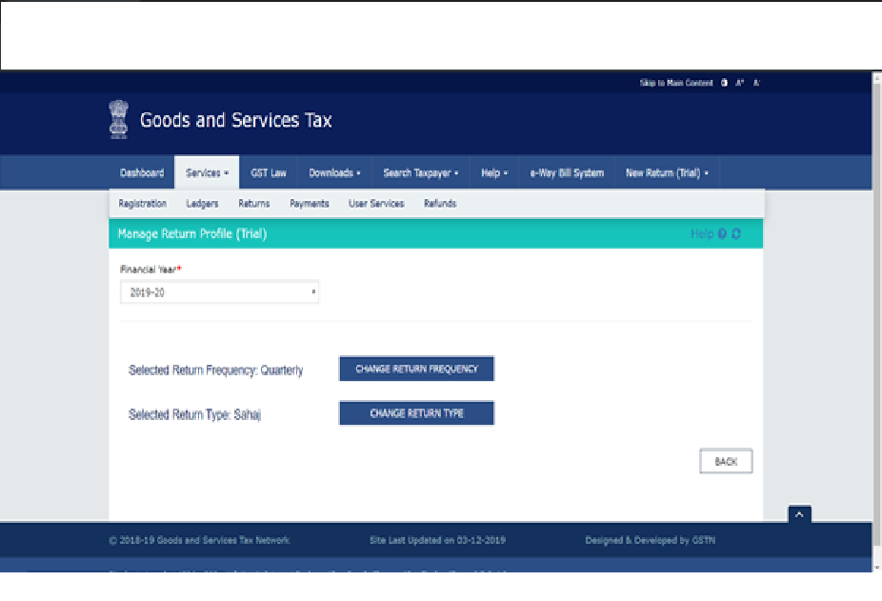
SWITCH-OVER OPTION

Slide 13
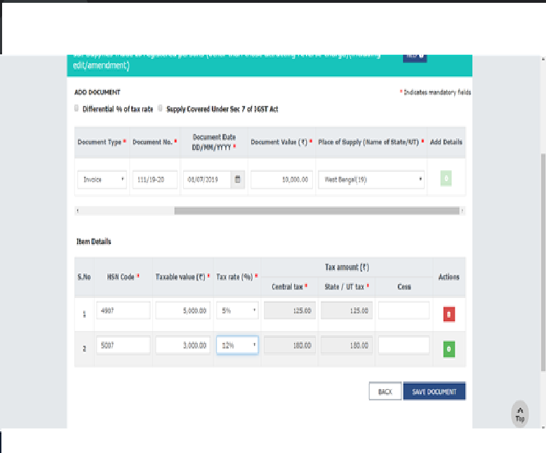
SUGAM B2B

Slide 14
GSTR-9 Annual Return

Slide 15
N. No. 56/2019 dt. 14.11.19
Seventh amendment (2019) in the CGST Rules, 2017. [Primarily related to Simplification of the Annual Return / Reconciliation Statement]
Applicable to Which Financial Years?
Due date ?

Slide 16
Optional Furnishing of Annual Return
For F.Y. 2017-18 & 2018-19
Whose aggregate turnover in FY does not exceed Rs. 2 crores
Should we opt it?

Slide 17
GSTR-9
Part I | Part II | Part III | Part IV | Part V | Part VI
Basic Details | Liability | ITC | Taxes Paid | Circular 26/2017 Adjustments | Other Info
Table 1-3 | Table 4-5 | Table 6-8 | Table 9 | Table 10-14 | Table 15-19

Slide 18
GSTR-9 at a glance
Description |  | Table No. of GSTR 9
Turnover as per Books | = | 4 + 5 + 10-11
Tax Paid as per Books | = | 9 & 14
ITC as per Books | = | 6-7-12+13
Refund | = | 15
Informative details | = | 1,2,3,8,16,17,18
Late Fee payment | = | 19

Slide 19
Changes in GSTR-9
Conditional Optional
Absolute Optional

Slide 20
Changes in GSTR-9
Conditional Optional |  | Description
T4, T5 | = | Outward Supply
T-6, T7, T8 | = | ITC
T9 | = | Tax Paid (No Change)
T10, T11 | = | Outward Supply reported in subsequent period (No Change)

Slide 21
Changes in GSTR-9
Absolute Optional |  | Description
T12,T13 | = | Inward Supply reported in subsequent period
T14 | = | Tax Paid (No Change)
T15 | = | Refund & Demand
T16 | = | Composite Supply, Deemed Supply u/s 143, Sale on Approval basis
T17, T18 | = | HSN Summary of Outward & Inward Supply

Slide 22
Changes in Outward Supplies

Slide 23
Changes in Table 4
Table No. 4I to 4L [DN/CN & amendments in outward supply reported in T-4B to T-4E:
Now optional
If not reported in above tables:
can be reported in T-4B to T-4E after taking net effect

Slide 24
Changes in T-5
Table No. 5D, 5E & 5F [Exempted, Nil rated and Non- GST supply]:
Break up now optional
Consolidated information may be furnished in T-5D (Exempted Supply)

Slide 25
Changes in Table 5 (Contd..)
Table No. 5H to 5K [DN/CN & amendments in outward supply reported in T-5A to T-5F:
Now optional
If not reported in above tables:
can be reported in T-5A to T-5F after taking net effect

Slide 26
Table 9,10 & 11
No Changes
Table 9- Tax Paid
Table 10- Amendments/additions of outward supplies
Table 11- Amendments/reductions of outward supplies

Slide 27
Changes in ITC

Slide 28
Changes in Table 6
Break up of ITC now optional
Entire amount can be reported in Inputs column only.
Tables
6B
6C & 6D (Entire ITC of both can be reported in 6D)
6E

Slide 29
Changes in Table 7
Table 7A to 7H:
Entire amount can be reported in 7H alongwith other reversals.
Reversal of TRAN-1 & TRAN-2
Mandatorily to be reported in T-7F and T-7G respectively.

Slide 30
Changes in Table 12 & 13
T-12: ITC taken in F.Y. 17-18 reversed in 18-19
-Now optional
T-13: ITC of F.Y. 17-18 taken in 18-19
-Now optional
Is it really optional?

Slide 31
Changes in Informative Tables

Slide 32
Table 8- Related to 2A
Auto populated data of 2A
F.Y. 17-18: 1st May, 2019
F.Y. 18-19: 1st Nov, 2019

Slide 33
Table 8- Related to 2A
Table No. 8A to 8D:
Now optional
However, if option is exercised, details of 8A-8D to be uploaded in PDF form with 9C
Without CA certification

Slide 34
Table 15, 16, 17, 18
All These tables now optional
Table No. 15: Demand & Refund
Table No. 16: Composition Tax Payer, Deemed Supply (Sec.143), & Goods sent on approval basis
Table No. 17: HSN Summary of Outward Supplies
Table No. 18: HSN Summary of Inward Supplies

Slide 36
GST Audit

Slide 37
Changes in Table 5 of Form 9C
Table No. 5B to 5N in respect of various items in Turnover reconciliation:
after reporting of GSTIN wise turnover as per Books of Accounts in T-5A and turnover as per GSTR-9 (5N+10-11) in T-5Q, if any difference exists, then:
instead of reporting the adjustments in various tables of T-5, Taxpayer now have an option to report such adjustments in T-5O.
Consequences

Slide 38
Changes in Table 12 of Form 9C
Table No. 12B(ITC booked in earlier Financial Year claimed in current Financial Year): Now optional
Table No. 12C (ITC booked in current Financial Year to be claimed in subsequent Financial year): Now optional
Consequences

Slide 39
Changes in Table 14 of Form 9C
Table No. 14: Reconciliation of ITC declared in annual Return (GSTR9) with ITC availed on expenses as per audited annual financial statement or books of account: Now optional

Slide 40
Changes in Certification Part

Slide 41
Changes in Certification Part
Now in Para 5 of B(i) and in Para 4 of B(ii) of audit certificate the word True and correct is replaced by the word “True and Fair”.
Now cash flow statement needs to be attached only if applicable under any law. However, in B(i) or B(ii), Cash Flow Statement is still a mandatory field in Form. In such a case, put date there and give observation in Para 5.

Slide 42
Data Flow-GSTR-9 to 9C
Table No. of 9C | Description |  | Table No. of GSTR 9
5Q | Turnover as declared in Annual Return (GSTR-9) | = | 5N +10-11
7F | Taxable turnover as per liability declared in Annual Return (GSTR-9) | = | 4N-4G+10-11
9Q | Total amount paid as declared in Annual Return (GSTR 9) | = | 9+14
12E | ITC claimed in Annual Return (GSTR 9) | = | 7J
14S | ITC claimed in Annual Return (GSTR 9) | = | 7J

Slide 43
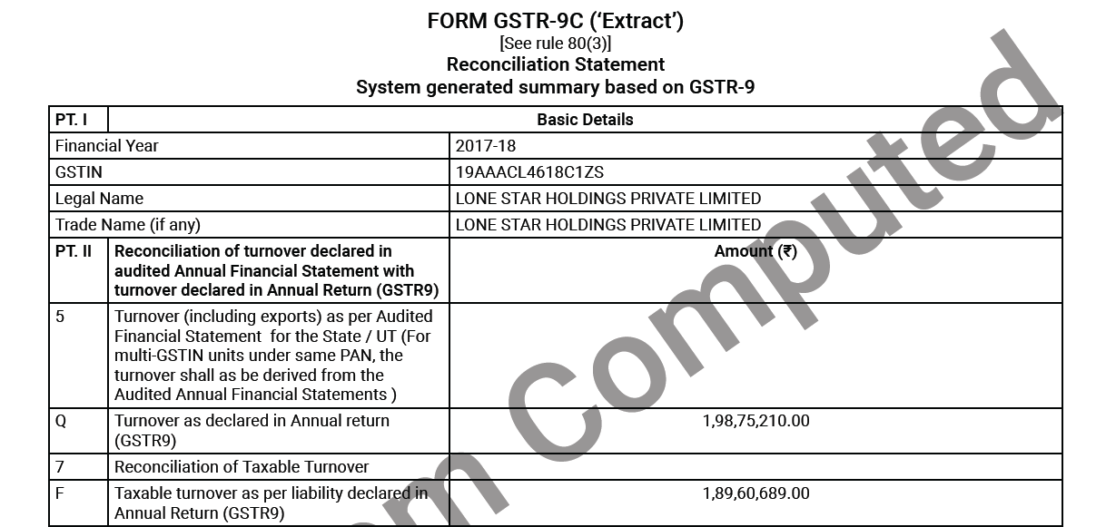

Slide 44
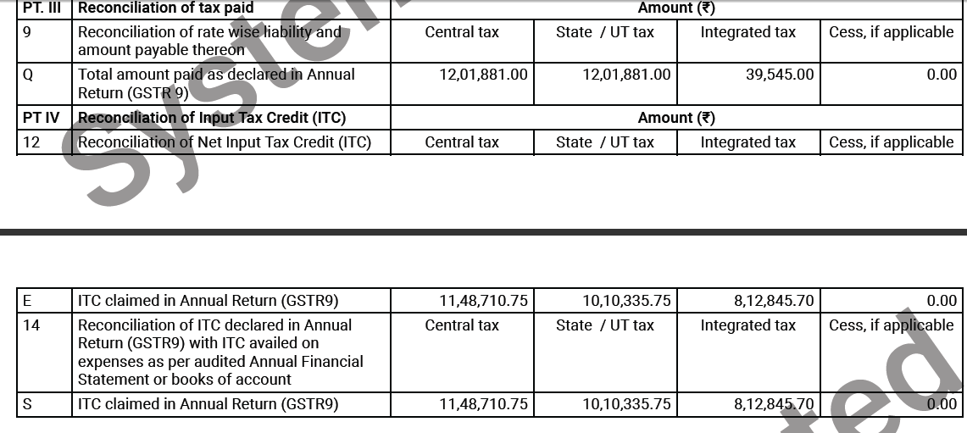

Slide 45
Some Suggestions
Don’t put zero before membership No. in Part V and in B(i) or B(ii) in GSTR 9C.
PAN No. of Auditor in Part V of GSTR 9C must be same as in DSC.
To get HSN code of 4 digit, type 3 digit. If you type 4 digits, it will show 8 digits. (If you report the figures in T17 & T18 of GSTR9)
Para 5-Observation/Qualification: Even if there is no observation/ Qualification, enter at least Nil.

Slide 46
Some Tech issues
Sl. No. | Steps
1 | Before signing 9C, close all other emsigners. Download emsigner from GST portal and run as administrator.
2 | Java Version 8 update 101 and above
3 | Excel 2007 and above
4 | If web socket for emsigner is not opening, then type https:\\127.0.0.1:1585 in address bar. Then click ‘proceed to safety’ and follow instructions.

Slide 47
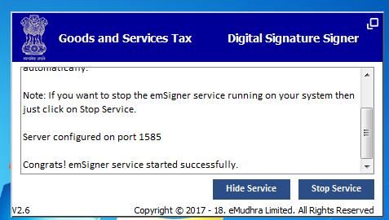

Slide 48
Steps for signing GSTR-9C using Offline Utility V1.2:
Sl. No. | Steps
1 | Please ensure Internet Explorer 11 is installed.
2 | Open the Offline Utility excel file and make sure all data is correctly filled up.
3 | Click on generate JSON file. This will open Internet Explorer.
4 | Click on the Internet Explorer (e) icon in the taskbar.
5 | Press F12 to open Developer Tools.

Slide 49
Steps for signing GSTR-9C using Offline Utility V1.2:
Sl. No. | Steps
6 | On the right side of Developer Tools, there should be a button with "5" written on it. Click on it and change it to Edge.
7 | Then click on the ‘x’ button on the right to close Developer Tools.
8 | Continue signing as per instructions given in the web page.

Slide 50
Any Question ?

Slide 51
CA Vikash Kumar Banka
Email: Vikash_banka@hotmail.com
(M) 98309-85000

