Slide 1
Seminar organized by
Tuesday, 29th January 2019 at Kolkata
Shailesh Sheth
Advocate
shailesh.sheth@spslegal.co.in

Slide 2
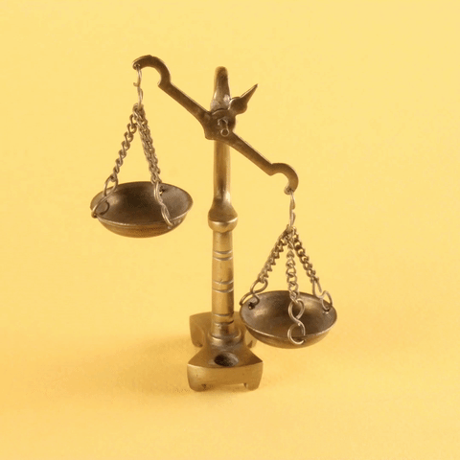
‘Recent Judicial Developments
Under GST’
Shailesh Sheth
Advocate
shailesh.sheth@spslegal.co.in

Slide 3
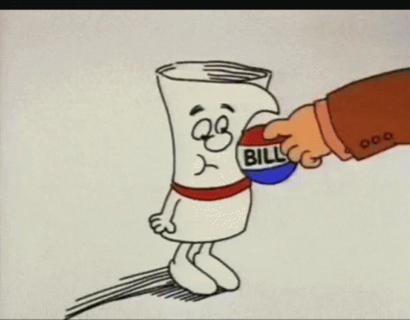
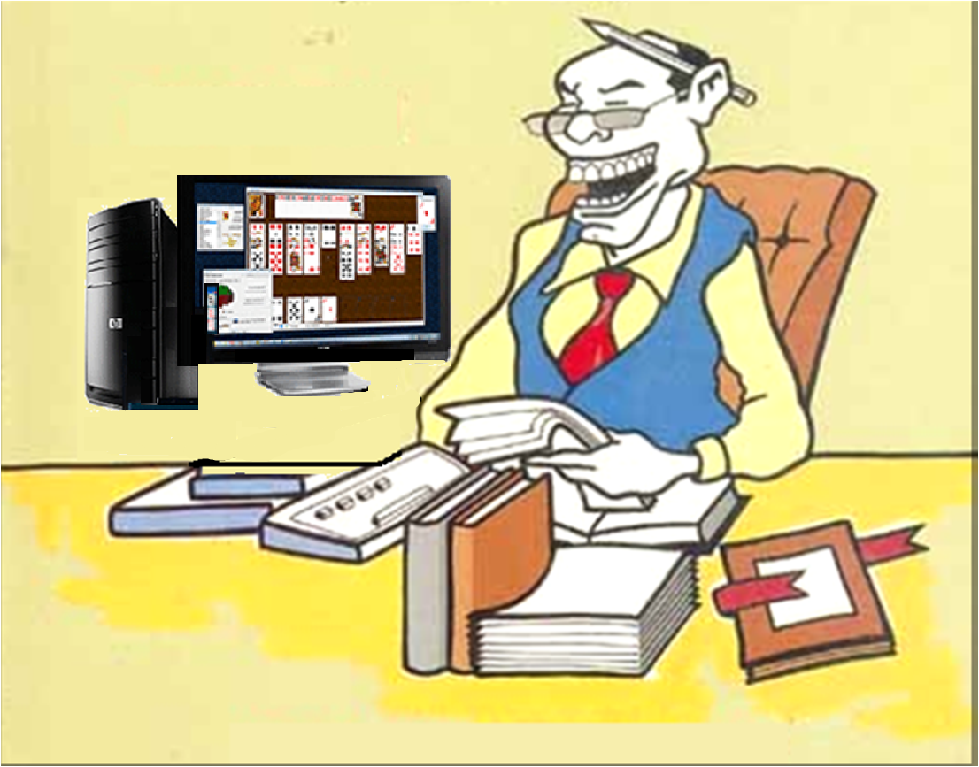
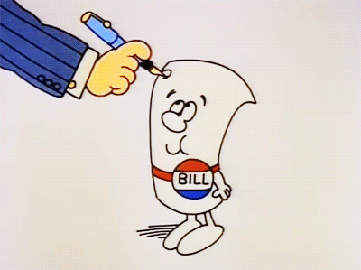
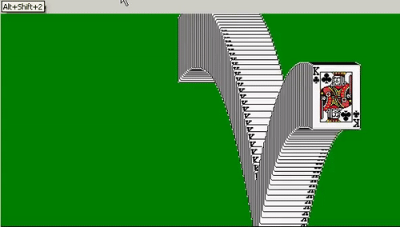
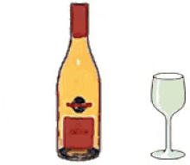
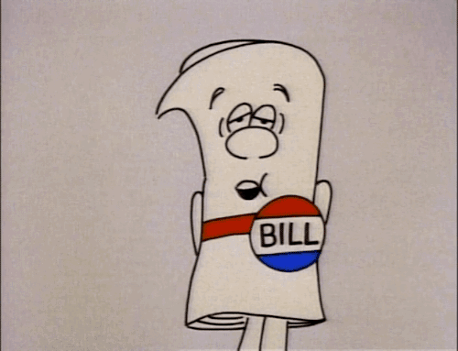

Slide 4
Issues raised before the High Courts:
Challenge to CC on the imported coal
Right to collect ‘Entertainment Tax’ post repeal of UPEBT Act under GST regime
Challenge to continuation of proceedings under the State VAT Act and issue of order post GST
Challenge to issue of SCN by DGCEI/DGGSTI demanding service tax post- GST
Challenge to ‘Pre-import’ condition relating to imports against AAs.
Challenge to vires of R.6A of STR providing for ‘POPS’ as ‘outside India’ for tour operators service

Slide 5
Issues raised before the High Courts:
Challenge to levy of IGST on Ocean Freight
Right to collect ‘Advertisement Tax’ under the omitted provisions of UPMC post-GST
Challenge to levy of IGST on the sale of warehoused goods
Challenge to vires of R.44A of CGST Rules
Challenge to second proviso to S.140(1) of the CGST Act
Challenge to clause (iv) of S.140(3) of the CGST Act
Challenge to the restriction on the availment of SGST in case of supply in other States

Slide 6
Issues raised before the High Courts:
Challenge to ‘Demand Letters’
GST & TDS – Kerala HC
Electricity- Gujarat HC

Slide 7
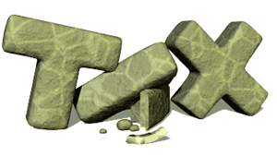
Levy and Collection of Tax- Constitutional Scheme

Slide 8
Levy and Collection of Tax - Constitutional Scheme
Part XII of the Constitution
Articles 264 to 300A
‘Finance, Property, Contracts and Suits’
Article 265 of the Constitution
‘No tax shall be levied or collected except by authority of law’
‘Tax’ includes ‘all types of taxes’
Mafatlal Indus. Ltd. vs. UOI – 1997(87)ELT 247(SC)
‘Levy’ and ‘Collection’ both should be ‘lawful’

Slide 9
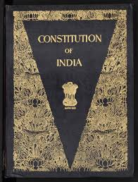
Fundamental Rights
Guaranteed by the Constitution

Slide 10
Fundamental Rights guaranteed
Articles 14 & 19(1)(g)
Fundamental Rights
Law(to levy tax) not to violate fundamental rights
Article 14
Equality before the law
State of LLP vs. Deepak Fertilizers & Petrochemicals Corps. Ltd. 2007(10) SCC 342 (SC)
UOI vs. N. S. Rathnan & Sons.- 2015 (322) ELT 353 (SC)
Super Traders vs. UOI- 1983 (12) ELT 258 (Del.)

Slide 11
Fundamental Rights guaranteed
L. V. Sankeshwar vs. Supdt. Of C. x.- 2006(4) STR 257 (SC)
Fuljit Kaur vs. State of Punjab- 2010 (262) ELT 40 (SC)
Fed. Of hotel & Restaurants vs. UOI- AIR 1990 SC 637
Article 19(1)(g)
Fed. Of Hotel’s case (Supra)
Chintamani Rao vs. State of MP- AIR 1951 SC 118
Articles 301 and 304
Free intercourse, trade and commerce throughout the territory of India
Entry tax (Art. 304)
Article 21 : Protection of Life and Liberty

Slide 12
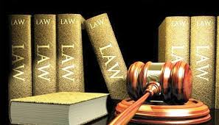
Enforcement of
Fundamental Rights

Slide 13
Enforcement of Fundamental Rights
‘ubi jus ibi remedium’ – Meaning
Blackstone explains.
Articles 32 and 226
Grant of writs by Supreme Court and High Courts.
Article 226- High Courts’ powers to interfere
UOI vs. Mangal Textile Mills (P) Ltd.- 2011 (269) ELT3 (SC)
M. Nagabhushan vs. State of Karnataka- 2011(271) ELT 481 (SC)

Slide 14
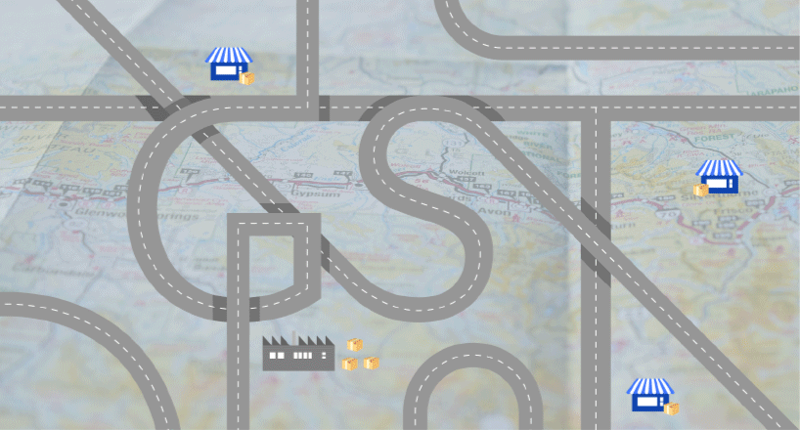
GST & Constitutional Framework

Slide 15
GST & Constitutional Framework
Article 366(12A)
Defines ‘goods and services tax’ means any tax on supply of goods, or services or both except taxes on the supply of the alcoholic liquor for human consumption
Alcoholic liquor for human consumption – completely outside purview of
GST
Article 279A
GST council to recommend date from which GST on petroleum crude, high speed diesel, motor spirit (commonly known as petrol), natural gas and aviation turbine fuel shall be levied

Slide 16
Constitutional Provisions relating to GST
Article 246A
Notwithstanding anything contained in articles 246 and 254, Parliament, and,
subject to clause (2), the Legislature of every State, have power to make laws
with respect to goods and services tax imposed by the Union or by such State.
(2) Parliament has exclusive power to make laws with respect to goods and
services tax where the supply of goods, or of services, or both takes place in
the course of inter-State trade or commerce.

Slide 17
Constitutional Provisions relating to GST
Article 269A
Goods and services tax on supplies in the course of inter-State trade or commerce shall be levied and collected by the Government of India and such tax shall be apportioned between the Union and the States in the manner as may be provided by Parliament by law on the recommendations of the Goods and Services Tax Council.
Explanation.—For the purposes of this clause, supply of goods, or of services, or both in the course of import into the territory of India shall be deemed to be supply of goods, or of services, or both in the course of inter-State trade or commerce.

Slide 18
Constitutional Amendments
and Certain Issues

Slide 19
Constitutional Amendments and certain issues
Whether the amendment leads to change in the basic structure of the constitution?
Retention of residual entry 97 in List I of Sch. VII
Retention of Article 366(29A)
Taxation of supply of electricity post-GST

Slide 20
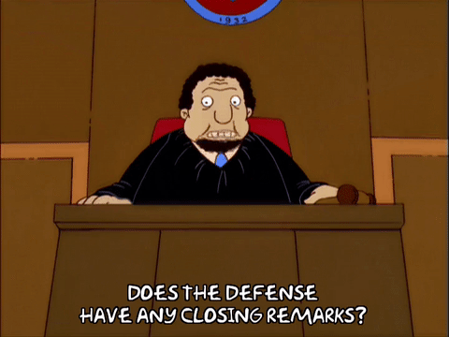
High Courts’ Rulings under GST regime

Slide 21
High Courts’ Rulings under GST regime
Background
Unprecedented rush to High Courts
Challenges to various provisions of GST Laws.
18 months old ‘Law’ and more than 200 (reported) judgements!

Slide 22
High Courts’ Rulings under GST regime
Mohit Minerals Pvt. Ltd. vs. UOI- 2018(17)GSTL 561 (SC)
Issues Involved:
Whether the Compensation to Sates Act, 2017 is beyond the legislative competence of Parliament?
Whether compensation to Sates Act, 2017 violates Constitution (One Hundred and First Amendment) Act, 2016 and is against the objective of Constitution (One Hundred and First Amendment) Act, 2016?
Whether the Compensation to States Act, 2017 is colourable legislation?
Whether levy of Compensation to States Cess and GST on the same taxing event is permissible in law?

Slide 23
High Courts’ Rulings under GST regime
Whether levy of Compensation to States Cess and GST on the same taxing event is permissible in law?
Whether on the basis of Clean energy Cess paid by the petitioner till 30th June, 2017, the petitioner is entitled for set off in payment of Compensation to States Cess?

Slide 24
High Courts’ Rulings under GST regime
Legislations/ Statutory Provisions/ Notifications/ Circulars involved:
GST (CS) Act, 2017
The Taxation Laws (Amendment) Act, 2017
The Constitution (101st Amendment) Act, 2016
Article 248 r/w Articles 246 & 246A of the Constitution
Article 270 of the Constitution
S. 8 of the GST (CC) act
S. 9 of the CGST Act
S. 5 of the IGST Act
Notification No. 1/2017 – CC (Rate) Dt. 28.06.2017

Slide 25
High Courts’ Rulings under GST regime
Order[03.10.2018]:
The Compensation to States Act, 2017 is not beyond the legislative competence of the Parliament.
The Compensation to States Act, 2017 does not violate Constitution (One Hundred and First Amendment) Act, 2016
The Compensation to Sates Act is not a colourable legislation

Slide 26
High Courts’ Rulings under GST regime
Levy of Compensation to States Cess is an increment to goods and services tax which is permissible in law.
The petitioner is not entitled for any set off of payments made towards Clean Energy Cess in payment of Compensations to States Cess.

Slide 27
High Courts’ Rulings under GST regime
GNG Enterprises vs. State of UP- 2017 (4) GSTL 436 (All.)
Multiplex Cinevision Pvt. Ltd. vs. State of UP- 2018(14)GSTL 3 (All.)
Issues involved:
Whether the Petitioner is entitled to collect and retain the Entertainment Tax post-repeal of UPEBT Act, 1979 by S. 74 of UPGST Act,2017 in the absence of rescinding of notification permitting the collection and retention of such tax till 2020?
Repeal and Saving Clause

Slide 28
High Courts’ Rulings under GST regime
Legislations/ Statutory Provisions/ Notifications/ Circulars involved:
UPEBT Act, 1979
S. 174 of UPGST Act, 2017
Order [decided on 28.07.2017/ 08.05.2018]:
Respondents to file counter affidavit
Petitioners allowed to file rejoinder thereafter
Respondents to answer “Whether the scheme granting tax benefit to the petitioner is still continuing or stand revoked either automatically or by any fresh notification?”
Listed for admission/ final disposal in July, 2018( both petitions)

Slide 29
High Courts’ Rulings under GST regime
FC Agarwal Coal Pvt. Ltd.vs. UOI 2017 (6) GSTL 368 (Guj.)
Issue involved:
Challenge to vires of GST (CC) Act read with Notifications thereunder providing for the levy of CC on the imported coal that has already suffered CES.
Legislations/ Statutory Provisions/ Notifications/ Circulars involved:
GST (CC) Act
Article 279A of COI

Slide 30
High Courts’ Rulings under GST regime
Order [Dt. 04.10.2017]:
Notice returnable on 15.11.2017
Notice to AG as well

Slide 31
High Courts’ Rulings under GST regime
Industrial Trade and Agencies vs. State of Assam- 2018 (19) GSTL 613 (Gau.)
1.Laxmi Narayan Sahu vs. UOI 2018(19) GSTL 626 (Gau.)
2.Mascot Entrade Pvt. Ltd. vs. UOI
Issues involved:
Challenge to order Dt. 08.08.2017 of the Assam Board of Revenue alongwith earlier Orders Dt. 17.04.2015 and 26.02.2015 of thr Supdt. Of Taxes and Dy. Comr. Of Taxes (Appeal) respectively on SCN Dt.. 07.04.2014 issued under AVAT Act of 2003.

Slide 32
High Courts’ Rulings under GST regime
Challenge to the demand-cum-show cause notices demanding service tax issued after introduction of GST.
Continuation of proceedings under the repealed enactment.
Maintainable of Writ where alternative remedy is available
Legislations/ Statutory Provisions/ Notifications/ Circulars involved:
AVAT Act, 2003
S. 174 of the CGST Act
S. 173 of the CGST Act
S.6 and s.6A of the GC Act, 1857.

Slide 33
High Courts’ Rulings under GST regime
Final Judgements [Dt. 12.04.2018 & 12.10.2018]:
SCN issued during pre-GST period is protected by saving clause till it attained finality
Adjudication, investigation, enquiry or other proceedings for recovery of service tax to continue after omission of chapter V of the Finance Act, 1994 by section 173 of the CGST Act.
S.6 and 6A of GC Act apply to repeal as well as omission of an enactment.
Small Bench clarifying earlier larger Bench decision does not require reference to Larger Bench
Conflict between decisions of Bench of equal strength- proposition more appealing to be taken into consideration.
Writ not maintainable when specific statutory remedy available.

Slide 34
High Courts’ Rulings under GST regime
NKG Infrastructure Ltd. vs. UOI 2017(6) GSTL 254 (Del.)
Issues involved:
Challenge to issue of SCN issued by DGCEI/DGGSTI re-visiting the completed assessment of service tax returns filed by the petitioner for a period of five years preceding SCN by reclassifying the services under a different head.
Challenge to very authority of DGCET/DGGSTI to issue SCN
Legislations/ Statutory Provisions/ Notifications/ Circulars involved:
Proviso to S.73(1) of FA
R.3 of STR

Slide 35
High Courts’ Rulings under GST regime
Order[ Dt. 15.09.2017]:
SCN stayed
Reply/ rejoinder to be filed by the respective parties
Listed on 22.11.2017

Slide 36
High Courts’ Rulings under GST regime
Vedanta Limited vs. UOI- 2018(19) GSTL 637 (Mad.)
Issues involved:
Challenge to conditions at Sr. No. 2(c) of Notification No. 79/2017- Customs Dt. 13.10.2017
Challenge to Para 1 of DGFT Notification No. 33/2015-20 Dt. 13.10.2017
Challenge to Notice Dt. 15.03.2018 issued by DRI, Kolkata Zonal Unit
Prayer seeking permission for imports w/o payment of IGST under AA without enforcing Pre-import condition.
Legislations/ Statutory Provisions/ Notifications/ Circulars involved:
S.3(7) and 3(9) of CTA
FTP 2015-20

Slide 37
High Courts’ Rulings under GST regime
DGFT Notification No. 33/2015-20.
Notification no. 18/2015-Customs Dt.. 01.04.2015
Notification no. 79/2017- customs Dt.. 23.10.2017
Para 4.3 and 4.13 of FTP 2015-20
Order[Dt. 29.10.2018]:
Petitioners to participate in DRI enquiry
Narendra Plastics Pvt. Ltd. Vs. UOI- 2017(4) GSTL 439 (Del.)/ 204/(11) GSTL 27(Del.) [interim order] & Jindal Dyechem Inds. Pvt. Ltd. Vs. UOI- 2018(17) GSTL 222(Del.) relied upon and distinguished.
WP dismissed.

Slide 38
High Courts’ Rulings under GST regime
Indian Association of Tour Operators vs. UOI- 2017(5) GSTL 4 (Del.)
Issues involved:
Challenge to vires of Rule 6A of STR to the extent it stipulates ‘place of provision of service’ to be ‘outside India’ for treating tour operating service as ‘export of service’
Legislations/ Statutory Provisions/ Notifications/ Circulars involved:
S. 66B r/w S.65(51), 65(52) and 64(1) and 64(3) of the FA
S.66C of FA r/w POPS Rules.
S.94(2)(f) of FA.
Rule 6A of STR
Order[ dt.31.08.2017]:

Slide 39
High Courts’ Rulings under GST regime
Mohit Minerals Pvt. Ltd. Vs. UOI- 2018(10) GSTL 424(Guj)
Issues involved:
Challenge to levy of IGST on ocean freight
Legislations/ Statutory Provisions/ Notifications/ Circulars involved:
IGST Act
Notification No. 8/2017-IGST Dt.. 28.06.2017
Notification No. 10/2017- IGST Dt.. 28.06.21017
Order[ dt.09.02.2018]:
Notice returnable on 09.03.2018.

Slide 40
High Courts’ Rulings under GST regime
Modern advertising and Marketing vs. State of UP- 2018(16) GSTL 438 (All.)
Issues involved:
Whether ‘Advertisement Tax’ would be continued to be levied by UPMC in view of omission of Cl. (h) of sub-section (2) of S.172 and S.192 and 193 of UPMC Act by S.173 of UPGST Act?
Legislations/ Statutory Provisions/ Notifications/ Circulars involved:
UPMC Act
UPGST Act
Order[Dt. 11.04.2018]:
Parties to file counter and rejoinder within stipulated time
Proceedings under Tender Notice stayed
Listing after expiry of period stipulated

Slide 41
High Courts’ Rulings under GST regime
Liberty Chemtrade Pvt. Ltd. Vs. UOI- 2018(12) GSTL 353(Guj.)
Devashish Polymers Pvt. Ltd. Vs. UOI- 2018(12) GSTL 18(Del.)
Issues involved:
Whether IGST is leviable at the time of sale of warehoused goods by the importer or at the time of customs clearance?
Legislations/ Statutory Provisions/ Notifications/ Circulars involved:
IGST Act
Circular Dt.. 24.11.2017 of CBEC
Order[Dt. 12.04.2018 & 22.12.2017]:
Notice returnable on 10.05.2018(Guj. HC)
Re-listed on 08.03.2018(Delhi HC)

Slide 42
High Courts’ Rulings under GST regime
Kundan care Products Ltd. Vs. UOI- 2017(4) GSTL 118(Del.)
&
Salasar Synthetics vs. UOI- 2017(6) GSTL 396(Del.)
Issues involved:
Challenge to the vires of Rule 44A of CGST Rules requiring reversal of 5/6th of already accrued Cenvat Credit of CVD paid on imported gold dore bar
Legislations/ Statutory Provisions/ Notifications/ Circulars involved:
S.140 and S.164 of the CGST Act
Rule 44A of CGST Rules
Notification dated 17.08.2017

Slide 43
High Courts’ Rulings under GST regime
Order [Dt. 25.08.2017 & 01.09.2017]:
No coercive action
Reply/ Rejoinder to be filed within the stipulated period
Listed on 25.09.2017

Slide 44
High Courts’ Rulings under GST regime
Willowood Chemicals Pvt. Ltd. Vs. UOI- 2018(19) GSTL 228(Guj.)
Issues involved:
Challenge to the constitutionality of second proviso to S.140(1) of the CGST Act prescribing time limit for filing TRAN-1
Challenge to S.164 of the CGST Act
Challenge to vires of Rule 117 of the CGST Rules
Legislations/ Statutory Provisions/ Notifications/ Circulars involved:
S.140(1) and 140(3) of the CGST Act
S.164 of the CGST Act
R.117of the CGST Rules
S.100 (2A) of GVAT Act, 2003
Order[dt. 20.03.2018]: Petition dismissed.

Slide 45
High Courts’ Rulings under GST regime
Filco Trade Centre Pvt. Ltd. Vs. UOI- 2018(17) GSTL 3 (Guj.)
Issues involved:
Challenge to vires of the condition as Cl.(iv) of S.140(3) prescribing the validity period of ‘12 months’ for the invoices for input in stock/WIP to claim ITC in terms of S. 140(3) of the CGST Act.
Legislations/ Statutory Provisions/ Notifications/ Circulars involved:
Clause (iv) of S. 140(3) of the CGST Act
CEA & CCR
Order[dt. 05.09.2018]:
Clause (iv) of S. 140(3) struck down as ultra vires and unconstitutional

Slide 46
High Courts’ Rulings under GST regime
JCB India Ltd. Vs. UOI- 2018(15) GSTL 145(Bom.)
Issues involved:
Challenge to vires of the condition at Cl.(iv) of S.140(3) prescribing the validity period of ‘12 months’ for the invoices for input in stock/WIP to claim ITC in terms of S. 140(3) of the CGST Act.
Legislations/ Statutory Provisions/ Notifications/ Circulars involved:
Clause (iv) of S. 140(3) of the CGST Act
CEA & CCR
Order[dt. 05.09.2018]:
Clause (iv) of S. 140(3) existing both in Central GST & State GST Laws is
Constitutionally valid

Slide 47
High Courts’ Rulings under GST regime
D. Pauls Travels & Tours Ltd. Vs. UOI- 2018(11) GSTL 255(Del.)
Issues involved:
Challenge to the restriction on the availment of ITC of SGST charged by Hotels, etc. In different states due to non-registration.
Legislations/ Statutory Provisions/ Notifications/ Circulars involved:
CGST Act
SGST Act

Slide 48
High Courts’ Rulings under GST regime
Order[Dt. 06.12.2017]:
Respondents to examine the assertions and the so called anomalies.
To inform the Court of the treatment accorded on sale of manufactured goods and other services provided by an assessee across the country.
To consider whether the matter to be put up before the GST Council
Listed on 08.02.2018

Slide 49
High Courts’ Rulings under GST regime
TVS Motor Company Ltd. Vs. UOI- 2018-TIOL-71-HC-Mad-GST.
Issues involved:
Challenge to demand letter ‘requiring the reversal of the transitional credit of Education Cess’ carried forward by the Petitioner u/s. 140(1) of the CGST Act.
Legislations/ Statutory Provisions/ Notifications/ Circulars involved:
S. 140(1) of the CGST Act
S.73 of the CGST Act
Order[dt. 05.09.2018]:
Impugned ‘order’ set aside and WP allowed
Respondents at liberty to proceed afresh in accordance with law.

Slide 50
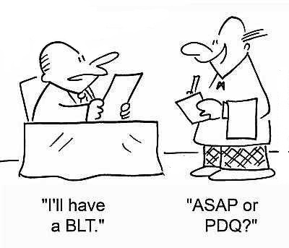
AA - Advance Authorisations
AVAT Act – Assam Value Added Tax Act, 2003
CBEC – Central Board of Excise and Customs
CC - Compensation Cess
CCR - Cenvat Credit Rules, 2004 as amended
CEA - Central Excise Act, 1944 as amended
CES - Clean Energy Cess
CGST Act - Central Goods and Service Tax Act, 2017
CGST Rules - Central Goods and Service Tax Rules,2017
COI – Constitution of India
COI (101st Amendment) Act- Constitution of India (101st Amendment) Act, 2016
CTA- Customs Tariff Act, 1975 as amended

Slide 51
DGCEI – Directorate General of Central Excise Intelligence
DGFT- Directorate General of Foreign Trade
DGGSTI - Directorate General of Goods and Services Tax Intelligence
DRI - Directorate of Revenue Intelligence
FA – Finance Act, 1994 as amended
FA, 2010 – Finance Act, 2010
FTP 2015-20 – Foreign Trade Policy
2015-20
GC Act – General Clauses Act, 1857
GVAT Act – Gujarat Value Added Tax, 2003
GST- Goods and Services Tax
GST(CC) Act - Goods and Services (Compensation Cess) Act, 2017
IGST Act – Integrated Goods and Services Tax Act, 2017

Slide 52
IGST – Integrated Goods and Services Tax
ITC – Input Tax Credit
POPS Rules – Place of Provision of Services Rules, 2012 as amended
SGST Acts – States’ Goods and Services Tax Acts, 2017
STR – Service Tax Rules, 1994 as amended
UPEBT Act – Uttar Pradesh Entertainment and Betting Act, 1979
UPGST Act - Uttar Pradesh Goods and Services Tax Act, 2017
UPMC Act - Uttar Pradesh Municipality Act,…

Slide 54
Shailesh Sheth
Advocate
Mumbai Chamber:
119/3, Maskati Mahal, KS Marg
(Lohar Chawl), Mumbai 400 002.
T: +91 22 22005096
Rajkot Chamber:
201, Trade Centre, Sardarnagar Main Road, Rajkot 360 002.
T: +91 281 246 3757
shailesh.sheth@spslegal.co.in

Slide 55
Important Terms & Definitions: >>>> 56 to 64
Legislative Provisions: >>>> 65 to 73
Schedules: >>>> 74 to 87
Shailesh Sheth Advocate
shailesh.sheth@spslegal.co.in

Slide 56
Important Terms & Definitions
S.2 (17) - “business” includes––
(a) any trade, commerce, manufacture, profession, vocation, adventure, wager or any other similar activity, whether or not it is for a pecuniary benefit;
(b) any activity or transaction in connection with or incidental or ancillary to sub-clause (a);
(c) any activity or transaction in the nature of sub-clause (a), whether or not there is volume, frequency, continuity or regularity of such transaction;
(d) supply or acquisition of goods including capital goods and services in connection with commencement or closure of business;
(e) provision by a club, association, society, or any such body (for a subscription or any other consideration) of the facilities or benefits to its members;
(f) admission, for a consideration, of persons to any premises;
56

Slide 57
Important Terms & Definitions
S.2 (17) - “business” continue……..
(g) services supplied by a person as the holder of an office which has been accepted by him in the course or furtherance of his trade, profession or vocation;
(h) services provided by a race club by way of totalisator or a licence to book maker in such club ; and
(i) any activity or transaction undertaken by the Central Government, a State Government or any local authority in which they are engaged as public authorities;
57

Slide 58
Important Terms & Definitions
S.2(31) - “consideration” in relation to the supply of goods or services or both includes––
any payment made or to be made, whether in money or otherwise, in respect of, in response to, or for the inducement of, the supply of goods or services or both, whether by the recipient or by any other person but shall not include any subsidy given by the Central Government or a State Government;
the monetary value of any act or forbearance, in respect of, in response to, or for the inducement of, the supply of goods or services or both, whether by the recipient or by any other person but shall not include any subsidy given by the Central Government or a State Government:
Provided that a deposit given in respect of the supply of goods or services or both shall not be considered as payment made for such supply unless the supplier applies such deposit as consideration for the said supply;

Slide 59
Important Terms & Definitions
S.2 (47) - “exempt supply” means supply of any goods or services or both which attracts nil
rate of tax or which may be wholly exempt from tax under section 11, or under section 6
of the Integrated Goods and Services Tax Act, and includes non-taxable supply;
S.2 (67) - “inward supply” in relation to a person, shall mean receipt of goods or
services or both whether by purchase, acquisition or any other means with or without
consideration;
59

Slide 60
Important Terms & Definitions
S.2 (75) - “money” means the Indian legal tender or any foreign currency, cheque, promissory note, bill of exchange, letter of credit, draft, pay order, traveller cheque, money order, postal or electronic remittance or any other instrument recognised by the Reserve Bank of India when used as a consideration to settle an obligation or exchange with Indian legal tender of another denomination but shall not include any currency that is held for its numismatic value;
S.2(78) - “non-taxable supply” means a supply of goods or services or both which is
not leviable to tax under this Act or under the Integrated Goods and Services Tax Act;
S.2 (79) - “non-taxable territory” means the territory which is outside the taxable
territory;

Slide 61
Important Terms & Definitions
S.2 (83) - “outward supply” in relation to a taxable person, means supply of goods or services or both, whether by sale, transfer, barter, exchange, licence, rental, lease or disposal or any other mode, made or agreed to be made by such person in the course or furtherance of business;
S.2 (84) - “person” includes—
(a) an individual;
(b) a Hindu Undivided Family;
(c) a company;
(d) a firm;
(e) a Limited Liability Partnership;
(f) an association of persons or a body of individuals, whether incorporated or not, in India or outside India

Slide 62
Important Terms & Definitions
S.2 (84) - “person” continue……..
(g) any corporation established by or under any Central Act, State Act or Provincial Act or a Government company as defined in clause (45) of section 2 of the Companies Act, 2013;
(h) any body corporate incorporated by or under the laws of a country outside India;
(i) a co-operative society registered under any law relating to co-operative societies;
(j) a local authority;
(k) Central Government or a State Government;
(l) society as defined under the Societies Registration Act, 1860;
(m) trust; and
(n) every artificial juridical person, not falling within any of the above;

Slide 63
Important Terms & Definitions
S.2(94) - “registered person” means a person who is registered under section 25 but
does not include a person having a Unique Identity Number;
S.2(98) - “reverse charge” means the liability to pay tax by the recipient of supply of
goods or services or both instead of the supplier of such goods or services or both
under sub-section (3) or sub-section (4) of section 9, or under sub-section (3) or subsection
(4) of section 5 of the Integrated Goods and Services Tax Act;
S.2 (102) – (102) “services” means anything other than goods, money and securities but
includes activities relating to the use of money or its conversion by cash or by any
other mode, from one form, currency or denomination, to another form, currency or
denomination for which a separate consideration is charged;

Slide 64
Important Terms & Definitions
S.2(107) - “taxable person” means a person who is registered or liable to be registered under section 22 or section 24;
S.2(108)- “taxable supply” means a supply of goods or services or both which is leviable to tax under this Act;
S.2(109) - “taxable territory” means the territory to which the provisions of this Act
apply;

Slide 65
Important Legislative Provisions
S.7 – “scope of supply” – [Amended by CGST (Amendment) Act, 2018 w.e.f. 30.08.2018] (1) For the purposes of this Act, the expression “supply” includes–
(a) all forms of supply of goods or services or both such as sale, transfer, barter, exchange, licence, rental, lease or disposal made or agreed to be made for a consideration by a person in the course or furtherance of business;
(b) import of services for a consideration whether or not in the course or furtherance of business and;
(c) the activities specified in Schedule I, made or agreed to be made without a consideration;
(1A) where certain activities or transactions constitute a supply in accordance with the provisions of sub-section (1), they shall be treated either as supply of goods or supply of services as referred to in Schedule II;
65

Slide 66
Important Legislative Provisions
S.7 – “scope of supply” continue ……..
(2) Notwithstanding anything contained in sub-section (1),––
(a) activities or transactions specified in Schedule III; or
(b) such activities or transactions undertaken by the Central Government, a State Government or any local authority in which they are engaged as public authorities, as may be notified by the Government on the recommendations of the Council, shall be treated neither as a supply of goods nor a supply of services.
(3) Subject to the provisions of sub-sections (1), (1A) and (2), the Government may, on the recommendations of the Council, specify, by notification, the transactions that are to be treated as—
(a) a supply of goods and not as a supply of services; or
(b) a supply of services and not as a supply of goods.
66

Slide 67
Important Legislative Provisions
S. 9 – “Levy and collection”- [Amended by CGST (Amendment) Act, 2018 w.e.f. 30.08.2018]- (1) Subject to the provisions of sub-section (2), there shall be levied a tax called the central goods and services tax on all intra-State supplies of goods or services or both, except on the supply of alcoholic liquor for human consumption, on the value determined under section 15 and at such rates, not exceeding twenty per cent., as may be notified by the Government on the recommendations of the Council and collected in such manner as may be prescribed and shall be paid by the taxable person.
(2) The central tax on the supply of petroleum crude, high speed diesel, motor spirit (commonly known as petrol), natural gas and aviation turbine fuel shall be levied with effect from such date as may be notified by the Government on the recommendations of the Council.
67

Slide 68
Important Legislative Provisions
S. 9 – “Levy and collection continue……….
(3) The Government may, on the recommendations of the Council, by notification, specify categories of supply of goods or services or both, the tax on which shall be paid on reverse charge basis by the recipient of such goods or services or both and all the provisions of this Act shall apply to such recipient as if he is the person liable for paying the tax in relation to the supply of such goods or services or both.
(4) The Government may, on the recommendations of the Council, by notification, specify a class of registered persons who shall, in respect of supply of specified categories of goods or services or both received from an unregistered supplier, pay the tax on reverse charge basis as the recipient of such supply of goods or services or both, and all the provisions of this Act shall apply to such recipient as if he is the person liable for paying the tax in relation to such supply of goods or services or both.
68

Slide 69
Important Legislative Provisions
S. 9 – “Levy and collection continue……….
(5) The Government may, on the recommendations of the Council, by notification, specify categories of services the tax on intra-State supplies of which shall be paid by the electronic commerce operator if such services are supplied through it, and all the provisions of this Act shall apply to such electronic commerce operator as if he is the supplier liable for paying the tax in relation to the supply of such services:
Provided that where an electronic commerce operator does not have a physical presence in the taxable territory, any person representing such electronic commerce operator for any purpose in the taxable territory shall be liable to pay tax:
Provided further that where an electronic commerce operator does not have a physical presence in the taxable territory and also he does not have a representative in the said territory, such electronic commerce operator shall appoint a person in the taxable territory for the purpose of paying tax and such person shall be liable to pay tax.
69

Slide 70
Important Legislative Provisions
S.15. ‘Value of taxable Supply’ – (1) The value of a supply of goods or services or both shall be the transaction value, which is the price actually paid or payable for the said supply of goods or services or both where the supplier and the recipient of the supply are not related and the price is the sole consideration for the supply.
(2) The value of supply shall include –
any taxes, duties, cesses, fees and charges levied under any law for the time being in force other than this Act, the State Goods and Services Tax Act, the Union Territory Goods and Services Tax Act and the Goods and Services Tax (Compensation to States) Act, if charged separately by the supplier;
(b) any amount that the supplier is liable to pay in relation to such supply but which has been
incurred by the recipient of the supply and not included in the price actually paid or payable
for the goods or services or both;
70

Slide 71
Important Legislative Provisions
S.15. ‘Value of taxable Supply continue……..
(c) incidental expenses, including commission and packing, charged by the supplier to the recipient of a supply and any amount charged for anything done by the supplier in respect of the supply of goods or services or both at the time of, or before delivery of goods or supply of services;
(d) interest or late fee or penalty for delayed payment of any consideration for any
supply; and
(e) subsidies directly linked to the price excluding subsidies provided by the Central Government and State Governments.
Explanation.- For the purposes of this sub-section, the amount of subsidy shall be included
in the value of supply of the supplier who receives the subsidy.
71

Slide 72
Important Legislative Provisions
S.15. ‘Value of taxable Supply continue……..
(3) The value of the supply shall not include any discount which is given –
(a) before or at the time of the supply if such discount has been duly recorded in the invoice issued in respect of such supply; and
(b) after the supply has been effected, if –
(i) such discount is established in terms of an agreement entered into at or before the time of
such supply and specifically linked to relevant invoices; and
(ii) input tax credit as is attributable to the discount on the basis of document issued by the
supplier has been reversed by the recipient of the supply.
(4) Where the value of the supply of goods or services or both cannot be determined under sub-section (1), the same shall be determined in such manner as may be prescribed.
72

Slide 73
Important Legislative Provisions
(5) Notwithstanding anything contained in sub-section (1) or sub-section (4), the value of such supplies as may be notified by the Government on the recommendations of the Council shall be determined in such manner as may be prescribed.
Explanation.—For the purposes of this Act,––
(a) persons shall be deemed to be “related persons” if––
(i) such persons are officers or directors of one another’s businesses;
(ii) such persons are legally recognised partners in business;
(iii) such persons are employer and employee;
(iv) any person directly or indirectly owns, controls or holds twenty-five
per cent. or more of the outstanding voting stock or shares of both of them;
(v) one of them directly or indirectly controls the other;
(vi) both of them are directly or indirectly controlled by a third person;
(vii) together they directly or indirectly control a third person; or
(viii) they are members of the same family;
(b) the term “person” also includes legal persons;
(c) persons who are associated in the business of one another in that one is the sole agent or sole distributor or sole concessionaire, howsoever described, of the other, shall be deemed to be related.
73

Slide 74
SCHEDULE I
SCHEDULE I
[See section 7]
ACTIVITIES TO BE TREATED AS SUPPLY EVEN IF MADE WITHOUT CONSIDERATION
1. Permanent transfer or disposal of business assets where input tax credit has been
availed on such assets.
2. Supply of goods or services or both between related persons or between distinct
persons as specified in section 25, when made in the course or furtherance of business:
Provided that gifts not exceeding fifty thousand rupees in value in a financial year by
an employer to an employee shall not be treated as supply of goods or services or both.

Slide 75
SCHEDULE I
Schedule I (Contd….)
3. Supply of goods—
(a) by a principal to his agent where the agent undertakes to supply such goods
on behalf of the principal; or
(b) by an agent to his principal where the agent undertakes to receive such
goods on behalf of the principal.
4. Import of services by a person from a related person or from any of his other establishments outside India, in the course or furtherance of business.
[Amended by CGST (Amendment Act, 2018 w.e.f. 30.08.2018]

Slide 76
SCHEDULE II
SCHEDULE II
[See section 7]
ACTIVITIES OR TRANSACTIONS TO BE TREATED AS SUPPLY OF GOODS OR SUPPLY OF SERVICES
1. Transfer
(a) any transfer of the title in goods is a supply of goods;
(b) any transfer of right in goods or of undivided share in goods without the transfer of title thereof, is a supply of services;
(c) any transfer of title in goods under an agreement which stipulates that property in goods shall pass at a future date upon payment of full consideration as agreed, is a supply of goods.

Slide 77
SCHEDULE II
Schedule –II (Contd…)
2. Land and Building
(a) any lease, tenancy, easement, licence to occupy land is a supply of services;
(b) any lease or letting out of the building including a commercial, industrial or residential complex for business or commerce, either wholly or partly, is a supply of services.
Treatment or process
Any treatment or process which is applied to another person's goods is a supply of services.

Slide 78
SCHEDULE II
4. Transfer of business assets
(a) where goods forming part of the assets of a business are transferred or disposed of by or under the directions of the person carrying on the business so as no longer to form part of those assets, whether or not for a consideration, such transfer or disposal is a supply of goods by the person;
(b) where, by or under the direction of a person carrying on a business, goods held or used for the purposes of the business are put to any private use or are used, or made available to any person for use, for any purpose other than a purpose of the business, whether or not for a consideration, the usage or making available of such goods is a supply of services;
(c) where any person ceases to be a taxable person, any goods forming part of the assets of any business carried on by him shall be deemed to be supplied by him in the course or furtherance of his business immediately before he ceases to be a taxable person, unless—

Slide 79
SCHEDULE II
Schedule II (Contd….)
(i) the business is transferred as a going concern to another person; or
(ii) the business is carried on by a personal representative who is deemed
to be a taxable person.
5. Supply of services
The following shall be treated as supply of services, namely:—
(a) renting of immovable property;
(b) construction of a complex, building, civil structure or a part thereof, including a complex or building intended for sale to a buyer, wholly or partly, except where the entire consideration has been received after issuance of completion certificate, where required, by the competent authority or after its first occupation, whichever is earlier.

Slide 80
SCHEDULE II
Schedule II (Contd…)
Explanation.—For the purposes of this clause—
(1) the expression "competent authority" means the Government or any authority authorised to issue completion certificate under any law for the time being in force and in case of non-requirement of such certificate from such authority, from any of the following, namely:—
(i) an architect registered with the Council of Architecture constituted
under the Architects Act, 1972; or
(ii) a chartered engineer registered with the Institution of Engineers (India); or
(iii) a licensed surveyor of the respective local body of the city or town or village or development or planning authority;
(2) the expression "construction" includes additions, alterations, replacements or remodelling of any existing civil structure;

Slide 81
SCHEDULE II
Schedule-II (Contd…
(c) temporary transfer or permitting the use or enjoyment of any intellectual property right;
(d) development, design, programming, customisation, adaptation, upgradation, enhancement, implementation of information technology software;
(e) agreeing to the obligation to refrain from an act, or to tolerate an act or a situation, or to do an act; and
(f) transfer of the right to use any goods for any purpose (whether or not for a specified period) for cash, deferred payment or other valuable consideration.
6. Composite supply
The following composite supplies shall be treated as a supply of services, namely:—
(a) works contract as defined in clause (119) of section 2; and

Slide 82
SCHEDULE II
Schedule II (Contd…)
(b) supply, by way of or as part of any service or in any other manner whatsoever, of goods, being food or any other article for human consumption or any drink (other than alcoholic liquor for human consumption), where such supply or service is for cash, deferred payment or other valuable consideration.
7. Supply of Goods
The following shall be treated as supply of goods, namely:—
Supply of goods by any unincorporated association or body of persons to a member thereof for cash, deferred payment or other valuable consideration.
[Amended by CGST (Amendment Act, 2018 w.e.f. 30.08.2018]

Slide 83
SCHEDULE III
SCHEDULE III
[See section 7]
ACTIVITIES OR TRANSACTIONS WHICH SHALL BE TREATED NEITHER AS A SUPPLY OF GOODS NOR A SUPPLY OF SERVICES
1. Services by an employee to the employer in the course of or in relation to his employment.
2. Services by any court or Tribunal established under any law for the time being in force.
3. (a) the functions performed by the Members of Parliament, Members of State Legislature, Members of Panchayats, Members of Municipalities and Members of other local authorities;
(b) the duties performed by any person who holds any post in pursuance of the provisions of the Constitution in that capacity; or

Slide 84
SCHEDULE III
Schedule III (Contd…)
(c) the duties performed by any person as a Chairperson or a Member or a Director in a body established by the Central Government or a State Government or local authority and who is not deemed as an employee before the commencement of this clause.
4. Services of funeral, burial, crematorium or mortuary including transportation of the deceased.
5. Sale of land and, subject to clause (b) of paragraph 5 of Schedule II, sale of building.
6. Actionable claims, other than lottery, betting and gambling.
7. Supply of goods from a place in the non-taxable territory to another place in the non-taxable territory without such goods entering into India.

Slide 85
SCHEDULE III
Schedule –III (Contd…)
8. (a) Supply of warehoused goods to any person before clearance for home consumption;
(b) Supply of goods by the consignee to any other person, by endorsement of documents of title to the goods, after the goods have been dispatched from the port of origin located outside India but before clearance for home consumption”;
Explanation 1.—For the purposes of paragraph 2, the term "court" includes District
Court, High Court and Supreme Court.
Explanation 2. – For the purposes of paragraph 8, the expression “warehoused goods” shall have the same meaning as assigned to it in the Customs Act, 1962.
[Amended by CGST (Amendment Act, 2018 w.e.f. 30.08.2018]

Slide 86
Exemption from GST
Exemption from payment of CGST in respect of specified Intra-state Services vide Notification No. 12/2017-CT (Rate) dated 28.06.2017 w.e.f. 01.07.2017:
Exemption to S.12AA entities:
Services by an entity registered under section 12AA of the Income Tax Act, 1961 (43 of 1961) by way of charitable activities.[Entry 2 of the Notification]
“Charitable activities” defined vide clause (r) of para 2 of the Notification as under:
“charitable activities’ means activities relating to –
Exemption in respect of Educational Institutions: (66)
Relevant terms defined:
“educational institution”[clause (y) of para 2]
“approved vocational educational course” [clause (h) of para 2]

Slide 87
Exemption from GST
Exemption in respect of religious trusts/activities: entry 13
Relevant terms defined:
“general public” [clause (zc) of para 2]
“religious place” [clause (zy) of para 2]

