Slide 1






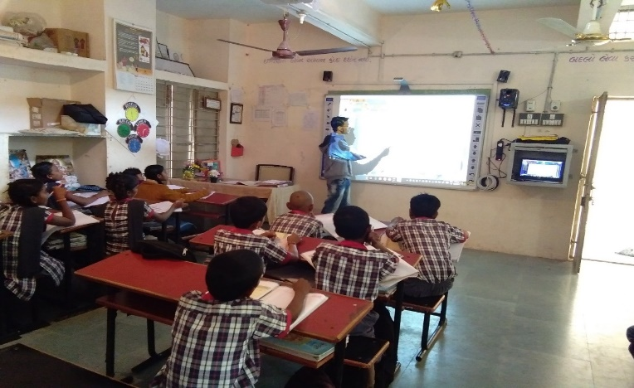

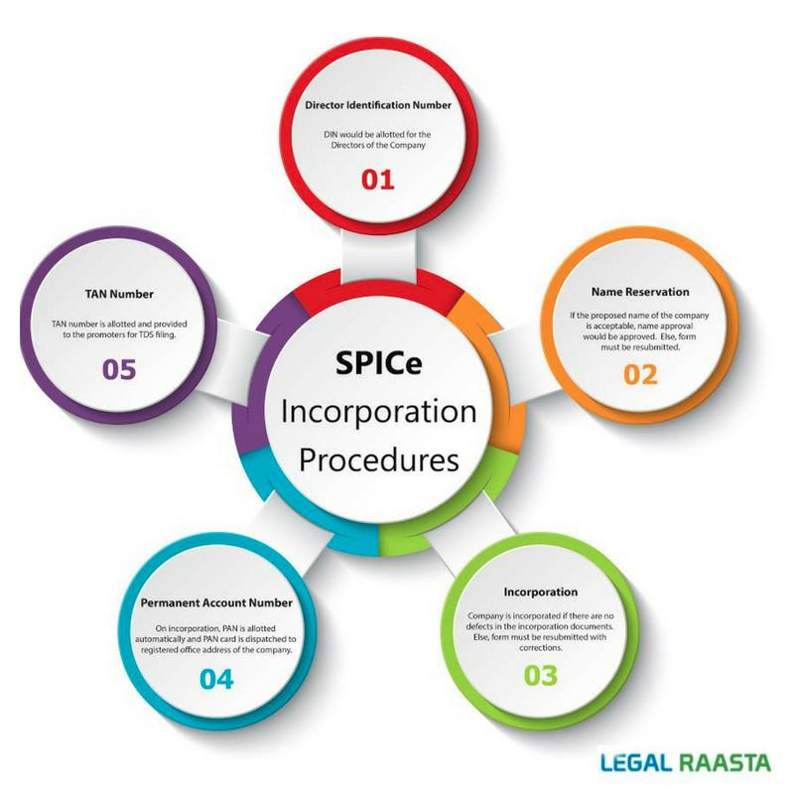

Government Of India
STRATEGIC REFORMS
and
GROWTH INITIATIVES
Atmanirbhar Bharat || आत्मनिर्भर भारत
B

Slide 2

WHY ARE WE HERE TODAY ??
Whether my business qualifies as MSME
How do I avail the benefits announced in Stimulus Package
Positive Strategies
M & A Deals
Cash Management
Advantage INDIA “Vocal for Local”
Professional Opportunities

Slide 3
Existing and Revised Definition of MSMEs
Existing MSME Classification
Criteria : Investment in Plant & Machinery or Equipment
Classification | Micro | Small | Medium
Mfg. Enterprises | Investment<Rs. 25 lac | Investment<Rs. 5 cr. | Investment <Rs. 10 cr.
Services Enterprise | Investment<Rs. 10 lac | Investment< Rs. 2 cr. | Investment<Rs. 5 cr.
Composite Criteria : Investment And Annual Turnover
Classification | Micro | Small | Medium
Manufacturing & Services | Investment< Rs. 1 cr. and Turnover < Rs.5 cr. | Investment< Rs. 10 cr. and Turnover < Rs.50 cr. | Investment< Rs. 20 /50 cr and Turnover < Rs.100/250 cr.
1. Why was there a need to amend the definition of MSME ?? Composite Criteria
2. Can an MSME obtain registration now (after FMs announcement) and avail Government sop ??
3. Are Retail MSME's eligible for this scheme ?
4. Is there any funding or relief or incentives allocated for ITES/IT companies. Do IT startups get any support from MSME ??

Slide 4
Important Announcements
Composite Criteria of Investment & Turnover for Classification;
Calculation of Investment In Plant & Machinery or Equipment;
Calculation of Turnover;
Registration Process;
Registration of Existing Enterprises;
Updation of Information and Transition Period In Classification;
Facilitation And Grievance Redressal Of Enterprises;
Registration at : https://udyamregistration.gov.in/

Slide 5
Important MSME benefits during pre-COVID regime
Easy finance availability from Banks ;
Interest Rate Concession (MSME can avail a benefit of 1 to 1.5 % Reduction in interest rate);
Credit Linked Guarantee Scheme ( subject to certain conditions);
Registered entities must be paid their dues by the buyers within 45 days. Any delay in such payment will attract mandatory interest. The said Interest payable to MSME will not be allowed as a Business Expenditure under Income Tax Act;
Waiver in Earnest Money (Security Deposit ) in Government tenders;
Concession in electricity bills in certain cases;
Marketing Development Assistance and Export Promotion by Government;
MSME Training and Development program;
And many more ..

Slide 6
NEW MSME benefits and Current Stimulus Package
ACCESS TO FINANCE || https://champions.gov.in/
Rs 3 lakh crores Guarantee free Collateral free Automatic Loans for Business, incl MSME
Working Capital Term Loan
Upto 20% of entire Outstanding credit as on 29.02.2020;
Loans up to Rs. 25 cr. outstanding and units upto Rs. 100 cr turnover;
Loans to have 4 year tenor with one year moratorium on principal payment, no processing fees and cap on rate of interest;
No pre-payment penalty to be charged in case of early repayment;
Loan taken by promoter or director in personal capacity shall not be covered;

Slide 7
NEW MSME benefits and Current Stimulus Package
ACCESS TO FINANCE || https://champions.gov.in/

Slide 8
NEW MSME benefits and Current Stimulus Package
ACCESS TO FINANCE || https://champions.gov.in/
Rs 20,000 crore Subordinate Debt for MSMEs
APPLICATION BY PROMOTERS
MSMEs survive on thin margins and come under financial stress at slightest disruption. To support MSME units which have become stressed, there is a need to infuse capital in the MSME unit in the form of equity or sub debt so that they can be revived
The Distressed Assets Fund–Sub Debt Scheme seeks to extend support to the promoter(s) of the distressed units MSMEs by providing a debt facility of upto 15% of the promoter contribution or Rs 75 lakhs, to the Promoter(s);
Promoter(s) in turn will infuse the amount in the MSME unit as equity and thereby enhance the liquidity and maintain debt-equity ratio.

Slide 9
NEW MSME benefits and Current Stimulus Package
ACCESS TO FINANCE || https://champions.gov.in/
Equity Infusion for MSMEs through Fund of Funds
Growth Funding to MSMEs through equity financing: GOI will support VC/PE firms in investing in commercially viable MSMEs in meeting their growth requirements. The proposed fund of funds will encourage private sector investments in the MSME sector and leverage Rs.50,000 crore. GOI will support VC/PE firms in investing in commercially viable MSMEs in meeting their growth requirements. Roadmap to Listing on Stock Exchange
Mother Fund – GOI anchor Investor;
Daughter Funds – GOI anchor Investor;
How to Apply : Through Investor Funds onboarded and registered with proposed Fund of Funds

Slide 10
NEW MSME benefits and Current Stimulus Package
Stimulus Package – Other Incentives
Global tender to be disallowed upto Rs 200 crores;
No fresh insolvency proceeding against MSMEs for 1 year;
eMarket linkage for MSMEs to be promoted to act as a replacement for trade fairs and exhibitions;
Rs. 90,000 crores liquidity injection for DISCOMs;
Reduction of CRR by RBI resulting in increased liquidity with Banks;
MSME receivables from Government to be cleared in 45 days;
Fast Track Compliant redressed on champions portal;
COMPANY FRESH START SCHEME 2020 - One time condonation of delay;
LLP SETTLEMENT SCHEME, 2020 – One time condonation of delay;

Slide 11
Positive Strategies
M & A Deals
Cash Management

Slide 12
DEAL MAKING UNDER THE “NEW NORMAL” & DUE DILIGENCE
CONSERVING CASH
Recasting business plans and forecasts;
Re-negotiating Legal Contracts;
Business Valuations and impact on DCF Valuations
Adopting innovative survival strategies, ESOPs in lieu of cash salaries
Possibility for Joint Ventures;
Mastering supply chain challenges ;
Focus on generating revenues and unit economics;
Significant splurge in cross border M & A;
Consolidation and scale would be the new norm and hence collaboration would be key to success;

Slide 13





Regulatory Relaxations (PART I)
Extension in various Due Dates of GST, TDS & Income Tax Returns
#1
All pending GST Refunds to be cleared
#3
#5
Reduction in TDS Rates by 25%
(Salary Excluded)
All pending Income Tax Refunds to be cleared
Statutory PF contribution
of both employer and employee will be reduced to 10% each from existing 12% each for all establishments covered by EPFO for next 3 months.
#2
#4

Slide 14
Regulatory Relaxations (PART II)
#6
16 compoundable offences shifted to an in-house adjudication & penalty mechanism
#8
10
Extension of due dates for filings with SEBI & relaxations in LODR
Reduce compliance burden under various provisions of the Companies Act,2013 as well as enable Companies conduct Board Meetings, EGMs & AGMs, Rights issue by leveraging the strengths of Digital India
Private companies which list NCDs on stock exchanges not to be regarded as listed companies
Decriminalization of Companies Act violations involving minor technical and procedural defaults
#7
#9

Slide 15
Regulatory Relaxations (PART III)
Extension in due date of filings for PF and ESI and various Commercial Taxes, Property Tax
11
Direct listing of securities by Indian public companies in permissible foreign jurisdictions
13
15
Extension of Aadhaar-PAN linking date to 30 June, 2020
Extension of last date of filing of Income Returns FY 2018-19 (AY 2019-20) to 30 June, 2020, 80C Investments till 30 June, 2020
Tax relief on Forced Tax Residency to help income tax implications
12
14

Slide 16
Advantage INDIA
“Vocal for Local”
Professional Opportunities

Slide 17

INDIA : world class destination
for Multi – Nationals
Improved Ease of Doing Business
Competitive Corporate Tax Rate: 17.16% (for new manufacturing units),
Dividend Distribution tax abolished in 2020
3rd Largest Consumer Market by 2030/2025
Young and Growing Workforce
Acceptance of Disruptive Ideas
Growing digital penetration

Slide 18
Lets collaborate and capitalize on new opportunities with an open mind !!
Thank you
www.merfinadvisors.com
www.devmantra.com
#Rise India
11th July, 2020

