Slide 1
Achieving PEACE in Investing

Slide 2
We all love PEACE..

Slide 3
Protecting downside

Slide 4
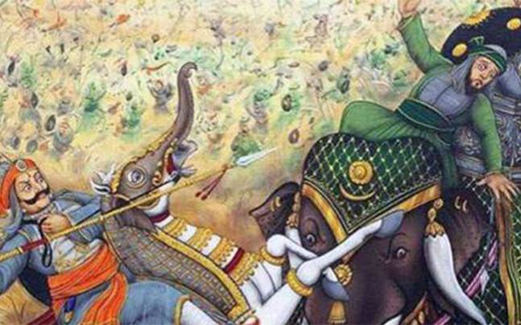
Sometimes to win a battle, not loosing your soldiers is important..

Slide 5
Markets go through cycles
Demoneti- -sation
Global Financial Crisis
US QE Taper worries
Stock market scam
Asian Financial crisis
PM Vajpayee resigns
Fed Rate hikes
Global terror attack
Kargil
War
Eurozone
Crisis
Terror attacks

Slide 6
Protecting downside is important..
If You Lose | Gain required to breakeven
20% | 25%
30% | 43%
50% | 100%
% gain by protecting downside
18%
57%

Slide 7
3 ways of Protecting downside..
Asset Allocation
Asset Allocation
Asset Allocation

Slide 8
Emotional Control

Slide 9
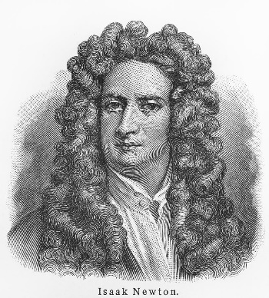
World’s first bubble
Reached @ 1050
He re-enters
the stock @ 680
Sir Isaac Newton
His friends got rich
Exits the stock @ 360
Newton invests a small amount @ 180
Newton Exits the stock @175
South Sea Company Share Price

Slide 10
Emotional Control
EQ is more important than IQ
Don’t get swayed by the crowd
Greed and Fear are powerful emotions
Be disciplined in your approach

Slide 11
Controlling Emotions can make a huge difference
7.2% cagr from 2007 peak
13.2% cagr from 2009 lows

Slide 12
Automate Investing

Slide 13
Investing decision cycle
Let’s invest!
Wait for more correction
Let’s invest when markets correct!
Oh! Markets are looking good
Markets are bad..
Let’s wait
Markets are bad..
Let’s wait

Slide 14
Hence, automate the process
Invest
Invest
Invest
Invest
Invest

Slide 15
How to do Automatic Investing?
Systematic Investment Plan
Systematic Transfer Plan
Systematic Withdrawal Plan

Slide 16
Chase consistency, not top returns

Slide 17
Winners keep changing..
2007
Infrastructure Funds
2008
Debt Funds
2010
2011
Gold
2012
2013
Pharma & FMCG
2014
2017
Midcaps & Smallcaps

Slide 18
Winners vs Nifty 50..
Period | Top Performers | Return % | Nifty -50 | Return %
01-Jan-07 To 30-Nov-18 | Infrastructure Funds | 8.22 | Nifty 50 TRI | 10.13
01-Jun-08 To 30-Nov-18 | Income Funds | 8.03 | Nifty 50 TRI | 9.24
01-Jan-10 To 30-Nov-18 | Gold Funds | 5.72 | Nifty 50 TRI | 9.94
01-Jan-13 To 30-Nov-18 | FMCG Funds | 14.16 | Nifty 50 TRI | 12.10
01-Jan-13 To 30-Nov-18 | Pharma Funds | 13.93 | Nifty 50 TRI | 12.10
01-Jan-16 To 30-Nov-18 | Midcap Funds | 10.75 | Nifty 50 TRI | 12.76
01-Jan-16 To 30-Nov-18 | Smallcap Funds | 8.43 | Nifty 50 TRI | 12.76
 | Avg. Return | 9.89 | Avg. Return | 11.29

Slide 19
Just stay the course..
Benchmark | 10 Years | 15 Years | 20 Years
NIFTY 50 - TRI | 15.39% | 15.01% | 14.85%
Nifty Midcap 100 - TRI | 18.42% | 17.69%
@ 12% Rs. 10 lakhs grows to…
31 lakhs in 10 years
96 lakhs in 20 years
2.5 crore in 30 years

Slide 20
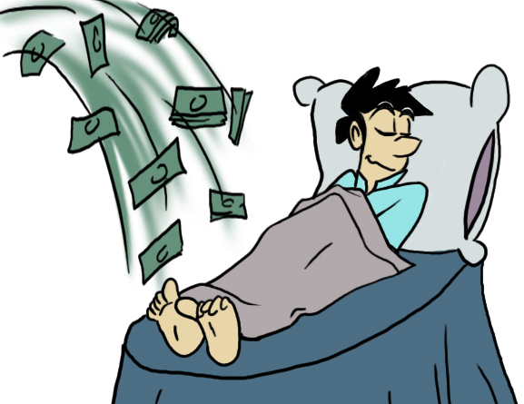
Remember to forget
Fidelity study revealed that the best returns were made in their dead accounts
People who forgot their investments made maximum returns!

Slide 21
Expert Advice

Slide 22
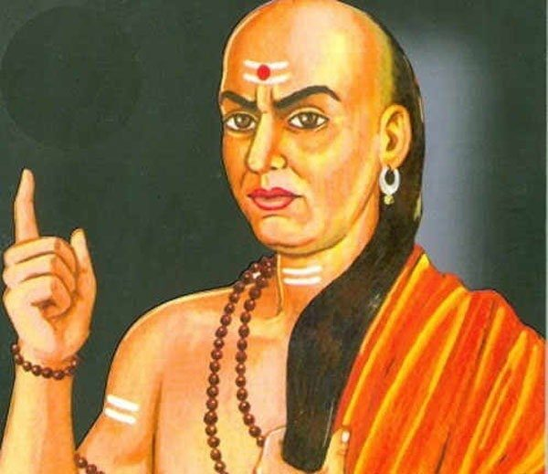
#AdviceZarooriHai

Slide 23
How to achieve PEACE in investing..
Protecting downside
Emotional Control
Automatic Investing
Chase consistency, not top returns
Expert Advice

Slide 24
Thank you!

