Slide 1
Recent Amendments in GST
Adv Ankit Kanodia
ACAE CA SC
13.10.2022

Slide 2
Introduction & Key Discussions
Cancellation Charges & Notice Pay
GST Transition & Amendment In
IDS Refund Formula
The GST entrance throughout the course of recent months has seen a few changes and updates. All the new updates are rolled out on a regular basis to help and assist the taxpayers in smooth and effective documentation of their GST returns.
With provision of online compliances and payments, the framework of GST has become more accountable. The one nation, one tax system aims to improve India’s competitiveness in global markets.
Extension Of Timelines
Utilisation Of ECrL
GSTR-3B Changes
Sec 38

Slide 3
Circular No. 180/12/2022 – GST Transition
Taking note of the various High Court Judgments allowing filing/revising Form GST TRAN-1 and TRAN-2 (hereinafter collectively referred to as ‘transitional forms’), the Supreme Court in the case of UOI vs Filco Trade Centre has given one time opportunity to all the taxpayers for filing/revising the transitional forms.
The Supreme Court has directed the GSTN to open the portal and allow filing or revising transitional forms during the period between October 01, 2022, and November 30, 2022
The procedure provided by the CBIC for availing the transitional credit by filing / revising transitional forms is sequentially summarized as under:
STEP 1
STEP 2
STEP 3
Filing/revising TRAN-1 and TRAN-2 online on GSTN portal
Copy of documents to be submitted to GST authorities within 7 days
Credit of claim in Electronic credit ledger after verification by proper officer

Slide 4
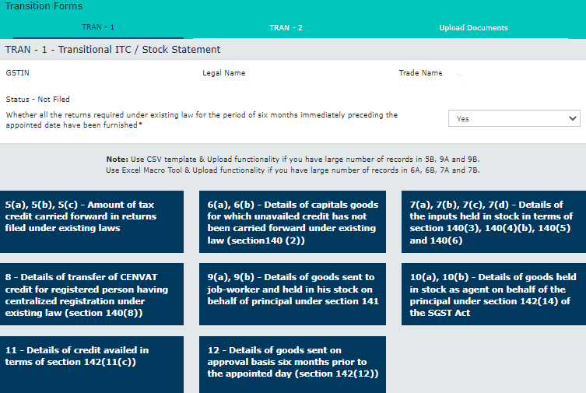
Circular No. 180/12/2022 – GST Transition
The snapshots of GSTN Portal facilitating Transitional Forms has been annexed below:

Slide 5
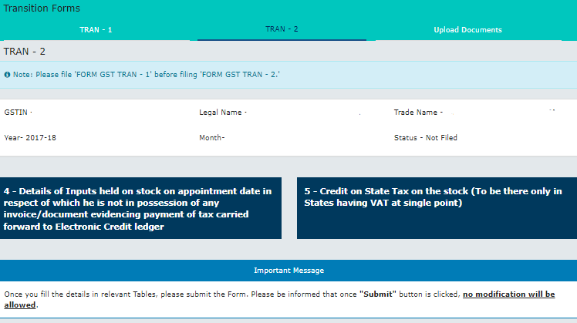
Circular No. 180/12/2022 – GST Transition
The snapshots of GSTN Portal facilitating Transitional Forms has been annexed below:

Slide 6
Circular No. 180/12/2022 – GST Transition
The applicant shall submit a copy of following documents to the jurisdictional tax officer within 7 days of filing the declaration in FORM TRAN-1/TRAN-2 on the GSTN portal:
(a) Downloaded TRAN-1/ TRAN-2 along with self-certified copy of the same
(b) Copy of Annexure A
(c) Copy of TRAN-3, wherever applicable
(d) Other documents/records/returns/invoices as required by the proper officer to support their claim of transitional credit
In terms of the Supreme Court directions, the department would be required to complete the verification within 90 days. Notably, the CBIC guidelines has not provided that whether the order should be in writing and whether the same should be available to the taxpayer.

Slide 7
Notification No. 14/2022[CT] – Amendment In IDS Refund Formula
The Amendment in Formula prescribed in Rule 89(5) of CGST Rules 2017 would now increase the refund of those taxpayers who are availing ITC on Input Services also under INVERTED DUTY STRCUTURE (IDS) Mechanism.
Amended Formula :-
The Hon’ble Supreme Court, in its judgement in the case of UOI Vs VKC Footsteps, in the matter of refund on account of inverted rate structure, has directed the GST Council to look into the anomaly in the formula prescribed under Rule 89 (5) for computation of the refund entitlement.
Now, GST Council has accepted that there is an anomaly in the formula and amended the same. It may be noted that earlier, the formula was retrospectively amended from 01.07.2017 to restrict the refund only for inputs. It would have been better if the present beneficial amendment was also made retrospective.
Maximum Refund Amount =
{(Turnover of inverted rated supply of goods and services) x Net ITC ÷ Adjusted Total Turnover} - tax payable on such inverted rated supply of goods and services x (Net ITC ÷ ITC availed on inputs and input services)
Pre – Amendment Formula :-
Maximum Refund Amount =
{(Turnover of inverted rated supply of goods and services) x Net ITC ÷ Adjusted Total Turnover} - tax payable on such inverted rated supply of goods and services.

Slide 8
Refund as per Old Formula
Refund as per New Formula
Formula | Particulars | GST
A | ITC on input goods | 25
B | ITC on input services | 15
C = A + B | Total ITC | 40
D | Inverted Rate Turnover | 100
E | Adjusted Total turnover | 150
F | Output Tax on inverted rate turnover | 12
F = A*D/E-F | Eligible Refund | 4.67
Calc. | Particulars | GST
A | ITC on inputs | 25
B | ITC on services | 15
C = A + B | Total ITC | 40
D | Inverted rate turnover | 100
E | Adjusted Total Turnover | 150
F | Output Tax on inverted rate turnover | 12
G=F*A/C | Output Tax on inverted rate turnover in proportion to input goods | 7.5
H = A*D/E-G | Refund eligible | 9.17
Notification No. 14/2022[CT] – Amendment In IDS Refund Formula

Slide 9
Notification No. 18/2022 [CT] – Time period for availing ITC
Pre - Amendment | Post - Amendment | Remarks
Previously, section restricted availment of ITC for a particular FY till due date of filing GSTR-3B for September of subsequent FY or filing of annual return for said FY, which ever is earlier. | It has been proposed that – for the words and figures “due date of furnishing of the return under section 39 for the month of September”, the words “thirtieth day of November” shall be substituted. | By making changes in this section, govt has – Delinked availment of ITC from due date of filing return under section 39. Extended time period to avail ITC for any FY up to earlier of following – 30th Nov of subsequent FY date of furnishing Annual Return This is a welcome change as extension of time limit for availing credit has been an ask of the industry ever since inception of GST laws.
This is a welcome measure as FinMin clarifies the extended timelines to heave a sigh of relief for RTP under the regime vide Press Release dated 4th October,2022 making it applicable for F.Y. 2021-22 onwards.

Slide 11
Circular 172/04/2022 – Utilization Of ECrL Balance
About The Circular
it is clarified that any payment towards output tax, whether self-assessed in the return or payable as a consequence of any proceeding instituted under the provisions of GST Laws, can be made by utilization of the amount available in the electronic credit ledger of a registered person.
It is further reiterated that as output tax does not include tax payable under reverse charge mechanism, implying thereby that the electronic credit ledger cannot be used for making payment of any tax which is payable under reverse charge mechanism.
HC Judgement
“Oasis Reality vs UOI & ors”
Bombay HC remarks that “a party can pay 10% of the disputed Tax either using the amount available in” ECL or ECrL;
In this regard, HC relies upon the CBIC Circular F.No. 20001/2/2022-GST dated July 6, 2022, which itself clarifies that amount payable towards output tax, as a consequence of any proceeding instituted under the provisions of GST Laws, can be paid by utilization of the amount available in ECL
As against Revenue’s reliance upon an order of Orissa HC in Jyoti Construction, HC opines that, in view of subsequent CBIC clarification “it will not be necessary to discuss the said order”;
Therefore, HC disposes writ and quashes order-in-appeal and restores the same to file on the undertaking that Petitioner shall debit ECrL within one week of this order getting uploaded

Slide 12
Circular 170/02/2022 – GSTR-3B Changes
Changes in Input Tax Credit reporting in FORM GSTR-3B
Table | Pre - change | Post Change | Remarks
4A | ITC Available (whether in full or part) | ITC Available (whether in full or part)
4A(1) | Import of Goods | Import of Goods | Auto populate from GSTR-2B, Editable
4A(2) | Import of Service | Import of Service | Manually, self assessed
4A(3) | Inward supplies liable to reverse charge (other than 1 & 2 above) | Inward supplies liable to reverse charge (other than 1 & 2 above) | Auto populate from GSTR-2B, Editable
4A(4) | Inward supplies from ISD | Inward supplies from ISD | Auto populate from GSTR-2B, Editable

Slide 13
Circular 170/02/2022 – GSTR-3B Changes
Changes in Input Tax Credit reporting in FORM GSTR-3B
Table | Pre - change | Post Change | Remarks
4A(5) | All other ITC | All other ITC | • Auto Populated from GSTR-2B • Ineligible ITC in GSTR-2B due to Section 16(4) and different POS shall not be disclosed here • Reclaim of temporary deferred ITC due to Rule 37, sec 16(2)(b)/(c) etc disclosed in Table 4(B)(2) in earlier months GSTR-3B to be added in this row. • Above reclaim to be disclosed in Table 4(D)(1)
4(B) | ITC Reversed | ITC Reversed

Slide 14
Circular 170/02/2022 – GSTR-3B Changes
Changes in Input Tax Credit reporting in FORM GSTR-3B
Table | Pre - change | Post Change | Remarks
4B(1) | As per rules 42 & 43 of CGST Rules | As per rules 38, 42 and 43 of CGST Rules and subsection (5) of section 17 | • All permanent reversals including that done on account of Section 17(5) to be disclosed here.
4B(2) | Others | Others | • Reversal of Temporary nature like under Rule 37, section 16(2)(b)/(c) etc to be disclosed here. • These ITC can be reclaimed in succeeding returns in Table 4A(5).
4C | Net ITC available (A-B) | Net ITC available (A-B)

Slide 15
Circular 170/02/2022 – GSTR-3B Changes
Changes in Input Tax Credit reporting in FORM GSTR-3B
Table | Pre - change | Post Change | Remarks
4D | Ineligible ITC | Other Details
4D(1) | As per section 17(5) | ITC reclaimed which was reversed under Table 4(B)(2) in earlier tax Period | • Temporary reversals done in Table 4B(2) in earlier months but availed in Table 4A(5) in current GSTR-3B to be disclosed here. • No disclosure in Ineligible ITC to be done here now.
4D(2) | Others | Ineligible ITC under section 16(4) and ITC restricted due to Place of Supply provisions | Details available in Table 4 of GSTR-2B to be disclosed here. These ITC are marked ineligible in GSTR-2B itself.

Slide 16
Notification 18/2022 – Introduction Of Amended Sec 38
Section 38 – Now provides for “Communication of details of inward supplies and Input Tax Credit” substituting provision for “furnishing details of Inward supplies”.
Pre – Amendment | Registered person shall verify, validate, modify or delete details of outward supplies and credit or debit note to prepare his details of inward supplies and shall furnish details of inward supplies after 10th and before 15th of the month succeeding the tax period. Such details of supplies modified, deleted or included shall be communicated to the supplier.
Post – Amendment | The details of outward supplies furnished by the registered persons under sub-section (1) of section 37 and of such other supplies as may be prescribed, and an autogenerated statement containing the details of input tax credit shall be made available electronically to the recipients of such supplies in such form and manner, within such time, and subject to such conditions and restrictions as may be prescribed. The auto-generated statement under sub-section (1) shall consist of–– (a)details of inward supplies in respect of which credit of input tax may be available to the recipient; and (b) details of supplies in respect of which such credit cannot be availed, whether wholly or partly, by the recipient, on account of the details of the said supplies being furnished under sub-section (1) of section 37,––

Slide 17
Notification 18/2022 – Introduction Of Amended Sec 38
Section 38 – Now provides for “Communication of details of inward supplies and Input Tax Credit” substituting provision for “furnishing details of Inward supplies”.
Post – Amendment | by any registered person within such period of taking registration as may be prescribed; or by any registered person, who has defaulted in payment of tax and where such default has continued for such period as may be prescribed; or by any registered person, the output tax payable by whom in accordance with the statement of outward supplies furnished by him under the said subsection during such period, as may be prescribed, exceeds the output tax paid by him during the said period by such limit as may be prescribed; or by any registered person who, during such period as may be prescribed, has availed credit of input tax of an amount that exceeds the credit that can be availed by him in accordance with clause (a), by such limit as may be prescribed; or by any registered person, who has defaulted in discharging his tax liability in accordance with the provisions of sub-section (12) of section 49 subject to such conditions and restrictions as may be prescribed; or by such other class of persons as may be prescribed.”.

Slide 18
Notification 18/2022 – Introduction Of Amended Sec 38
Section 38 – Now provides for “Communication of details of inward supplies and Input Tax Credit” substituting provision for “furnishing details of Inward supplies”.
Remarks | Proposed amendments has firstly done away with two-way communication concept which was envisaged earlier. Further, ignoring the doctrine of impossibility (Lex non cogit ad impossibilia) ITC reflecting in GSTR-2B of a recipient can be restricted if – Supplier is a newly registered person under GST Registered person has defaulted in payment of tax for a continued period. Liability disclosed by supplier in GSTR-1 exceeds that discharged through GSTR-3B. Supplier has availed excess ITC than that reflecting in its GSTR-2B. Percentage shall be prescribed. Supplier has discharged liability from ITC instead of Cash for case provided in section 49(12). Other restriction as may be prescribed. The law which was introduced with the view to allow seamless flow of credit seems to have lost its essence. This provision can prove to be draconian for the tax payers and might lead to increasing litigations in future.

Slide 19
Circular No. 178/10/2022 – GST On Cancellation Charges
1.
2.
3.
1.
2.
3.
The amount forfeited in the case of non-refundable ticket for air travel or security deposit, or earnest money forfeited in case of the customer failing to avail the travel, tour operator or hotel accommodation service or such other intended supplies should be assessed at the same rate as applicable to the service contract, say air transport or tour operator service, or other such services.
However, forfeiture of earnest money by a seller in case of breach of ‘an agreement to sell’ an immovable property by the buyer or such forfeiture by Government or local authority in the event of a successful bidder failing to act after winning the bid for allotment of natural resources, is a mere flow of money, as the buyer or the successful bidder does not get anything in return for such forfeiture of earnest money.
Forfeiture of earnest money is stipulated in such cases not as a consideration for tolerating the breach of contract but as a compensation for the losses suffered and as a penalty for discouraging the non-serious buyers or bidders. Such payments being merely flow of money are not a consideration for any supply and are not taxable.
This is a welcome clarification as rate of tax applicable on cancellation charges has been linked with underlying principal supply. Same shall not be taxable under SAC 999794. Therefore, if principal supply is exempt from GST, cancellation charges collected for such supply shall also be exempted and same shall not be taxed under SAC 999794.

Slide 20
Circular No. 178/10/2022 – GST On Notice Pay Recovery
The circular states that above compensation shall not be taxable due to following reasons –
Said amounts are recovered by the employer not as a consideration for tolerating the act of such premature quitting of employment.
Said amounts are recovered as penalties for dissuading the non-serious employees from taking up employment and to discourage and deter such a situation.
The employee does not get anything in return from the employer against payment of such amounts.
Therefore, such amounts recovered by the employer are not taxable as consideration for the service of agreeing to tolerate an act or a situation.
In the GST regime, there has been divergent view by Advance Ruling Authorities regarding taxability on Notice Pay Recovery.
Thus, post this circular, it is settled that NO GST is applicable on Notice Pay recovery since the basic essence of Supply is missing in such transaction.

Slide 21
THANK YOU !
39A, Jorapukur Square Lane(Behind Girish Park),
Room # 202, Kolkata- 700006, WB, INDIA
T | 033-7960-9924
E | info@skkassociates.com
W| www.skkassociates.com
Advocate Ankit Kanodia
LLM, LLB, FCA, CS, B.Com(H), CIDT- ICAI
Indirect Tax Litigation & Consultancy
39A, Jorapukur Square Lane(Behind Girish Park),
Room # 205, Kolkata- 700006, WB, INDIA.
T | 098315 43580
E | ankit@advocateak.com

