Slide 1
TRIVIAS!!
85%
of women are not confident enough to invest in mutual funds.
85% of women are not confident enough to invest in mutual funds.
98%
of women have no concrete financial plan for their retirement.
91%
of women do not invest their money independently.
76%
of women are looking for a platform that would make investing easier.
Money power survey 2022

Slide 2
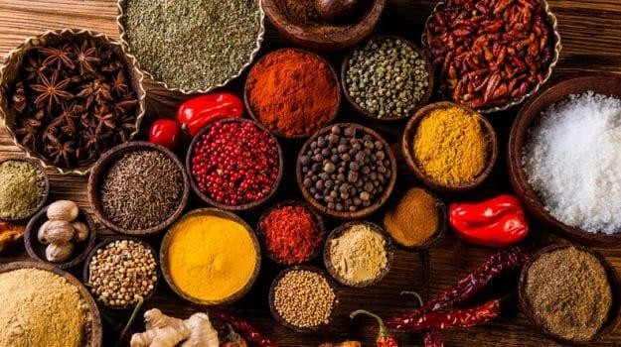
The Perfect Recipe
VINSAN FINANCIAL SERVICES PVT LTD
For professional clients / qualified investors only

Slide 3
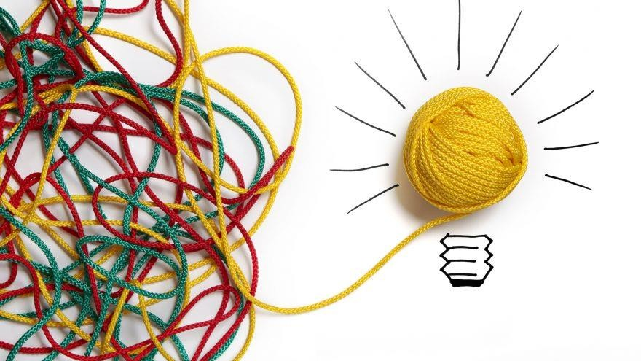
Do you Like - Money, Finance, Maths, & Economics ?
VINSAN FINANCIAL SERVICES PVT LTD

Slide 4
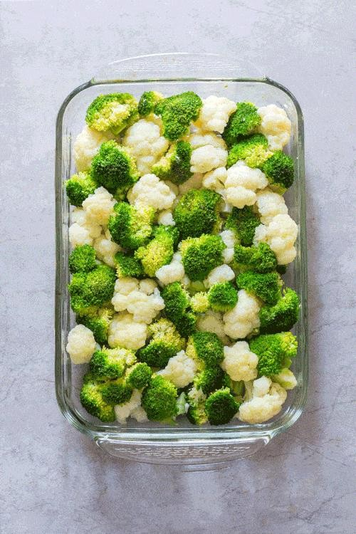
Recipe
VINSAN FINANCIAL SERVICES PVT LTD

Slide 5
Define your goals
VINSAN FINANCIAL SERVICES PVT LTD

Slide 6
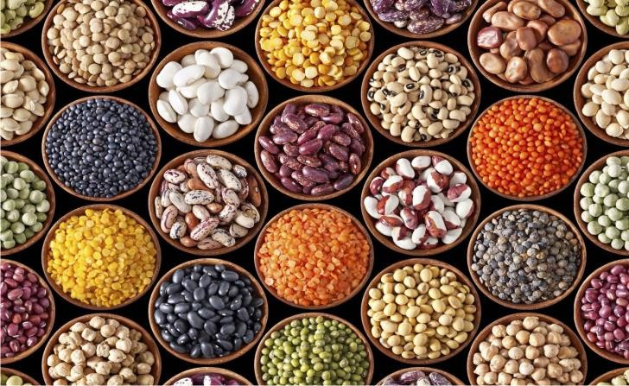
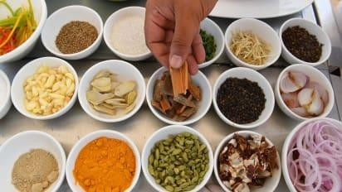
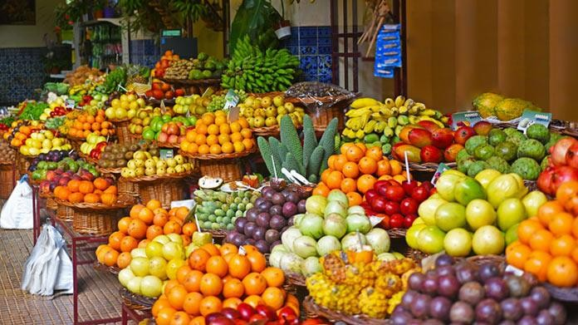
Ingredients
VINSAN FINANCIAL SERVICES PVT LTD

Slide 8
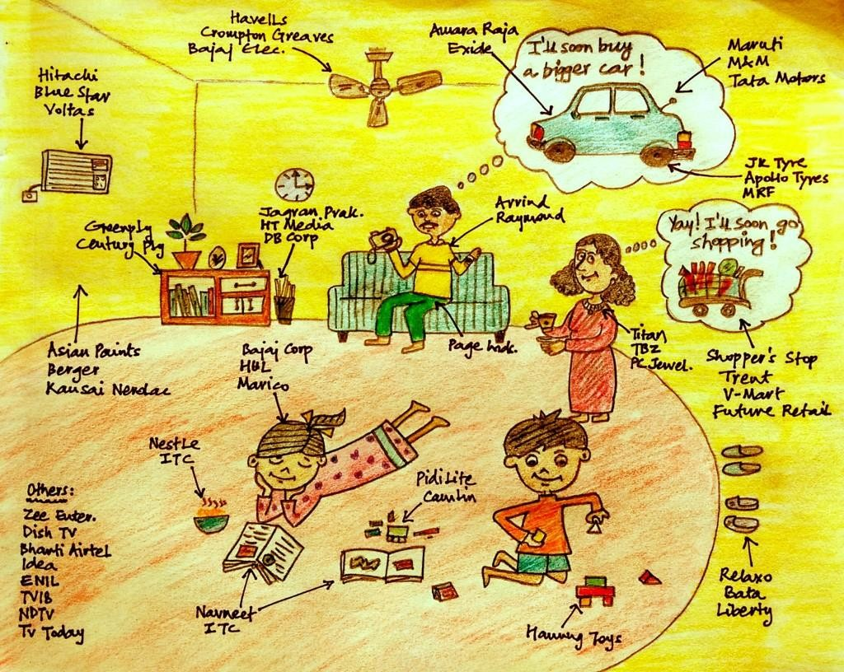
Ingredient No 1 - Equity (Healthy Ingredient )
VINSAN FINANCIAL SERVICES PVT LTD

Slide 9
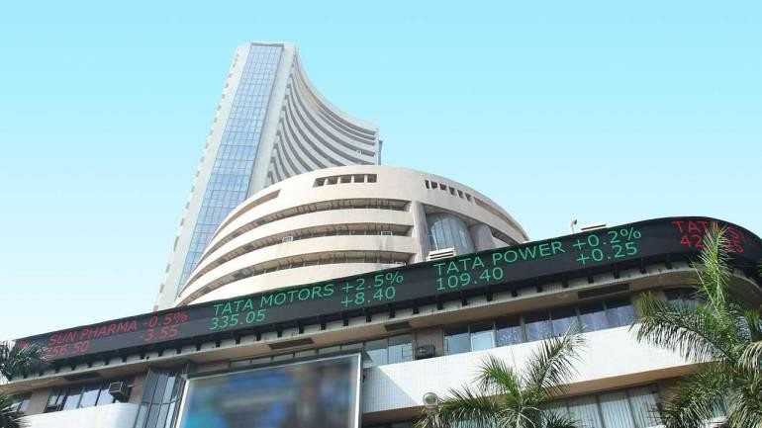
Equity - Get money whenever you want
VINSAN FINANCIAL SERVICES PVT LTD

Slide 10
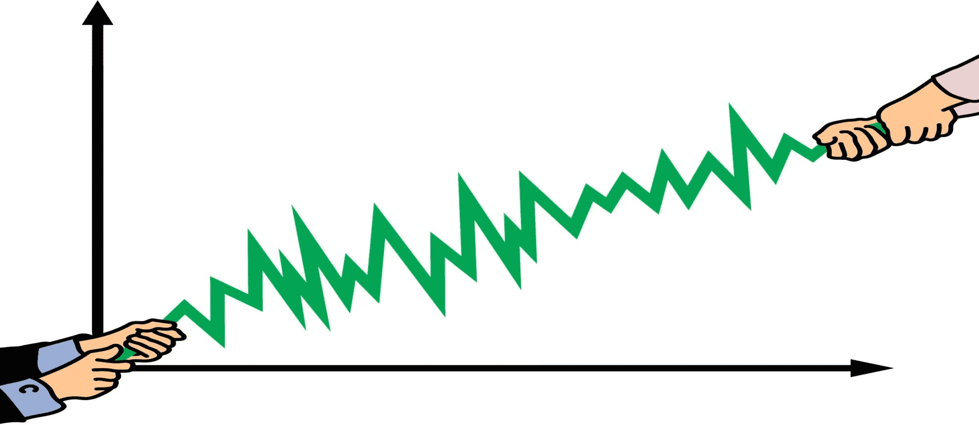
Benefit & Risk
VINSAN FINANCIAL SERVICES PVT LTD

Slide 11
Ingredient No 2 – Fixed Deposit / Fixed Income (Safety Ingredient)

Slide 12
Equity and Fixed Income
Sensex & FD
1200000
1000000
800000
600000
400000
200000
0
Source – MFIE and Morgan Stanley research
S&P BSE Sensex
Fixed Deposit
VINSAN FINANCIAL SERVICES PVT LTD

Slide 13
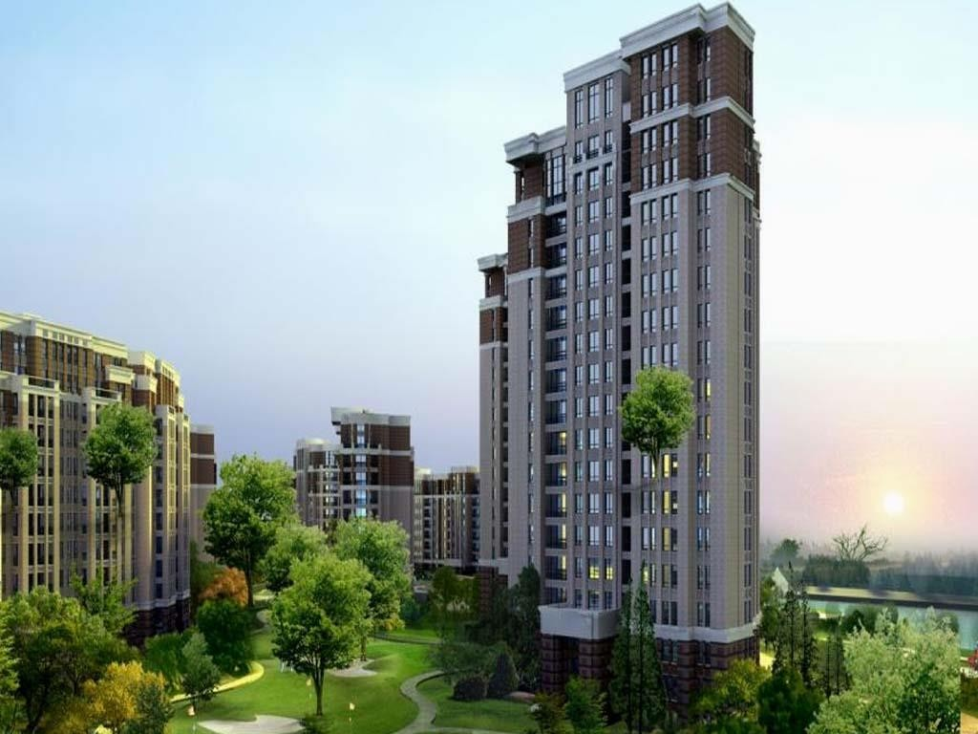
Real Estate Vs. Home
VINSAN FINANCIAL SERVICES PVT LTD

Slide 14
Returns – Various Asset Classes
VINSAN FINANCIAL SERVICES PVT LTD

Slide 15
Systematic Investment Plan (SIP) – Mutual Fund
VINSAN FINANCIAL SERVICES PVT LTD

Slide 16
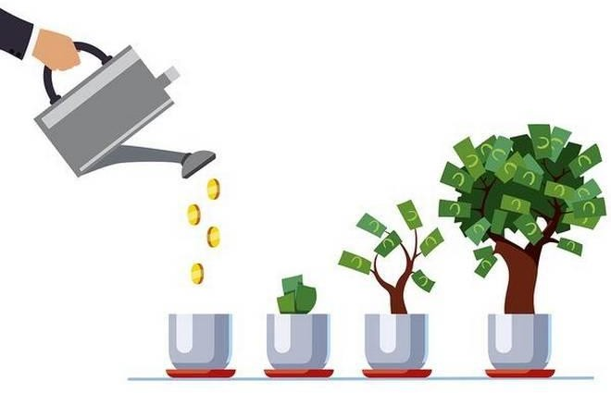
Give time and see magic
VINSAN FINANCIAL SERVICES PVT LTD

Slide 17
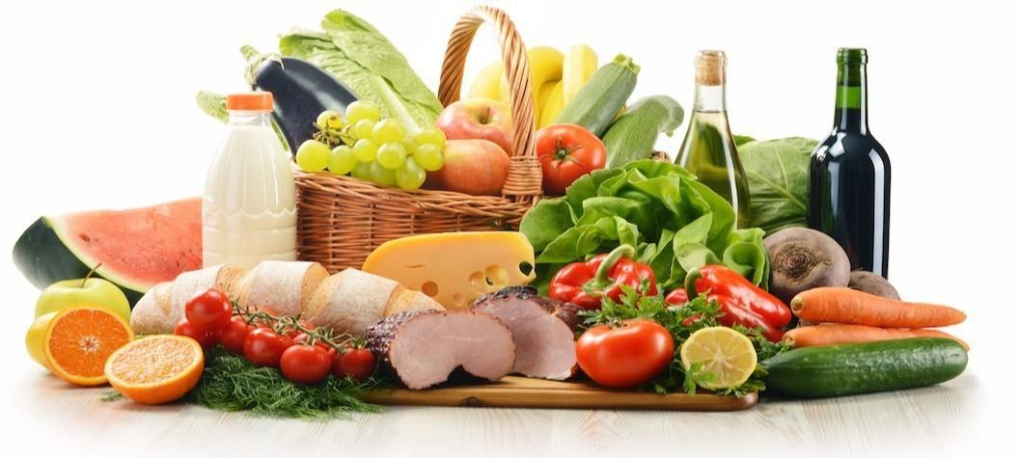
Balanced Diet – Build your own plan
VINSAN FINANCIAL SERVICES PVT LTD

Slide 18
Junk Food
VINSAN FINANCIAL SERVICES PVT LTD

Slide 19
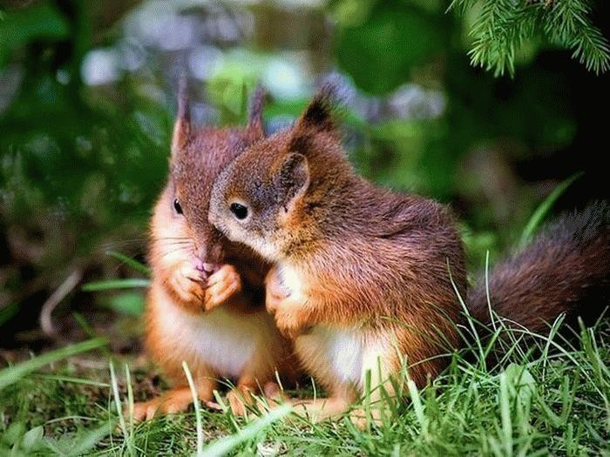
Junk Food
VINSAN FINANCIAL SERVICES PVT LTD

Slide 20
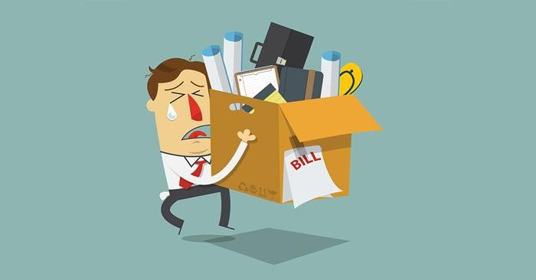
Emergency
VINSAN FINANCIAL SERVICES PVT LTD

Slide 21
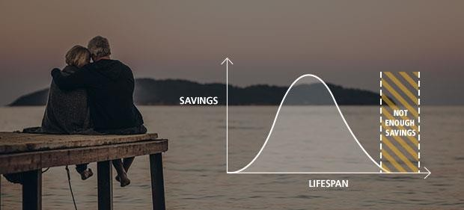
Primary Goals
VINSAN FINANCIAL SERVICES PVT LTD

Slide 22
Its Simple – women have an edge
VINSAN FINANCIAL SERVICES PVT LTD
20

Slide 23
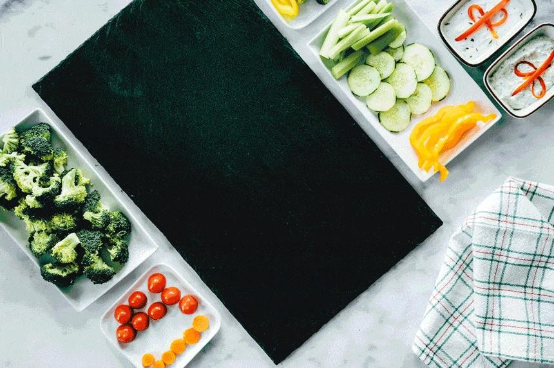
Few Recipes
VINSAN FINANCIAL SERVICES PVT LTD

Slide 24
Single Mother – Recipe
Rashmi is Independent women.
She works in Sales & Marketing. She got divorced 2
years back and has a 3 years daughter.
Her Primary goals
Travel
Childs Education
Her Retirement
Getting married is not part of her plan.
She stays in a rented apartment in Mumbai
Parents in home town
Father is diabetic patient (Otherwise healthy)
Mother is running an NGO
Father - Has a house
50 Lakhs in Equity Mutual fund & 50% in Fixed icnome
What should be Rashmi’s Recipe to achieve her financial goals?
VINSAN FINANCIAL SERVICES PVT LTD
24

Slide 25
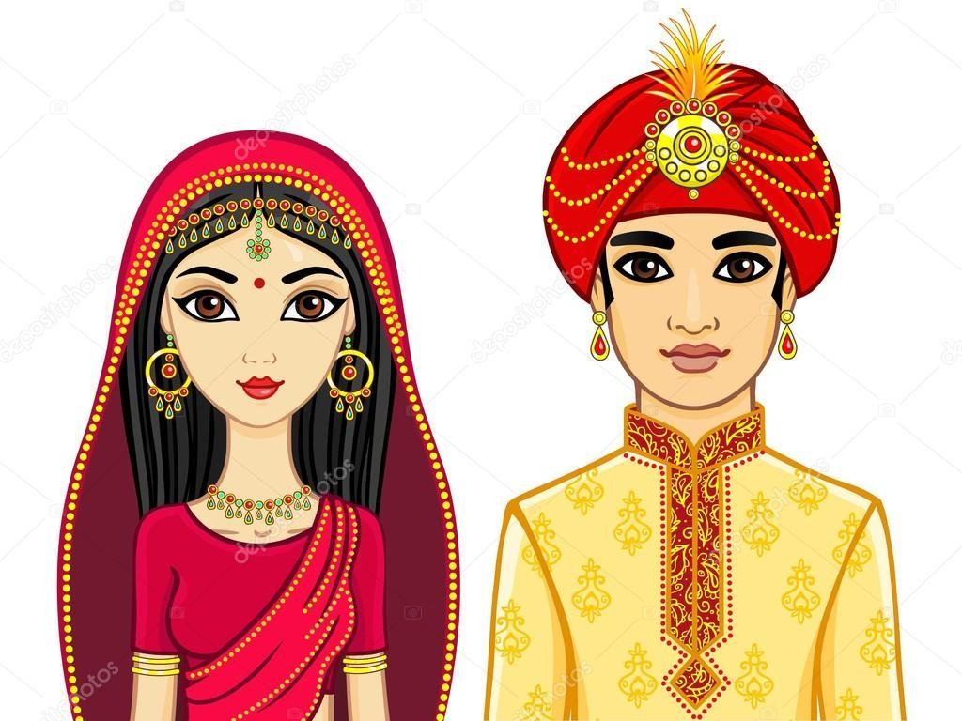
Just Married – Recipe
Rajesh and Rekha have Just got married – They stay in a rented flat.
Primary Goals
Travel Vacations
Party and good life
Car after 2 years
Buy a House after 7 years
Both are well educated & have a Job.
High stress job
They are not thinking about retirement
& children education now as they think It’s a distant dream.
They think they don’t need life insurance & health insurance as they don’t have dependents.
What should be the Recipe for Rajesh and Rekha?
VINSAN FINANCIAL SERVICES PVT LTD
25

Slide 26
Mid Life - Recipe
Abdul and Zoya are in – Mid Life Stage
Both around 40 years.
2 children – 6 and 10 years old.
Primary Goals
Retirement
Children's Education
Wife has left her job and now a home maker as her children need her.
She does some free lancing work and gets some money but not on a consistent basis
Husband is working in a company with a steady job. Husband is also thinking of starting his own business.
What should be the Recipe for Abdul and Zoya?
VINSAN FINANCIAL SERVICES PVT LTD
26

Slide 27
Retirement – Recipe
Rajesh and Nancy have retired after working for 30
years.
Rajesh retired as a Zonal Branch Manager in a PSU Bank and Nancy retired as a Principal in a convent school.
They have 2 children – Son is well settled now in US
and Daughter is married and has a business.
New Goals
Leisure Travel
Health
Staying touch with family & friends
Travel to religious places
Social work for society
Charity
They want to leave money as inheritance to their children
What should be the Recipe of Rajesh and Nancy?
VINSAN FINANCIAL SERVICES PVT LTD
27

Slide 28
Financial Partnership
Sakshi is a homemaker.
Her husband invest in stocks of companies – he does no research & invests based on tips.
He gets very excited when markets go up.
He feels very disappointed when markets fall.
Spends randomly without a plan
Buys latest gadgets at fancy prices
As a partner what is Sakshi responsibilities?
VINSAN FINANCIAL SERVICES PVT LTD
28

Slide 29
Build Your Own Recipe
VINSAN FINANCIAL SERVICES PVT LTD
29

Slide 30
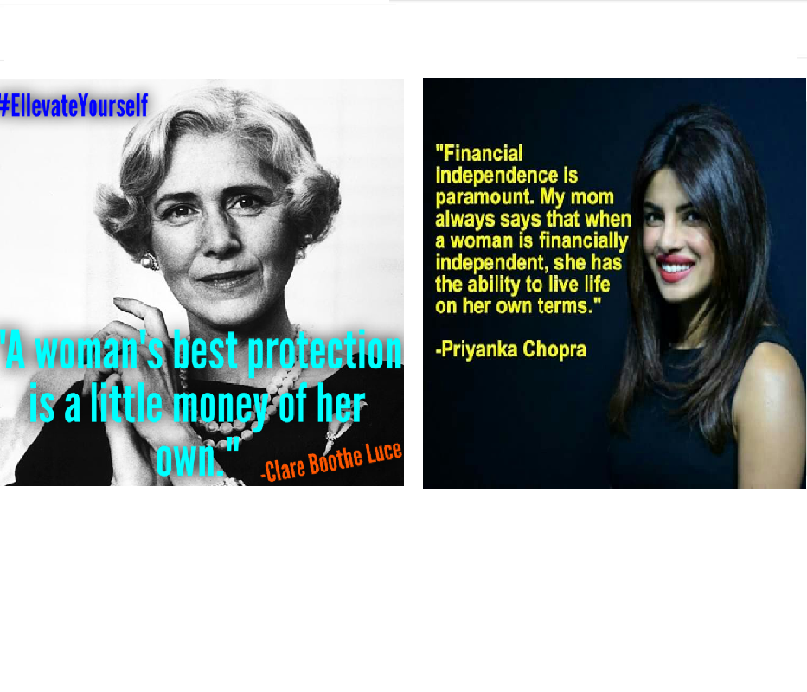
Clare Booth Luce, American author and US ambassador
Priyanka Chopra, Indian actress
VINSAN FINANCIAL SERVICES PVT LTD
30

Slide 31
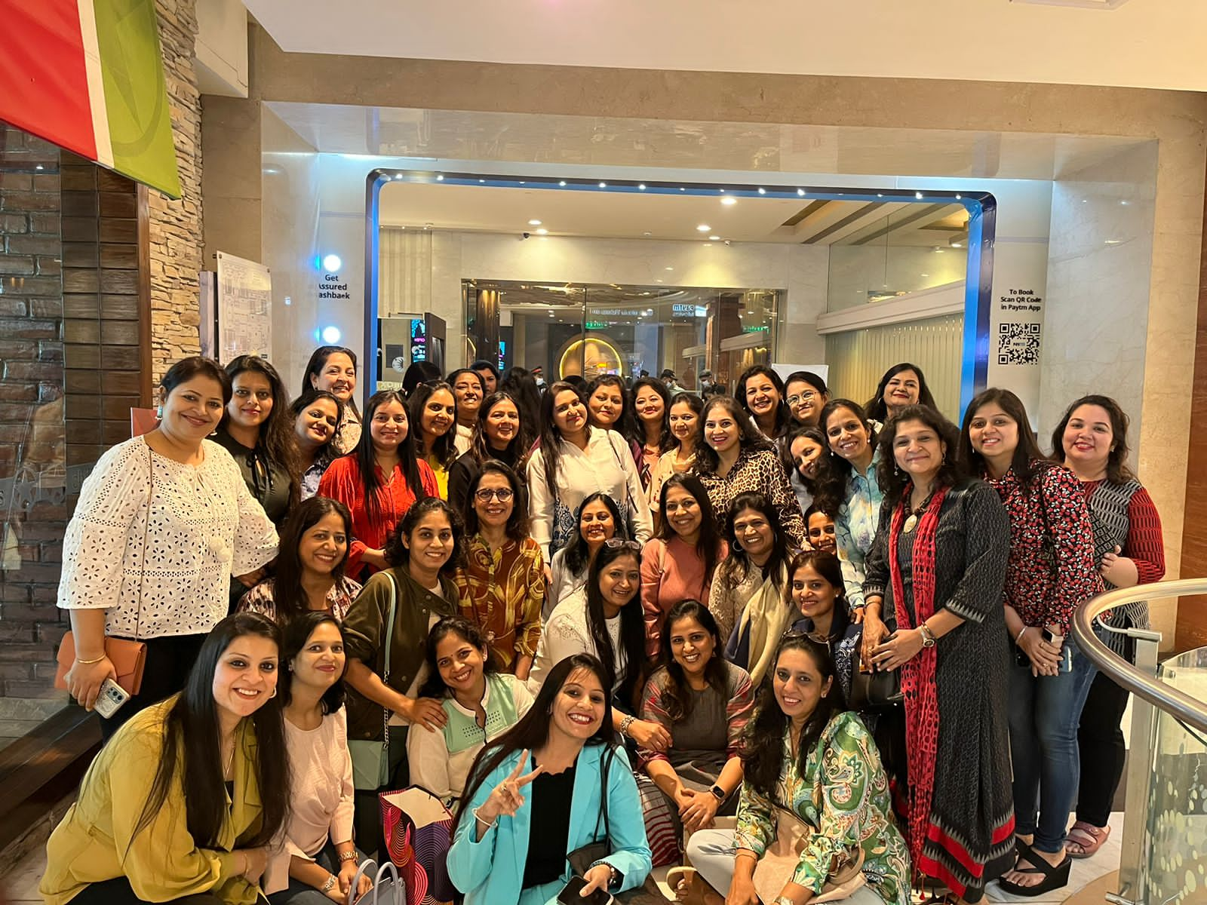
# Empower women # Empower Her # Encourage Her

Slide 32
VINITA KEJRIWAL (CA , CFP)
VINSAN FINANCIAL SERVICES PVT LTD
16/1A, British Indian Street,
6th Floor, Room No. 6J,
Kolkata-700069.
033- 40037479
98300670085
vinsanfinancial@gmail.com
https://www.facebook.com/vinsanconsult.in/
https://www.instagram.com/vinitahisahihai/
https://www.youtube.com/@vinitahisahihai
https://www.linkedin.com/in/vinsan-financial-services-pvt-ltd-012886122/
www.vinsanfinancial.com

