Slide 1

Global Transactions
Local Challenges
Navigating Cross-Border Payments
Sanjay Tripathy
Co-Founder & CEO BRISKPE

Slide 2



BRISKPE
Cross-Border Payments
are Growing!
$290T+
Global Cross-Border Payments by 2030
Asia and Africa are the hotspots for cross-border payments; Growing at 10%-15%
$260B+
Revenue for Banks globally in 2024
Contributing Factors
Expanding manufacturing supply chains
Global investment flows
International trade and e-commerce
B2B
> 50% of the flow
$4T+
Global cross-border E-com by 2030
2
Source: Bank of England 2023, Juniper Research, “Cross-Border e-Commerce, McKinsey

Slide 3

INDIA: Import Projections
India Imports FY23-24
B2B Imports to Rise 4X by FY2028; MSMEs to Fuel Growth
$885B
($687B+$198B)
Total Market
BRISKPE
Imports Market Size
15% from
Medium & Small Businesses
$128B
Serviceable Market
Goods and Services exporters selling through phygital mode require faster payment solutions and new-age checkouts.
$26B
Total Addressable Market
For Cross-border Payment Fintechs
India Addressable Market: 10%
Expected Fintech share in 3 years!
India Imports expected to reach $2T by 2029 - 30
3

Slide 4
INDIA: Export Projections
India Exports 2023 - 24
B2B Exports to Rise 3X by FY2028; MSMEs to Fuel Growth
$778B
($437B+$341B)
Total Market
BRISKPE
Exports Market Size
45-50% from
Medium & Small Businesses
$339B
Serviceable Market
Goods and Services exporters selling through phygital mode require faster payment solutions and new age checkouts.
~63% are not even aware of alternate channels and costs they incur today.
$68B
Total Addressable Market
For Cross-border Payment Fintechs
India Addressable Market: 20%
Expected Fintech share in 3 years!
India Exports expected to reach $2T by 2029 - 30
4

Slide 5
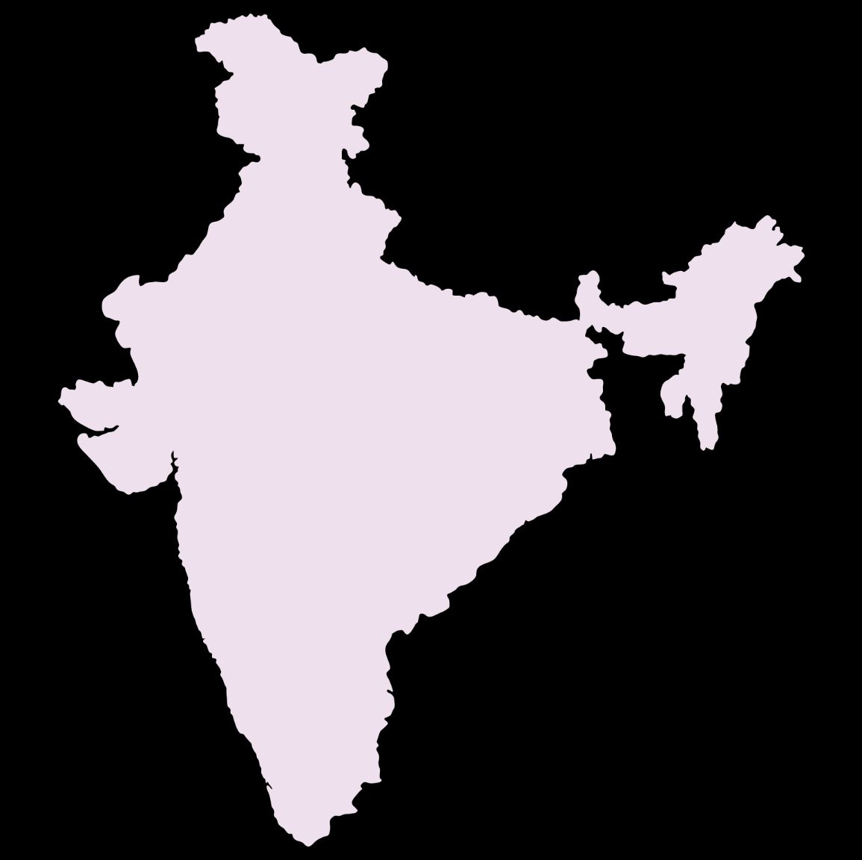
INDIA: B2B Exports Projections
Diverse needs of the
fast-growing economy
BRISKPE
Fast-growing social and web commerce in international markets
Diverse and new age payments need: not met by traditional Banks or PSPs
Highly regulated and requires local compliance beyond payments
Regulatory tightening for PA-CB license and data localisation leading to foreign PSPs staying out, leaving exporters in a complex compliance net
Lack of domestic PSPs ensuring regulatory compliance for payments and beyond payments
2.5x-3X
$1
Trillion
$1
Trillion
$340
Billion
$437
Billion
Service
Goods
Service
Goods
2023-24
2029-30
​
Growth Drivers: Incentives Boosting Manufacturing and Tailwinds from Global Supply Chain Diversification
5
​​
Sources: GOI, *Our Research & Banks

Slide 6
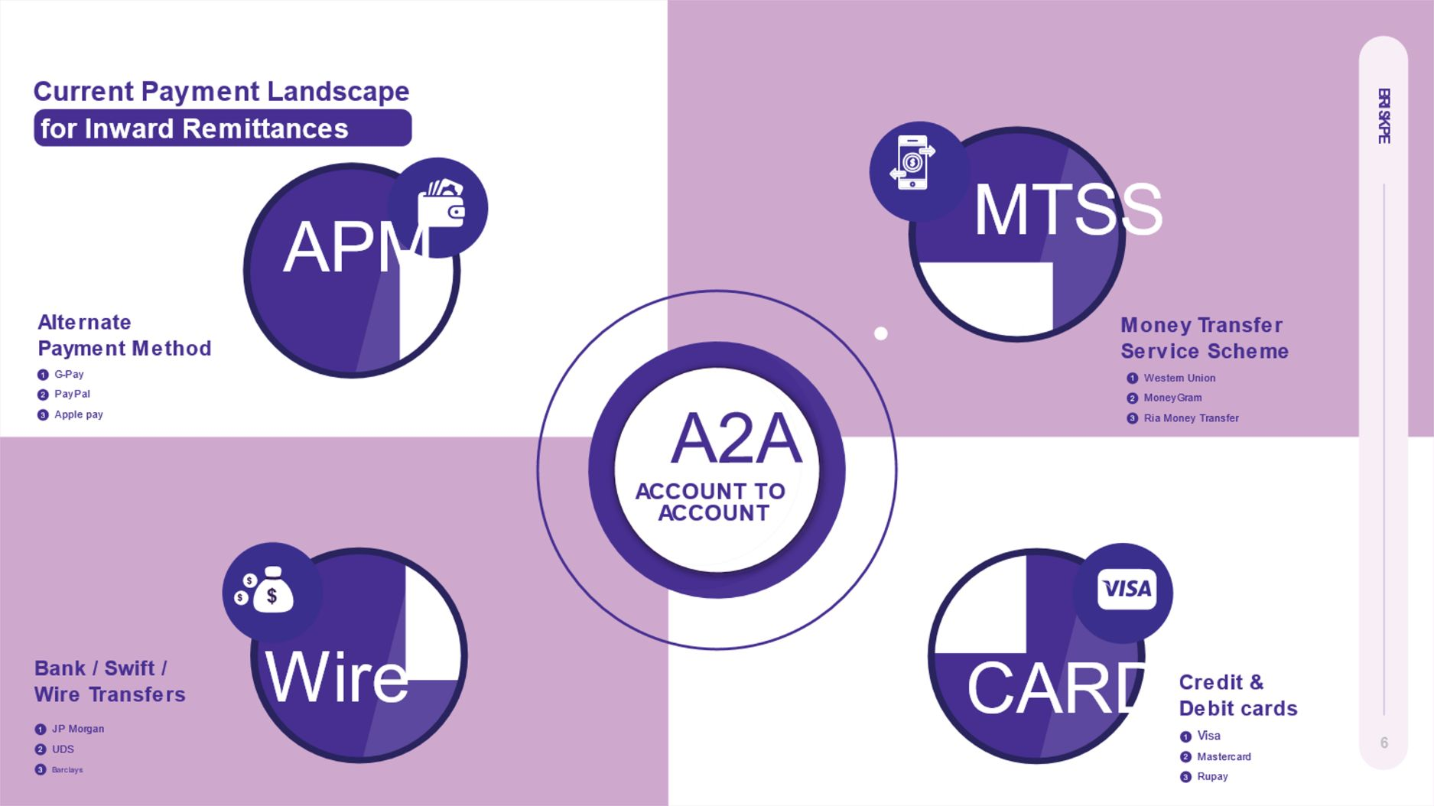
6

Slide 7
Pain Points for Businesses
Expensive
FX: 1.5%-4%
Receiver Fee: $25-$120
BRISKPE
1
Global Banks
Not MSME focused
1
Delayed
Rely of Swift & Correspondent Banks
Settlement time of 2-7 days
2
Fintechs
Mostly in P2P
Not focused on B2B, B2C, C2B Cross-Border flows
Core Problems
For MSMEs
2
Opaque
Lacks visibility w.r.t whereabouts of fund
Leads to cash flows problems
3
Local Banks
Not enough focus on
cross-border payments of
small businesses
3
Hard to reconcile
Absence of auto matching of invoices
Heavy reliance on paper-based process
4
Lack of Options
7

Slide 8
28%
38%
Avoid non USD/EUR/ GBP Trades
BRISKPE
Orders rejectedforlocalpaymentpreference
Can’t Get Local Payment options
What
500+ MSMEs
Exporters
told
BRISKPE
80%
Of Trades
Finaanced
Can’t execute the order seamlessly
79%
Loss of 1% Revenue
in free Samples
Can’t Pay Easily
26%
Find newbankfor diverse paymentneeds
44%
Investingtosetupe-commerce
8

Slide 9
BRISKPE: Endless Possibilities
Borderless Payments. Driving Growth
BRISKPE
Monthly Transactions
10000+
2023
Incorporated
Trusted by
2000+
Businesses
Incorporated in Feb’23, launched the solution in Sep’23 at GFF
Faster XB Payments
Multiple Models
>70% of payments settled in 24 hours
More than 2000 businesses trust BRISKPE’s international collections solution
Operating as Payment Aggregator-Cross Border (PA-CB)
9

Slide 10





BRISKPE: Built with the best: Safe & Secure
BRISKPE
Available on
Registered with Financial Intelligence Unit-India (FIU-Ind)
10

Slide 11




BRISKPE: Comprehensive Segment Coverage: B2B, C2B & B2C
Manufacturing, Services, D2C, Marketplace & Freelancers
BRISKPE
Goodstraders
andmanufacturers
Service providers
Contractors /
Freelancers
Marketplace
SMB exporters of Fashion & apparel, handicraft, leather, electronics, agriculture, imitation jewellery, home décor etc
Service SMBs in IT, business process, outsourcing, HR, Accounting etc.
Contractors and freelancers paid by marketplaces and direct clients
B2C Sellers selling on marketplaces (Amazon, e-Bay, Walmart etc) and DTC stores
11

Slide 12
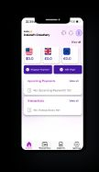
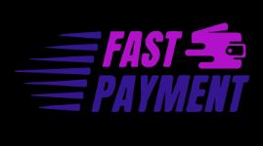
BRISKPE: Value Proposition
​
BRISKPE
01
02
03
04
05
Forex
Named Global
Accounts
Receive Funds
In 24-48 Hours
Free e-FIRA
& BRC
​
Multi-platform Based Solution
Zero Forex
Lowest Fees
​
​
6 currencies - USD, EUR, CAD, GBP, SGD, AUD​
Accept Local
Payments
​
Built-in SWIFT Capability
White-labeled Web and Mobile UI
Instant Virtual
A/Cs
Collect via payment links via PayU and PayPal
Send Requests/
Reminders​
Track Payments​
Settlement with
24 hours
Same Day Issuance ​
No Charges for e-FIRA​ issuance
GST Compliant Invoice​
E-BRC solution on the way. **
Inter-bank Forex
Rates​
No FX Markup​
Fee of <1%
(Including GST)​
PA-CB as Service:
For Aggregators and Marketplaces serving merchants
12

Slide 13

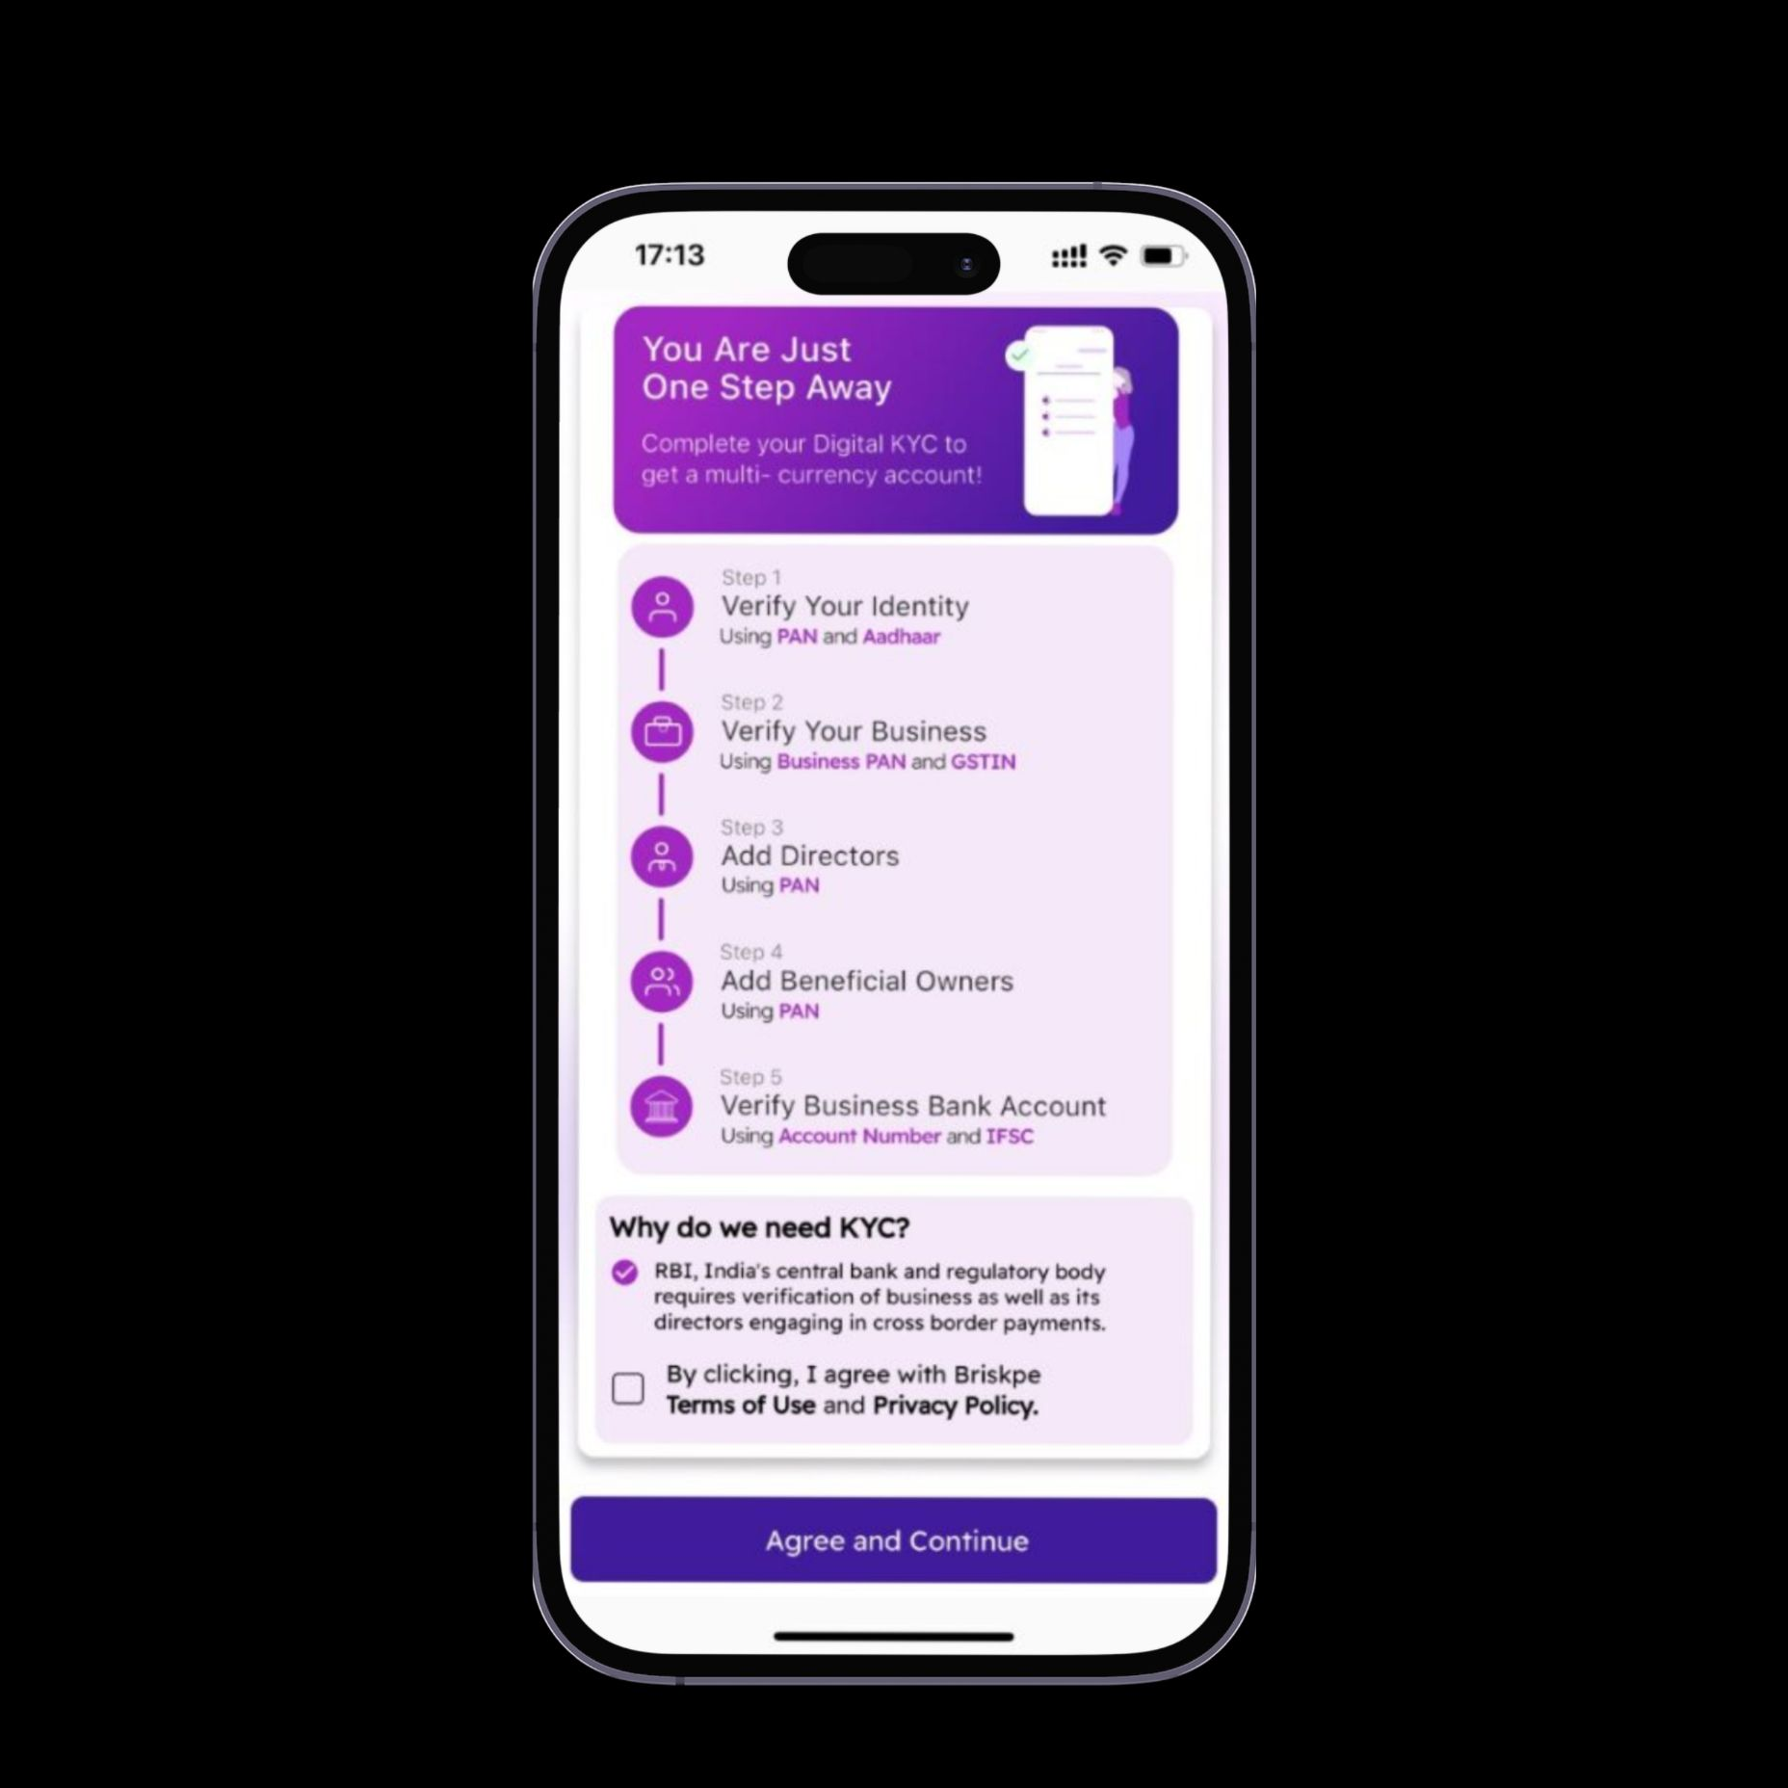
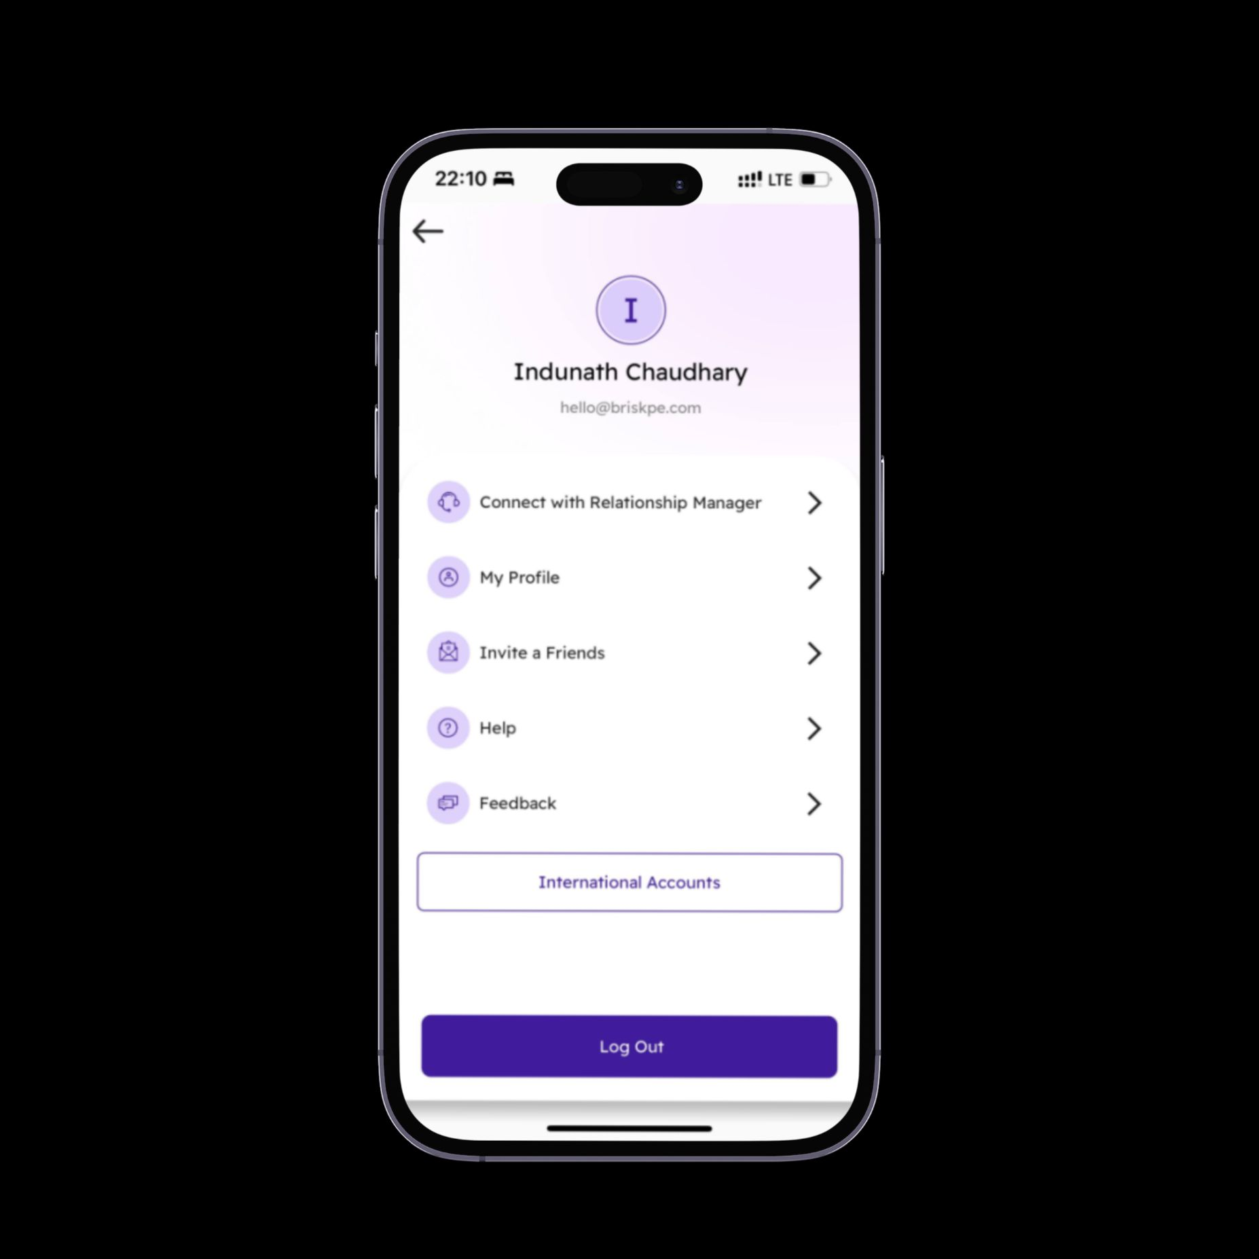
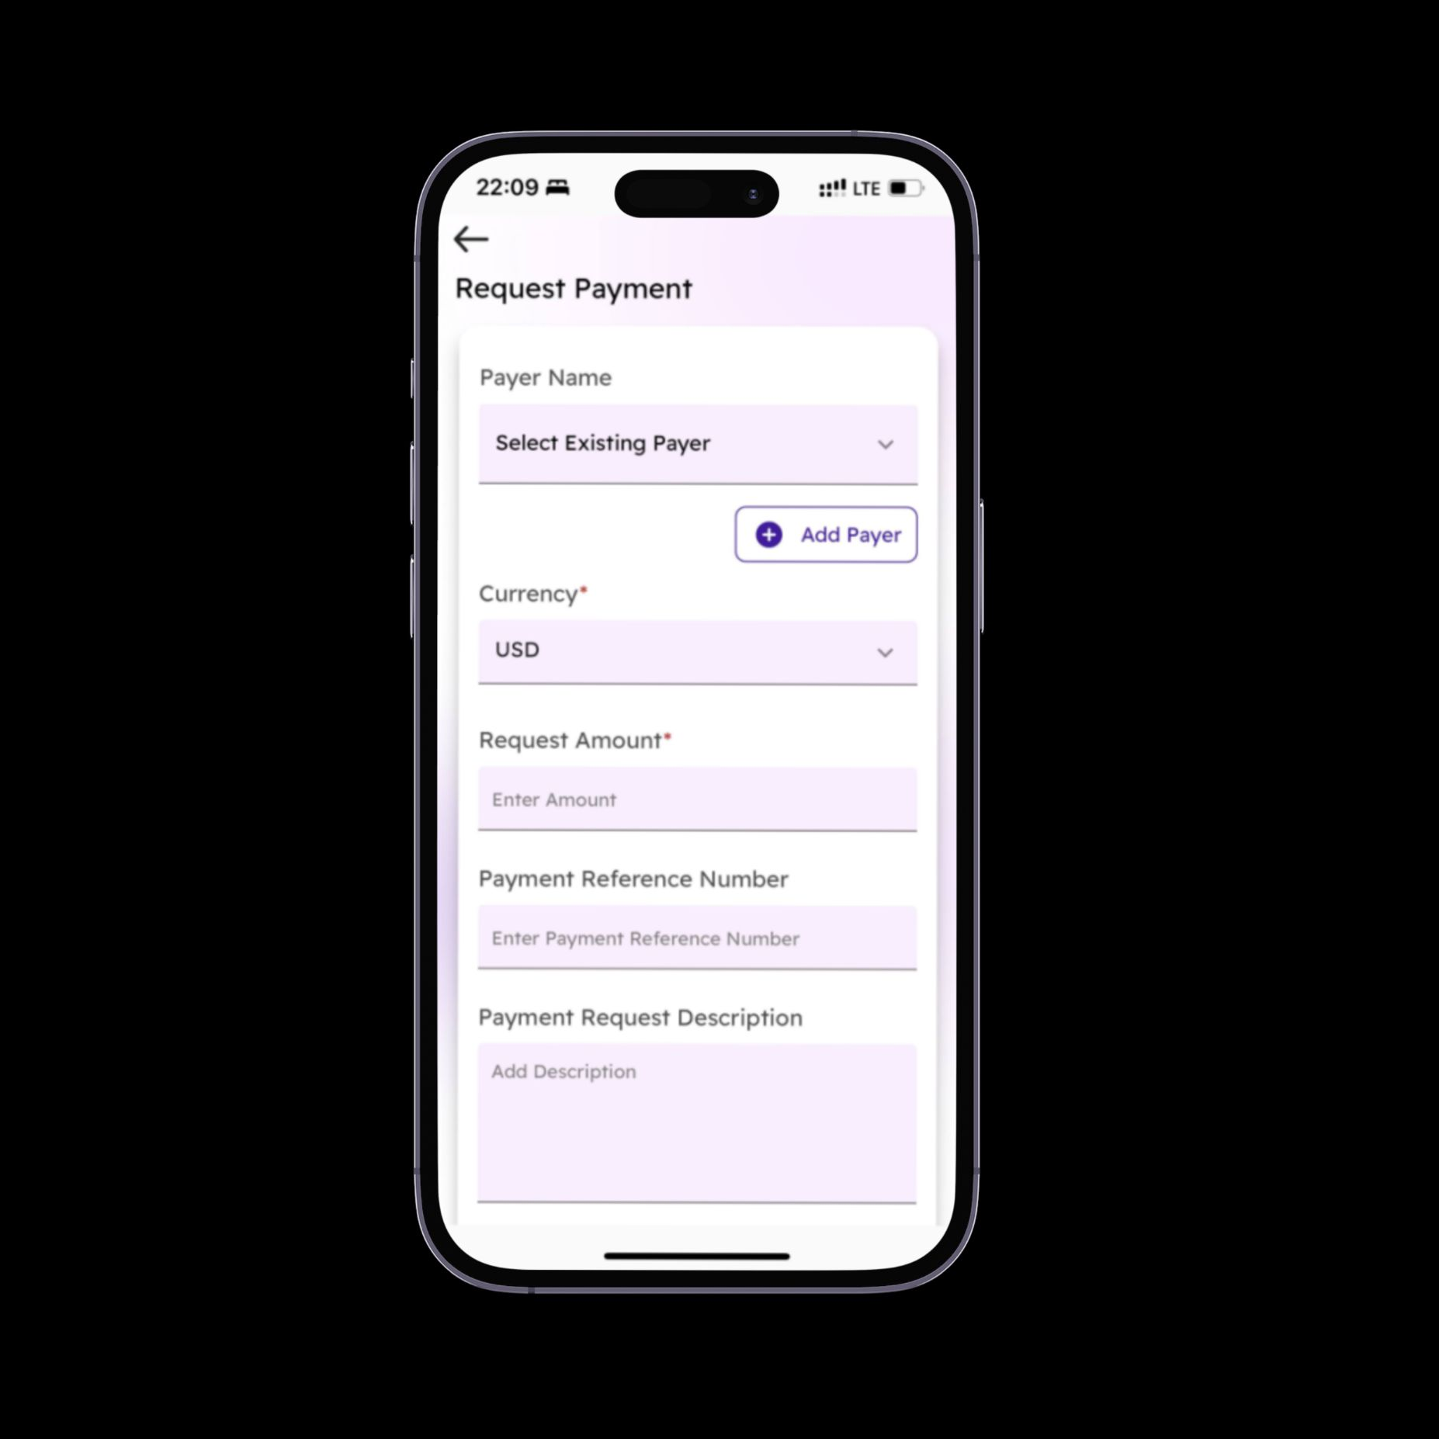
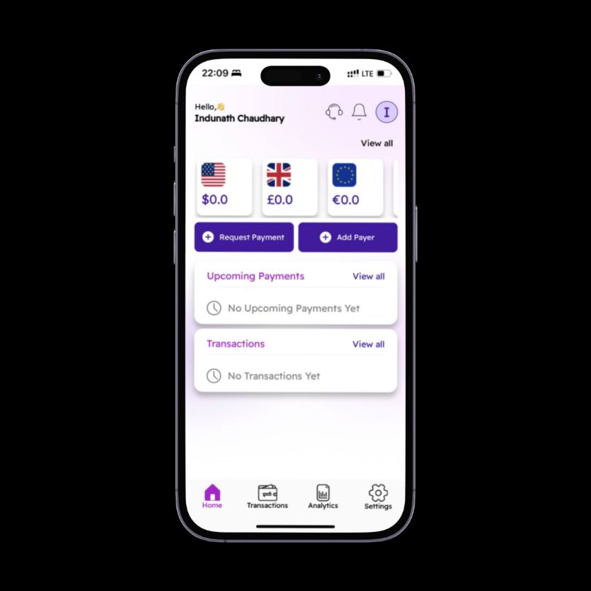
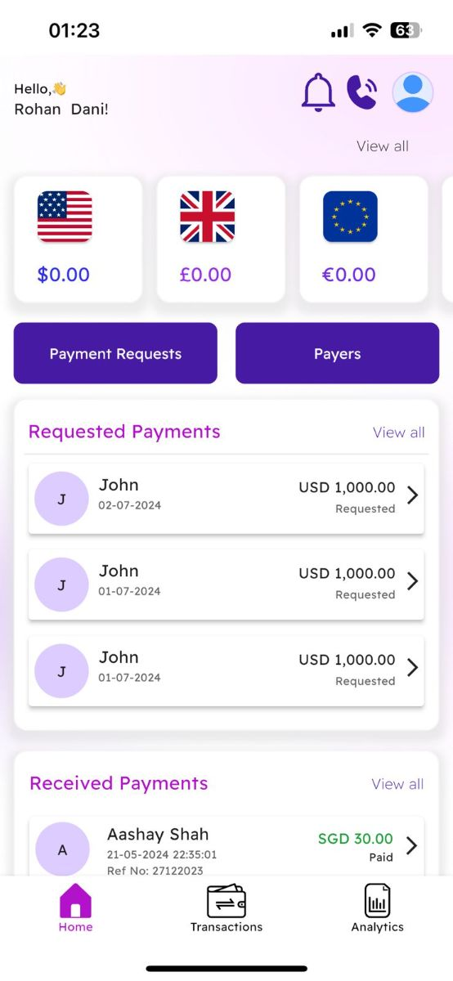
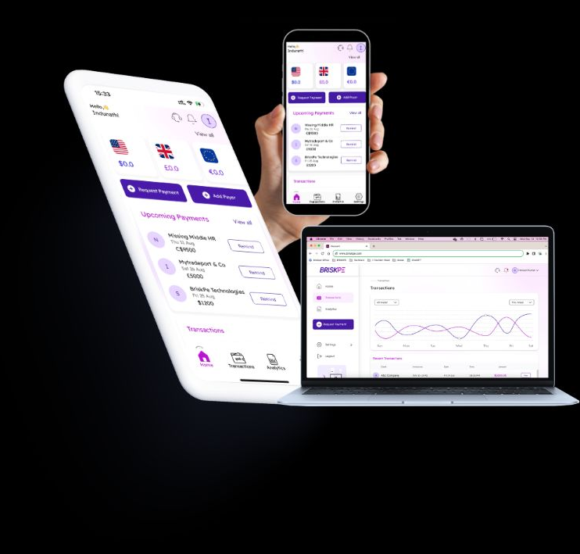



What sets BRISKPE apart
International Collections A/C Stack:
BRISKPE
<5 minutes onboarding
Complete Digital Verification
Instant Virtual Accounts
Payment Tracking
Request Payment
Buyer intimation
Accessibility
Connect with Service
All in one platform:
Collect using virtual accounts; cards and wallets
Powered by:
13
Supporting International Collections for all Business Purposes

Slide 14
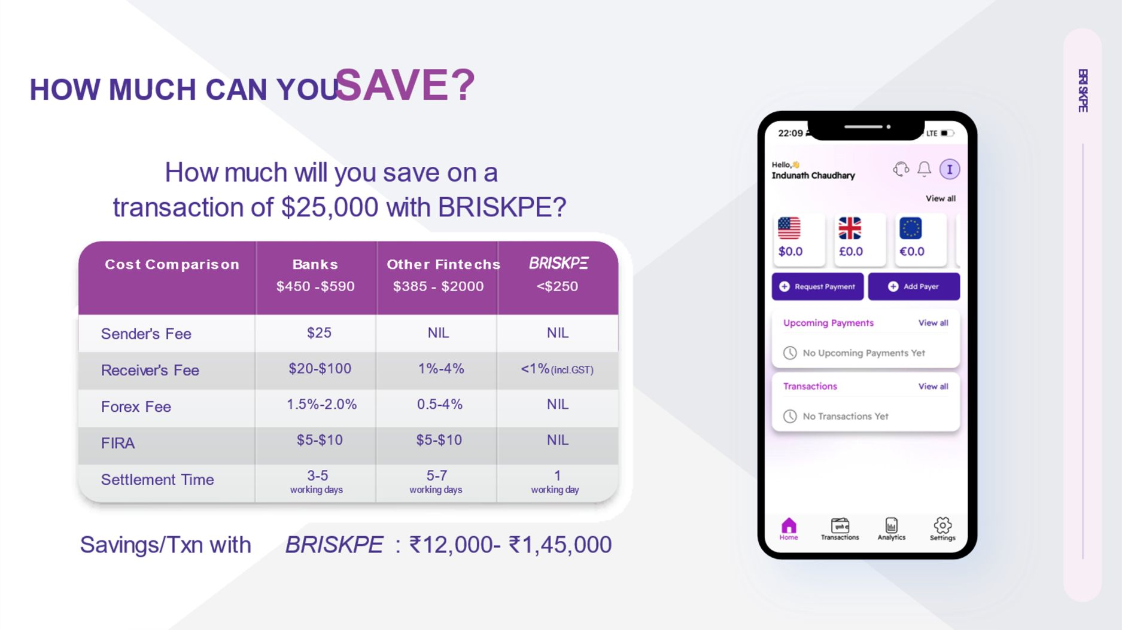
BRISKPE
13
14

Slide 15




Engage and Earn with BRISKPE
Maximise Your Earnings by Referring Clients
BRISKPE
1
Partner Participation
Partner with BRISKPE and refer exporter clients to avail BRISKPE services
2
Lucrative Referral Incentives
Perpetual referral incentive program based on the revenue sharing
3
Utilize the BRISKPE Platform
Better visibility on social media with recommendations and referrals
15

Slide 16



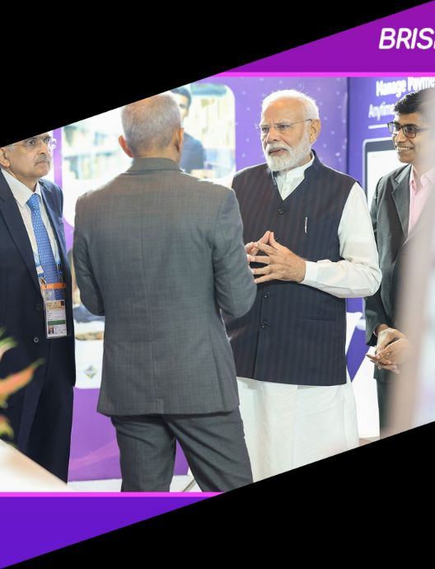
BRISKPE
Recognized by the honourable
Prime Minister Shri Narendra Modiji and former RBI Governor Shri Shaktikanta Das
16

Slide 17



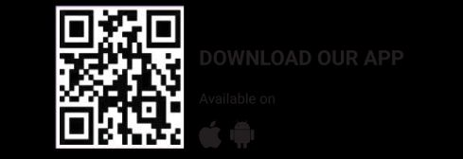




Linkedin
Email
linkedin.com/company/briskpe
info@briskpe.com
Phone
Website
+91-7507-412-090
www.briskpe.com

