Slide 1

REAL ESTATE SUMMIT
2024
                Presentation By,
                Vinay Thyagaraj
                Partner M/s. Venu & Vinay
                Chartered Accountants,
                Bengaluru
Critical Aspects related to RERA

Slide 2
Presentation Overview - Contents
Real Estate Sector Challenges
Laws evolved over Real Estate Transactions
Present WB RERA Picture
RERA Applicability for Real Estate Project
Latest and important Circulars and Notification
RERA and Other Laws - Interplay
Judicial Rulings

Slide 3
Real Estate Sector Challenges -
GOVT INTERVENTION, MARKET SENTIMENTS AND NATURAL CALAMITIES
Demonetization in 2016
RERA 2016
IBC 2016
GST 2017
Finance Act
NBFC Crises
Liquidity Crises
Investors left the Sector
Covid 19 followed by lockdown
All these Challenges are taken as an opportunity and the Industry has Tripled its Business and Growth

Slide 4
LAWS EVOLVED WRT PROPERTY TRANSACTION
Contract Act 1872 –General – 152 years legacy
Transfer of Property Act,1882 – 142 years legacy
Indian Stamp Act, 1899 – 100 plus year legacy
Registration Act, 1908
Cooperative Societies Act 1912
Ownership Flats Act/ Apartment Act
Consumer Protection Act 1986
Real Estate(Regulation & Development) Act, 2016

Slide 5
STATEMENT OF OBJECTS AND REASONS OF THE ACT
Ensure Accountability Towards Allottees and Protect their Interest;
Infuse Transparency, Ensure Fair-play and Reduce Frauds & Delays;
Introduce Professionalism and Pan India Standardization;
Establish Symmetry Of Information between The Promoter And Allottee;
Imposing Certain Responsibilities On both Promoter And Allottees;
Establish Regulatory Oversight Mechanism to Enforce Contracts;
Establish Fast- Track Dispute Resolution Mechanism;
Promote Good Governance in the Sector which in turn would create investor confidence;

Slide 6
GOVERNANCE / AUTHORITY
The West Bengal Real Estate Regulatory Authority (WBRERA) is established under section 20 (1) of the Real Estate (Regulation and Development) Act, 2016 (Act No. 16 of 2016).
Objective: To regulate and promote the housing sector and to ensure sale of plot, apartment or building, as the case may be, or sale of real estate project, in an efficient and transparent manner and to protect the interest of consumers in the real estate sector and to establish a mechanism for speedy dispute redressal and for matters connected therewith or incidental thereto.
Registration of Real Estate Project with the Real Estate Regulatory Authority is compulsory under section 3 of the Real Estate (Regulation and Development) Act, 2016 (Act No. 16 of 2016).

Slide 7
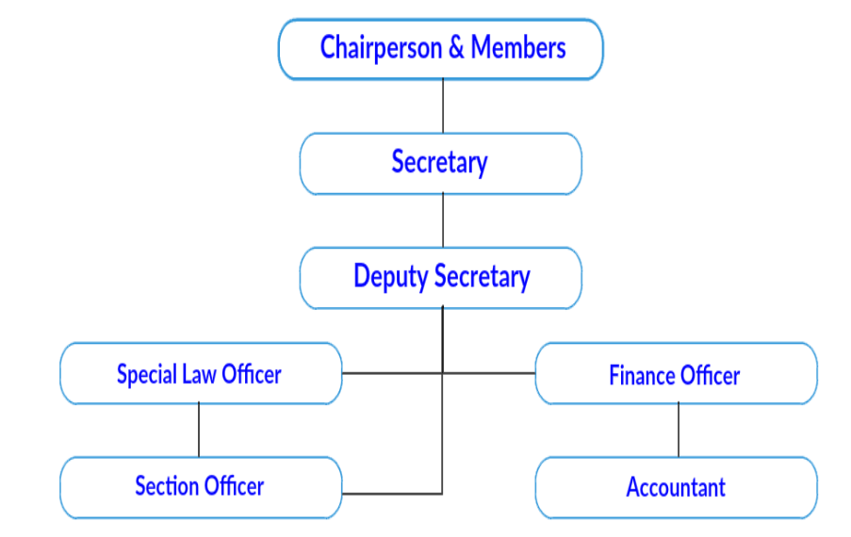
Organisation Structure – WB RERA
West Bengal Real Estate Regulatory Authority,
Calcutta Green
Commercial Complex
(1st Floor), 1050/2, Survey Park,
Kolkata-700075

Slide 8

STATUTE – ACT, RULES, NOTIFICATIONS, ORDERS
WB HIRA
2016
RERA
Act 2016
WB - RERA
Rules 2021
(27.07.2021)
Orders
RERA Authority Established –
29.07.2021
Notifications /
circulars / Orders
RERA Website operationalized
31.01.2023

Slide 9
RERA - PROJECT LIFE CYCLE
Preparation
  Business Plans
  Due Diligence
  Feasibility
Start
  Statutory Approvals
  NOC’s
  RERA Registration
  Bank / Financing
  Modification
  Extension
  Change of professionals
  Customer Complaints
During the Development
  70 / 30 Collections
  Compliances – Quarterly Filing
  Annual Audit
  Follow mandatory Practices under RERA
End of the project Development
  Project Completion
  Reporting of Completion
  Funds withdrawn
  Association formation
  Handover possession of common Areas
  Handover of Corpus funds to the Association
  Handover title deeds / documents
  Handover Approvals, plans, NOC
  Handover Drawings – plumbing, electricals
Post Completion / Handover
  Mortgage Release
  Loan / Hypothecation
  Sec 17
  DLP for 5 years

Slide 10
STAGE WHEN PROJECT CAN BE LAUNCHED AFTER RERA
1 – Due Diligence of Land and Project
6 – Obtain Sanctions of Plans
7 – Prepare All Doc’s for filing RERA Application
2 – Feasibility of the Project / Market Study etc
5- Apply for Noc’s clearances, etc.,
8 – RERA registration
3 – Enter MOU/Agreement with Land Owner/Purchase land
4 – DA / JDA / GPA
9 – LAUNCH / ADVERTISEMENT ETC

Slide 11
FLOW OF SALE/PROCESS - POST RERA
1 - Booking Form
6 - Complete development and
Obtain OC
7 - Conveyance deed within 3 months of OC
2 - Allotment Letter
5- Formation of Association of Allottees once majority of units are booked
8 – Title Insurance / Defect Liability for 5 years
3 - Enter Agreement for Sale
4 - Register Agreement for Sale – if promoter collects > 10 % of total cost
9 – Handover to Association

Slide 12
RERA – APPLICABILITY - ACT
Notification No,
42-H4l2M-0t12023
Dt 06.06.2023 of the Housing Department,
Govt. of West Bengal
where the area of land proposed to be developed does not exceed five hundred square meters (5382sft) or the number of apartments proposed to be developed does not exceed eight inclusive of all phases.
where the promoter has received completion certificate for a real estate project prior to commencement of this Act;
Does not exceed 200 square meters or the number of flats/apartments/plots to be developed are more than 6, compulsorily required to registered under WB-RERA
for the purpose of renovation or repair or re-development which does not involve marketing, advertising selling or new allotment of any apartment, plot or building, as the case may be, under the real estate project.
where the real estate project is to be developed in phases, every such phase shall be considered a stand alone real estate project, and the promoter shall obtain registration under this Act for each phase separately.

Slide 13
REAL ESTATE PROJECT
REGISTRATION
UNDER RERA

Slide 14
RERA REGISTRATION-SECTION 3
Prior registration of Project – Section 3 and WB RERA Rules – 3 and 4
KYC of the Promoters and organization documents
Legal Title Documents including Title Search Report
Plan Sanction and NOC related, Mortgage
Area Statement – Carpet, Built-up area, Parking Area, Common Area
Estimated Cost of the project, RERA Designated Project Bank Account
Legal Draft – Allotment Letter, Agreement of Sale, Sale Deed
Professionals associated for the project – Architect, CA, Structural Engineer
Affidavits, undertaking
Online filing of Application and Registration Fees

Slide 15
RERA REGISTRATION-NON-COMPLIANCE - SECTION 59
Prior registration of Project – Section 3 and WB RERA Rules – 3 and 4
Non-compliance of Section 3 of the RERA Act 2016, shall attract penal action under Section 59, which entitles RERA to levy penalty upto 10 % of the Estimated cost of the project.

Slide 16
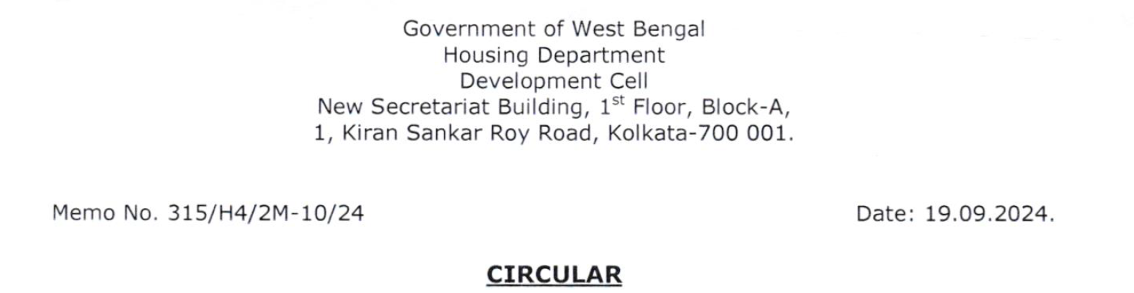
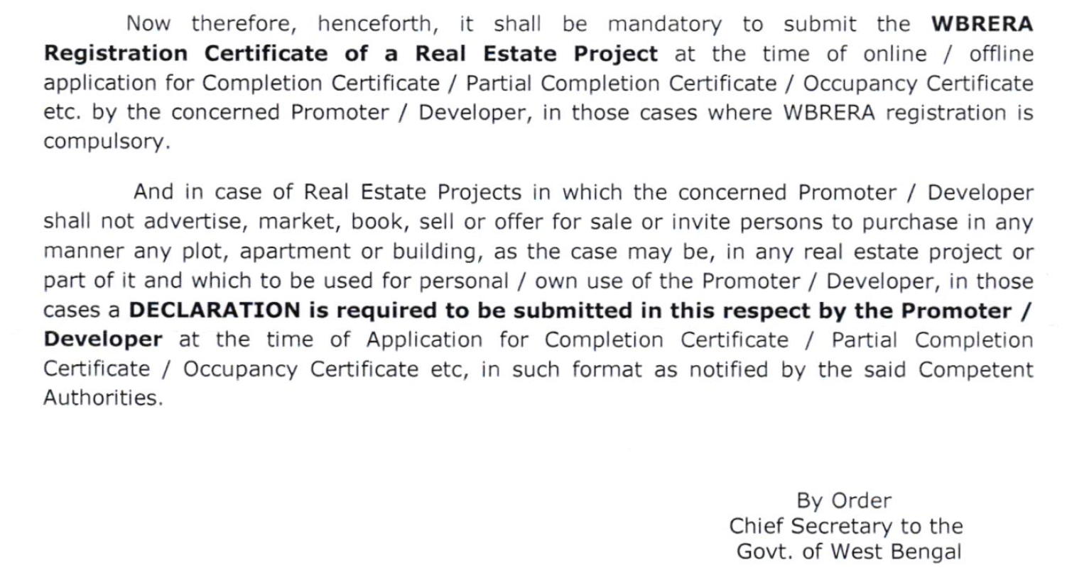

Slide 17
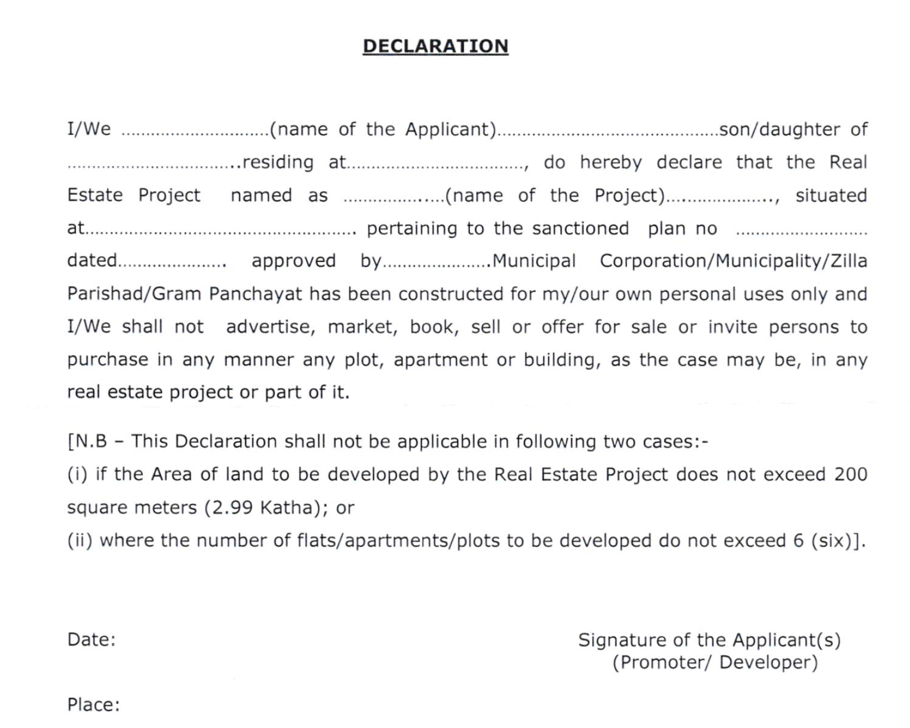
RERA REGISTRATION-NON-COMPLIANCE - SECTION 59

Slide 18
Question Frequently Asked
RERA Registration – for the real estate projects obtained the completion certificate
We frequently encounter the question: Why is RERA registration required for projects that have already received a completion certificate?
This question serves as a powerful reminder and encourages continuous reflection on the value and purpose of RERA: Why is registration under RERA required even for projects that have already received a completion certificate?

Slide 19
Question Frequently Asked
Section | Provisions under the Act
11(4)(d) | responsible for providing - maintaining the essential services, on reasonable charges, till the taking over of the maintenance of the project by the association of the allottees;
11(4)(e) | enable the formation of an association or society or co-operative society, as the case may be, of the allottees, or a federation of the same, under the laws applicable. (in case of absence of local laws, the association shall be formed within 3 months of majority allotments in the project)
11(4)(e) | execute a registered conveyance deed of the apartment, plot or building in favour of the allottee along with the undivided proportionate title in the common areas to the association of allottees or competent authority, as the case may be, as provided under section 17 of this Act
11(4)(g) | pay all outgoings until he transfers the physical possession of the real estate project to the allottee or the associations of allottees (a) Land Cost (b) Ground Rent, (c) Municipal Taxes, (d) Water, (e)Electricity charges (f) Maintenance charges, (g) Mortgage loan, interest, (h)Any other liabilities
14 | Defect Liability Period of 5 Years from the date of handover of the possession of the apartment or the common areas to the association of allottees
17 | (a) execute a registered conveyance deed in favour of the allottee along with the undivided proportionate title in the common areas to the association of the allottees or the competent authority, (b) hand over the physical possession of the plot, apartment of building, as the case may be, to the allottees and the common areas to the association of the allottees or the competent authority, (c) other title documents pertaining thereto within specified period as per sanctioned plans as provided under the local laws

Slide 20
RERA Registration is Mandatory
For Bankers to release the loan
Lenders to fund the project
Buyers to purchase the unit
Insurance company’s
Planning authority to release / Completion certificate

Slide 21
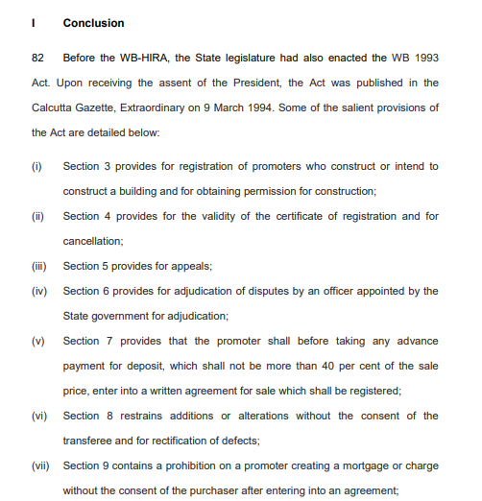
Supreme Court Judgement - Conclusion
From WB-HIRA to WB-RERA

Slide 22
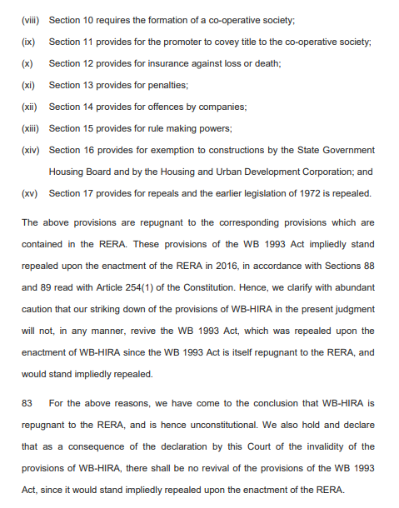
Supreme Court Judgement - Conclusion
From WB-HIRA to WB-RERA

Slide 23
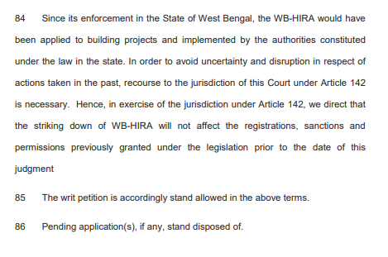
Supreme Court Judgement - Conclusion
From WB-HIRA to WB-RERA

Slide 24
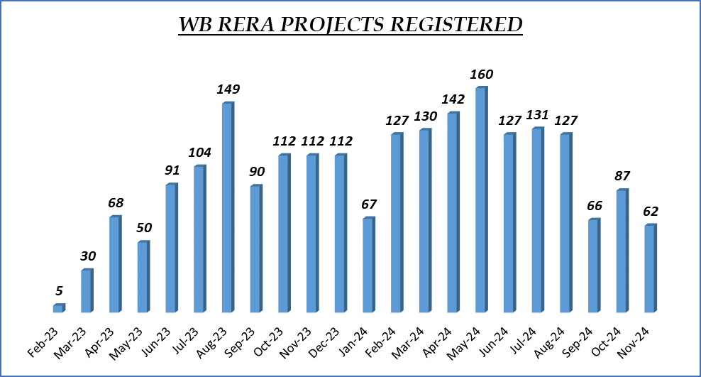
UNDER WB-RERA
TOTAL PROJECTS REGISTERED – 2149 Projects

Slide 25
UNDER WB-RERA
TOTAL PROJECTS REGISTERED – 2149 Projects
      1. This indicates that 900 projects have already been registered during the Financial Year 2024-25 ie., from April 2024 to November 2024, which is a significant portion of the total projects registered and it is expected to reach upto 1000 projects on March 2025 which implies a rapid growth of the real estate market in the State.
2. However, the number of real estate projects typically fluctuates based on market conditions, seasonal trends, and regional factors, highest number of projects are registered during the month May 2024.

Slide 26
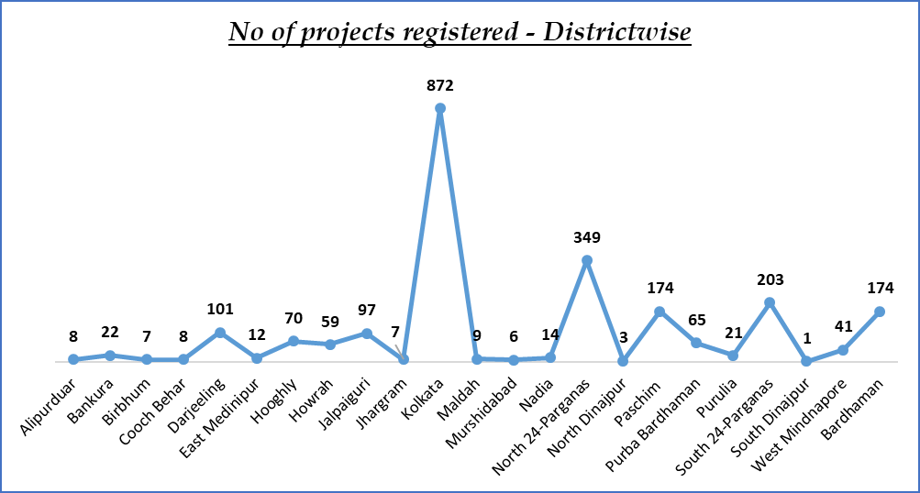
UNDER WB-RERA
TOTAL PROJECTS REGISTERED – 2149 Projects
Kolkata is indeed one of the major real estate markets in West Bengal and has historically been a significant hub for both residential and commercial real estate. The city's real estate market is influenced by various factors, including its strategic location, infrastructure development, economic growth, and demographic trends.

Slide 27
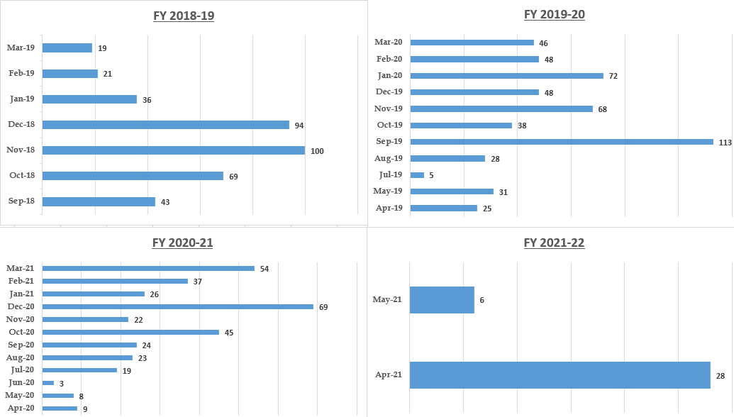
UNDER HIRA (Housing Industry Regulatory Authority)
TOTAL PROJECTS REGISTERED – 1277 Projects

Slide 28

The judgment by the Supreme Court of India on May 4, 2021, brought a significant shift in the regulatory framework for real estate projects in West Bengal. After the Supreme Court ruling, the registration of real estate projects in West Bengal was mandated to take place under WB RERA (West Bengal Real Estate Regulatory Authority), aligning the state’s regulatory framework with the provisions of the Real Estate (Regulation and Development) Act (RERA), 2016.
There are no registrations further made under West Bengal Housing Industry Regulation Act (WB HIRA) after May 2021 and the registrations are shown separately in the WB RERA Website which aims to enhance transparency, protect homebuyers’ interests, and streamline real estate project registrations and regulations across the country.

Slide 29
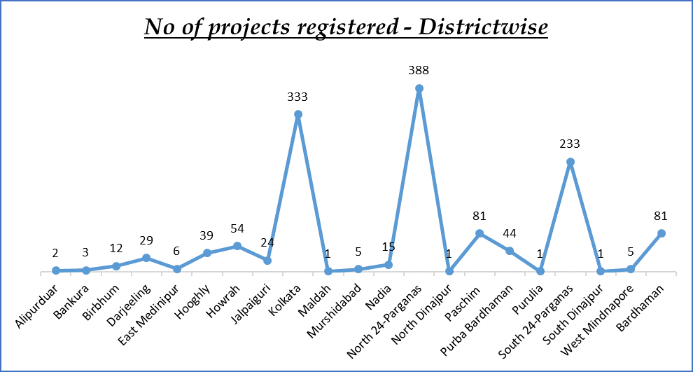
UNDER HIRA (Housing Industry Regulatory Authority)
TOTAL PROJECTS REGISTERED – 1277 Projects
North 24 Parganas, a district adjacent to Kolkata, has seen rapid urbanization due to the city’s expansion and Kolkata, as the capital city of West Bengal, is a major urban hub with a large and growing population, driving demand for both residential and commercial properties are among the most urbanized and economically active districts in West Bengal, making them prime locations for real estate development registered under WB HIRA (West Bengal Housing Industry Regulation Act).
With Kolkata being the commercial and cultural heart of the state and North 24 Parganas becoming an extension of the city, these regions continue to be key hotspots for real estate development

Slide 30
Key Implications of the Shift from WB HIRA to WB RERA:
Standardization Across India
Stronger Consumer Protection
Developer Compliance
Regulatory Authority
Impact on Ongoing Projects

Slide 31
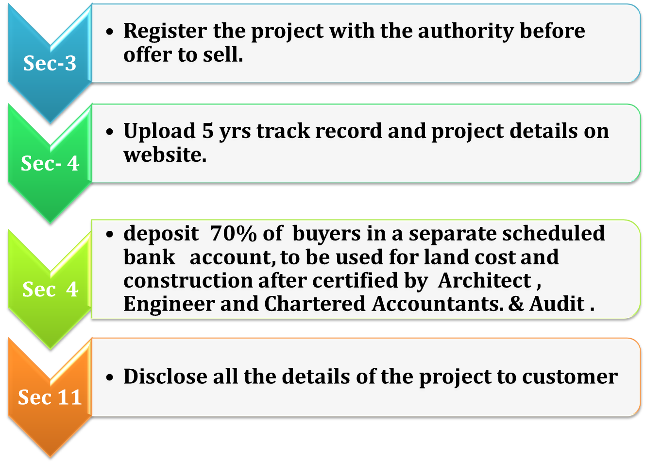
Obligation of Promoters

Slide 32
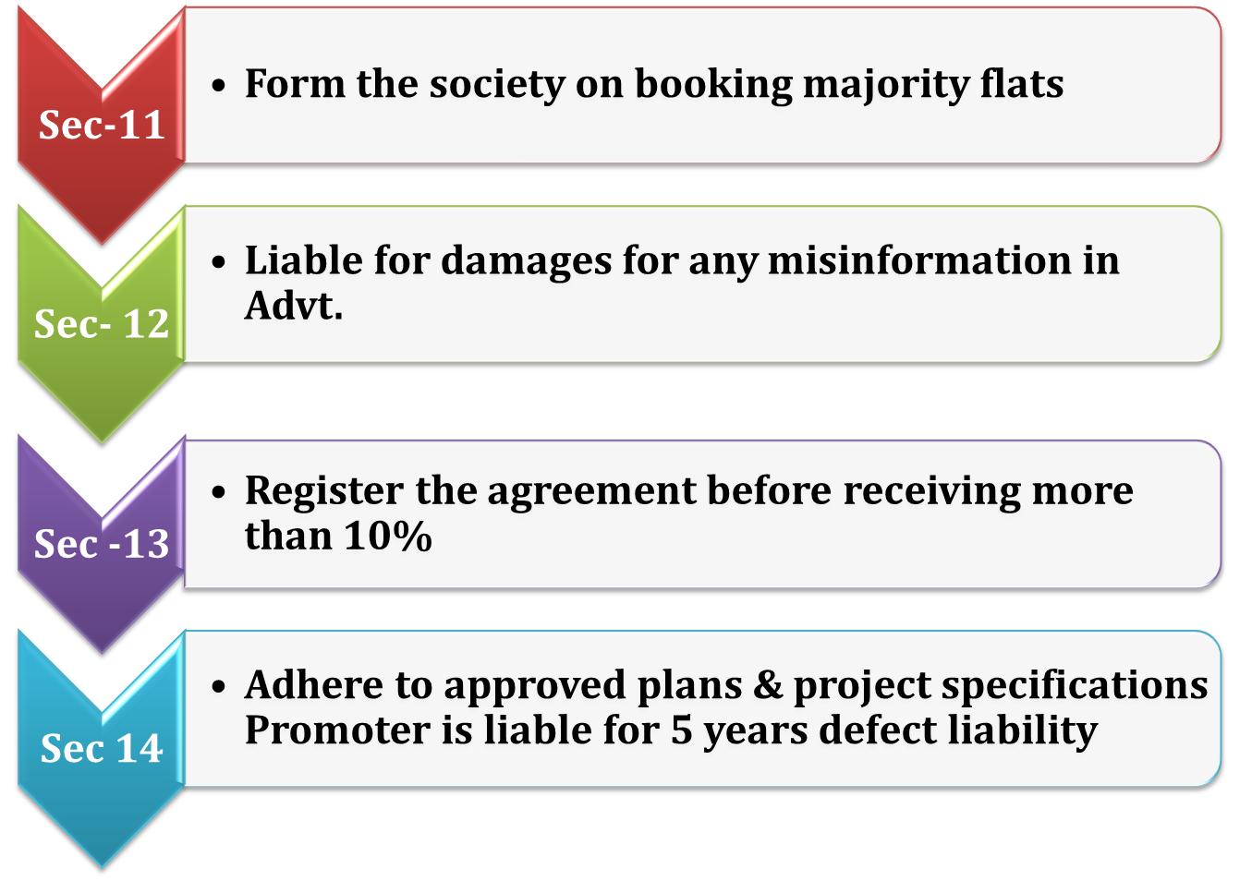
Obligation of Promoters

Slide 33
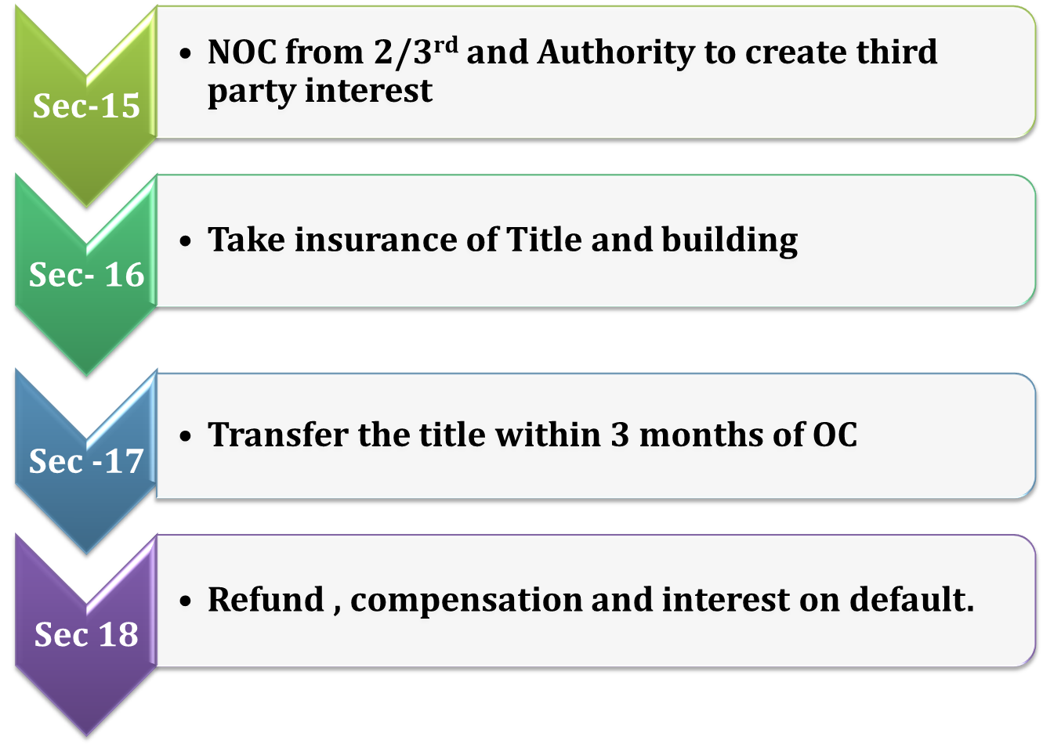
Obligation of Promoters

Slide 34
Role of Professionals –
CA, Architect, Engineer, Lawyer….
Consultancy
Real estate project Registration
Compliance and Financial Discipline
Consumer Protection
Complaint Redressal
Consultancy
Real estate agent Registration

Slide 35
LATEST NOTIFICATION AND CIRCULARS
UNDER WB RERA

Slide 36
Sl No. | Description | Dated
1 | Directions with regard to the Quarterly Update of Real Estate Projects registered with WBRERA / erstwhile WBHIRA in the website of West Bengal Real Estate Regulatory Authority | Kolkata, 06/12/2024
2 | Circular regarding RERA Registration number mandatory in the Application for C.C. / Partial C.C. / O.C. in West Bengal | Kolkata, 30/09/2024
3 | Order Regarding Advertisement and other Publicities of Registered Projects | Kolkata, 25/07/2024
4 | Notification for Online Registration of Projects which have obtained Occupancy Certificate but not Completion Certificate as on 31.01.2023 | Kolkata, 13/05/2024
5 | Extended List (till 25.08.2023) of Real Estate Agent under PMLA, 2002 | Kolkata, 26/09/2023
6 | Awareness for Real Estate Agents made by Security Council 1718 Sanctions Committee – 1 | Kolkata, 25/08/2023
7 | Notification for Compulsory Registration before Advertisement, Sale and Booking etc. | Kolkata, 27/06/2023
8 | Notification for registration of Real Estate Projects under WBRERA | Kolkata, 14/06/2023
9 | Notice regarding Refund of Project / Agent Registration and Adjudication fees deposited to erstwhile WBHIRA | Kolkata, 27/04/2023
10 | Order relating to Application of Section 3 (1) of RERA Act beyond the Planning areas in the state of W B | Kolkata, 22/03/2023
11 | Notification for ongoing Projects | Kolkata, 08/02/2023

Slide 37
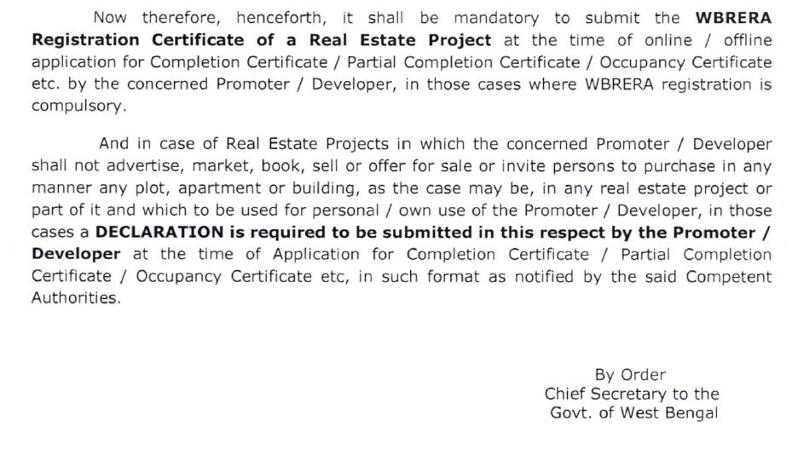
Circular regarding RERA Registration number mandatory in the Application for C.C. / Partial C.C. / O.C. in West Bengal dated 30-09-2024

Slide 38
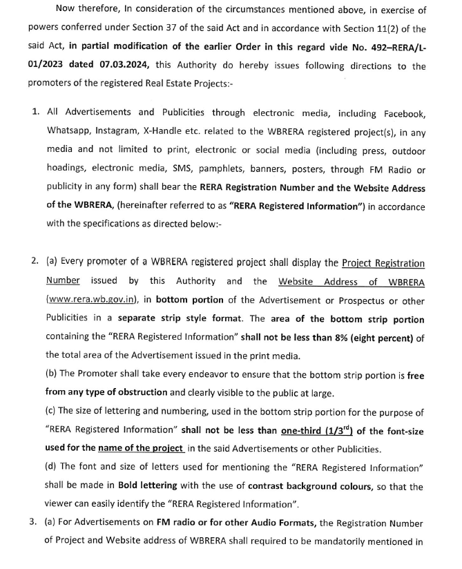
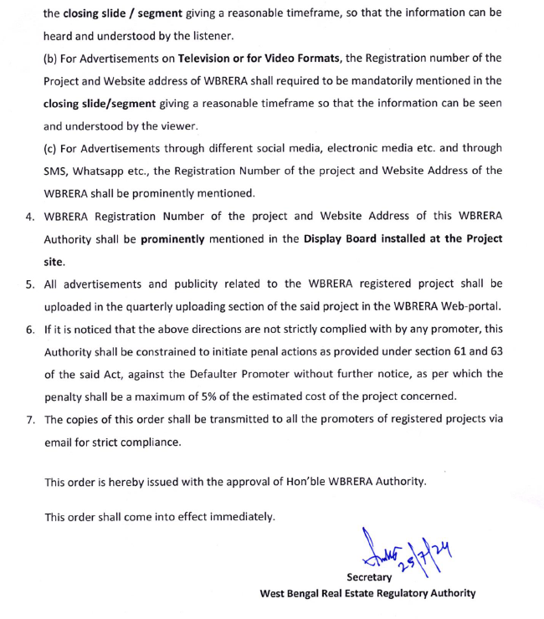
Order Regarding Advertisement and other Publicities of Registered Projects
dated 25-07-2024

Slide 39
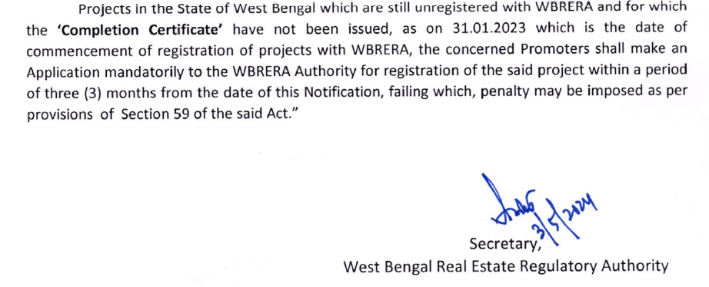
Notification for Online Registration of Projects which have obtained Occupancy Certificate but not Completion Certificate as on 31.01.2023 dated 13-05-2024

Slide 40
FINANCIAL MANAGEMENT
UNDER RERA

Slide 41

RERA - Financial management – Sec 4
Project Designated Bank Account
Disclose in RERA Registration Application
Scheduled Bank
Allottees Realisation
Mandatory Deposit of
70 % of realization from allottees
Withdrawal of 70 % based on % of Completion of the Project development
Professional Certificates mandatory for withdrawal of money
Utilise the withdrawn money for the specific project

Slide 42
Withdrawal of money from the Designated Bank Account
Rule 5 –
For the purposes of sub-clause (D) of clause (l) of sub-section (2) of section 4 of the Act, the land cost shall be the costs incurred by the promoter, whether as an outright purchase or lease premium
For the purposes of sub-clause (D) of clause (l) of sub-section (2) of section 4 of the Act, the construction cost shall be the cost incurred by the promoter, towards the on-site expenditure for the physical development of the project.

Slide 43

EXTENSION / RENEWAL OF RERA REGISTRATION
OF RERA REGISTRATION

Slide 44
EXTENSION / RENEWAL OF REGISTRATION – SEC 6 /RULE 7
Section 6 of the RERA Act
WB RERA Rule 7
Application in Form E
Application to be filed 3 months before expiry of registration
Extension fees – Twice of the Registration fees (for 1 year)

Slide 45
COMPLETION UNDER RERA

Slide 46
COMPLETION UNDER RERA
On completion of development of the project-
  Internal development
  External development
On Project Completion - Submit
  Occupancy Completion certificate
  Consolidated Bank Statement
  Mortgage release
  Structural Liability Certificate (for Building)
  Sold and Unsold Inventory
  Association of Allottees (for Building)
  Project Photograph
  Common Areas / Amenities handed over to the Association – Affidavit

Slide 47
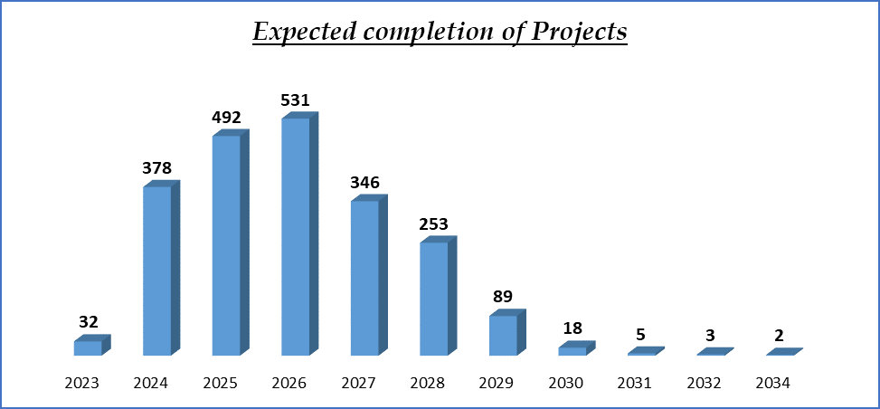
The typical real estate development project lifecycle is segmented into distinct phases, with 1 to 5 years being a common range for completion, depending on the type and complexity of the development.
Hence the most of the projects already registered during the period from 2023 under WB RERA are expected to complete the construction phases by 2024 to 2028

Slide 48
AGREEMENT OF SALE - AOS

Slide 49
AGREEMENT FOR SALE - AOS
Section 2(c)"agreement for sale" - means an agreement entered into between the promoter and the allottee;
Section 13 (1) A promoter shall not accept a sum more than ten per cent of the cost of the apartment, plot, or building as the case may be, as an advance payment or an application fee, from a person without first entering into a written agreement for sale with such person and register the said agreement for sale, under any law for the time being in force.

Slide 50
AGREEMENT FOR SALE - AOS
Section 13 (2) The agreement for sale referred to in sub-section (1) shall be in such form as may be prescribed and shall specify the particulars of development of the project including the construction of building and apartments, along with specifications and internal development works and external development works, the dates and the manner by which payments towards the cost of the apartment, plot or building, as the case may be, are to be made by the allottees and the date on which the possession of the apartment, plot or building is to be handed over, the rates of interest payable by the promoter to the allottee and the allottee to the promoter in case of default, and such other particulars, as may be prescribed.

Slide 51
WB RERA Rule 9- AGREEMENT FOR SALE -
WB RERA Rule 9(1) For the purpose of sub-section (2) of section 13 of the Act, the agreement for sale shall be in the Form in Annexure ‘A’ –
WB RERA Rule 9(2) Any application letter, allotment letter or any other document signed by the allottee, in respect of the apartment, plot or building, prior to the execution and registration of the agreement for sale for such apartment, plot or building, as the case may be, shall not be construed to limit the rights and interests of the allottee under the agreement for sale or under the Act or the rules or the regulations made thereunder.

Slide 52
WB RERA Rule 9- AGREEMENT FOR SALE -
WB RERA Rule 9(3) The Promoter shall not make any additions and alterations beyond the extent of 5(five) percent in the sanctioned plans, layout plans and specifications and the nature of fixtures, fittings and amenities described therein in respect of the apartment, plot or building, as the case may be, without the previous written consent of the Allottee

Slide 53

PROFESSIONAL
PERSPECTIVE
AND
RERA

Slide 54
PROFESSIONAL PERSPECTIVE
Rera – Regulatory Authority for the Real Estate Industry
Providing uniform data across all stakeholders
Differences and Variances
Stakeholders and CA’s Role
Role of CA’s
Post RERA Practices

Slide 55
PROVIDING UNIFORM DATA ACROSS ALL STAKEHOLDERS
Management of the Business houses – in case of a large organisation, management/board of directors to know the various critical numbers/data of the organisation/business
Regulatory Body – Real Estate Regulatory Authority – is the custodian of all information related to the real estate project. Act as a bridge between the promoter entity and the public at large
Lenders – to ensure the funds so released/lent is utilized for the purpose of project development or intended use
Prospective Customers – Customers will look into the project details, business house, or organisation before they make a decision in the selection of the property and more so, the performance & delivery of the earlier projects to the customers.
Government Agencies – planning authorities and other statutory authorities, granted permission to construct or develop the real estate project
Tax Authorities – wanting to collect the applicable taxes based on the transactions
Research Agencies – Research Agencies to prepare the Analytical report to publish
Investors
Stock Exchanges

Slide 56
DIFFERENCES AND VARIANCES
1. The Estimated costs submitted with RERA are different from that of cost details submitted to the lenders/financial institutions
2. Details of Amount realised from the allottees as per RERA and as per Books of Accounts. The amount realised is classified under various heads (like sales, current liabilities, taxes etc)
3. % Of completion is more in RERA and less with Income Tax or GST
4. Number of units booked/sold is more with RERA compared to Income Tax or GST
5. Amount incurred as per RERA is more compared with the Purchases in GST R
6. Amount incurred as per RERA is more compared the Books of Accounts audited
7. Sold/unsold inventory or receivables as per RERA compared to the certificate submitted to the banker as stock or receivable statements.

Slide 57
STAKEHOLDERS AND CA’S ROLE
Promoter – Developer / Builder
Promoter – Landowners
Allottees – Customers
Professionals – CA’s, Engineers, Architects
Bankers of RERA Designated Bank Account
Lenders – Construction Finance
Lenders – Housing Loans to Customers
Government Agencies / Govt Agency
Legal Professionals
Other Revenue Authorities – GST, IT
RERA Authorities

Slide 58
ROLE OF CA’S
Decision regarding Entity creation to implement the Project – Ind, PF, LLP, Co
Purchasing an Agricultural Land with the intention to convert into Non-Agricultural Land and propose a plot layout scheme – Revenue Laws, Taxation
Acquiring Development rights from a Landlord under Revenue Sharing or Area Sharing arrangement – IT, RERA, GST, Legal, stamp duty, viability
Acquiring Development rights from another Developer as a co-developer along with the existing Developer – in case of stressed projects
Obtain RERA registration and initiating the Project Execution.
Mobilization and structuring the funds for the Real Estate Project
Completion of Project and handover to association

Slide 59

OTHER JUDICIAL RULINGS

Slide 60
Judgements by the WBREAT
Complaint No. | Parties to the case | Issue | Decisions
WBRERA / COM000934 | Yes Bank Limited vs Mega Resources Ltd and Ideal Real Estates (P) Ltd | 1.While the customer entered into the sale agreement, there was nothing in the records of the learned Regulatory Authority/WBHIRA that any mortgage had been created and obtained the possession of the apartment. 2.Later Debts Recovery Tribunal passed the order against the promoter. Promoter has taken and loan from the yes bank and the account became NPA. 3.Without the permission/two third confirmation of the allottees, the mortgage has been entered into by the promoter. | 1.Directed to stop all proceedings of Yes Bank including notice of auction 2.Bank is directed to take steps to vacate the physical possession of the flat 3.Any mortgage/charge created in respect of a project, the rights of an allottee shall remain unaffected.
WBRERA/COM000040 & COM000662 | M/s Maa Batai Construction vs Smt. Bharati Das & Asis Das | 1.Relief of termination of agreement of sale and refund the total amount paid with interest and compensation. 2. Promoter failed to complete the construction and handover the flat within schedule time | Ordered to refund back principal amount with interest.

Slide 61
ACCOUNTABILITY OF PROFESSIONALS
BOMBAY HC : 2nd APPEAL 13781 of 2018
M/s Sea Princess Realty Vs Allottees
Project : Gundecha Trillium
Possession Date : 31st December, 2016
MahaRERA order: 16.01.2018,
Decided - Interest for 6 months
MahaREAT order : 4th April, 2018
Conducted joint inspection & Allowed claim for interest for 1 year without relying on the certificate issued by the Architect which gave another date of completion.
Action against Architect for issuing wrong certificate of completion
Order for payment of interest on Delayed possession for 1 year.

Slide 62
RERA RULES CANNOT BE IN DEROGATION OF THE ACT
2020 SCC ONINE MAD 20120 4 LW 865
MADRAS HIGH COURT
SUBHASHINI THULASIRAM vs SPR & RG CONSTRUCTIONS PVT LTD.,
Held:
It is well settled law that the parent Act will prevail over the rules and there cannot be rules contrary to Act. Assuming Rule 2 (h) (ii) gives some relief to the 1st Respondent , it is contrary to Section 3 of the Act. When the Act has come into force on 01-05-2017, the first respondent should have complied with. The principle that the subordinate legislation cannot be in violation of the Act is supported by following decisions of the Apex Court :
Ramesh Mehta V Sanwal Chand Singhvi (2004) 5 SCC 409
Global Energy Ltd v Central Electricity Regulation Commission (2009) 15 SCC 570

Slide 63
REGISTRATION OF THE PROJECT EXEMPTED UNDER RULES
W.P 18843/2022
KARNATAKA HIGH COURT
Cambrian Technologies Pvt Ltd Vs KA RERA & ors., Order dt: 15-02-2023
Held:
The Rules exempt registration of the Project on account of filing of application for grant of OC as on the date of notification of Rules as per Rule 4 of KA RERA rules.
If the project is not required to be registered then the Authority would not get jurisdiction to entertain the compliant

Slide 64
DEVELOPMENT MANAGER TO BE TREATED AS PROMOTER
Gauri Datte Vs. Nirmal Developers and Shapoorji Pallonji Development Managers Private Limited
And 4 Other complainants
Maharashtra Real Estate Regulatory Authority
COMPLAINT No. CC00600000192886
Nirmal Developers is registered as promoter with RERA
Lucrative Properties Limited-LPL (Subsidiary and group company of Shapoorji Pallonji Private Limited)
Nirmal Developers appointed LPL as Development Manager under a Development Management Agreement.
Given exclusive rights to develop the project to LPL as Development Manager
5. Advertisement made showing both DM and Promoter Logos
6. DM agreement mentions – DM is responsible for sales, marketing, CRM, handover possession, assistance in formation of society on behalf of Developer
Ordered that Lucrative Properties Private Limited be added as a Promoter on the webpage of the project within thirty days of the order.

Slide 65
SECTION 2(ZK) - PROMOTER
a person who constructs or causes to be constructed an independent building or a building consisting of apartments, or converts an existing building or a part thereof into apartments, for the purpose of selling all or some of the apartments to other persons and includes his assignees; or
any development authority or any other public body in respect of allottees of
an apex State level co-operative housing finance society and a primary co-operative housing society…..
any other person who acts himself as a builder, coloniser, contractor, developer, estate developer….

Slide 66
RERA APPLIES TO LONG LEASES
2018 SCC OnLine Bom 2074
Lavasa Corporation Limited Vs Jitendra Jagdish Tulsiani & others
Held :
Upheld the decision of the MAHA Real Estate Appellate Tribunal holding that long term lease of '999 years', would definitely amount to sale and is thus covered under RERA.

Slide 67
APPLICABILITY OF RERA TO INDUSTRIAL UNITS
GMR Krishnagiri SIR Limited … Appellant
TN RERA …Respondent
TN RERA APELLATE TRIBUNAL
Appellant entered into MOU with TIDCO to develop SEZ
The object is to develop a specialised industrial area
The entire act and legislative history clearly mentioned about the sale of plots, apartments, etc. Therefore, the very purpose of the enactment is only for the regulation of sale of plots and apartments and not for any other purpose. Hence, the respondent, Real Estate Regulatory Authority, has rightly pointed out that the act has not differentiated plots into housing plots, commercial plots or industrial plots. So there is no infirmity on the findings of the respondent. Hence in such circumstances, this Tribunal comes to the conclusion that this appeal has no merits and not deserved to be allowed.

Slide 68
SC :CIVIL APPEAL NO(S). 3533-3534 OF 2017
INT & REFUND ON DELAYED POSSESSION BEYOND 3 YEARS
M/s. FORTUNE INFRASTRUCTURE (NOW KNOWN AS M/S. HICON INFRASTRUCTURE) V/s TREVOR D’LIMA & ORS.
Held
Upheld the decision of NCDRC that in the absence of date of Possession in the Agreement is not mentioned, 3 years will be reasonable time from the date of booking.
Authorities/ Appellate Tribunals have relied upon this and passed number of decisions.

Slide 69
RERA TO SUPERSEDE ONE SIDED AGREEMENT
MAHAREAT APPEAL NO. AT -10679
Mr. Sandeep Shivram Jadhav Vs Rahul Excellence
Date: 15th March, 2019
The order of MahaRERA for allowing the deduction of 20% of the agreement value by the Promoter as per the registered agreement, challenged.
Held
Adjudicating officer committed error in deducting 20% as per deduction clause in an agreement while allowing exit.
Section 18(1)(a) of RERA Act 2016 will prevail over said deduction clause of agreement which took place prior to application of provisions of RERA.
Any term or condition in an agreement which are against the spirit of provisions of RERA cannot be implemented as parties are governed by obligations and duties as per RERA.

Slide 70
RATE OF INTEREST PAYABLE BY PROMOTER AND ALLOTTEE AND TIMELINES FOR REFUND.
WB RERA Rule 17 -
The rate of interest payable by the promoter to the allottee or by the allottee to the promoter, as the case may be, shall be the State Bank of India Prime Lending Rate plus two per cent:
WB RERA Rule 18 –
Any refund of monies along with the applicable interest and compensation, if any, payable by the promoter in terms of the Act or the rules and regulations made thereunder, shall be payable by the promoter to the allottee within forty-five days from the date on which such refund along with applicable interest and compensation, if any, becomes due

Slide 71
OFFENCES AND PENALTIES – UNDER RERA ACT
RERA Provision | Promoter | Agent | Allottee
Non-registration of project/agent with RERA and continue to do so | Up to 10% of project cost and imprisonment of 3 years for continuous default | Penalty of INR10,000 per day during default tenure up to 5% of property cost
False information while making an application to RERA | Up to 5% of the estimated project cost
Non-compliance with any provisions of the Act | Up to 5% of the estimated project cost | Up to 5% of the property cost
Non-compliance with the aforesaid order of RERA | Up to 5% of the estimated project cost | Up to 5% of cost property cost | Up to 5% of cost property cost
Non-compliance with the aforesaid order of the Appellate Tribunal | Up to 10% of cost and imprisonment of up of up to 3 years or both | Up to 10% of cost and imprisonment of up of up to 1 years or both | Up to 10% of cost and imprisonment of up of up to 3 years or both

Slide 72
RERA – BIG PICTURE
Regulation
  Sec 3 to Sec 8 – Registration, Rejection, Extension, Revocation
  Advertisement, Modification, Transfer, Agents, Agreement for Sale, Transfer of Titles
  70 / 30 Collections
  Compliances – Quarterly Filing
  Annual Audit
  Follow mandatory Practices under RERA
Promotion
  Sec 32 of the Act
  Recommendations to the Government to improve the RE –
  Single window clearance
  Encourage investments
  Grading of the projects -
  Digitization of land records for conclusive property titles with title guarantee
Efficient
  Timely delivery of the project
  Equal Rate of Interest
  Professional involvement –
  Architect
  Engineer
  Chartered Accountant
Transparent
  Information available online
  Functions and Duties of Promoters
  Rights and Duties of Allottees
Protect The Interest Of Consumers
  Adjudication mechanism –
  AO, Appellate
  Conciliation of disputes

Slide 73
POST RERA PRACTICES
Prior Registration of Real estate projects is mandatory – every project required to obtain the registration from RERA Authority before marketing, advertise, collect advance, invite people etc
Authority either grants or rejects the application for registration within 30 days – further the Act mention the deemed registration if the Authority fail to issue the registration within 30 days of the application
Details of registration granted by RERA for the project available on RERA portal
Details of the Project including Number/ types of apartments or plots booked, approvals granted, NOC’s, the status of the project etc are published by the Authority on RERA Portal
Sanctioned plan, layout plan, stage-wise schedule of completion of the project including the provisions for civic infrastructures like water, sanitation and electricity available on RERA portal
RERA Registration Number shall be displayed on Project Site
All advertising or marketing collaterals shall carry Rera Registration Number, RERA Website address - Print, hoarding, social media, SMS, Television etc
RERA Registration number shall be displayed prominently on advertising or marketing collaterals.
Promoter is responsible for obtaining leasehold certificate, commencement and completion/ occupancy certificate / completion certificates for all projects

Slide 74
POST RERA PRACTICES
Shall provide Estimated Cost of the Project while application for registration. Means the promoters of the project shall prepare the comprehensive plan considering the various aspects / situation / risks in the life cycle of development of project.
Landowner and Developer both are responsible under the Act as Promoter and liable to deliver to the allottees in terms of the agreement entered.
Financial management under the Act is mandatory since inception to completion - collection, deposit and withdrawal of money
70 % amount realised from the allottees shall be deposited into RERA Designated Project Bank Account
Amount shall be withdrawn based on % of completion of development work
Withdrawal of money from RERA Designated Project Bank Account shall be supported by Architect, Engineer and CA certificates certifying the % of completion of development work
RERA Annual Audit Due date is 30th Sep of every year (6 months from the end of financial year) – Applicable to all projects since inception to completion.
RERA Audit report shall be uploaded along with quarterly updates (Sep quarter)

Slide 75
POST RERA PRACTICES
Quarterly Updates due date - 15 days from the end of the quarter
Any modification in the sanctioned plan shall require Section 14 Compliance – there cannot be unilateral decision of the promoter. Promoter shall obtain the consent from the allottees for any modification in plan.
Change of promoter / transfer of rights requires Section 15 compliance
2/3rd Consent of Allottees required for modification of plan or change of promoter
Extension application for End Date (renewal) for project is mandatory. Means every promoter shall plan and develop the project and deliver with in timelines provided.
File application for extension 3 months before End Date
All Compliances shall be in place (Quarterly updates, Annual Audit etc to seek for extension of end date)
Extension of Registration in accordance with Section 6 of the Act
Revocation of Registration of Project by authority as per Section 7 - Suomoto or based on complaint received
Display of defaulter list on the website of the Authority and inform to all other states about such defaulter

Slide 76
POST RERA PRACTICES
Formation of Allottees Association once major bookings are to be done as per Section 11 – it is mandatory for the promoter to enable the formation of Association of Allottees once major booking in the project is done. Such Association shall be in accordance with the local applicable laws.
Responsible for compensation for loss or damage caused due to incorrect/ false statement made in prospectus or notice of advertisement or in relation to the model apartment, plot or building – Section 12
Communication to Allottees from time to time about progress of development works in the project through any medium
Mention of schedule of development of the projects part of Agreement for Sale
Mention the Carpet Area in all documents (marketing, offer documents, agreement, sale deed etc) – Carpet Area is the unit of measurement under RERA.
Car Park allotment only for exclusive use of private residence of the project. Such car parks shall be allotted in terms of sanctioned plan
No Escalation in price once the agreement is entered with the allottees except in case of increase in statutory levies. Means promoter shall consider all possible escalation cost during the tenure of development of the project as part of estimate cost of the project.

Slide 77
POST RERA PRACTICES
Defect Liability is for 5 years - consider the cost of attending / rectifying such defects as part of the cost of the project. Such defects shall be attended with in 30 days of notice by the allottees in the project.
Title Defect - Lifetime warranty
Appointment of RERA Registered Agent only to promote / market the RERA Registered project
Periodical training of Agents / Channel partners and train them on importance of communication with customers
Filing of completion application on receipt of Completion certificate and completion of developments works and all obligations as per Agreement for sale
Change of RERA Project designated Bank Account with prior approval of the Authortiy.
Promoter Shall not collect more than 10 % of cost of the unit without entering into Agreement of Sale with the allottees
Agreement for Sale shall be registered
Follow Agreement of sale (mandatory) format as notified by RERA
Cash collection is not permitted as per Agreement for Sale

Slide 78
POST RERA PRACTICES
After executing an agreement for sale, not to mortgage or create a charge on the apartment, plot or building
Cancellation of allotment only in terms of the agreement for sale
Execute a registered conveyance deed of the apartment, plot or building within 3 months from the date of issue of Occupancy Certificate
Providing and maintaining essential services until handover the maintenance to the Association of allottees
Handing over of the common areas, project land to the Association of Allottees as per Section 17 of the Act
Penalties for noncompliance are based on % of Estimate Cost of the Project Sec 59 to Sec 68 of the Act
Proper clauses in Joint Development Agreement in relation to roles, responsibilities, mandatory deposit of landowner share of realization of money from the allottees into the project designated bank account, restrictions on withdrawal and utilisation for the development of project and all other compliances under RERA shall be deliberated and mentioned.
Construction insurance and Title Insurance is mandatory for the Project
Same Rate of interest as compensation (maximum of SBI MCLR + 2%) in case of delay by promoter for completion or delay of payment of installment by allottees.
Speedy dispute redressal mechanism and timely disposal of complaints under the Act.
Promoter can forfeit only booking amount in case of cancellation by the Allottee.

Slide 79

For any clarifications, write to -
Vinay@vnv.ca
9341246770

