Slide 1
INSIGHTS OF GSTR 9 AND 9C –outward supplies
PREPARED BY: -
CA SUKRIT SINHA ,
PARTNER AT S SINHA & ASSOCIATES
OFFICE ADDRESS: - “SIDDHI”, SUITE NO: - GA, 75C, BRAHMA SAMAJ ROAD, KOLKATA: - 700-034
CONTACT: - 9836249421, ssinhaassociates.kolkata@gmail.com

Slide 2
BASICS OF ANNUAL RETURN and reconciliation statement
As per Section 44 of CGST Act, 2017 every registered person other than ISD, a person paying tax under Section 51 or collecting tax under section 52, a CTP or a NRTP shall furnish an annual return which may include a self certified reconciliation statement, reconciling the value of supplies declared in the return furnished for the financial year with the audited financial statements for every financial year electronically, within such time and in such form as may be prescribed
As per notification no 14/2024 – Central tax dated 10th July 2024, registered person having aggregate turnover up to Rs 2 crore in the financial year 2023-24 is exempted from filing of annual return.
As per rule 80(3) of CGST Rules, every registered person whose aggregate turnover exceeds Rs 5 crore in FY is required to submit a self certified reconciliation statement.

Slide 3
Due date to file GSTR-9 (Annual return) and GSTR – 9C (reconciliation statement) is 31st December following the end of the financial year.
Annual return can be used to report an increase in sales but it cannot be used to avail input tax credit.
If a registered person having multiple GSTIN on the same PAN, then separate GSTR-9 would be required to filed for each GSTIN.

Slide 4
QUESTION: - EVEN THOUGH THERE IS EXEMPTION LIMIT OF RS 2 CRORE, THEN WHETHER GSTR – 9 CAN BE FILED VOLUNTARILY?
ANSWER: -THE ANSWER TO THIS YES. THE MAIN PURPOSE TO FILE ANNUAL RETURN IS TO PRESENT THE GST DATA OF THE WHOLE YEAR IN A SUMMARISED WAY AND TO IDENTIFY MISTAKES THAT HAS HAPPENED WHILE FILING GSTR-1 AND GSTR-3B. THERE CAN BE INSTANCES SUCH AS MISREPORTING OF B2C SALES OR UNREGISTERED REVERSE CHARGE WHICH CAN BE EASILY RECTIFIED THROUGH FILING OF GSTR-9.

Slide 5
VARIOUS TABLES IN GSTR-9 AND GSTR-9C RELATING TO OUTWARD SUPPLIES
Definition : - As per section 2(83) of CGST Act , 2017 “outward supply” in relation to a person, means supply of goods or services, whether by sales, transfer , barter, exchange, license, rental, lease or disposal or any other mode, made or agreed to be made by such persons in the course or furtherance of business.
S. No | Table No | Description | From where figure is derived
1. | 4(A) | Supplies made to unregistered person (B2C) | Table 5 + Table 7 of GSTR-1
2. | 4(B) | Supplies made to registered person (B2B) | Table 4A of GSTR-1
3, | 4(C) | Zero rated supply (Export) on payment of tax “excluding supplies to SEZ | Table 6A (1) of GSTR-1

Slide 6
A
S. No | Table No | Description | From where figure is derived
4. | 4(D) | Supplies to SEZ on payment of tax | Table 6(B)(1) of GSTR-1
5. | 4(E) | Deemed Exports | Table 6C of GSTR-1
6. | 4(F) | Advances on which tax has been paid but invoice has been not issued (not covered under (A) to (E) above) | Table 11(A)-Table 11(B) of GSTR-1
7. | 4(G) | Inward supplies on which tax is to be paid on reverse charge basis | Table 3.1(d) of GSTR-3B
8. | 4(G1) | Supplies on which E-commerce operator is required to pay tax as per section 9(5) | This table has to be reported by an e-commerce operator
9. | 4(I) | Credit Notes issued in respect of Table 4(B) to 4(E) | Table 9B of GSTR-1
10. | 4(J) | Credit Notes issued in respect of Table 4(B) to 4(E) | Table 9B of GSTR-1
11. | 4(K) | Supplies/tax declared through amendments (+) | Table 9A + Table 10 of GSTR-1

Slide 7
S. No | Table No | Description | From where figure is derived
12. | Table 4(L) | Supplies/tax reduced through amendments (-) | Table 9A+Table 10 of GSTR-1
13. | Table 5(A) | Zero rated supply (Export) without payment of tax | Table 6A of GSTR-1
14. | Table 5(B) | Supply to SEZ without payment of tax | Table 6B of GSTR-1
15. | Table 5(C) | Supplies on which tax is to be paid by the recipient on reverse charge basis | It has to be reported by the registered person
16. | Table 5(C1) | Supplies on which tax is to be paid by e-commerce operators as per Section 9(5) – supplier to report | To be reported by the supplier and derived from table 14(b) of GSTR-1
17. | Table 5(D) | Exempted | Table 8B of GSTR-1
18. | Table 5(E) | Nil rated | Table 8A of GSTR-1
19. | Table 5(F) | Non – GST Supply (includes “no supply”) | Table 8C of GSTR-1
20 | Table 5(H) | Credit note issued in respect of transactions in table 5(A) to 5(F) | User input
A

Slide 8
A
S. No | Table No | Description | From where figure is derived
21. | Table 5(I) | Debit Notes issued in respect of transactions in Table 5(A) to 5(F) | User Input
22. | Table 5(J) | Supplies declared through amendments (+) | User Input
23. | Table 5(K) | Supplies reduced through amendments (-) | User Input
24. | Table 9 | Details of tax paid as declared in returns filed during the financial year | Table 6.1(A) + Table 6.1 (B) of GSTR-3B
25. | Table 10 | Supplies/tax declared through amendments (+) (debit notes) – declared after the financial year till the specified period | Figures are not auto-populated in this case. The registered person has to fill the details as per the amount disclosed in GSTR-1 before the specified period but after the end of financial year
26. | Table 11 | Supplies/tax declared through amendments (-) (debit notes) – declared after the financial year till the specified period

Slide 9
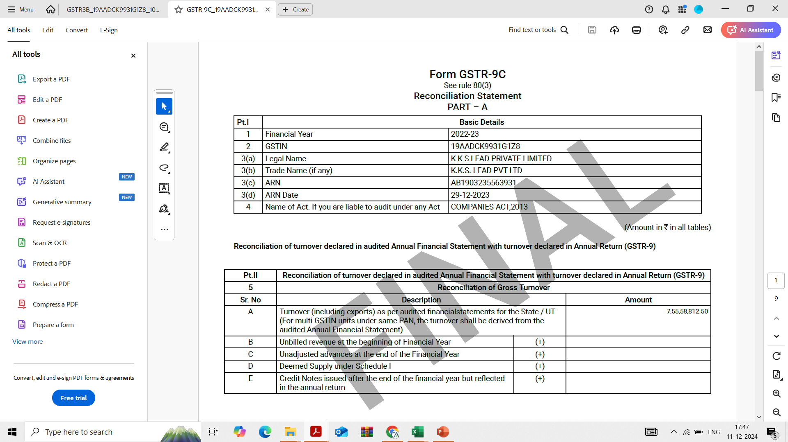
Details of tables present in reconciliation statement relating to outward supplies

Slide 10
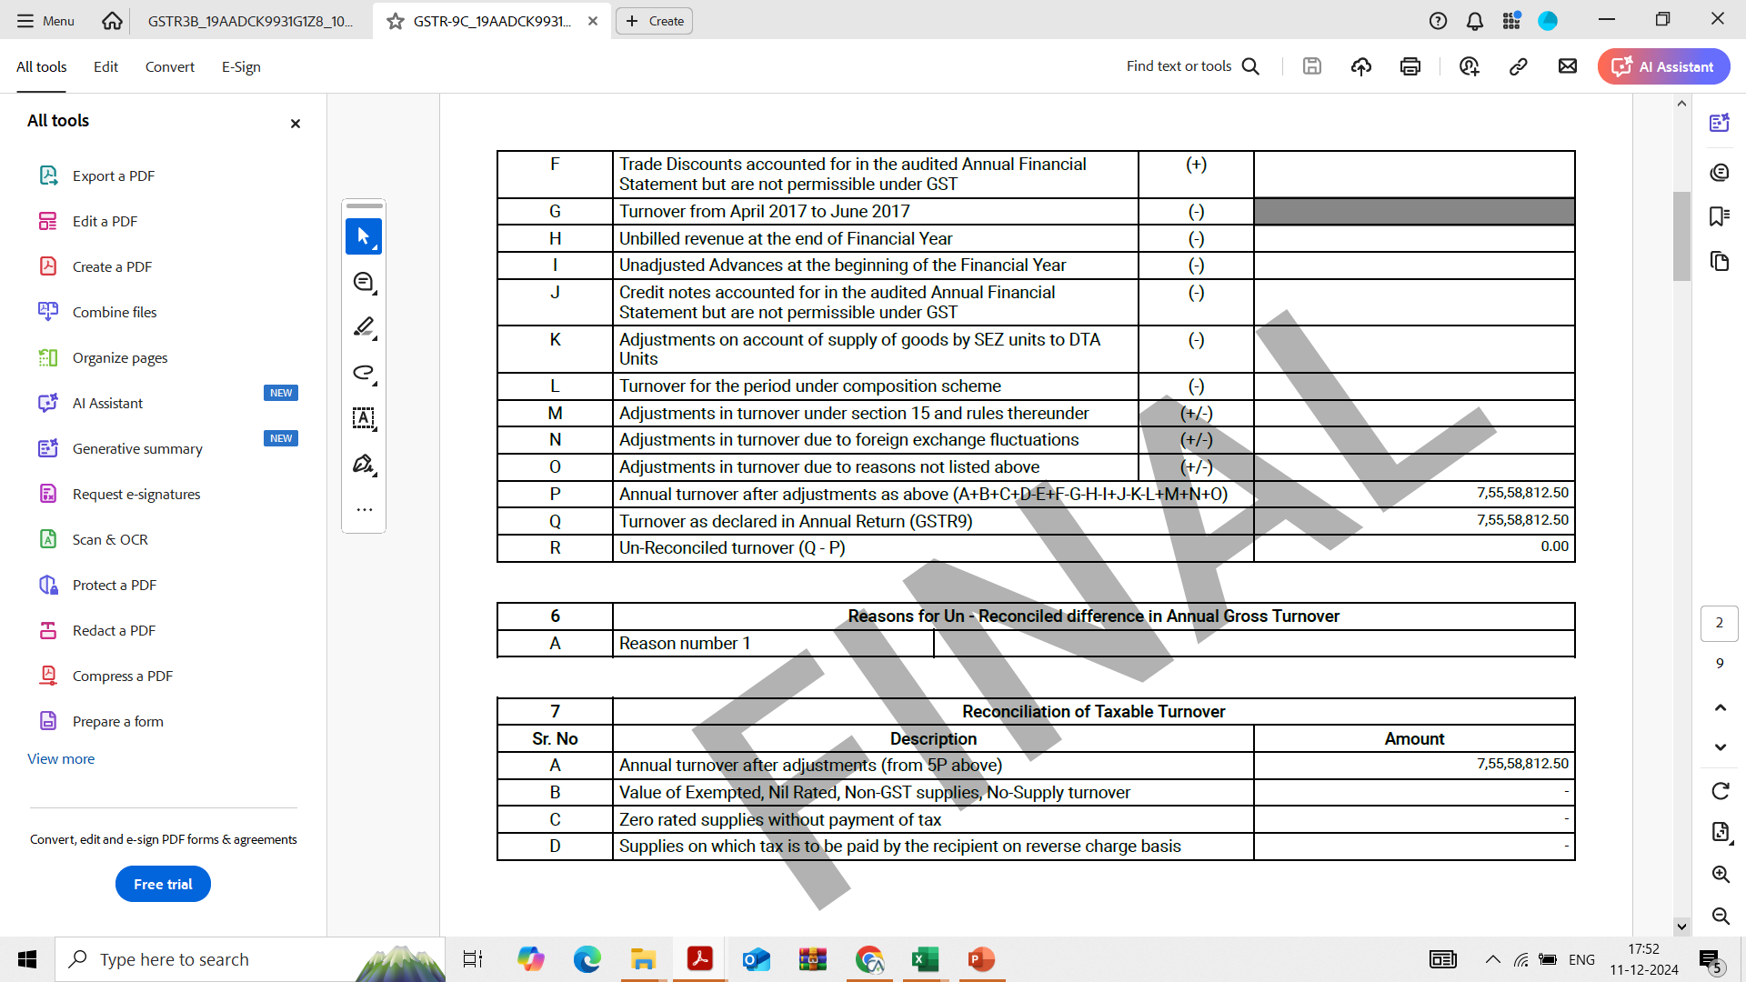
Details of tables present in reconciliation statement relating to outward supplies

Slide 11
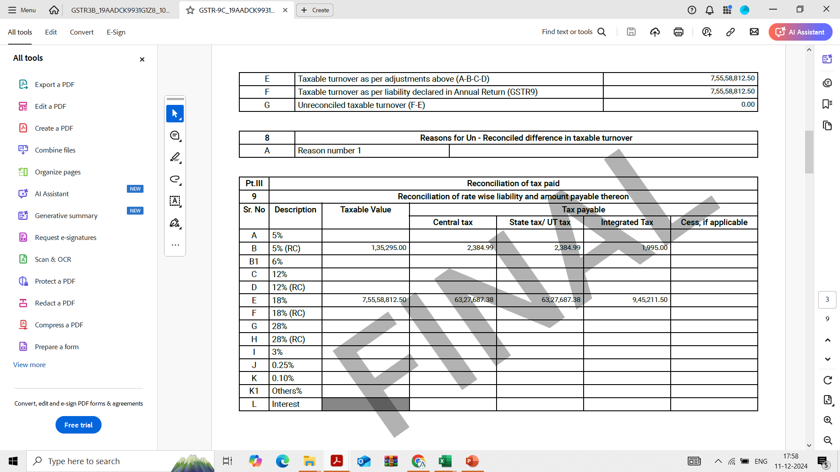
Details of tables present in reconciliation statement relating to outward supplies

Slide 12
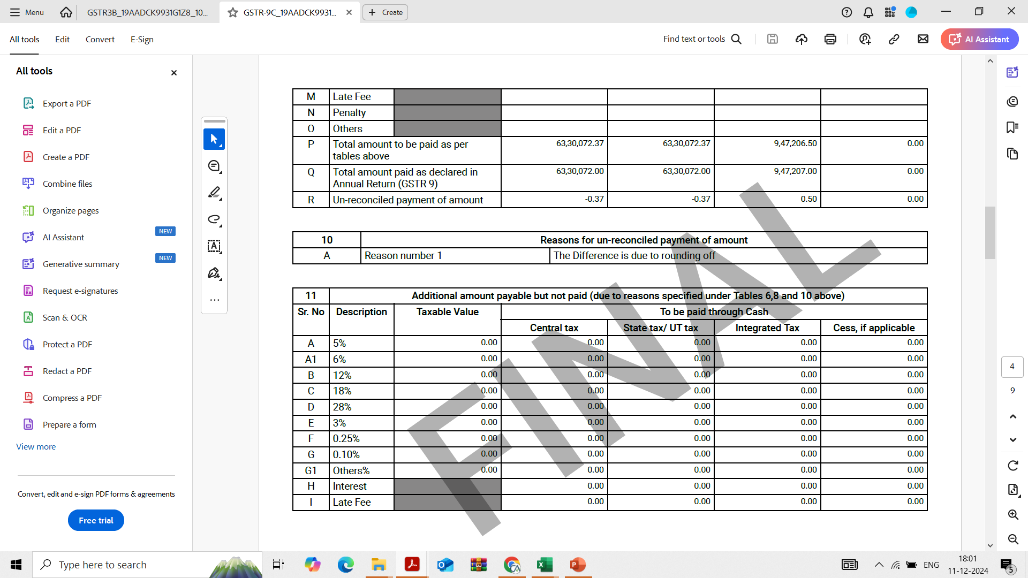
Details of tables present in reconciliation statement relating to outward supplies

Slide 13
CASE STUDY 1
Problem: - Mr. X is engaged in the business of trading goods. He has its own shop and through which he sales directly to customers (B2C Sales). Apart from the B2C Sales, he frequently ships the goods to Gujrat and Chennai (B2B Sales). In the month of March’24 , his accountant while filing the GST Returns calculated GST @ 5% on all the goods even on the goods that were to be taxed at 12%. Further, B2C sales amounting to Rs 3,50,000 (GST rate 5%) was not reported in GST returns. However, the accountant realized its mistake in the month of May’24 and amended the B2B invoices but B2C invoices was left unattended.
Details of Sales in the month of March ‘ 24
The client has sought your expert opinion while filing GSTR-9 and GSTR-9C.
Assume: - There is no discrepancies from the month of April’23 to February’24.
12% consists of Inter-state Sales amounting to Rs 5,00,000 and Intra – state sales amounting to Rs 5,00,000.
GST Rate | As per books |  |  |  | As per return |  |  |  | Difference
 | Taxable value | IGST | CGST | SGST | Taxable value | IGST | CGST | SGST | Taxable value | IGST | CGST | SGST
12% | 10,00,000.00 | 60,000.00 | 30,000.00 | 30,000.00 | 10,00,000.00 | 25,000.00 | 12,500.00 | 12,500.00 | - | 35,000.00 | 17,500.00 | 17,500.00
5% | 24,50,000.00 | - | 61,250.00 | 61,250.00 | 21,00,000.00 |  | 52,500.00 | 52,500.00 | 3,50,000.00 | - | 8,750.00 | 8,750.00

Slide 14
CASE STUDY 1
Solution: -
S.No | Problem | Table | Solution
1. | Rs 3,50,000 B2C Sales is not reported in GST returns | 4(A) | Manually increase the B2C Sales by Rs 3,50,000 and correspondingly increase the Output GST by Rs 17,500.
2. | B2B Invoices amended by the accountant in the month of May’24 | 10 | Disclose the amount so amended (i.e tax amount of IGST -35,000)
3. | B2C invoices left unattended | 4(A) | Manually increase the GST liability in Table 4(A) – B2C Sales by Rs 17,500 each in CGST and SGST
4. | Payment of additional amount | NA | The amount pertaining to B2C Sales (i.e. Rs 17,500+35,000) has to be paid through DRC-03 while the amount amended in the month of May’24 must have been discharged through GSTR-3B of May’24

Slide 15
CASE STUDY 1
S.No | Problem | Table | Solution
5. | Differential amount paid on account of reporting in Table 10. | Table 14 | Show Rs 35,000 as payable in IGST and Rs 35,000 paid in IGST as the amount should have been paid through GSTR-3B. If the amount is not paid through GSTR-3B, then paid shall be 0 and the amount should be discharged through DRC-03
6 | Impact on other tables | Table 9 | The extra liability should be manually updated in Table 9 in respective columns. When the payment made shall be deducted and reporting under table 14 would be considered it will show an exact difference of the amount paid through DRC-03
 |  | Table 17 | Reporting shall be made on the basis of correct information available with registered person

Slide 16
CASE STUDY 1
In GSTR-9C, the turnover gets automatically reconciled as the amount of Rs 3,50,000 is manually updated in GSTR- 9.
Further, the taxable turnover also gets reconciled assuming that there is no exempt supply or there is no exempt supply by the registered person.
In Table 9 (reconciliation of rate wise liability and amount thereon), rate wise liability has to be disclosed as per audited financial statements. In Table 9Q of the reconciliation statement i.e. total amount paid as declared in annual return the amount has to be duly filled from Table 9 of GSTR-9.
There will be no difference in Table 9 of GSTR-9C as the figures in the books had already been adjusted in GSTR-9.

Slide 17
CASE STUDY 2
Problem: - ABC Private Limited is engaged in real estate business which involves primarily constructing residential housing (both affordable and non-affordable). During the year many units were booked by customer’s and advances were received by the company. The company believes that the existing accountant is incapable of handling this complex GST transaction. The client has sought your expert advice in Filing of regular GST Returns as well as GST Annual returns.
The excerpt of the data shared by ABC Private Limited is as follows: -
Assuming the registered taxable person is recognising revenue as per AS-9 and not POCM.
S.no | Name of Allotee | Advance received (Amount in lacs) |  |  |  |  |  |  |  |  |  |  |  |  | Unit when allotted
 |  | April | May | June | July | August | September | October | November | December | January | February | March | Total
1 | Mr.A | 5.00 | - | - | - | 10.00 | - | 15.00 | 15.00 | 15.00 | - | - | - | 60.00 | December’23
2 | Mr.B | - | 20.00 | - | 5.00 | - | 15.00 | - | 10.00 | - | 15.00 | - | - | 65.00 | April’24
3 | Mr.C | - | - | 17.00 | - | 12.00 | - | 20.00 | - | 13.00 | - | - | - | 62.00 | December’23
4 | Mrs.D | - | 18.00 | - | 21.00 | - | 11.00 | - | 14.00 | - | - | - | - | 64.00 | November’23
5 | Mr.E | 7.00 | - | 5.50 | - | 8.50 | 12.00 | 20.00 | 10.00 | - | - | - | - | 63.00 | November’23
6 | Mrs.E | - | 14.00 | - | 20.00 | - | - | - | - | - | 15.00 | 16.00 | - | 65.00 | May’24
7 | Mrs.F | - | - | 17.50 | - | 18.80 | - | - | 5.00 | 5.00 | 17.70 | 4.00 | - | 68.00 | April’24
8 | Mr.G | - | 12.00 | - | 14.00 | - | 8.00 | 10.00 | 20.00 | - | - | - | - | 64.00 | December’23
9 | Mrs.H | - | 15.00 | 19.00 | 2.00 | 24.00 | - | 5.00 | - | - | - | - | - | 65.00 | October’23
10 | Mr.I | 10.00 | - | 10.00 | 15.00 | 10.00 | - | 5.00 | 17.00 | - | - | - | - | 67.00 | November’23

Slide 18
CASE STUDY 2
Solutions for GST Returns: -
The advances that has been received in the respective months shall be shown in Table 11A of GSTR-1 in respective months.
When the unit is allotted to the allottee i.e. the risk and reward associated with the units is transferred to the allotee, the entire amount is shown as either B2B or B2C depending upon the recipient. The advance received before the date of allotment is adjusted through table 11B of GSTR-1.
Solutions for Annual return
S.No | Problem | Table A | Solution
1. | Reporting of B2B/B2C Sales | 4A / 4B | The units which are allotted to the allotees within the F.Y shall be reported in table 4A or 4B depending upon the recipient

Slide 19
CASE STUDY 2
S.No | Problem | Table A | Solution
2. | Reporting of advances | 4F | There might be cases where the unit is not allotted to the allottees and hence the revenue could not be recognized. In such cases, the advance remains unadjusted and as the invoice is not issued within the FY and the such advances has to be reported.
3. | Impact on other tables |  | The other tables shall remain intact.
4 | Reporting of unadjusted advances at the end of the year (+) | 5C of GSTR9C | The unadjusted advances shall be present in the liability side of the audited financial statements. However, in GSTR-9 it is disclosed and it becomes a reconciling item between GSTR-9 and Audited FS. The entire unadjusted advances has to be reported in Table 5C.

Slide 20
SOME COMMON SCENARIOS
S.No | Issue | Solution
1. | B2B invoice was skipped during filing of GSTR-1 in FY: - 23-24. The same was incorporated in GSTR-1 in FY: - 24-25 before the specified period. | Report the invoice in Table no 10 of GSTR-9 with no impact on Table no 9. Since the amount is declared through GSTR-1 it is assumed that the same is paid through GSTR-3B, show the relevant amount of tax in table no 14 as both payable and paid. In GSTR-9C, in Table no 9 (rate wise liability reconciliation) there will be difference of the said invoice and that can be explained in the reasons column. Further, while filing the GSTR-9 and 9C of the next year the said invoice will come auto populated in GSTR-9. We can manually reduce the B2B Sales in table 4B, with corresponding no impact on Table 9. In GSTR9C, in table 9 and inverse difference will come which can be explained through reasons.

Slide 21
SOME COMMON SCENARIOS
S.No | Issue | Solution
2. | Motor car sold in the FY amounting to Rs 1,00,000 and GST thereon 18,000. | This sale of motor car shall be treated as B2B or B2C supplies depending upon the recipient and GSTR-1 and GSTR-3B would have been filed accordingly. Similarly, this invoice will be auto reflected in GSTR-9. However, the turnover as per Audited FS would not constitute the sale of old and used motor car as the same would have been adjusted against the asset reflecting in the balance sheet. At this point of time this transaction would become a reconciling item and will be shown in table 5O and the reasons shall be disclosed in the reasons column.

Slide 22
THANK YOU FOR YOUR TIME AND ATTENTION

