Slide 1
Form GSTR 9 & GSTR 9C
(2023-24)
Prepared by:
CA Priyanshi Agarwal
priyanshi1016@gmail.com

Slide 2
GSTR 9 & 9C || Statutory Provision
(1) Every registered person, other than ISD/ TDS/ TCS/ CTP/ NRTP shall furnish
an annual return
a self-certified reconciliation statement, reconciling the value of supplies declared in the return furnished for the financial year with the audited annual financial statements
for every financial year electronically.
CGST Act, 2017
44
Every registered person u/s 44 shall furnish an annual return in FORM GSTR-9 on or before the 31th December of next FY.
Composition Tax Payer – Form GSTR 9A
E-Commerce operator – Form GSTR 9B
(3) Every registered person, whose aggregate turnover exceeds Five Crore rupees, shall furnish a self-certified reconciliation statement in FORM GSTR-9C on or before the 31th December of next FY.
80
CGST Rules, 2017
Notification No. 14/2024
The Commissioner, exempts the registered person whose aggregate turnover in 2023-24 is up to two crore rupees, from filing annual return for the said financial year.

Slide 3
Annual Return + Self Certified Reconciliation Statement
Turnover of F.Y. 2023-24 | GSTR-9 | GSTR-9C
Upto 2 Crore | Exempted | Not Applicable
Above Rs. 2 Cr but up to Rs.5 Crore | Mandatory | Not Applicable
Above Rs.5 Crore | Mandatory | Mandatory

Slide 4






GSTR 9C || Overview
Part I
Part II
01
02
Basic Details of the Company
Details of Outward &
Inward Supply under RCM
Table 1 to 3
Table 4 to 5
06
03
Part VI
Part III
GSTR 9
Other Information
Details of Input Tax Credit
Table 15 to 19
Table 6 to 8
05
04
Part V
Part IV
Details of transactions for the Financial Year which is declared in the returns of the next FY.
Details of Tax Paid as declared in the returns filed during the Financial Year
Table 10 to 14
Table 9

Slide 5
GSTR-9
Part I | Part II | Part III | Part IV | Part V | Part VI
Basic Details | Liability | ITC | Taxes Paid | Circular 26/2017 Adjustments | Other Info
Table 1-3 | Table 4-5 | Table 6-8 | Table 9 | Table 10-14 | Table 15-19

Slide 6
GSTR-9 at a glance
Description |  | Table No. of GSTR 9
Turnover as per Books | = | 4 + 5 + 10-11
Tax Paid as per Books | = | 9 & 14
ITC as per Books | = | 6-7-12+13
Refund | = | 15
Informative details | = | 1,2,3,8,16,17,18
Late Fee payment | = | 19

Slide 7
Changes in GSTR-9
        Mandatory
        Optional

Slide 8
Changes in GSTR-9
Mandatory |  | Description
T4, T5 | = | Outward Supply
T6, T7, T8 | = | ITC
T9 | = | Tax Paid (No Change)
T10, T11 | = | Outward Supply reported in subsequent period (No Change)
T17 | = | HSN Summary of Outward Supply (No Change)

Slide 9
Changes in GSTR-9
Optional |  | Description
T12,T13 | = | Inward Supply reported in subsequent period
T14 | = | Tax Paid (No Change)
T15 | = | Refund & Demand
T16 | = | Composite Supply, Deemed Supply u/s 143, Sale on Approval basis
T18 | = | HSN Summary of Inward Supply

Slide 10
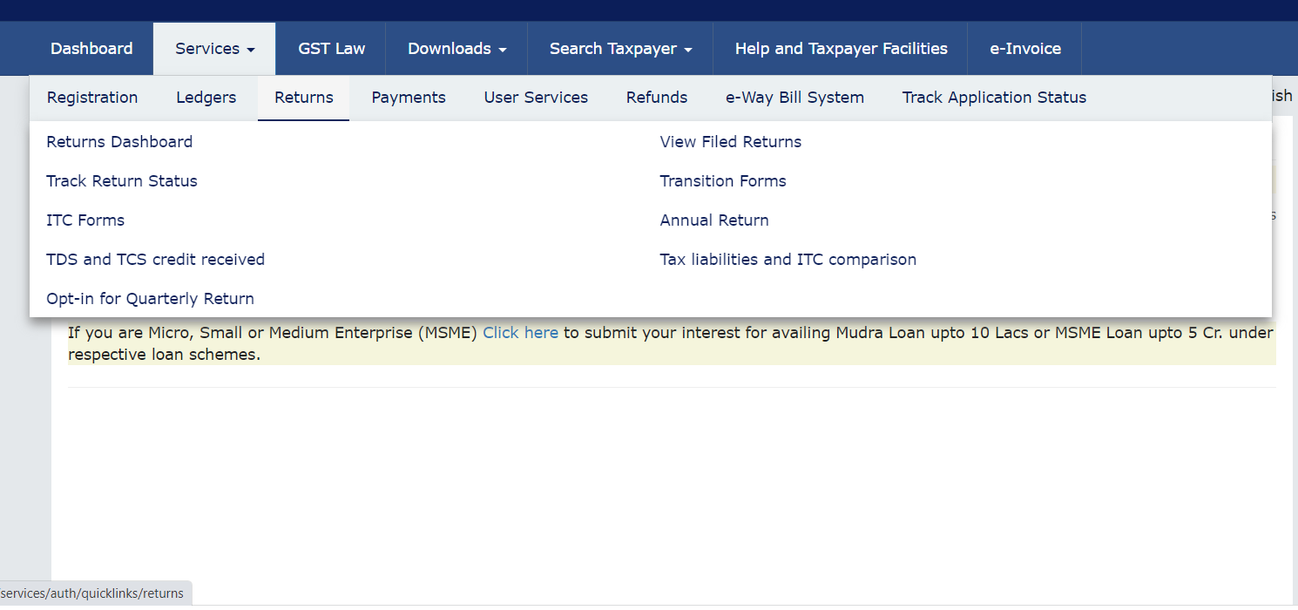
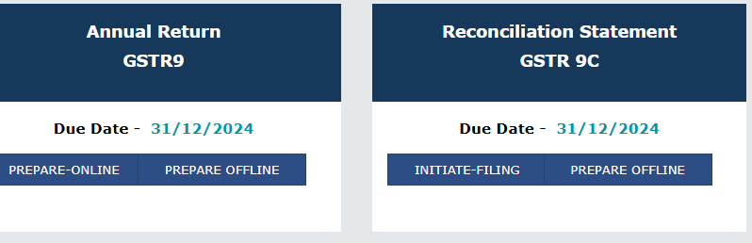
GSTR 9 || Introduction
Due Date of GSTR 9 & 9C – 31st December
Section 16(4) - A RP shall not be entitled to take ITC in respect of any invoice/DN after the
30th November following the end of FY to which such invoice/DN pertains or furnishing of the relevant annual return, whichever is earlier.
Section 37: No rectification of error or omission in respect of the details furnished in GSTR 1 shall be allowed after 30th November.
Section 39(9): Where any RP after furnishing a return GSTR 3B discovers any omission or incorrect particulars therein he shall rectify such omission or incorrect particulars by 30th November.

Slide 11
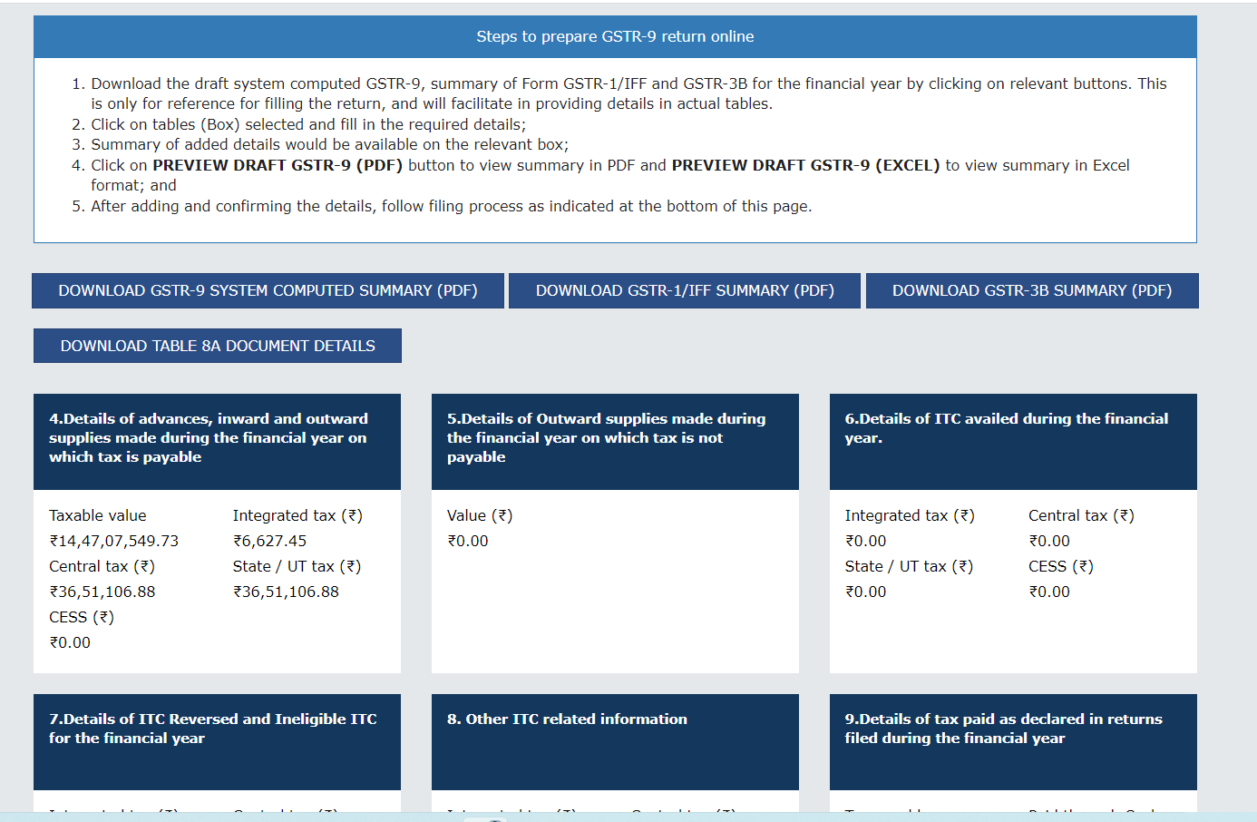
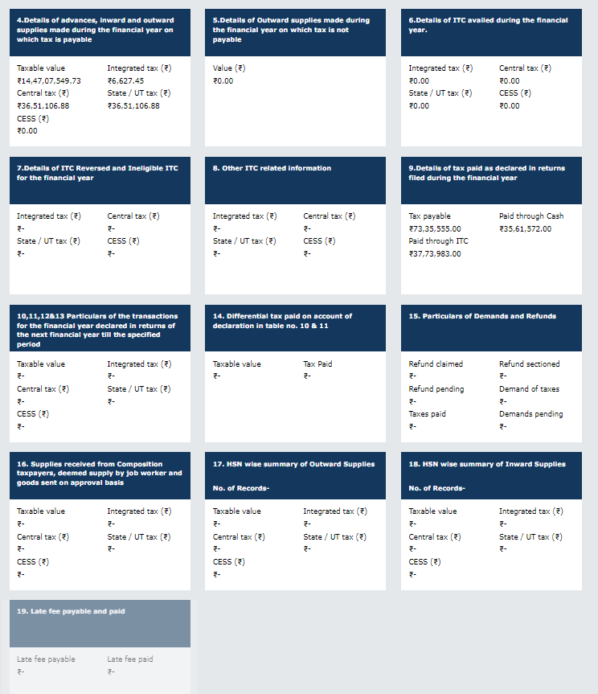
GSTR 9 || Introduction

Slide 12
CIRCULAR 170/02/2022- GST dated 06-07-2022
CBIC vide circular No. 170/02/2022-GST dated July 2022 has emphasized furnishing of information regarding amount of ineligible/blocked Input Tax Credit and reversal thereof in return in FORM GSTR-3B and statement in FORM GSTR-1.
Table 4(A) of the FORM GSTR-3B is getting auto-populated from FORM GSTR-2B.
Reversals of ITC on account of rule 42 and 43 of the CGST Rules or for any other reasons are shown in Table 4(B) of FORM GSTR-3B .
Any reversal of ITC or any ineligible ITC under any provision of the CGST Act should not be part of Net ITC Available in Table 4(C) of GSTR-3B and should not get credited into the ECL (electric credit ledger) of the registered person.
The reversal of ITC of ineligible credit under section 17(5) required to be made under Table 4(B) and not under
Table 4(D) of FORM GSTR-3B.
Registered person will report reversal of ITC, which are not permanent in nature and can be reclaimed in future subject to fulfilment of specific conditions as per rule 37, sec 16 in Table 4(A)(5).

Slide 13
GSTR 9 || Table 4, 5 & 6
Supply
Outward Supply
Not Taxable under GST
Taxable under GST
Inward Supply
Under RCM
Input Available
Others
5A. Zero-Rated Supply
5B. Supply to SEZ
5C. RCM by recipient
5C1. Supplies on which tax is to be paid by e-commerce operators as per section 9(5) [Supplier to report]
5D. Exempted
5E. Nil Rated Supply
5F. Non GST Supply
5H/5I. Debit / Credit Notes
5J/5K. +/- Amendments
TABLE 5
TABLE 4
4A. B2C
4B. B2B (inc. ECO)
4C. Zero Rated
4D. SEZ
4E. Deemed Export
4F. Advance but no Invoice
4G. Inward liable to RCM
4G1. Supplies on which e-commerce operator is required to pay tax as per section 9(5) (including amendments)
[E-commerce operator to report]***
4I/4J. Debit/Credit Note (A to F)
4K/4L. +/- Amendments
TABLE 6
6B. Inward Supply - CG & (I+IS)
6C. Inward RCM from URP - CG & (I+IS)
6D. Inward RCM from RP - CG & (I+IS)
6E. Import of Goods (CG)
6F. Import of Input Services (I+IS)
6G. ITC from ISD
6H. ITC Reclaimed
6K/6L. Transitional Credit
6M.Other ITC
TABLE 4 - New Change:
Till 20-21, we had an option to Adjust Dr./Cr. Notes with the 4B to 4E, but no such option in 21-22 onwards.
TABLE 5 – Relaxation:
5D (Exempted) and 5E (Nil Rated) can be clubbed together in 5D.
5A to 5F can be shown net of Adjustments

Slide 14
GSTR 9 || Table 7, 8, 9 & 19
ITC REVERSALS –
7H Other Reversals:
7A: Rule 37 – 180 days
7B: Rule 39: ISD
7C: Rule 42: I/IS partly other use
7D: Rule 43: CG partly other use
7E: Section 17(5) – Negative List only if ITC taken & then reversed.
7H: Other Reversals (eg. ITC 03)
7A to 7E & 7H can be clubbed in 7H
7F – Tran 1 Reversal
7G – Tran 2 Reversal
Other ITC Information
8A ITC as per GSTR 2B
8B ITC availed in FY (other than RCM/Import) = 6B + 6H
8C ITC received during FY but availed in next FY
8D = 8A – (8B + 8C)
8E: ITC Available not availed
8F – ITC available not eligible
Logically if 8D = 8E + 8F
8J = 8I = IGST paid on Import (8G) – IGST availed on Import (8H)
8K: ITC Lapsed = 8E + 8F + 8J
Tax Paid Details –
Tax Payable
Tax Paid by Cash
Tax Paid by ITC
Late Fees details –
Late Fees Payable
Late fees Paid
Table 7
Table 8
Table 9
Table 19

Slide 15
GSTR 9 || Table 10 to 14
Table 10
Table 11
Table 12
Table 13
10
11
12
13
Supply declared through Amendments in F.Y. 2024-25 (till 30th Nov. 2024) in 9A/9B/9C of
GSTR 1
Supply reduced through Amendments in F.Y. 2024-25 (till 30th Nov. 2024) in 9A/9B/9C of
GSTR 1
Reversal of ITC which was availed in 2023-24 but reversed in F.Y. 2024-25 (Till 30th Nov 2024)
ITC of Supply which was received in 2023-24 but reversed in F.Y. 2024-25 (Till 30th Nov 2024)
TABLE 14
Differential Tax on account of Amendments as per Table 10 & 11
Optional

Slide 16
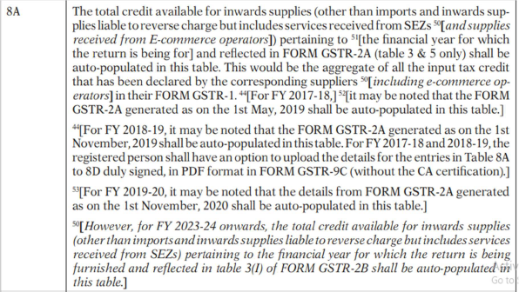
NOTIFICATION NO. 12/2024 Dated 10-07-2024 (Instruction)

Slide 17
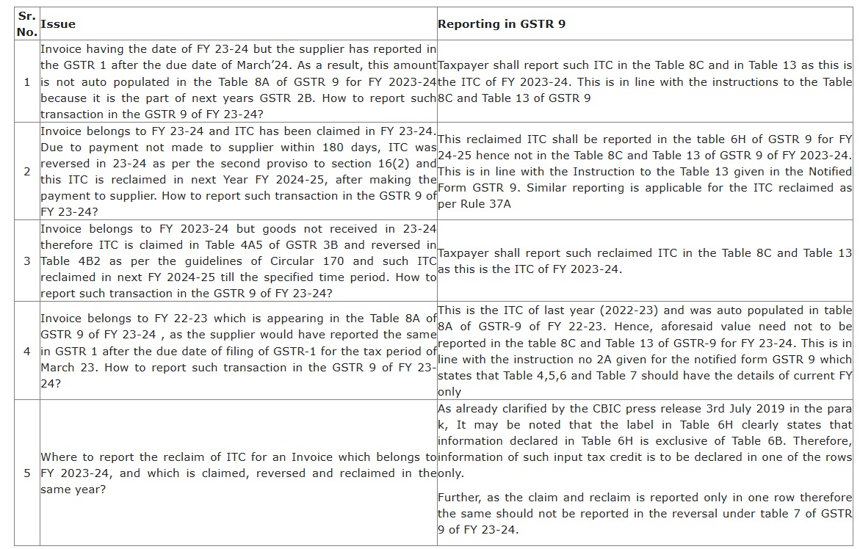
Advisory on difference in value of Table 8A and 8C of Annual Returns FY 23-24 (dated 9-12-24)

Slide 18
GSTR 9 || Table 15 to 18
15
16
17
18
Table 15
Table 16
Table 17
Table 18
Demands &Refunds
Refund claimed; Sanctioned; Rejected; Pending
Total Demand; Tax Paid; Demand Pending
Inward Supplies from Composite Taxpayers
Deemed Supply U/s 143 (Job Work)
Goods sent on approval but not returned
HSN Summary
If T/o > 5Cr – 6 Digits
If T/o =< 5 Cr
– 4 Digits for B2B
– 2 Digits for B2C
HSN of Inward Supply
HSN of only those Inward Supply needs to be declared whose value independently account for 10% or more of Total Value of Inwrad Supply.
Optional
Optional
Optional

Slide 19
GSTR 9C || Overview
Part I
Part II
Part III
Basic Details of the Company
Reconciliation of Turnover
Reconciliation of
Tax Paid
Table 1 to 4
Table 5 to 8
Table 9 to 11
Part IV
Part V
Reconciliation of Input Tax Credit
Additional Liability due to Non Reconciliation
Table 12 to 16

Slide 20
GSTR 9C || Table 5 to 8
TABLE 5 – Reconciliation of Gross Turnover
5A. Turnover as per Audited FS
5B/5H. Unbilled Revenue at begin & end.
5C/5I Unadjusted Advance at the end & begin.
5D. Deemed Supply
5E. Credit Note issued after FY
5F. Trade Disc. not allowed under GST
5J. Credit Note not allowed under GST
5K. Adjustment – supply to SEZ
5L. Turnover under Composition
5M. Adjustment due to Valuation Rules
5N. Adjustments due to For.Ex. Fluctuation
5O. OTHER ADJUSTMENTS
5R. Unreconciled T/o = 5Q (GSTR 9) – 5P (Adjust. T/O)
TABLE 6 – Reasons for non reconciliation
TABLE 7 – Reconciliation of Taxable Turnover
7A. Annual Adjusted Turnover = 5P
7B. Value of Exempted, Nil Rated, Non-GST & No-Supply Turnover
7C. Zero Rated without payment of tax
7D. Supply under RCM by recipient
7E. Taxable Adjusted Turnover
7F. Turnover as per GSTR 9
7G. Unreconciled Taxable Turnover = 7F – 7E
TABLE 8 – Reasons for non reconciliation
All adjustments from 5B to 5N can be clubbed and be shown under 5O.

Slide 21



GSTR 9C || Table 9 to 11
Table 9
Table 10
Table 11
Reconciliation of Rate Wise Tax Liability & Tax Payable
9P. Total amount to be paid (Rate Wise)
9Q. Total amount paid as per GSTR 9
9R. Un-reconciled payment amount
= 9P – 9R
Reasons for non reconciliation of Tax Liability Payable and Tax Liability Paid
Additional amount payable but not paid
[Table 6 + 8 + 10]

Slide 22
TABLE 12 – Reconciliation of Net ITC
12A. ITC availed as per Audited FS
12B. (+) ITC booked in Last FY to be claimed in current FY
12C. (-) ITC booked in current FY to be claimed in Next FY
12D. Adj. ITC availed as per Audited FS
12D = 12A + 12B - 12C
12E. ITC Claimed in GSTR 9
12F. Un-reconciled ITC [12E – 12D]
TABLE 13 – Reasons for non reconciliation
TABLE 14 – Reconciliation of ITC Declared in GSTR 9 with ITC availed on expenses as per books.
Expense Value, Amount of ITC & Amount of eligible ITC availed for –
Purchases, Freight, Power, Imported goods, Rent, Insurance, Goods lost / destroyed / stolen, Royalties, Employee Cost, Conveyance, Bank Charges, Entertainment Charges, Repair, Maintenance, Other Misc., Capital Goods, etc.
Total eligible ITC Availed
Total ITC claimed in GSTR 9
Un-reconciled ITC
TABLE 15 – Reasons for non reconciliation
GSTR 9C || Table 12 to 16
TABLE 14 & 15 are OPTIONAL
TABLE 16 –
Tax Payable due to Non reconciliation in table 13 & 15

Slide 23


GSTR 9C || Part V & Declaration
Part V
Additional Liability due to Non Reconciliation has to be disclosed in Part V.
Any tax / Interest / Late Fee Penalty / Refund to be paid back – disclosed here has to be paid by Cash via Form DRC 03 by choosing “Reconciliation Statement” in in the drop down of DRC 03.
Declaration
Declaration by the Authorised Signatory that the information given herein above is true and correct and nothing has been concealed there from. I am uploading this self-certified reconciliation statement in FORM GSTR-9C. I am also uploading other statements, as applicable, including financial statement, profit and loss account and balance sheet, etc.

Slide 24

Prepared by:
CA Priyanshi Agarwal
priyanshi1016@gmail.com
8013601939

