Slide 1
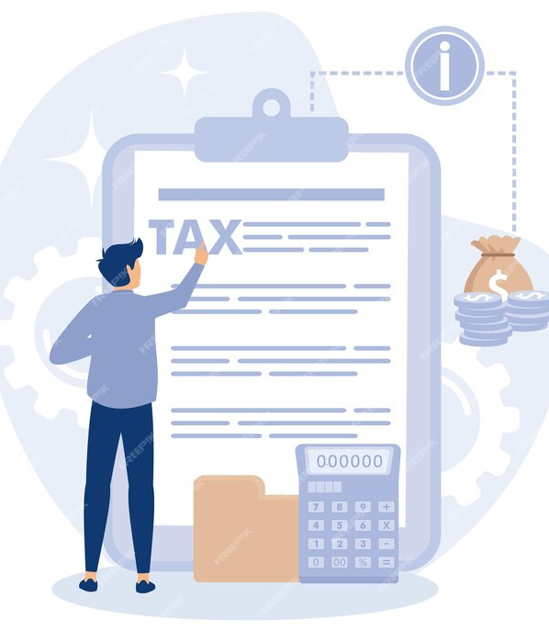
SUBMISSIONS UNDER FACELESS ASSESSMENT

Slide 2
Discussion on practical issues faced by the taxpayers
How to deal with notices issued by IT department
Ecosystem & Structure of Faceless Assessment
Introduction
Salient Features
Best practices needs to be adopted to deal with the faceless assessment
Point to remember while drafting submission
Presentation Title

Slide 3
Introduction
Faceless Assessment has replaced the conventional manual mode of conducting of regular assessments involving physical interface and verbal communication between the assesses and the assessing officer (Income Tax Officials).
It covers the following assessments :
Regular Scrutiny Assessment [Section 143(3)]
Best Judgement Assessment [Section 144]
Income Escaping Assessment [Section 147]

Slide 4
Who are not covered by scheme
Exceptions have been provided and these are:
Assessment orders in cases assigned to Central Charge (Block Assessment Cases u/s 153A/153C)
Assessment Orders in cases assigned to International Tax Charges.
Assessment orders in cases where pendency could not be created on ITBA portal because of technical reasons or cases not having a PAN, as the case may be

Slide 5
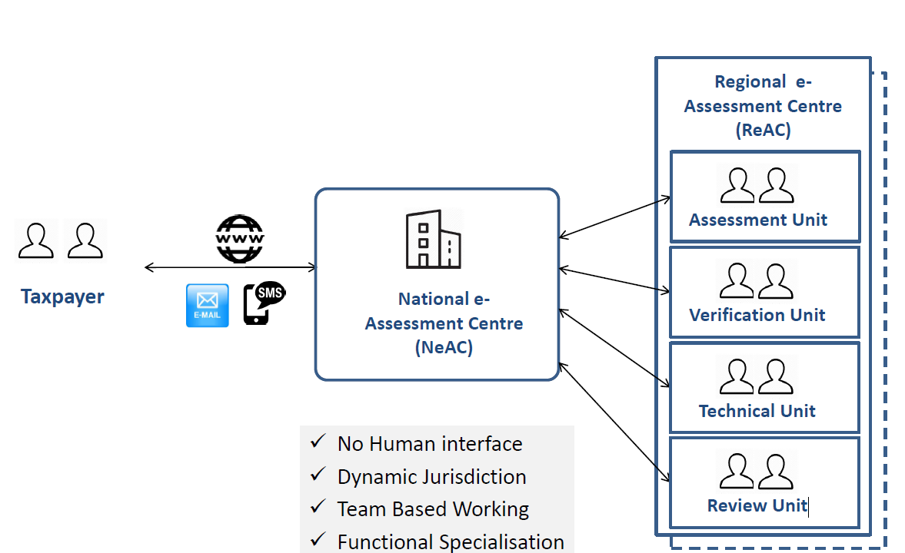
Ecosystem And Structure of Faceless Assessment

Slide 6
Salient Features
No human Interface
End to end electronic medium
Eliminating interface between Assessing Officer and Assessee to the extent technologically feasible
Expeditious disposal of cases
Selection of a taxpayer only through system using data analytics and Artificial Intelligence (AI)
Automated random allocation of cases Central issuance of notices with Document Identification No (DIN)
Abolition of territorial jurisdiction which means a taxpayer may belong to one city but the ITR may be assessed in some other city through random selection by computer.

Slide 7
Ease of compliance
All online response
Authorization of submissions thought DSC or EVC
No physical interface and no need to visit the Income Tax Office
Functional Specialization
Optimizing the utilization of resources through economies of scale and functional specialization
Team based assessments and team-based review with dynamic jurisdiction
Improvement in the time and Quality of assessment
Complete SOPs and procedure set out to be followed

Slide 8
Every notice or order under the FAS shall be delivered to the assessee by way of the following means and followed by a real-time alert -
In the assessee's registered account
To the registered email address of the assessee
On the assessee's Mobile App
“real time alert” means any communication sent to the assessee by way of SMS on his registered mobile number or by way of update on his mobile app or by way of email at his registered email address, so as to alert him regarding delivery of an electronic communication.
Such real time alert prompt the assessee to visit Income tax Portal where the full content of the notice is available:
How will communication be received

Slide 9
“registered e-mail address” of the assessee means the e-mail address at which an electronic communication may be delivered or transmitted to the addressee, including:
a)The email address available in the e-filing account of the addressee registered in the designated portal;
b)The e-mail address available in the last income-tax return furnished by the addressee;
c)The e-mail address available in the PAN database relating to the addressee;
d)In the case of addressee being an individual who possesses the Aadhaar number, the e-mail address of addressee available in the database of Unique Identification Authority of India (UIDAI);
e)In the case of addressee being a company, the e-mail address of the company as available on the official website of Ministry of Corporate Affairs (MCA); or
f)Any e-mail address made available by the addressee to the income-tax authority or any person authorized by such authority.
“registered Mobile number” of the assessee means the mobile number of the assessee, or his authorized representative, appearing in the user profile of the electronic filing account registered by the assessee in the designated portal.

Slide 10
Practical Compliance Issues Faced by Taxpayers
The assessee need to be fully familiar and conversant with the following:
Manner, mode and methodology of the conducting of ‘Faceless Assessments’ involving therein
Viewing and retrieving ‘e-scrutiny’ notices
Requisitions in the registered ‘e-filing accounts’
‘e-Filing’ and uploading of qualitative and meritorious ‘e-responses’ to such notices requisitions
1. Issues with notices
Notice not received/ communication issue
Enablement of communication window
Post adjournment, fresh notice not received
One same notice received multiple time

Slide 11
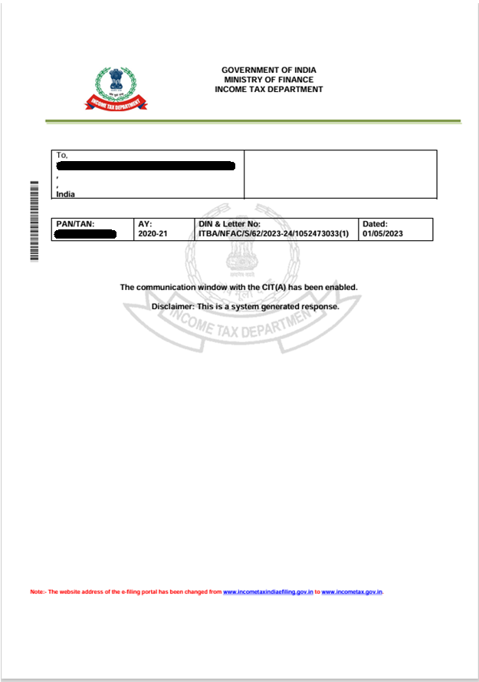
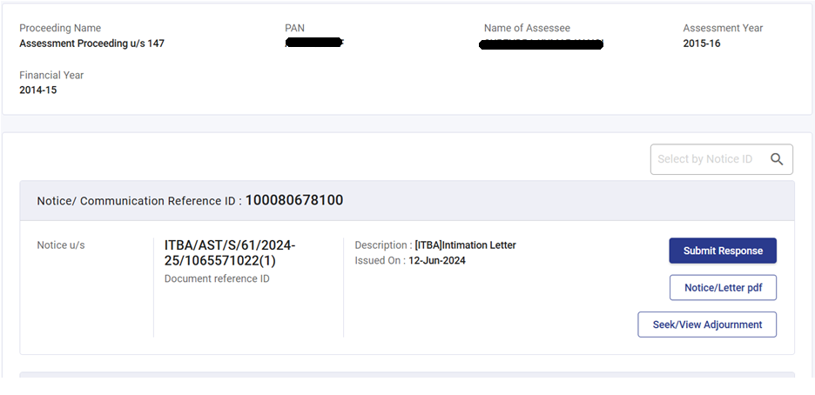

Slide 12
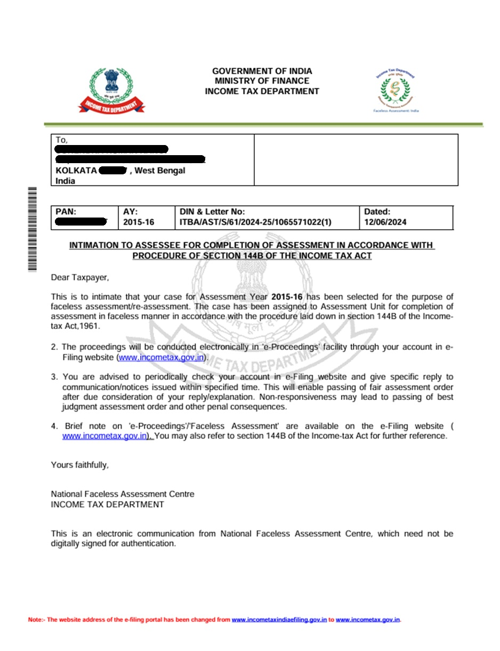

Slide 13
2. Limitations of response to be submitted
Limitation of words and size of the attachments – 500/1000 character, 10 files 5 MB each
Voluminous and vague details asked for
Uploading to wrong attachment inadvertently
No specific format provided
Response submission tab disabled
Submissions not considered
Sr. No | Questionnaire | Reply
1 |  | Brief note on the activities are attached As Annexure No. __ (Page Nos.___ to___ )
2 |  | Loan confirmation of Mr ----- attached as Annexure No ___ (Pages Nos.___ to___ )
3 |  | The volume of Purchases Bills of Fixed Assets purchase in very high. We are attaching the ledger extract of each of the type of fixed assets as Annexure No.___(Pages Nos. __to __) and we are attaching sample bills as Annexure No.___(Pages Nos. __to __) for your ready reference. In case, you desire any further details/bills, we pray you to provide the specific details from the ledger extract. We shall provide the such details in the subsequent submission.
4 |  | The details are under preparation. We pray your honour to allow 15 days time.
13

Slide 14
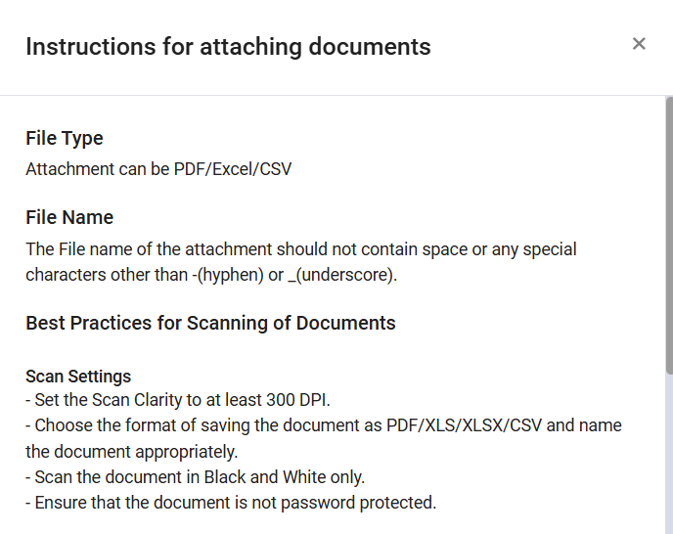
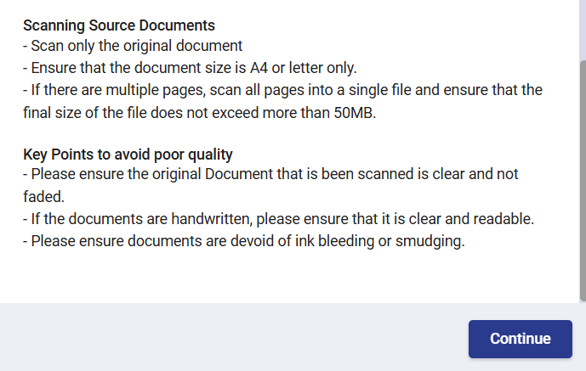

Slide 15
3. Short time limit for submission
Notices issued with 2 to 3 days’ time limits specially on Fridays
Response time mentioned in the notice like by 11AM or 3PM
No time limits specified for faceless appeals
Stay gets vacated if order not passed on time
4. System and technical issues
Standard Operating Procedure not followed
Show cause notice not issued
Personal Hearing not granted
Issues with Video conference facility
Use of Grievance portal – E-Nirvaan and CPgrams

Slide 16
SOME BEST PRACTICES NEEDS TO BE CONSIDERED
Benjamin Franklin rightly said, “By failing to prepare, you are preparing to fail.” This quotation is apt while considering the need for taxpayers to prepare themselves to face the challenges posed by the faceless ecosystem.
Technologically updated
Taxpayers will need to increasingly adopt technology to maintain, reconcile and present data. This will require them to invest in IT infrastructure, including appropriate ERP systems, and/or upgrade their ERP systems, and video conferencing and video telephony facilities.
Be attentive to communication
Taxpayers should keep their email IDs and contact numbers on the Income Tax e-Filing portal regularly updated, along with validating the bank account details. They should keep tabs on any communication from the Income-tax Department (via the e-Filing portal, email and SMS) and respond within the due date.
It will be essential to access the Income-tax portal regularly to check for updates and notices issued so that there are no lapses and appropriate responses can be filed in time.
Under the faceless regime, responses to pre-assessment enquiries should be prompt, since any laxity may entail a detailed assessment.

Slide 17
Maintaining documents
All documentation should be maintained for positions taken in Income-tax returns, as well as appropriate documentation substantiating claims of expenditure and disallowances made in earlier years by the Income-tax Department.
Taxpayers have been usually expected to furnish evidence, such as invoices supporting expenses on a sample basis. However, with its focus on technology-enabled tools, the Income-tax Department may ask for 100% backup data or documents. Therefore, taxpayers will need to furnish such data and documents. This will make it imperative for them to maintain robust documentation for every transaction.
Accounting entries should be self-explanatory so that appropriate submissions and explanations can be furnished by taxpayers when these are required by the Income-tax Department.
Taxpayers will need to maintain a ratio analysis on their large expense heads as well as comparisons from the previous year’s numbers. This will support explanations to questions posed by the Income-tax Department about the business impact of an increase or decrease under such expense heads.
Over a period of time, filing requirements have been enhanced with respect to the nature and degree of information being sought from taxpayers. Taxpayers will need to ensure that they maintain appropriate back-ups to support such disclosures, including comprehensive calculations for forex conversion, bond stripping, allocation of costs and valuation of stock, etc.

Slide 18
Keys to Drafting
The reference should be specifically mentioned with DIN and date of notice against which the response is being submitted for every submission
Use polite and professional language without using the word like ‘you have wrongly understood’ or ‘failed to apply mind’ or like words.
Readers perspective as a layman to be kept in mind while drafting the response. Written submissions covering all the factual aspects and legal positions should be comprehensive but brief.
Short sentences to be used and the language shall be simple, lucid and up to the point.
Cite relevant judicial pronouncements specially highlighting decision by jurisdictional Appellate Authority wherever applicable.
Highlight important points using bold, italics or different font. Many a times graphical presentation such as diagrams, flow chart, detailing tables etc. help I easy understanding of the issue.
Current practices of leaving selective questions in a notice unanswered and resorting to opportunities for giving explanations to tax officers verbally is not available now. Therefore, taxpayers will need to address every query raised in a notice, and back their submissions by the documentation and evidence required.
Summarize submission in the beginning referring to all the key annexures. All the attachments to be named appropriately and it is advisable to use a naming or numbering protocol for easy cross- referencing. If only attachments are there, it should be referred to with a forwarding letter or written note.
Don’t wait till fag end of the specified time frame. Submit your response promptly beforehand.

Slide 19
Maintaining consistency
Data submitted during the course of assessment proceedings will need to be aligned with that submitted to other statutory or non-statutory authorities.
At the time of personal hearings, taxpayers or their authorized representatives will need to ensure that representations are brief, well-articulated and aligned with the written submissions filed earlier.
It will be essential that reconciliation of various data points, submissions, filings, etc., are prepared at each stage and maintained to justify any differences that may arise. In addition, it will be necessary to synchronize information submitted before the Income-tax Department with that submitted to other authorities, including the GST authorities and in filings with SEBI and RBI etc.

Slide 20
CONCULSION
The Income-tax Department now has a significant cache of information through-
Introduced of the reporting portal and compliance portal for filing statements of specified financial transactions
Widened the ambit of TDS and TCS provisions
Widened the scope and inclusion of AIS, TIS and 26AS
Curbed cash transactions through various legislative changes in Income-tax Law
Widened the network of information exchange agreements with various countries and among its various other tax departments.
Therefore, it is imperative for taxpayers to prepare themselves by having explanations for their business transactions and to respond to all the enquiries from the department.
This process is expected to be an evolving and ever-changing journey as we tread along the path of this new faceless regime.
BE HONEST AND COMPLIANT

Slide 21
THANKYOU
~CA PUJA AGARWAL

