Slide 1
APPEAL UNDER GST
ACAE CHARTERED ACCOUNTANTS CPE STUDY CIRCLE OF
EIRC OF ICAI
14th June, 2024 (Friday)
(Errors if any are purely un-intentional. The views are shared in the individual capacity of the speaker and not in his professional capacity and the hosts may or may not subscribe to the views of the speaker.)

Slide 2

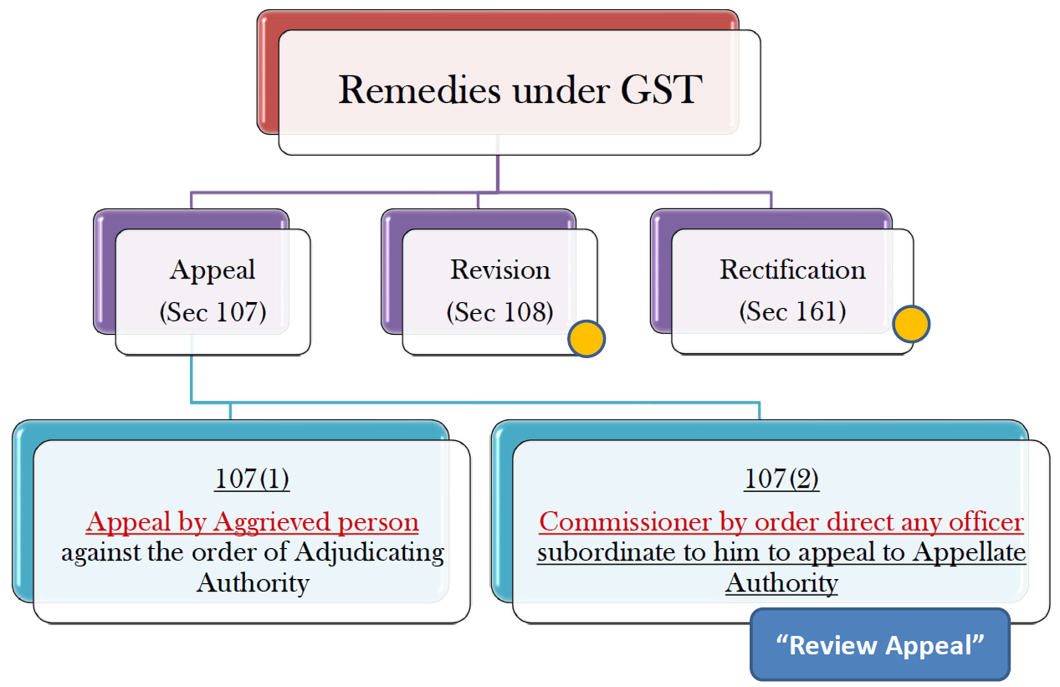
Remedies under GST
Note : Subject to Section 120- Appeal not to be filed in certain cases.

Slide 3
Some Important definition under GST
APPEAL :Not defined in the act
“An Appeal under any law is an application to a higher court for a reversal of the decision of a court. Appeals arise when there are any legal disputes.
Appellate authority – Section 2(8)
‘’Appellate Authority" means an authority appointed or authorised to hear appeals as referred to in section 107
Revisional Authority: Section 2(99)
"Revisional Authority" means an authority appointed or authorised for revision of decision or orders as referred to in section 108.
ADJUDICATION ORDER :- Disputes arise due to non-compliance of taxpayer with the provisions under law. The initial resolution of this dispute is done by a departmental officer by a quasi judicial process resulting into the issue of an initial order known as Adjudication order.

Slide 4
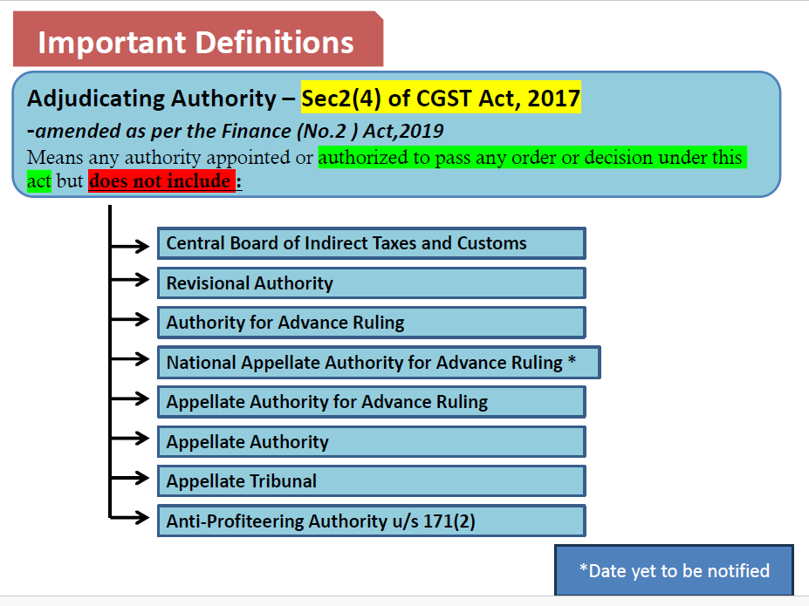
DEFINITIONS

Slide 5
Aggrieved Person
•Meaning of ‘person Aggrieved’
“Aggrieved” means one whose pecuniary interest is directly affected by the
adjudication, one whose right of property may be established or divested
thereby.”
[‘Advanced Law Lexicon]
Illustrations:
A person may feel aggrieved in cases like
DENIAL OF EXEMPTION
IMPOSITION OF PENALTY
ITC DISALLOWED

Slide 6
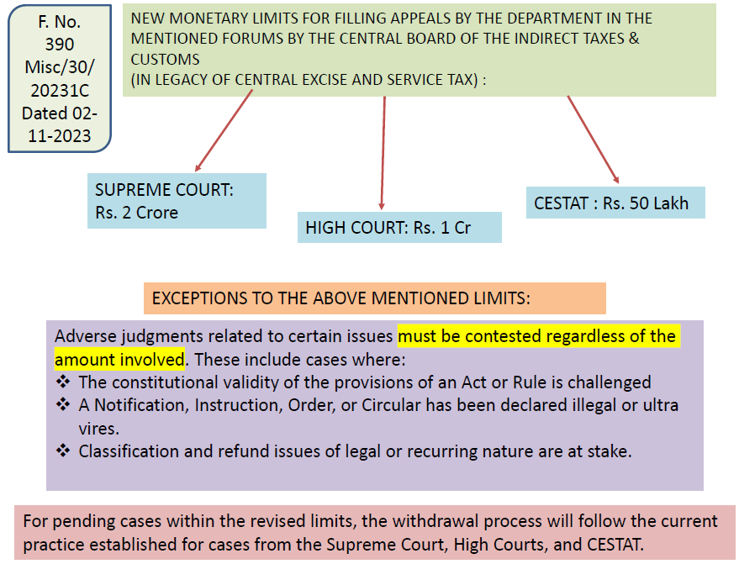
Appeal not to be filed in certain cases. Section 120 & Illustration

Slide 7
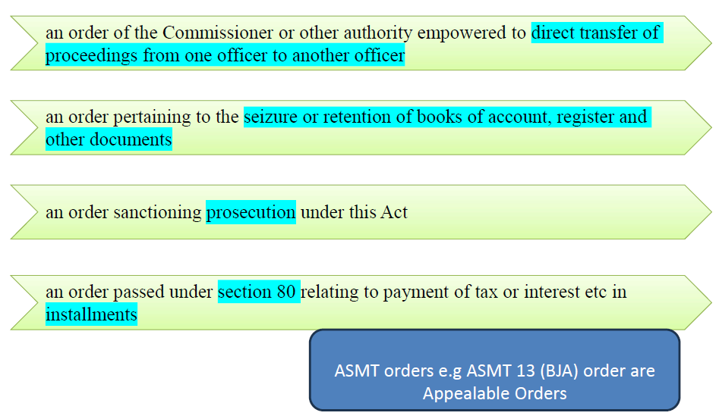
Non-appealable decisions and orders
-relating to any of the following matters:- SEC 121
SEC 121- Non-appealable decisions and orders
-relating to any of the following matters

Slide 8
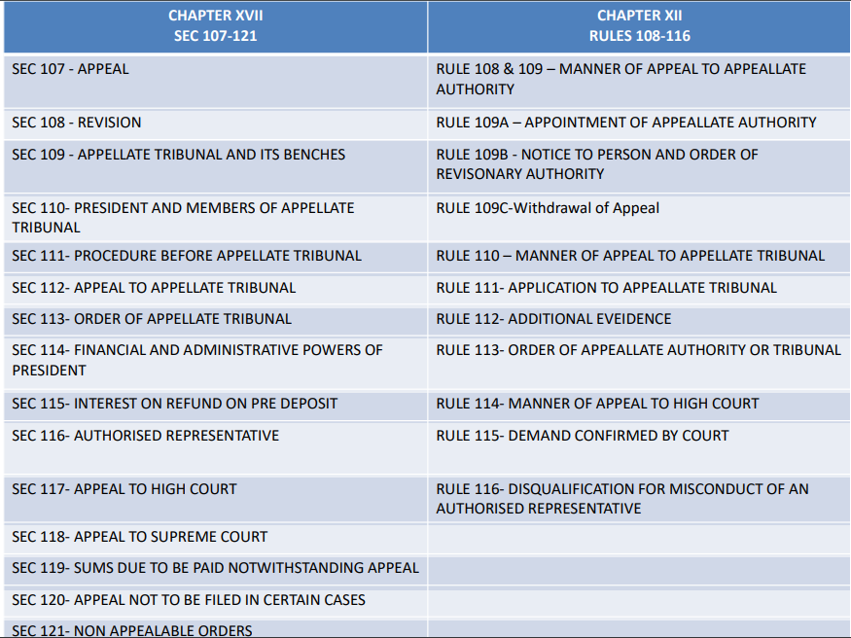
Relevant Section & Rule under GST
Notes:
A taxpayer must promptly act or reply to notices within the time limit specified in such notice. Any failure to do so can land the taxpayer in a legal soup. In such eventuality, the authorities can proceed to prosecution or consider that as a willful default and charge penalty.

Slide 9
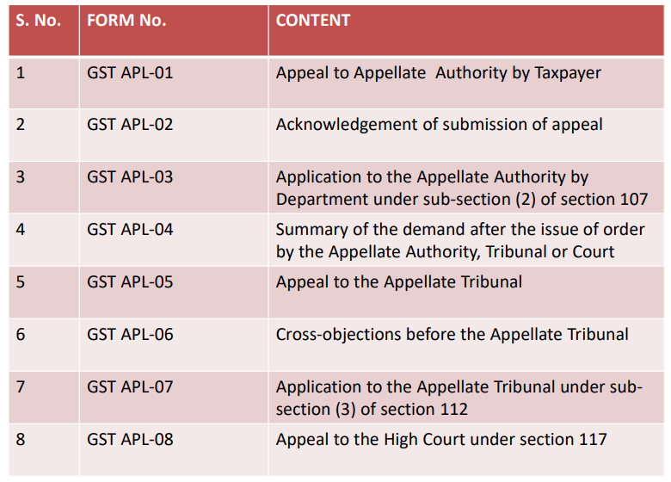

Slide 10
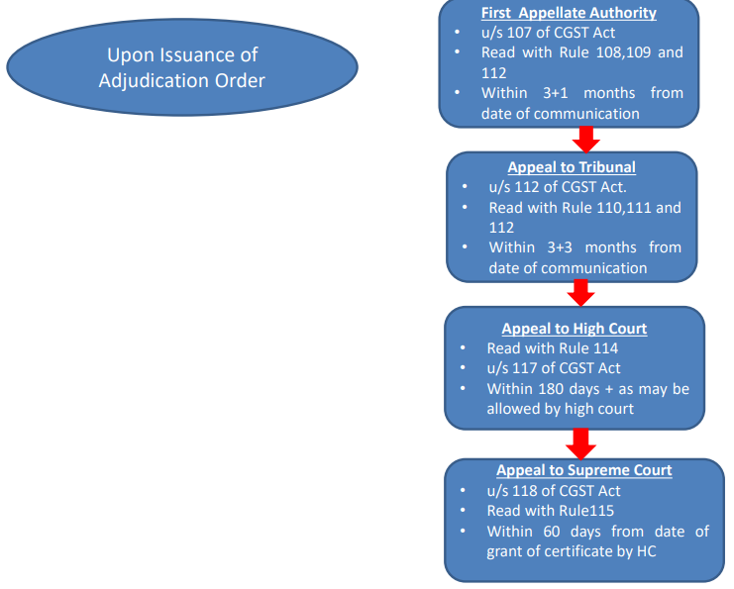

Slide 11
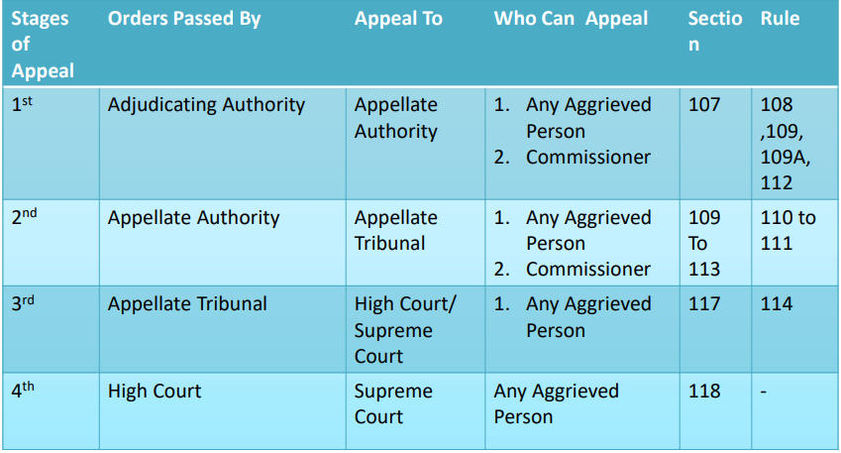
Hierarchy in GST

Slide 12
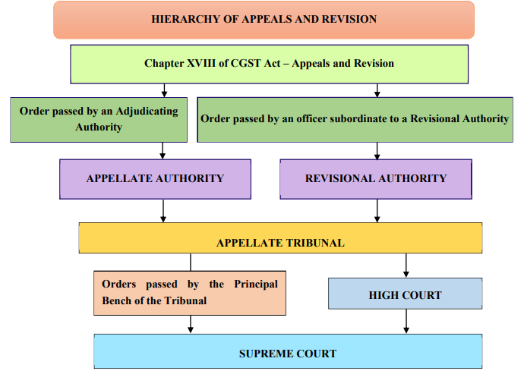

Slide 13
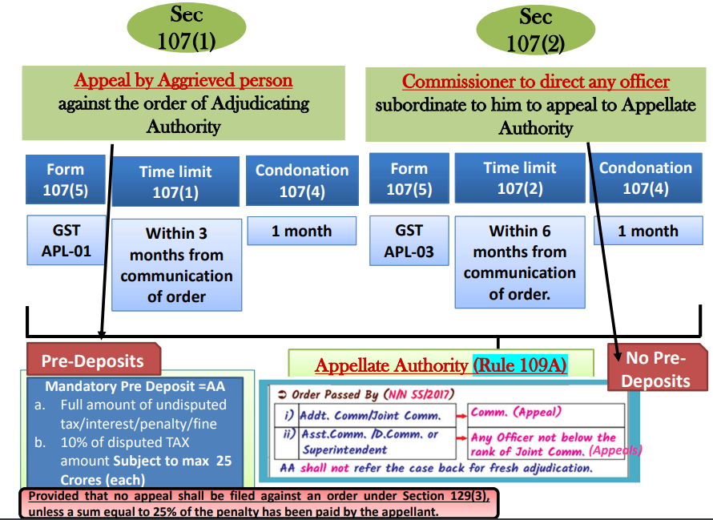

Slide 14
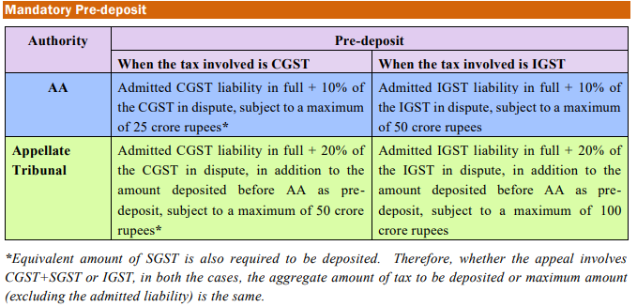

Slide 15
Circular No. 172/02/2022 Can
Pre-Deposit made through utilisation of ITC Ledger?
IV. Utilization of the amounts available in the electronic credit ledger and the electronic cash ledger for payment of tax and other liabilities
Q6. Whether the amount available in the electronic credit ledger can be used for making payment of any tax under the GST Laws?
• It is clarified that any payment towards output tax,
--whether self-assessed in the return , OR
--payable as a consequence of any proceeding instituted under the provisions of GST can be made by utilization of the amount available in the electronic credit ledger of a registered person.
• Also, the electronic credit ledger cannot be used for making payment of any tax which is payable under reverse charge mechanism.

Slide 16
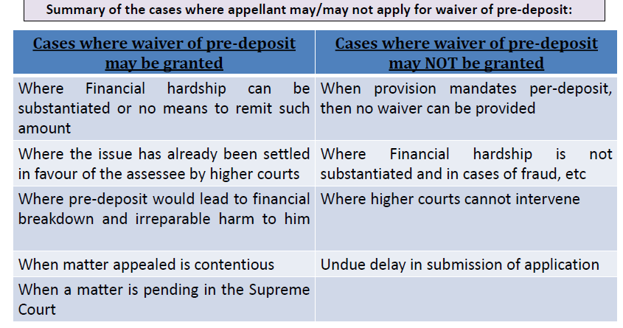
Can Pre-Deposit be waived ?
Waiver depends on the Merits of Case
No hard-and-fast rule for where pre-deposit may be waived. It depends on the facts and circumstances of the case how strong is the case presented.

Slide 17
HC granted relief to assessee to take 10% of amount required for filing appeal as his bank a/c was frozen by GST dept.
THE HON'BLE MADRAS HIGH COURT IN THE CASE OF RATHINAVEL PANDIAN V/s ASSISTANT COMMISSIONER (ST) , decided on 27-11-2023
👉 Issue:-✔Can assessee was permitted take 10% of amount required for filing appeal from its freezing bank account?
👉 The Hon'ble High Court Judgement:-
✔Assessee had challenged Recovery order passed by revenue, confirming demand for recovery of ITC along with interest and penalty each against CGST and SGST –
✔Since assessee was having a statuary appeal remedy, instant writ petition was to be disposed of and assessee was directed to file statuary appeal before Appellate Authority within four weeks and as an interim arrangement assessee was permitted take 10% of amount required for filing appeal from its bank account. - Section 73 read with 107 of Central Goods and Services Tax Act, 2017.

Slide 18
Penalty order under GST to be treated as SCN to seek release of vehicle seized u/s 129
THE HON'BLE ALLAHABAD HIGH COURT in the case of AKBAR ALI TRANSPORT SERVICES V/s STATE OF U.P., decided on 9-1-2024
👉 Issue:-✔Can Penalty order under GST to be treated as SCN to seek release of vehicle seized u/s 129?
👉 The Hon'ble High Court Judgement:-
✔Where Competent Authority had seized vehicle of assessee under section 129(1) and imposed penalty under section 129(3), said authority was to be directed to pass a reasoned order after affording /due opportunity of hearing to assessee for release of vehicle.
✔Assessee was entitled to one opportunity of hearing before /authority to furnish his explanation and assessee was to be directed to treat penalty order as show cause notice and furnish reply only for purpose of obtaining release of truck - Subject to such reply / application being filed by assessee, appropriate reasoned order was to be passed by authority after affording due opportunity of hearing to assessee Section 129 of Central Goods and Services Tax Act, 2017.

Slide 19
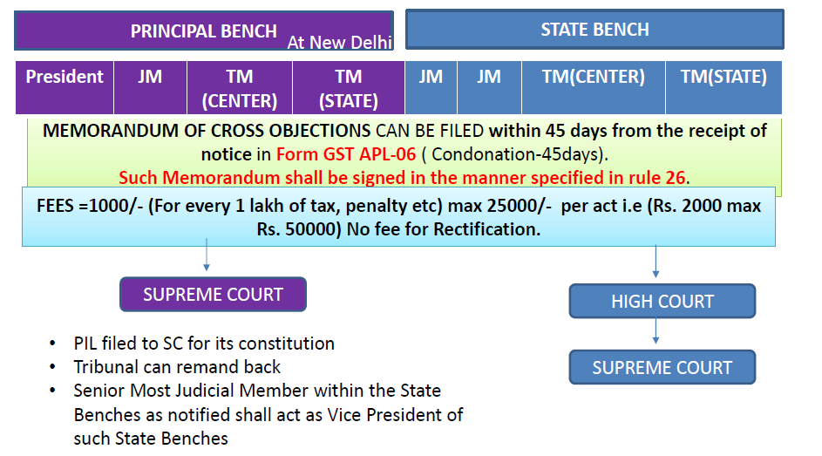
Section 109- Composition of Appellate Tribunal

Slide 20
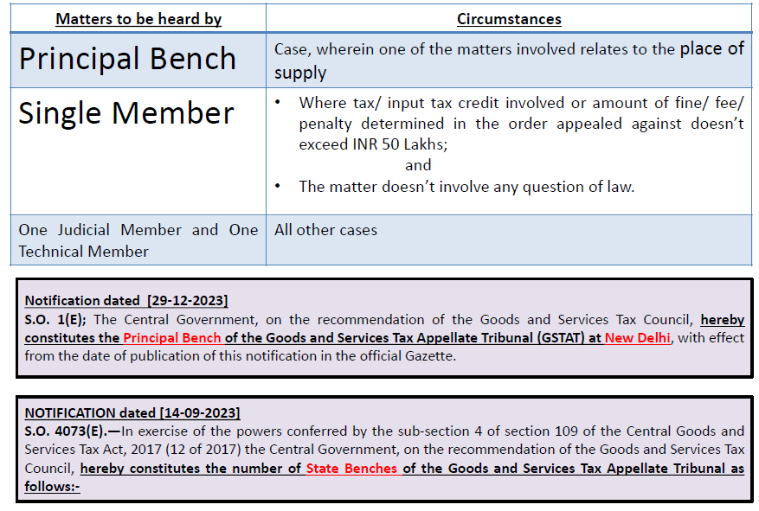
Section 109- Jurisdiction of Members AGAINST orders passed by APPELLATE AUTHORITY or THE REVISIONAL AUTHORITY

Slide 21
Time limit for filing appeal before the GST Appellate Tribunal.
Due to the delay in constitution of the Appellate Tribunal, appeals could not be filed within the time limit prescribed under Section 112 of the CGST Act. Thus, vide Removal of Difficulty Order No. 09/2019-Central Tax dated 03.12.2019 it has been provided that the time limit of three months (for assessee appeals) or six months (for departmental appeals), shall be reckoned from the following dates, whichever is later.
(i) Date of communication of order; or
(ii) The date on which President or the State President as the case may be of the Appellate Tribunal after its constitution under Section 109, enters office.
This was further clarified vide Circular No. 132/2/2020-GST dated 18th March 2020.
As per the above clarification issued by the Central Government the three months' time limit for filing appeal against the orders passed by the Appellate Authority or Revisional Authority shall commence from the date on which President of the GSTAT or the President of the State Bench of the Appellate Tribunal enters office, after it has been constituted as per Section 109 of CGST Act, 2017.

Slide 22
Query: As we all know GST Tribunals across various states are presently non functional.
What to do with the order passed by the Additional Commissioner (Appeals), which is now appealable to GST Tribunal? Should we keep them pending? Will the time limt of the limitation be counted from the day the GST Tribunal will be made functional in the particular jurisdiction?
The President (Shri. Sanjaya Kumar Mishra) has taken oath on 06.05.24 ; you have 3 months time i.e. 05.08.24. Please do not be so helpless.
Answer:- As I have commented, the President has to enter the office, to start the work and his office is yet to be notified. This gives additional time. This argument is debatable and not final.
Please wait till 04.08.24. The government will issue some clarification before this date. Hon'ble Justice (Retd) Shri. Sanjaya Kumar Mishra has been appointed to the post of president of GSTAT

Slide 23
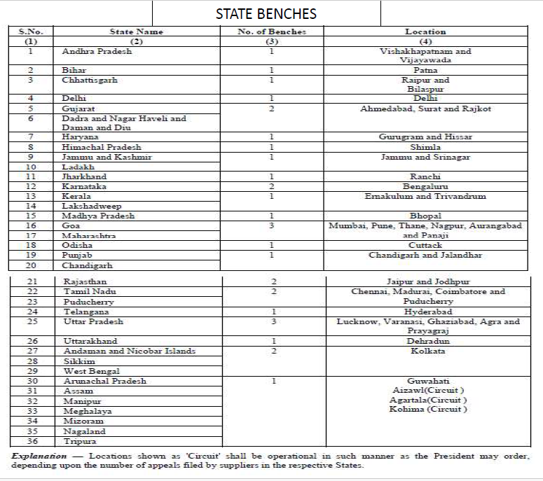

Slide 24





Measures to reduce litigations arisen due to the non-constitution of the GST Tribunal
Case: Gulf Oil Lubricants India Ltd. [2023-TIOL-253-HC-MUM-GST]
Issue : Measures to reduce litigations arisen due to the non-constitution of the GST Tribunal
Observations : The Hon’ble Bombay High Court in Gulf Oil Lubricants India Ltd. [2023-TIOL-253- HC-MUM-GST] has directed the Revenue Department to incorporate measures to reduce the inflow of litigations in the Court, which has arisen due to the non-constitution of the GST Tribunal, by incorporating the stipulation contained in Circular No. JC (HQ)-1/GST/2020/Appeal/ADM-8 dated May 26, 2020 (“the Circular”), to put the taxpayer into notice, that the time limit for filing the appeal is extended and if a declaration is filed within the stipulated period, the protective measure would automatically come into force.

Slide 25
✔ Can attachment was effected of assessee’s immovable property without waiting for statutory period of three months of appeal filing?
Non-Constitution of GSTAT: Kerala GST Dept directs Taxpayers to Submit Declaration of appeal proposal before GSTAT to stay Revenue Recovery
Section 78. Initiation of recovery proceedings
Section 79. Recovery of tax.-
Instruction No. 01/2024-GST | 30-May-2024 | Guidelines for initiation of recovery proceedings before three months from the date of service of demand order- reg.

Slide 26
Measures to reduce litigations arisen due to the non-constitution of the GST Tribunal
HC granted statutory benefit of stay of recovery due to non-constitution of Tribunal THE Hon'ble PATNA HC in the case of DAYANAND PRASAD V/s STATE OF BIHAR decided on 25-7-2023
👉Issue : Due to non-constitution of GST Tribunal, what sort of remedy to the Assessee ?
👉Hon'ble HC Judgement : First appellate authority specifically rejected appeal on ground that there was absolutely no evidence produced to substantiate contention - Petitioner essentially had a statutory remedy of appeal against impugned order before Tribunal under section 112 of GST Act - However, due to non-constitution of Tribunal, Assessee was deprived of his statutory remedy and availing benefit of stay of recovery hence Assessee was allowed to file appeal on constitution of Tribunal and statutory benefit of stay was granted.

Slide 27
HC stayed demand recovery in absence of GST Tribunal
The Hon’ble ORISSA HIGH COURT in Pravakar Behera v/s Commissioner of CT & GST W.P (C) NO. 15051 OF 2023 I.A. NO. 6935 OF 2023 MAY 15, 2023
👉Issue : Petitioner wants to avail remedy under provisions of law by approaching second Appellate Tribunal which had not yet been constituted.
👉Hon'ble HC Judgement : HC stayed demand recovery in absence of GST Tribunal during pendency of writ petition.

Slide 28
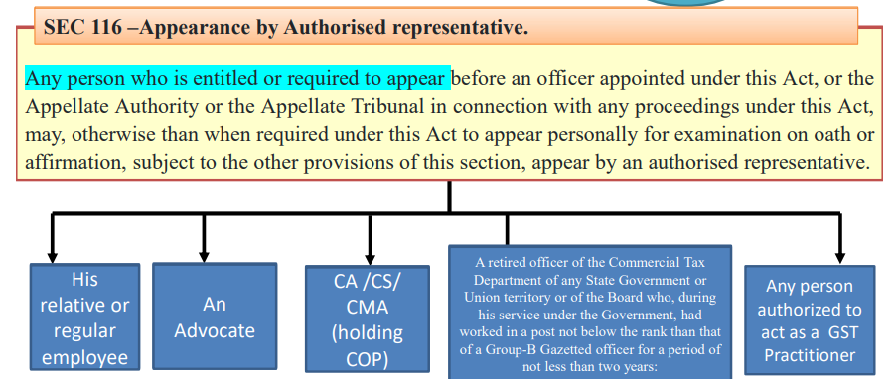

Slide 29
TITBITS OF APPEALS
No Pre deposit in case of Refund Appeals.
If Online Order then Online Appeal, if manual Order then Manual Appeal.
No specific Format of Memorandum of Cross Objections in case of First Appellate Authority.
Some Important points under GST Appeals
1) Detailed Appeal Drafting in GST
2) First Appeal can be by Department in GST
3) No Pre Deposit waiver in GST
4) Max 3 adjournments
5) Directory time period of 1 year for disposal.
6 )1st Appeal may like to JC/Addl/ Comm, as per order passing authority.
Appeal be made to both CGST & SGST authorities? –No As per the GST Act, CGST & SGST/UTGST officers are both empowered to pass orders. As per the Act, an order passed under CGST will also be deemed to apply to SGST. If an officer under CGST has passed an order, any appeal/review/revision/ rectification against the order will lie only with the officers of CGST, vice a versa for SGST.
In case of transfer of appellate authority
Same officer to hear and decide the case The requirement of fair hearing involves decision being taken by the officer who heard the case. If after hearing, that particular officer is transferred, normal rule would be that the successor must hear the arguments afresh before he could pass an order. Laxmi Devi v. State of Bihar, (2015) 10 SCC 241.So Stringent is this right that it mandates that the person who heard and considered the objections can alone decide them; and not even his successor is competent to do so even on the basis of the materials collected by his predecessor

Slide 30
Date of filing Appeal
After filing GST appeal online, We have to submit these documents to the office of GST Appeal Authority within 7 days.
Singed Copy of APL 1
Acknowledgment comes for APL 01, its copy
Self Certified copy of DRC 07 and Detailed Order, the taxpayer will self certify on this, earlier this was certified by the Proper Officer, now it has been changed to Self Certified by the taxpayer.
Copy of Detailed Appeal with grounds
Related Docs of your point or appeal
Appeal Pre-deposit 10% Deposit Confirmation
You have to give all this within 7 days of APL1
then the appeal authority will give you APL 2, APL 2 means that your appeal has now been received by the appeal authority.
If you give all this within 7 days, then your appeal date will be considered the same as the day you filed APL 1.
If you give all this after 7 days, then the date of your appeal will be considered to be the day on which you give all this.

Slide 31
▪Appeals rejected as time-barred due to late submission of self-certified copy of the decision.
▪Cites Rule 108 of the CGST Rules, 2017, arguing that self-certified copies are not required when appeals are filed electronically via FORM GST APL-01.
High Court Rulings:
▪Various High Courts, including Orissa and Madras, ruled that non-submission of certified copies is a technical defect.
▪Appeals should not be dismissed on this ground if filed electronically on time.
▪Orissa High Court emphasized that procedural requirements should not overshadow the merits of the case.

Slide 32
High Court Decision:
▪Non-filing of the certified copy within seven days, when the appeal is filed electronically on time, is a technical defect.
▪Appeals should not be dismissed solely for this reason.
▪The appellate authority is directed to re-hear the appeals and pass a reasoned order on merits within three months.
The impugned order is quashed, and the case is remanded for a fresh hearing.

Slide 33
Manual Filing of Appeal Notification 29/2023-CT
Manual Filing of Appeal
An Appeal to the Appellate Authority shall be made in FORM GST APL-01 electronically.
However, the same appeal may be filed manually in FORM GST APL-01 only in specified circumstances along with the relevant documents, only if-
✔ The Commissioner has so notified, or
✔ The same cannot be filed electronically due to non-availability of the decision or order to be appealed against on the common portal,
✔ In such a case, a provisional acknowledgement shall be issued to the Appellant immediately.
For details, please refer to Rule 108 of CGST Rules, 2017 read with Notification No. 38/2023-Central Tax dated 04.08.2023

Slide 34
PRADEEP KANTHED V/S UNION OF INDIA & OTHERS [SUPREME COURT PETITION NO. 1006/2023] DTD. 20.10.2023
GST returns are filed under sections 39 of the GST Act, but there is no provision for revised returns in the Act, Rules, or the GSTN Portal. This is in stark contrast to other revenue laws, such as the Income Tax Act, VAT Act, and Customs and Duties Act, which all typically include provisions for revised returns.
Supreme Court Seeks Finance Ministry's Response on Revised GST Returns
In the petition filed by Pradeep Kanthed, it is stated that despite seven years having passed since the enactment of the GST Act and Rules, along with more than 3,500 amendments, circulars, and notifications, no significant attention has been given to the availability of revised returns on the GSTIN Portal to date.
The matter is scheduled for a hearing on January 12.

Slide 35
B2B Supply wrongly shown as B2C -Credit denied to Buyers
Case:
M/s. WIPRO LIMITED INDIA
M/s. SUN DYE CHEM HC-MAD-GST
M/s SHIVA JYOTI CONSTRUCTION HC-ORISSA-GST
Issue : B2B Supply wrongly shown as B2C.
Observations : Court permits the petitioner to resubmit corrected Form-B2B under GSTR- 1 and to enable the petitioner to do so a direction is issued to Opposite Parties to receive it manually

Slide 36
WRONG GSTIN MENTIONED INADVERTENTLY -CREDIT NOT DENIED TO BUYERS even if earlier periods
Assessee's request to amend/rectify Form GSTR-1 could not be rejected if wrong GSTIN mentioned inadvertently even if earlier periods
The Hon'ble Bombay High Court in the case of Star Engineers (I) (P.) Ltd. v. Union of India
👉 Issue
✔During the financial year 2021-22, the petitioner (assessee) mistakenly reported the GSTIN of third-party vendors instead of the correct GSTIN belonging to 'XYZ' (presumably another entity) in Form GSTR-1 for the months of July 2021, November 2021, and January 2022. This resulted in 'XYZ' being unable to claim Input Tax Credit (ITC) for the invoices, leading to a reduction in the payment amount by 'XYZ.’
✔Rectification Request and Rejection The petitioner acknowledged the error and sought approval to rectify the mistake in Form GSTR-1.
✔However, the Deputy Commissioner rejected the request, citing that the matter was time-barred.

Slide 37
WRONG GSTIN MENTIONED INADVERTENTLY -CREDIT NOT DENIED TO BUYERS even if earlier periods
👉 The Hon'ble High Court Judgement
✔The errors made by the petitioner were inadvertent and made in good faith, without any intention to gain illegally. Consequently, the court directed the respondent authorities to allow the petitioner to amend/rectify Form GSTR-1 for the relevant period, either through online or manual means, within a four-week period.

Slide 38
Time Limit for Correction of Return
Section 39(9) Time Limit for Correction of Return
If any registered person after furnishing a return discovers any omission or incorrect particulars therein, other than as a result of scrutiny, audit, inspection or enforcement activity by the tax authorities, he shall rectify such omission or incorrect particulars in such form and manner as may be prescribed, subject to payment of interest under this Act.
Provided that no such rectification of any omission or incorrect particulars shall be allowed after the the thirtieth day of November following the end of the financial year, or the actual date of furnishing of relevant annual return, whichever is earlier.
PROCEDURAL AMENDMENT EXTENDING THE RETURN FILING DATE TO 30TH NOVEMBER IS GIVEN RETROSPECTIVE EFFECT FROM 01.07.2017: KERALA HIGH COURT

Slide 39
Hon'ble High Court of Kerala a recent judgment in the case of M/s. M.Trade Links vs Union of India. (Case WP(C) No. 31559 of 2019) has generated considerable debate among GST consultants. The court's decision to allow extension of deadline under Article 16(4) till November 30 for the years 2017-18 and 2018-19.

Slide 40
ITC Sec 16(4)
The Section 16(4) of CGST Act 2017 prescribes that the date to claim Input Tax Credit (ITC) for any financial year would be: , whichever is earlier.
1. A registered person shall not be entitled to take input tax credit in respect of any invoice or debit note for supply of goods or services or both after the thirtieth day of November following the end of financial year to which such invoice or debit note pertains or
2. furnishing of the relevant annual return whichever is earlier else such ITC would be lapsed forever.

Slide 41
Thirumalakonda Plywoods Vs. Assistant Commissioner –Division Bench judgement dated 18.07.2023
Time limit prescribed for claiming ITC under section 16(4) of APGST Act/CGST Act, 2017 is not violative of Articles 14, 19(1)(g) and 300-A of Constitution of India.
Section 16(2) of APGST/CGST Act, 2017 has no overriding effect on section 16(4) as both are not contradictory with each other; they operate independently.
Mere acceptance of Form GSTR-3B returns with late fee will not exonerate delay in claiming ITC beyond period specified under section 16(4) of APGST/CGST Act, 2017.
The PATNA HIGH COURT in the case of GOBINDA CONSTRUCTION V/S UOI decided on 08-09-2023 has been delivered same type of judgement

Slide 42
N.No.47/2019-Central Tax:
Dtd. 9th October, 2019
In respect of FY: 2017-2018 and 2018-2019, Registered Persons:
-whose aggregate turnover in a financial year does not exceed Rs. 2 crores &
-who have not furnished the Annual Return before the due date, will follow a special procedure, such that they shall have the option to furnish the Annual Return.
Provided, that the said annual return shall be deemed to be furnished on the due date if it has not been furnished before the due date.
GSTR-9 and 9C -Not . No. 32/2023-CT financial year 2022-23
Exempts filing of GSTR-9 the registered person whose aggregate turnover in the financial year 2022-23 is up to two crore rupees.

Slide 43
How Long to Keep the Records Sec 36
Period of Retention of Documents
72 months from due date of filing of annual return i.e. 31stDec 20xx
6 years and 9 months from end of the year
Party to Appeal / Revision/other proceeding -1 year after the Final disposal or period specified above, which ever is later.

Slide 44
DETERMINATION OF TAX
LIABILITY AND ISSUE OF ORDER
Assessment of tax liability and issue an assessment order within a period of five years from the date specified under section 44 for furnishing of the annual return for the financial year to which the tax not paid relates :
Section 62. Assessment of non-filers of returns.
Section 63. Assessment of unregistered persons.
Section 74. Determination of tax by reason of fraud or any wilful misstatement or suppression of facts. (Fraud cases)
Section 73. Assessment of Non Fraud Cases.
Determination of tax and Issue of order by proper officer for any reason other than fraud or any wilful misstatement or suppression of facts relates to or within three years from the date of erroneous refund. Section 73 read with sub section (10).

Slide 45
GSTR-9/9C DUE DATES & OTHER VIS-À-VIS DATES
Financial Year | Due Date/ Extended Due Date | Period of retention of accounts (72 Months) | Assessment of Non-Filers of Returns (5 Years) | Assessment Unregistered Person (5 Years) | Determination of tax not paid or short paid or erroneously refunded or input tax credit wrongly availed or utilized
 |  | Section 36 | Section 62 | Section 63 | Section 73(10) Other than fraud |  | Section 74(10) By Fraud
2022-23 | 31.12.2023 | 31.12.2029 | 31.12.2028 | 31.12.2028 | 31.12.2026 |  | 31.12.2028
2021-22 | 31.12.2022 | 31.12.2028 | 31.12.2027 | 31.12.2027 | 31.12.2025 |  | 31.12.2027
2020-21 | 28.02.2022 (CT-40/2021) | 28.02.2028 | 28.02.2027 | 28.02.2027 | 28.02.2025 | 28.02.2027
2019-20 | 31.03.2021 (CT-04/2021) | 31.03.2027 | 31.03.2026 | 31.03.2026 | 31.03.2024 30.06.2024 31.08.2024 | 31.03.2026
2018-19 | 31.12.2020 (CT-80/2020) | 31.12.2026 | 31.12.2025 | 31.12.2025 | 31.12.2023 31.03.2024 30.04.2024 | 31.12.2025
2017-18 | 05.02.2020 (CT-06/2020)* 07.02.2020 (CT-06/2020)# *(Chandigarh, Delhi, Gujarat, Haryana, Jammu & Kashmir, Ladakh, Punjab, Rajasthan, Tamil Nadu, Uttar Pradesh, Uttarakhand.) #(Andaman and Nicobar Islands, Andhra Pradesh, Arunachal Pradesh, Assam, Bihar, Chhattisgarh, Dadra and Nagar Haveli and Daman and Diu, Goa, Himachal Pradesh, Jharkhand, Karnataka, Kerala, Lakshadweep, Madhya Pradesh, Maharashtra, Manipur, Meghalaya, Mizoram, Nagaland, Odisha, Puducherry, Sikkim, Telangana, Tripura, West Bengal, Other Territory) | 05.02.2026 07.02.2026 | 05.02.2025 07.02.2025 | 05.02.2025 07.02.2025 | 05.02.2023 07.02.2023 31.12.2023 30th September 2023 NN 13/2022 dtd 5th July 2022 N. 09/2023 dated 31/03/2023 | 05.02.2025 07.02.2025

Slide 46
Section 75(2) which provide converting proceeding from section 74 to section 73.
“(2) Where any Appellate Authority or Appellate Tribunal or court concludes that the notice issued under sub-section (1) of section 74 is not sustainable for the reason that the charges of fraud or any wilful-misstatement or suppression of facts to evade tax has not been established against the person to whom the notice was issued, the proper officer shall determine the tax payable by such person, deeming as if the notice were issued under sub-section (1) of section 73.”
How a tenor of notice can be changed once, case is decided against the revenue.
Section 75(11) need to be omitted, which provide exclusion of period of pending proceedings in other cases.
Section 75(11) - “(11) An issue on which the Appellate Authority or the Appellate Tribunal or the High Court has given its decision which is prejudicial to the interest of revenue in some other proceedings and an appeal to the Appellate Tribunal or the High Court or the Supreme Court against such decision of the Appellate Authority or the Appellate Tribunal or the High Court is pending, the period spent between the date of the decision of the Appellate Authority and that of the Appellate Tribunal or the date of decision of the Appellate Tribunal and that of the High Court or the date of the decision of the High Court and that of the Supreme Court shall be excluded in computing the period referred to in sub-section (10) of section 73 or sub-section (10) of section 74 where proceedings are initiated by way of issue of a show cause notice under the said sections.”

Slide 47
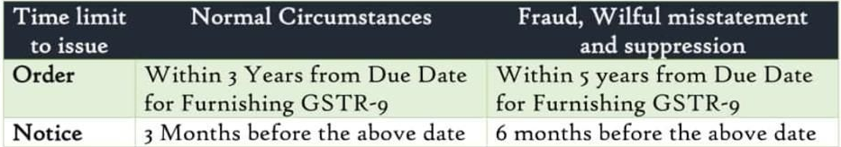
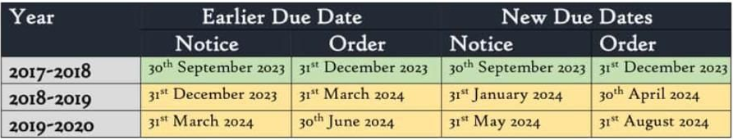
NN- 56/2023 CT Dtd : 28/12/2023

Slide 48
Issuance of Goods and Services Tax Demand Order under Section 73(9) of Central Goods and Services Tax (CGST) Act as per limitation periods under Section 73(10) extended in line with the following Notifications —
Covid Extension
Notification No. 35/2020 – Central Tax [3rd April, 2020],
Notification No. 14/2021 – Central Tax [1st May, 2021],
Notification No. 13/2022 – Central Tax [5th July. 2022],
Notification No. 09/2023 – Central Tax [31st March, 2023] and
No Covid Extension
Notification No. 56/2023 – Central Tax [28th December, 2023]
Section 168 – Power to issue instructions or directions
Section 168A - Power of Government to extend time limit in special circumstances
Section 168A of the CGST Act has been Inserted via The Taxation and Other Laws (Relaxation and Amendment of Certain Provisions) Act, 2020.

Slide 49
Section 168A of Central Goods and Services Tax Act, 2017 Power of Government to extend time limit in special circumstances —
(1) Notwithstanding anything contained in this Act, the Government may, on the recommendations of the Council, by notification, extend the time limit specified in, or prescribed or notified under, this Act in respect of actions which cannot be completed or complied with due to force majeure.
(2) The power to issue notification under sub-section (1) shall include the power to give retrospective effect to such notification from a date not earlier than the date of commencement of this Act.
Explanation.- For the purposes of this section, the expression “force majeure” means a case of war, epidemic, flood, drought, fire, cyclone, earthquake or any other calamity caused by nature or otherwise affecting the implementation of any of the provisions of this Act.

Slide 50

The following grounds can be relied on while moving an appeal/petition against Section 73 demand orders that are issued invoking the extended period of limitation as per the said Notifications–
No Force Majeure in existence, at the time of issuance of notification to extend the time limit.
GST Council Meetings or Press Releases give no reference to recommending such an extension.
Perpetual extension is possible, citing “Force Majeure”, giving a wide range of
power to the government to act against honest GST taxpayers.

Slide 51
Question
Whether the SCN date will be calculated from the Annual Retrun Due date or the date on which the Annual Return is filed. Also, what will be due date in case no Annual Return is filed for the particular Year
In a scenario where the tax liability is short reported in GSTR 3B but considered in GSTR 9, can the supplier contend that section 74 is not applicable?
In the case of RCM can take ITC, there is no suppression of facts. But the department may say that since you have not taken ITC that time, now you are not eligible to take ITC as it is time barred but you have to pay RCM. Therefore, there is supression of facts
Excess ITC claimed = found at the time of GSTR 9=but it was not utilised against any Out put tax liability = DRC 03 filed= will have to pay INTEREST AND PENALTY ?

Slide 52
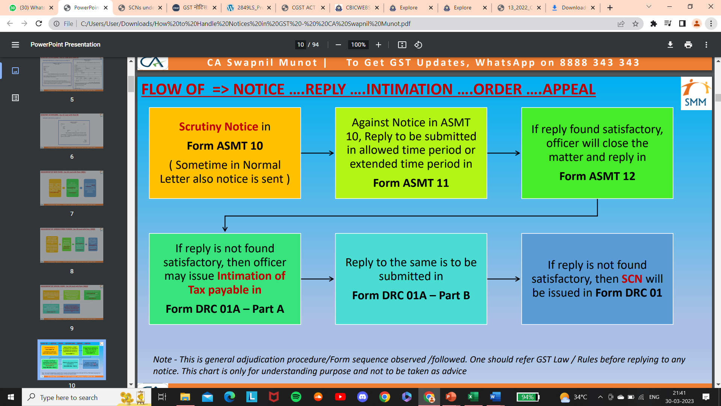

Slide 53
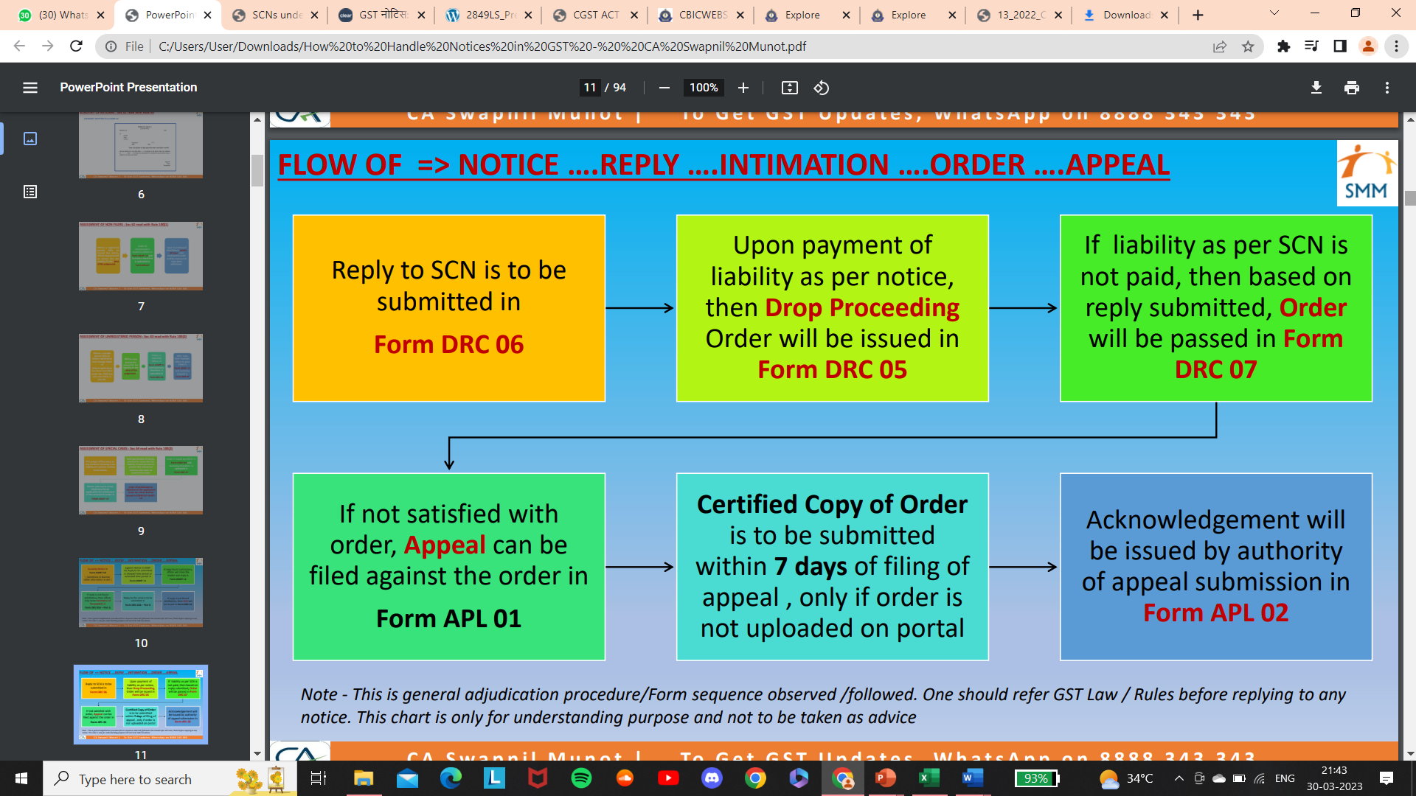

Slide 54
Important Section for Appeal Order
Opportunity of being heard
Sec 75(4)- An opportunity of being heard shall be granted • where a request is received in writing from the person chargeable with tax or penalty ,or • where any adverse decision is contemplated
against such person.
Speaking Order
Sec 75(6)- The proper officer, in this order, shall set out the relevant facts and the basis of his decisions
Notice and order should be on same lines
Sec 75(7)- The amount of tax , interest and penalty demanded in the order shall not be in excess of the amount specified in the notice and no demand shall be confirmed
on the grounds other than grounds specified in the notice.
One penalty for one default
Sec 75(13)- Where any penalty is imposed under section 73 or section 74, no penalty for the same act or omission shall be imposed on the same person under any other provision of this Act.

Slide 55
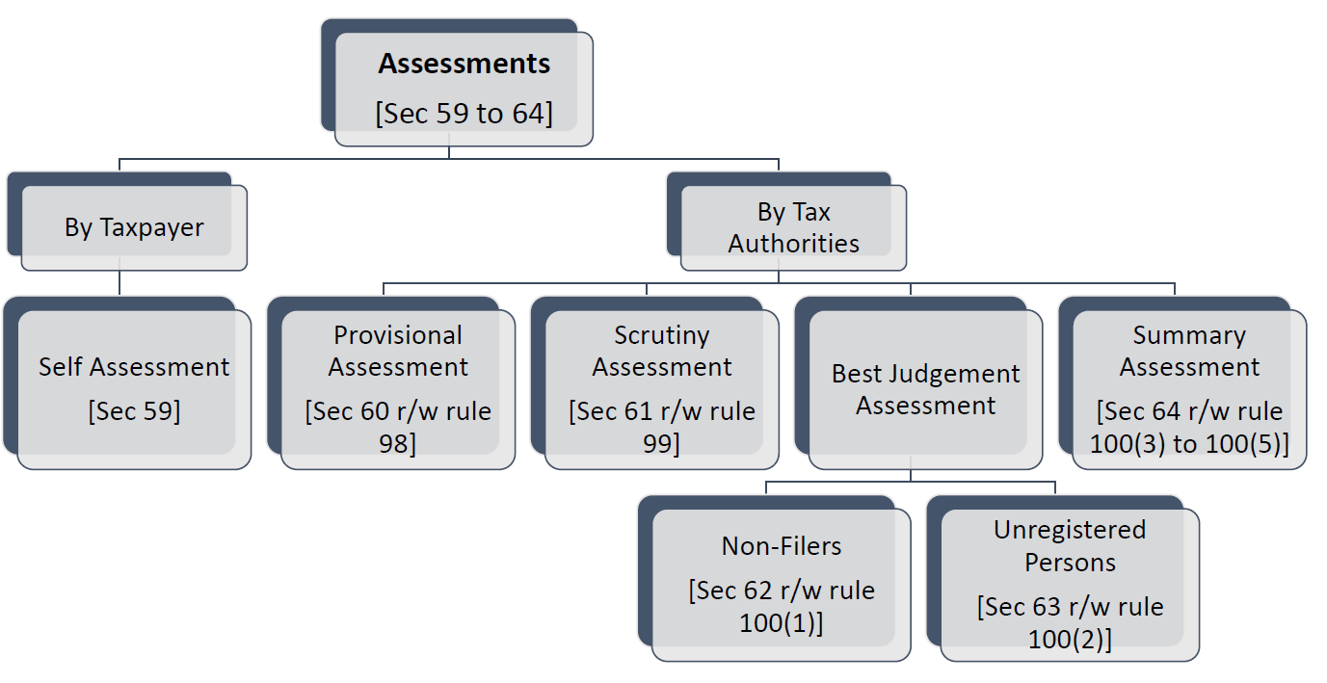
Type of Assessments?

Slide 56
Self Assessment u/s 59
Section 59 of the Act provides for self-assessment of tax liability by the tax payer.
It states that every registered person shall himself:
assess the taxes payable under this Act and
furnish a return for each tax period as specified under section 39.
“Registered Person” means a person who is registered undersection 25 but does not include a person having a Unique Identity Number;
“Taxable Person” means a person who is registered or liable to be registered under section 22 or section 24;

Slide 57
Provisional Assessment Sec-60
When can a Person request for Provisional Assessment
A taxable person can request for provisional assessment wherein he is unable to determine
Value of goods or services or both
Rate of tax applicable on goods or services or both.
Question:-
where the issue is related to classification (lets assume - the taxpayer agrees to remit 18% instead of 12%), whether the differential credit can be passed to the buyer?

Slide 58
Benefit of concessional fees to given to taxpayers who filed GSTR 9/9C of FY 2017-18 onwards even before 1.04.23
The Hon'ble KERALA High Court in the case of SALOOM TRADING V/s SUPERINTENDENT OF CENTRAL GOODS AND SERVICES TAX AND CENTRAL EXCISE decided on 22-11-2023
Issue
✔Can Taxpayers get benefit of concessional fees who have filed GSTR 9/9C of FY 2017-18 onwards even before 1.04.23?
The Hon'ble High Court's judgment
✔Where assessee was served notice under Section 47 and assessee claimed that he was liable to avail benefit under CBIC Circular No.8/2023 dated 31-3-2023 stated that any person who had filed GSTR 9/9C in respect of financial years from 2017-18, up to 31.8.2023 should be eligible for concessional late fee, therefore, court was of prima facie view that assessee was liable to avail aforesaid benefit.
Section 47 of Central Goods and Services Tax Act, 2017.

Slide 59
PROPER OFFICER?
DEFINATION IN SEC 2 OF CGST ACT
REFER CIRCULAR 3/ 2017 OF CGST ACT 2017
2 (91)“Proper officer” in relation to any function to be performed under this Act, means the Commissioner or the officer of the central tax who is assigned that function by the Commissioner in the Board – section 2(91) of CGST Act.
2 (16) BOARD” means the Central Board of Excise and Customs constituted under the Central Boards of Revenue Act, 1963;
2(25) COMMISSIONER IN THE BOARD: means The Commissioner referred to in sec 168 ( power to issue instructions or directions)
COMMONLY JURISDICTION OFFICER IS THE PROPER OFFICER FOR ISSUING NOTICES RELATED TO RETURNS

Slide 60
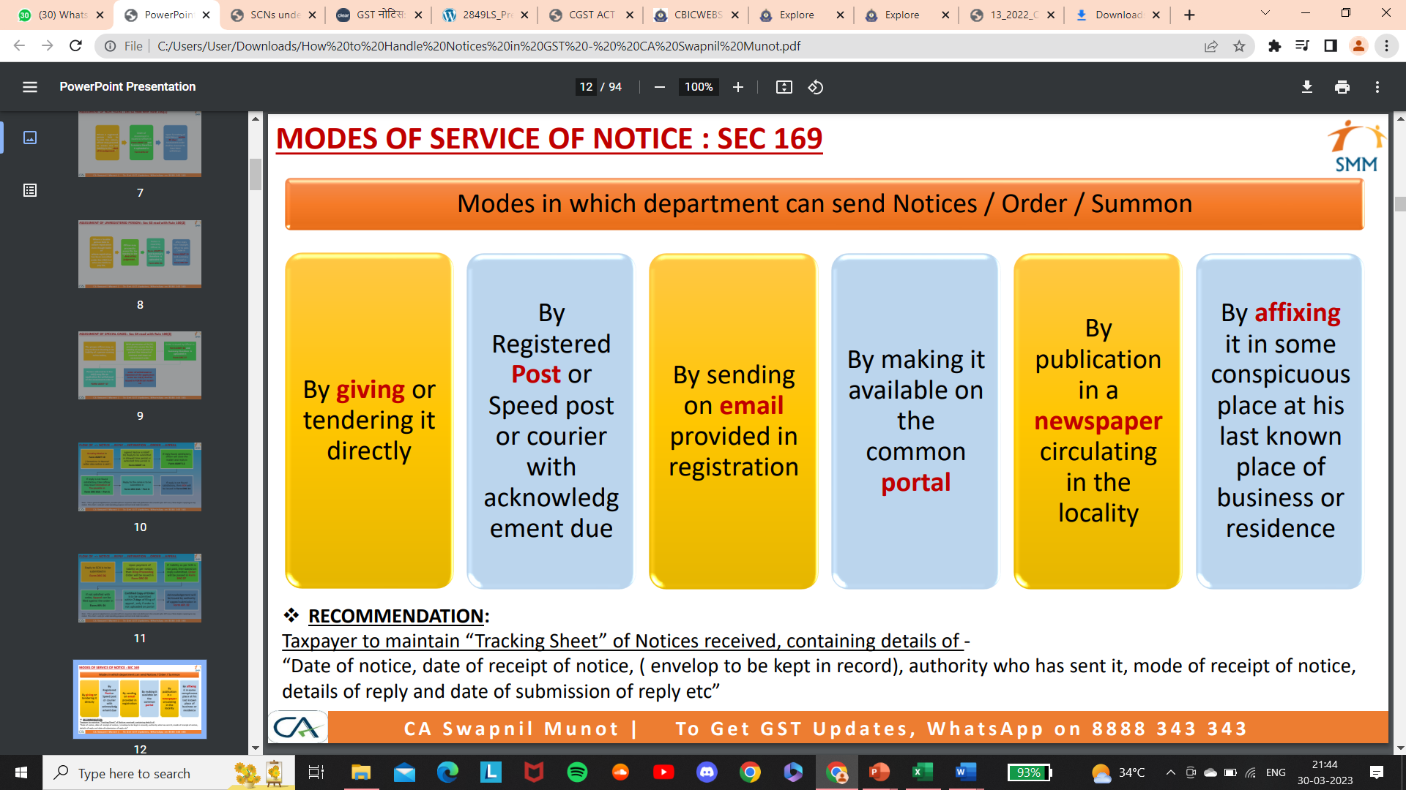

Slide 61
REQUIREMENT OF DIN
▪ Keeping government objective of accountability and transparency , Document Identification Number – DIN
system was introduced on all communication / notices from GST Department from 23rd Dec 2019 . It would
also provide the taxpayer a digital facility to verify any communications and its genuiness.
▪ Any communication from GST or Custom or Central Excise department without a computer generated DIN,
would be treated as invalid and shall be deemed to be as if it has never been issued.
▪ In exceptional circumstances, notice can be issued without DIN, on satisfaction of below condition:
✓ Exceptional reason to be recorded in writing in the file. Such exceptional reason can be :
o Technical difficulties in generating DIN or
o When communication is to be made at short notice/urgent situation & authorised officer is outside the office.
✓ Such communication/notice should expressly state that, it has been issued without a DIN.
✓ Said communication is regularised within 15 working days of its issuance - (i) by post facto approval of superior officer (ii) mandatorily generating DIN after post facto approval

Slide 62
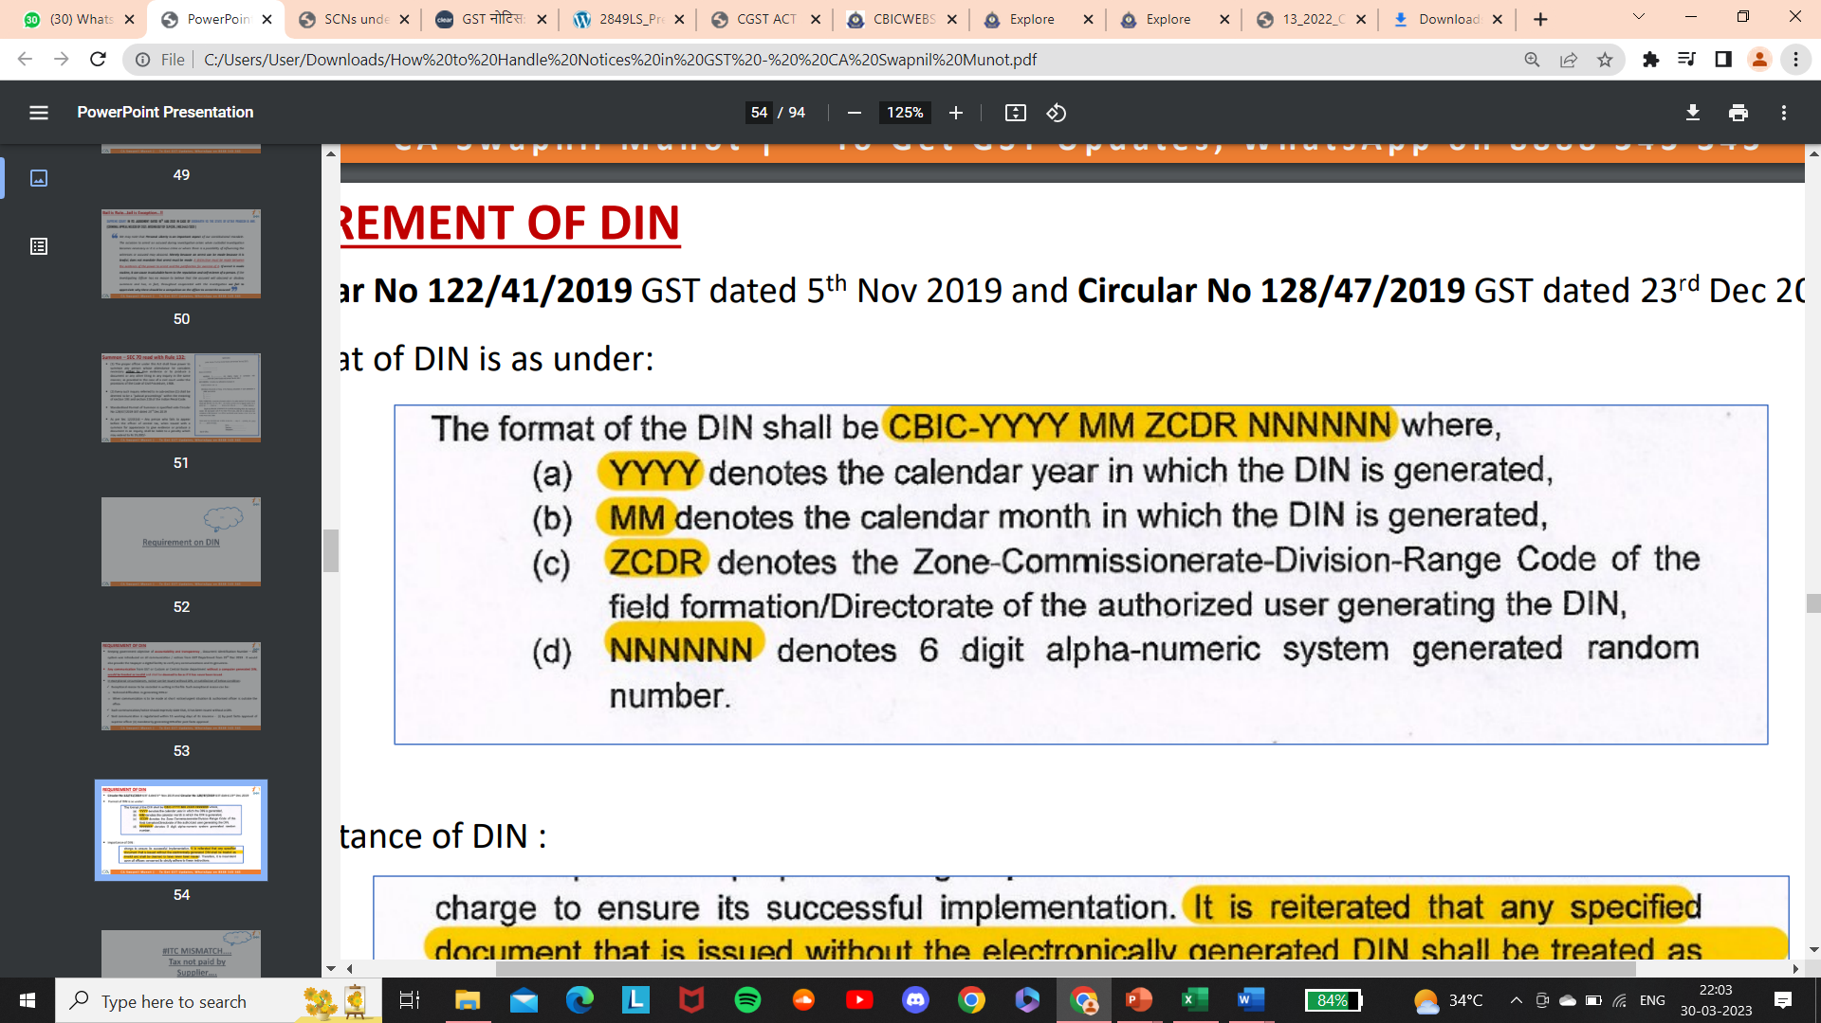
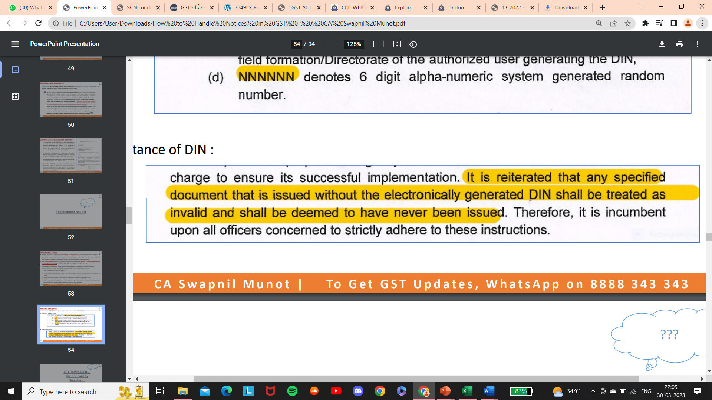
REQUIREMENT OF DIN
Circular No 122/41/2019 GST dated 5th Nov 2019 and
Circular No 128/47/2019 GST dated 23rd Dec 2019
▪ Format of DIN is as under:
▪ Importance of DIN :

Slide 63
REPLY TO GST NOTICES & EFFECTS OF NOT REPLYING
Any reply to the GST notices can be submitted online on the GST portal.
A taxpayer can use the digital signature or e-signature of the authorised personnel of such taxpayer or himself. Where the payment of tax and interest is required, pay such liability in the requisite form and manner. After such payment, the reply letter in requisite form must be submitted before the tax authority who sent notice.
In case the taxpayer receiving the GST notices does not reply within the stipulated time limit, he shall be liable for penalties and further proceedings as each case demands under the GST law.
A taxpayer can authorise another representative or a practising chartered accountant to look into the matters related to GST notices. He can do so, by issuing Letter of Authorisation under GST. GST authorisation letter gives the power of replying to GST notices by another representative and taking action on behalf of him.

Slide 64
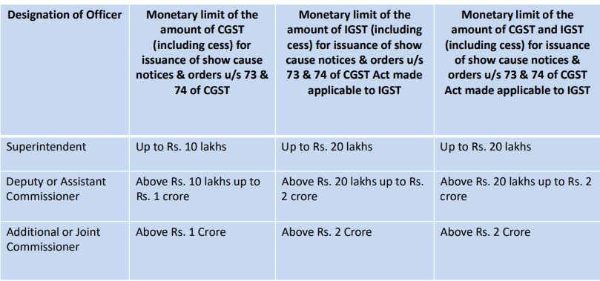
Monetary limits for SCN – 31/2018 (Circular) read with Circular 169/01/2022-GST

Slide 65
SECTION 73:- A SYNOPSIS
Section 73(1):- Where it appears to the proper officer that
Any tax has not been paid or short paid or erroneously refunded, or
Where ITC has been wrongly availed or utilised for any reason, other than the reason of other than fraud or any wilful-misstatement or suppression of facts to evade tax,
He shall serve notice on the person chargeable with tax Requiring him to show cause as to why he should not pay the amount specified in the notice along with interest payable thereon under section 50 and a penalty leviable under the provisions of this Act or the rules made thereunder
73(2):- TIME LIMIT FOR THE NOTICE under this section shall be issued at least 3 months prior to the time limit specified for issuance of order.
73(10):- TIME LIMIT FOR THE ORDER under this section shall be issued within 3 years from the due date for furnishing of annual return for the financial year to which the tax not paid or short paid or input tax credit wrongly availed or utilized relates to.
73(10):- Order under this section shall be issued within 3 years from the date of erroneous refund

Slide 66
SECTION 73:- A SYNOPSIS
73(3):- ADDITIONAL STATEMENT FOR OTHER PERIODS
73(4):- STATEMENT EQUIVALENT TO NOTICE
73(5) PROACTIVE PAYMENT BY TAXPAYER & INFORM:- Before service of notice or the statement, pay the amount of tax along with interest payable on the basis of his own ascertainment of such tax or the tax as ascertained by the proper officer and inform the proper officer in writing of such payment.
73(6) NO NOTICE AFTER PROACTIVE PAYMENT :- The proper officer on receipt of such information, shall not serve any notice under sub-section (1) or the statement under sub-section (3), in respect of the tax so paid or any penalty payable under the provisions of this Act or the rules made thereunder.
73(7) SHORT PAYMENTS If the officer believes that the taxpayer’s proactive payment is less than the actual owed amount, they will serve a notice for the outstanding amount.

Slide 67
SECTION 73:- A SYNOPSIS
73(8):- WAIVER OF PENALTY After issuance of SCN, pays the said tax along with interest payable within 30 days of issue of show cause notice, no penalty shall be payable and all proceedings in respect of the said notice shall be deemed to be concluded
73(9):- FINAL DETERMINATION If any representation made by person chargeable with tax, determine the amount of tax, interest and a penalty equivalent to 10% of tax or 10000/-, whichever is higher, due from such person and issue an order.
73(11):-PENALTY FOR LATE SELF-ASSESSED TAX Notwithstanding anything contained in 73(6) or 73(8), Penalty under 73(9) shall be payable where any amount of self-assessed tax or any amount collected as tax has not been paid within a period of 30 days from the due date of payment of such tax.

Slide 68
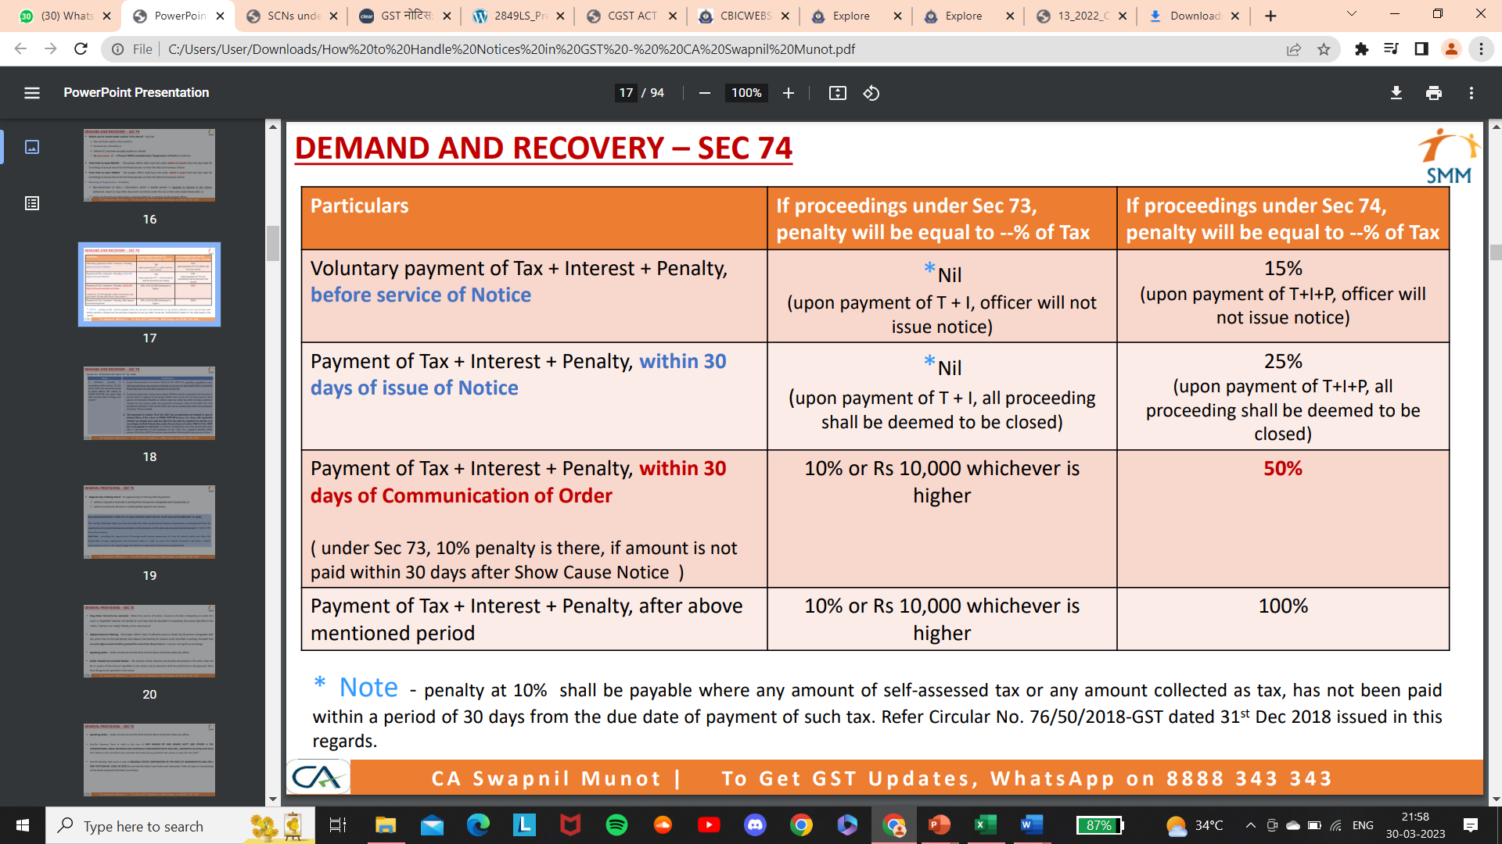

Slide 69
“Assessment orders passed without affording opportunity of hearing to the assesse is violative of the principles of natural justice”
Hon’ble Madras High Court
M/s. Novateur Electrical and Digital Systems Pvt. Ltd
Vs. The Assistant Commissioner (ST) and Ors.
(W.P Nos. 4376,4379,4382,4385 of 2023 and W.M.P Nos.4412,4413,4415,4417 of 2023
dtd February 16,2023)

Slide 70
“Mere expiry of E-way Bill does not create any scope for evasion”
Hon’ble Madras High Court
Thiruvannamalaiyar Transport Vs. the Deputy State Tax Officer
(W.P No.32960 of 2022 dated December 13,2022)

Slide 71
“SCN issued without reasons/allegations violates the Principles of Natural Justice”
Hon’ble Delhi High Court
Surender Kumar Jain Vs. Principal Commissioner & Anr.
(W.P.(C) 17700/2022 dated January 25,2023

Slide 72
Whether Cash can be seized?
Section 67(2) of the Act. Where the proper officer, not below the rank of Joint Commissioner, either pursuant to an inspection carried out under sub-section (1) or otherwise, has reasons to believe that any goods liable to confiscation or any documents or books or things, which in his opinion shall be useful for or relevant to any proceedings under this Act, are secreted in any place, he may authorise in writing any other officer of central tax to search and seize or may himself search and seize such goods, documents or books or things:
• Provided that where it is not practicable to seize any such goods, the proper officer, or any officer authorized by him, may serve on the owner or the custodian of the goods an order that he shall not remove, part with, or otherwise deal with the goods except with the previous permission of such officer:

Slide 73
Whether Cash can be seized?
Cash can’t be seized during inspection under section 67 of CGST Act:
HC The Hon’ble KERALA High Court in the case of DHANYA SREEKUMARI V/s STATE TAX OFFICER (IB) decided on 27-6-2023
👉Issue : During the search an inspection team found cash from manufacturing unit as well as residence of petitioner they seized same under section 67(2) of the CGST Act ,2017. Is it justified?
👉Hon'ble High Court Judgement : In an investigation aimed and detecting tax evasion under CGST Act, no cash can be seized under section 67 of CGST Act, especially when cash did not form part of stock-in-trade of assessee's business.
Therefore, cash seized was to be released to petitioners forthwith – Section 67 of the CGST Act, 2017.

Slide 74
Whether Cash can be seized?
Seizure of currency by GST officers during search is illegal and without any authority The Hon’ble Delhi High Court in Arvind Goyal CA v. Union of India [W.P. (C) NO. 12499 OF 2021 JANUARY 19, 2023.
👉Issue Search operation was conducted at residence of petitioners by GST officers under section 67(2) - During course of search, officers found cash and took possession of said cash.
👉Hon'ble High Court Judgement Since documents, books or things could only be seized under section 67 if same were useful or relevant to any proceedings under GST Act, therefore, seizure of currency by concerned officers was illegal and without any authority; and seized currency was returned.

Slide 75
GST Registration Can’t be Cancelled Merely Stating a Firm as Bogus.
The Allahabad High Court held in M/s Apparent Marketing Private Limited.
👉Issue : The department surveyed the petitioner’s business premises and issued a notice proposing the cancellation of registration. The department proposed the cancellation as the petitioner was found bogus during the inspection.
👉Hon'ble HC Judgement : The department could cancel the registration only if the assessee found one of the five conditions of Section 29(2). Since the statute has not used the word ‘bogus’, the Court ruled that registration under the Act cannot be cancelled by merely describing the firm as bogus.
👉Conclusion:- The Court ruled that the notice seeking to cancel the petitioner’s GST registration remained defective as the reason for cancellation does not fall under Section 29(2) of the GST Act. Hence, the High Court allowed the petition and set aside the order passed by the Assistant Commissioner, State-Tax, cancelling the petitioner’s GST registration.

Slide 76
Section 29. Cancellation or suspension of registration
(2) :The proper officer may cancel the registration of a person from such date, including any retrospective date, as he may deem fit, where,-
(a) a registered person has contravened such provisions of the Act or the rules made thereunder as may be prescribed; or
(b) a person paying tax under section 10 has not furnished the return for a financial year beyond three months from the due date of furnishing the said return​; or
(c) any registered person, other than a person specified in clause (b), has not furnished returns for a such continuous tax period as may be prescribed; or
(d) any person who has taken voluntary registration under sub-section (3) of section 25 has not commenced business within six months from the date of registration; or
(e) registration has been obtained by means of fraud, wilful misstatement or suppression of facts:
Provided that the proper officer shall not cancel the registration without giving the person an opportunity of being heard:
Provided further that during pendency of the proceedings relating to cancellation of registration, the proper officer may suspend the registration for such period and in such manner as may be prescribed.

Slide 77
ITC can’t be denied merely because registration of supplier was cancelled with retrospective effect
The Hon’ble Calcutta High Court in M/s Gargo Traders v/s Joint Commissioner, Commercial Taxes (State Tax) W.P.A. 1009 OF 2022 JUNE 12, 2023.
👉Issue : Petitioner claimed credit of input tax against supply made from a supplier - Said claim was rejected by respondent-revenue on ground that supplier from whom petitioner claimed to have purchased goods were all fake and non-existing.
👉Hon'ble HC Judgement : Where petitioner's claim for input tax credit was rejected due to supplier's fraudulent activity, since petitioner had paid amount of purchased articles as well as tax on same through bank and not in cash and without proper verification, it could not be said that there was any failure on the part of petitioner, order rejecting said claim was to be set aside .

Slide 78
Dept. can’t expect from buyer to verify that seller obtained GST registration by producing fake documents or not
THE Hon'ble ANDHRA PRADESH HC in the case of ARHAAN FERROUS AND NON-FERROUS SOLUTIONS PVT. LTD. V/s DEPUTY ASSISTANT COMMISSIONER-1 (ST) decided on 3-8-2023.
👉Issue : What are the responsibility of Purchaser if Seller obtained GST registration by producing fake documents?
👉Hon'ble HC Judgement : Responsibility of purchaser would be limited to the extent of establishing that he bonafidely purchased goods from the seller for valuable consideration by verifying GST registration of the seller available on the official web portal; the purchaser needed not aware of credentials and business activities of the seller or about the fact that the seller obtained GST registration by producing fake documents. .

Slide 79
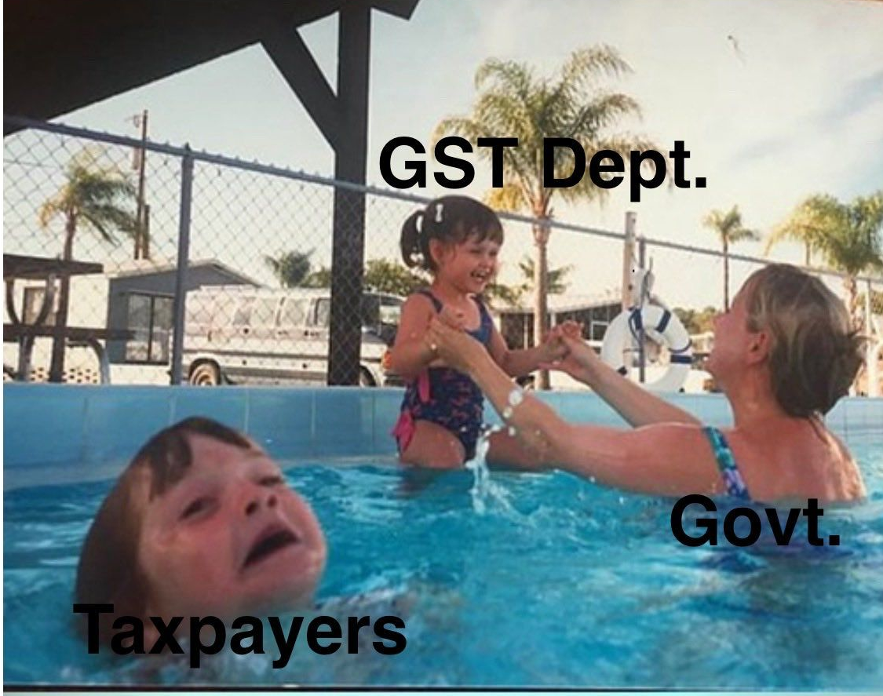
ACTUAL PICTURE

Slide 80
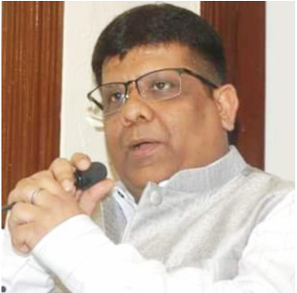
Disclaimer: Above is for the education purposes only, and is not intended to be treated or used as legal advice or opinion.
Follow this link to join my WhatsApp group OR Copy & Paste the below link:
https://chat.whatsapp.com/EsezrvFY1cxBhXMwhPyY7Y
THANKS
CA. PRADEEP MODI
(FCA, LLB, DISA, IDT)
9433033882

Slide 81
