Slide 1

The Art of Wealth Creation
Vishal Kapoor
18th May, 2024

Slide 2

So, how can we create wealth?

Slide 3





Ways to create wealth
1. Get Lucky!
Land an inheritance
Win a lottery
2. Cheat?

Slide 4

So, what do we really need to create wealth?
Education / Qualification?
Experience?
Capital?

Slide 5

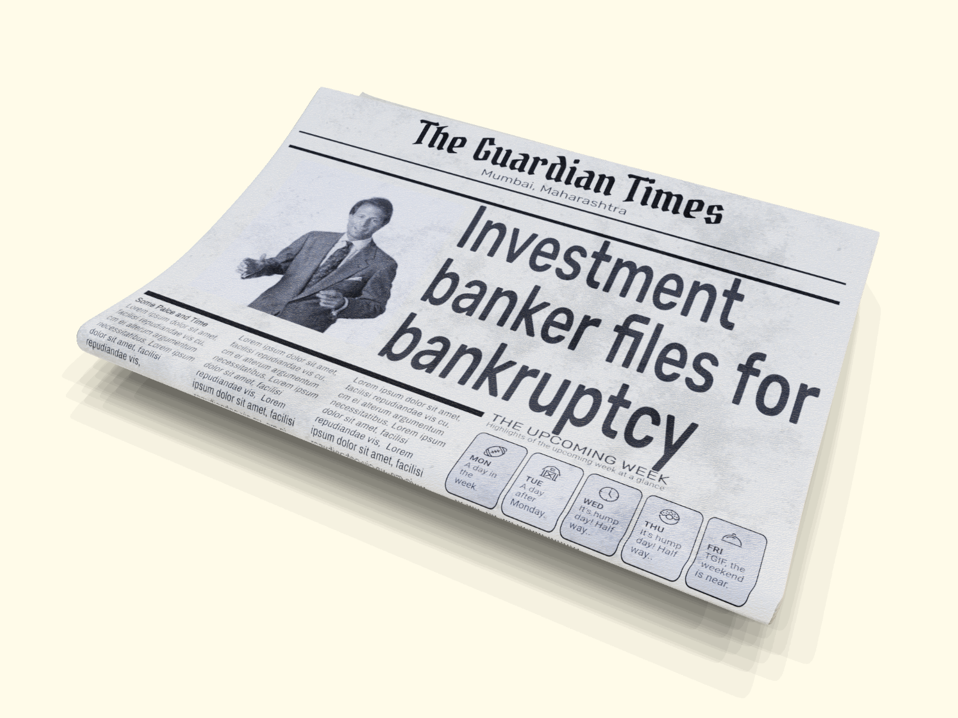
News that caught my eye
Grace Groner
Life-long career as a secretary
Orphaned at 12; Unmarried
Lived in a one-bedroom house all her life
Left $7 million to charity
Richard Fuscone
Harvard-educated
Merrill Lynch executive
Lived in a $14 million mansion
Declared bankruptcy

Slide 6
What do we really need to create wealth?
Education / Qualification?
Experience?
Capital?

Slide 7
So…What do you need then?

Slide 8


TIME
BEHAVIOUR

Slide 9
TIME
How does time help in creating wealth?

Slide 10

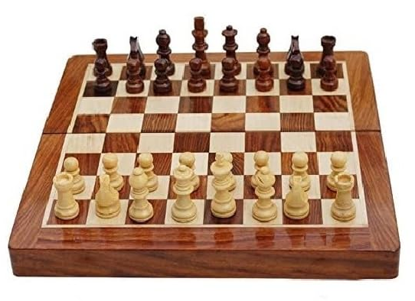
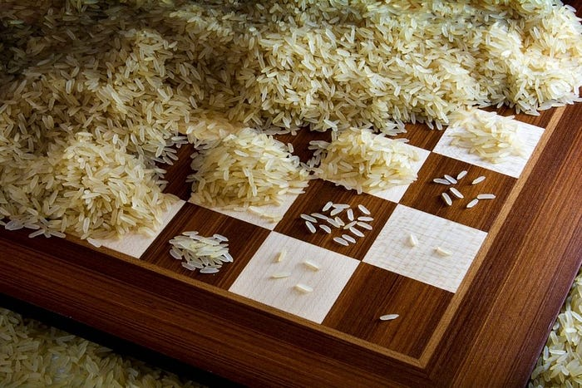

TIME
Starting with one grain on the first square, simply double the amount on each square of a chessboard
18,446,744,073,709,551,615
Enough rice to cover the entire country of India with a meter-high layer of rice!!
Such is the power of compounding!
Notes:
More than 18 quintillion grains of rice, which would weigh approximately 210 billion tonnes and would be enough rice to cover the entire country of India with a metre-high layer of rice

Slide 11

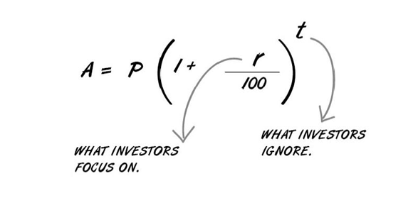
TIME
The Wealth Creation Formula

Slide 12

It is never too late, but the sooner you start the better
Monthly SIP of Rs. 10,000 in Sensex
₹ 6.4 Cr
₹ 1.8 Cr
₹ 0.4 Cr
16X
4.5X
X
SIP started 15 years ago
SIP started 25 years ago
SIP started 35 years ago
Past performance may or may not be sustained in the future. The above information depicts the performance of BSE Sensex for illustration purposes only. The intention is to highlight the importance of starting early to benefit from compounding The starting SIP date for 15 years ago – Sep’08; for 25 years ago is Sep’98; for 35 years ago is Sep’88. Current Market value is as on 31st August 2023.

Slide 13
TIME
BEHAVIOUR

Slide 14
BEHAVIOUR
What not to do?

Slide 15




BEHAVIOUR
Since we are in Kolkata…let’s delve into some Football!

Slide 16

#1 On the field, but without a goal post

Slide 17
Equity MF Net Flows and Nifty 50 Index
Flows
Nifty 50
Chasing returns seems to take precedence over investing towards a goal
Financial goals and not past returns should drive your investment behaviour
Source: MFIE, AMFI

Slide 18

Investing without a Goal
is like walking,
but without a sense of speed or direction.

Slide 19

#2 Straying from your formation

Slide 20
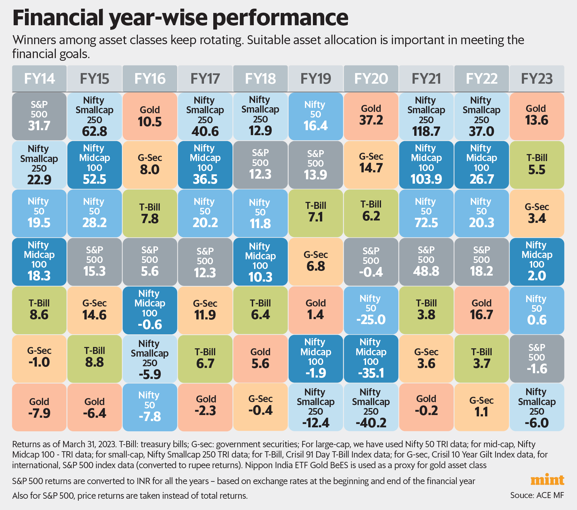
Returns from different asset classes
Winners among asset classes keep rotating
Stick to asset allocation and rebalance from time to time

Slide 21
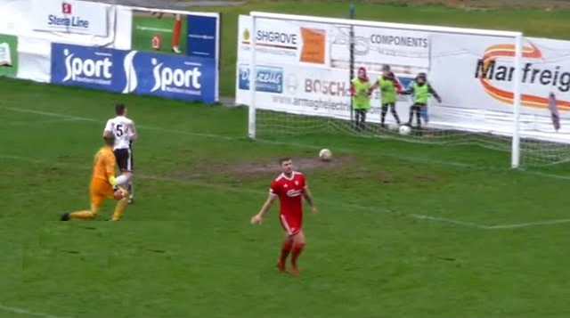
#3 Aborting too early

Slide 22
Last 1-year Returns
Investor Emotion
Action Taken
Next 5-year CAGR
> 20%
Invest More
9%
10 - 20%
Stay Put
13%
0 - 10%
Re-evaluate
14%
< 0%
Stop/Redeem
15%
Redeeming early based on past returns can backfire
Source: MFIE; Calculation based on S&P BSE 500 TRI. Rolling Daily Return Data for Aug 2006 to Dec 2022

Slide 23
Equity investing for the long term?
47%
47% of equity assets don’t continue beyond 2 years
Equity as per AMFI classification; Data as on Mar 31 , 20234
Notes:
55% redeem early

Slide 24
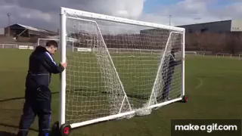
#4 Moving the goal posts

Slide 25
Did your portfolio do well?
Mar 2018
Portfolio Return (3 year CAGR) | 12.3%
Mar 2020
Portfolio Return (3 year CAGR) | -1.9%
Mar 2023
Portfolio Return (3 year CAGR) | 29.0%
Fund A | 15.6%
Fund B | 15.4%
Fund C | 12.8%
Fund D | 11.6%
Fund E | 11.2%
Fund F | 6.8%
E | 2.5%
F | 2.4%
D | -1.4%
C | -2.9%
A | -5.0%
B | -6.7%
B | 46.0%
E | 33.0%
D | 27.2%
F | 24.5%
C | 25.8%
A | 17.0%
Investors often compare their aggregate portfolio performance against the best-performing fund(s), rather than their objective
Source: MFIE, Data as on 31st Mar for every year
Funds considered in the Flexi Cap category

Slide 26
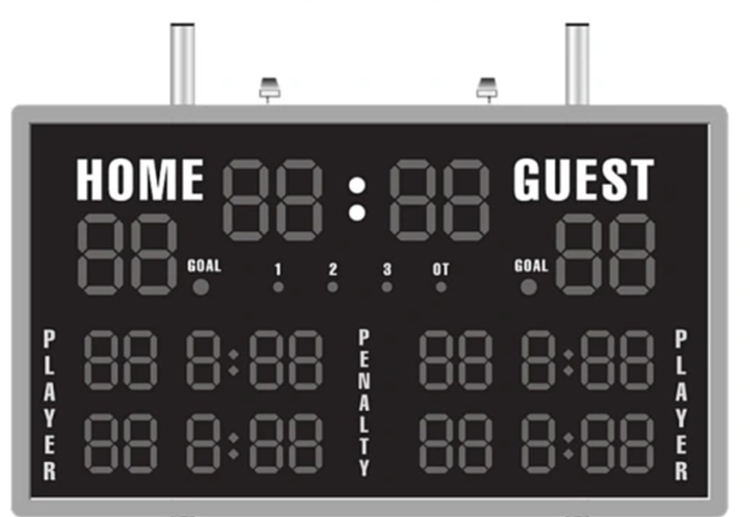
#5 Looking at the wrong scoreboard

Slide 27
How should we think about Fund Performance?
Fund A
1-year return
3.5%
Good?
Okay?
Bad?
Period Considered is 31st Oct 2021 to 31st Oct 2022; Benchmark is NIFTY Large Midcap 250 TRI; Returns are in XIRR for the last one year period. Past performance may or may not be sustained in the future

Slide 28
How should we think about Fund Performance?
Fund A
Benchmark
1-year return
3.5%
2.8%
Good?
Okay?
Bad?
Period Considered is 31st Oct 2021 to 31st Oct 2022; Benchmark is NIFTY Large Midcap 250 TRI; Returns are in XIRR for the last one year period. Past performance may or may not be sustained in the future

Slide 29
How should we think about Fund Performance?
Fund A
Benchmark
1-year return
3.5%
2.8%
1-year SIP return
15.9%
11.8%
Good?
Okay?
Bad?
Period Considered is 31st Oct 2021 to 31st Oct 2022; Benchmark is NIFTY Large Midcap 250 TRI; Returns are in XIRR for the last one year period. Past performance may or may not be sustained in the future

Slide 30
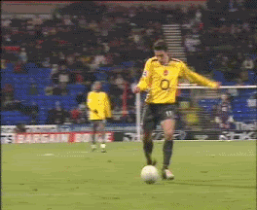
#6 Trying to score the perfect goal

Slide 31
Timing the market?
CAGR over 10 years
Invest all days
Miss best 5 days
Miss best 10 days
Miss best 20 days
Miss best 50 days
Timing the market can lead to a significant loss of potential returns
Source: ShareKhan research
Period taken from Jan 1, 2009 to Jan 1, 2019

Slide 32
Anyone can create wealth (no prior qualification required)
1
Time and behavior management can be great partners
2
KEY TAKEAWAYS
3
The sooner you start the better - Use the power of compounding to your advantage
4
Start with a goal in mind – Diversify using asset allocation and ignore the herd
5
Don’t time the market - Use volatility to your advantage and stay the course

Slide 33

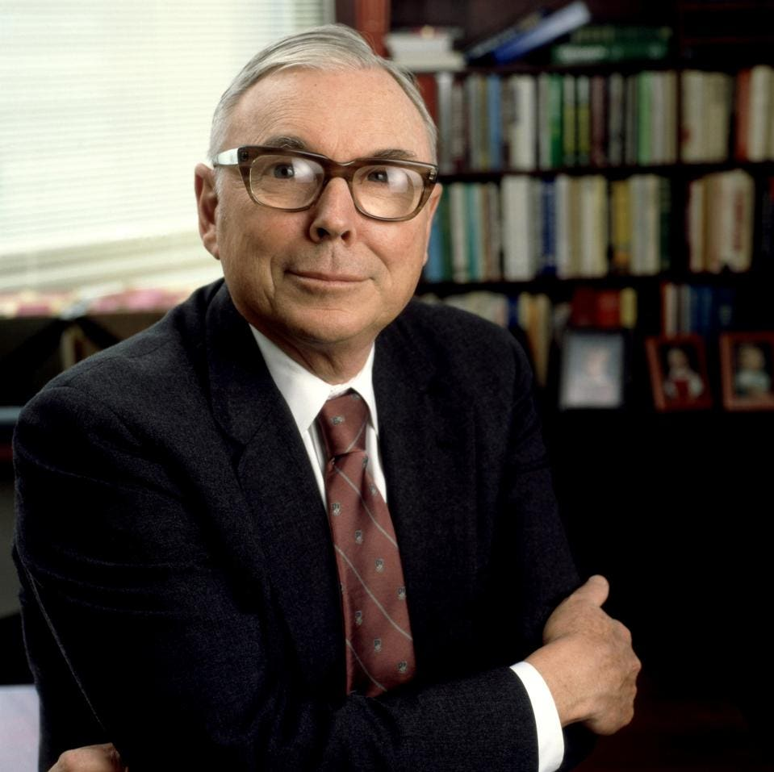
“The big money is not in the buying or selling. But in the waiting.”
Charlie Munger

Slide 34
THANK YOU

