Slide 1







Dynamic Gems – The
Art and Science behind
Identifying Stocks
Presents
Mr. Sandeep Jain
(Co-Founder Tradeswift)
#JAINSAABKEGEMS
18th May

Slide 2


About Tradeswift
First breed of Commodity Brokers in the country.
An established name in the Equity, Commodity & Currency Broking Industry.
The Company has achieved many remarkable highs since its inception in 2003.
Strong focus on Research & Client Servicing.
Impressive growth in the number of Ultra HNIs and HNI Clients, Franchisees & Business Associates nationwide.
Strong team of Professionals, Experienced and Qualified pool of Human Resources forms the back bone of our sizeable infrastructure.
Providers of one of the best Trading Platforms to trade in NSE, BSE, NCDEX, MCX.
First Broker in Rajasthan to launch it’s own Mobile Trading Application
Dynamic Gems – The Art and Science behind Identifying Stocks

Slide 3













Accolades & Achievements
Won the CNBC Awaaz Champion of the Year (2013) IPL Positional Maha-Muqabla, a competition amongst leading analysts on CNBC Awaaz.
BSE’s Top Performer in Retail Segment 2011-12
Acclaimed as one of the Top Stock Pickers in the country by the channels and media.
A lead speaker in various awareness programmes organized by the equity & commodity exchanges, seminars and conferences on equities, commodities and investments organized by various trade bodies and academia across the country.
MR. SANDEEP KUMAR JAIN
Financial Freedom Fighter
#JainSaabKeGems
Other Achievements
Amongst few of the prominent spokespersons playing influential role for the broking industry and has served on several committees.
Vice President of Commodity Participants Association of India (CPAI), One of the Strongest Voices for Commodity and Capital Markets.
Vice Chairman of JITO Jaipur Chapter
Member Secretary of Rajasthan Exchange Members Association (REMA)
Ex-member of Education and Training Committee of Association of National Exchanges Members of India (ANMI)
Brief Profile
Co-founder of Tradeswift, a leading Full-Fledged Broking House and Wealth Managers in India.
Serial Entrepreneur with Interests and Investments in NBFC, Publications, Online Business, Real Estate and Startups.
A very well-known face featuring on various business channels like Zee Business, CNBC Awaaz, TV-18, Bloomberg Quint, Print Media and Social Media as well for his Analysis on Equities & Commodities since last 18 years.
Now a member of Exclusive Panel of Analysts on Zee Business.
Perhaps one of the most followed business Twitter handles in Jaipur with 2.40 Lac followers
Personal Likings and Hobbies
Reading, Travelling, Playing Tabla, Singing, Music Lover, Networking, Mentoring
Contact Info
Education and Extra Curriculars
sandeepjainboltu@gmail.com / sandeep@tradeswift.net
A commerce graduate from Mumbai’s Mithibai College and MBA (Finance) from Mumbai’s K.J. Somaiya - Sandeep, with his passion for general knowledge, equities, investments and economic affairs, brings to the table a rare combination of being an equally articulate and knowledgeable speaker on equities, commodities and economic issues.
Won many awards in Quizzes, Debates, Extempore Speeches, Personality Contest during Student life
@SandeepKrJainTS
@SandeepJain
@SandeepJainboltu
@SandeepJainStocks
+91 9828072000

Slide 4
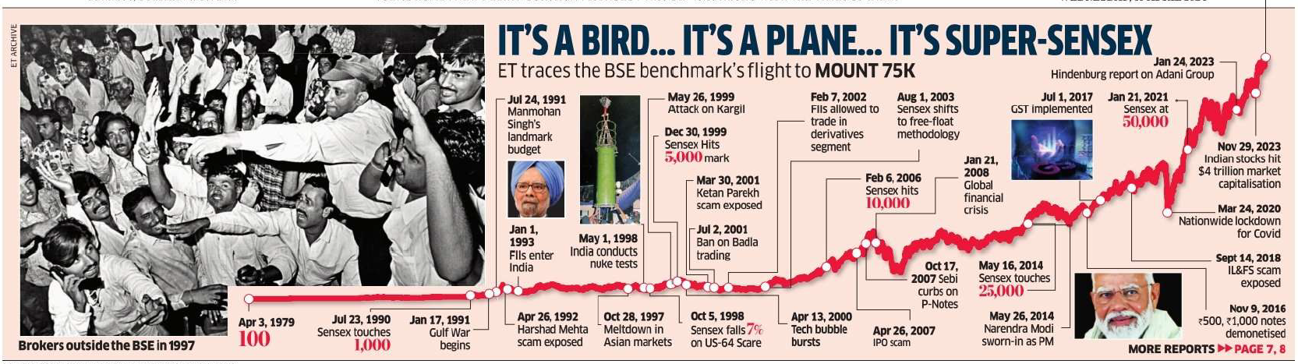
India’s Capital Market Journey So Far…
April 9, 2024
SENSEX HITS
75,000
Dynamic Gems – The Art and Science behind Identifying Stocks

Slide 5

“Compound interest is the eighth wonder of the world. He who understands it, earns it … he who doesn’t … pays it.”
Who Said It ???
Dynamic Gems – The Art and Science behind Identifying Stocks

Slide 6
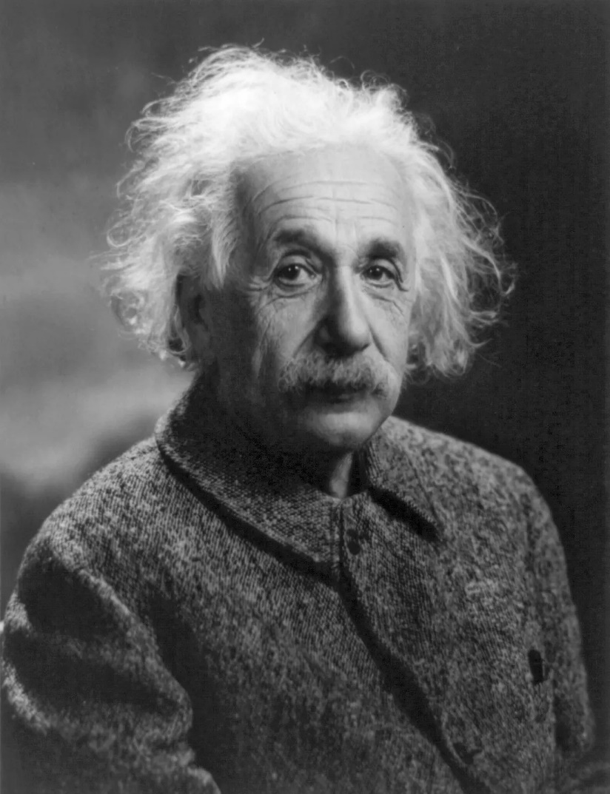
ALBERT
EINSTEIN

Slide 7
1
Ego=
Knowledge
“More the Knowledge Lesser the Ego,
Lesser the Knowledge More the Ego..”
- Albert Einstein
Dynamic Gems – The Art and Science behind Identifying Stocks

Slide 8
Different Types of
Investment Avenues & Asset Classes
Guaranteed Return Investment
Non-Guaranteed Return Investment
Fixed Deposit
Post Office scheme
Provident Fund
PPF
Equity
Gold
Mutual Fund
Commodity
Real Estate
Others
Diversified Equity Fund
Sectoral Equity Fund
Physical Form
Mutual Fund
& ETF
Mutual Fund & ETF
Physical
Market
Direct
Indirect
PMS
AIF
Commercial
Residential
Farm House
Warehouse
REIT
ULIP
INVIT
Stock Market
IPO
Sovereign Gold Bonds
If you go into a cricket match with 11 specialist batsmen and bat first, at the end of the first innings it may appear that you are doing phenomenally well in the match. But when your team walks in to bowl in the next innings, you will most likely be exposed. Likewise when you invest everything in equity, at the peak of a bull run you will feel like a superstar but when the tide turns...P.S: if you are only into FDs / fixed income, Remember you can’t win cricket matches with 11 bowlers either. A judicious blend of Equities, Commodities, Currencies, Rent Yielding Real Estate and Debts Instruments is advisable.
Magic of 26% CAGR = 10 times in 10 years, 100 times in 20 years and 1000 times in 30 years

Slide 9

In stock markets, these 4 conditions are permanent
Everyday fluctuations
Short-term corrections
Medium-term crashes
Long-term recovery and compounding
The investor who stays the course through conditions one t(w)o three reaps the best rewards
Saare conditions ki dawaa hai – RRR
R – Research
R – Risk Management
R – Right Position Sizing
Dynamic Gems – The Art and Science behind Identifying Stocks

Slide 10
Post Crises Opportunities ??
How Market has bounced back during prominent corrections
Global Recession (1986-88) : Market Fall - 40.8%⬇ | Post Return 3Yrs - 199.5%⬆
Gulf War/India Fiscal Crises (1990-91) : Market Fall - 39.3%⬇ | Post Return 3Yrs - 320.5%⬆
Harshad Mehta Scam (1992-93) : Market Fall - 56.4%⬇ | Post Return 3Yrs - 90.2%⬆
Stock Market Stumble (1994-96) : Market Fall - 41.6%⬇ | Post Return 3Yrs - 73.8%⬆
97 Market Meltdown (1997-98) : Market Fall - 40.5%⬇ | Post Return 3Yrs - 11.7%⬆
Dot-Com Bubble (2000-01) : Market Fall - 57.1%⬇ | Post Return 3Yrs - 110.6%⬆
Central Election Results (2004) : Market Fall - 32.4%⬇ | Post Return 3Yrs - 238.3%⬆
High Inflation (2006) : Market Fall - 30.6%⬇ | Post Return 3Yrs - 73.2%⬆
Financial Crisis (2008) : Market Fall - 63.7%⬇ | Post Return 3Yrs - 124.6%⬆
European Sovereign Debt Crises (2010-11) : Market Fall - 11.6%⬇ | Post Return 3Yrs - 80.8%⬆
Corona Lockdown (2020 & 2021) : China + 1
Market Fall - 36.5%⬇ (24 Feb, 20 - 11829 to 24 March, 20 - 7511) | Post Return 4.2 Years – 199.58 %⬆ (18 May, 2024 - 22502) ⬆
Russia – Ukraine Crisis : Russia + 1, Europe +1, Inflation
Market Fall - 36.5%⬇ (17 Jan, 22 - 18350 to 07 March, 22 - 15711) | Post Return 2.2 Years – 43.22 %⬆ (18 May, 2024 - 22502) ⬆
Every time the crisis hit the market, it has fallen but it has definitely recovered and surged ahead ..
This is a slide presented in my various webinars dated 18th April, 10th May, 28th May, 25th July, 28th Aug, 2020, 25th Sep, 2020, 12th Dec, 2020, 04th Jan, 2021, 07th March, 2021, 29th May, 2021, 05th June, 2021, 12th June, 2021, 17th June, 2021, 19th June, 2021, 26th June, 2021, 02nd July, 2021 & 13th July, 2021
Dynamic Gems – The Art and Science behind Identifying Stocks

Slide 11
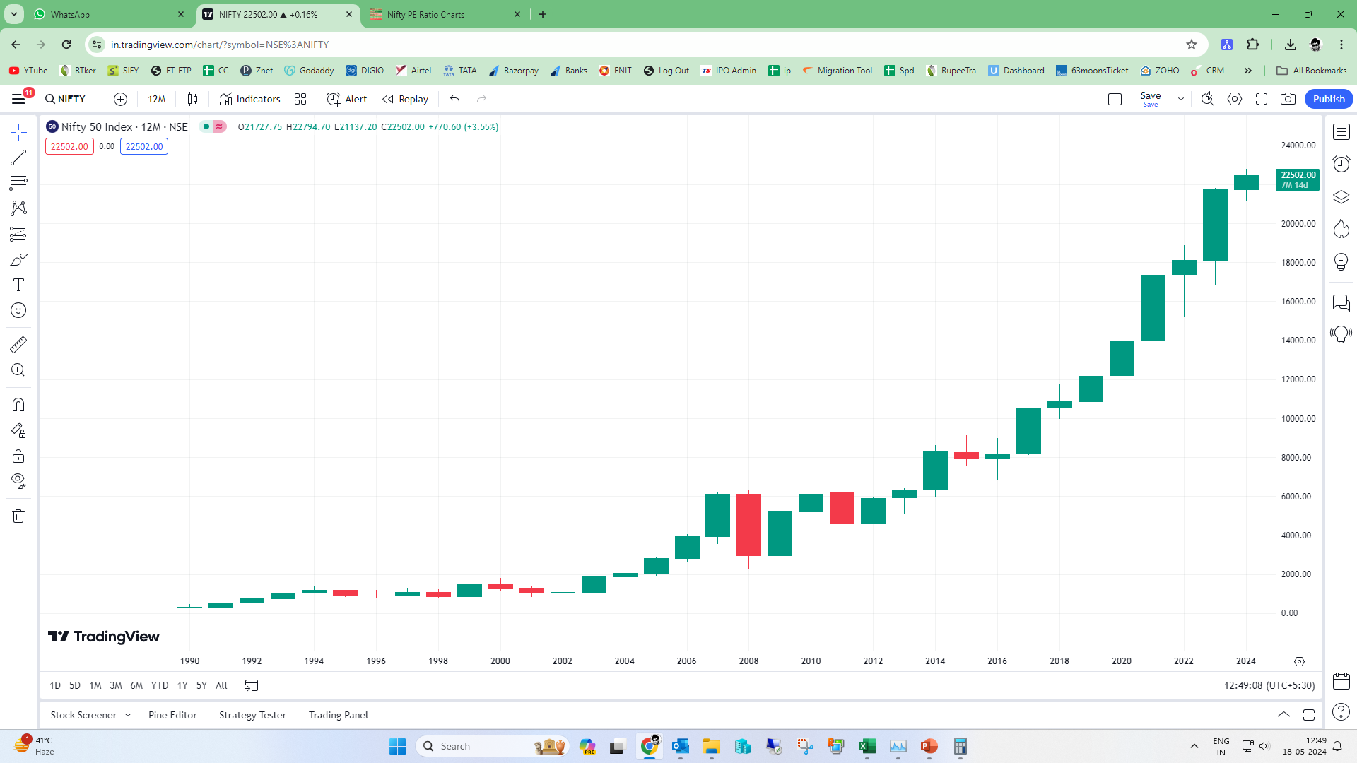
Post Crises Opportunities ??
Guess
The Chart ?
Dynamic Gems – The Art and Science behind Identifying Stocks

Slide 12
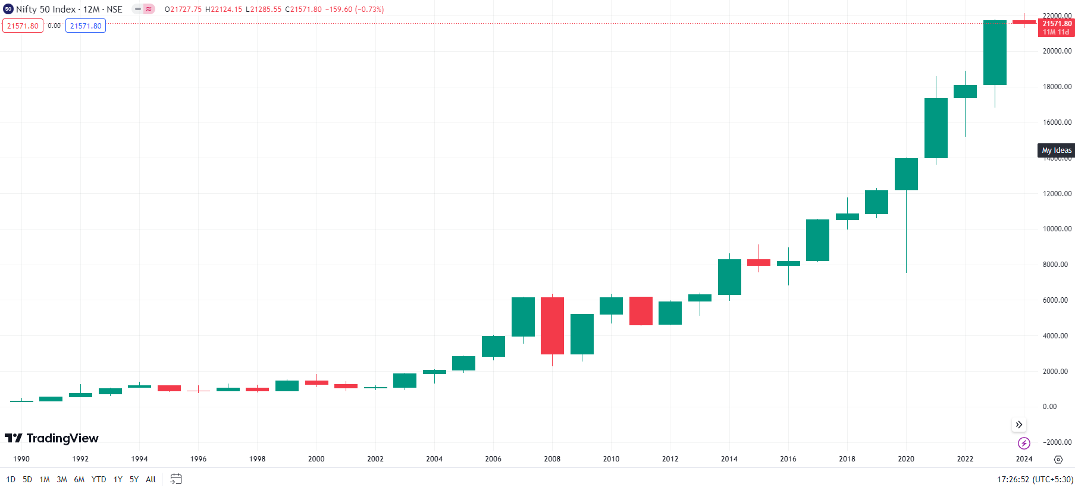
NIFTY
Yearly Chart
Dynamic Gems – The Art and Science behind Identifying Stocks

Slide 13
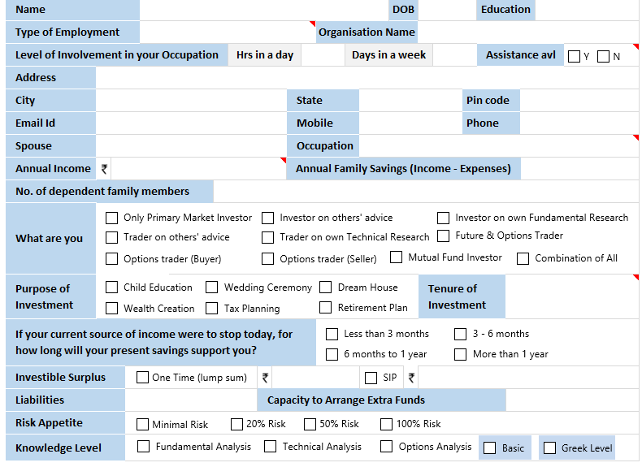
Financial Freedom &
Risk Profiling Questionnaire
(Non-Scoring)
Dynamic Gems – The Art and Science behind Identifying Stocks

Slide 14
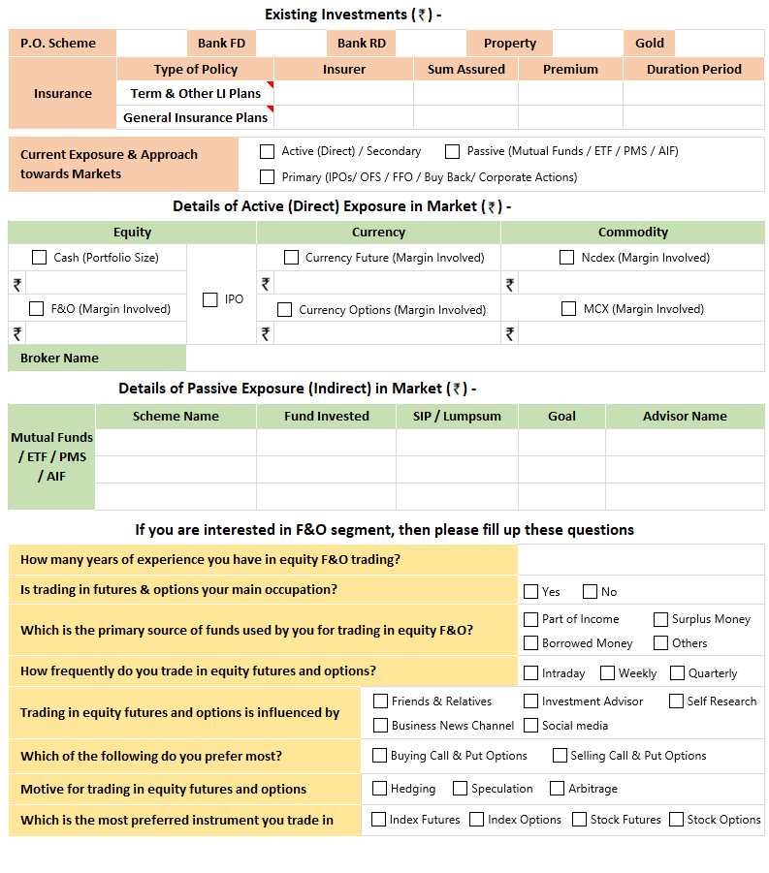
Financial Freedom &
Risk Profiling Questionnaire
(Non-Scoring)
Dynamic Gems – The Art and Science behind Identifying Stocks

Slide 15
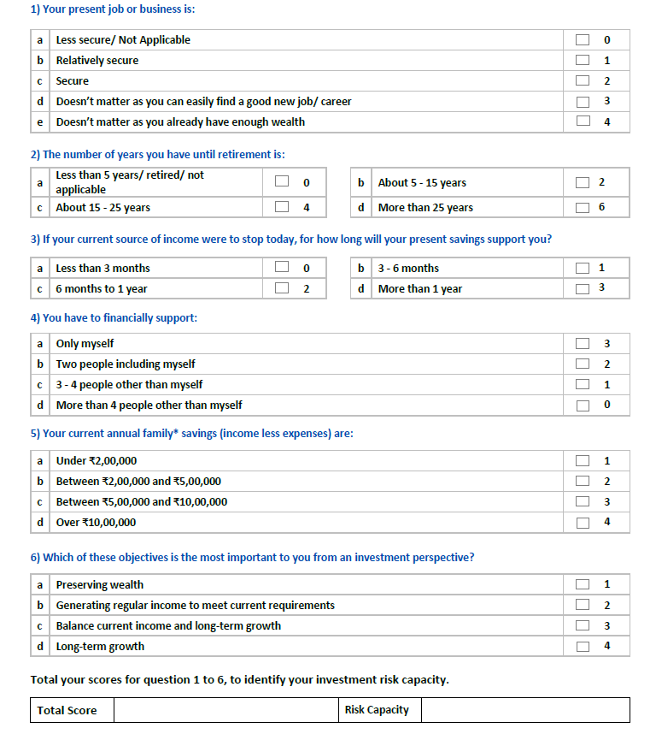
Financial Freedom &
Risk Profiling Questionnaire (Scoring)
For having a smooth investing and trading journey it is important to know one’s Risk Capacity
Risk capacity refers to the amount of financial risk that an individual or investor can afford to take in pursuit of their financial goals. It takes into account various factors such as the investor's age, income, financial goals, and other personal circumstances that determine their ability to bear risk. For example, an investor who needs a retirement corpus of ₹50 lakhs after 10 years and has a current savings of ₹5 lakhs and monthly additions of ₹20,000 will need to earn a return of approximately 10% per year. Achieving this level of return may require taking on a certain level of risk, such as investing in equities or other volatile assets. However, it is important to note that risk capacity is not the same as risk tolerance. While risk capacity reflects an investor's ability to take on risk, risk tolerance reflects their willingness to take on risk. It is important to strike a balance between risk capacity and risk tolerance to ensure that an investment portfolio is aligned with an investor's financial goals and personal circumstances.
Dynamic Gems – The Art and Science behind Identifying Stocks

Slide 16
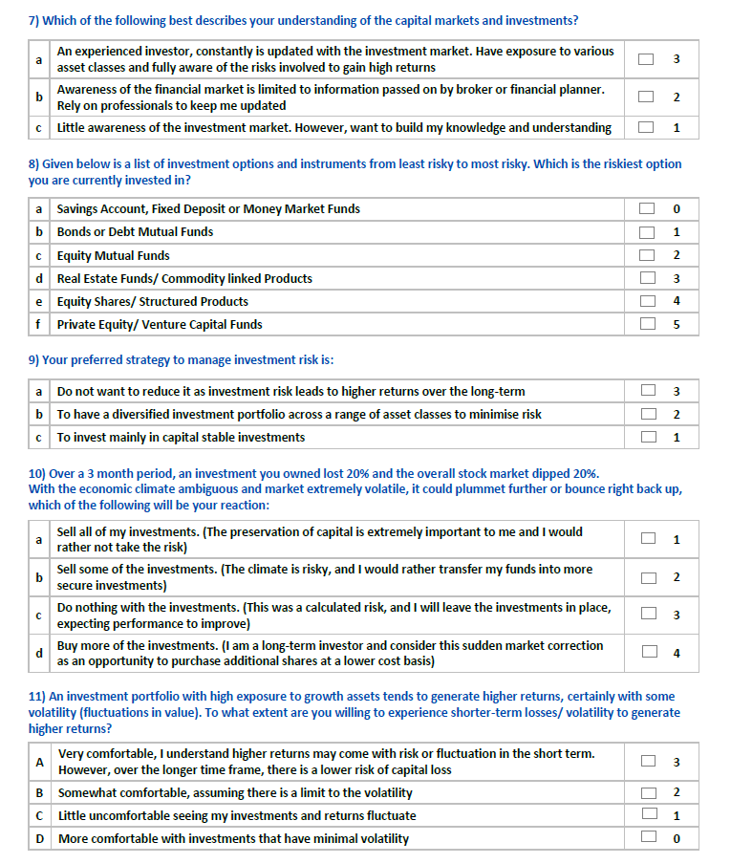
Financial Freedom &
Risk Profiling Questionnaire (Scoring)
In these current volatile markets it is very important to know one’s Risk Tolerance
Risk Tolerance is the amount of risk that an investor is comfortable taking or the degree of uncertainty that an investor may be able to handle or tolerate. It is crucial as it can greatly influence one’s emotional reaction to portfolio. Investing too far out of once comfort zone (appropriate risk tolerance) may result into buying-selling for wrong reasons or react improperly to wild swings in the markets that could hurt the portfolio and returns.
Dynamic Gems – The Art and Science behind Identifying Stocks

Slide 17
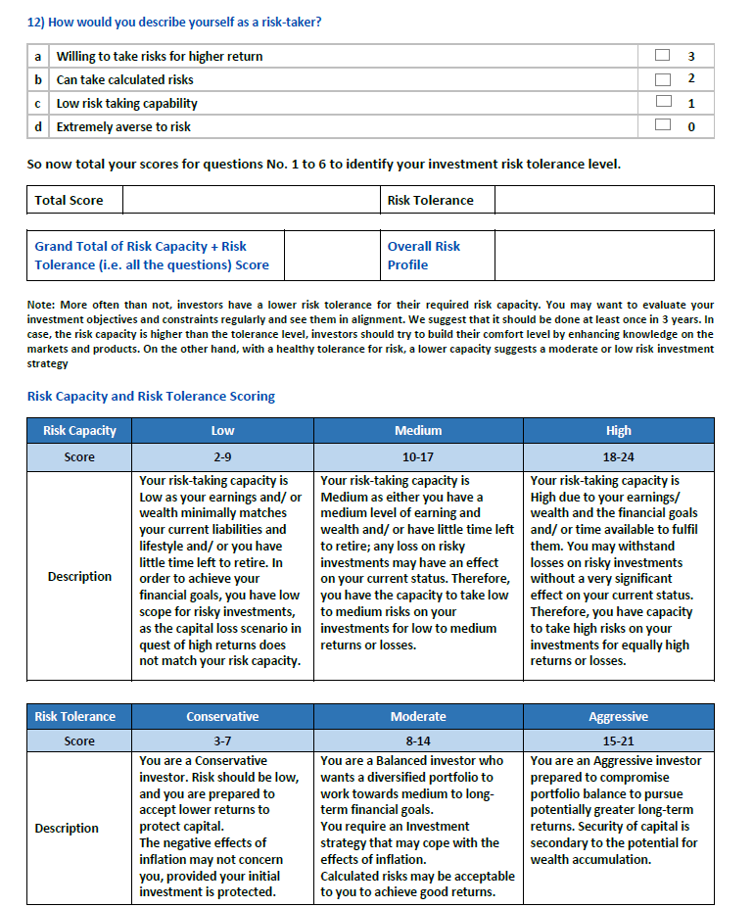
Financial Freedom &
Risk Profiling Questionnaire (Scoring)
In these current volatile markets it is very important to know one’s Risk Tolerance
Risk Tolerance is the amount of risk that an investor is comfortable taking or the degree of uncertainty that an investor may be able to handle or tolerate. It is crucial as it can greatly influence one’s emotional reaction to portfolio. Investing too far out of once comfort zone (appropriate risk tolerance) may result into buying-selling for wrong reasons or react improperly to wild swings in the markets that could hurt the portfolio and returns.
Dynamic Gems – The Art and Science behind Identifying Stocks

Slide 18
Challenges involved in Investing & Trading directly in Capital Markets
Time
Compromise with Existing Occupation
Expertise & Skills
Lack of Information
Portfolio
Volatility
Indirect Investing through Mutual Funds, PMS and AIFs
Passive Investing through ETFs
Dynamic Gems – The Art and Science behind Identifying Stocks

Slide 19

















Full-time Investors & Traders need to learn these skills
Fundamental
Analysis
Technical
Analysis
Knowledge about
Futures & Options
Read & Analyse Financial
Statements
Macro
Economics
Micro
Economics
Industry
Specific Knowledge
Company Specific
Knowledge
Tax
Efficiency
Basic
Accounting
Using
Spreadsheet
Filtering
Information
?
Long Term
Thinking & Discipline
Human
Psychology
Self
Reflection
Inquisitive
Thinking
Combating
Biases
Emotional
Control
Dynamic Gems – The Art and Science behind Identifying Stocks

Slide 20
How to Start your Journey of Markets and Investments
After filling the questionnaire either you are confused or you are very clear that you were not right and were going wrong somewhere
After finalising what you are, set a long vision/goal you want to achieve
Do a Self Belief exercise
Write down the skills you have & skills you need to acquire
Build a knowledge base by starting or pursuing right courses, regular reading and keeping track of news & price
Learn to keep your emotions in control (Meditation will help)
Finally Practice, Discipline and Perseverance
Jack of all trades is fine but must be a master of one
Dynamic Gems – The Art and Science behind Identifying Stocks

Slide 21
Different Investing Styles
Growth investing
Value investing
Quality investing
Index investing
Buy and hold investing
Dynamic Gems – The Art and Science behind Identifying Stocks

Slide 22
Different Trading Styles
Intraday Trading
Swing Trading
Arbitrage Trading
Positional Trading
Options Strategies
Trade using Technical Analysis
Money Flow Based Trading
Trade Driven by Events
High Frequency Trading
Quantitative Trading
Dynamic Gems – The Art and Science behind Identifying Stocks

Slide 23
360° Approach
Should Open all the Family Members’ Trading & Demat accounts
Should do Aggressive Primary participation through all family members’ accounts (easy and lesser risky though small returns in markets should not be overlooked)
Can have different strategy portfolios in different accounts
Must open HUF account (preferable for trading in Cash + F&O market)
If possible should trade in Corporate Account for Taxation Arbitrage
Should have an OD limit for grabbing sudden opportunities like OFS etc.
Special Situations Arbitrage or opportunities should not to be missed
Should have full fledged team comprising a fundamental analyst, technical analyst and a back-office executive cum dealer, accountant
Must do a formal course on Fundamental Analysis, Technical Analysis and Options before entering into the markets
If possible Should try hands on various strategies to understand the markets better
  Fundamental
  Chart patterns
  Price action / BTST / STBT / BTSTT
  News / results arbitrage
  Cash-futures arbitrage
  Settlements arbitrage
  Special situations investing
  Options parity trading
Dynamic Gems – The Art and Science behind Identifying Stocks

Slide 24
360° Approach
Should subscribe to good research plans, analytics apps, softwares
Should try to have mentor/s and a knowledgeable group for regular discussions
Should have a Quarterly Result Tracker (format in excel)
Should buy Sovereign Gold Bonds as 5 to 10% of your portfolio and it should be used for margin pledging.
Can buy midcap, smallcap mutual funds for margin pledging as there is lower haircut than pledging midcap & smallcap stocks directly
Must watch the management interviews on TV Channels & Social Media. eg News Par Views on Zee Busniess
There are various tools available for Fundamental Analysis. They are generally very basic and most of them are available easily and freely :
 Annual report of the company  Industry related data  Access to news  MS Excel  Various softwares  Mobile Apps  Concalls
Should never miss to attend stock market research related seminars and conferences
Last but not the least, Common sense, street smartness, basic mathematics and a bit of business sense and reading habit is all that is required
Plan the Trade & Trade the Plan (Play it by the Numbers)
  Document your Plan
  Monitor your Position
  Learn from the Numbers
  Keep a Trading Diary
Dynamic Gems – The Art and Science behind Identifying Stocks

Slide 25
SPECULATION
may be
Injurious
to your
Wealth & Career
Dynamic Gems – The Art and Science behind Identifying Stocks

Slide 26
Why a Process based Investing & Trading ?
Investing & Trading is very complex and it's a path of uncertainity
So we need here some guide or navigator or a process
Process of or rules based strategy helps us as guide or navigator to take faster and better decisions very simply in this complex market business.
We need to have a process which helps us in taking decisions on stock selection and screening through fundamentals & technicals and strategising through blending with options in F&O stocks
Position sizing, risk management, fund management
Well defined entry and exit rules.
80/20 Rule or Law of Pareto also applies here. Research is just 20%, rest 80% is fund management, risk management, position sizing and discipline
Dynamic Gems – The Art and Science behind Identifying Stocks

Slide 27
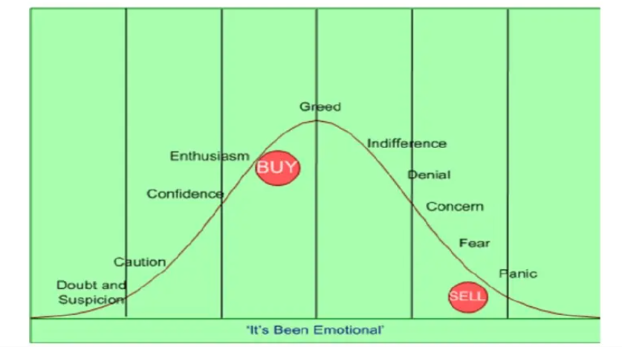
This process may help you avoid these problems
Dynamic Gems – The Art and Science behind Identifying Stocks

Slide 28
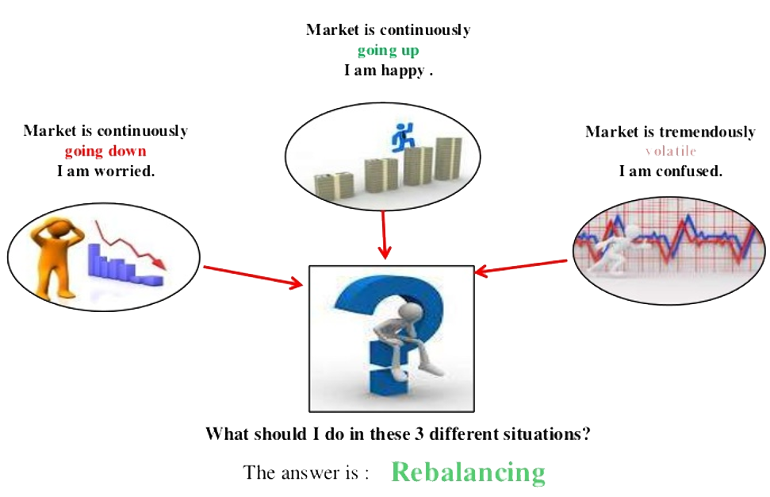
The answer is : Research
Dynamic Gems – The Art and Science behind Identifying Stocks

Slide 29

Never try to time the market rather invest time in the market
Dynamic Gems – The Art and Science behind Identifying Stocks

Slide 30

Dynamic Gems – The Art and Science behind Identifying Stocks

Slide 31
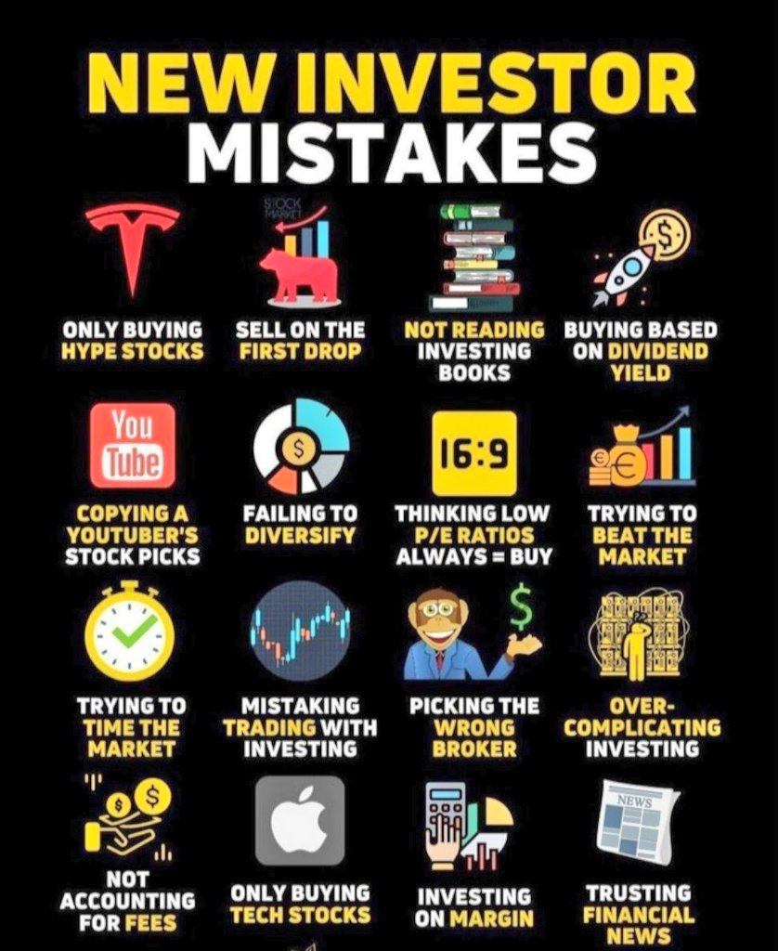

Slide 32
Primary Participation in Equity Markets
Your First Step to the World of Wealth Creation & Generating Aplha in very Safe and Predictive Manner
Invest in IPOs, ETFs, OFSs and Buybacks.
Make the chances higher by opening family members A/c (including Minors).
Invest your hard earned money in Mutual Funds through SIP, STP & Lumpsum.
A great way to be with the markets
A great TIME PASS.
But our objective is to learn stock picking … so let’s jump into exploring the Equity markets directly
Dynamic Gems – The Art and Science behind Identifying Stocks

Slide 33
Art and Science
of
Investing
Dynamic Gems – The Art and Science behind Identifying Stocks

Slide 34
Art and Science of Investing
Fundamental Analysis
Corporate Governance Analysis
Technical Analysis
Fund Management
Risk Management
Dynamic Gems – The Art and Science behind Identifying Stocks

Slide 35
Fundamental
Analysis
Dynamic Gems – The Art and Science behind Identifying Stocks

Slide 36

The following 3 charts are historically very important for tracking overall valuations of the markets and can be very instrumental in making logical & broader entry and exit decisions and last but not the least for right position sizing and efficient risk management
The
Big
Picture
Dynamic Gems – The Art and Science behind Identifying Stocks

Slide 37
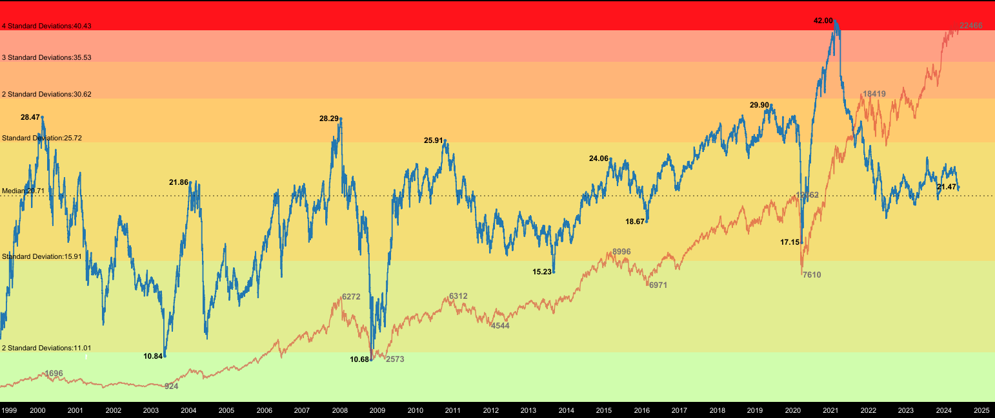
Nifty PE Ratio
Date | Nifty | Nifty PE | Nifty EPS
11/02/2000 | 1756 | 28.47 | 61.67
21/09/2001 | 854.4 | 12.3 | 69.46
07/03/2002 | 1193.1 | 19.11 | 62.43
12/05/2003 | 936 | 10.84 | 86.34
08/02/2021 | 15115 | 42 | 359
19/10/2021 | 18418 | 27.97 | 658.49
17/05/2024 | 22466 | 21.47 | 1046.39

Slide 38
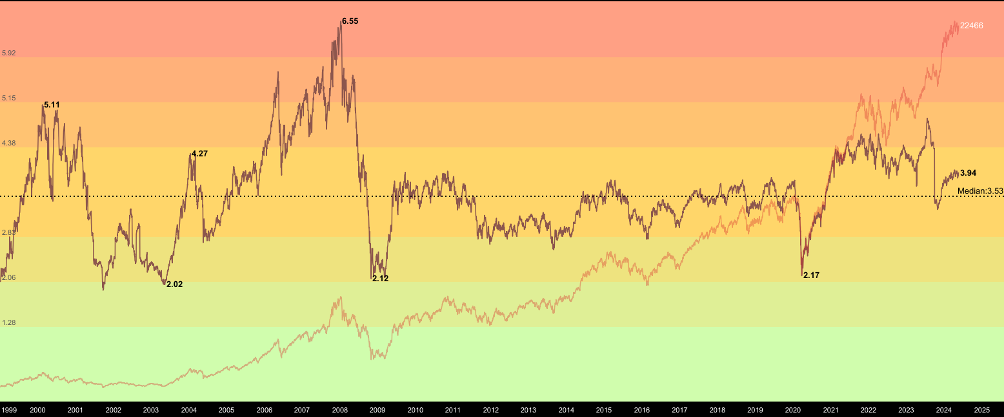
Nifty PB Ratio
Date | Nifty | Nifty PB | Nifty Book Value
02/05/2003 | 938 | 2.02 | 464.35
08/01/2008 | 4771 | 6.54 | 729.51
27/10/2008 | 2524 | 2.12 | 1190.5
25/03/2020 | 7610 | 2.17 | 3506.9
17/02/2021 | 15208 | 4.31 | 3528.5
04/08/2023 | 19382 | 4.69 | 4132.62
17/05/2024 | 22466 | 3.95 | 5,687.59

Slide 39
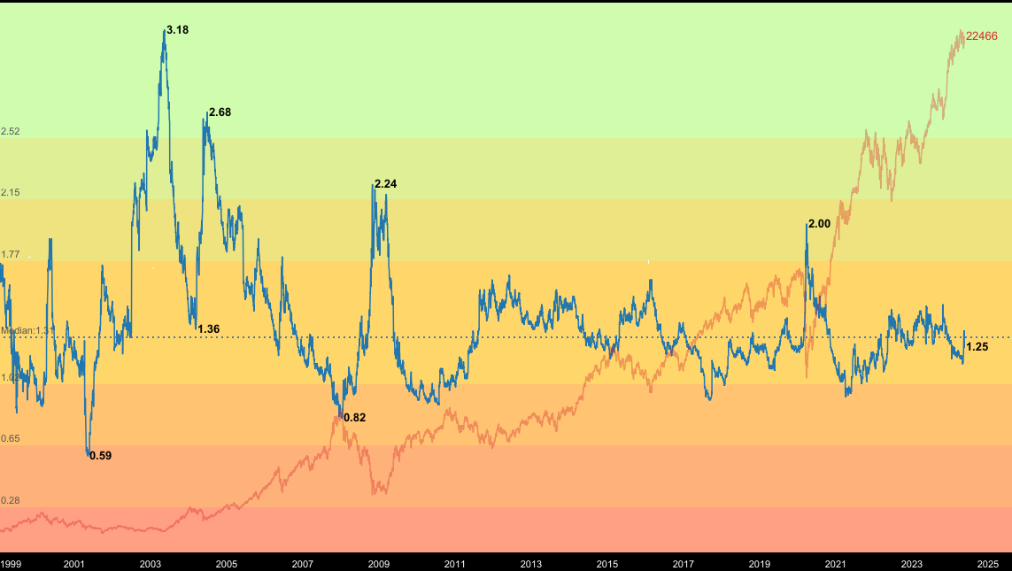
Nifty Dividend Yield Ratio
Date | Nifty | Nifty Dividend Yield (%) | Dividend Value
07-05-2001 | 1139 | 0.59 | 6.72
12-05-2003 | 936 | 3.18 | 29.76
08-03-2004 | 1885 | 1.36 | 25.63
27-10-2008 | 2524 | 2.24 | 55.53
28-07-2010 | 5430 | 0.9 | 48.87
23-03-2020 | 7610 | 2.00 | 152.2
20-02-2022 | 15350 | 1.48 | 227.18
17-05-2024 | 22466 | 1.25 | 280.83

Slide 40
I Love
MidCaps, SmallCaps, MicroCaps and NanoCaps
INDEX | 2013 | 2024 | Growth
NIFTY | 5937 | 22502 | 3.79x
Sensex | 19513 | 74005.94 | 3.79x
NIFTY Midcap 100 Index | 8507 | 51869.25 | 6.10x
NIFTY Small Cap 100 Index | 3719 | 17009.6 | 4.57x
NSE Micro Cap 250 Index (Jan, 2022)* | 10581 | 21230 | 2.01x
S&P BSE AllCap (April, 2015)* | 3022 | 9738.53 | 3.22x
*NSE Micro Cap and BSE All cap were launched recently compared to other indices so we have do not have data for 10 years
We look for opportunities to play with high growth and
Under researched companies and unsung heros
for higher returns and alpha
Dynamic Gems – The Art and Science behind Identifying Stocks

Slide 41
AMFI Categorisation of Average Market Capitalisation of Listed Companies dated 31st December 2023
Name | Mkt Cap (in Cr.) as on 31.12.23 | Name | Mkt Cap (in Cr.) as on 17.05.23
LARGE CAP BOTTOM 10
UNIONBANK | ₹ 71,498.35 | IOB | ₹ 1,17,346.46
MARICO | ₹ 70,881.73 | UNIONBANK | ₹ 1,06,256.27
IOB | ₹ 69,083.44 | ZYDUSLIFE | ₹ 1,05,453.22
IDBI | ₹ 68,890.16 | JSWENERGY | ₹ 1,03,445.94
SRF | ₹ 68,383.55 | CANBK | ₹ 1,03,224.00
JINDALSTEL | ₹ 68,263.76 | JINDALSTEL | ₹ 1,01,936.80
BERGEPAINT | ₹ 67,507.96 | HEROMOTOCO | ₹ 1,01,814.91
ICICIGI | ₹ 67,463.40 | CGPOWER | ₹ 99,932.77
CANBK | ₹ 67,063.57 | TORNTPHARM | ₹ 91,530.86
TORNTPHARM | ₹ 67,017.69 | BOSCHLTD | ₹ 91,430.25
MID CAP TOP 10
HEROMOTOCO | ₹ 64,425.15 | IDBI | ₹ 90,696.49
MOTHERSON | ₹ 64,251.79 | MOTHERSON | ₹ 87,622.65
CGPOWER | ₹ 63,871.43 | ICICIGI | ₹ 82,298.66
ZYDUSLIFE | ₹ 63,049.38 | MAXHEALTH | ₹ 81,543.45
JSWENERGY | ₹ 61,813.48 | NAUKRI | ₹ 80,333.63
TIINDIA | ₹ 61,590.00 | MARICO | ₹ 77,224.19
IDFCFIRSTB | ₹ 59,484.29 | TIINDIA | ₹ 73,166.27
BOSCHLTD | ₹ 58,208.63 | SRF | ₹ 67,653.14
MAXHEALTH | ₹ 58,145.26 | BERGEPAINT | ₹ 57,322.05
NAUKRI | ₹ 58,124.20 | IDFCFIRSTB | ₹ 54,625.50
Name | Mkt Cap (in Cr.) as on 31.12.23 | Name | Mkt Cap (in Cr.) as on 17.05.23
MID CAP BOTTOM 10
ENDURANCE | ₹ 23,234.27 | BDL | ₹ 42,557.04
BAYERCROP | ₹ 22,770.17 | EXIDEIND | ₹ 40,502.68
RELAXO | ₹ 22,758.88 | MEDANTA | ₹ 38,160.26
IIFL | ₹ 22,750.09 | NAM-INDIA | ₹ 37,297.91
EXIDEIND | ₹ 22,749.62 | CARBORUNIV | ₹ 32,916.55
NAM-INDIA | ₹ 22,377.86 | ENDURANCE | ₹ 30,495.70
AJANTPHARM | ₹ 22,261.84 | AJANTPHARM | ₹ 29,930.64
RAMCOCEM | ₹ 22,250.64 | GLENMARK | ₹ 28,825.52
NH | ₹ 22,013.27 | JBCHEPHARM | ₹ 28,245.44
GLENMARK | ₹ 21,994.01 | ABFRL | ₹ 26,762.77
SMALL CAP TOP 10
EMAMILTD | ₹ 21,975.95 | NH | ₹ 26,378.60
CARBORUNIV | ₹ 21,932.28 | BAYERCROP | ₹ 24,439.42
JBCHEPHARM | ₹ 21,606.07 | ISEC | ₹ 23,613.16
KAJARIACER | ₹ 21,553.62 | EMAMILTD | ₹ 22,488.48
FIVESTAR | ₹ 21,345.22 | FIVESTAR | ₹ 21,582.74
BATAINDIA | ₹ 21,213.04 | RELAXO | ₹ 20,785.12
BDL | ₹ 21,145.83 | KAJARIACER | ₹ 20,289.51
ISEC | ₹ 20,923.47 | RAMCOCEM | ₹ 18,359.91
MEDANTA | ₹ 20,881.85 | BATAINDIA | ₹ 17,392.38
ABFRL | ₹ 20,869.52 | IIFL | ₹ 16,900.76
 | Large Cap
 | Mid Cap
 | Small Cap
Current Status as per 31.12.23 AMFI Report
Dynamic Gems – The Art and Science behind Identifying Stocks

Slide 42
SMALL CAP COMPANIES WITH MARKET CAP > 10,000 Cr.
S.No. | Name | NSE Symbol | 31.12.2023 | 17.05.2024
1 | EMAMI LTD | EMAMILTD | 21,975.95 | ₹ 22,770.02
2 | CARBORUNDUM UNIVERSAL LTD., | CARBORUNIV | 21,932.28 | ₹ 34,034.23
3 | J.B. CHEMICALS & PHARMACEUTICALS LT | JBCHEPHARM | 21,606.07 | ₹ 29,331.80
4 | KAJARIA CERAMICS LTD | KAJARIACER | 21,553.62 | ₹ 20,464.69
5 | FIVE-STAR BUSINESS FINANCE LTD. | FIVESTAR | 21,345.22 | ₹ 21,781.61
6 | BATA INDIA LIMITED | BATAINDIA | 21,213.04 | ₹ 17,592.20
7 | BHARAT DYNAMICS LIMITED | BDL | 21,145.83 | ₹ 44,728.86
8 | ICICI SECURITIES LIMITED | ISEC | 20,923.47 | ₹ 23,629.33
9 | GLOBAL HEALTH LIMITED | MEDANTA | 20,881.85 | ₹ 38,367.02
10 | ADITYA BIRLA FASHION AND RETAIL LIMITED | ABFRL | 20,869.52 | ₹ 26,823.44
11 | LAURUS LABS LIMITED | LAURUSLABS | 20,568.25 | ₹ 23,868.10
12 | SUMITOMO CHEMICAL INDIA LIMITED | SUMICHEM | 20,549.28 | ₹ 20,340.18
13 | DR. LAL PATHLABS LIMITED | LALPATHLAB | 20,359.30 | ₹ 21,227.66
14 | NAVIN FLUORINE INTERNATIONAL LIMITED | NAVINFLUOR | 20,240.74 | ₹ 17,086.44
15 | ATUL LIMITED., | ATUL | 20,225.78 | ₹ 17,612.20
16 | RATNAMANI METALS & TUBES LTD | RATNAMANI | 20,145.69 | ₹ 22,864.36
17 | NLC INDIA LIMITED | NLCINDIA | 20,080.32 | ₹ 33,327.80
18 | BSE LTD. | BSE | 20,017.63 | ₹ 37,891.83
19 | GODREJ INDUSTRIES LTD. | GODREJIND | 19,793.88 | ₹ 26,598.56
20 | WHIRLPOOL OF INDIA LTD | WHIRLPOOL | 19,551.60 | ₹ 20,046.38
21 | CHOLAMANDALAM FINANCIAL HOLDINGS LIMITED | CHOLAHLDNG | 19,432.02 | ₹ 21,218.85
22 | GILLETTE INDIA LTD. | GILLETTE | 19,425.10 | ₹ 22,278.51
23 | IRB INFRASTRUCTURE DEVELOPERS LIMITED | IRB | 19,372.48 | ₹ 41,669.10
24 | 360 ONE WAM LIMITED | 360ONE | 19,343.92 | ₹ 28,432.20
25 | IDFC LIMITED | IDFC | 19,292.71 | ₹ 18,319.82
26 | ITI LIMITED (INDIAN TELEPH.IND.LTD) | ITI | 19,248.44 | ₹ 30,219.89
27 | CYIENT LIMITED | CYIENT | 19,020.87 | ₹ 19,566.42
28 | CROMPTON GREAVES CONSUMER ELECTRICALS LIMITED | CROMPTON | 18,865.49 | ₹ 26,029.76
29 | HITACHI ENERGY INDIA LIMITED | POWERINDIA | 18,798.67 | ₹ 48,264.25
30 | APAR INDUSTRIES LTD | APARINDS | 18,778.19 | ₹ 32,620.88
31 | ANGEL ONE LIMITED | ANGELONE | 18,685.42 | ₹ 24,791.75
32 | CIE AUTOMOTIVE INDIA LIMITED | CIEINDIA | 18,561.37 | ₹ 19,074.34
33 | VINATI ORGANICS LTD., | VINATIORGA | 18,498.65 | ₹ 17,311.12
34 | TRIDENT LTD | TRIDENT | 18,267.52 | ₹ 20,480.90
35 | PNB HOUSING FINANCE LIMITED | PNBHOUSING | 18,249.43 | ₹ 19,349.43
36 | AARTI INDUSTRIES LTD | AARTIIND | 18,213.72 | ₹ 22,928.38
37 | RADICO KHAITAN LTD. | RADICO | 18,167.28 | ₹ 22,928.83
38 | PFIZER LTD., | PFIZER | 18,058.42 | ₹ 20,408.06
39 | MANGALORE REFINERY & PETROCHEMICALS | MRPL | 17,789.33 | ₹ 37,330.34
40 | NATIONAL ALUMINIUM CO. LTD., | NATIONALUM | 17,525.98 | ₹ 36,466.31
S.No. | Name | NSE Symbol | 31.12.2023 | 17.05.2024
41 | INDIAMART INTERMESH LIMITED | INDIAMART | 17,522.57 | ₹ 15,870.29
42 | KIOCL LIMITED | KIOCL | 17,362.44 | ₹ 27,835.00
43 | TATA TELESERVICES (MAHARASHTRA) LTD. | TTML | 17,236.22 | ₹ 15,219.11
44 | BLUE STAR LTD | BLUESTARCO | 17,152.19 | ₹ 32,930.22
45 | R R KABEL LIMITED | RRKABEL | 17,103.66 | ₹ 20,111.63
46 | SANOFI INDIA LTD | SANOFI | 17,069.87 | ₹ 20,566.45
47 | ASTER DM HEALTHCARE LIMITED | ASTERDM | 16,895.22 | ₹ 17,310.05
48 | CELLO WORLD LIMITED | CELLO | 16,766.94 | ₹ 20,065.38
49 | ELGI EQUIPMENTS LTD., | ELGIEQUIP | 16,318.83 | ₹ 19,997.35
50 | SONATA SOFTWARE LTD. | SONATSOFTW | 16,315.19 | ₹ 14,915.67
51 | PVR INOX LIMITED | PVRINOX | 16,274.12 | ₹ 12,978.28
52 | BLUE DART EXPRESS LTD. | BLUEDART | 16,181.96 | ₹ 17,025.26
53 | KEC INTERNATIONAL LTD. | KEC | 16,142.66 | ₹ 20,407.67
54 | GUJARAT STATE PETRONET LTD. | GSPL | 15,996.85 | ₹ 16,728.87
55 | JBM AUTO LIMITED | JBMA | 15,986.46 | ₹ 21,706.03
56 | CAPRI GLOBAL CAPITAL LIMITED | CGCL | 15,960.42 | ₹ 19,031.36
57 | HOUSING &URBAN DEVELOPMENT CORPORATION LTD. | HUDCO | 15,784.30 | ₹ 49,136.61
58 | TATA INVESTMENT CORPORATION LTD., | TATAINVEST | 15,607.37 | ₹ 33,342.30
59 | FINOLEX CABLES LTD., | FINCABLES | 15,428.34 | ₹ 16,176.39
60 | KRISHNA INSTITUTE OF MEDICAL SCIENCES LIMITED | KIMS | 15,428.01 | ₹ 15,700.65
61 | BRIGADE ENTERPRISES LIMITED | BRIGADE | 15,130.58 | ₹ 27,572.50
62 | HINDUSTAN COPPER LTD. | HINDCOPPER | 15,126.91 | ₹ 37,230.42
63 | CENTRAL DEPOSITORY SERVICES (INDIA) LTD. | CDSL | 14,978.15 | ₹ 22,150.84
64 | DCM SHRIRAM LIMITED | DCMSHRIRAM | 14,877.72 | ₹ 15,452.76
65 | CENTURY PLYBOARDS (INDIA) LTD. | CENTURYPLY | 14,810.36 | ₹ 15,043.33
66 | CLEAN SCIENCE AND TECHNOLOGY LIMITED | CLEAN | 14,776.26 | ₹ 14,138.42
67 | ALEMBIC PHARMACEUTICALS LIMITED | APLLTD | 14,721.04 | ₹ 18,693.14
68 | LAKSHMI MACHINE WORKS LTD., | LAXMIMACH | 14,689.05 | ₹ 18,534.99
69 | AFFLE (INDIA) LIMITED | AFFLE | 14,679.53 | ₹ 17,022.67
70 | NATCO PHARMA LTD. | NATCOPHARM | 14,621.62 | ₹ 17,911.88
71 | RHI MAGNESITA INDIA LIMITED | RHIM | 14,543.92 | ₹ 13,383.36
72 | BIRLASOFT LIMITED | BSOFT | 14,472.80 | ₹ 16,947.33
73 | EIH LTD | EIHOTEL | 14,344.13 | ₹ 30,236.36
74 | MOTILAL OSWAL FINANCIAL SERVICES LIMITED | MOTILALOFS | 14,329.02 | ₹ 35,374.31
75 | SUVEN PHARMACEUTICALS LIMITED | SUVENPHAR | 14,290.20 | ₹ 16,699.46
76 | FINE ORGANIC INDUSTRIES LIMITED | FINEORG | 14,226.88 | ₹ 13,429.37
77 | APTUS VALUE HOUSING FINANCE INDIA LIMITED | APTUS | 14,208.42 | ₹ 15,676.19
78 | TEJAS NETWORKS LIMITED | TEJASNET | 14,175.74 | ₹ 20,736.46
79 | RBL BANK LIMITED | RBLBANK | 14,113.05 | ₹ 15,287.37
80 | CASTROL INDIA LTD | CASTROLIND | 14,046.98 | ₹ 19,332.40

Slide 43
SMALL CAP COMPANIES WITH MARKET CAP > 10,000 Cr.
S.No. | Name | NSE Symbol | 31.12.2023 | 17.05.2024
81 | NMDC STEEL LIMITED | NSLNISP | 14,001.70 | ₹ 19,136.86
82 | WESTLIFE FOODWORLD LIMITED | WESTLIFE | 13,978.04 | ₹ 13,318.64
83 | PIRAMAL PHARMA LIMITED | PPLPHARMA | 13,976.03 | ₹ 19,864.00
84 | TANLA PLATFORMS LIMITED | TANLA | 13,926.10 | ₹ 12,195.50
85 | ASAHI INDIA GLASS LTD. | ASAHIINDIA | 13,689.76 | ₹ 14,931.80
86 | RAJESH EXPORTS LTD. | RAJESHEXPO | 13,645.52 | ₹ 9,033.48
87 | HAPPIEST MINDS TECHNOLOGIES LIMITED | HAPPSTMNDS | 13,440.77 | ₹ 12,262.74
88 | JYOTHY LABS LIMITED | JYOTHYLAB | 13,342.22 | ₹ 16,524.38
89 | POLY MEDICURE LTD | POLYMED | 13,337.88 | ₹ 15,758.51
90 | FINOLEX INDUSTRIES LTD. | FINOLEXIND | 12,914.89 | ₹ 18,195.00
91 | V-GUARD INDUSTRIES LTD. | VGUARD | 12,883.23 | ₹ 16,117.90
92 | NUVOCO VISTAS CORPORATION LIMITED | NUVOCO | 12,815.61 | ₹ 11,561.15
93 | REDINGTON LIMITED | REDINGTON | 12,743.44 | ₹ 16,554.08
94 | KAYNES TECHNOLOGY INDIA LIMITED | KAYNES | 12,702.31 | ₹ 20,673.34
95 | AETHER INDUSTRIES LIMITED | AETHER | 12,690.63 | ₹ 11,034.81
96 | COCHIN SHIPYARD LIMITED | COCHINSHIP | 12,688.07 | ₹ 39,041.18
97 | TRIVENI TURBINE LIMITED | TRITURBINE | 12,680.53 | ₹ 20,469.68
98 | WELSPUN LIVING LIMITED | WELSPUNLIV | 12,651.95 | ₹ 14,074.64
99 | IRCON INTERNATIONAL LTD | IRCON | 12,485.50 | ₹ 25,760.72
100 | HONASA CONSUMER LIMITED | HONASA | 12,474.86 | ₹ 13,159.44
101 | AAVAS FINANCIERS LIMITED | AAVAS | 12,438.98 | ₹ 12,606.95
102 | BAJAJ ELECTRICALS LTD., | BAJAJELEC | 12,347.49 | ₹ 11,000.65
103 | MANAPPURAM FINANCE LIMITED | MANAPPURAM | 12,335.10 | ₹ 15,544.78
104 | BIKAJI FOODS INTERNATIONAL LIMITED | BIKAJI | 12,334.84 | ₹ 13,720.94
105 | CENTURY TEXTILES & INDUSTRIES LTD., | CENTURYTEX | 12,269.23 | ₹ 24,211.91
106 | ADITYA BIRLA SUN LIFE AMC LIMITED | ABSLAMC | 12,259.43 | ₹ 15,240.25
107 | CONCORD BIOTECH LIMITED | CONCORDBIO | 12,258.72 | ₹ 15,326.80
108 | COMPUTER AGE MANAGEMENT SERVICES LIMITED | CAMS | 12,252.79 | ₹ 16,349.91
109 | CHAMBAL FERTILISERS & CHEMICALS LTD | CHAMBLFERT | 12,186.80 | ₹ 16,306.54
110 | JINDAL SAW LTD. | JINDALSAW | 12,175.84 | ₹ 17,645.39
111 | RAYMOND LIMITED | RAYMOND | 12,154.46 | ₹ 14,960.77
112 | AEGIS LOGISTICS LTD. | AEGISLOG | 12,107.10 | ₹ 22,150.00
113 | CESC LIMITED, | CESC | 12,009.25 | ₹ 19,618.44
114 | INDIAN ENERGY EXCHANGE LIMITED | IEX | 11,973.48 | ₹ 13,560.72
115 | ALKYL AMINES CHEMICALS LTD., | ALKYLAMINE | 11,936.20 | ₹ 10,326.52
116 | GREAT EASTERN SHIPPING CO. LTD., | GESHIP | 11,827.92 | ₹ 15,276.79
117 | AKZO NOBEL INDIA LIMITED | AKZOINDIA | 11,803.33 | ₹ 11,899.00
118 | G R INFRAPROJECTS LIMITED | GRINFRA | 11,773.02 | ₹ 15,122.65
119 | JUPITER WAGONS LIMITED | JWL | 11,754.26 | ₹ 21,156.85
120 | SHEELA FOAM LIMITED | SFL | 11,737.11 | ₹ 10,146.89
S.No. | Name | NSE Symbol | 31.12.2023 | 17.05.2024
121 | BASF INDIA LTD | BASF | 11,728.33 | ₹ 20,150.98
122 | TVS HOLDINGS LIMITED | TVSHLTD | 11,714.05 | ₹ 23,818.24
123 | ZENSAR TECHNOLOGIES LTD. | ZENSARTECH | 11,573.71 | ₹ 14,143.33
124 | SHYAM METALICS AND ENERGY LIMITED | SHYAMMETL | 11,530.99 | ₹ 17,572.03
125 | DATA PATTERNS (INDIA) LIMITED | DATAPATTNS | 11,423.33 | ₹ 18,418.73
126 | ERIS LIFESCIENCES LIMITED | ERIS | 11,420.81 | ₹ 12,054.48
127 | AMARA RAJA ENERGY & MOBILITY LIMITED | ARE&M | 11,332.28 | ₹ 20,746.84
128 | RITES LIMITED | RITES | 11,319.09 | ₹ 17,254.88
129 | CHALET HOTELS LIMITED | CHALET | 11,303.01 | ₹ 17,344.42
130 | KARUR VYSYA BANK LTD. | KARURVYSYA | 11,139.09 | ₹ 15,903.62
131 | MULTI COMMODITY EXCHANGE OF INDIA LTD | MCX | 11,133.68 | ₹ 20,689.96
132 | FIRSTSOURCE SOLUTIONS LTD. | FSL | 11,123.55 | ₹ 13,578.73
133 | ASTRAZENECA PHARMA INDIA LTD. | ASTRAZEN | 11,023.92 | ₹ 14,497.49
134 | VARDHMAN TEXTILES LIMTED | VTL | 10,925.70 | ₹ 13,417.71
135 | CERA SANITARYWARE LTD. | CERA | 10,890.87 | ₹ 9,355.12
136 | RAINBOW CHILDREN'S MEDICARE LIMITED | RAINBOW | 10,851.54 | ₹ 14,053.93
137 | TTK PRESTIGE LTD. | TTKPRESTIG | 10,793.97 | ₹ 10,026.64
138 | BLS INTERNATIONAL SERVICES LTD | BLS | 10,751.78 | ₹ 13,199.79
139 | NBCC (INDIA) LIMITED | NBCC | 10,709.45 | ₹ 26,100.00
140 | WELSPUN CORP LIMITED | WELCORP | 10,685.47 | ₹ 16,322.60
141 | RAMKRISHNA FORGINGS LTD. | RKFORGE | 10,675.28 | ₹ 13,343.56
142 | GODFREY PHILLIPS INDIA LTD., | GODFRYPHLP | 10,671.52 | ₹ 21,577.47
143 | MAHANAGAR GAS LIMITED | MGL | 10,585.93 | ₹ 13,027.31
144 | EQUITAS SMALL FINANCE BANK LIMITED | EQUITASBNK | 10,449.83 | ₹ 10,783.95
145 | SHREE RENUKA SUGARS LTD. | RENUKA | 10,412.60 | ₹ 9,067.36
146 | KALPATARU PROJECTS INTERNATIONAL LIMITED | KPIL | 10,373.62 | ₹ 19,481.35
147 | ANUPAM RASAYAN INDIA LIMITED | ANURAS | 10,283.00 | ₹ 8,673.08
148 | NUVAMA WEALTH MANAGEMENT LIMITED | NUVAMA | 10,269.65 | ₹ 17,534.26
149 | CAN FIN HOMES LTD., | CANFINHOME | 10,207.77 | ₹ 10,172.97
150 | UJJIVAN SMALL FINANCE BANK LIMITED | UJJIVANSFB | 10,149.76 | ₹ 10,335.10
151 | CRAFTSMAN AUTOMATION LIMITED | CRAFTSMAN | 10,107.30 | ₹ 9,419.42
152 | CITY UNION BANK LTD | CUB | 10,097.77 | ₹ 11,295.24
153 | UTI ASSET MANAGEMENT COMPANY LIMITED | UTIAMC | 10,066.36 | ₹ 11,707.83
154 | EUREKA FORBES LIMITED | EUREKAFORBE | 10,040.80 | ₹ 8,683.00

Slide 44
Fundamental Analysis
Fundamental Analysis helps in making long term investments in companies with strong fundamentals
Fundamental Analysis helps us to separate an investment grade company from a non investment grade company
For Fundamental Analysis one does not require any special skill. Common sense, street smartness, basic mathematics and a bit of business sense is all that is required
There are various tools available for Fundamental Analysis. They are generally very basic and most of them are available easily and freely :
Annual report of the company
Industry related data
Access to news
MS Excel / Spreadsheet / Power BI
Various softwares
Mobile Apps
Dynamic Gems – The Art and Science behind Identifying Stocks

Slide 45
Top-down and Bottom-up Approaches in Fundamental Analysis
Top-down
Economy
Sector
Industry
Company
Economy
Sector
Industry
Company
Bottom-up
Dynamic Gems – The Art and Science behind Identifying Stocks

Slide 46
Identifying & Riding the Right Cycle is very Important
1996-2000
Technology
Media
2003-2008
Infrastructure
Commodities
2009-2014
Consumption
Pharma
2015-2019
2020-21 onwards ??
Real Estate
FMCG
Auto
Financials (NBFCs, HFCs )
Import Substitution (Chemicals, APIs, Electronic Manufacturing)
Financial Intermediaries & Financialisation Theme (Insurance, Wealth, AMC, Exchange Ecosystem {MII})
Healthcare (Herbal, Organic, Wellness)
Staffing
Agri Theme
Edutech
Online Businesses
New Gen IT Companies (AI, Cloud)
Retail
Dotcom Boom & Bust
PSU Privatisation
PLI
Sustainability
EV
Green Energy
Dynamic Gems – The Art and Science behind Identifying Stocks

Slide 47
Company Analysis
Art
Science
Qualitative Factors
Business Model
Management
Corporate Governance
Corporate Culture
Quantitative Factors
Earnings of the company
Financial Leverage
Operating Leverage
Competitive Edge
Financial Ratio Analysis
Valuation Ratios
Liquidity Ratios(ability to meet financial obligations)
Leverage Ratios (use of debt)
Turn over Ratios (asset management or efficiency ratios)
Profitability Ratios (Reflect profitability)
Financial Analysis
Balance Sheet
Profit and Loss Account
Fund Flow and Cash Flow Statement
Dynamic Gems – The Art and Science behind Identifying Stocks

Slide 48
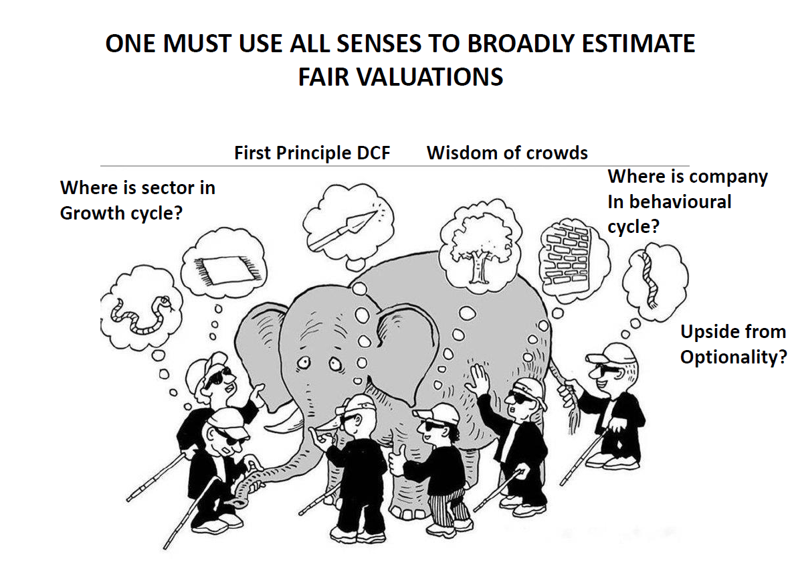
Dynamic Gems – The Art and Science behind Identifying Stocks

Slide 49
Fundamental Indicators
Valuation
Ratios & Parameters
Dividend Yield
Debt to equity
Interest Coverage Ratio
Shareholding pattern
(Promoters, FIIs, DIIs & Celebrity Investors)
Pledged percentage
Market Cap / EBITDA
Market Cap / Net Profit
Market Returns
P/E
EV/EBITDA
P/BV
PEG Ratio
Price Range
Current Price
52 weeks High / Low
5 year High / Low
Life time High / Low
Dynamic Gems – The Art and Science behind Identifying Stocks

Slide 50
Fundamental Indicators
Margins
Management Effectiveness
Performance Parameters
EBITDA Margin
Net Profit Margin
ROCE
ROE
Asset Turnover Ratio
Inventory Turnover Ratio
Debtor Turnover Ratio
Current Ratio
Sales growth 3 Years
Sales growth 5 Years
Profit growth 3 Years
Profit growth 5 Years
Average ROE 3 Years
Average ROE 5 Years
Average ROCE 3 Years
Average ROCE 5 Years
Last 5-10 Annual Results
Last 5 Quarterly Results
Size
Market Cap
Book Value
Equity capital
Reserves
Debt
Face Value
Cash Flow Statement
Cash from Operating Activity
Cash from Investing Activity
Cash from Financing Activity
Dynamic Gems – The Art and Science behind Identifying Stocks

Slide 51
Fundamental Indicators – Valuation Ratios
Price to Earning
The price-to-earnings ratio is a metric that represents a company's profit potential. The value paid by equity investors for each stock unit is used to calculate this potential. As a result, it shows whether a stock is cheaper or more expensive than its competitors in the same industry. In order to track the company's growth, the current price-to-earnings ratio can be compared to previous ratios.
P/E Ratio = Share Price/Earnings Per Share
Price to Sales Ratio
The Price-to-Sales Ratio (P/S) compares the value of a company to the total amount of annual sales it generated previously. The P/S ratio, often known as the "sales multiple," is a valuation multiple based on the market value that investors place on a company's revenue.
PS Ratio= Market Capitalization/ Annual Revenue
Price to Book Value
The Price-to-Book Ratio (P/B Ratio) compares a company's market capitalization to its book value of equity. The P/B ratio, popular among value investors, can be used to find cheap companies in the market.
P/B Raito = Market Capitalization / Book Value of Equity
Dynamic Gems – The Art and Science behind Identifying Stocks

Slide 52
Fundamental Indicators – Valuation Ratios
EV/EBITDA
The enterprise value to earnings before interest, taxes, depreciation, and amortization ratio (EV/EBITDA) compares the value of a company—debt included—to the company’s cash earnings less non-cash expenses.
The EV/EBITDA metric is a popular valuation tool that helps investors compare companies in order to make an investment decision.
EV calculates a company's total value or assessed worth, while EBITDA measures a company's overall financial performance and profitability.
Typically, when evaluating a company, an EV/EBITDA value below 10 is seen as healthy.
It's best to use the EV/EBITDA metric when comparing companies within the same industry or sector.
PEG Ratio
The PEG ratio was popularized by Peter Lynch. It is calculated as follows:
The PEG ratio takes into account growth rate when considering valuation. This is intuitive. A company growing at 10% a year should have a higher price-to-earnings ratio than a company growing at 2% a year. The PEG ratio takes this into account.
A PEG ratio below one is generally said to be a bargain.
Dynamic Gems – The Art and Science behind Identifying Stocks

Slide 53
Cash Flow Statement – Doodh ka Doodh, Paani ka Paani
Net Cash Flow of a Company = Operating Activities + Investing Activities + Financing Activities
The Cash flow statement provides us a picture of the true cash position of the company
Each activity either generates or drains money for the company
Investors should pre-dominantly and specifically look at the cashflows from the operating activities
When the liabilities increase, cash level increases and vice versa
When the assets increase, cash level decreases and vice versa
The net cash flow number for the year is also reflected in the balance sheet
This Statement is a useful addition to the financial statements of a company because it indicates the company’s performance
Dynamic Gems – The Art and Science behind Identifying Stocks

Slide 54
Cash Flow Statement – Doodh ka Doodh, Paani ka Paani
Classification of a Company’s Activities
Operational Activities (OA): Activities directly related to the daily core business operations are called operational activities. Typical operating activities include sales, marketing, manufacturing, technology upgrade, resource hiring etc.
Investing Activities (IA): Activities pertaining to investments that the company makes with an intention of reaping benefits at a later stage. Examples include parking money in interest bearing instruments, investing in equity shares, investing in land, property, plant and equipment, intangibles and other non current assets etc
Financing Activities (FA): Activities pertaining to all financial transactions of the company such as distributing dividends, paying interest to service debt, raising fresh debt, issuing corporate bonds etc
Dynamic Gems – The Art and Science behind Identifying Stocks

Slide 55
Correlating and Connecting the Balance Sheet and P&L
The P&L Statement
Sales Revenue
Operating Expenses
Depreciation & Amortization
Finance Cost
Other Income
PAT
The Balance Sheet Statement
Receivable and Cash Balance
Inventory and Trade Payables
Accumulted Depreciation
Debt
Investments
Shareholders Equity
Dynamic Gems – The Art and Science behind Identifying Stocks

Slide 56
Categorisation of Businesses helpful in making
Investment Decisions
Extractors
A business that grows products or takes raw materials from nature
Marketers
A type of business involved in moving the goods from producers to consumers
Types of Business (Stage)
Manufacturers
Takes the extractors products or raw materials and changes them into a for that consumers can use
Service Business
Type of Business providing Services eg. IT, Banking, Insurance and others
Dynamic Gems – The Art and Science behind Identifying Stocks

Slide 57
Potential
Entrants
Porter’s 5 Forces Model
Threat of
New Entrants
Bargaining Power of Suppliers
Industry Competitors Rivalry Among Existing Players
Suppliers
Buyers
Bargaining Power of Buyers
Threat of
Substitutes
Substitutes
Five Forces Shaping Competition & Determining Profitability in Industry
Dynamic Gems – The Art and Science behind Identifying Stocks

Slide 58
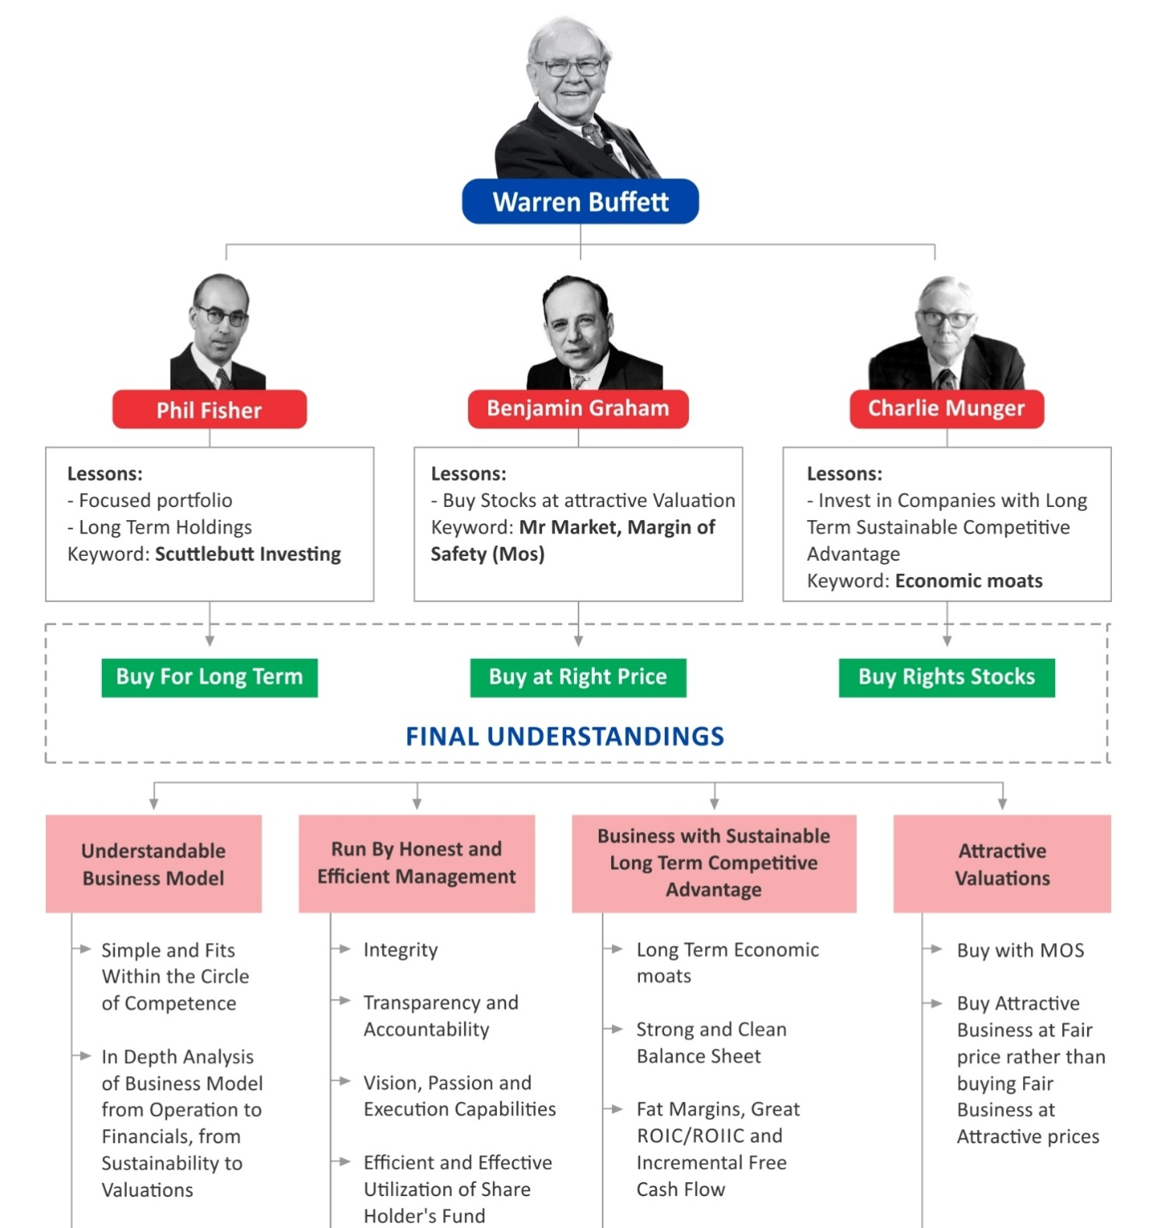
Warren Buffett
in a Nutshell
Dynamic Gems – The Art and Science behind Identifying Stocks

Slide 59
Parameters we look for beyond Fundamentals & Technicals (Art)
High growth non-cyclical lesser regulated companies
Companies having promoters with skin in the game
Companies with no political connections & Government dependence
Pledging - a big NO
Debt - Net cash companies (zero net debt) - growth should be funded by internal accruals and not debts
C3 Corporate Governance, Credit Reports and Channel Checks (Continuous Interaction with company suppliers, distributors, direct consumers, employees & other stakeholders and last but not the least Domain Experts)
Buy-Backs \ Creeping Acquisition : Companies which have done buy-backs / creeping acquisition in the last 2-3 years.
Other than the financials - social, economic, cultural, environmental, general look & feel and other dynamics of a company to be looked for
A BIG NO to
PDC
Dynamic Gems – The Art and Science behind Identifying Stocks

Slide 60
What we AVOID & RED FLAGS
Impulsive decisions
Being influenced by financial news channels and platforms
Acting on market movements
Chasing winners or hot stocks
Low promoter holdings
Poor corporate governance
High institutional ownership
Leverage
Fad / hot sectors
Expensive valuations
We Avoid
Red Flags
Dynamic Gems – The Art and Science behind Identifying Stocks

Slide 61
Generating a Stock Idea
Trying to identify Multibaggers
Stocks that gives return in multiples of their actual costs are called multi-baggers
Strong Industry Tailwinds
A Strong MOAT
High Market Share
Lowest cost producer / unique resources / Bargaining power
Pricing Power
Scale of Operations
Strong Brand Equity
Extensive Research & Development Resources and Capability
Strong Technical Tie-Ups or Intellectual property
Wide, Strong & Reliable Distribution Network
Favorable Regulations or Lesser Regulated
Capable and Reliable Management
Light Balance Sheet
Reasonable Valuations
Last but not the least Patience & Discipline
Multibaggers
milte nahi hai…
banana parte hai…
General Observation
Stock screener
Macro Trends
Sectoral Trends
Special Situation
Circle of Competence
Dynamic Gems – The Art and Science behind Identifying Stocks

Slide 62



Multibagger Approach
GROWTH
CONTRARIAN
VALUE
The company has to be a growth company with above-average growth potential for the next 3-5 years. Markets reward a higher PE multiple for growth companies.
Contrarian approach does not mean doing the opposite of others, rather, it means doing things differently. Buying in popular names will not provide multibagger returns.
The valuation has to be reasonable. This is important because there has to be potential for re-rating. A combination of EPS growth
and PE re-rating leads to multibagger returns.
Dynamic Gems – The Art and Science behind Identifying Stocks

Slide 63
Understanding Risk
Risk is not a number, rather, it is a concept or notion.
Risk equates to what Ben Graham called a “Permanent Loss of Capital".
Valuation Risk
Earnings Risk
Balance Sheet Risk
Risk of buying stocks dear without adequate margin of safety. Reasonable valuation is the corner stone of all our investment decisions.
Risk that current earnings could decline due to technological changes, economic changes or deterioration in management.
The risk of an overleveraged balance sheet which is
ignored during good times in favour of the cyclic high and unsustainable earnings.
Dynamic Gems – The Art and Science behind Identifying Stocks

Slide 64
Risk Management
Buying Right
Don't invest in what we don't understand
Avoid complexity and poor governance
Use check lists
Position sizing - Increase size of bet with conviction and liquidity
Constant Vigil
Track progress of Financial and Operating variables
Track capital allocation decisions of surplus cash flow
Track valuations
Selling Right
When facts change that requires us to change our views
When we encounter evidence that our analysis is wrong
Exit/trim during euphoria - Bull case IRR falls below NIFTY returns estimate
Ability to re-allocate capital to a significantly better
Dynamic Gems – The Art and Science behind Identifying Stocks

Slide 65

The 10-Minute Test (Initial Screening)
Does the Company Pass the Quality Hurdle?
Is the Company making Operating Profit?
Does the Company Generate Consistent Cash Flow from Operations?
Are ROCE Consistently over 10 Percent, with acceptable Leverage?
Is Earnings Growth Consistent or Erratic?
How Clean Is the Balance Sheet?
Does the Firm Generate Free Cash Flow?
How Much "Other" Is There?
Has the Number of Shares Outstanding Increased Markedly over the Past Several Years?
How is the Credit Rating ?
Beyond the 10 Minutes : If the firm does pass these tests and it looks as through it's worth a detailed examination, then we can proceed with detailed & thorough research which will take much longer than 10 minutes, but it's worth the effort for an idea that passes the initial hurdles
Deep
Dive
Dynamic Gems – The Art and Science behind Identifying Stocks

Slide 66
Corporate Governance Analysis
Board Composition and tenure
Removal of / Resignation by Independent Directors
Succession Plan, especially if control is in the hands of the Founder
Management salary and growth of company
Related Party Transactions
Ethics Violation
Transparency, no manipulations
Management achieve targets / defer targets ? If defer, reason ?
Quality of Auditors
Group Companies History and Pedigree
Rating Agencies (Upgrade and Downgrade)
Dynamic Gems – The Art and Science behind Identifying Stocks

Slide 67
Important Points & Sources for Analysing a Company
Parameter
Relevance
Last 10 Years Financials
AGM Notice
Chairman's Speech
Director's report
Mgt Discussion & Analysis
Shareholding Patterns
Notes on Accounts
Schedules
Cash Flow Statement
Continuity
Coherence
Sales & Debt
Depreciation
Taking Loss to BS
Tax Rate
Contingent Liability
Diluted EPS
How the company has grown in the past 10 years ? Were there any down years and Why?
Gives lots of information about agenda and special resolutions
Vision about the Future
Current Business Structure - Issues faced and mitigation
Where the company is headed for the next 3 to 5 years
Note the Top 10 Non Promoter shareholder, free float and Institutional ownership & shareholders >1%
Understand all minute details regarding the financials
Very important, look into borrowing Banks, details of receivables due - entities and timelines
Check OCF, Capex and FCF trends also OCF to PAT and OCF / Sales trends in last 10y. 5y and 3y rolling
Compare management commentary from last year to this year
Numbers at different parts of the Annual report should match, Capacity addition not showing up in Fixed Assets etc.
Check growth in Sales vs Growth in Receivables, trends of receivables due (30D, 60D 90D and beyond)
Check Depreciation as %age of Sales over 10 years and see aberrations, R&D should be expensed, not capitalized
If large expenses are directly debited from the Reserves bypassing the P&L
If proper tax rate has been paid on the profits, Apply median tax rates to profits and consider final EPS not the reported one
Whether company has provided adequate cover for the Contingent Liabilities. CL as % of Net Worth
Consider net profits to company (excluding any MI) and diluted EPS post considering all potential warrant conversion
Dynamic Gems – The Art and Science behind Identifying Stocks

Slide 68

Important Points & Sources for Analysing a Company
Parameter
Relevance
Tax Rate
Contingent Liability
Diluted EPS
Goodwill
Related Party Transaction
Management Salary
Frequent Dilution
Warrant Conversion
Composition of Board
Fees for Audit
Auditor Remuneration
Auditor Report
Cash Yield
If proper tax rate has been paid on the profits, Apply median tax rates to profits and consider final EPS not the reported one
Whether company has provided adequate cover for the Contingent Liabilities. CL as % of Net Worth
Consider net profits to company (excluding any MI) and diluted EPS post considering all potential warrant conversion
Investors should remove Revaluation Reserve and Goodwill from Networth for calculations
Watch out for sales to group entities at low margins. Also consider RPT/Sales trends over years
As percentage of Profits, 10% of PAY is celling under Companies Act. Approaching >5% should raise a red flag
Diluting Equity cheaply is a big detractor. See whether equity dilution is absolutely necessary (already high debt etc.)
Check for outstanding warrants to be converted and resulting dilution from this
Qualification of Independent Directors on the Board. How many premature early resignations
Bulk of Auditor expenses should be audit fees and not legal and other charges
Auditor's salary as part of Sales - 10 year trends and should not see sudden jumps
Comments and Observations ( debt payments, taxes overdue, PF contribution pending)
Compare the interest earned on the Cash and Cash equivalents. Too low rate means cash is non existent
And Above All Channel Check…
Dynamic Gems – The Art and Science behind Identifying Stocks

Slide 69
Important Financial Ratios & Metrics to Improve Stock Picking Skills
Basics (Income Statement) Revenue Expenses Depreciation Earnings & Adjusted Earnings EPS Gross Margin Operating Margin Net Margin
Basics (Balance Sheet) Assets Current Assets Liabilities Current Liabilities Debt Equity
Basics (Cash Flow) Capital Expenditures Cash flow from operating activities Free Cash Flow
Basics (Miscellaneous) Market Capitalization Enterprise Value Sector Volume
Profitability Ratio ROA ROE ROCE Net Profit Ratio Gross profit ratio
Stock Price Risk Metrics Standard Deviation Beta Maximum Drawdown Value at risk
Fundamental Metrics Margin of Safety Sloan Ratio Piotroski F-Score Altman-Z Score Beneish-M Score
Risk/Return Ratio Sharpe Ratio Treynor Ratio Sortino Ratio Calmer Ratio & MAR Ratio Sterling Ratio Omega Ratio Information Ratio Upside & Downside Ratio
Dynamic Gems – The Art and Science behind Identifying Stocks

Slide 70
Important Financial Ratios & Metrics to Improve Stock Picking Skills
Dividend Ratio & Metrics Dividend Yield Dividend Payout Ratio Dividend Payback Ratio Yield on cost Dividend Discount Model Dividend History
Growth, Return, Performance Ratio & Metrics Arithmetic Growth Ratio Geometric Growth Ratio Total Return Survivorship bias
Equity to Assets Ratio
Cash Flow to Debt Coverage Ratio
Quick Ratio
Debt to Equity Ratio
Interest Coverage Ratio
Technical & Momentum Ratios and Indicators
52 Week Range
Momentum
Simple Moving Average
Relative Strength Index
Average True Range
Capital Asset Pricing Model & Portfolio Ratios & Metrics
Alpha
Risk Free Rate and Returns
WACC
R-Squared
Active Share
Tracking Error
Correlation
Alternative Earnings Metrics
Owner's Earnings
FFO
AFFO
Miscellaneous Descriptive Ratios & Metrics
Short Ratio
Insider Ownership
Institutional Ownership
Other Business Performance Ratios & Metrics
Cash Conversion Cycle
Days Sales of Inventory
Days Sales Outstanding
Days Payable Outstanding
Inventory Turnover Ratio
Dynamic Gems – The Art and Science behind Identifying Stocks

Slide 71
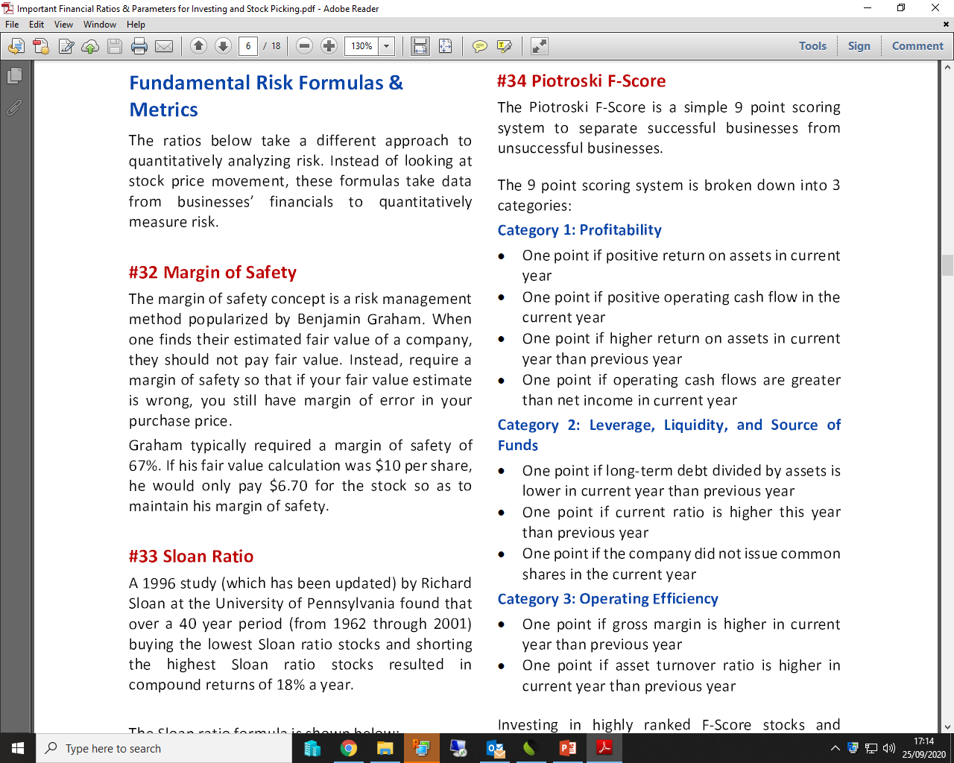
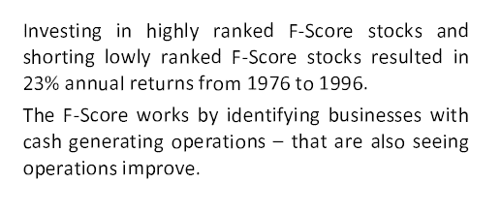
Fundamental Metrics
Piotroski F-Score
Dynamic Gems – The Art and Science behind Identifying Stocks

Slide 72
Technical
Analysis
The Science of Investing
Dynamic Gems – The Art and Science behind Identifying Stocks

Slide 73
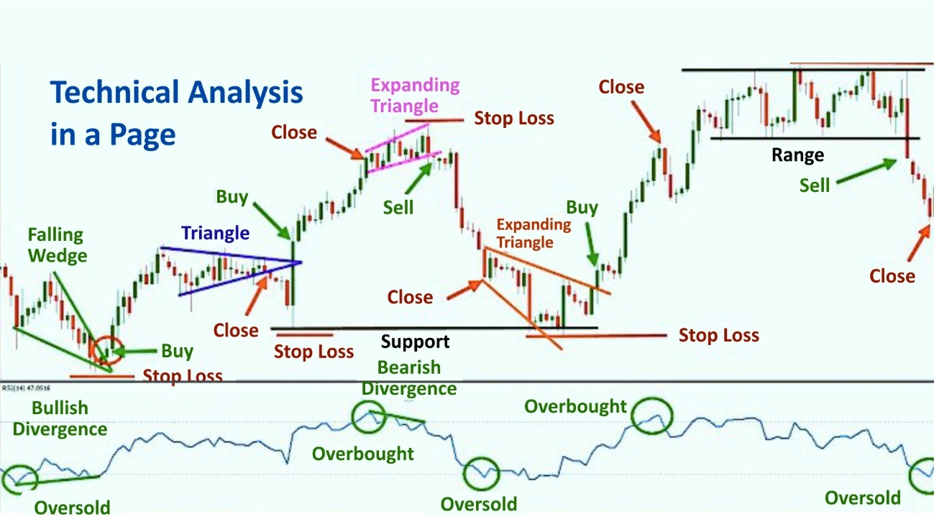

Slide 74
Technical Indicators
Moving Averages (DEMA , WEMA & MEMA)
Trend
20 Days
50 Days
100 Days
200 Days
1000 Days
Short Term
Medium Term
Long Term
Supertrend
Momentum
RSI
MACD
ADX
Dynamic Gems – The Art and Science behind Identifying Stocks

Slide 75
Timeframes
For Weekly Options... 15 Minutes Charts
For Futures and Short Term Investment...Hourly Chart Better
For Delivery Based Medium Term Investment...Daily Chart
For Long Term Investment... Weekly Chart
Dynamic Gems – The Art and Science behind Identifying Stocks

Slide 76
Technical Analysis
Exponential Moving Average: -
An exponential moving average (EMA) is a type of moving average (MA) that places a greater weight and significance on the most recent data points. The exponential moving average is also referred to as the exponentially weighted moving average. An exponentially weighted moving average reacts more significantly to recent price changes than a simple moving average (SMA), which applies an equal weight to all observations in the period.
MACD Histogram
MACD is often displayed with a histogram (see the chart below) which graphs the distance between the MACD and its signal line. If the MACD is above the signal line, the histogram will be above the MACD’s baseline. If the MACD is below its signal line, the histogram will be below the MACD’s baseline. Traders use the MACD’s histogram to identify when bullish or bearish momentum is high.
Relative Strength Index
The relative strength index (RSI) is a momentum indicator used in technical analysis that measures the magnitude of recent price changes to evaluate overbought or oversold conditions in the price of a stock or other asset.
Traditional interpretation and usage of the RSI are that values of 70 or above indicate that a security is becoming overbought or overvalued and may be primed for a trend reversal or corrective pullback in price. An RSI reading of 30 or below indicates an oversold or undervalued condition.
Super Trend Indicator
The super-trend indicator relies on two fundamental dynamic values- period and multiplier. But before we get into that, it is important to understand the concept of ATR or Average True Range. ATR is yet another indicator that gives you market volatility value by decompressing the range of prices of a security for a particular time.
Dynamic Gems – The Art and Science behind Identifying Stocks

Slide 77
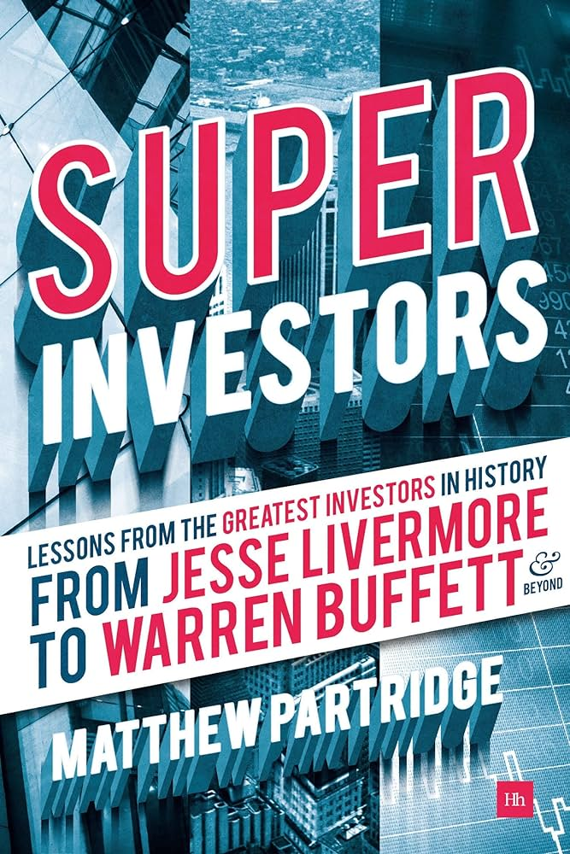
The World’s Greatest Investors
Jesse Livermore - The Trend-Following Boy Plunger
David Ricardo - The Napolenic Speculator
George Soros - The Alchemist Who Broke the Bank of England
Michael Steinhardt - The Contrarian Hedge Funder
Benjamin Graham - The Father of Value Investing
Warren Buffett - The Elder Statesman of Finance
Anthony Bolton - The British Warren Buffett
Neil Woodford - The Top Current Value Manager in Britain
Philip Fisher- The Inventor of Growth Investing
T.Rowe Price - The Pragmatic Growth Investor
Peter Lynch - The Man who Beat the Street
Nick Train - The Inactive Optimist
Georges Doriot - The Venture Capital Pioneer
Eugene Kliener and Tom Perkins - The VCs of Silicon Valley
John Templeton- The Global Investor
Robert W. Wilson - The Short Seller
Edward O. Thorp - The Revange of the Quants
John Maynard Keynes - The Stockpicking Economist
John ‘Jack’ Bogle- The Founder of Index Investing
Paul Samuelson- The Secret Investor
Please read the book
“Super Investors” by Matthew Partridge
Dynamic Gems – The Art and Science behind Identifying Stocks

Slide 78
Stocks Filtered on our Fundamental and Technical Parameters
Fundamental Parameters
S.No. | Parameter
1 | Price to Earning >8
2 | Price to book value >1
3 | Profit growth >10
4 | Profit growth 3Years >10
5 | Sales growth >10
6 | Sales growth 3Years >10
7 | Debt to equity <0.30
8 | Pledged percentage <1
9 | Return on capital employed >15
10 | Return on equity >10
11 | Market Capitalization >100
12 | Current ratio >1
13 | EV/EBITDA
14 | PEG Ratio
15 | Promoter holding
16 | YOY Quarterly sales growth >15
17 | Piotroski score
18 | Interest Coverage Ratio >4
19 | OPM > 10%
Technical Parameters
S.No. | Parameter
1 | 20 DEMA | Y(Above) & N(Below)
2 | 50 DEMA | Y(Above) & N(Below)
3 | 100 DEMA | Y(Above) & N(Below)
4 | 200 DEMA | Y(Above) & N(Below)
5 | MACD | P(Positive Divergence & N(Negative Divergence)
6 | RSI | P(Positive Divergence & N(Negative Divergence)
7 | Super Trend | P(Positive) & N(Negative)
Dynamic Gems – The Art and Science behind Identifying Stocks

Slide 79

Exit
Strategy
How to Exit & Why Exit is Important ?
Dynamic Gems – The Art and Science behind Identifying Stocks

Slide 80
How to Exit & Why Exit is Important ?
If stock down 50%, you need it to double to come back to cost
If stock down 70%, you need it to more than triple to come back to cost
If stock down 75%, you need it to rise 4x to come back to cost
If stock down 90%, you need it to rise 10x to come back to cost
Why to
love
small
losses
Dynamic Gems – The Art and Science behind Identifying Stocks

Slide 81

Its very tough to
make EXIT decisions
Technicals
Fundamentals
Multibaggers or Multibeggars
You have to apply Art,
Science and what not…
Dynamic Gems – The Art and Science behind Identifying Stocks

Slide 82
Exit Decisions Tracking Fundamentals
Fundamental analysis is a continuous process, and it's essential to stay updated with the company's performance and industry trends. These exit strategies are not rigid rules but rather guidelines to help you make informed decisions based on changing fundamentals. Always conduct thorough research and consider seeking advice from financial experts before making any investment decisions.
Targets
Stop Losses - ?
Trailing Stop losses
Better Opportunity or need of funds
Change in Fundamentals
Change in Management & other Parameters
Corporate Governance Issues
Change in broader market trends & valuations (Market PE, P/BV, Dividend Yield)
Price has gone up too much too fast
If buying the stock was a mistake
The stock price has reached unsustainable levels
Dynamic Gems – The Art and Science behind Identifying Stocks

Slide 83
Exit Decisions Tracking Fundamentals
Stagnancy in Growth Stocks
Look Out for Media Hype
Reduced Dividends
Continuously under performing or bad 4 to 5 quarters ( see quarterly result tracker)
Competitive Threats: Exit if new competitors or disruptive technologies emerge that could potentially erode the company's market share and profitability. Example: Nokia lost its dominance in the mobile phone market due to the rise of smartphones from competitors like Apple and Samsung.
Industry or Regulatory Changes: Exit if there are major shifts in the industry landscape or unfavorable regulatory changes that could impact the company's operations and growth prospects. Example: The ban on mining activities in Goa had a significant negative impact on mining companies like Sesa Sterlite (now Vedanta Limited).
Erosion of Competitive Advantage: Exit if the company's competitive advantage weakens, leading to a loss of market share or pricing power. Example: Kingfisher Airlines lost its competitive advantage and struggled to maintain profitability in the aviation sector.
Mergers and Acquisitions: Exit if the company undergoes a merger or acquisition that might negatively impact its business or financials. Example: Tata Steel's acquisition of Corus led to increased debt and financial strain on the company.
Dynamic Gems – The Art and Science behind Identifying Stocks

Slide 84
Exit Decisions using Technicals
Technical analysis provides insights into short-term price movements, and exit decisions should be aligned with your trading or investment goals. Combine technical analysis with fundamental analysis for a well-rounded approach to decision-making. Regularly reassess your positions and adapt your exit strategies based on changing technical conditions. As always, seek guidance from financial experts or professionals before making critical decisions.
Stop Losses
Trailing Stop losses
Targets
Timeframe
Resistance Levels: Exit when the stock price approaches a significant resistance level, which may act as a barrier preventing further price increases. Example: Tata Motors faced strong resistance around the ₹450 level in 2018, leading to a reversal and subsequent decline.
Overbought Conditions: Exit when technical indicators like Relative Strength Index (RSI) show the stock is overbought, indicating a potential reversal or correction. Example: In 2020, HDFC Bank reached overbought levels on the RSI, followed by a pullback.
Bearish Reversal Patterns: Exit when bearish chart patterns like Head and Shoulders or Double Tops emerge, signaling a potential trend reversal. Example: Hindustan Unilever displayed a Head and Shoulders pattern in 2019 before a significant decline.
Dynamic Gems – The Art and Science behind Identifying Stocks

Slide 85
Exit Decisions using Technicals
Moving Average Crossovers: Exit when a shorter-term moving average crosses below a longer-term moving average, indicating a potential shift from a bullish to a bearish trend.
Example: Tech Mahindra experienced a death cross (50-day moving average crossing below the 200-day moving average) in 2019.
Breakdown from Support: Exit when the stock price breaks below a key support level, signaling a potential continuation of the downtrend. Example: Reliance Communications broke down from a long-term support level in 2017, leading to a sustained decline.
Divergence in Indicators: Exit when there's a divergence between the stock price and technical indicators like MACD or Stochastic, suggesting a weakening trend. Example: ONGC exhibited a bearish divergence between price and RSI in 2020, followed by a decline.
Volatility and ATR: Exit if the Average True Range (ATR) indicates heightened volatility, which could lead to unpredictable price swings.
Example: Vodafone Idea displayed increased volatility during its significant price fluctuations.
News and Event-driven Moves: Exit if the stock experiences a sudden price spike due to news or events, as such moves may be short-lived.
Example: Yes Bank witnessed sharp intraday movements in response to news and events related to its financial health.
Dynamic Gems – The Art and Science behind Identifying Stocks

Slide 86
Different Trading Styles
Momentum Investing
Momentum Trading
Swing Trading
Swingtum Trading
Dynamic Gems – The Art and Science behind Identifying Stocks

Slide 87
Momentum Investing
Momentum investing is a strategy that involves buying securities that have shown an upward price trend and selling those that have shown a downward trend. The underlying principle is that securities that have performed well in the past will continue to do well in the future, and those that have performed poorly will continue to underperform.
Key Concepts in Momentum Investing
Trend Following: Momentum investors look for stocks or other assets that are on an upward trajectory and continue to invest in them as long as the upward trend persists.
Relative Strength: This is a common metric used to identify momentum stocks. It compares the performance of a stock to the overall market or a specific sector.
Time Horizons: Momentum investing can be applied over different time frames, ranging from short-term (weeks or months) to longer-term (a year or more).
Quantitative Analysis: Many momentum investors rely on quantitative models and technical indicators to identify trends and make investment decisions. Popular indicators include moving averages, Relative Strength Index (RSI), and price momentum indicators.
Behavioural Finance: The strategy leverages behavioural biases in the market, such as herd behaviour and the tendency of investors to overreact to news.
Dynamic Gems – The Art and Science behind Identifying Stocks

Slide 88
Advantages of Momentum Investing
Potential for High Returns: By riding on the price trends, investors can potentially achieve higher returns compared to traditional buy-and-hold strategies
Systematic Approach: The use of quantitative models and indicators can create a disciplined and systematic approach to investing.
Implementation
Momentum investing can be implemented in various asset classes, including stocks, commodities, and currencies. It is often used in conjunction with other investment strategies to diversify risk and enhance returns.
Conclusion
Momentum investing is a strategy that can yield substantial returns by capitalizing on existing market trends.
Dynamic Gems – The Art and Science behind Identifying Stocks

Slide 89

Momentum Investing - Richard Driehaus
Investing legend, Richard Driehaus is called the Father of Momentum Investing
Investors frequently have to challenge conventional wisdom, as opportunities for truly attractive investments are often not obvious.
Right brain Investing (Intuition, or gut feeling, leads me to an investment decision different from that reached through traditional, analytical research or ‘Left Brain’ investing)
Driehaus was not as popular as the likes of Warren Buffett and George Soros but his performance as a fund manager was truly phenomenal and he was well respected in the investing circle.
His extraordinary success can be attributed to his expertise in “aggressive growth” style of investing, for which he is also known as the ‘Father of Momentum Investing’.
Driehaus identified and bought stocks when they are in a strong upward price movement and stayed with them as long as the upward move continued.
The basic concept of momentum investing is that short-term performance is repeated with winners continuing to be winners and losers continuing to be losers in the short
Driehaus founded Driehaus Capital Management in 1982, which now manages over $13.2 billion through its mutual funds and other accounts. It produced a compounded annual return in excess of 30% over 12 years.
Richard Driehaus
Dynamic Gems – The Art and Science behind Identifying Stocks

Slide 90
Momentum Investing - Richard Driehaus
Investors’ expectations of a firm’s earnings growth was the main driver of its stock price
Companies that have a record of strong and consistent earnings growth have been the most successful ones
the key to extraordinary performance in the stock market is picking companies with the greatest earnings growth potential
He focused on picking smallcap stocks, instead of largecaps. His approach for picking stocks was in sharp contrast to the more conservative approach that most investors used called ‘value investing’ whereby an investor tried to find undervalued stocks having relatively low valuations evident by their low P/E ratios
Driehaus invested mainly based on fundamentals. But to improve his entries and exit timings and to confirm his stock selection, he considered technical analysis as a helpful tool
Investors should avoid the following common pitfalls that lead them to mediocre performance
Stock prices heavily influenced by market dynamics
Don't hold stocks for the sake of diversification
Adjust to new ideas
Dynamic Gems – The Art and Science behind Identifying Stocks

Slide 91
Momentum Investing – Some Paradigms to be avoided
The legendary investor says there were some conventional wisdoms or investment paradigms worth avoiding as they were now almost outdated and were really no longer true. He says investors make the mistake of holding on to these beliefs and often search for clues to support them and reject information that conflict with the paradigm.
Some of these paradigms he felt should be avoided by investors-
Buy low and sell high
Don’t try to hit home runs. You make the most money by hitting a lot of singles
A high turnover strategy is risky
An investment process needs to be very systematic
You must have a value-based process
You need to buy good Street research and have contact with the best analysts
The best measure of investment risk is the standard deviation of return
It’s Risky to place your money with a ‘Star System’ manager
Dynamic Gems – The Art and Science behind Identifying Stocks

Slide 92
Investing Parameters
Investing parameters refer to the specific criteria or guidelines used by investors to evaluate and select investment opportunities. These parameters are essential for constructing an investment strategy that aligns with an investor's financial goals, risk tolerance, and investment horizon. They provide a framework for decision-making and help ensure a disciplined and systematic approach to investing.
 | CORE INVESTING | SATELLITE INVESTING
Outlook For Investment | Sector based Future Growth Outlook | No Specific Sector
Strategy | Fundamentals (75%) + Technical (25%) | Technical (75%) + Fundamentals (25%)
Average Holding period | 2-5 Yrs. | Upto 1 yr.
No. of Stocks | No Number Specified | Being Opportunistic & Grab every Opportunity
Portfolio Allocation | 70-75% | 20-25%
Returns | Consistent Returns | Slightly Higher Returns
Churn Rate | Low | High
Stock Screening | Predominantly invests to capture underlying value of the business which gets "Unlocked" Over a Period of Time. | Is Tactically managed aiming to take advantage of Market Trends
Timeframe | Weekly Or Monthly | Weekly Or daily
Risk | Low - Moderate | High
Entry | Strong Support of any Moving Average (100/200) with volume. Near Support or Giving Breakout on Weekly or Monthly Time Frame with Volumes. | Strong support previously followed by any Moving Average with volumes or Reversal from support with Volumes.
Stoploss | No Specific Stop Loss | Churning based on Opportunity.
Exit | It depends on Market Sentiments & Company Fundamentals. | Near resistance, Any Moving Average Resistance OR On achieving the Target.
Target | No Specific Return or Target | Avg. 20-25%
Average Win/Loss Rate | No Average win or Loss Rate | Being Opportunistic
Dynamic Gems – The Art and Science behind Identifying Stocks

Slide 93
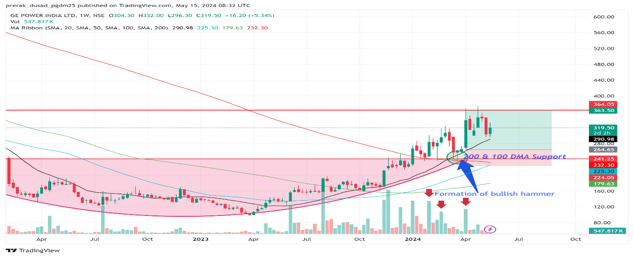
Stock Taking Support of 200DMA with Volumes
In this case, the stock is taking support from 200 DMA with volumes forming a “bullish hammer” and rallied from 265-365 in approx. 5 weeks.
Dynamic Gems – The Art and Science behind Identifying Stocks

Slide 94
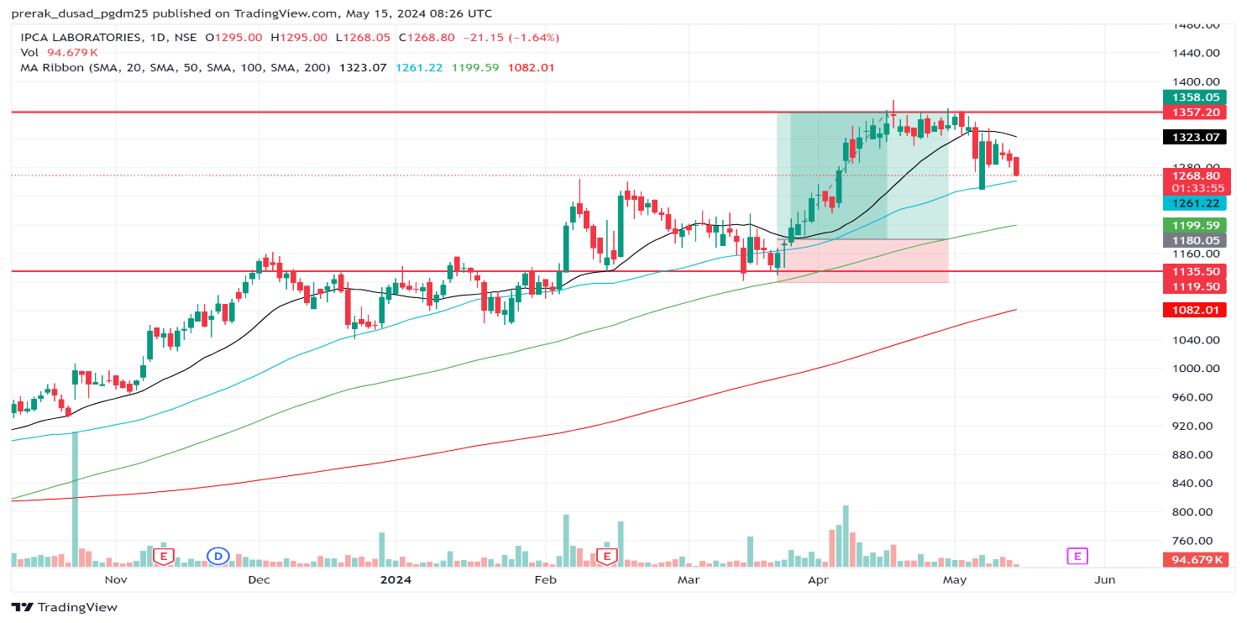
Stock Taking Support of 50DMA with Volumes
In this case, the stock has taken support from 50 DMA with volumes forming a “bullish hammer” and rallied from 1180-1350 in approx. 15 Days.
Dynamic Gems – The Art and Science behind Identifying Stocks

Slide 95
Momentum Trading vs Swing Trading
Key differences | Momentum trading | Swing trading
Meaning | Momentum traders aims and tries to enter during an uptrend and exit before the start of a downtrend by monitoring overall price patterns. These trades can last for a few weeks and months. | Swing trading only sometimes adheres to the broad price trend of a stock. Traders may get engaged in swing trading if there are significant fluctuations.
Frequency of trade | Momentum followers trade lesser frequently since their trades may result in greater profits. | The objective of a swing trader is to profit from short fluctuations in the price of a stock. This implies that they quickly enter and exit their positons.
Market Timing | They can invest early and with lesser risk because they follow the larger general trend of a stock’s price movement. They wait for a trend to be confirmed or watch for a countertrend. | Alternatively, swing traders will run to seize the opportunity when volumes and momentum indicators reveal a positive price trend. Since swing traders are just riding a short-term movement, timing is extremely important.
Dynamic Gems – The Art and Science behind Identifying Stocks

Slide 96
Swingtum Trading (Swing + Momentum Trading)
As the name suggests, Swingtum stands for Swing and Momentum. Swingtum Theory is presented here in order to provide a scientiﬁc and engineering foundation to professional swing trading and momentum trading . The origins of Swingtum theory naturally go deep into the empirical professional technical analysis, fundamental analysis and strategic analysis, and academic quantitative analysis including ﬁnancial mathematics, econophysics and computational intelligence. The central perspective of Swingtum theory is the pervasive existence of multi-level swings and abrupt momentum moves in the market prices, business fundamentals, mass psychology and even the news ﬂows.
Dynamic Gems – The Art and Science behind Identifying Stocks

Slide 97
Frequently Asked Questions (FAQs)
How to select stocks for momentum trading?
One element traders must consider before picking a stock is the time frame. The period within which the investor wants to profit is important, along with the reason behind the volatility, whether it is short-lived or not, and whether it can be profitable, among other things.
How to calculate momentum trading?
The value of momentum indicators is calculated by dividing the current closing price by the price from a previous period and multiplying the quotient by 100. Therefore it can be represented as an (asset’s current closing price ÷ closing price from the previous period) x 100.
Is momentum trading profitable?
It can be profitable. It is time intensive and often works on “buying high and selling higher.” This may work best in a bull market and have a high fee. Therefore it depends on the trader and timing.
Dynamic Gems – The Art and Science behind Identifying Stocks

Slide 98
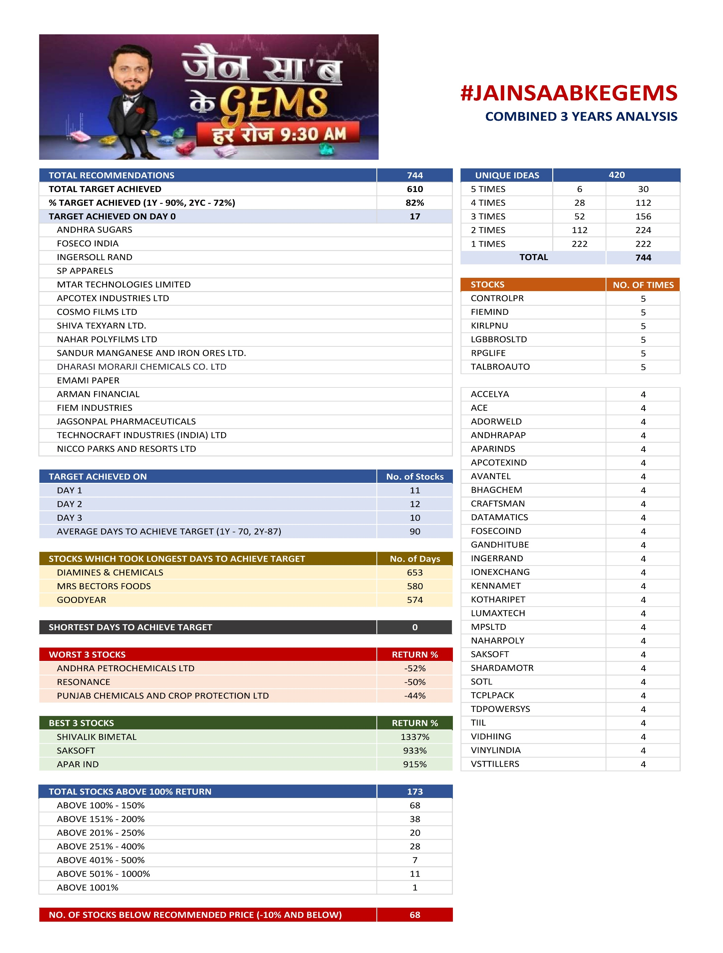


Slide 99
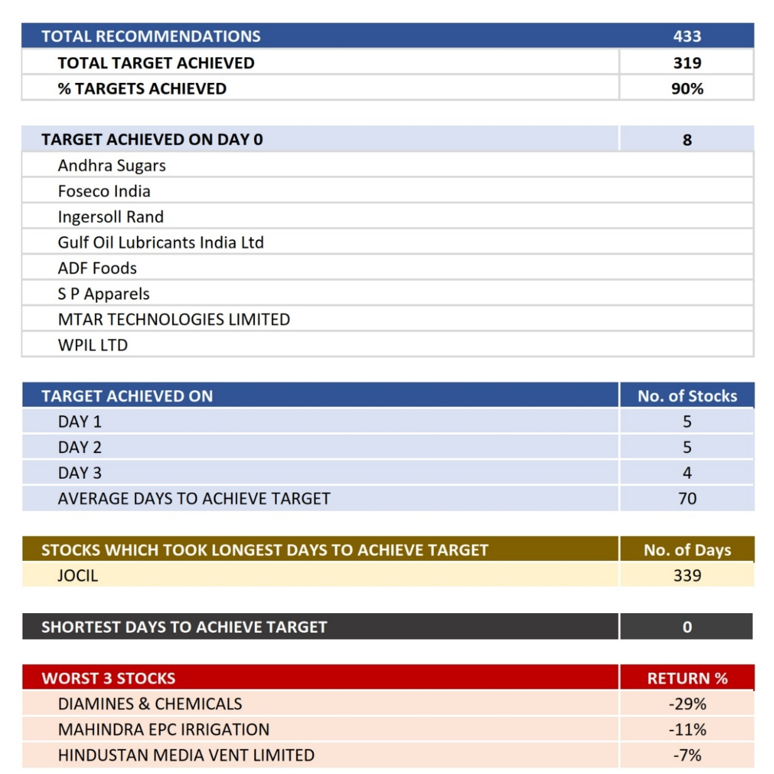

#JAINSAABKEGEMS
1st YEAR ANALYSIS
249
232
93%

Slide 100
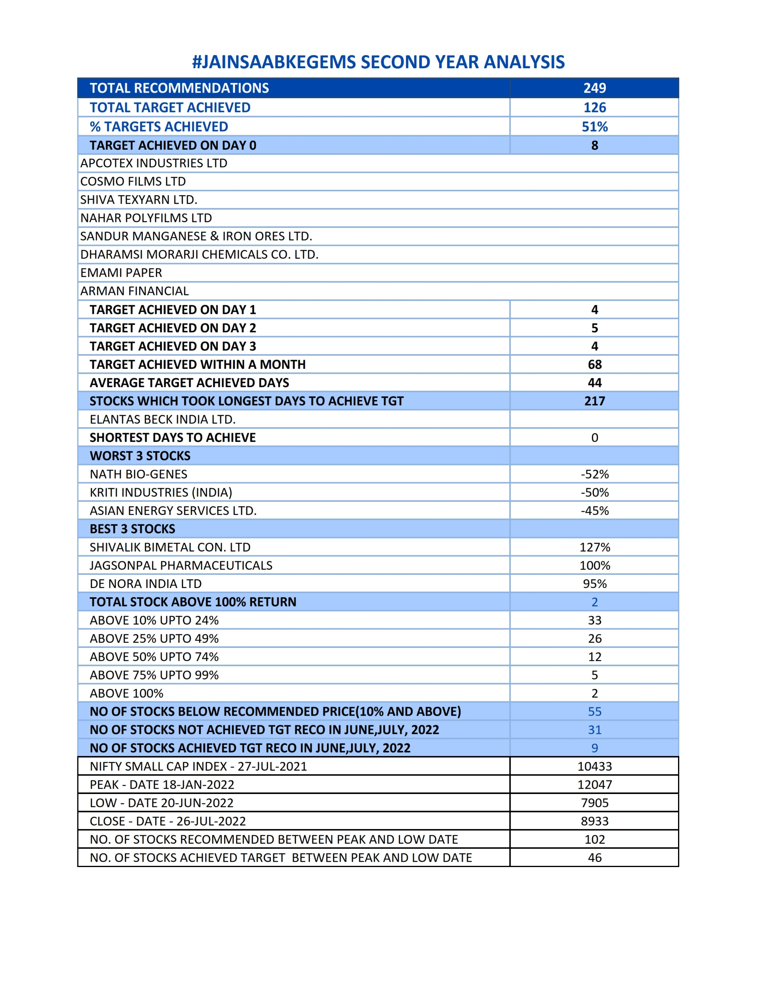
#JAINSAABKEGEMS
2nd YEAR ANALYSIS
Dynamic Gems – The Art and Science behind Identifying Stocks

Slide 101
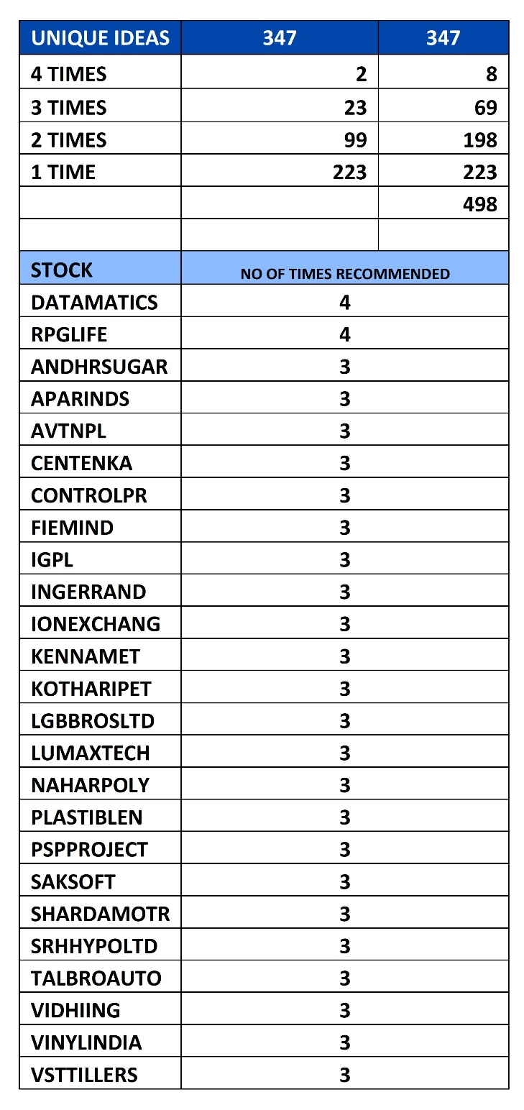

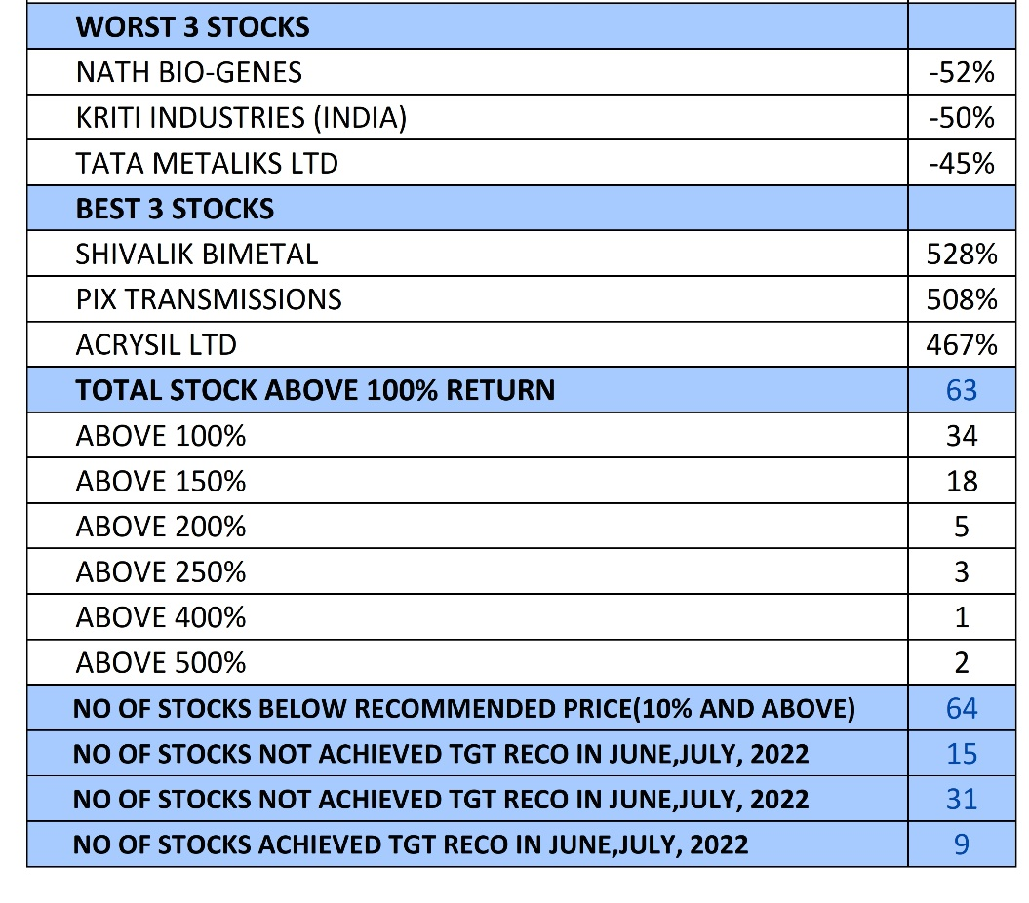
#JAINSAABKEGEMS
COMBINED 2 YEARS ANALYSIS

Slide 102
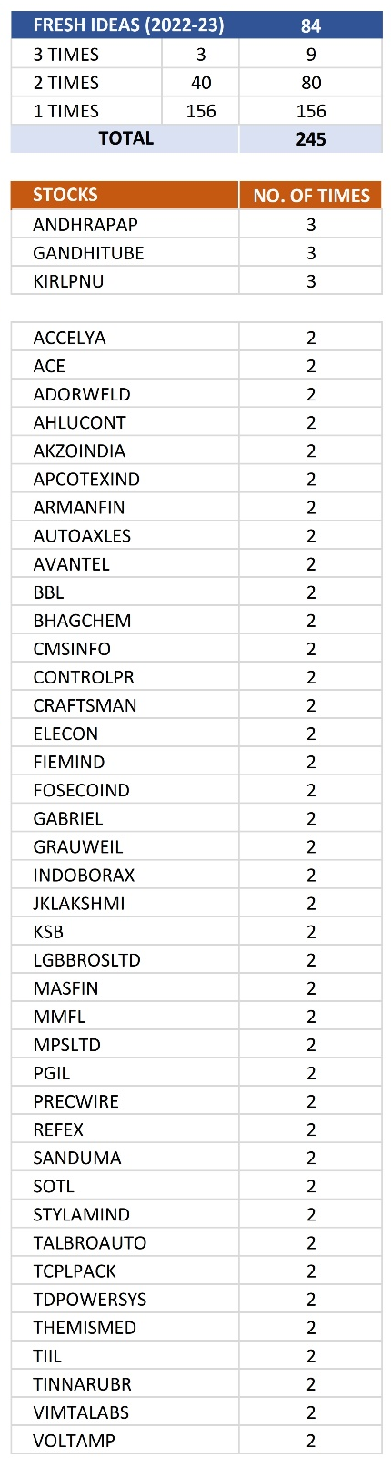


#JAINSAABKEGEMS
3rd YEAR ANALYSIS (1 Year)
Dynamic Gems – The Art and Science behind Identifying Stocks

Slide 103



#JAINSAABKEGEMS
COMBINED 3 YEARS ANALYSIS

Slide 104

#JAINSAABKEGEMS
If 10000 Invested in every Recommendation and Exit on Target
Particulars
Total Recommendations | 744
Total Target Achieved | 610
Net Investment as on 26-07-23 | 268,732
Valuation of Stock which are open for Target as on 26-07-23 | 1,177,757
Profit (Closing Stock Valuation Basis) | 909,024
XIRR* | 50.36 %
Maximum Fund Involvement | 895,362
Entry & Exit on Target
*This is just a indicative figure, not an guaranteed return
Dynamic Gems – The Art and Science behind Identifying Stocks

Slide 105

#JAINSAABKEGEMS
If 10000 Invested in every Recommendation
Particulars
Total Recommendations | 744
Total Target Achieved | 610
Net Investment as on 26-07-23 | 7440000
Valuation of Stock which are open for Target as on 26-07-23 | 12681007
XIRR* | 39 %
Buy
&
Forget
*This is just a indicative figure, not an guaranteed return
Dynamic Gems – The Art and Science behind Identifying Stocks

Slide 106
#JAINSAABKEGEMS
Annual Target Achieved Statistics
Year | Total Days | Target Not Done | Target Achieved Status %
2023 | 243 | 36 | 85 %
2022 | 246 | 35 | 86 %
2021 | 250 | 17 | 93 %
2020 | 109 | All Target Done | 100 %
Dynamic Gems – The Art and Science behind Identifying Stocks

Slide 107
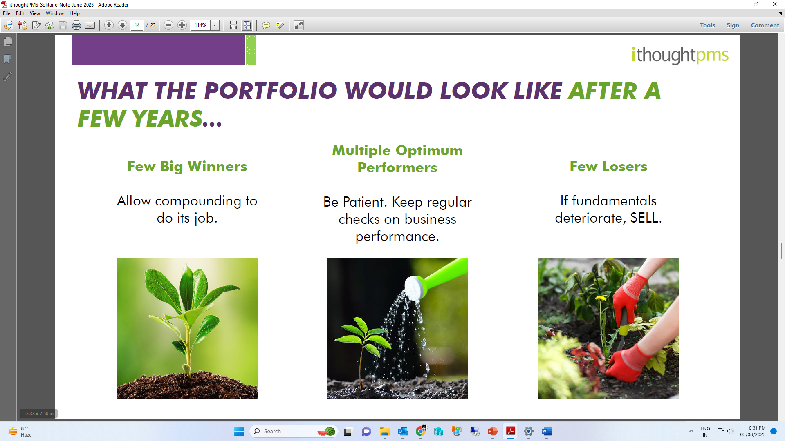
WHAT THE PORTFOLIO WOULD LOOK LIKE
AFTER A FEW YEARS..
Few Big Winners
Let compounding
do its job
Multiple Decent Performers
Have Patience. Keep regular checks on business performance
Few Losers
If fundamentals
deteriorate, SELL
Dynamic Gems – The Art and Science behind Identifying Stocks

Slide 108

Case Study on Stock Picking and Choosing Son in Law (Jawaai)
All parents are more concerned about their daughters and their future life as compared to their sons. They want to find the most perfect and most compatible partner for her. All parents want 100% assurance that their daughter will spend a good and happy life after marriage. They have some basic expectations from him like:
Good looks and physically fit
Well educated and well-mannered
Good & Comparable Family background ( is family nice and will they love and respect her)
Social status & reputation (are they clear from any sort of police / court cases or anything that affected their name in society)
Wealth (How wealthy a person and his family)
Character & habits of the groom (If groom smokes etc it become negative point for him)
Sensitive, caring, loving and responsible
Financially and professionally stable
Able to take care of his family in future
Understanding and liberal
Give her respect and should be compassionate
Mentally strong and able to make his own decisions if situation comes
Able to support and remain with her in all situations and conditions
Should remain loyal to her
Compatible to her
One gives Higher Valuation
to the Most Eligible Bachelor
Insaan sabse jyada research Jawaai chun
ne main karta hai..
Stocks bhi waise hi dhoondne chaahiye…
Dynamic Gems – The Art and Science behind Identifying Stocks

Slide 109
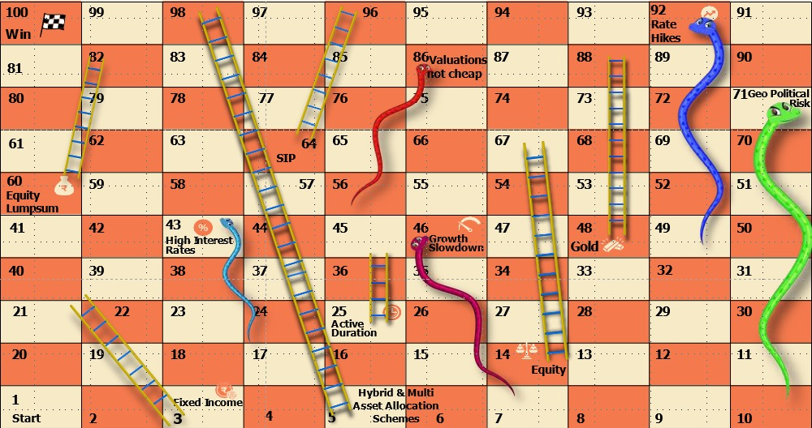
Sap Sidi of
Stock Market

Slide 110
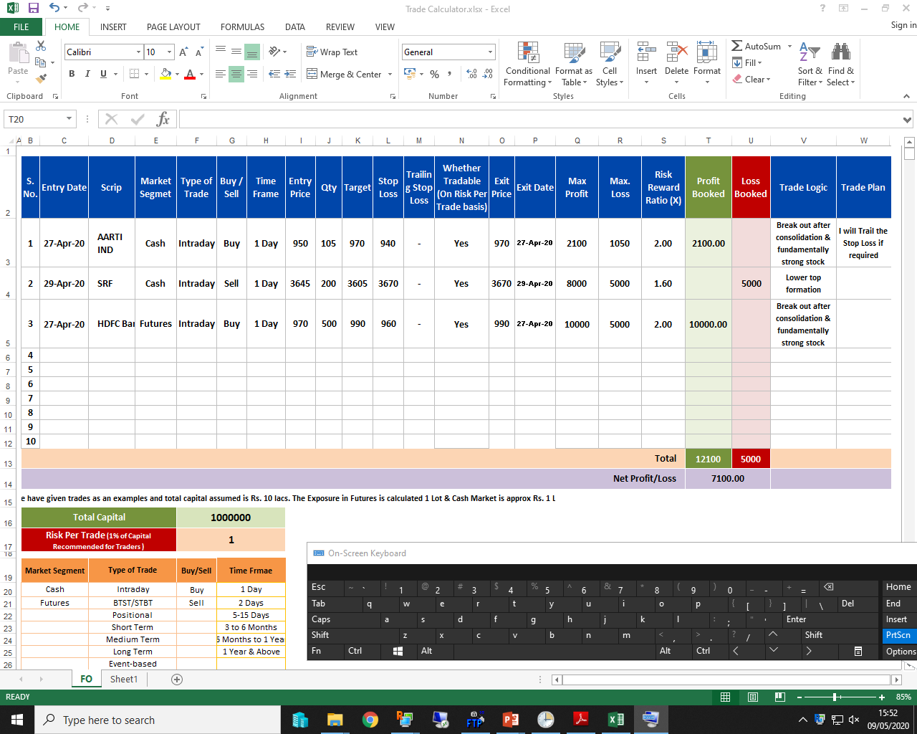
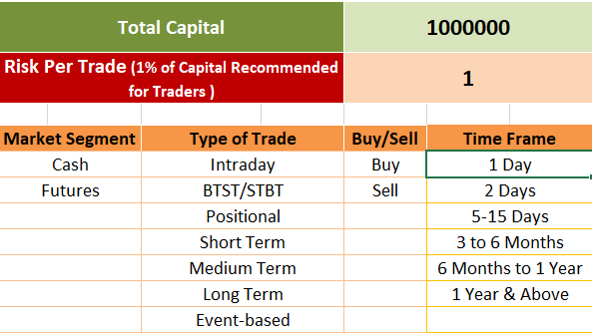
Investment & Trading Planner
Dynamic Gems – The Art and Science behind Identifying Stocks

Slide 111
Picks of the Seminar
Stocks | Recommended Price | Target | Time Frame
Gandhi Special Tubes Ltd | 850 | 950/970 | 6 to 9 Months
KNR Constructions Ltd | 259 | 310/330 | 3 to 6 Months
India Tourism Development Corporation Ltd | 670 | 790/830 | 3 to 6 Months
Craftsman Automation Ltd | 4456 | 5030/5150 | 9 to 12 Months
NESCO Ltd | 890 | 1030/1070 | 6 to 9 Months
Panasonic Energy India Company Ltd | 538 | 630/670 | 6 to 9 Months
Panasonic Carbon India Company Ltd | 513 | 590/630 | 6 to 9 Months
Disclaimer : It is safe to assume that the similar advice has been given to our clients also, please take into consideration all the risk factors including your financial condition, suitability to risk return profile and the like and take professional advice before investing.

Slide 112


Dynamic Gems – The Art and Science behind Identifying Stocks

Slide 113


PMS
Our Dynamic Gems (FlexiCap) Strategy
Tradeswift Dynamic Gems (the “Flexicap Strategy”) is a diversified equity strategy that endeavours to achieve long term capital appreciation and generate returns by investing across market capitalisations and across different listed instruments.
The Flexicap Strategy comprises a ‘Core’ and ‘Satellite’ portfolio strategy. The Core Portfolio could be 55% - 65% is predominantly targeted towards sectors which are value on an absolute and relative basis.
The Satellite Portfolio will be a blend of investment strategies that are aimed to be inline with the GARP (Growth at Reasonable Price) Philosophy. This bucket will be used opportunistically to book profits.
Satellite
Core
The Strategy features as stated herein is only indicative in nature and is subject to change within the provisions of the disclosure document and client agreement
Dynamic Gems – The Art and Science behind Identifying Stocks

Slide 114
Success Mantra in Markets
“Spend lesser money than you make.
Save the difference.
Buy a diverse portfolio of different asset classes.
- Be patient.”
Sandeep Jain

Slide 115
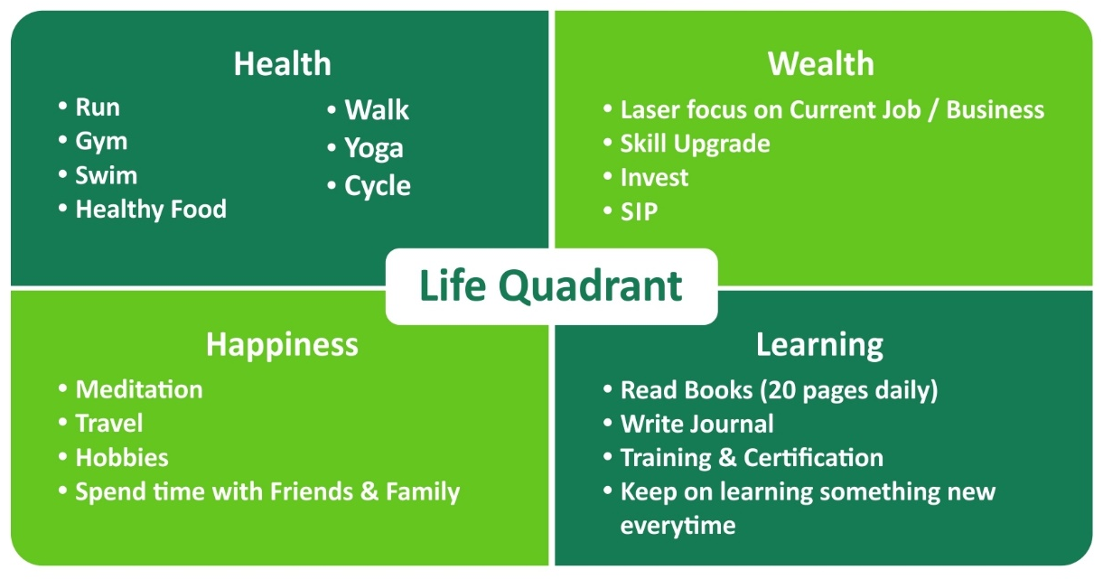

Slide 116
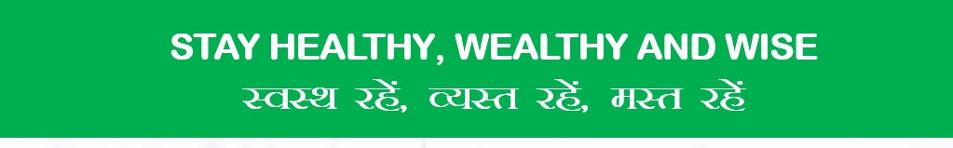
Thank you so much for being a
Great Audience

