Slide 1
Investing in Current Times
Aashish P Somaiyaa
Executive Director & CEO
CONFIDENTIAL- DO NOT REPRODUCE OR DISTRIBUTE
These materials are provided solely on the basis of request received from the recipient and it should not be construed as an investment advice and form a primary basis for any person’s or investor’s investment decisions. See the important disclaimer at the end of this presentation.

Slide 2
Has the market gone up too much?
Is Indian equity market too expensive?

Slide 3
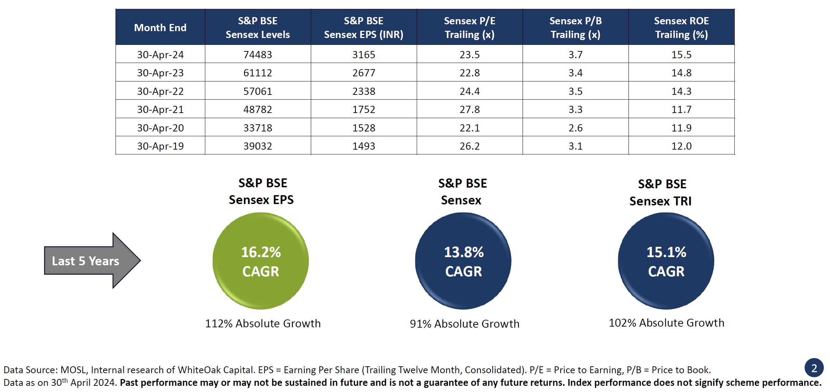
The story so far…

Slide 4
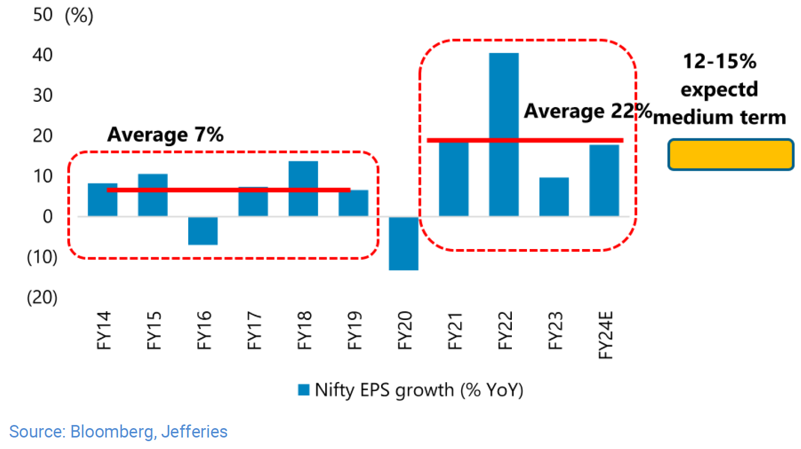
Nifty Earnings Growth Trend

Slide 5
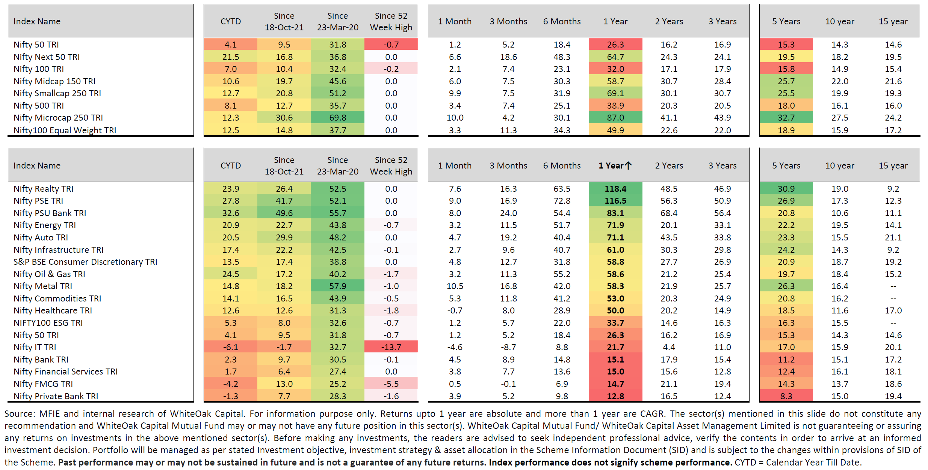
Key Sectoral and Market Cap Indices

Slide 6
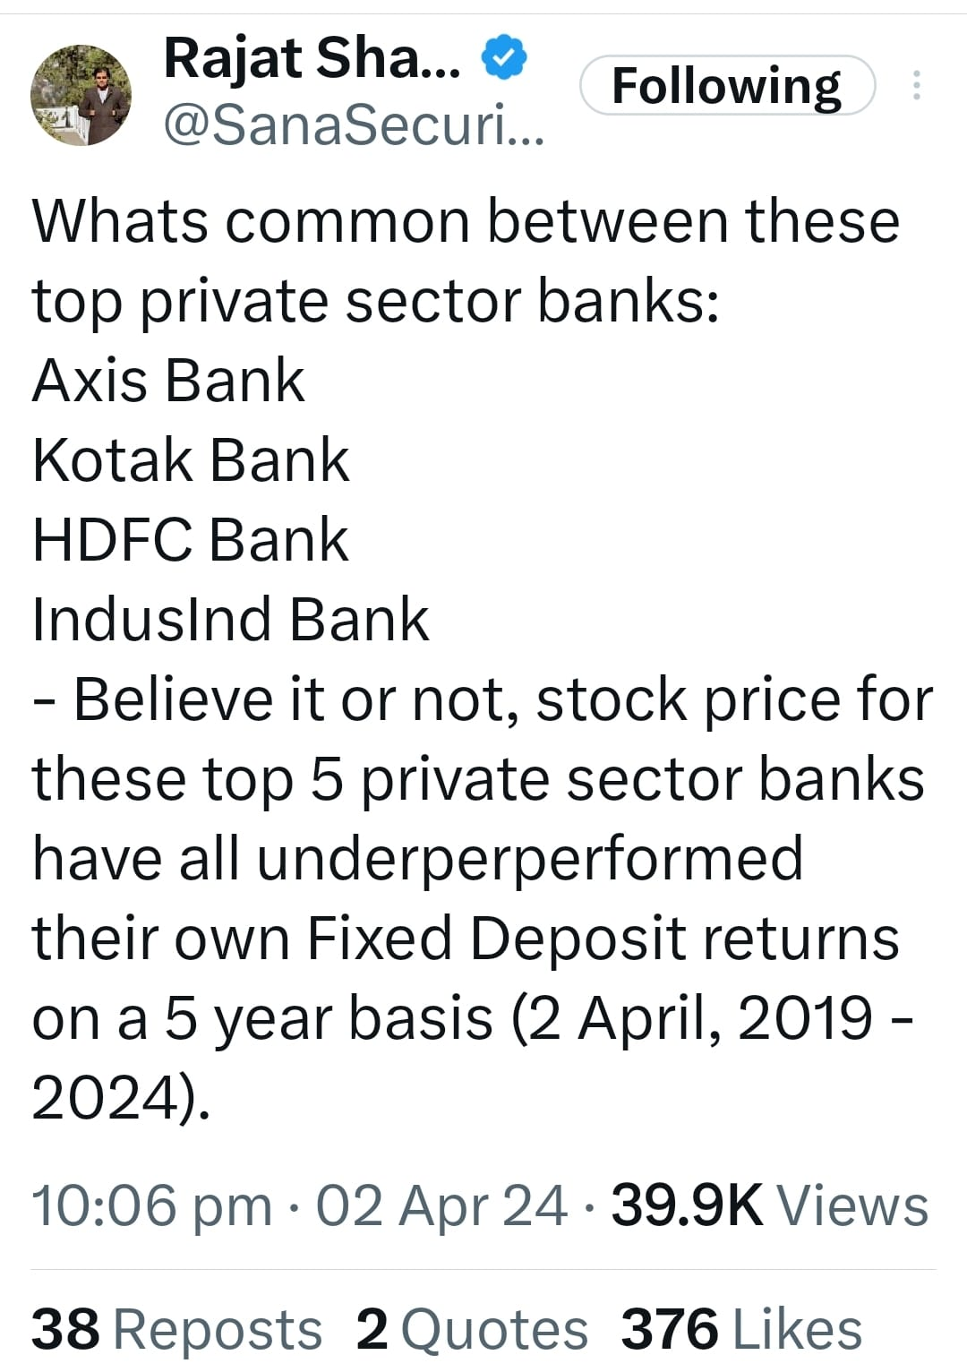

Slide 7
When macroeconomic parameters change, the best performing style, sector and market cap will change
Alpha comes from Active Weights
Active Weights result in Active Risk
Please understand what drives performance
Don’t chase past alpha
You’ve got to shoot where the rabbit will be, not where the rabbit was

Slide 8
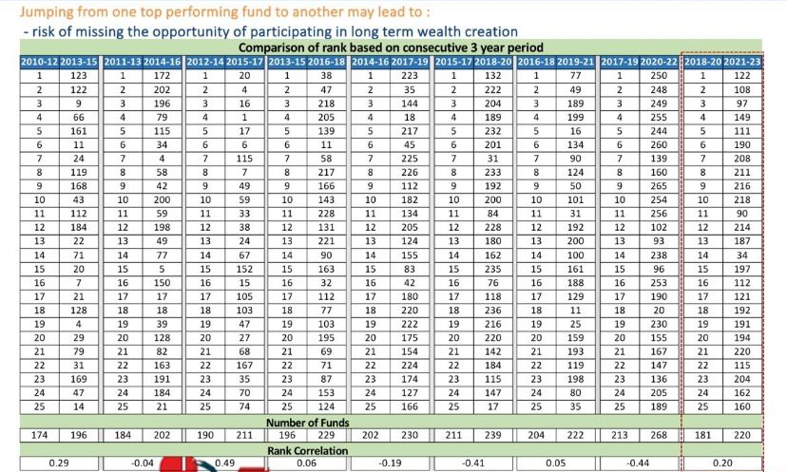
Chasing performance leads to accidents…

Slide 9
India as a global investment destination

Slide 10
What we take for granted…
Historical growth and returns: Compounded Annual Growth Rates
FY93-FY23: 11.7% CAGR
Sensex Return (%)
FY 20-23: 20% CAGR
FY93-FY22: 12.6% CAGR
FY93-FY23: 12.3% CAGR
Nominal GDP Growth (%)
FY 08-20: 5% CAGR
FY 03-08: 25% CAGR
FY 96-03: 1% CAGR
FY 93-96: 45% CAGR
Corporate Profits as a Percentage of GDP
Average Return on Equity from 2002-2022
India | 16.5%
Asia Pacific ex-Japan | 12.0%
Emerging Markets | 12.5%
World | 11.2%
Source: Motilal Oswal Institutional Research, Spark, Bloomberg, White Oak Research; As at March 2023; CAGR refers to Compounded Annual growth Rate, EPS= Earnings per share, FY=Fiscal Year (ending March). GDP = Gross Domestic Product, FY23 GDP estimate as per the CSO (Central Statistical Office, Government of India).

Slide 11
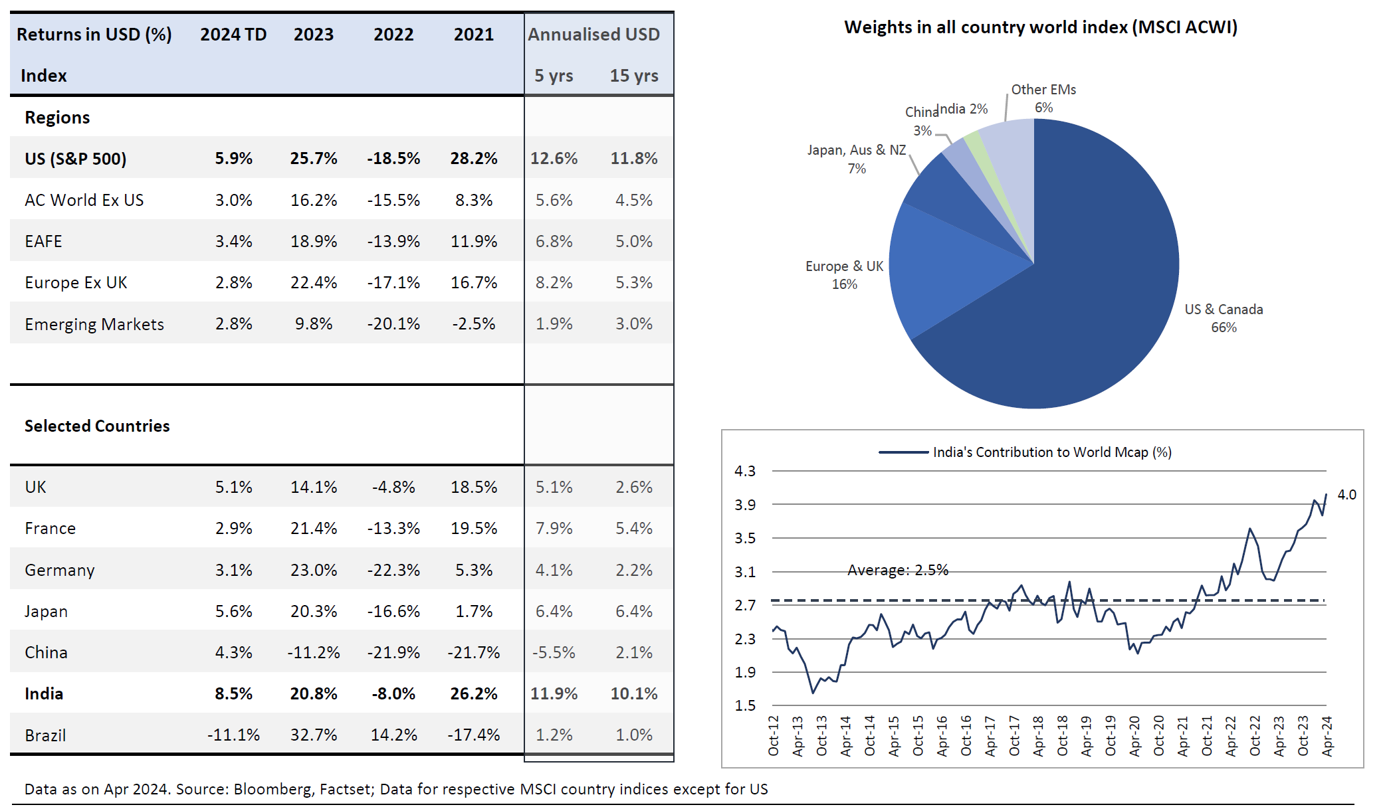
Returns across emerging markets…does all growth result in profits?

Slide 12
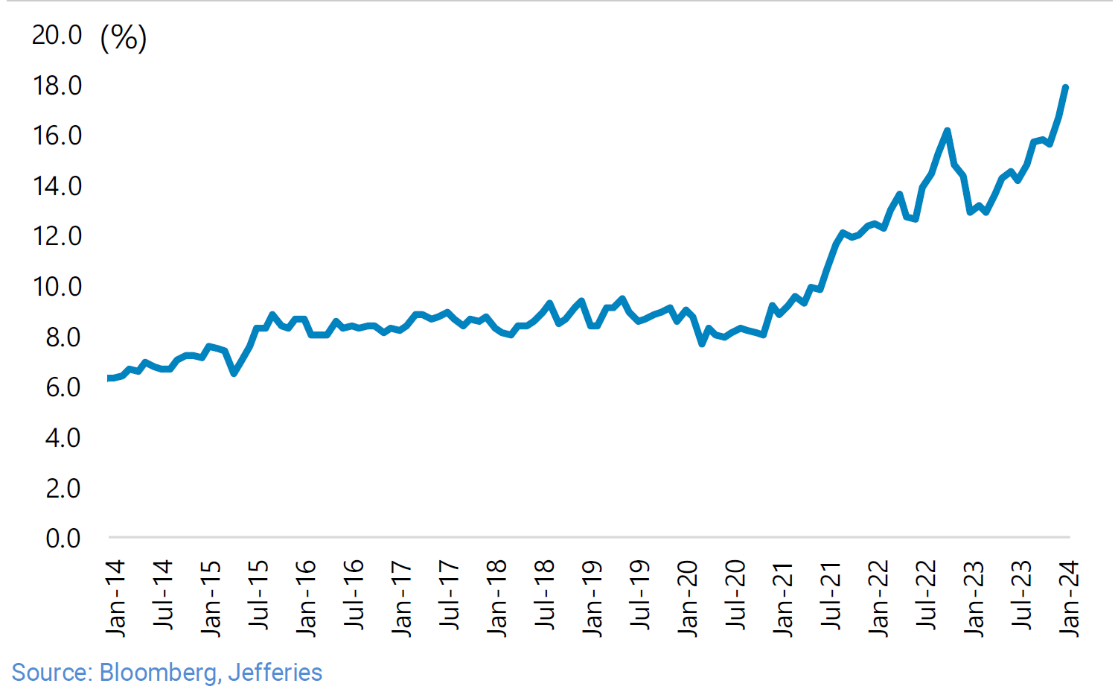
Hence… India’s weight in Emerging Markets

Slide 13
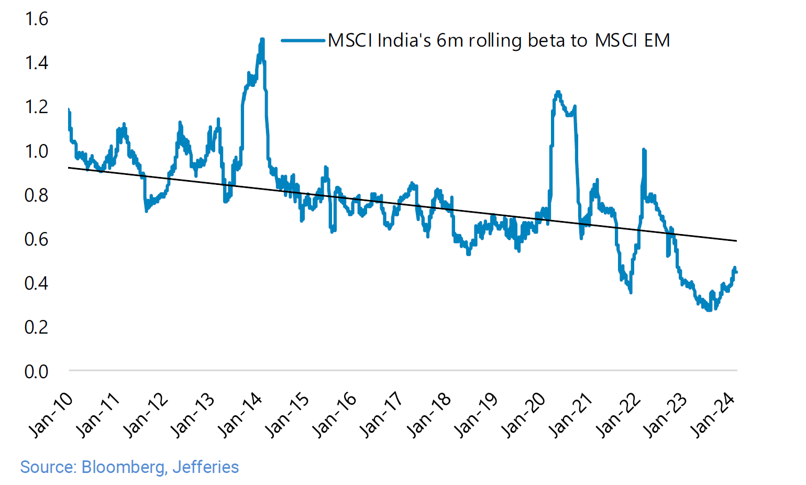
Reducing correlation and volatility vis-à-vis Emerging Markets

Slide 14
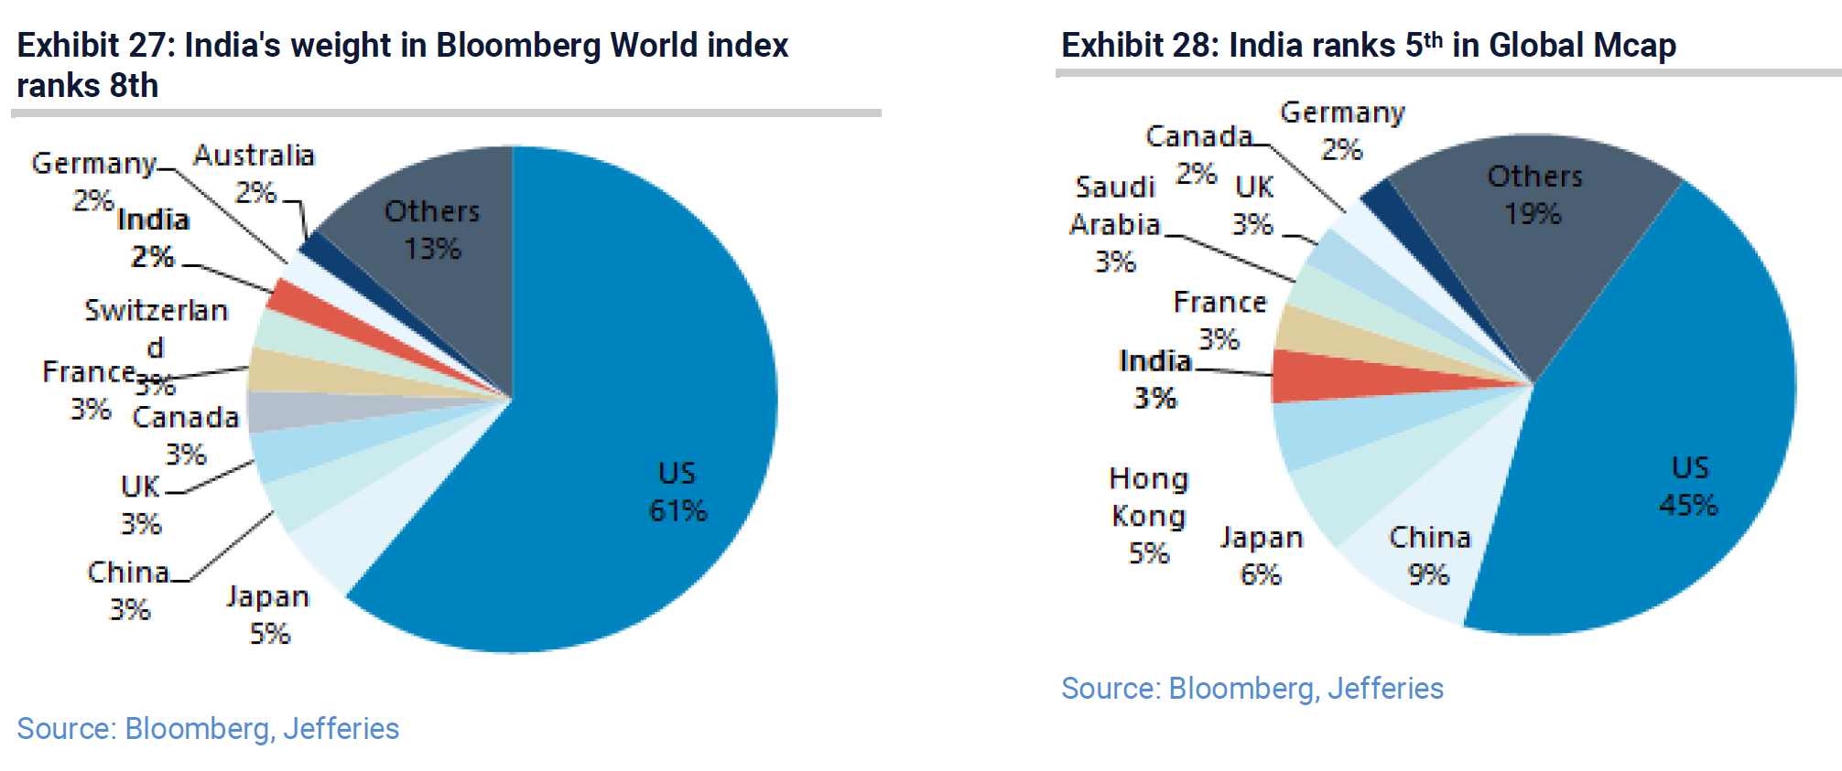
Long way to go…

Slide 15
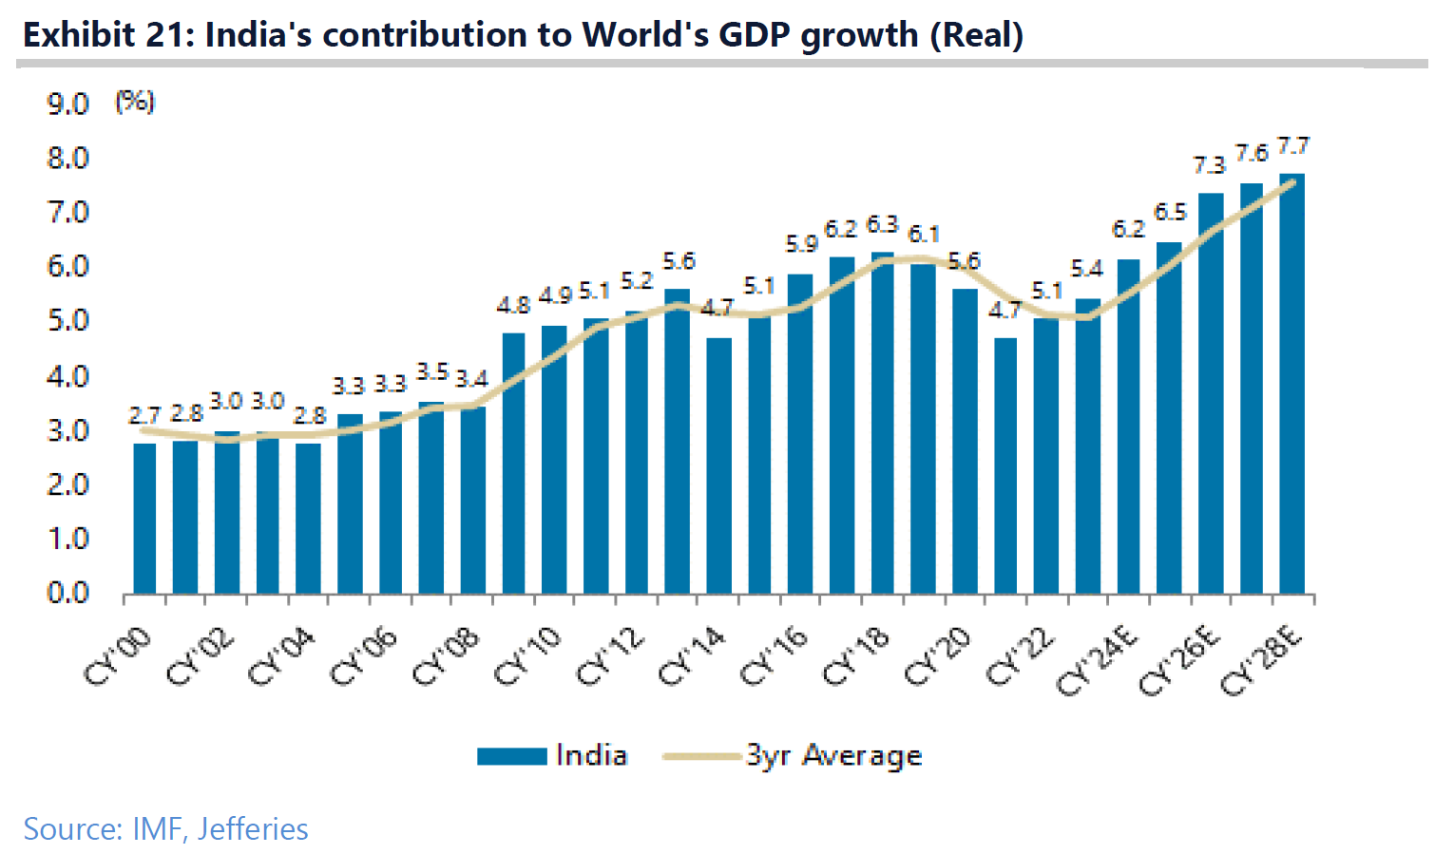
Long way to go for rising contribution to get recognised and future to be discounted…

Slide 16
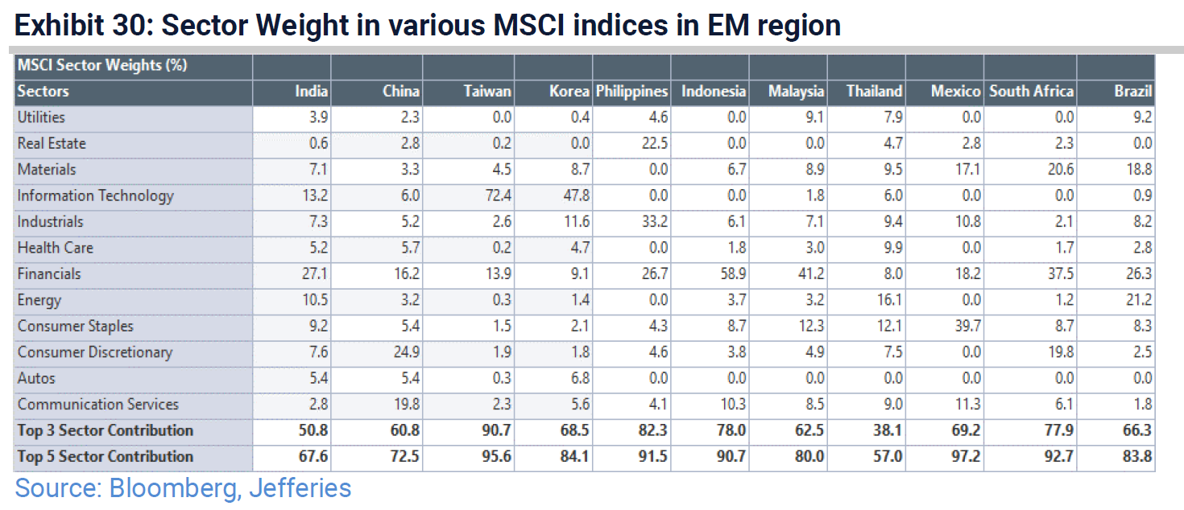
Diversity and richness of investment opportunities

Slide 17
Democracy and SOE composition impact PE multiples
PE differential – Most and Least Democratic countries
PE differential among EM universe – SOE vs non SOE
Median PE
Sample list of countries that are most democratic (Net Democracy score >= 8) | India, Taiwan, Indonesia, South Africa, Poland, Brazil, Chile
Sample list of least democratic economies (Net Democracy score < 5) | China, Egypt, Ukraine, Russia, Saudi Arabia, Turkey
Source: Polity Project Database, Factset, data updated till Dec 2022
Notes:
Median PE - Y Axis

Slide 18
Democratic Institutions and Minority Investor Protection - India vs EM
Net Democracy Score- India vs EMs
Minority Investor Protection Rank – India vs EMs
Source: World Bank Doing Business Report 2020, Polity Project database
.* Net Democracy Score = Polity score obtained by deducting autocracy score from democracy score. In the Polity database, countries are rated between -10 (full autocracy) to +10 (full democracy).

Slide 19
The best is yet to come..

Slide 20
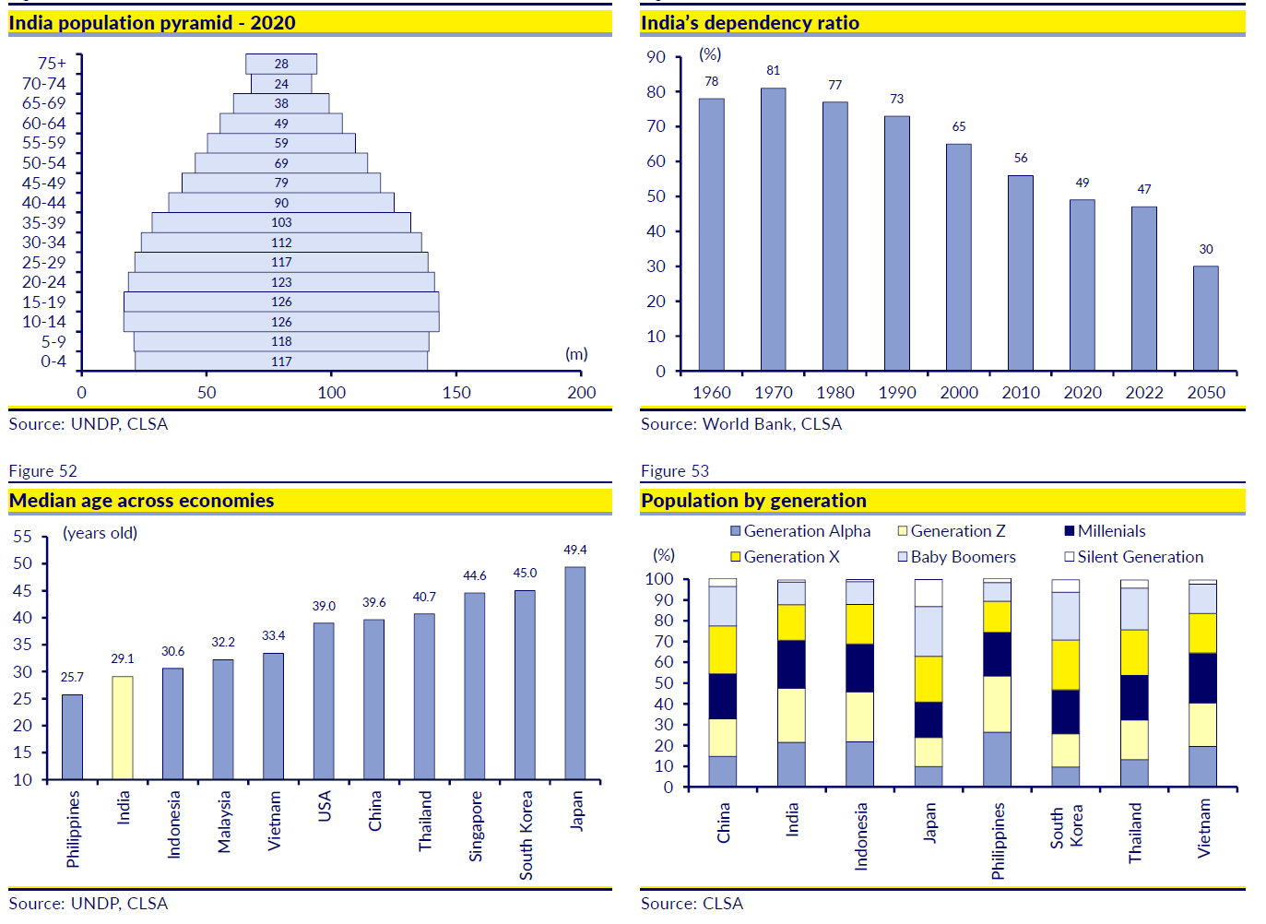
Demography

Slide 21
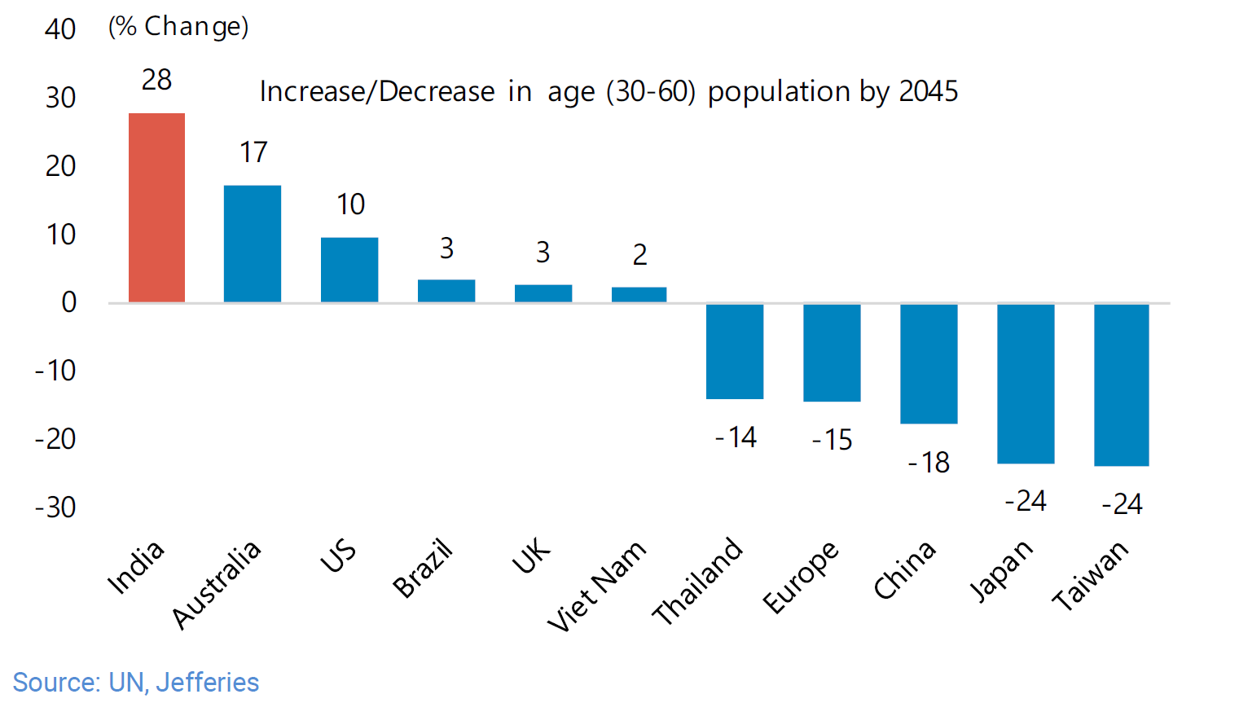
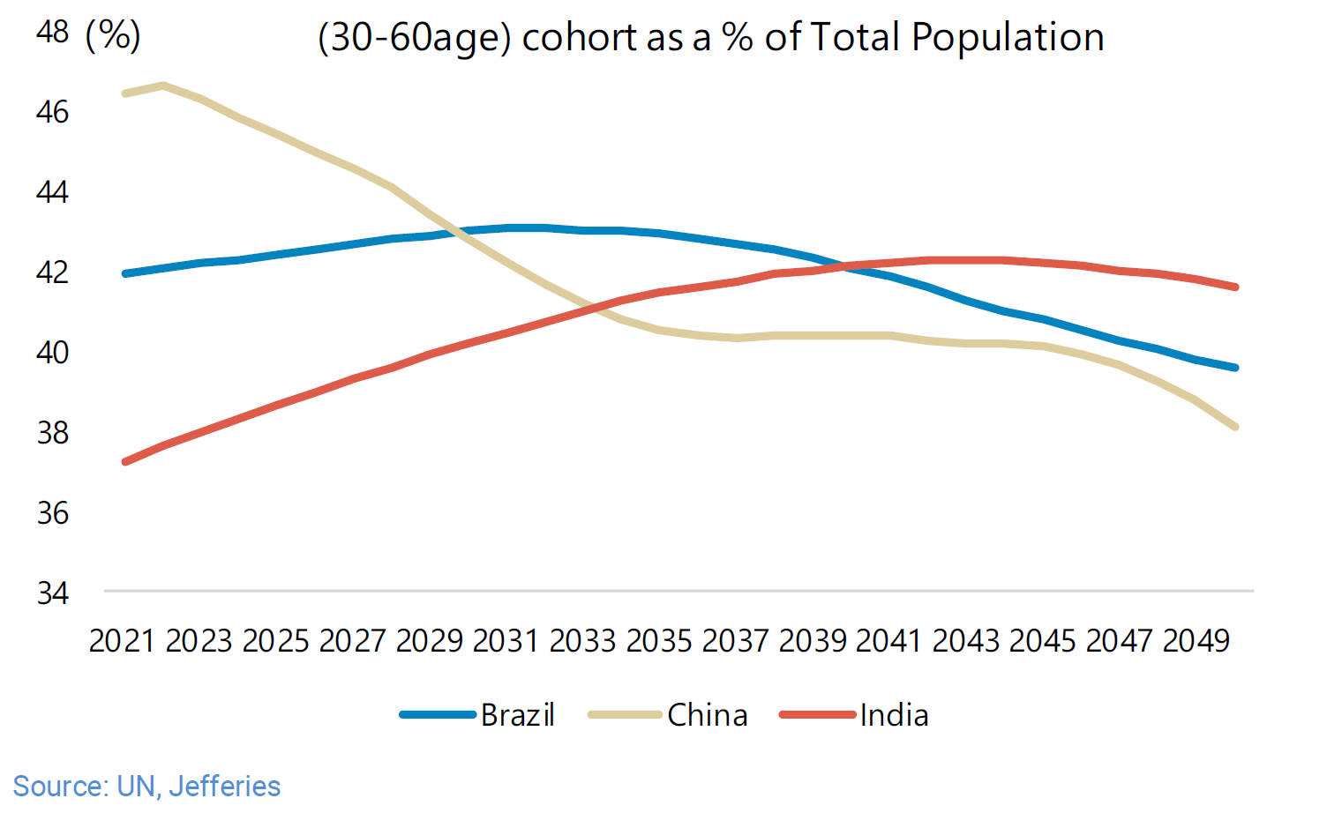
Demography

Slide 22
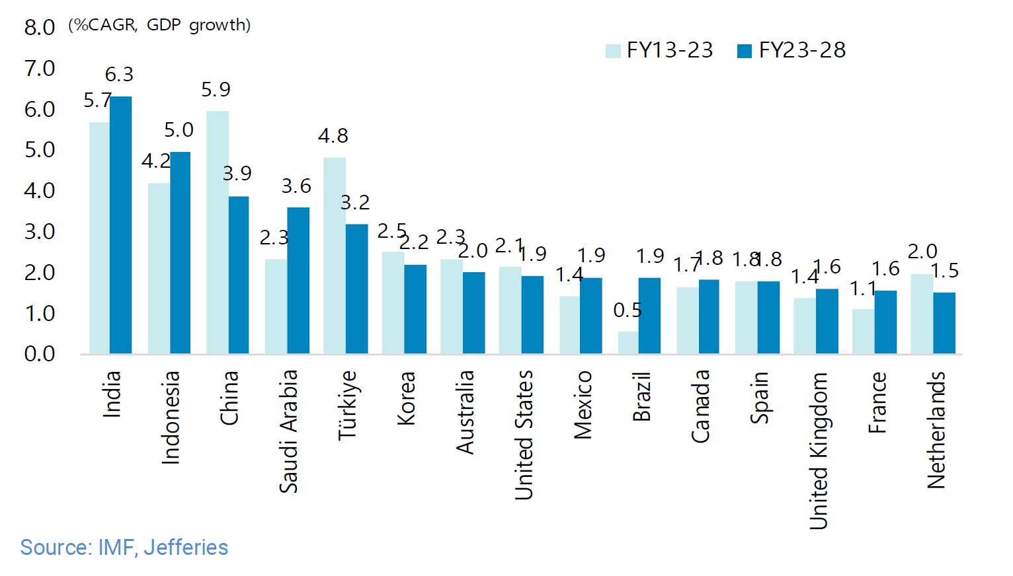
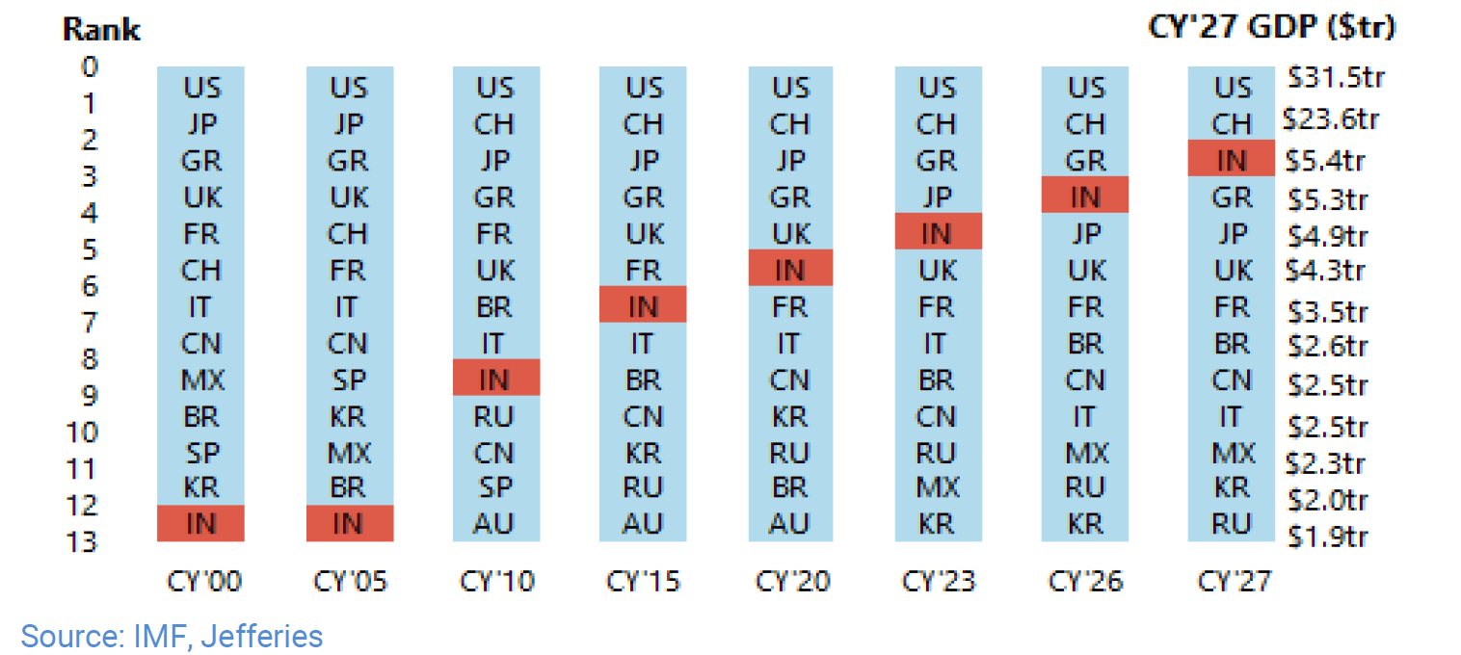
Economic growth prospects…

Slide 23
Facts about investments and returns..
Returns are made on growth…investments will always chase growth
Growth is a function of population and productivity of population
Growth is relevant only at scale; there are no economies with $4tn GDP growing at 7%+
India will be the biggest consumer market, labour market and highest growth investment destination for the foreseeable future
India will be the amongst the largest contributors to the world’s growth

Slide 24
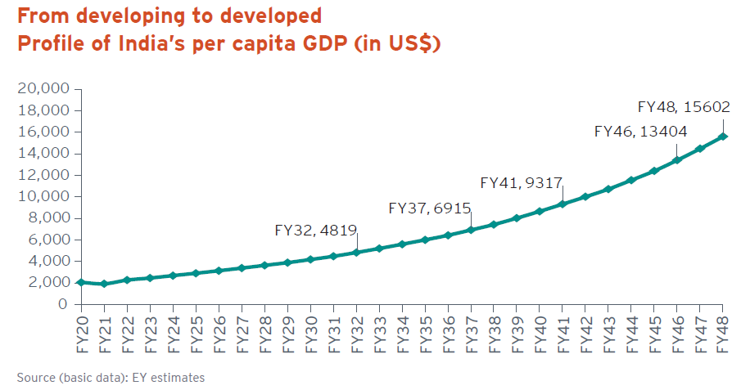
Projected Per Capita Income…
Source: EY India @ 100

Slide 25
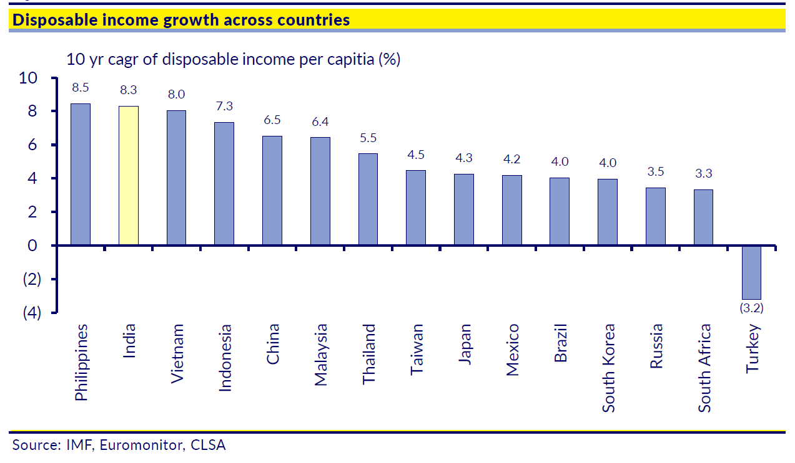
Growing fast …

Slide 26
Effect of Rising Per Capita Incomes…
Retail
Credit
Inflection points of consumer goods at various per capita GDP levels
Per capita GDP, US$
Real estate
Mobility
Durables
US$ 8,500
Real-estate*
Recreation
High street
Credit
US$ 6,500
Recreation
Retail
Durables
US$ 3,000
US$ 5,000
Mobility
India
US$ 2,500
Mobility
Higher scope for value add
Real estate
Real-estate
Lower scope for value add
Credit
Credit
Retail
Years of economic progress
Retail
Source: Bain, IMF, White Oak, * includes ancillary segments like building products and home improvement

Slide 27
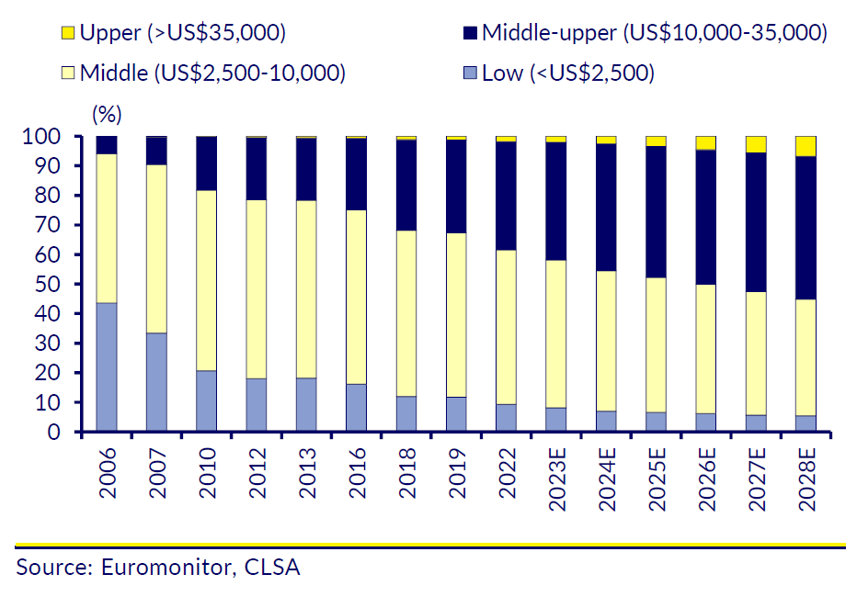
Impact…
$2000 + signifies rising share of discretionary spending; the number of households with earnings >$35K is likely to rise 5x

Slide 28
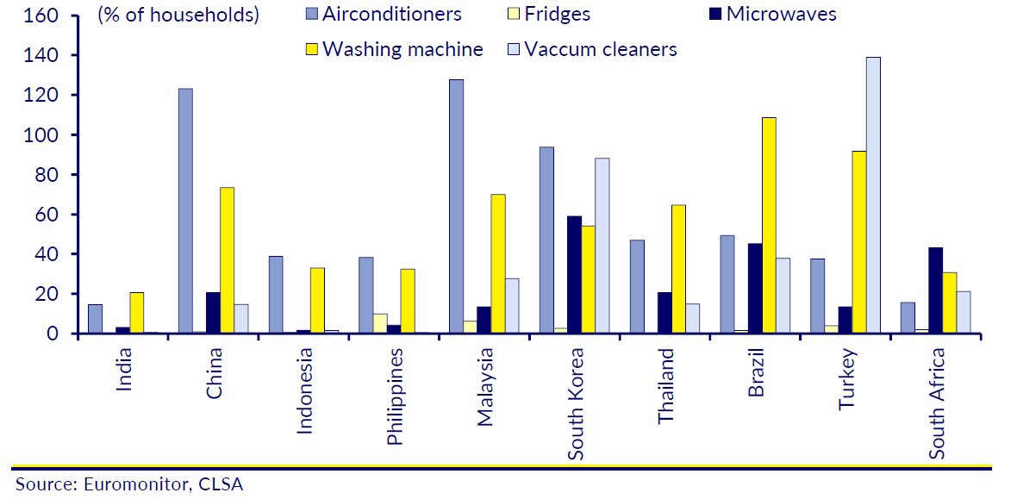
Impact…

Slide 29
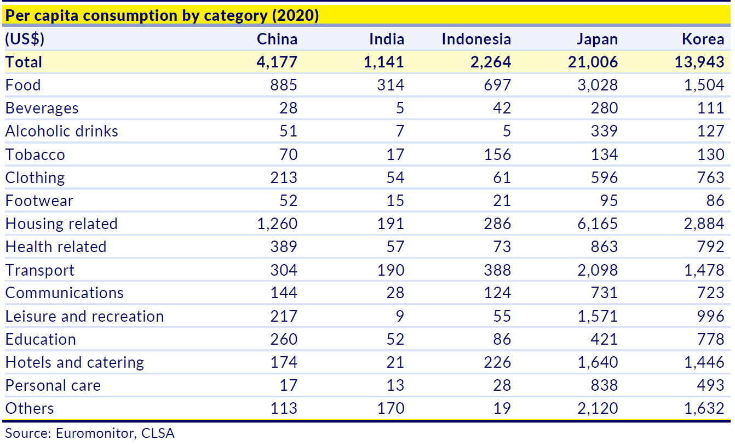
Impact…

Slide 30
The India Opportunity Funnel: From internet user to buyer
2023 (mn)
2028 (mn)
Population
4G connections
Digital payment penetration
OTT Users
Online Transactors
Online Buyers
ROD/OFD Users
Online AST
1,500
1,420
Large unmet demand
< 160mn MF folios
< 33mn NSE active demat accounts
< 100mn credit cards
< 60mn retail health insurance
800
1,110
40%
75%
480
780
380
750
220
400
80
150
15
60
ROD: Ride on Demand, OFD: Online Food Delivery, AST: After School Tutoring (Ed-Tech), Source: UBS, Jefferies estimates

Slide 31











Investible universe evolving and expanding…
Spate of IPOs in niche segments*
Source: Factset, Nuvama Research, White Oak, * for representation purposes and indicative list only

Slide 32




















Tech disrupting across industries
E – Commerce
Food Tech
Fintech
Health-Tech
OTT / Gaming/Ent
Ed-Tech
Illustrative list
Size (US$bn)
60.0
6.5
$1tn (txn value)
1.0
4.5
4.0
Next 5 yr CAGR
22-27%
20-25%
25-30%
40-45%
25-30%
25-30%
Traditional Banks
Traditional Media / Multiplexes
Who is getting disrupted?
Traditional Retail
Restaurant Chains
Pharmacy Stores
Coaching Institutes
Ancillary Segments/Key enablers
Key drivers
Demographics, Internet penetration, Simple yet robust financial eco-system, customer behavior
Leveraging technology/internet to serve a consumer need at scale
Source: Company, BofA Global Research, Citi Research, White Oak Research, Jefferies estimates, Note: Size refers to GMV or Gross Merchandise Value

Slide 33
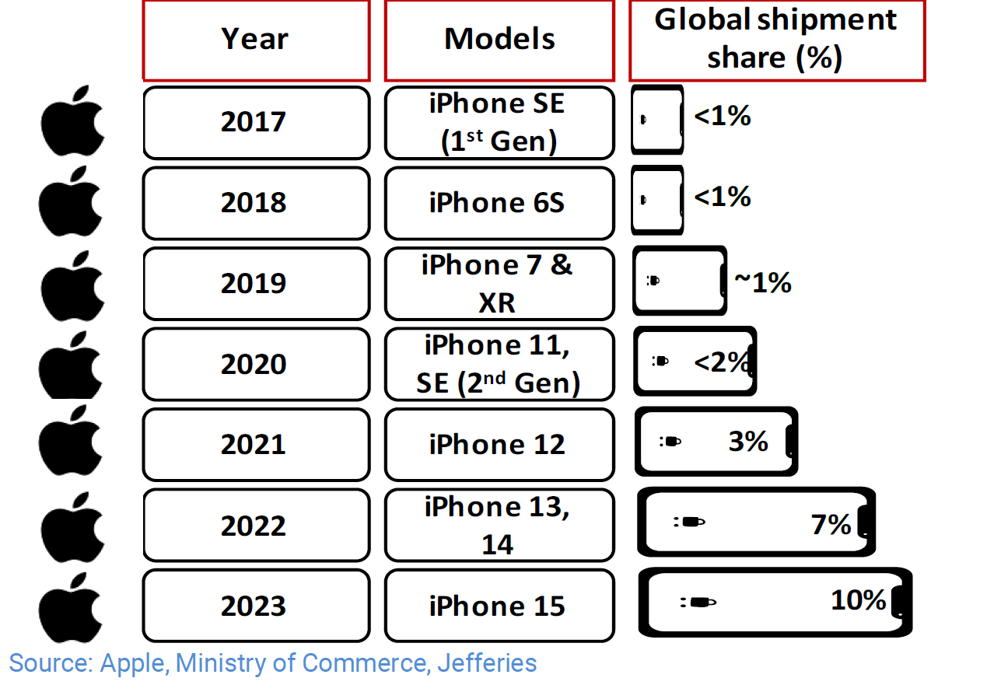
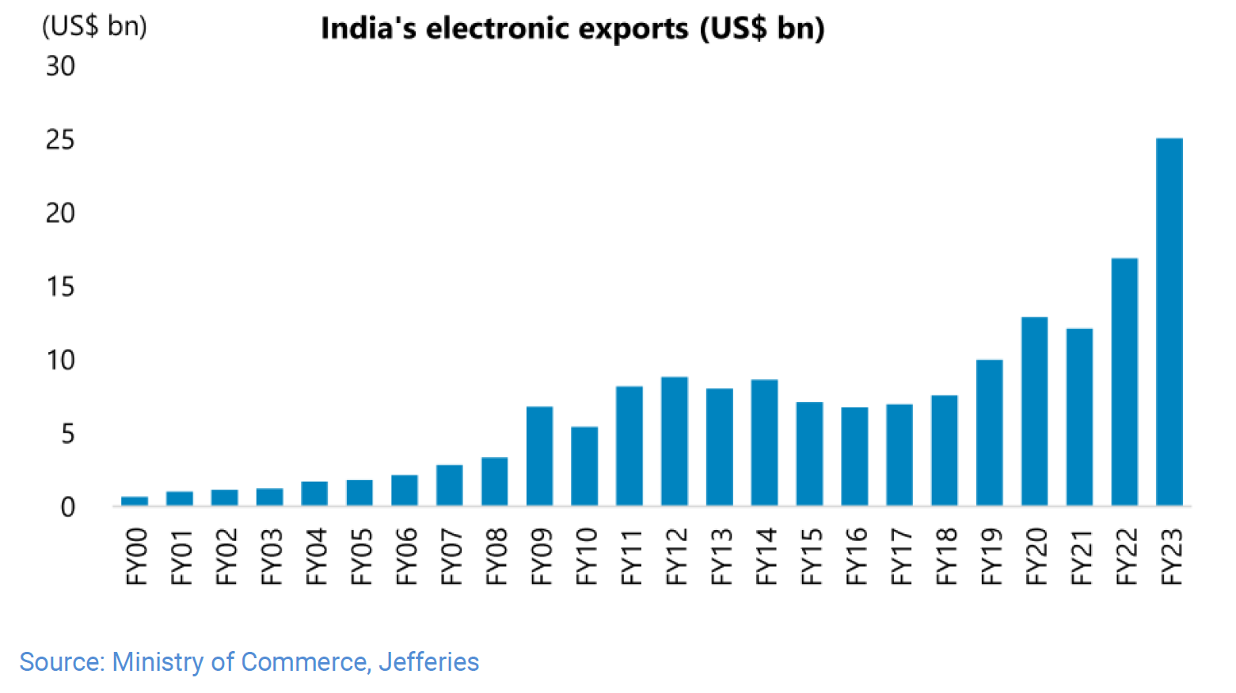
Evolving manufacturing…

Slide 34
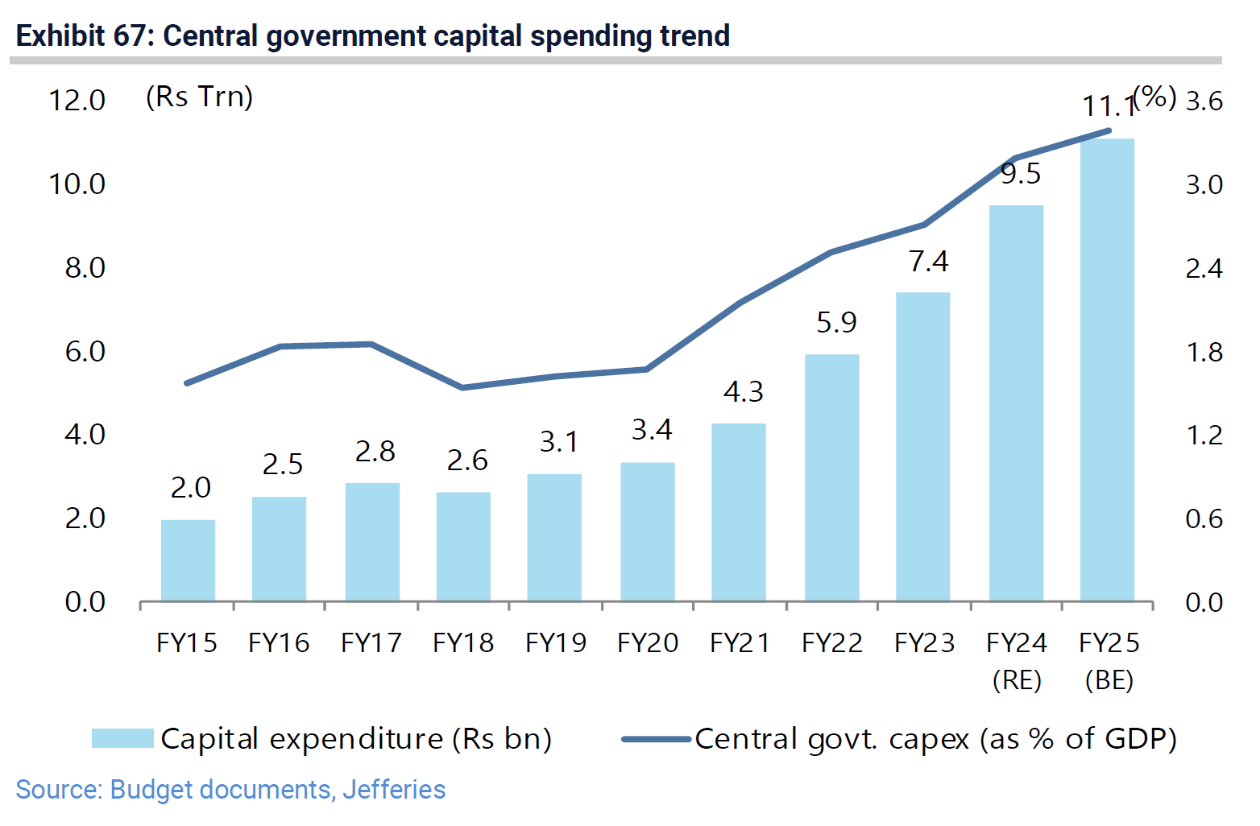
Government driving capital investment…

Slide 35
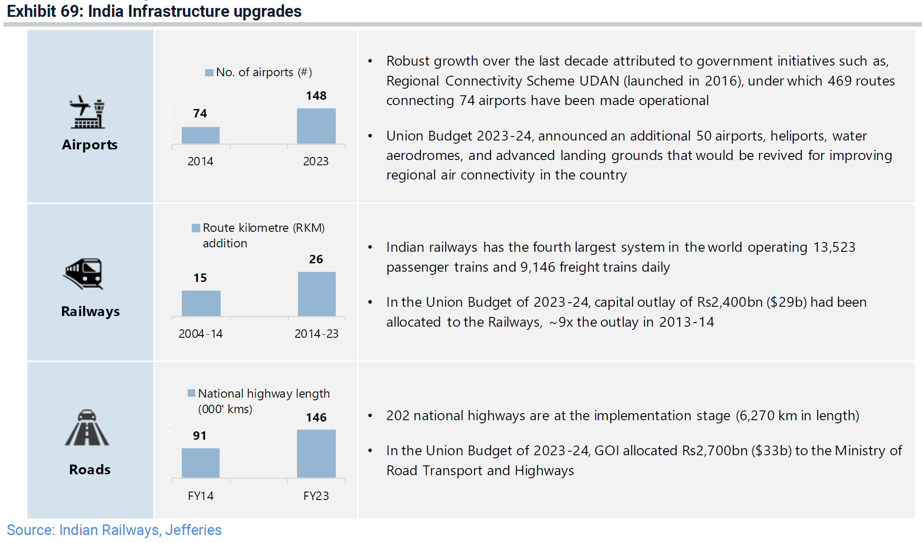
Government driving infrastructure spending…

Slide 36
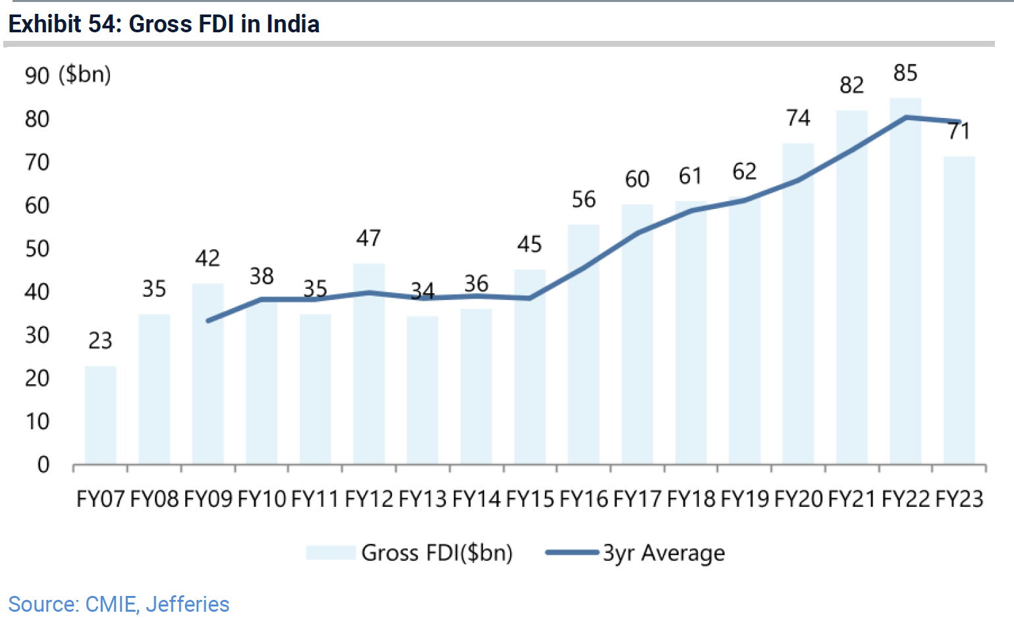
Attracting FDI…

Slide 37
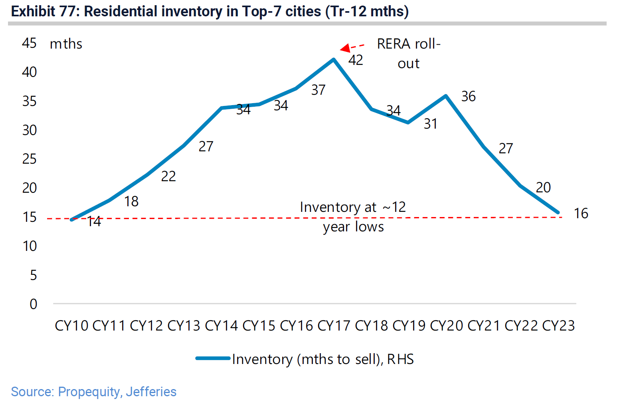
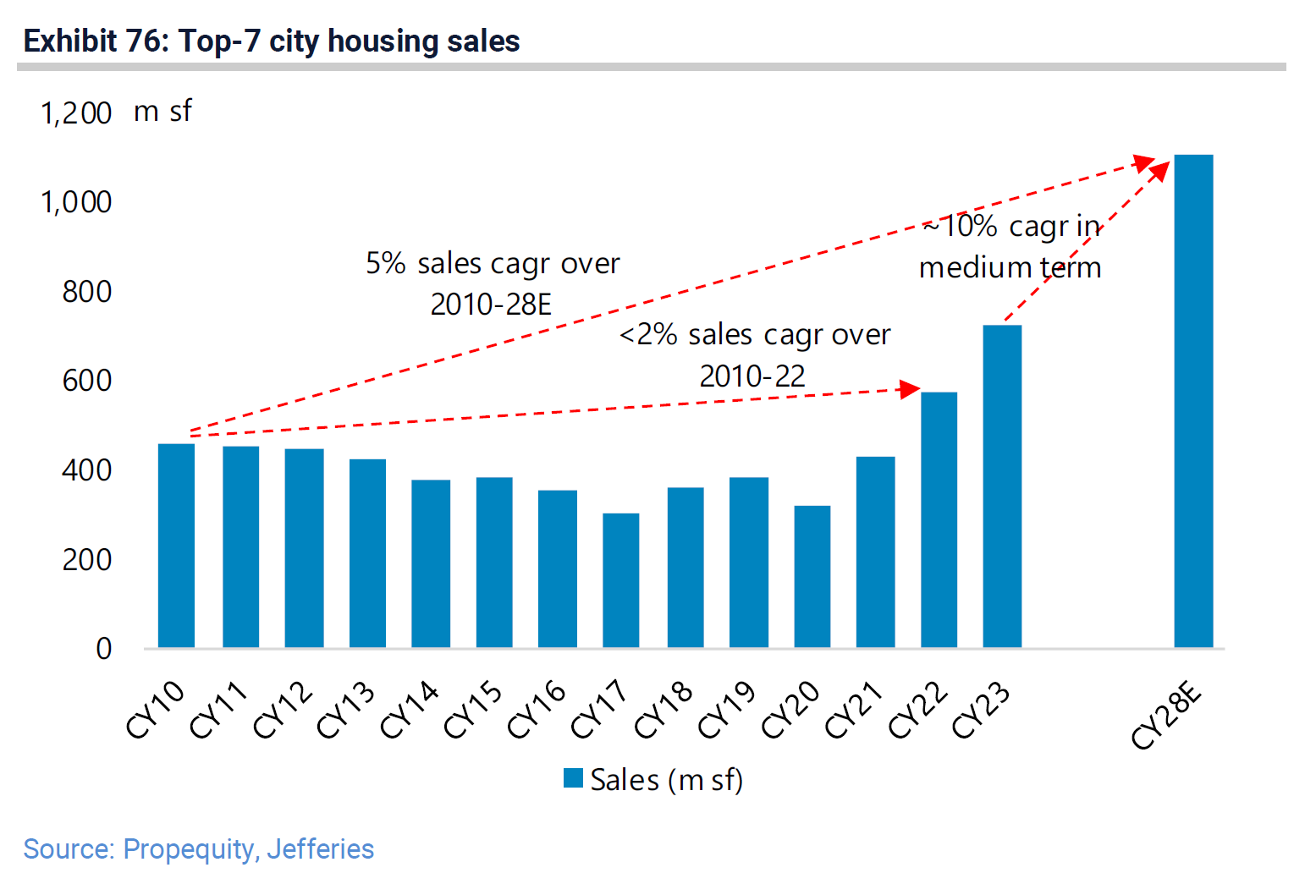
Housing growth

Slide 38
Thank You…
Right Place, Right Time… Do the Right Things
aashishps@whiteoakamc.com

