Slide 1
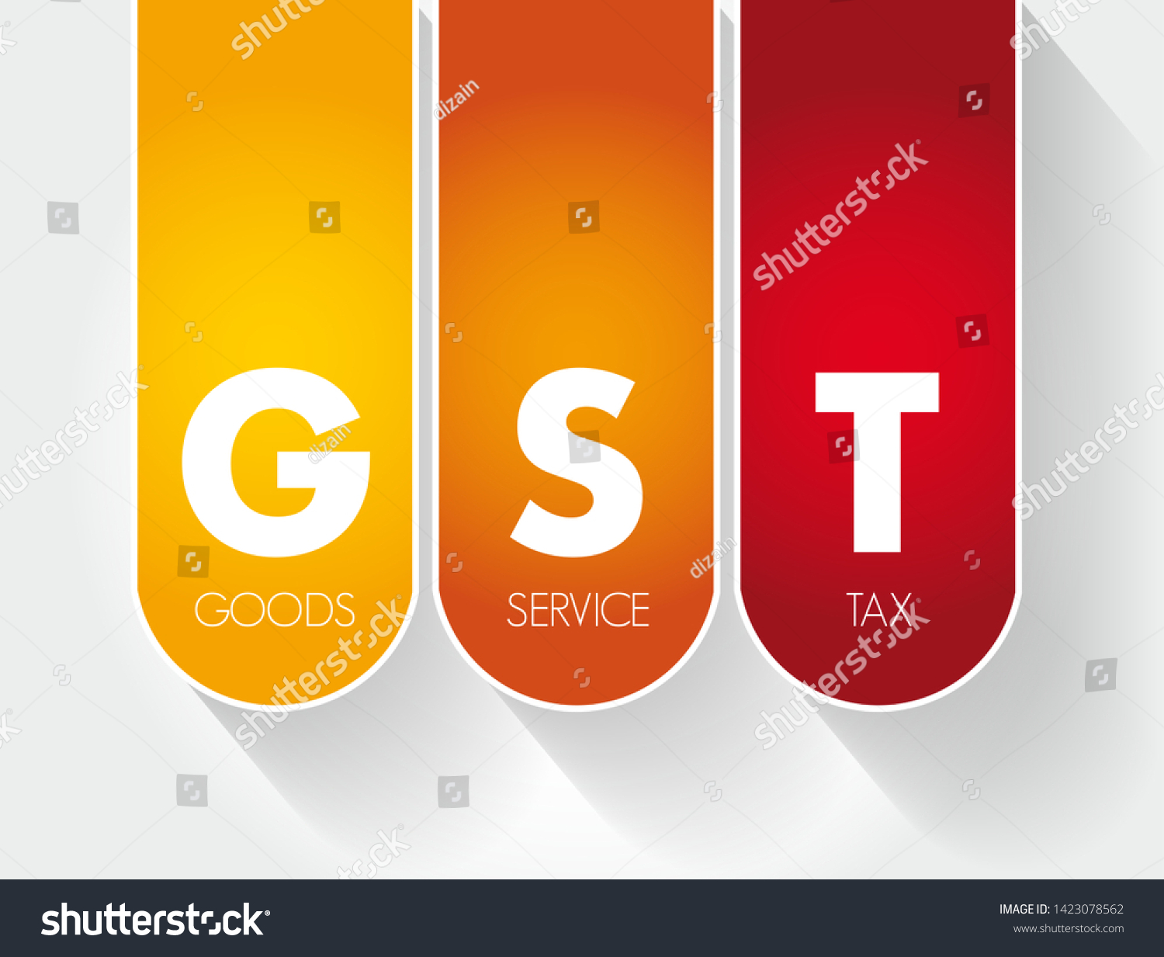

GST
Recent Amendments
Notes:
CTR - 102
CT 203
C 228

Slide 2
Notification No. 49/2019 – Central Tax – Amendment of CGST Rules
The aforesaid notification shall be effective from 9th October,2019.
Rule 21A
Rule 36(4)
Rule 61(5)
Rule 83A(6)
Rule 91
Rule 97
Rule 117
Rule 142
Notes:
6th amendment in rules
Issued on 9th October,2019

Slide 3
Restriction on ITC-New sub rule (4) inserted to Rule 36
  “Input tax credit to be availed by a registered person in respect of invoices or debit notes, the details of which have not been uploaded by the suppliers under sub-section (1) of section 37, shall not exceed 20 per cent of the eligible credit available in respect of invoices or debit notes the details of which have been uploaded by the suppliers under sub-section (1) of section 37.”
Notes:
Issues:
Section 16 – Every regd person subject to such conditions and restrictions as prescribed and in the manner specified in Sec 49
Rule 36 prescribes restriction
Sec 49 – ITC to be credited in acc with Sec 41 or 43A
Sec 41 – Every regd. person subject to Rule 69 shall be entitiled to take credit
Rule 69 - Matching of credit - still refers to GSTR 3
Similar provisions are included in section 43A of CGST Act,2017, however the said section is still not made effective.
Press Release - In order to nudge taxpayers to file their GSTR1 timely

Slide 4
Restriction on ITC-New sub rule (4) inserted to Rule 36
Invoices or debit notes uploaded by supplier u/s 37(1)i.e. invoices or debit notes reflected in GSTR 2A
Full amount of ITC can be claimed by the supplier subject to conditions specified u/s 16 of CGST Act,2017
Invoices or debit notes NOT uploaded by supplier u/s 37(1)i.e. not reflected in GSTR 2A
ITC shall be available only to the extent of 20%of eligible ITC available above.
Notes:
ITC Restriction is based on Invoices detail reflected in 2A which is dynamic.
Delay in reflection of invoices in 2A for GSTR-1 filed quarterly by the supplier.
How the balance amount will be claimed?
Periodicity of such calculation?

Slide 5
Example-CGST Rule 36(4)
Particulars | Case 1 | Case 2
Total ITC to be availed as per books | 1,00,000 | 1,00,000
Invoice Reflected in 2A | 60,000 | 90,000
Invoice Not Reflected in 2A | 40,000 | 10,000
ITC Available w.r.t invoices reflected in 2A | 60,000 | 90,000
ITC available w.r.t invoices not reflected in 2A 20% of Eligible ITC i.e Rs 60,000 | 12,000 | 10,000
Total ITC Available | 72,000 | 100,000
ITC Restricted | 28,000 | -
Notes:
ITC Restriction is based on Invoices detail reflected in 2A which is dynamic.
Delay in reflection of invoices in 2A for GSTR-1 filed quarterly by the supplier.
How will the balance amount will be claimed?
Periodicity of such calculation?

Slide 6
Status of 3B:GSTR 3B is a return u/s 39
Original Rule 61(5):Where the time limit for furnishing of details in FORM GSTR-1 under section 37 and in FORM GSTR-2 under section 38 has been extended and the circumstances so warrant, return in FORM GSTR-3B, [in lieu of FORM GSTR-3]¹, may be furnished in such manner and subject to such conditions as may be notified by the Commissioner."
1st amendment : NOTIFICATION No. 17/2017
  Words –in lieu of GSTR-3 removed
2nd amendment : NOTIFICATION No. 22/2017
  For the words “specify that”, the words “specify the manner and conditions subject to which the” shall be substituted
3rd amendment : NOTIFICATION No. 49/2019
  Words-the return specified in sub-section (1) of section 39 added
Notes:
GSTR 1 & GSTR 2
New rule – OR
All amendments Wref 1st July 2017

Slide 7
Status of 3B:GSTR 3B is a return u/s 39
Rule61(5):-Where the time limit for furnishing of details in FORM GSTR-1 under section 37 or in FORM GSTR-2 under section 38 has been extended, the return specified in sub-section (1) of section 39 shall, in such manner and subject to such conditions as the Commissioner may, by notification, specify, be furnished in FORM GSTR-3B electronically through the common portal, either directly or through a Facilitation Centre notified by the Commissioner
Further a proviso has been inserted that where a return in FORM GSTR-3B is required to be furnished by a person referred to in sub-rule (1) then such person shall not be required to furnish the return in FORM GSTR-3.
Hence, the government has now changed status GSTR-3B by referring GSTR-3B as return u/s 39.
Sub Rule 6 of the rule 61 shall now be omitted retrospectively w.e.f 1st July, 2017.The said rule talked about manner and procedure of Filling up of GSTR Form 3.
Notes:
Rule 6 omitted – reference to GSTR 3 & 3B removed
This amendment is to circumvent the Gujarat High court ruling in case of AAP & Co vs. UOI which held the that GSTR 3B is not a return under section 39.

Slide 8
TRAN I AND TRAN II Date Extended-Rule 117
TRAN 1
31.03.2019
31.12.2019
Due date of filing TRAN 1 and TRAN 2 in respect of registered person who could not submit the said declaration by the due date on account of technical difficulties on the common portal extended:
TRAN 2
30.04.2019
31.01.2020
Notes:
Rule 117 - Tax or duty credit carried forward under any existing law or on goods held in stock on the appointed day

Slide 9
Rule 142:Notice and order for demand of amounts payable under the Act
The proper officer shall, before service of notice to the person chargeable with tax, interest and penalty, u/s 73 or 74, as the case may be, shall communicate the details of any tax, interest and penalty as ascertained by the said officer, in Part A of FORM GST DRC-01A.
The assesse may file any submissions against the proposed liability, he may make such submission in Part B of FORM GST DRC-01A.
Failing which Show Cause Notice will be issued u/s 73 or 74
New Sub Rule 1A inserted

Slide 10
Filing of Annual Return Made voluntary
Notification No 47/2019
Annual Return for FY 2017-18 and 2018-19 u/s 44(1)
Registered persons whose aggregate turnover in a FY is upto 2Cr
Mandatory
Optional
Annual Return shall be deemed to be furnished on the due date if not furnished
Notes:
Deeming provision – time limit for claiming of credit - 16(4)

Slide 11
Due Date of GSTR 3B and 1 notified
New return system now to be introduced from April, 2020 (earlier proposed from October, 2019), in order to give ample opportunity to taxpayers as well as the system to adapt and accordingly specifying the due date for furnishing of return in FORM GSTR-3B and details of outward supplies in FORM GSTR-1 for the period October, 2019 - March, 2020
Notes:
Vide Notifications No. 46,45,44/2019 – Central Tax CBIC Notifies Due Date Of GSTR 3B And GSTR 1 for Oct’19 to March’20

Slide 12
Composition Scheme: Amended Provisions
Notification No 43/2019 specifies that manufacturers of aerated waters shall not be eligible to opt for Composition Levy from 1st October, 2019.

Slide 13
ITC-04 Waived Off
CBIC vide Notification No. 38/2019 – Central Tax notifies the registered persons required to furnish the details of challans in FORM ITC-04 u/s 143 read with Rule 45(3) shall not be required to furnish FORM ITC-04 for the period July, 2017 to March, 2019.
The said amendment was ought to come as the portal had several technical glitches and many taxpayers faced difficulty in filing ITC-04.
However goods dispatched to a job worker in the period July, 2017 to March, 2019 but not received from a job worker or not supplied from the place of business of the job worker as on the 31st March, 2019, has to be furnished in FORM ITC-04 for the quarter April-June, 2019.
Notes:
Last Due Date: 31st August 2019

Slide 14
Rule 138E:Blocking of E-Way bill-Date Extended
The Central Board of Indirect Taxes and Customs (CBIC) has extended the date from which the non-filers of GST returns would be blocked from generating E-Way Bill vide Notification No.36/2019-Central Tax till 21st November,2019.
Taxpayers will not be able to generate e-way bill when they default in filing of GST Returns for two periods consecutively.
Blocking of E-way Bill:
Implementation date
Old Date:21.08.2019
New Effective Date:21.11.2019
Old Date:21.06.2019

Slide 15
Reverse Charge Mechanism U/s 9(4)
Notification No. 24/2019- (CT Rate) issued amending the entry related to cement on which GST is leviable under Reverse Charge mechanism.
The condition of minimum purchase from registered dealer now removed in case of cement.
Hence on purchase of cement from unregistered person GST under RCM shall be paid by the promoter irrespective of shortfall.
RCM shall be applicable in all the cases-whether opting for 1%/5% or 12%-earlier it was applicable only on projects with GST rate of 1%/5%.
Notes:
Anomaly removed

Slide 16
Reverse charge Mechanism
CBIC notifies certain services under Reverse Charge Method u/s 9(3):
Supply of services by authors, music composers, artists by way of transfer or permitting the use or enjoyment of a copyright - RCM on producer, publisher, etc.
Services provided by suppliers paying GST @ 5% by way of renting of a motor vehicle by a non corporate to a body corporate – RCM on body corporate.{If supplier charges 12% with ITC then no RCM}
Services of lending of securities under Securities Lending Scheme, 1997 ("Scheme") of SEBI – RCM on borrower
Notes:
LLP – body corporate or firm - Notification no.13/2017

Slide 17
Exemption to certain services
CBIC vide Notification No. 21/2019-Central Tax (Rate) and Notification No. 20/2019-IntegratedTax (Rate) exempted following services from GST:
Warehousing
Services by way of storage or warehousing of cereals, pulses, fruits, nuts and vegetables, spices, copra, sugarcane, jaggery, raw vegetable fibres such as cotton, flax, jute etc., indigo, unmanufactured tobacco, betel leaves, tendu leaves, rice, coffee and tea
Transportation
The validity of conditional exemption of GST on export freight by air or sea increased by another year, i.e. till 30.09.2020
Export promotion
Services provided by an intermediary to a supplier of goods or recipient of goods when both the supplier and recipient are located outside the taxable territory is now exempted
Specified documents to be maintained for 5 years.
Government Services
Service received from government exempt for business entities with aggregate turnover upto the limit for which registration is not required.
Notes:
Earlier storage of agricultural produce exempted

Slide 18
Rate Changes: Hotel & Restaurant Services.
Services | GST New Rates | GST Old Rates
Hotel Accommodation Transaction Value per Unit (Rs) per day < Rs 1000 | Nil | Nil
Hotel Accommodation Transaction Value per Unit (Rs) per day Rs 1001 to Rs 7500 | 12% | 12% upto 2499 18% on 2500-7500
Hotel Accommodation Transaction Value per Unit (Rs) per day Rs 7501 and more | 18% | 28%
Outdoor catering services other than at “Specified Premise” | 5% without ITC | 18% without ITC
Outdoor catering services in “Specified Premises | 18% with ITC | 18% with ITC
Restaurant Service other than at “Specified Premise” | 5% without ITC | 5% without ITC
Restaurant Service at “Specified Premise | 18% with ITC | 18% with ITC
Note: “Specified Premise” means premise providing hotel accommodation service having declared tariff of any unit of accommodation above Rs 7500 per unit per day or equivalent.
Notes:
Declared Tariff: Without any discount
For common ITC reversal such services with ITC restriction deemed to be exempt supplies

Slide 19
Job work service:
Rate of GST reduced from 5% to 1.5% on supply of job work services in relation to diamonds reduced (Entry no 26(ib))
Job work in relation to bus body building would remain at 18% (Entry no. 26(ic)
Services by way of job work other than (i), (ia), (ib) and (ic) taxable at 12% (Entry no. 26(id))
Existing entry no. 26(iv)
  Manufacturing services on physical inputs (goods) owned by others, other than (i), (ia), (ib), (ic), (id), (ii), (iia) and (iii) above – taxable at 18%

Slide 20
Job work service
A new a residuary provision (id) to entry no 26 has been inserted which states that GST at 12% shall be charged on services by way of job work other than (i),(ia),(ib),(ic) above.
It is to be noted that GST rate of Entry No 26 (iv) remains unchanged at 18% i.e. GST on Manufacturing services on physical inputs (goods) owned by others shall be 18%.
Notes:
Press release 20th Sep - Rate of GST reduced from 18% to 12% on supply of machine job work such as in engineering industry
Confusion in entry id and iv – whether job work wise or nature of activity wise
job work means any treatment or process undertaken by a person on goods belonging to another registered person.
manufacture” means processing of raw material or inputs in any manner that results in emergence of a new product having a distinct name, character and use and the term “manufacturer” shall be construed accordingly.

Slide 21
ITC REVERSAL FOR ONGOING PROJECTS
In case of ongoing residential projects (not opting to pay tax at existing rates) ITC attributable to apartments having time of supply on or after 1stApril, 2019 shall be calculated
Computation has to be done separately for each project.
Any excess/shortfall in ITC claimed will be reversed/paid or availed as the case may be.
Any shortfall shall be paid by debit in the electronic credit ledger or electronic cash ledger and Form DRC-03 to be filed on or before the filing of return for Sep 2019
An application may be filed in FORM GST DRC- 20, seeking extension of time for the payment of taxes in installments.
Notes:
DRC-03 – Corrigendum dtd 30/8/2019

Slide 22
Clarifications

Slide 23
GST on service of display of donor ‘s name.-Circular No. 116/35/2019
Individual Donor gives
Gift or donations to ..
Charitable organisations involved in advancement of religion, spirituality or yoga..
Acknowledgment of receipt of donation is done by by placing name plates in the name of the individual donor.
Whether GST shall be applicable on receipt of such donation?
No,if adjacent three conditions are satisfied:
The gift or donation is made to a charitable organization,
The payment has the character of gift or donation
The purpose is philanthropic (i.e. it leads to no commercial gain) and not advertisement,

Slide 24
Clarification on Refund application under GST-Circular No. 110/29/2019
Assesse can now re-claim the refund if he has already filed nil refund application if he satisfies following two conditions:
(a)NIL refund application has already been filed for a certain period
Condition (b) shall apply only for refund claims falling under the following
categories:
i. Refund of unutilized input tax credit (ITC) on account of exports without payment of tax;
ii. Refund of unutilized ITC on account of supplies made to SEZ Unit/SEZ Developer without
payment of tax;
iii. Refund of unutilized ITC on account of accumulation due to inverted tax structure;
(b)No refund claims in FORM GST RFD-01A/RFD-01 must have been filed by the registered person under the same category for any subsequent period.
Notes:
Registered persons satisfying the above conditions may file the refund claim under “Any Other” category instead of the category under which the NIL refund claim has already been filed.

Slide 25
Clarification on Refund application under GST-Circular No. 111/29/2019
The assesse can now file fresh refund application in case a favorable order has been received by registered person in appeal or in another forum under the category "Refund on account of assessment/provisional assessment/appeal/any other order.
Notes:
Integrated refund system with disbursal by single authority to be introduced from 24th September, 2019

Slide 26
GST on contribution charged by a Residential Welfare Association
Supply of service by RWA to its own members by way of reimbursement of charges or share of contribution up to an amount of Rs. 7500 per month per member per residential unit is exempt.
In case the charges exceed Rs. 7500/- per month per member, the entire amount is taxable.
Annual TO of RWA | Monthly Maintenance Chg. | Whether Exempt?
More than Rs. 20 lakhs | More than Rs 7500 | No
 | Rs 7500 or Less | Yes
Rs 20 Lakhs or less | More than Rs 7500 | Yes
 | Rs 7500 or Less | Yes
Notes:
Circular 109

Slide 27
Circular on Post sales discount withdrawn
CBIC vide Circular No. 112 withdrew Circular No. 105 issuing clarification on GST applicability on post sales.
The said circular had clarified:
Discount without any obligation on the part of dealer
Supplier in such case issue CN with GST and dealer is required to reverse the ITC
In case of issuance of FCN,the dealer will be eligible to claim ITC on original amount not be required to reverse proportionate ITC
Discount with some obligation on the part of dealer
In such case Dealer would be required to charge GST and supplier of Goods shall be eligible to claim Itc on the same.
Discount by supplier to offer price reduction by dealer to customer
The customer if registered would be eligible to claim ITC of the tax charged by the dealer only to the extent of the tax paid by the said customer to the dealer as per second proviso to Sec 16(2) of CGST Act 2017

Slide 28
Clarification on goods taken out of India for exhibition or on consignment basis for export promotion
The activity of taking goods out of India on consignment basis for exhibition would not in itself constitute a supply under GST since there is no consideration received at this time.
The movement of these goods out of India shall be accompanied by a delivery challan issued in accordance with the provisions contained in rule 55 of the CGST Rules.
Since taking such goods out of India is not a supply, it necessarily follows that it is also not a zero-rated supply. Therefore, execution of a bond or LUT, as required under section 16 of the IGST Act, is not required.
The goods taken out of India in this manner are required to be either sold or brought back within a period of six months from the date of removal.
No tax invoice is required to be issued in respect of goods which are brought back to India within the period of six months

Slide 29
Clarification on supply of IT enabled services as intermediary services under GST
Scenario - I: Supply on own account Services in the form of back-end services to the client on its own account or even the client’s customer, have been clarified to not qualify as an “intermediary .”
Scenario - II: When the supplier arranges or facilitates the supply of goods or services between two or more persons e.g. back-end support services in the nature of pre-delivery, delivery and post-delivery , such services will be considered as intermediary services under section 2(13) of the IGST Act.
Scenario - III: The supplier is providing a combination of services described in Scenarios I & II, i.e., two sets of services, namely, services on its own account and other back-end facilitation services. In this case, the circular prescribes that the supplier of such services may fall under the purview of intermediary services depending on the facts and circumstances of each case, and the set of services determined as the principal/ main supply.

Slide 30
Interest on Net Cash Liability
Under existing law, every person who is liable to pay tax under GST fails to pay the tax or any part thereof to the Government within the due date then he shall pay on his own, interest on outstanding tax liability.
However, the section was silent as to whether interest is to be paid on gross output liability or on net liability after setting off Input Tax Credit
The government now has amended the section 50(1) of CGST act so as to clarify that interest shall be charged on the net cash tax liability.
Notes:
Finance No. 2 Act - 1st Aug 2019
Move towards end – since not a recent amendment
Effective date yet to be notified
What about prior period? – mails recd
Status of interest already paid
Press Release 22/12/2018
in case returns are filed subsequent to initiation of any proceedings under GST Act, the interest shall be levied on the Gross tax liability”.
Telangana High Court, then in case of Megha Engineering & Infrastructures Ltd. – Gross
Delhi High Court, then in the case of Landmark Lifestyle v. Union of India [2019], accepted the contention of assessee – stay granted – matter pending

Slide 31
Other amendments
Notification No 33/2019 CT: Tenure of National Anti Profiteering Authority under rule 137 extended to 4 years.
Notification No 25/2019 CT(Rate):Granting of Alcoholic Liquor License by State Govt specified in Schedule III.
Notes:
Press Release - In order to tackle the menace of fake invoices and fraudulent refunds, in principle decision to prescribe reasonable restrictions on passing of credit by risky taxpayers including risky new taxpayers.

Slide 32

CA Vikash Parakh
GARV & Affiliates
Chartered Accountants
403, Shantiniketan Building
8 Camac Street
Kolkata – 700 017
19, R. N. Mukherjee Road, Eastern Building, 1st Floor
Kolkata - 700001
Email: info@garvca.com
Website: www.garvca.com

