Slide 1
Reserve Bank of India Department of Supervision (NBFCs) Kolkata
Features of New XBRL Reporting System to file the revised supervisory returns by NBFCs

Slide 2
Outline
Introduction
Present system of reporting of returns by NBFCs
New Reporting Platform for Returns Submission & Its Features
Procedures for populating the data and uploading the returns to XBRL system
Conclusion

Slide 3
Introduction to new reporting platform (XBRL) to file the returns by NBFCs

Slide 4
Present System – Based on Oracle
NBFCs
E-mail
Acknowledgement
Down Load Return
& Upload Return
Data Centre
H
A
R
D
C
O
P
Y
Oracle Database
Server
Off Line Entry
INTERNET
Web
Server
Off-line
Web sub-
mission
Application Server
WAN / INTRANET
Regional Offices
No Local DB
Central Office
Notes:
4
Elaborate

Slide 5
Present System of Reporting in COSMOS Application
Features of COSMOS application
(i) Front End Login: Web based Application (https://cosmos.rbi.org.in)
User Id:
Password:
(ii) Back End Database: Present COSMOS Returns data is stored in Oracle Database
(iii) Filling of Off-line Returns in COSMOS Application
NBFCs maker can download Returns (Excel sheet) and fill Returns Offline
NBFC Verifier will verify and go online and upload the return
For NBFCs filing only hard copies to ROs concerned the same procedure will have to followed by RBI user and verifier
(iv) Ease of User Administration on COSMOS system
Easy creation of User-id /Password for company vise in each RO
Controlling of Company profiles through localized RO administrator viz., RBI user, Power user, Administrator.
Features of XBRL system
XBRL is also web-based return filing reporting platform
Users can login to the XBRL portal with given USERID & Password
Types of Users in the XBRL system
XBRL Admin
Regional Analyst
NBFC Super User & Makers and Checkers
Statutory Auditor User ID

Slide 6
Migration of COSMOS Returns to XBRL system
All the existing Offsite COSMOS Return formats are rationalized and in the process of migration to XBRL platform with accurate, encryption and granular data to aid in improve the off-site monitoring system of NBFCs.
Total No of Returns in old format | Total No of Returns in New format
23 | 19
Existing COSMOS Returns
DNBS XBRL project Under Phase III
NBS01
NBS1A
NBS02
NBS03
NBS3A
NBS04
CRILC return
SMA2 return
NBS06
NBS07
NBS08
NBS09
NDSI 500 crore
SCRC_Rev
ALM-STDL
ALM-IRS
ALM-SL
ALM
FMR01
FMR02
FMR03
Overseas Return
Statutory Auditor Certificate
Migration of DNBS returns to XBRL system under phase III of Bank’s XBRL project.
DNBS01
DNBS02
DNBS03
DNBS04A & DNBS04B
DNBS05
DNBS06
DNBS07
DNBS08
DNBS09
DNBS10
DNBS11
DNBS12
DNBS13
DNBS14
DNBS15
DNBS16
DNBS17
DNBS18

Slide 7
Rationalization & Migration of COSMOS returns to XBRL system
COSMOS Returns
XBRL Returns
To be submitted by:
NBFCs – D
NBS1_Rev
DNBS01
NBFCs-D and NBFCs-NDSI
NBFCs- NDSI
NDSI_500_Rev2
Non-NDSI
NBS-8 _Rev
DNBS02
Non-NDSI-non-deposit-taking
NBS-9_Rev
NBFCs-D
NBS-2_Rev
NBFCs-D and NBFCs-NDSI
DNBS03
NBS- 3
NDSI
NBS-7_Rev
NBFCs – D
ALM - Annual
ALM-STDL
DNBS04A
DNBS04B
NBFCs-D and NBFCs-NDSI
NDSI
ALM-SL
ALM-IRS

Slide 8
Rationalization & Migration of COSMOS returns to XBRL system
COSMOS Returns
XBRL Returns
To be submitted by:
NBS-4
DNBS05
Rejected NBFCs
NBS-1A
RNBCs
DNBS06
NBS-3A
SCRC
DNBS07
ARCs
CRILC XBRL return
DNBS08. Live
NBFCs-D and NBFCs-NDSI
SMA XBRL return
DNBS09. Live
NBFCs-D and NBFCs-NDSI
SAC hard copy
DNBS10
All NBFCs
Overseas investment in hard copy
DNBS13
All NBFCs

Slide 9
Rationalization & Migration of COSMOS returns to XBRL system
COSMOS Returns
XBRL Returns
To be submitted by:
FMR1
DNBS15
FMR2
DNBS16
NBFCs-D and NBFCs-NDSI
FMR3
DNBS17
FMR4
DNBS18
New Return for P2Ps
DNBS14
NBFCs-P2P platforms
New Return for CICs
DNBS11 and DNBS12
NBFCs-CICs
New returns introduced for - > For CICs (DNBS11 & DNBS12) and P2P Platforms(DNBS14)

Slide 10
List of Supervisory Returns submitted by NBFCs
S.No | Type of NBFC | Returns to be submitted in COSMOS | Returns to be submitted in XBRL | Fraud Monitoring Returns to be Submitted in XBRL system
1 | NBFC D | NBS-1 NBS-2 NBS-3 ALM SAC CRILC SMA 2 | DNBS01 DNBS03 DNBS04A DNBS04B DNBS08 – CRILC Return DNBS09 – CRILC Return DNBS10 DNBS13 | DNBS15 (FMR1) DNBS16 (FMR2) DNBS17 (FMR3) DNBS18 (FMR4)
2 | NDSI | NDSI_500cr NBS7 ALM-STDL ALM-IRS ALM-SL SAC CRILC SMA-2 | DNBS01 DNBS03 DNBS04A DNBS04B DNBS08 – CRILC Return DNBS09 – CRILC Return DNBS10 DNBS13 | DNBS15 (FMR1) DNBS16 (FMR2) DNBS17 (FMR3) DNBS18 (FMR4)
3 | Non NDSI and non deposit taking | NBS-8 NBS-9 SAC | DNBS02 DNBS10 DNBS13 | -
4 | ARCs | SCRC | DNBS07 DNBS10 DNBS13 | -
5 | RNBCs |  | DNBS05 | -
6 | Rejected Companies |  | DNBS06 | -

Slide 11
Issues with current reporting
Sources
Financial
systems
Explanatory Disclosure
Other information
XLS
Doc
Formats
PDF
Paper format
Proprietary methods
Receivers
Investors
Analysts
Lenders
Regulators
Current State
Future State
Entity A
Entity Z
Entity A
XBRL
Entity Z
Entity B
Entity E
Entity B
Entity E
Entity C
Entity F
Entity C
Entity F
Entity D
Entity G
Entity D
Entity G
Multiple formats and specifications of data which is difficult to communicate
Manual effort required to extract, process and make it comparable
Lack of standardization
Significant effort to validate
Integration of business and financial data entities
Automated exchange of data
Capability for business rules and standardization
Data validation at source
Ability to adapt to business changes without re-writing code`
Notes:
What XBRL do:-
It enables tags to be applied to items of financial data that uniquely identify each fact to a computer. These are more than simple identifiers. They provide a range of information about the item that computers need to understand it
It attaches large amounts of human readable information to each fact so that it is uniquely identified to a non-technical person. This additional information about each item can be made available in different languages
XBRL can show how items are related to one another in a classification system (e.g. financial statement) and also mathematically
The XML tagging means that the information in a business report is computer readable and can be more easily extracted, searched and analysed by users of that information
It represents an agreement between many countries and organisations on how this should be achieved

Slide 12
Need of Better System & Better Platform

Slide 13
XBRL - The Business Reporting Standard
An Information Standard
eXtensible
Business Reporting
Language
Allows customization
Uniquely defined concepts
Computer understandable language
XBRL - The “Bar Code” for Business Reporting
Features of XBRL System
Standardization of Definitions (Taxonomy)
Smart Tagging (Mapping) of Data Elements – Re-Usable
Complex Data Management - Easy integration of source data
Validations
Platform Independent & Economical
Tested and Operational in more than 50 Countries
Notes:
What XBRL do:-
It enables tags to be applied to items of financial data that uniquely identify each fact to a computer. These are more than simple identifiers. They provide a range of information about the item that computers need to understand it
It attaches large amounts of human readable information to each fact so that it is uniquely identified to a non-technical person. This additional information about each item can be made available in different languages
XBRL can show how items are related to one another in a classification system (e.g. financial statement) and also mathematically
The XML tagging means that the information in a business report is computer readable and can be more easily extracted, searched and analysed by users of that information
It represents an agreement between many countries and organisations on how this should be achieved

Slide 14
Steps to Install the XBRL Return Installer to access the return formats in the XBRL system

Slide 15
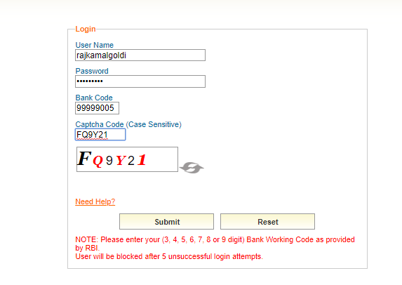
Steps to be followed by NBFCs to Install RBI i-File Return Installer
Once you get the NBFC SUPER USERID From RBI team, please login to the XBRL system (https://xbrl.rbi.org.in) and create the Maker & Checker User Ids for the officials identified in your company
After that, login with your user name, password and NBFC code. Kindly use Superuser user name and password
At time of first login, user will be asked to change password. New password must have minimum 8 characters and contain a combination of uppercase and lowercase letter, number and special character.

Slide 16
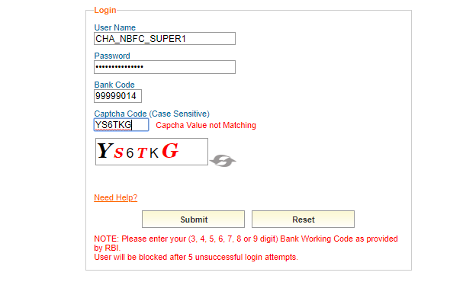
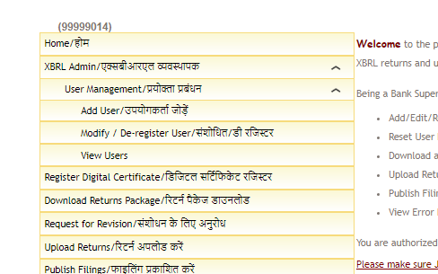
Creating Maker and Checker Login
Go to url https://xbrl.rbi.org.in/orfsxbrl/.
Click on “Add User” in “User Management” under “XBRL Admin”.

Slide 17
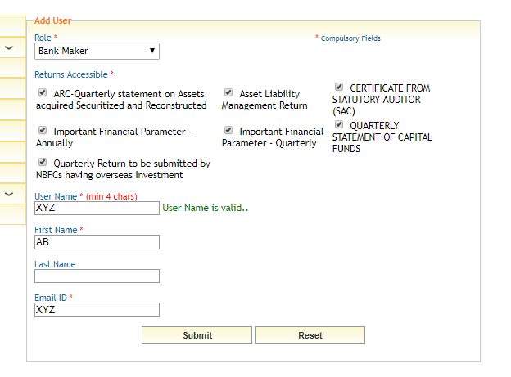
Creating Maker and Checker Login
Select Maker / Checker from dropdown menu under Role. Click on applicable returns for that particular user. Enter username, first name, last name and email id. Click on “Submit” button.
Below screen will appear on successful creation of user. An email will be sent on email id provided. Email will give login credentials to user created.

Slide 18
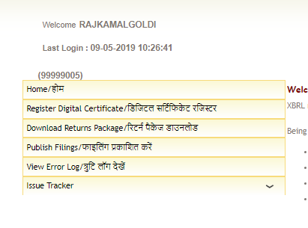
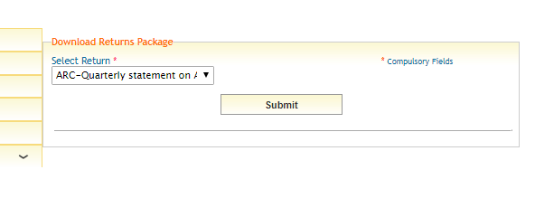
Steps to Install i-File
Click on “Download Returns Package” on left hand side panel.
Select the applicable return from drop down menu and click Submit button. It may be noted that there will be no need to download returns package separately for each return and once downloaded it can be used to file all applicable returns.
Note – It may be noted that this is a one time process and there will be no need to download returns package separately for each return and once downloaded it can be used to file all applicable returns. However, in case of an updated version of returns being released, same will need to be downloaded again.

Slide 19
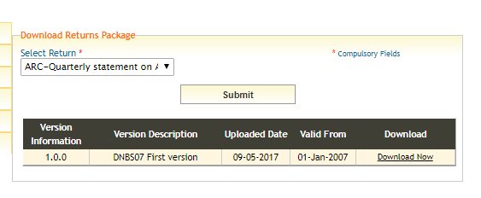
Steps to Install i-File
Click on Download now.
A zip file of installer package will be downloaded. Unzip the file to generate an .exe file.
Run the .exe file. This will require Administrator rights.
Installation will start and will take some time.
After successful installation “RBIiFile” shortcut will be created on desktop as shown below.

Slide 20
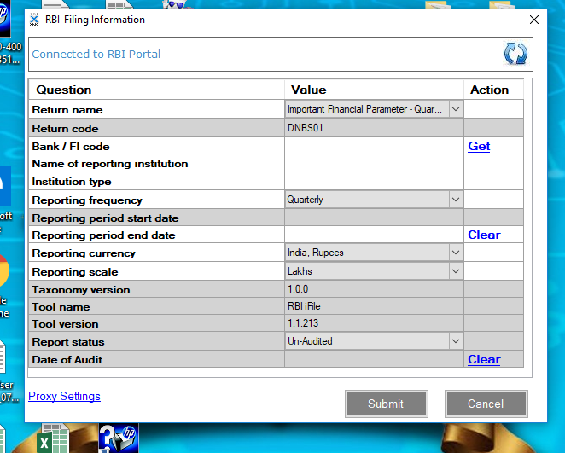
Procedure for Filling of Returns
Double click the RBI iFile desktop icon. It will open a screen to fill company particulars.
Select appropriate Return name as asked in first question of above screen. This will auto populate Returns Code, for example DNBS01 Returns Code shall be populated on selecting Important Financial Parameter – Quarterly in Returns name.
Enter “NBFC Code” in above screen and click “Get” link. It will auto-populate all details except “Reporting period start date” and “Reporting period end date.
Appropriate “Returning period end date” should be selected, for example 30-09-2018 should be entered to fill second quarter return of 2018. “Returning period start date” will be auto populated.

Slide 21
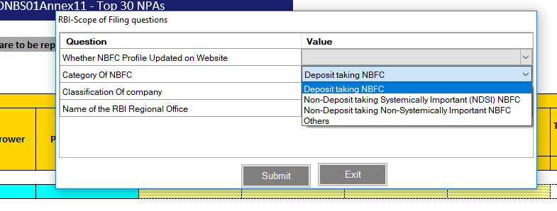
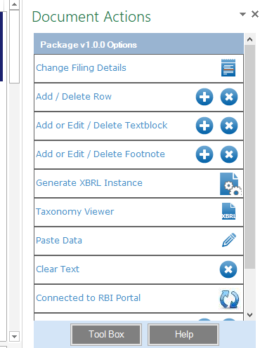
Procedure for Filling of Returns
Click “Submit” button after filling all the details. This will open corresponding excel file to fill details and user will be asked to choose answers to few scoping questions from a dropdown menu.
Now Returns excel file will open and ready to be filled with requisite returns data. (i) After filling all the sheets of excel file, an instance file needs to be generated which shall be uploaded to XBRL platform. (ii) To generate instance file, click on “Generate XBRL Instance” on the Tool Box available at right hand side of the Return excel file. Processing may take 5-10 minutes.

Slide 22
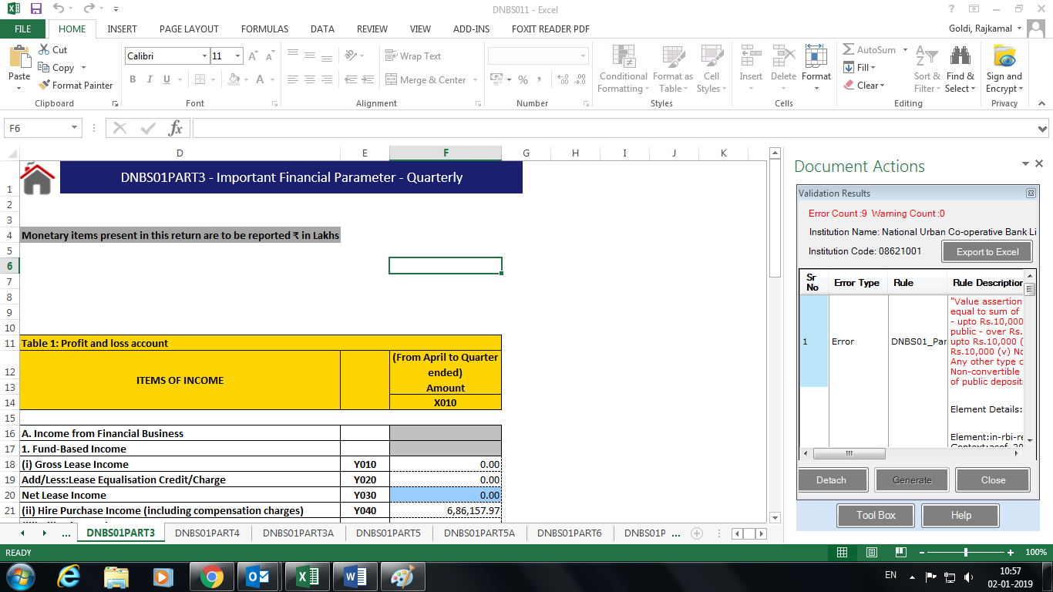
Procedure for Filling of Returns
This will run all the validation checks before generation of instance. If any validation errors are found, it will be visible in the tool box.
These validation errors can be exported to excel for better understanding, by clicking on “Export Excel” button in Tool Box.
Rectify all these validation errors and generate instance file.
On successful validation, an encrypted instance file shall be generated. Click ‘Ok’ to save generated instance file, which can be uploaded on Xbrl platform as explained in next section.

Slide 23
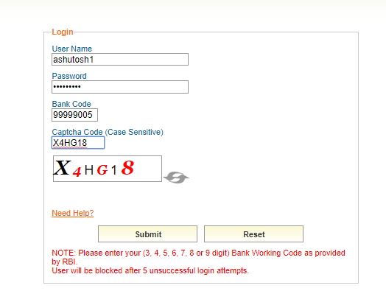
Steps to Upload Returns to the XBRL Portal
Go to url https://xbrl.rbi.org.in/orfsxbrl/.
Login with Checker User Name and Password. NBFC code is common for maker and checker login.
Ensure that “Profile” of NBFC has been updated at least once for the quarter for which return is to be uploaded.
Select “Upload Return provision” from main menu from the left side of the main screen and click on it.

Slide 24
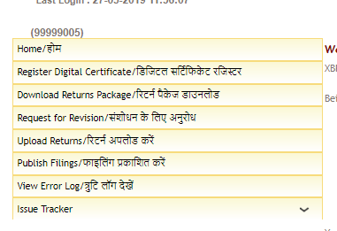
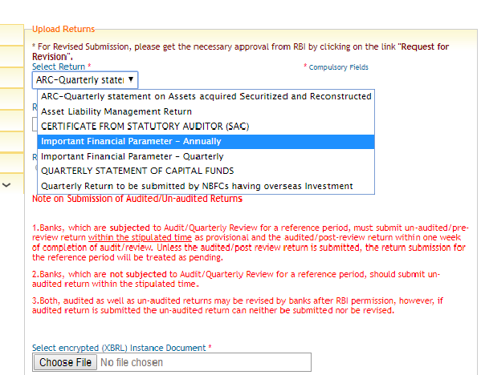
Steps to Upload Returns to the XBRL Portal
Select Upload Return from main menu from the left side of the main screen and click on it.
Select return to be uploaded from drop down menu Select Return.

Slide 25
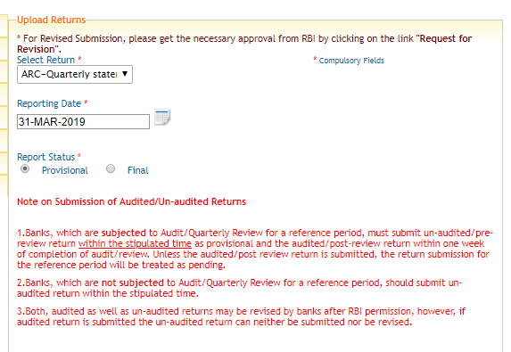
Steps to Upload Returns to the XBRL Portal
Enter reporting period end date under Reporting Date. For example, for a quarterly return for Q2, reporting period end date shall be 30-09-2018.

Slide 26
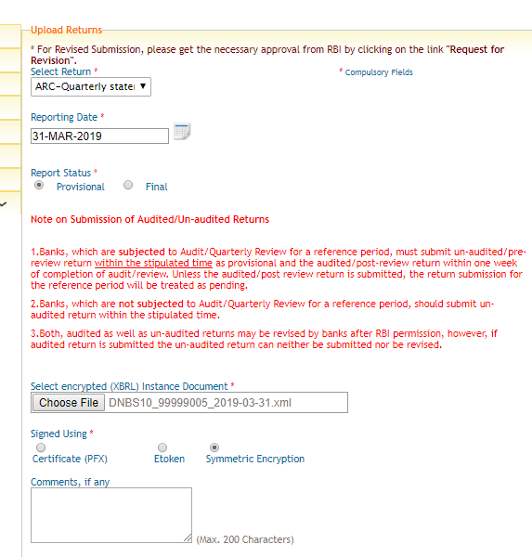
Steps to Upload Returns to the XBRL Portal
Select encrypted (XBRL) instance document. Under Signed Using, click on Symmetric Encryption. Click on Upload.

Slide 27
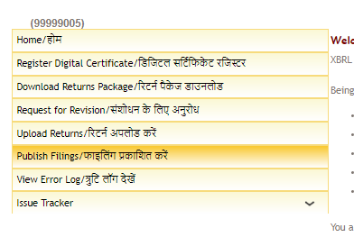
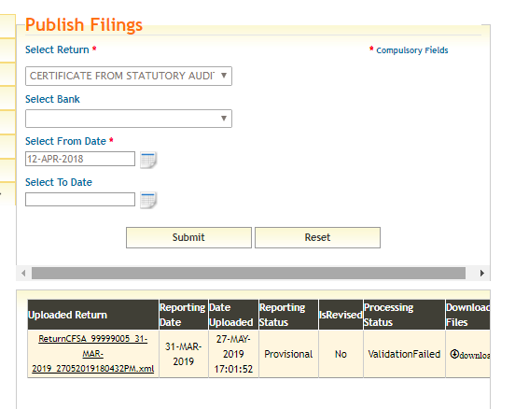
View status of the filed return before digitally signing it
Go to Publish Filings Menu on url https://xbrl.rbi.org.in.
Select Return, Bank, From Date and To Date and press Submit. It may be noted that selection of ‘’Bank’’ and “To Date” are not a mandatory field.

Slide 28
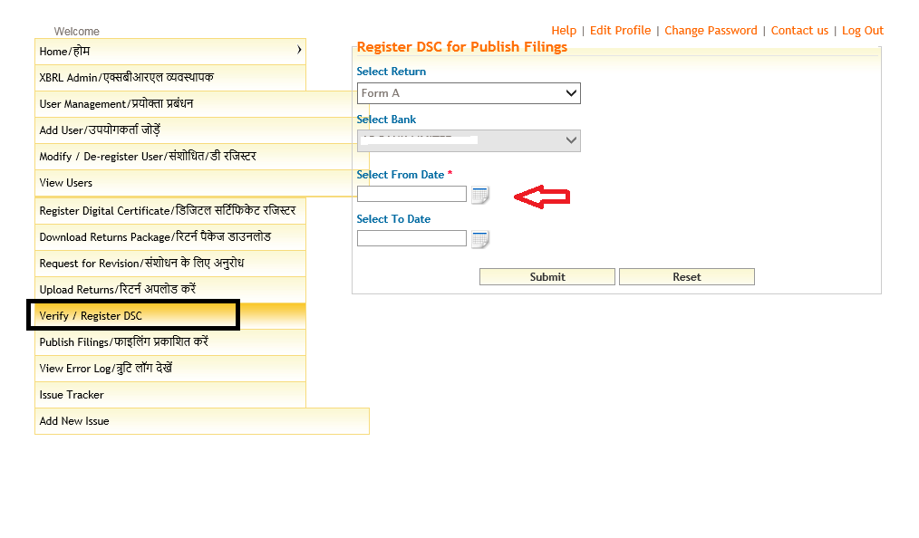
Steps for Digitally Signing Returns
Download the Digital Signature application. This is a one-time process. Select the option Verify/ Register DSC from the main menu. Enter the details in the screen and submit.
Click on the download Digital Sign Utility. Click on <<Save as>> and save the file to the desktop.

Slide 29
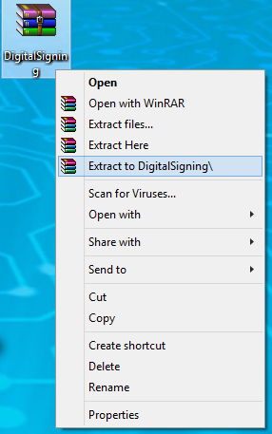
Steps for Digitally Signing Returns
The saved folder would be a zipped file. Unzip/extract the folder using WinRAR (ensure that WINRAR software is loaded on the system). Right Click on the folder and click on “Extract to Digital Signing” as shown below.
The digital signature application as shown below will appear in the folder.

Slide 30
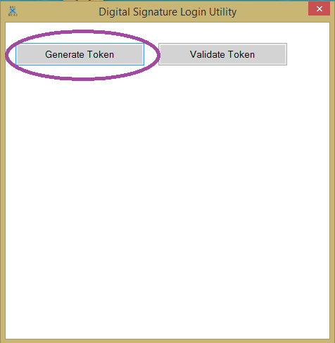
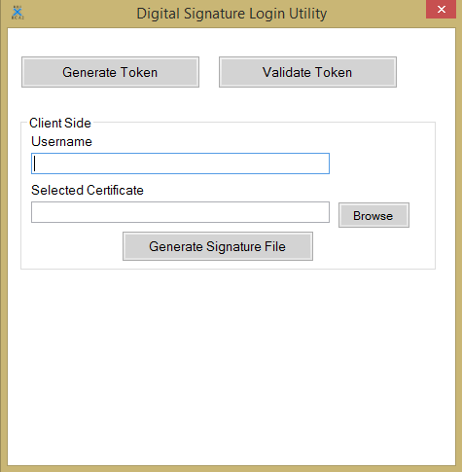
Steps for Digitally Signing Returns
Double click on <<DigitalSigning>> application which is saved in the Digital Signing folder as shown above.
Once you double click the application, following screen will pop-up.
Click on Generate Token. Enter the Username, which should be same as that of the username used for logging in to XBRL system.

Slide 31
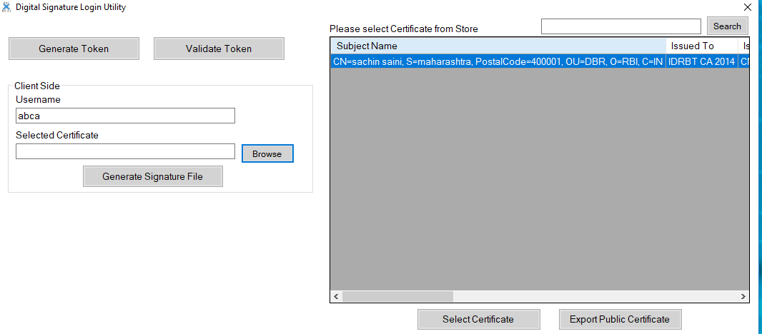
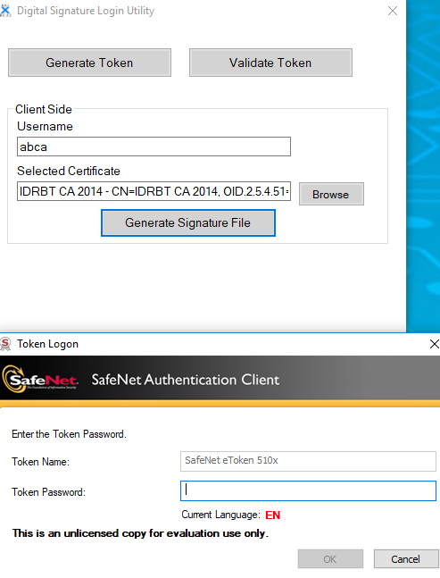
Steps for Digitally Signing Returns
Click on <<Browse>> button and the certificate is shown, thereafter select the certificate and click on Generate Signature File.
Enter your password in the pop-up authentication window.

Slide 32
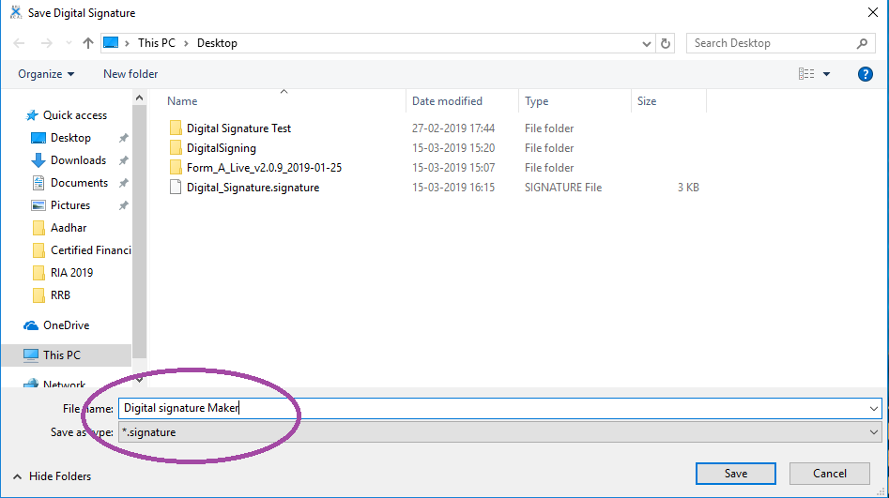
Steps for Digitally Signing Returns
Save the digital token containing the digital signature of authorized official thus generated.
The digital sign token be saved on the desktop as shown below:

Slide 33
Steps for Digitally Signing Returns
Affix Digital signature on the return
The return needs to be digitally signed by one authorized official(Checker Login). Login into the XBRL system using the user-id & password issued for the particular return.
Once the processing status changes to “Pending for Digital Signature 1” from “uploaded” under menu Verify/ Register DSC, the authorized official should use his digital signature token to affix his digital signature on the return.
Once the digital token is generated, upload the same in XBRL system. Click on the tab “Sign with Digital Signature” under menu Verify/ Register DSC. The following pop –up will appear. Browse and select the file saved at step 5.2.8 (e) to upload.

Slide 34
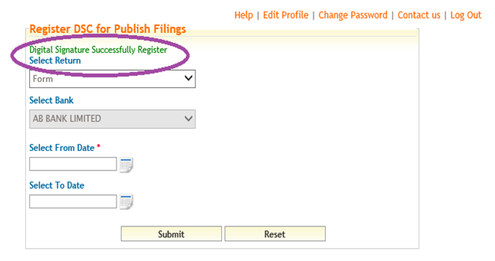
Steps for Digitally Signing Returns
After the digital signature of the first authorized official is uploaded, the following message will pop-up.
After signs the return digitally successfully in the XBRL portal, the status of return submission will change to “Completed” and the return would move to XBRL server.

Slide 35
Steps for Digitally Signing Returns
Please take note of the following points:
The XBRL user-id attaches a particular e-token that has been used for signing the return for the first time. From the next time onwards, XBRL system identifies the same XBRL user-id with a particular e-token. Thus the same person can only digitally sign the return in future for the same login Id. When the authorized person is on leave/transferred, a new user Id will have to be created for the new authorized official and the authorized official will have to use his/her e-token.
The digital signature token once used for signing the return cannot be used again. Therefore the official will have to follow the steps at 5.2.6 & 5.2.8 every time a return.

Slide 36
Steps to View the Filed Return
Go to Publish Filings Menu on url https://xbrl.rbi.org.in.
Select Return, Bank, From Date and To Date and press Submit. It may be noted that selection of ‘’Bank’’ and “To Date” are not a mandatory field.

Slide 37
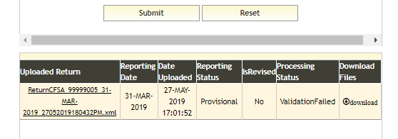
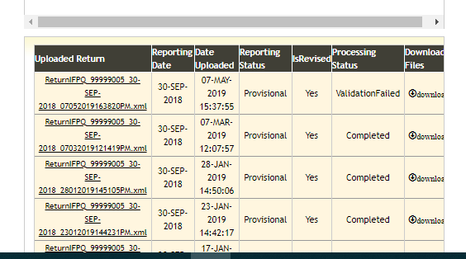
Steps to View the Filed Return
Click on ‘’Download’’ to publish respective returns.
Click on particular ‘’Uploaded Return’’ for viewing data submitted.

Slide 38
Steps to View the Filed Return
Click on arrow on top to select sub-sections for viewing.
Select sections which are to be viewed. Click “Submit”. All sections can be selected together by clicking “All”.

Slide 40
Notable points
Installer needs to be installed only once, for filing of returns but in case of any update of installer, new installer should be downloaded and has to be installed from the portal.
Before installing new version, uninstall the older version of return installer from system from the Control Panel and delete “RBI iFile” folder from C drive.

Slide 41
Timeliness of submission.
E-mail alerts – 5, 10, 15th- to CEO.
Penalty provision
Fixed window of submission – Contact RO for revision.
Accountability
Maker Checker
Digital Signature.
Authentic data
Data validation checks
Intra sheet
Inter sheet
Inter return

Slide 42
New Returns –
DNBS10
ALM
CIC and P2P
AA
Profile update
Will be sole platform – dispensing with hardcopies etc.

Slide 43
XBRL Help Desk Support Contacts
For any kind of support for smooth filing of returns in the XRBL system, please contact us on the following e-mail ID:
rbixbrlsupport@irisbusiness.com
cosmosdnbskolkata@rbi.org.in
Help Lines: 033-2231 0201

Slide 44
Thank You

