Slide 1


KRISHNA SINGH
Founder & CEO
Intellectual Property
Various Rights and Legal Agreements that are essential for business
ACAE Chartered Accountants CPE Study Circle of EIRC of ICAI
20th January 2023

Slide 2
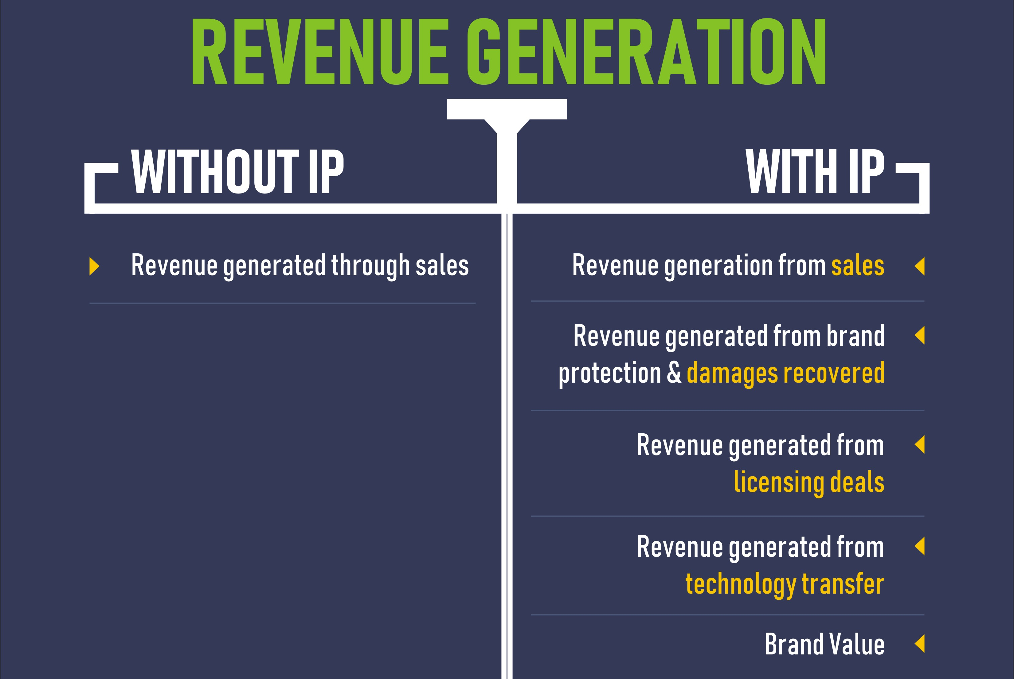
ACAE
CPE Lecture
Growth With or Without IP | P 2

Slide 3

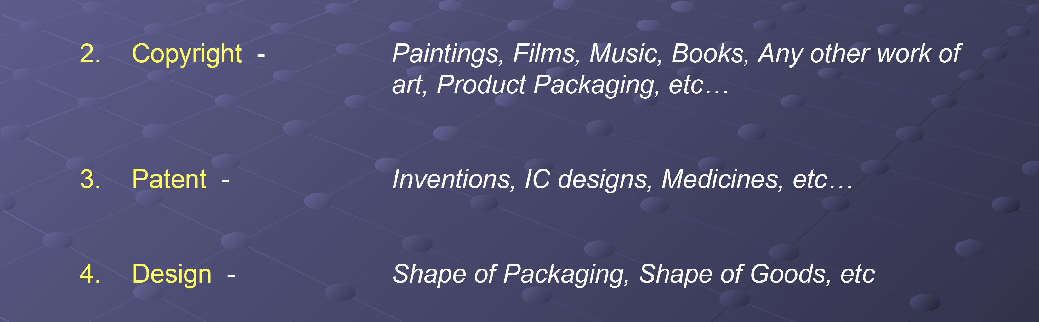

ACAE
CPE Lecture
Types of IPR | P 3

Slide 4



ACAE
CPE Lecture
Types of IPR | P 4

Slide 5

ACAE
CPE Lecture
IPR Importance | P 5

Slide 6

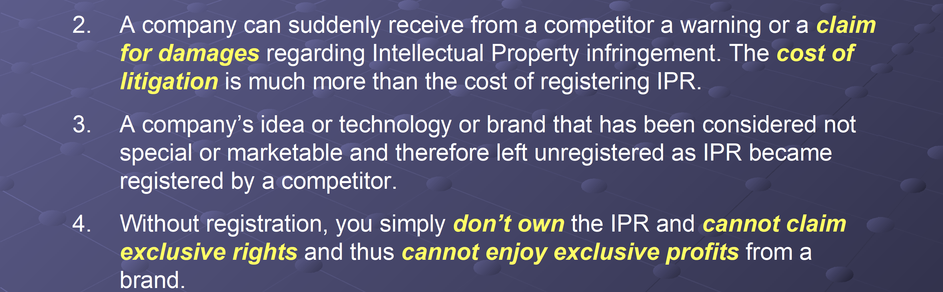

ACAE
CPE Lecture
What is a Brand ? | P 6

Slide 7

ACAE
CPE Lecture
IPR Importance | P 7

Slide 8

ACAE
CPE Lecture
IPR Importance | P 8

Slide 9
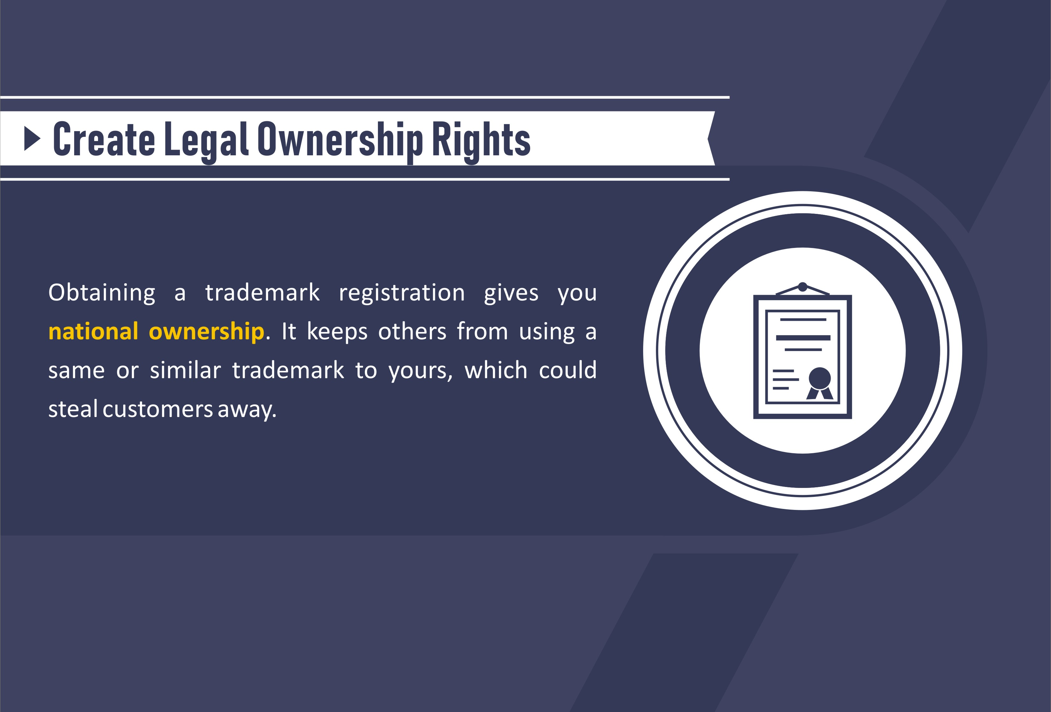
ACAE
CPE Lecture
IPR Importance | P 9

Slide 10
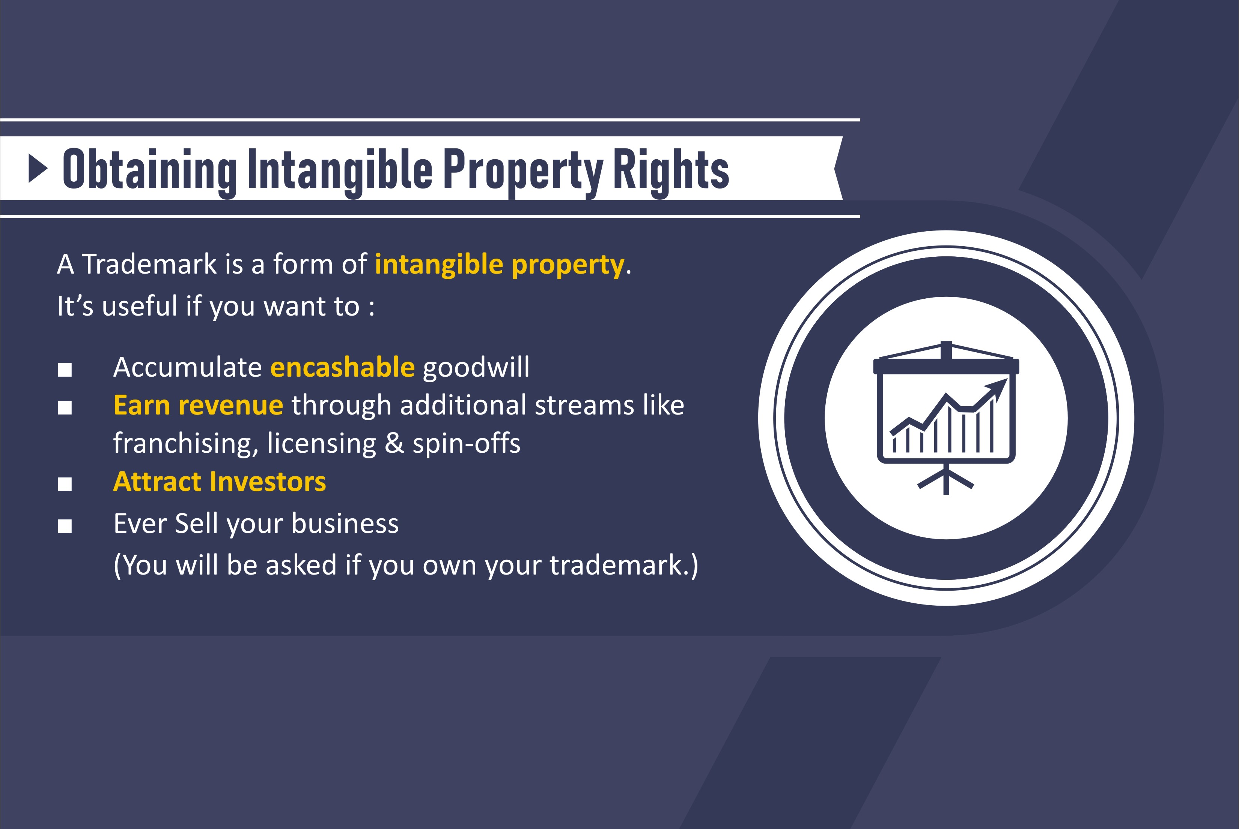
ACAE
CPE Lecture
IPR Importance | P 10

Slide 11
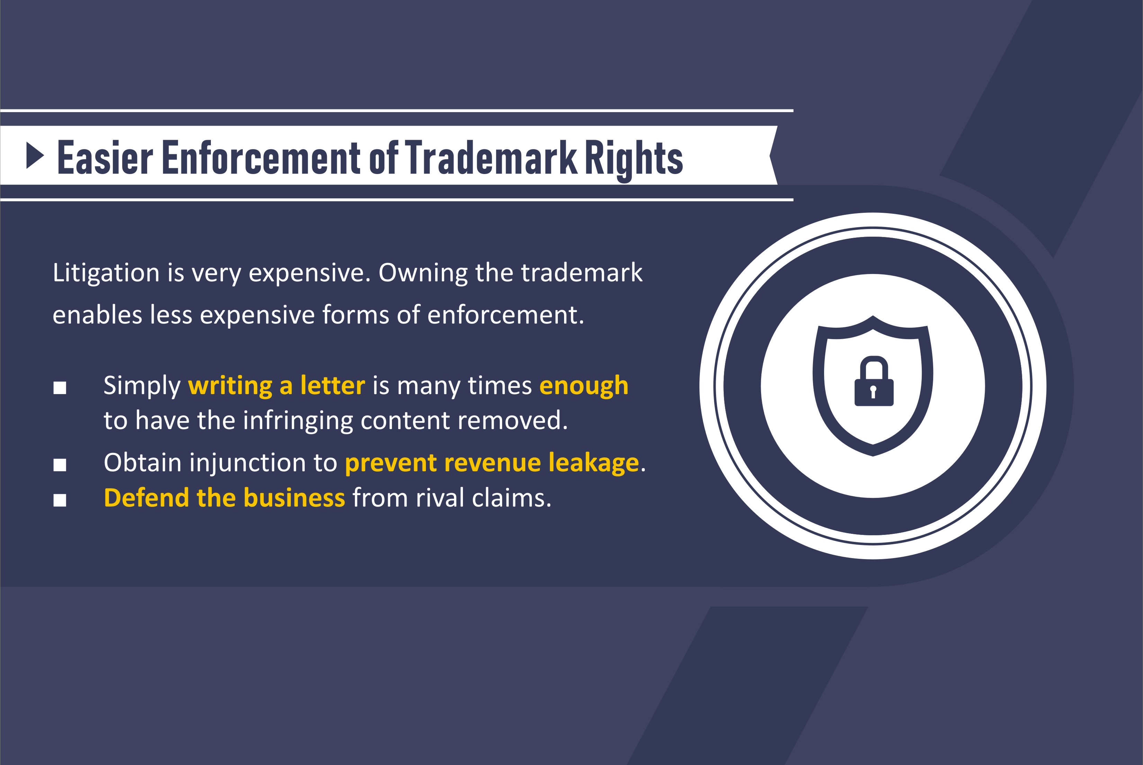
ACAE
CPE Lecture
IPR Importance | P 11

Slide 12
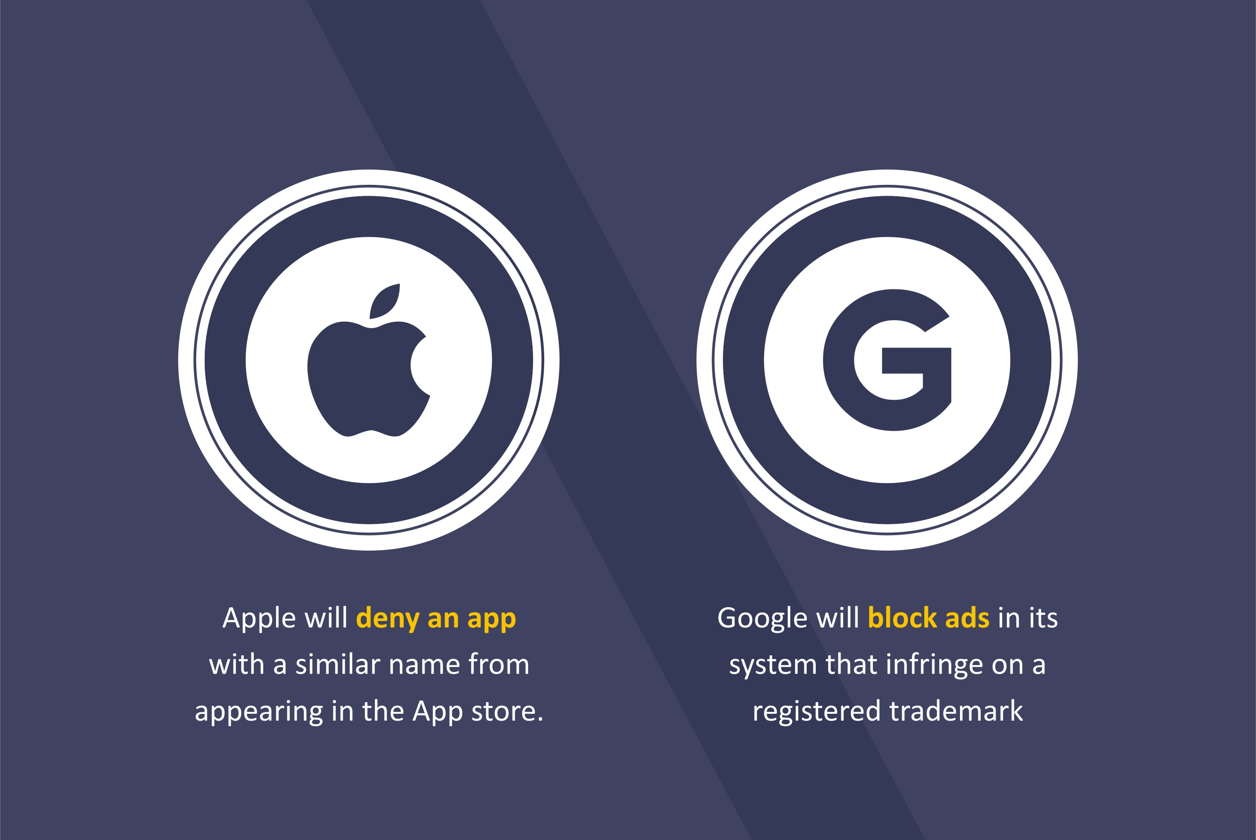
ACAE
CPE Lecture
IPR Importance | P 12

Slide 13
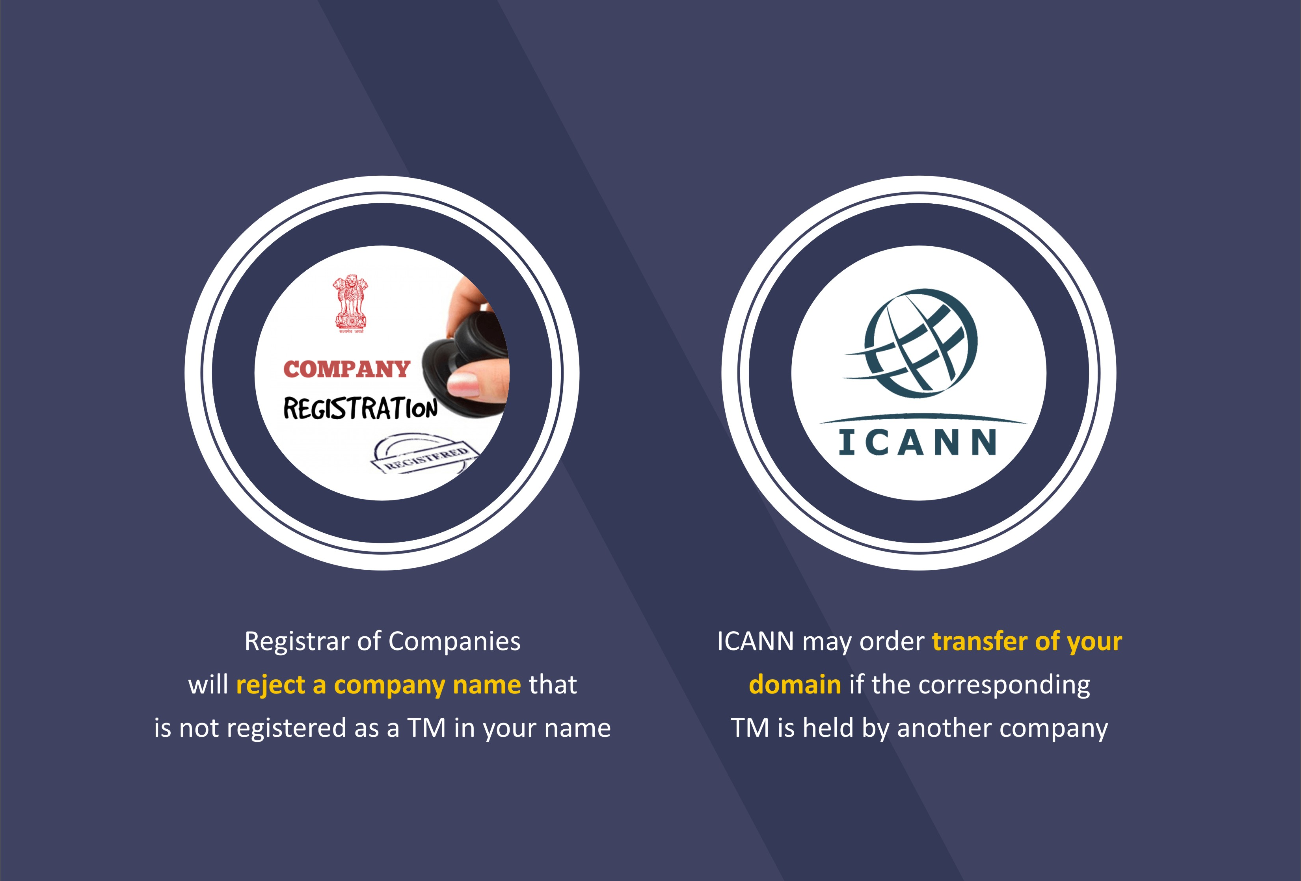
ACAE
CPE Lecture
IPR Importance | P 13

Slide 14

ACAE
CPE Lecture
IPR Importance | P 14

Slide 15
ACAE
CPE Lecture
Types of Brand Names | P 15
Types of Brand Names
Registrable vs Non Registrable

Slide 16
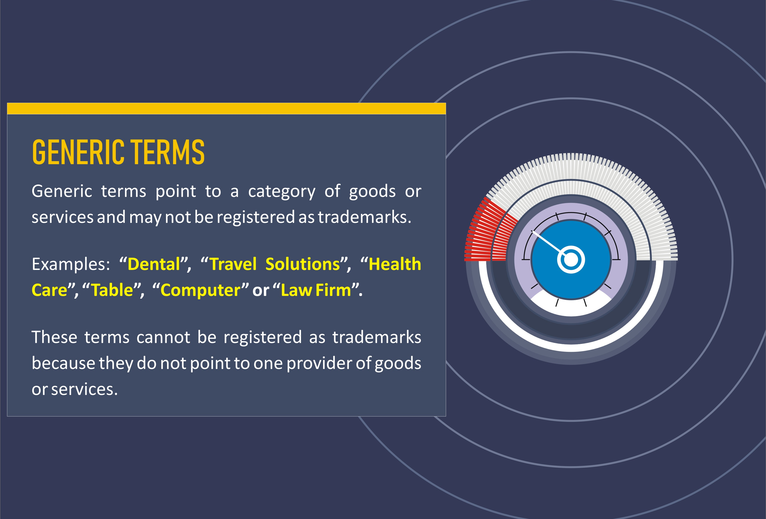
ACAE
CPE Lecture
Types of Brand Names | P 16

Slide 17
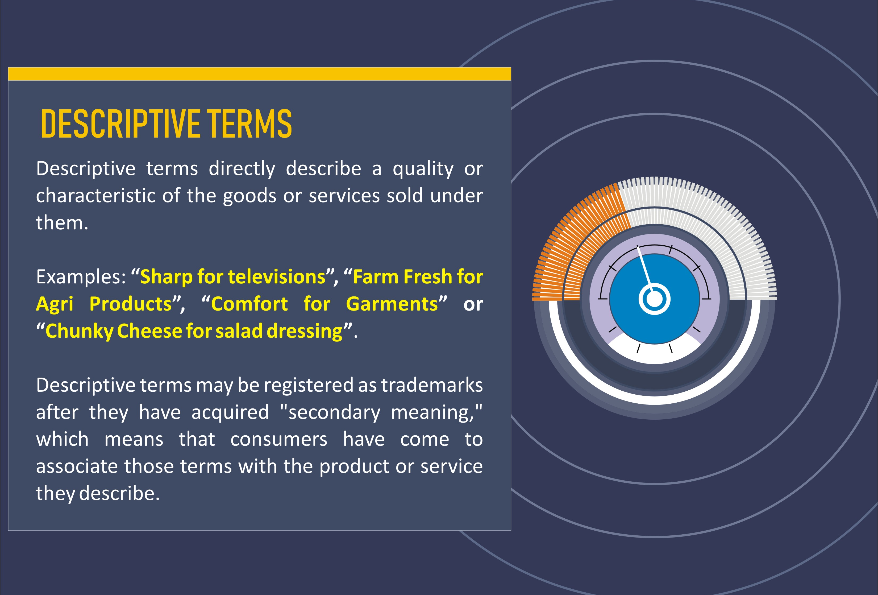
ACAE
CPE Lecture
Types of Brand Names | P 17

Slide 18
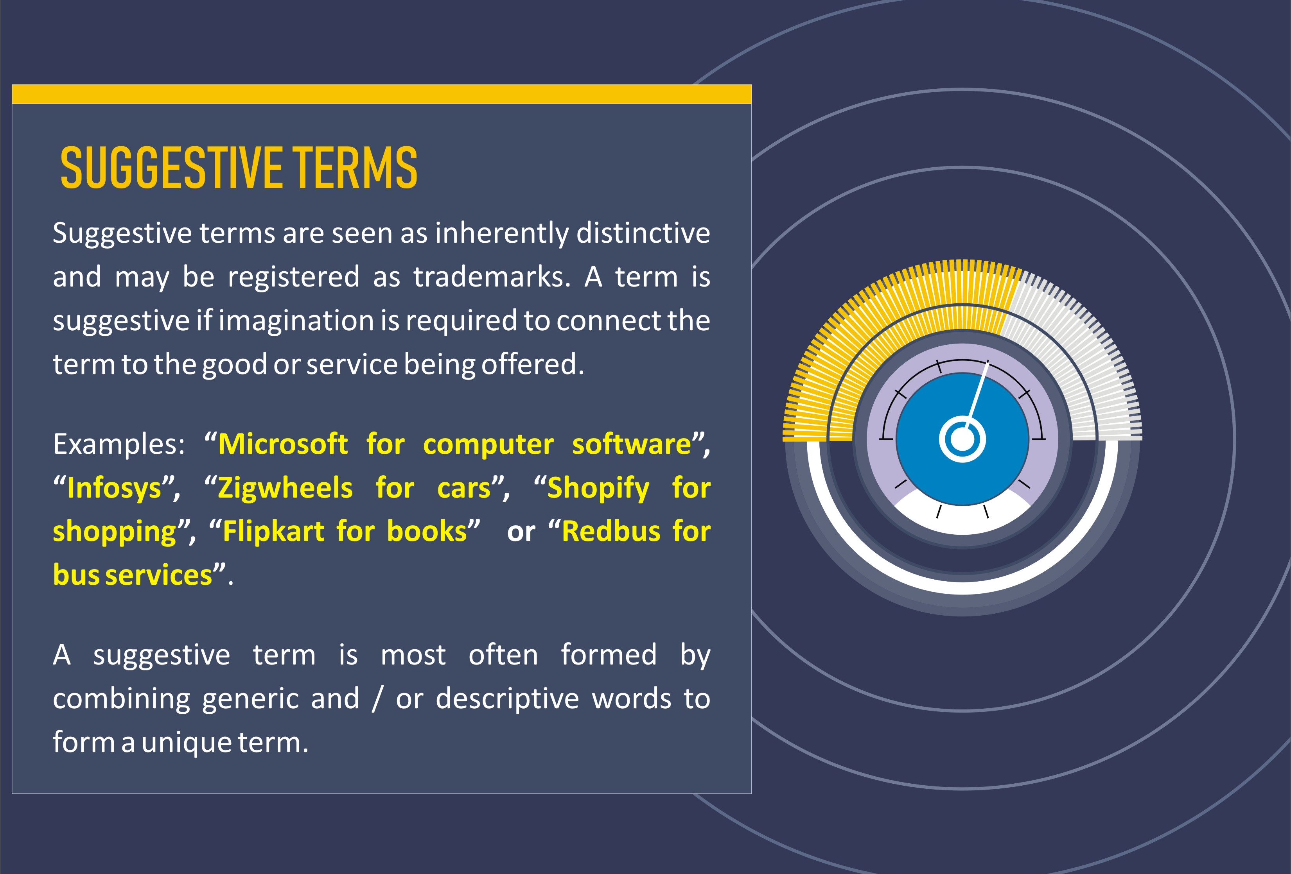
ACAE
CPE Lecture
Types of Brand Names | P 18

Slide 19
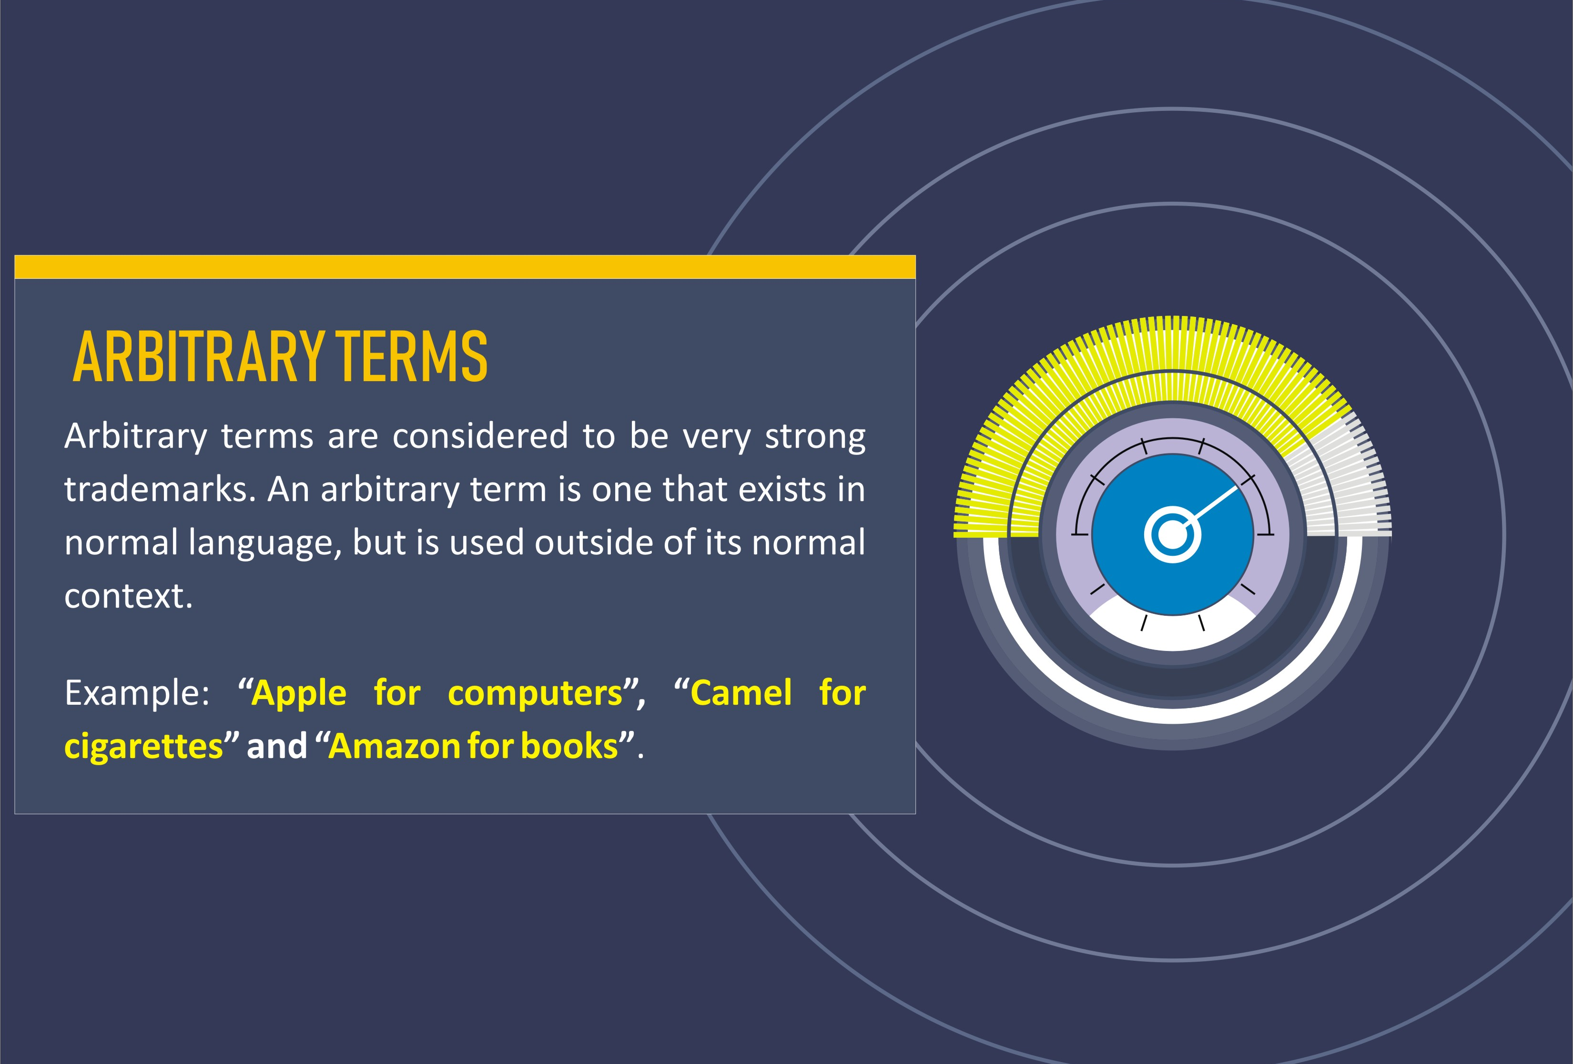
ACAE
CPE Lecture
Types of Brand Names | P 19

Slide 20
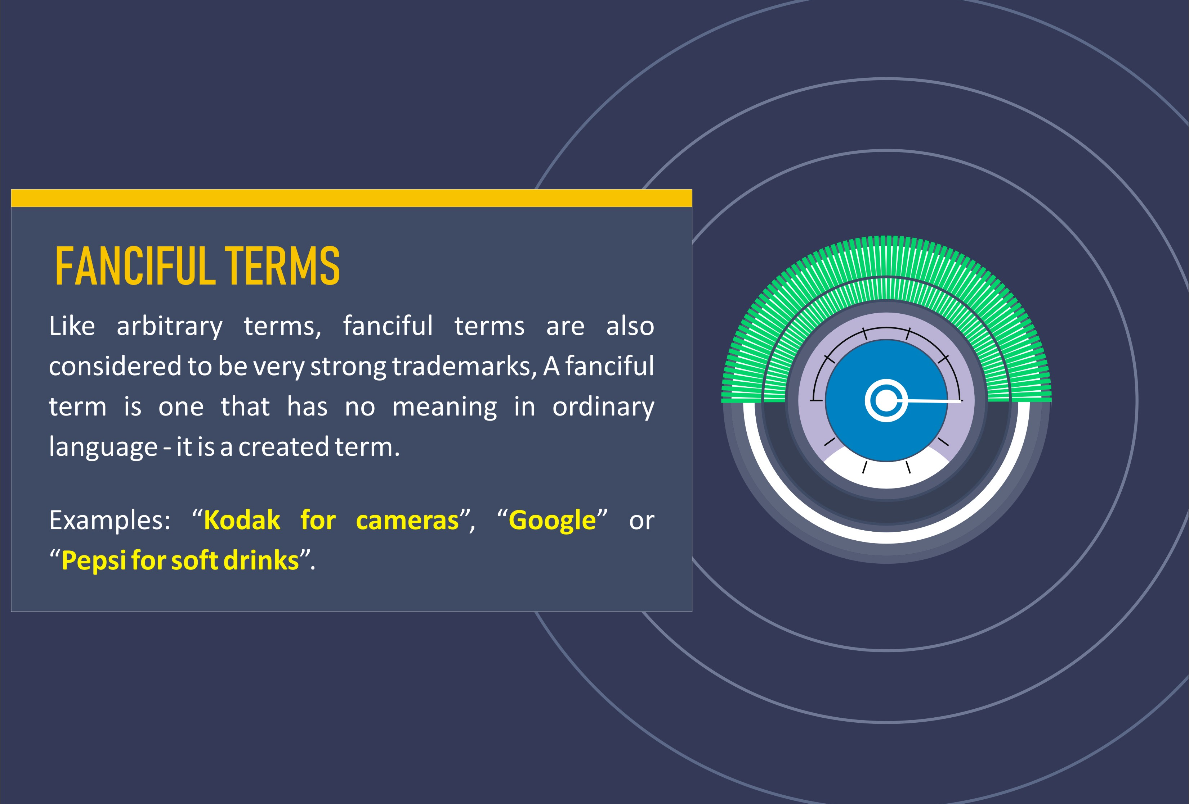
ACAE
CPE Lecture
Types of Brand Names | P 20

Slide 21

ACAE
CPE Lecture
The Intangibles | P 21
Intangibles
1 Rights
Leases, distribution agreements, employment contracts, covenants, financing arrangements, supply contracts, licences, certifications, franchises.
2 Relationships Trained and assembled workforce, customer and distribution relationships.
3 Intellectual Property
Patents; copyrights; trademarks; proprietary technology (for example, formulas, recipes, specifications, formulations, training programmes, marketing strategies, artistic techniques, customer lists, demographic studies, product test results); business knowledge — such as suppliers’ lead times, cost and pricing data, trade secrets and knowhow.

Slide 22
ACAE
CPE Lecture
Value of Intangibles | P 22
Source: Global Intangible Finance Tracker 2021 by Brand Finance Institute

Slide 23
ACAE
CPE Lecture
IPR Registration

Slide 24
ACAE
CPE Lecture
How to Register a Trademark | P 23
Conduct a thorough search for Trademark Availability
If clear, both in terms of Sec 9 & Sec 11, prepare to file
Chose the right company type for registration, depending upon your vision for the brand and also actual use.
File the application with proper affidavits and use evidence. Its always better to select a good IPR attorney as the registration process may require proper handholding, right decisions for the brand and its future. One wrong step before or during registration may affect the brand in future.
Monitor the application as non-compliance with office communications may lead to abandonment of the mark. Reply to any office objection with evidence.
Attend Showcause Hearing to clear objections. Take care of additional requirements, if any. If the mark gets accepted by the hearing officer, it is published in the Trademark Journal for 4 months review period. Any 3rd party may oppose the mark during this period.
If the mark gets opposed, you need to contest it to get it. If not, it gets registered.

Slide 25
ACAE
CPE Lecture
How to Register a Copyright | P 24
For Copyright of Logo / Brand or product packaging, NOC need to be obtained from the Trademark Office.
Once the NOC is obtained, copyright application is filed at the Copyright Office, Delhi.
If the copyright office has no objection, it issues the copyright certificate, else issues a scrutiny letter.
Once the copyright office objections are cleared by way of replies and / or hearing, the mark gets published online on the copyright website for 1 month.
Post the 1 month period, copyright certificate is issued.
Any copyright application may also be objected by a 3rd party in the 1 month period.
If the mark gets objected, you need to contest it to get it. If not, it gets registered.

Slide 26
ACAE
CPE Lecture
How to Register a Patent | P 25
To register a patent, thorough search of the global patent databases need to be done, for the same kind of invention or innovation.
If a prior patent exists similar to the invention being applied for, you need to think whether you should file it or file after modifications to the patent.
Proper drafting of Complete Specifications including the patent claims by an expert in the specific technical field.
Filing of patent application, request for publication & request for examination.
Attending to office actions from the patent office and getting the application cleared after modifications, as required.
Once granted, patent certificate is issued.
A patent application can be opposed pre-grant at any time before grant and then the patent office would have to follow the opposition procedure and once cleared from there, goes to registration or rejection.

Slide 27
ACAE
CPE Lecture
Most Suitable Company Type for
IPR & Monetization of IPR

Slide 28
ACAE
CPE Lecture
Suitable Company Type | P 26
Parameter | Individual | Proprietorship | Partnership | Company
Ease of Application | Very Easy | Very Easy | Very Easy | Easy
Document Requirement | Lowest | Lowest | Medium | Highest
Ease of Processing | Medium | High | High | Highest
Ease of Maintenance | Lowest | Highest | Medium | Highest
Ease of contesting litigation | Lowest | High | High | Highest
Ease of Transfer / Licensing | Highest | Highest | High | Highest
Ease of Amendments | Highest | Highest | Medium | Medium
Ease of Monetization | Lowest | Medium | Medium | Highest

Slide 29
ACAE
CPE Lecture
Infringement & Legal Action

Slide 30
ACAE
CPE Lecture
Infringement & Action | P 28
Types of Infringement
Direct Trademark Infringement
  Unauthorised Access
  Identical or deceptively similar
  Registered Trademark
  Indirect Trademark Infringement
    Contributory Infringement
    Vicarious Liability
  Passing Off

Slide 31
ACAE
CPE Lecture
Infringement & Action | P 29
Remedies & Actions
Courts may award the following remedies in the case of trademark infringement
Temporary Injunction
Permanent Injunction
Damages
Account of Profits (damages equal to the earnings made as a result of the infringement)
Destruction of goods using the infringing mark
Cost of legal proceedings
Civil & Criminal Raids
In the event of a criminal case, the court will impose the following penalties:
Imprisonment for a minimum of six months and a maximum of three years
Punishment of not less than Rs.50,000 and upto Rs.2 Lakh may be imposed.

Slide 32
ACAE
CPE Lecture
Infringement & Action | P 30
Do’s and Don’ts of IP Rights
Do
Consider IP Rights from the word go – think before you proceed.
Get help of a good IP Attorney from the outset.
Register your brand as a trademark before it hits the market. But even before you adopt a brand as a trademark, conduct proper searches to ascertain if it is available at all or you are copying somebody else’s brand knowingly or unknowingly.
Get agreements done with 3rd parties that ensure that ownership is established for any IP created.
Employee contracts / appointments should clearly state that IP created is owned by the company.
Keep ideas discreet and ensure all concerned like employees, key suppliers are bound by confidentiality.

Slide 33
ACAE
CPE Lecture
Infringement & Action | P 31
Do’s and Don’ts of IP Rights
Don’t
Think IP to be irrelevant and unimportant for any business. Either you are creating IP or you are using IP of someone else. Both ways, your business is exposed.
Ride on somebody else’s goodwill and reputation by using identical or similar IP as this would eventually lead to costly legal proceedings and immense heartburn.
Use anybody else’s work without permission or license.
Wait for your business to succeed before registering IP as it would be too late and may result in significant losses.
Don’t think that if others can do, I can do. You never know what legal action is going on against those others.
Use something available online as freely available for use. Create your own IP, register it properly and promptly and monetize it fully to create goodwill.

Slide 34
ACAE
CPE Lecture
Infringement & Action | P 32
Example of Damages Awarded by Courts
Microsoft v Yogesh Popat (2005) - Rs.1.97 Million
Glenmark v Curetech skincare - Rs.15 Million
Tata Sons v Fashion ID - Rs.1 Lakh each to the plaintiffs
Yahoo Inc v Rinshad Rinu & Ors - Rs.5 Lakh
Microsoft v Deepak Raval - Rs. 5 Lakh
Whatman International v P.Mehta & Ors - Rs.3.85 Crores
Koninlijke Philips v Amazestore - Rs.3.15 Crores

Slide 35
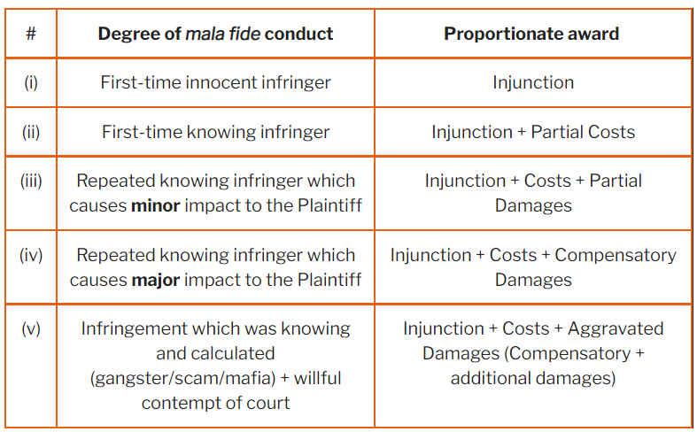
ACAE
CPE Lecture
Infringement & Action | P 33
Guidelines for assessment of damages to be paid to plaintiffs

Slide 36
ACAE
CPE Lecture
Farmers’ Rights | P 34
Protection of Plant Varieties & Farmers’ Rights (PPVFR) Act, 2001
Objectives of the PPVFR Act
Facilitate an effective system for the protection of plant varieties & the rights of farmers.
Encourage the development of new varieties of plants.
Protect the rights of the farmers in respect of their contribution in conserving plant genetic resources.
Facilitate the growth of the seed industry which will ensure the availability of high quality seeds.

Slide 37
ACAE
CPE Lecture
Farmers’ Rights | P 35
Protection of Plant Varieties & Farmers’ Rights (PPVFR) Act, 2001
PPVFR Act, 2001 has been enacted in India for giving effect to the TRIPS Agreement.
The PPVFR Act retained the main spirit of TRIPS viz., IPRs as an incentive for technological innovation.
However, the Act also had strong provisions to protect farmers’ rights.
The act allows farmers to plant, grow, exchange & sell patent-protected crops, including seeds, & only bars them from selling it as “branded seed”.
It recognised three roles for the farmer: cultivator, breeder & conserver.
As cultivators, farmers were entitled to plant-back rights.
As breeders, farmers were held equivalent to plant breeders.
As conservers, farmers were entitled to rewards from a National Gene Fund.

Slide 38
ACAE
CPE Lecture
Essential Agreements | P 36
Most Essential Agreements / Legal Documents for Businesses
Employment Agreement
Employee Invention Assignment and Confidentiality Agreement (EIACA)
Franchise / License Agreement
Assignment Agreement
Indemnity Agreement
Non Disclosure Agreement (NDA)
Non Compete Agreement (NCA)
Partnership Agreement
Scope of Work / Statement of Work
Terms of Use Agreement
Warranty

Slide 39
ACAE
CPE Lecture
Q & A

Slide 40
ACAE
CPE Lecture
Thank You
Goldfinn Technologies
66, Golf Club Road, 2nd Floor, Kolkata – 700033
E: ksingh@goldfinn.com
T: +91 8013011133

