Slide 1



Insolvency and Bankruptcy Code, 2016
And
Information Utility Services
ACAE Annual Conference 2022
Saturday, 10 Sep, 2022
at Taj Bengal, Kolkata
All rights reserved to NeSL | Confidential | Version 1.1

Slide 2
Hon’ble PM in his address to the nation on the occasion of India’s 76th Independence Day:
….“How long will the world continue to give certificates to us?... How long will we live on the certificates of the world?... Shall we not set our own standards?... ”

Slide 3
IBC: From Hopeless End to Endless Hope
A firm needs freedom broadly at three stages of a business - to start a business (free entry), to continue the business (free competition) and to discontinue the business (free exit).
The reforms in India in the 1990s focused on freedom of entry.
The reforms in the 2000s focused on creating a free and fair market competition.
The Code (2016) provided a market mechanism for (a) rescuing a failing, but viable firm, and (b) liquidating a failing and unviable one and releasing the resources, including entrepreneur, from failing firms for competing uses, and thereby provides the freedom to exit, the ultimate freedom.

Slide 4
Strategy of the IBC
Strong focus on default prevention
Envisages a market mechanism
Facilitates creative destruction
Promotes resolution over liquidation
Promotes entrepreneurship
An Act to consolidate and amend the laws relating to reorganization and insolvency resolution of corporate persons, partnership firms and individuals, in a time bound manner, for maximization of value of assets of such persons, to promote entrepreneurship, availability of credit and balance the interests of all the stakeholders, including alteration in the order of priority of payment of Government dues and to establish an Insolvency and Bankruptcy Board of India, and for matters connected therewith or incidental thereto.

Slide 5
Highlights of IBC
The Code brings a paradigm shift from “Debtors in Possession” to “Creditors in Control”.
Insolvency Professional to take control of the Corporate Debtor.
Information Utility are proposed to address the issues pertaining to the information asymmetry which are a critical barrier to fair negotiations, or ensuring swiftness of the process.
Single Insolvency and Bankruptcy framework replaces / modifies / amends certain existing laws.
Time Bound resolution process.
A clearly defined distribution of recovery proceeds.
Has provision to deal with concealment fraud and/or manipulation leading to fine and/ or imprisonment.
Provide confidence to Lenders and Investors in debt market.

Slide 6
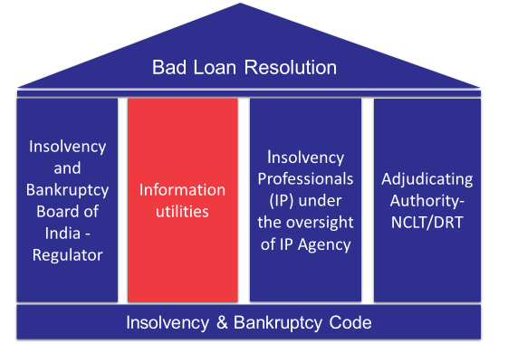
IBC– Four Pillars
Time Bound
Digital
Governance
  Adjudicating Authority - Specialized Tribunals
  Information Utility – Electronic Database of legal evidence
  Insolvency Professionals – Class of Regulated Professionals
  Insolvency and Bankruptcy Board of India –Regulator of IU and IPs
NeSL is India’s first and only
Information Utility registered with IBBI

Slide 7



Who can file for corporate insolvency resolution?
Financial Creditor (FC)
Under section 7
Operational Creditor (OC)
Under section 8 & 9
Corporate Debtor
Under section 10

Slide 8
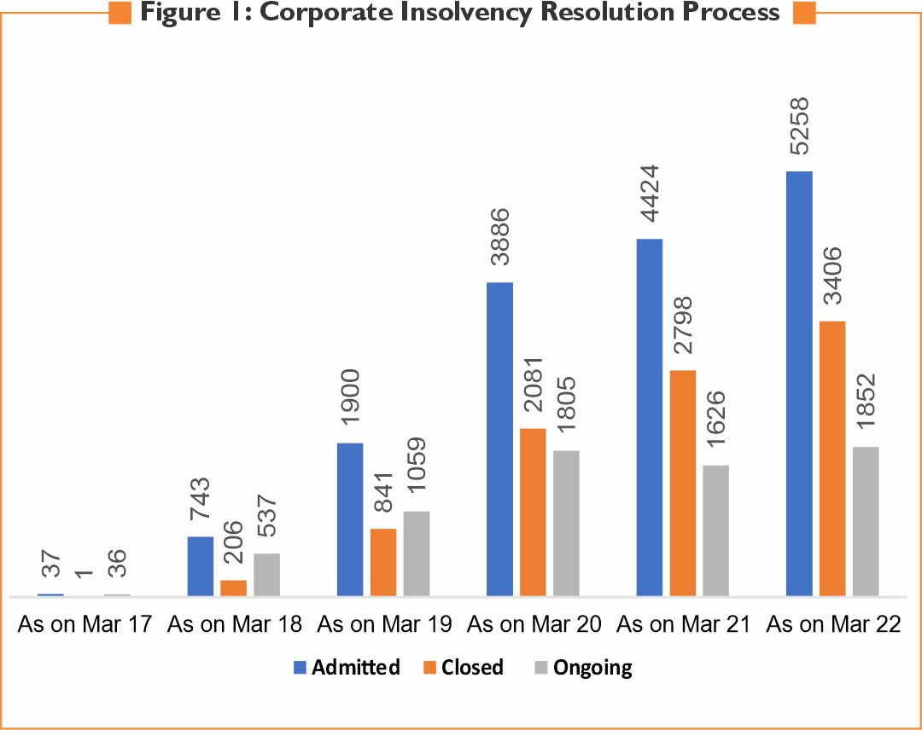
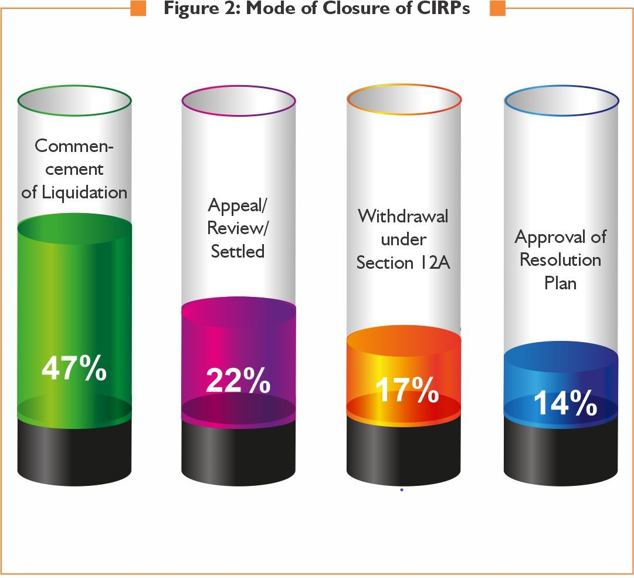
CIRP cases
(as on Mar 2022)
CIRP Cases
Mode of closure of CIRP Cases

Slide 9
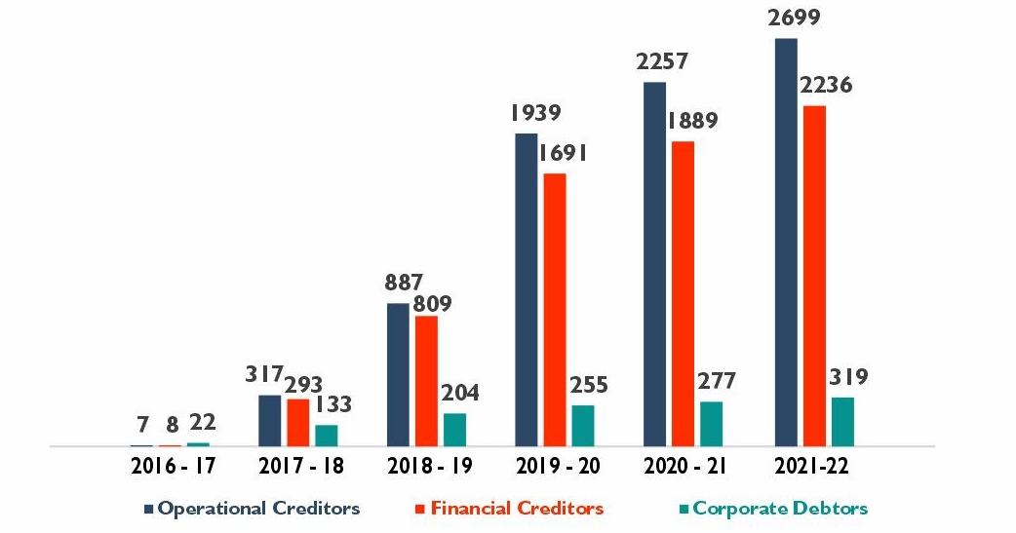
CIRP cases
(as on Mar 2022)
Stakeholder-wise Distribution and Trends of Initiation of CIRPs

Slide 10
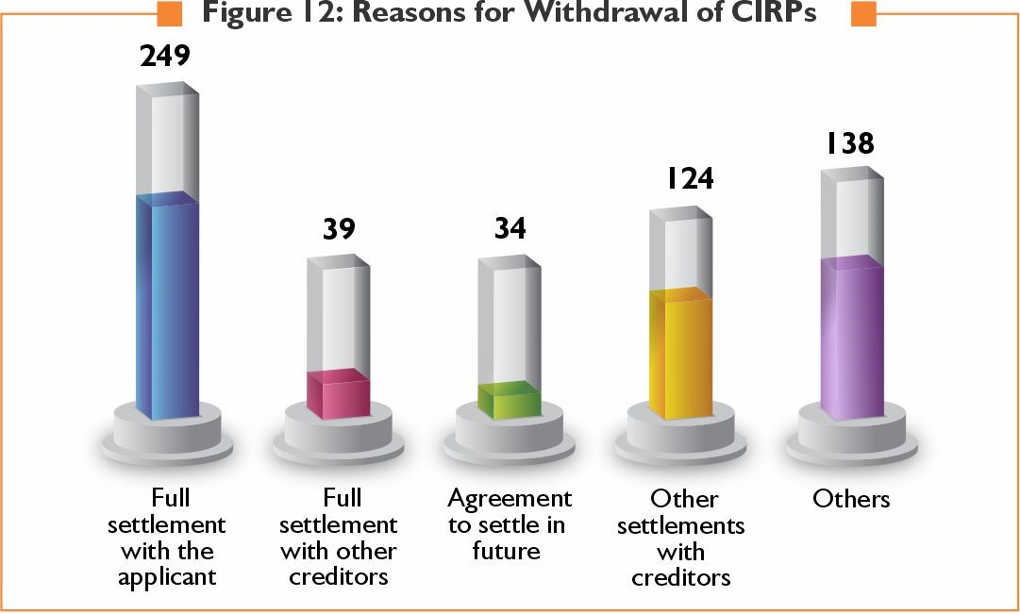
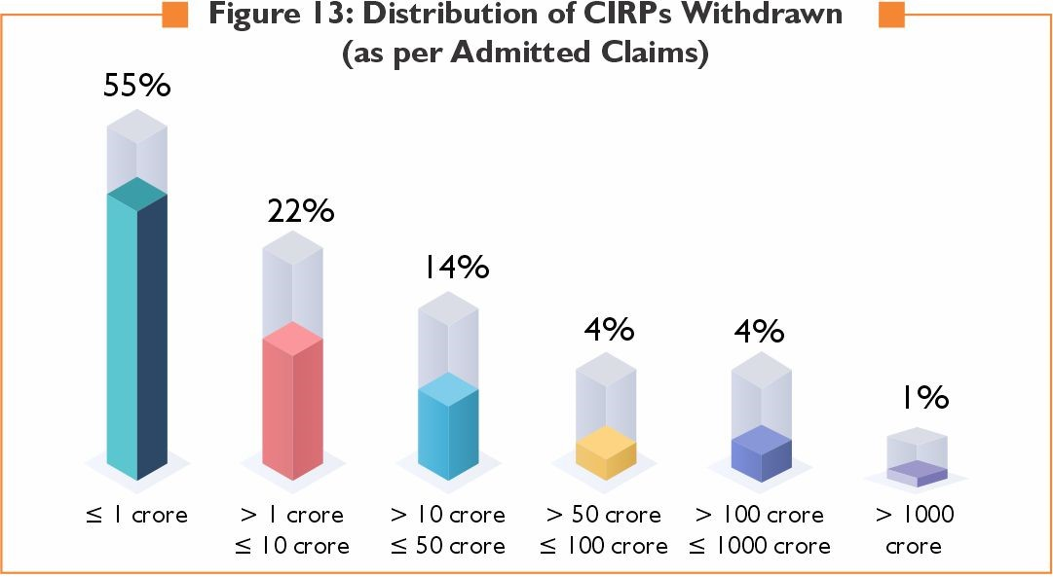
CIRP cases
(as on Mar 2022)
Reasons for withdrawals of CIRPs
Distribution of CIRPs withdrawn
(As per admitted claims)

Slide 11
The Code in Work
The cumulative recovery (Up to March 31, 2022) for FCs where resolution took place, stood at Rs 2.25 trillion, much higher than liquidation value of Rs 1.31 trillion. The cumulative admitted claims of FCs till end March 2022 were Rs 6.84 trillion.
Behavioural Change: 18,629 applications for initiation of CIRPs of CDs having underlying default of 5,89,516 crores were resolved before their admission. (Source : Economic Survey)

Slide 12
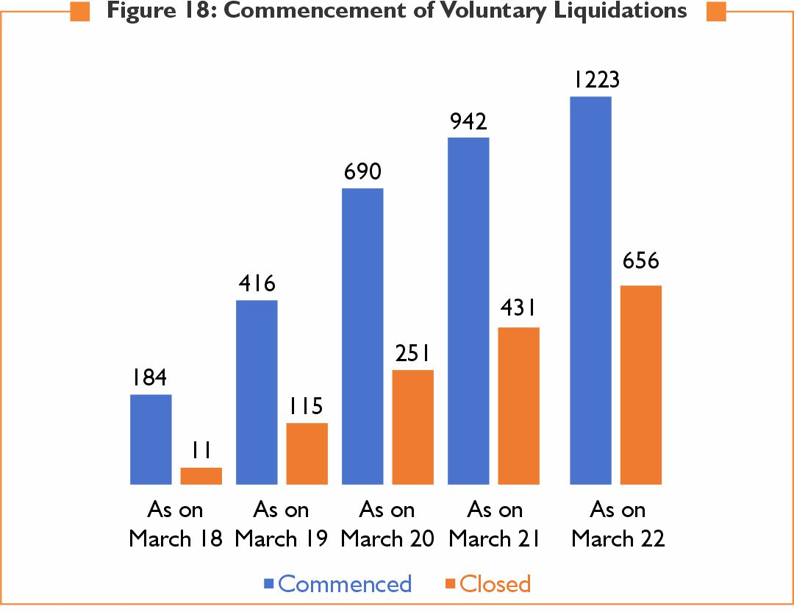
Voluntary Liquidations
(as on Mar 2022)
IBC is tool for
respectful EXIT from Business

Slide 13
















National E-Governance Services Ltd
2016
65%
NeSL Shareholding
Incorporated
Public Sector Equity
Insurance Companies, Depository
Banks
16
10%
5%
5%
Shareholders
10%
5%
2%
=
14%
5%
6%
9.9%
2%
4%
12
+
3
+
1
9.5%
1.6%
Banks
Insurance Companies
Depository
6%
5%

Slide 14

NeSL - Alerts and Reports
Credit Monitoring Reports
Credit Facility Report (CFR)
Debt Query Report (DQR)
Administrative Reports
Registration Status
Record of Default (ROD)
Authentication Status
Default Alerts
Application to AA alerts
Public Announcement Alerts
Annual Report

Slide 15
Obligations of information utility.
Sec. 214. Obligations of information utility:
For the purposes of providing core services to any person, every information utility shall–
create and store financial information in a universally accessible format;
accept electronic submissions of financial information from persons who are under obligations to submit financial information under sub-section (1) of section 215, in such form and manner as may be specified by regulations;
accept, in specified form and manner, electronic submissions of financial information from persons who intend to submit such information;
meet such minimum service quality standards as may be specified by regulations;

Slide 16
Obligations of information utility (Cont.)
(e) get the information received from various persons authenticated by all concerned parties before storing such information;
(f) provide access to the financial information stored by it to any person who intends to access such information in such manner as may be specified by regulations;
(g) publish such statistical information as may be specified by regulations.
(h) have inter-operatability with other information utilities.

Slide 17
Procedure for submission of financial information
Section 215 :Procedure for submission, etc. of financial information
Any person who intends to submit financial information to the information utility or access the information from the information utility shall pay such fee and submit information in such form and manner as may be specified by regulations.
A financial creditor shall submit financial information and information relating to assets in relation to which any security interest has been created, in such form and manner as may be specified by regulations.

Slide 18
Initiation of CIRP by financial creditors
The Code, Under Section 7, Initiation of corporate insolvency resolution process by financial creditor states that
(1) A financial creditor either by itself or jointly with other financial creditors, or any other person on behalf of the financial creditor, as may be notified by the Central Government may file an application for initiating corporate insolvency resolution process against a corporate debtor before the Adjudicating Authority when a default has occurred.
(2) The financial creditor shall make an application under sub-section (1) in such form and manner and accompanied with such fee as may be prescribed.
(3) The financial creditor shall, along with the application furnish –
(a) record of the default recorded with the information utility or such other record or evidence of default as may be specified;

Slide 19
Regulation 20 (1A) of IBBI (IU) Regulations
IBBI has notified the following amendments on IU Regulations dated 14th June, 2022.
Regulation 20 (1A): Acceptance and receipt of information.
Before filing an application to initiate corporate insolvency resolution process under section 7 or 9, as the case may be, the creditor shall file the information of default, with the information utility and the information utility shall process the information for the purpose of issuing record of default in accordance with regulation 21.

Slide 20
Regulation 21 of IBBI (IU) Regulations
21 .Authentication of default:
An information utility shall expeditiously undertake the process of authentication and verification of information of default as soon as it is received.
(2) For the purpose of sub-regulation (1), the information utility shall-
(a) deliver the information of default to the debtor seeking confirmation of the same within the time specified in the Technical Standards;
(b) remind the debtor at least three times for confirmation of information of default, in case the debtor does not respond, allow three days each time for the debtor to respond;
(c) deliver the information of default or the reminder, as the case may be, to the debtor either by hand, post or electronic means at the postal or e-mail address of the debtor

Slide 21
Status of authentication of information of default
Reg. 21 (3): On completion of the process under sub-regulation (2), the information utility shall record the status of authentication of information of default as indicated in the following Tables:

Slide 22
Regulation 21 (4) of IBBI (IU) Regulations
After recording the status of information of default under sub-regulation (3), the information utility shall communicate the status of authentication in physical or electronic form of the relevant colour, as indicated in column (4) of the Tables 1 or 2, as the case may be, by issuing a record of default in Form D of the Schedule, to the registered users who are-
  creditors of the debtor who has defaulted in payment of a debt;
  (b) parties and sureties, if any, to the debt in respect of which the information of default has been received.

Slide 23
NCLAT JUDGEMENT
In the matter of Vipul vs. Teco industries - Appeal no. 470 of 2022, NCLAT Delhi, Dated 18.05.2022
"NCLAT held that it is clear that in case the record of information utility shows that there is a debt which is in default, the Adjudicating Authority or the Appellate Authority are not required to further examine the record maintained by the information utility, more so when the record of the information utility is deemed authenticated and no dispute of refusion of said record has been done by the corporate debtor earlier."

Slide 24

Auditor access
Regulation 23 of IBBI IU Regulations 2017
An information utility shall allow the following persons to access information stored with it-
the user which has submitted the information;
all the parties to the debt and the host bank, if any, if the information is of the categories in section 3(13)(a), (c) and (d)
the corporate person and its auditor, if the information is of the categories in section 3(13)(b) and (e);

Slide 25
Next big things
Next phases of individual insolvency and bankruptcy
Cross border Insolvency
Group Insolvency

Slide 26

Digital Document Execution
eSIGN
Digital Stamp
Efficient
Quick
Cost Saving
Secure Storage
NeSL has introduced a fully automated Digital Document Execution platform with Digital Stamp certificate that helps to streamline the process of contracting and to reduce the execution time considerably & increase the overall efficiency in the document execution.

Slide 27
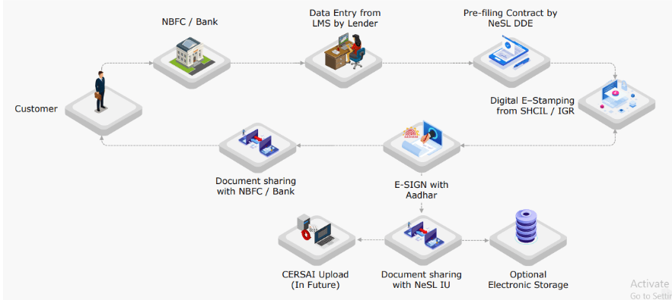
NeSL DDE Workflow

Slide 28
DDE e-stamp based on loan sanction(numbers)
Date range: April 1, 2021 to March 31, 2022

Slide 29
DDE e-stamp based on Loan sanction (amount)
Date range: April 1, 2021 to March 31, 2022

Slide 30









e-BG Through NeSL DDE Platform
SHCIL/ GRAS
States
3
5b
Digital Stamp
Certificate
Notification
1
BG initiation
2
DDE API Request
BG
Issuing Bank
e-BG
e-BG Repository
(eStamp and eSIGN)
4
Applicant/
Customer
6a
Notification
+
e-BG Download
5a
SFMS
IFN 760 COV
Prefilled BG template digitally signed by the Bank official(s)
Communication of copy of Digital Signed eBank Guarantee to Beneficiary
Similar process for eBG Issuance and Amendment
6b
Confirmation
Beneficiary/ Advising Bank
(if services availed)
Beneficiary

Slide 31
Key Features of eBG Through NeSL
Completely Digital
  Not just electronic stamping, the BG document itself is digital with digital signature
  Digital signed - tamper proof
  Eliminates pitfalls of paper based process
  Flexibility in using any BG documentation template as practiced presently, no need to migrate to standardized template across country
  Not only issuance, any amendment / invocation/closure also supported
  Quick issuance, savings for MSMEs – ease of doing business
Notification to beneficiary / customer from NeSL
  eBG downloadable from NeSL by beneficiary
  Banks free to follow regulatory requirements of SFMS msg notification at its end
NeSL as Central eBG repository
  Ease of verification
  Issuing bank can also store eBG issued
Ease of stamp duty enforcement

Slide 32

Vision 2025
Digitalization and AI
in IBC Processes

Slide 33
Vision 2025
Admission of Applications based on IU Records
  Quicker admission should be possible with the help of Record of Default (RoD) certificate.
  Information stored in IU is a prima-facie evidence of debt and its default.
  IU issues the RoD post completion of the processes specified under IBBI (Information Utilities) Regulations, 2017.
  An AI based software for the preliminary verification and scrutiny of applications at NCLTs and also to develop a dashboard giving important information about the case for the Hon’ble members to decide on the admission / rejection.
  An online MIS to manage the status of all applications for initiation of CIRP is envisaged with data not limited to, the no. of days since the application for initiation is made, no. of hearings since the application is made, the size of default etc. to help the Hon’ble Members to take quicker and informed decisions.

Slide 34
Vision 2025
Information Submission by OC and Dispensation of Demand Notice
  At present the OCs need attach the following documents along for initiation of CIRP-
    A copy of the invoice demanding payment or demand notice delivered by the OC to the CD.
    An affidavit to the effect that there is no notice given by the CD relating to a dispute of the unpaid operational debt.
    A copy of the certificate from the financial institutions maintaining accounts of the OC confirming that there is no payment of an unpaid operational debt.
    A copy of any record with information utility confirming that there is no payment of an unpaid operational debt by the corporate debtor.
  The Record of Default (RoD) from the IU should be able to replace all the above documents, Since the RoD will have all information relating to these documents and the IU also gives three reminders at certain intervals to reply on the information of default submitted by OCs which is more than the ‘10 days’ as prescribed under Sec. 8 (2) of the Code.

Slide 35
Vision 2025
Claims Management through NeSL
  Information submitted by creditors (financial and operational) and the data available with the IU can be treated as Claim.
  IRP/ RP would access the IU records and accept the information available as it is authenticated
  Claims which are disputed can be subject to close scrutiny
  The IU platform facilitates claim filing and verification by the IP in a completely online portal without the need for downloading any data by the RP/ Liquidator.
  The platform also helps in generating the final admitted claim list (Creditor-wise) as provided in law.
  This platform also digitizes the entire CIRP and Liquidation Process assisting the RPs/ Liquidators to keep-up with the timelines as prescribed by the code.

Slide 36
Thank You!!
Registered Office
Gresham Assurance House, 4th Floor, Sir P M Road, Fort, Mumbai 400 001. Phone: 022-6260 6666
Administrative Office:
5th Floor, “The Estate” Building, 121, Dickenson Road, Bengaluru – 560 042 Phone: 080-2558 0360
“The Knowledge Forum”
February 01, 2019
Mumbai
www.nesl.co.in

Slide 37
Paradigm Shift
Parameter | Erstwhile Regime | IBC
Framework | Multiple legislations | Single legislation
Objective | Recovery | Resolution
Approach | Debtor-in-Possession | Creditor-in-control
Priority of Interests | Government dues highest | Low for Government dues and just above equity
Moratorium | No | Yes
Time bound | No | Yes
Avoidance Transactions | No | Yes
Moral Hazard | Nothing specific | Section 29A
Professional help | No | Yes
Decision with | State | Market

Slide 38
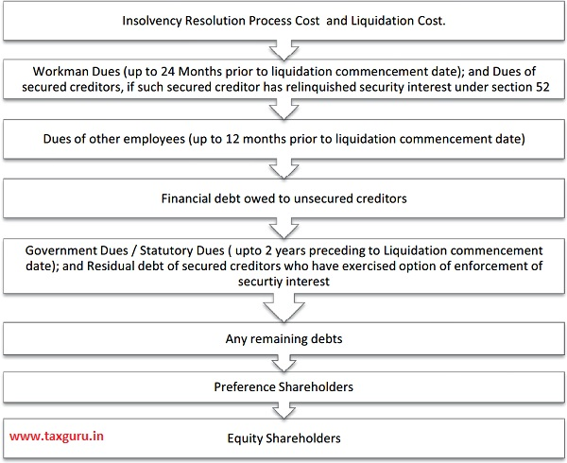
Waterfall

Slide 39
IBC balances interests of all stakeholders
IBC provisions
IBC ensures equitable treatment to each creditor depending upon class : secured/ unsecured, financial or operational
IBC (Amendment) Act, 2019
OCs shall be paid not less than the amount they would have received in the event of liquidation
1
2
4
3
Outcome: Initiation of CIRPs
51% by OCs
43% by FCs
6% by CDs
Essar Steel India Limited vs. Satish Kumar Gupta Supreme Court emphasized protecting creditors is an important objective.
Protecting creditors from each other also important

Slide 40
Statutory Provisions for IU
Covered under Sections 209-215 , Chapter V of the Code.
Regulated under the Insolvency and Bankruptcy Board of India (Information Utilities) Regulations 2017.
Core services of IU are defined under Section 3 (9) of the Code.
Section 99 (3)- Validity of the debt registered with the IU can not be disputed by the debtor. (Notified for Personal Guarantor cases).
Section 214 defines the obligations of the IU.
Section 215 (2) of the code mandates the financial creditors to submit financial information with the IU;
Section 215 (3) of the code is for operational creditor to share information with the IU
Section 235A - Punishment for contravention of the provisions where no specific penalty or punishment is provided.

Slide 41

IU as repository of contract evidence
Two way communication platform
Financial or Operational Creditor as submitter
Bank filing loan details or Supplier files supply details
Corporate / MSME / Individual
As Borrower or Buyer
1
Provides loan or goods / services invoice
Uploads Form C for financial
or Operational Credit
Send authentication
request
2
3
Inform Submitter about
authentication Status
5
4
Authentication with or without disputes
IRP / RP / Liquidator
IBBI / AA
Information Access
6

Slide 42


NeSL Services
Bank A - Form C
UIN-AAAAA1111A
UIN-BBBBB1111B
UIN-CCCCC1111C
1
2
Registration
Bank A
Debtor / Co-Obligant / Guarantor
UIN - AAAAA1111A
4
Bank B - Form C
UIN-XXXXX1111X
UIN-AAAAA1111A
UIN-CCCCC1111C
3
1
View and authenticate
Bank B
1
2
3
4
Information Submission
Form C
  Debt Details
  Parties Details
  Security Details
  Default Details
Authentication Request
Communication via email
Reminders thereon
Registration
Using UIN(PAN)
Authorised representative
Supporting Documents
Authentication
View Form C based on UIN
Authenticate/Dispute with remarks
Key Point
UIN is mapping parameter between information submitted and user for accessing information

