Slide 1
SEBI SETTLEMENT SCHEME, 2020
DR. S.K. JAIN

Slide 2
DEFINATION
Securities and Exchange Board of India (Settlement proceeding ) Regulations, 2018
Regulation 2(f) :- Specified Proceedings
"specified proceedings" means the proceedings that may be initiated by the Board or have been initiated and are pending before the Board or any other forum, for the violation of securities laws, under Section 11, Section 11B, Section 11D, sub-Section (3) of Section 12 or Section 15-I of the Act or Section 12A or Section 23-I of the Securities Contracts (Regulation)Act, 1956 or Section 19 or Section 19H of the Depositories Act, 1996, as the case may be;
Section 2(d) – Option In Securities
“ option in securities” means a contract for the purchase or sale of a right to buy or sell, or a right to buy and sell, securities in future, and includes a teji, a mandi, a teji mandi, a galli, a put, a call or a put and call in securities;

Slide 3
SEBI (PFUTP) Regulations, 2003
Section 2(1)(b) – Dealing in Securities
“dealing in securities” includes an act of buying, selling or subscribing pursuant to any issue of any security or agreeing to buy, sell or subscribe to any issue of any security or otherwise transacting in any way in any security by any person as principal, agent or intermediary referred to in section 12 of the Act.
Regulation 3 - Prohibition of certain dealings in securities
No person shall directly or indirectly—
buy, sell or otherwise deal in securities in a fraudulent manner;
use or employ, in connection with issue, purchase or sale of any security listed or proposed to be listed in a recognized stock exchange, any manipulative or deceptive device or contrivance in contravention of the provisions of the Act or the rules or the regulations made there under;
employ any device, scheme or artifice to defraud in connection with dealing in or issue of securities which are listed or proposed to be listed on a recognized stock exchange;
engage in any act, practice, course of business which operates or would operate as fraud or deceit upon any person in connection with any dealing in or issue of securities which are listed or proposed to be listed on a recognized stock exchange in contravention of the provisions of the Act or the rules and the regulations made there under.

Slide 4
Regulation 4 - Prohibition of manipulative, fraudulent and unfair trade practices
Without prejudice to the provisions of regulation 3, no person shall indulge in a fraudulent or an unfair trade practice in securities.
(2) Dealing in securities shall be deemed to be a fraudulent or an unfair trade practice if it involves fraud and may include all or any of the following, namely:—
(a) indulging in an act which creates false or misleading appearance of trading in the securities market;……….
Regulation 2 (1)(c) - Fraud
“fraud” includes any act, expression, omission or concealment committed whether in a deceitful manner or not by a person or by any other person with his connivance or by his agent while dealing in securities in order to induce another person or his agent to deal in securities, whether or not there is any wrongful gain or avoidance of any loss, and shall also include—

Slide 5
Securities Contract (Regulation) Act, 1956
Section 18 A - Contract In Derivatives
18A. Notwithstanding anything contained in any other law for the time being in force, contracts in derivative shall be legal and valid if such contracts are— (a) traded on a recognised stock exchange; (b) settled on the clearing house of the recognised stock exchange, in accordance with the rules and bye-laws of such stock exchange.
Section 2 (ac) – Derivative
“derivative” includes— (A) a security derived from a debt instrument, share, loan, whether secured or unsecured, risk instrument or contract for differences or any other form of security; (B) a contract which derives its value from the prices, or index of prices, of underlying securities;

Slide 6
A Call Option is an option to “buy”, that is, the contract is to buy the shares on a settlement date at the selected strike rate.
A Put Option is an option to sell, that is, the contract is to sell the shares on the settlement date at the selected strike rate.

Slide 7
Illustrative cases of reversal of trade in Option segment of BSE
1. X entered into contract in BPCL on 23/03/2015 at a strike price of Rs.700 with
expiry date of 15/04/2015. The buy and sell trades were done in the following
manner:
a. X at 11:19:42 hours placed a buy order for 2,23,000 units at a price of Re.1
(premium). This buy order of X got matched with sell order placed by Y.
b. Thereafter on the same day within 8 seconds from the above trade, X at 11:19:50
hours entered into 1 sell trade with Y for 2,23,000 units at a rate of Rs.14 per
unit.
c. Thus the buy order placed by X at Re. 1 was reversed with the same counter
party at Rs.14 within 8 second.
d. Thus, there was 1 unique contract, two trades and artificial volume, two non
genuine trades with artificial volume of 4,46,000 units (2,23,000 + 2,23,000)
which was 100% of the volume traded in the said contract.

Slide 8
2. A entered into one buy trade on 28/07/2015 at 11:04:26 hours with counter party B for 37,000 units at a rate of 10.25 unit in the contract of AUPL 15 SEP 795.00CE. On the same date A at 11:04:29 hours entered into sell trade with B for 37,000 unit at the rate of Rs.18 per unit in the same contract. Thus, there was total two reversal trade (one buy trade and one sell trade) with same counter party. The two non genuine trades constituted 100% of the total trades from the market and A had generated artificial volume of 74,000 unit which is 100% of the volume traded in the said contract.

Slide 9
REGULATION 8 - EFFECT OF PENDING APLLICATION ON SPECIFIED PROCEEDINGS
(1) The filing of an application for settlement of any specified proceedings shall not affect the continuance of the proceedings save that the passing of the final order shall be kept in abeyance till the application is disposed of.
(2) Where the application is filed in case of proceedings that may be initiated against the applicant, such proceedings shall not be initiated till the application is rejected or withdrawn:
Provided that, the filing of an application shall not prohibit the initiation of any proceedings, in so far as may be deemed necessary for the purpose of issuance of interim civil and administrative directions to protect the interests of investors and to maintain the integrity of the securities markets.

Slide 10
REGULATION 26 - SETTLEMENT SCHEMES
Notwithstanding anything contained in these regulations, the Board may specify the procedure and terms of settlement of specified proceedings under a settlement scheme for any class of persons involved in respect of any similar specified defaults.
Explanation - A settlement order issued under a Settlement scheme shall be deemed to be a settlement order under these regulations

Slide 11
REGULATION 27 - Effect of settlement order on third party rights or other proceedings.
(1) A settlement order under these regulations shall not be admissible as evidence in any other proceeding relating to an alleged default not covered under the settlement order nor affect the right of third parties arising out of the alleged default.
(2) Where any applicant who obtains a settlement order is also noticee along with any other person in any civil and administrative proceeding, the Adjudicating Officer or the Board while disposing proceedings against such other person may make necessary observations in respect of the applicant in so far as is necessary to prove the act of another:
Provided that, unless the settlement order is revoked, such observations shall qua the applicant be subject to the settlement order obtained by the applicant
(3) Where any person has obtained a settlement order, which contains observations in respect of any other person for the commission of an alleged default, such an order shall not in itself be admissible as evidence against such other person.

Slide 12
BSE CIRCULAR DATED 13TH DECEMBER, 2018 TO TRADING MEMBERS
Trading members are advised to refrain from entering abnormal / non – genuine transactions executed by the market participants primarily with an objective of transferring profit / loss between the concerned entities or creation of artificial volume in securities / contracts.
The Exchange shall send necessary advice / caution letter to Trading Members and initiate appropriate disciplinary actions against the members concerned in case the activity is observed to be abnormal / non-genuine. Exchange may also levy a penalty of 100% of the traded value / profit made / loss incurred as a result of the trades.
The decision whether a trade or trades is / are abnormal / non – genuine would be of the Exchange which would be final and binding.
The Exchange may also consider taking appropriate disciplinary actions against the member concerned for multiple instances of such abnormal / non-genuine trades as per the Rules, Bye-Laws and Business Rules of the Exchange.

Slide 13
In case the trading members suspect that there is an abnormal trading pattern, the amount equivalent to the trades in the security shall be blocked and released only after seeking rationale of the client on the said trades and carrying further scrutiny of KYC documents / source of funds.
The trading member shall intimate his decision to withhold the amount of the client along with his rationale to the Stock Exchange within 01 day of withholding. The intimation shall be sent to investigation@bseindia.com.
The provisions of this circular will be applicable to all segments with effect from December 17, 2018.

Slide 14
CIRCULARS LINK
BSE Circular dated 31st December, 2018 - https://www.bseindia.com/markets/MarketInfo/DispNewNoticesCirculars.aspx?page=20181213-31
NSE Circular dated 31st December, 2018 – https://www1.nseindia.com/circulars/circular.htm
Public Notice in respect of Settlement Scheme 2020 - https://www.sebi.gov.in/media/public-notices/jul-2020/public-notice-in-respect-of-sebi-settlement-scheme-2020_47150.html

Slide 15
CASE LAW
R S Ispat Ltd Vs SEBI
The Hon’ble SAT vide its Order dated October 14, 2019 in the matter of R S Ispat Ltd Vs SEBI, has inter alia directed as follows:
“…We are adjourning this matter today, so that SEBI may consider holding a LokAdalat or adopting any other alternative dispute resolution process with regard to the Illiquid Stock Options.“
Owning of large number of cases, SEBI has decided to come out with Settlement Scheme (“the Scheme”)

Slide 16
SEBI SETTLEMENT SCHEME 2020 – ONE TIME SETTLEMENT SCHEME
Securities Exchange Board of India (SEBI) vide Public notice dated 27th July, 2020 has issued Public notice in respect of SEBI-Settlement Scheme 2020 to provide one time settlement opportunity to the entities that have executed trade reversals in the stock options segment of BSE during the period from April 1, 2014 to September 30, 2015 against whom any proceedings are pending.

Slide 17
Settlement Scheme 2020
As a part of ongoing surveillance, SEBI came across several instances wherein a set of entities were consistently making losses by their trading in options on individual stocks which are listed on Bombay Stock Exchange (BSE). Trading of these entities appeared abnormal because they were consistently seen to be making significant losses by their trades, which were reversed with the same counterparties either on the same day or the next day.
Hence, an analysis of the stock options segment of Bombay Stock Exchange (BSE) for the period April 1, 2014 to September 30, 2015 was carried out. It was observed that there were several entities who consistently made significant losses, whereas there were others who consistently made significant profit by executing reversal trades in stock options on the BSE. It has been observed that out of 21,652 entities that executed trades on BSE Stock Options Segment, a total of 14,720 entities were involved in generation of artificial volume by executing non-genuine/reversal trades on the same day.
Out of the 14,720 entities involved in generation of artificial volumes by executing non-genuine/reversal trades, SEBI has initiated adjudication proceedings against 567 entities.

Slide 18
4. Meanwhile, the Hon’ble SAT vide its Order dated October 14, 2019 in the matter of R S Ispat Ltd Vs SEBI, hasinter alia directed as follows: “…We are adjourning this matter today, so that SEBI may consider holding a LokAdalat or adopting any other alternative dispute resolution process with regard to the Illiquid Stock Options.“
5. Given the aforesaid background, the Board has decided to introduce a Settlement Scheme (“the Scheme”) in terms of Regulation 26 of SEBI (Settlement Proceedings) Regulations 2018. The Scheme proposes to provide a onetime settlement opportunity to the entities that have executed trade reversals in the stock options segment of BSE during the period from April 1, 2014 to September 30, 2015 against whom any proceedings are pending.
6. The Board has considered three objective parameters viz., artificial volume, number of non-genuine trades and number of contracts resulting in creation of artificial volume/ non-genuine trades to arrive at an Indicative Settlement Amount. Further, a uniform consolidated Settlement factor of 0.55 in all cases wherein the entities had executed reversal trades, would be applicable while arriving at the Indicative Settlement Amounts.
7. The details of the respective Indicative Settlement Amounts under the Scheme, along with corresponding artificial volume, number of non-genuine trades and number of contracts resulting in creating of artificial volumes / non-genuine trades, in respect of entities who have executed trade reversals on stock options segment of BSE during the period from April 1, 2014 to September 30, 2015, are available on SEBI website and also on the BSE website.

Slide 19
REASON BEHIND THIS SETTLEMENT SCHEME
SEBI has conducted an analysis of the stock options segment of Bombay Stock Exchange (BSE) for the period April 1, 2014 to September 30, 2015 when SEBI came across several instances wherein a set of entities were consistently making losses by their trading in options on individual stocks which are listed on Bombay Stock Exchange (BSE).
SR. NO. | PARTICULARS | NO. OF ENTITIES
1. | Total Entities executed trades on BSE Stock Options Segment | 21,652
2. | Entities involved in generation of artificial volume by executing non- genuine/reversal trades | 14,720
3. | SEBI has initiated adjudication proceedings against | 567

Slide 20
CHARACTERSTICS OF SETTLEMENT SCHEME, 2020
Condition of eligibility to avail the Scheme
The Scheme is available to those organization who have made trade reversals in BSE Segment of stock option.
The above transaction was supposed to take place between 1 April, 2014 and 30 September, 2015.
The proceedings should be pending.

Slide 21
2. The timeframe to benefit from the Scheme.
In the period 1 August 2020 to 31 October 2020, the qualifying parties can submit. The One-time Settlement period as per the Scheme will start on August 01, 2020 and end on October 31, 2020.
3. Applicable fees for applying in the Scheme.
The entity filing a settlement application under the scheme is required to pay the following fees-
Type of Applicant | Applicable fee
Individuals | Rs. 15000
Companies/Corporates | Rs. 25000

Slide 22
4. Proposed amount for settlement
Following three objective parameters, the Board considered achieving suggestive settlement amount –
Artificial volume
No. of non genuine trades completed
The number of contracts which result in artificial volumes or non genuine trades
Uniform consolidated settlement factor of 0.55 shall be applied to calculate the net settlement amount payable by entities.

Slide 23
5. Other Important factors
The entity is required to pay the settlement amount via an online platform, as available on the SEBI’s website.
The entities covered within the scheme, but, don’t avail the benefit of the settlement scheme 2020 shall be liable for action as per provisions of section 15-I of the Securities and Exchange Board of India Act, 1992.

Slide 24
15-I. – POWER TO ADJUDICATE
(1) For the purpose of adjudging under sections 15A, 15B, 15C, 15D, 15E, 15F, 15G [,15H, 15HA and 15HB], the Board shall appoint any officer not below the rank of a Division Chief to be an adjudicating officer for holding an inquiry in the prescribed manner after giving any person concerned a reasonable opportunity of being heard for the purpose of imposing any penalty.
(2) While holding an inquiry the adjudicating officer shall have power to summon and enforce the attendance of any person acquainted with the facts and circumstances of the case to give evidence or to produce any document which in the opinion of the adjudicating officer, may be useful for or relevant to the subject-matter of the inquiry and if, on such inquiry, he is satisfied that the person has failed to comply with the provisions of any of the sections specified in subsection (1), he may impose such penalty as he thinks fit in accordance with the provisions of any of those sections. 88
(3) The Board may call for and examine the record of any proceedings under this section and if it considers that the order passed by the adjudicating officer is erroneous to the extent it is not in the interests of the securities market, it may, after making or causing to be made such inquiry as it deems necessary, pass an order enhancing the quantum of penalty, if the circumstances of the case so justify:
Provided that no such order shall be passed unless the person concerned has been given an opportunity of being heard in the matter:
Provided further that nothing contained in this sub-section shall be applicable after an expiry of a period of three months from the date of the order passed by the adjudicating officer or disposal of the appeal under section 15T, whichever is earlier.]

Slide 25
15HA. - Penalty for fraudulent and unfair trade practices.
If any person indulges in fraudulent and unfair trade practices relating to securities, he shall be liable to a penalty which shall not be less than five lakh rupees but which may extend to twenty-five crore rupees or three times the amount of profits made out of such practices, whichever is higher.
15JB. - Settlement of administrative and civil proceedings.
(1) Notwithstanding anything contained in any other law for the time being in force, any person, against whom any proceedings have been initiated or may be initiated under section 11, section 11B, section 11D, sub-section (3) of section 12 or section 15-I, may file an application in writing to the Board proposing for settlement of the proceedings initiated or to be initiated for the alleged defaults.
(2) The Board may, after taking into consideration the nature, gravity and impact of defaults, agree to the proposal for settlement, on payment of such sum by the defaulter or on such other terms as may be determined by the Board in accordance with the regulations made under this Act.
(3) The settlement proceedings under this section shall be conducted in accordance with the procedure specified in the regulations made under this Act.
(4) No appeal shall lie under section 15T against any order passed by the Board or adjudicating officer, as the case may be, under this section

Slide 26
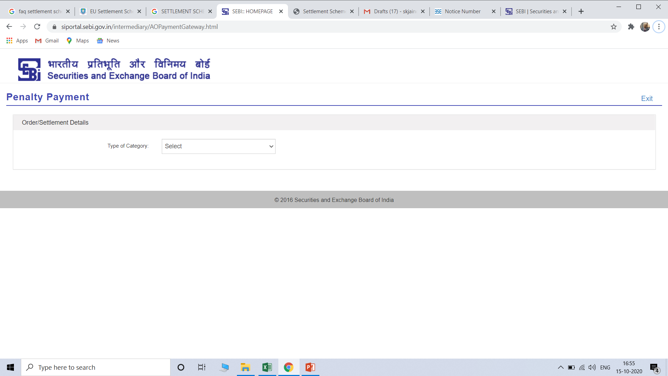
How to check settlement amount?
STEP 1 :- Applicants are advised to open the link https://siportal.sebi.gov.in/intermediary/AOPaymentGateway.html ,

Slide 27
STEP 2 :- Select Settlement Scheme Under Type of Category

Slide 28
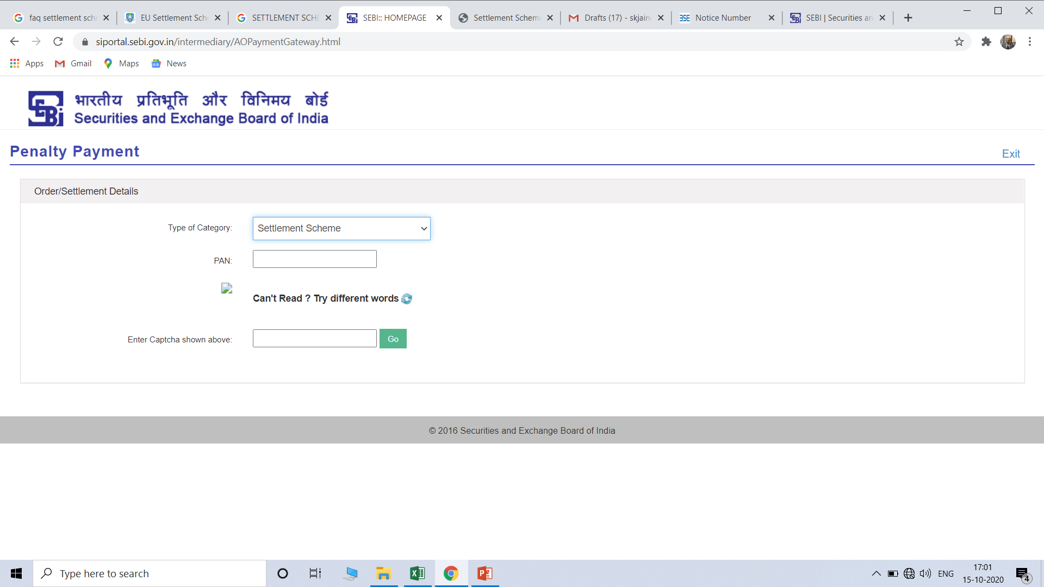
Step 3 -Enter PAN details

Slide 29
Details of Settlement Amount will display:-

Slide 30
Filing of the physical copy of the settlement application (to be received by SEBI on or before November 05, 2020) along with the following documents:
A settlement application in the specified format as per ANNEXURE 1
ii) A copy of the self-attested copy of the PAN Card of the applicant.
iii) The undertakings and waivers in Non-judicial stamp paper, duly notarised and stamped duty duly paid.
iv) Self-attested copies of the Income Tax Returns of the applicant for the last 3 financial years.
v) A self-attested copy of the payment of the non-refundable settlement application processing fees.
vi) A self-attested copy of the payment of the settlement amounts as displayed in respect of each of the applicants

Slide 31
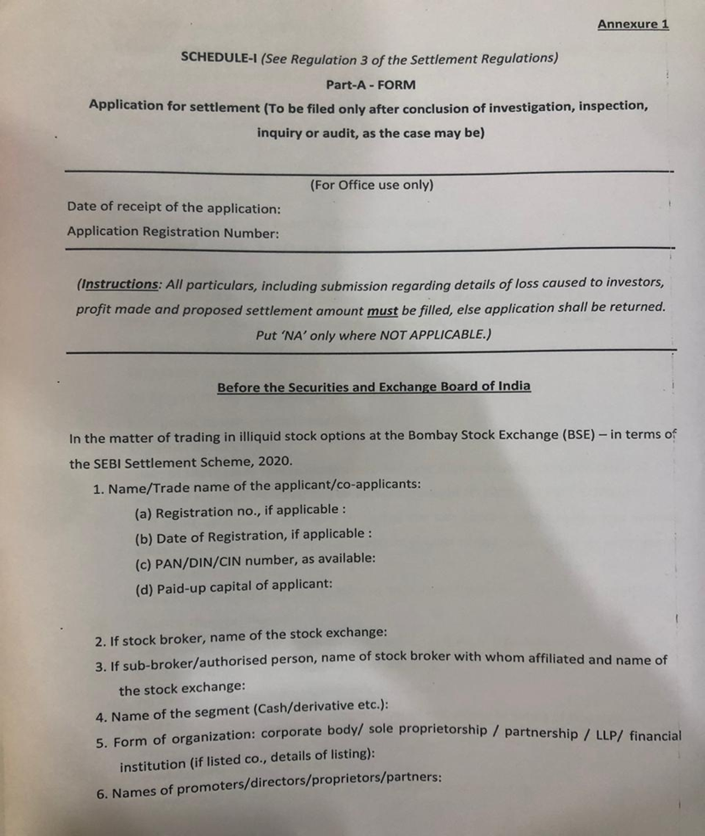
ANNEXURE 1
A
APPLICATION FORM FOR SETTLEMENT

Slide 32
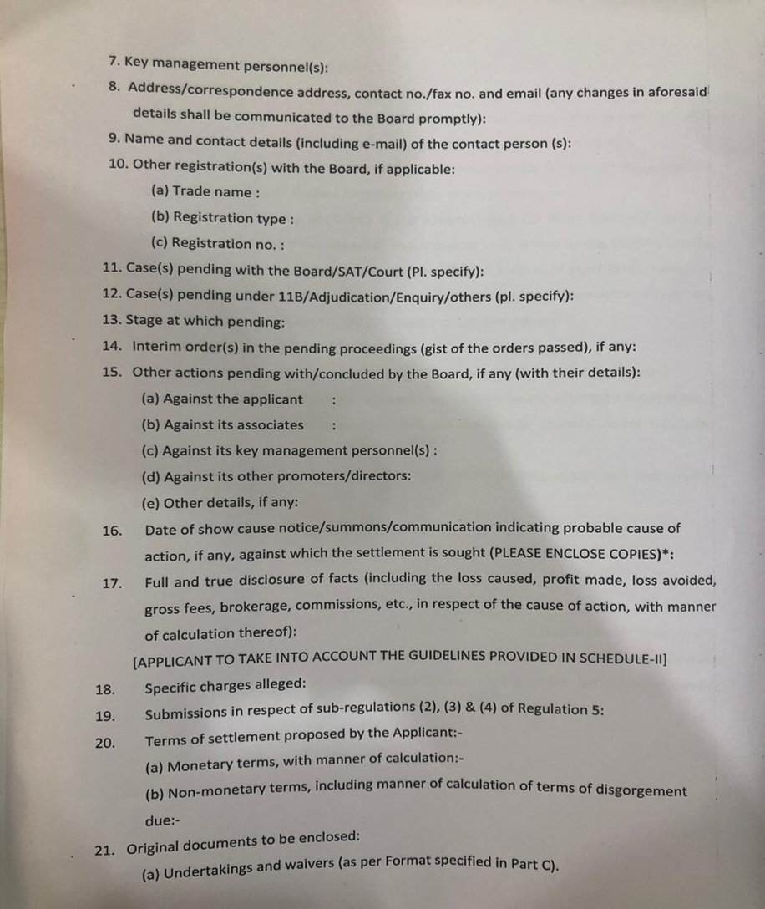

Slide 33
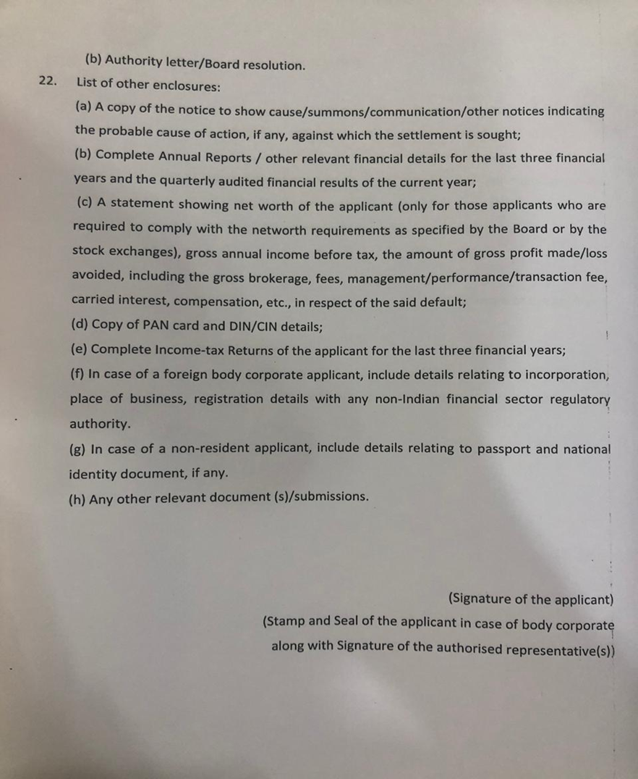

Slide 34
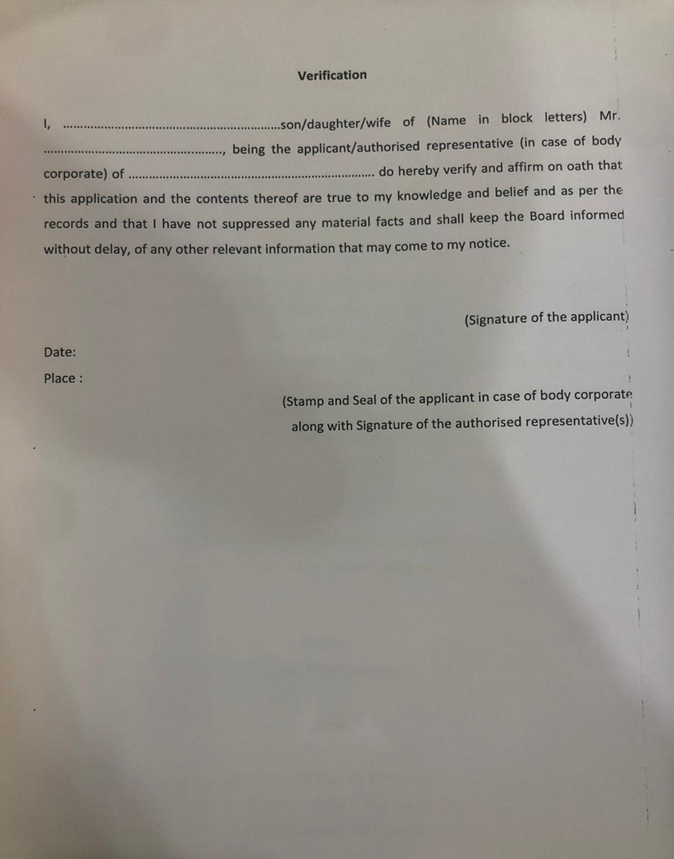

Slide 35
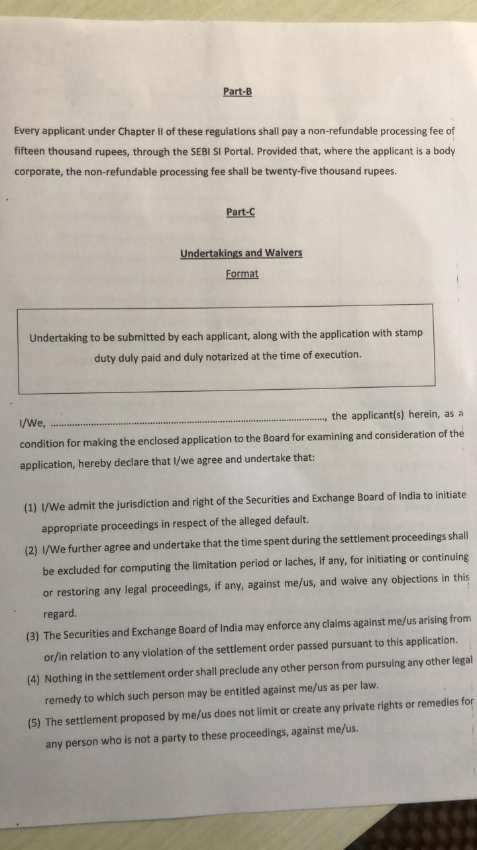

Slide 36
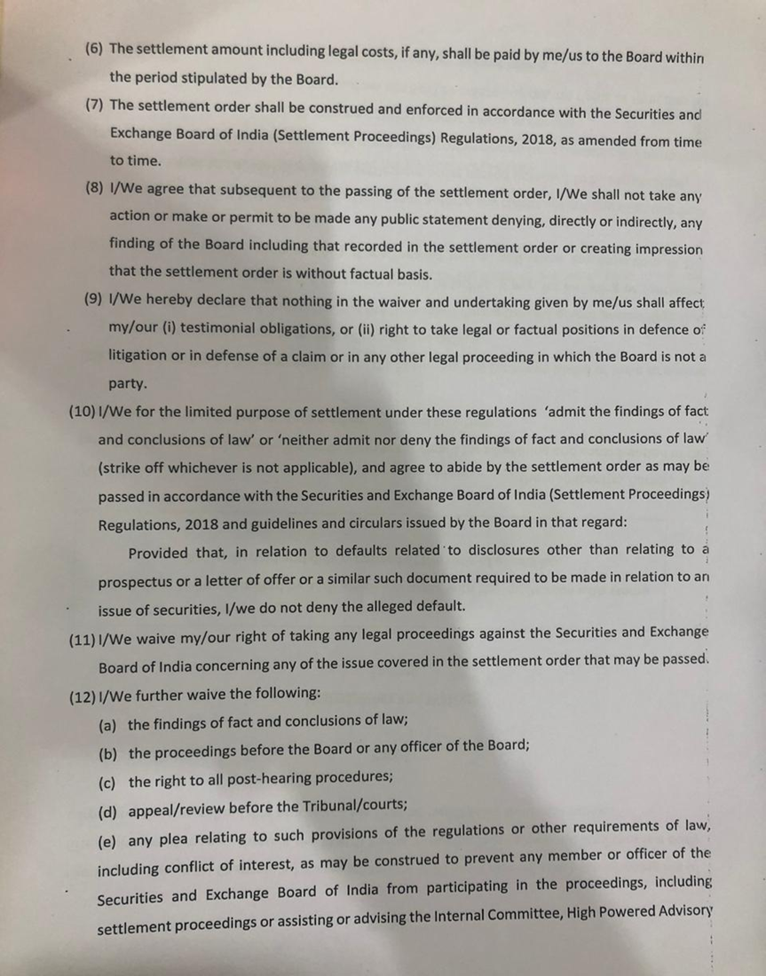

Slide 37
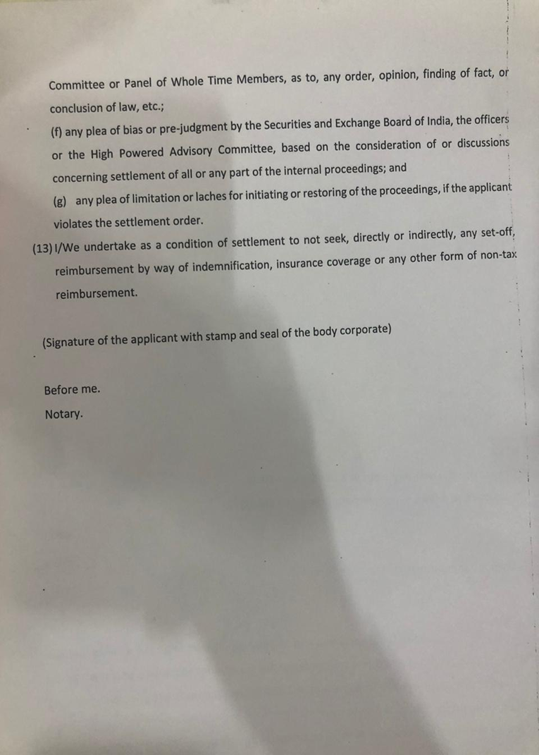

Slide 38
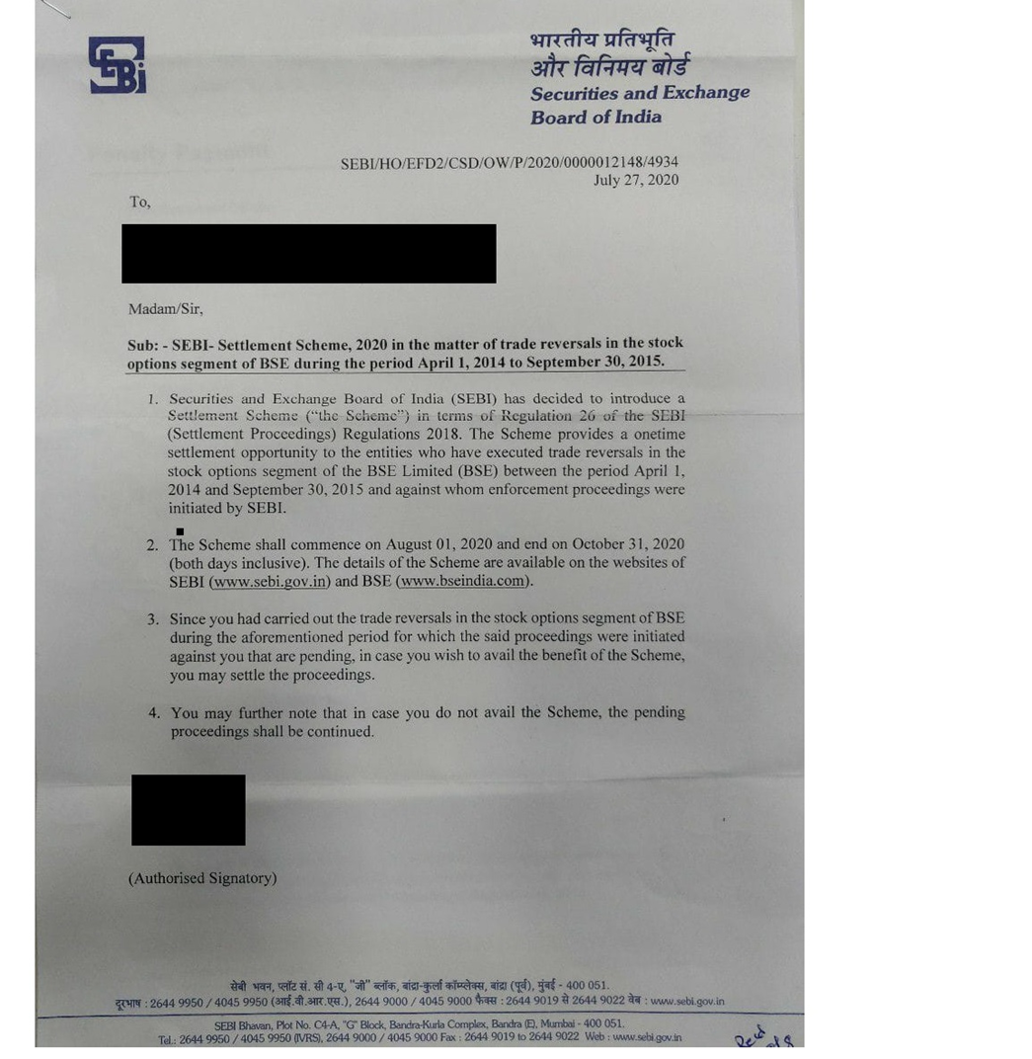
A
SHOW CAUSE NOTICE TO INDIVIDUALS

Slide 39
SAMPLE BASED ANALYSIS
IN THE SETTLEMENT SCHEME , THE SETTLEMENT AMOUNT IS NOT UNIFORM
NAME OF THE ENTITY | AMOUNHT OF PENALTY IMPOSED | ALLEGED CONTRACT | TRADES | VOLUME | SETTLEMENT AMOUNT | REGISTRATION FEE | TOTAL
Madhushree Finvest Private Limited | 500000 | 9 | 52 | 2,63,30,334 | 1782500 | 25000 | 1807500
Acira Consultancy PrivateLtd. | 600000 | 13 | 132 | 7527000 | 2092500 | 25000 | 2117500
Admire Vinimay Pvt Ltd | 800000 | 37 | 118 | 1,09,98,000 | 2402500 | 25000 | 2427500
Ajeit P S Rajbans HUF | 500000 | 15 | 112 | 52,22,000 | 2092500 | 15000 | 2107500
Chunchun Ispat Private Limited | 500000 | 16 | 38 | 1,79,60,000 | 1472500 | 25000 | 1497500
Clan Laboratories Private Limited | 500000 | 16 | 63 | 71,23,190 | 1627500 | 25000 | 1652500
Eveningstar Deal Trade Private Limited | 1730000 | 106 | 267 | 2,52,98,250 | 3332500 | 25000 | 3357500
Leelaben Sureshchandra Kachadia | 1000000 | 66 | 473 | 3,35,74,000 | 3177500 | 15000 | 3192500
Overactive Merchants Private Limited | 1500000 | 93 | 270 | 1,63,44,000 | 3022500 | 25000 | 3047500
Pragya Commodites Pvt., Ltd | 1000000 | 47 | 142 | 7,49,68,000 | 2712500 | 25000 | 2737500
Subhlabh Fiscal Services Private Limited | 1120000 | 67 | 203 | 2,73,40,000 | 3022500 | 25000 | 3047500
Suruchi Foods Private Limited | 2500000 | 378 | 911 | 4,74,18,500 | 4262500 | 25000 | 4287500
Indus Portfolio Private Limited | 2500000 | 280 | 685 | 1,16,12,000 | 3952500 | 25000 | 3977500

Slide 40
The settlement scheme 2020 favors entities which had created high Artificial Volume. The Executing Officers had levied higher amount of penalty then
proposed in the Settlement Scheme.
NAME OF THE ENTITY | AMOUNHT OF PENALTY IMPOSED | ALLEGED CONTRACT | TRADES | VOLUME | SETTLEMENT AMOUNT | REGISTRATION FEE | TOTAL
DB (International) Stock Brokers Ltd. | 5000000 | 254 | 3942 | 36597500 | 4417500 | 25000 | 4442500
N M Impex Pvt. Ltd. | 1,15,00,000 | 561 | 5547 | 245742500 | 6277500 | 25000 | 6302500
Matri Mangal Trading Private Limited | 5000000 | 133 | 1792 | 15633250 | 3797500 | 25000 | 3822500

Slide 41
SR. NO. | RANGE | NO. OF CASES
1. | UPTO 5,00,000 | 276
2. | 5,00,001- 6,00,000 | 26
3. | 6,00,000 – 7,00,000 | 16
4. | 7,00,001 – 8,00,000 | 19
5. | 8,00,001 – 9,00,000 | 14
6. | 9,00,001 – 10,00,000 | 12
5. | 10,00,001 – 20,00,000 | 42
6. | 20,00,001 – 30,00,000 | 15
7. | 50,00,001 – 60,000,000 | 2
8. | 60,000,001 – 70,00,000 | 1
9. | 70,00,001 – 80,00,000 | 1
10 | 80,00,001 – 90,00,000 | 1
11. | 90,00,001 – 1,00,00,000 | 0
12 | 1,00,00,001 – 1,20,00,000 | 1
 | TOTAL | 428

Slide 42
FAQ’s
Q 1. I have received a letter/email from SEBI wherein it is alleged that I had carried out the trade reversals in stock options segment of BSE during 1.4.2014 and 30.9.2015 for which certain proceedings were initiated against me are pending. I am unaware of the proceedings and any communications in this matter. What should I do?
A. 1. SEBI has initiated proceedings against entities who have engaged in trade reversals in illiquid stock options at BSE during the period April 01, 2014 to September 30, 2015. Show Cause Notices are yet to be issued in respect of certain entities. Applicants are advised to open the link https://siportal.sebi.gov.in/intermediary/AOPaymentGateway.html , enter PAN to check their details, and their eligibility for the scheme. Applicants can pay the application fee and settlement amount online to settle the proceedings against them.

Slide 43
Q. 2. I have already filed settlement application in respect of Show Cause Notice issued by Adjudicating Officer before the Scheme was introduced? Do I need to submit my application again?
A. 2. No. Such applicants may go to the link given below, enter their PAN and pay the settlement amount to settle the proceedings. They do not need to pay the registration fee. Such applicants would be required to upload the requisite documents. https://siportal.sebi.gov.in/intermediary/AOPaymentGateway.html
Q. 3. Where can the Scheme document be seen?
A. 3. The Scheme document is available at the following link: https://www.sebi.gov.in/media/public-notices/jul-2020/public-notice-in-respect-of-sebisettlement-scheme-2020_47150.html

Slide 44
Q. 4. Where can the Scheme document be seen?
A. 4. The Scheme document is available at the following link: https://www.sebi.gov.in/media/public-notices/jul-2020/public-notice-in-respect-of-sebisettlement-scheme-2020_47150.html
Q.5. When will the settlement order be passed under the Scheme?
A.5. Subsequent to the closure of the Scheme, a composite settlement order would be passed by the competent authority after reconciliation of records.
Q.6. Should I wait till the last day for filing the settlement application under the Scheme?
A. 6. It is advisable to file a settlement application under the Scheme as soon as possible in order to avoid last rush. Sufficient time of three months have been provided under the Scheme.

Slide 45
Clarification on Questions received by me
What is the Settlement Scheme, 2020
I have explained in my PPT in detail about Settlement Scheme, 2020. To recapitulate, SEBI had found that during the period 1st April 2014 to 30th September, large number of entities had reversed their trade in Option Segment of BSE with same Counter parties in miniscule time and such trade were fraudulent within the meaning of Regulation 3 & 4 of SEBI (PFUT) Regulation.
During the Investigation period i.e. 01/04/2014 to 30/09/2015, to the 2,91,643 trades comprising to 81.38 % of all the trades executed in Stock Option Segment of BSE were found to be non genuine trades. The non genuine trades resulted into creation of artificial volume of 826.81 crore units or 54.68% of total market volume in Stock Option Segment of BSE.

Slide 46
2. What is the background of these intimation? Why after a gap of 5 years?
It is shocking and surprising that how the sophisticated surveillance system installed by BSE as well as SEBI for detection of non genuine trades escaped and could not be captured for a long period of 18 months during which the alleged trades were executed i.e. 1/04/2014 to 30/09/2015. It appears that SEBI had conducted investigation much after the non – genuine trades took place on BSE Stock Option segment. In view of large number of entities involved in execution of alleged non genuine trades in BSE Stock Option Segment, investigation might have itself taken long time.
The Law of Limitation does not apply to the proceeding initiated by the SEBI. However, if there abnormal delay, there are judgements of Hon’ble Supreme Court and Hon’ble SAT, wherein such orders passed after lapse of long time have been set aside.

Slide 47
3. What is the process to avail the Scheme?
The Applicant can ascertain the Settlement Amount. SEBI has provided a link for ascertaining the Settlement Amount which is PAN based. The Applicant is required to file application in the prescribed form and make payment of processing fee.
If Individual then Rs. 15000/- and if Body Corporate – Rs. 25000/- .
The SEBI will pass order after the closure of settlement period i.e. 31st October, 2020.
4. What are the consequences in case someone does not avail this Scheme?
In the Settlement Scheme, 2020 it has been made clear that after the expiry of Settlement Scheme, 2020, the adjudication proceedings will be initiated against the concerned entities under Section 15(I) of SEBI act, 1992.

Slide 48
5. Why such a huge penalty - someone has a profit/loss of 50,000 or 100,000 but still has to settle for an amount of Rs. 500,000?
The adjudicating Officer has so far passed 427 orders against various entities which had executed non genuine trades on BSE Stock Option Segment. In 275 orders, minimum penalty of Rs. 5,00,000 has been imposed. In one case AO had imposed penalty of Rs. 3,00,000 which was enhanced to Rs. 500000 by Whole Time Member.
Hon’ble SAT by orders dated 14/09/2020 and 17/09/2020 has dismissed large number of appeals and has not given any relief on quantum of penalty.

Slide 49
6. Can I deny / retaliate that there has been no opportunity of being heard given and straight away an exorbitant amount is being asked for as settlement amount?
SEBI has sent individual letters to all the entities mentioning therein that the proceeding against them were initiated and are pending and they may avail the benefit of the scheme and settle the proceedings. The SEBI has also made it clear that if they do no avail the scheme then the pending proceedings shall be continued.

Slide 50
7. What happens in case the transaction is squared off after 4 or 5 hours and not immediately that is within seconds?
There are two legs of transactions. Both have been reversed in few seconds, though there may be time gap of 4 to 5 hours between the two. There may be few cases where time gap between placing of orders by Option Writer (seller) and option buyer may be 4 to 5 hours. However, as Option segment of BSE was illiquid such trades were also considered non genuine.

Slide 51
8. No opportunity of cross examination before availing / non availing this scheme possible?
There is no question of any cross examination as in case, one does not avail the Settlement Scheme, the adjudication proceeding will be initiated under section 15-I .
9. How to calculate the penalty that can be charged by the adjudicating officers if we do not go in this scheme. This should be done to see the cost in the scheme vs otherwise?
Ans. - As explained in the PPT in majority of the Cases the Adjudicating Officers have imposed minimum penalty of Rs. 5,00,000. However, the Adjudicating Officers before passing orders ought to have consider the factors as mentioned in section 15-J of SEBI Act 1992. Unfortunately a grave injustice has been caused to the entities who might have entered into one contract, two trades (buy + sell) resulting in significant volume as even in some case minimum penalty of Rs. 5,00,000 has been imposed.

Slide 52
10. How is SEBI calculating the settlement amount ? Can we have few example.
In Settlement Scheme, 2020 it is mentioned that 0.55 factor is to be applied for arriving at settlement amount . However, it has not been made clear how this 0.55 factor is to be applied.
11. What after 31st October, 2020? By when do we expect the Show cause notices? Is there an standard reply for the same?
The SEBI has sent letters to all the entities which have been found to have executed reversal of trade in BSE Stock Option segment. Out of 14720 entities, show cause notice, were issued to only 567 entities and order has been passed against 428 entities. Hence after the expiry of Settlement Scheme , 2020 the issuance of show cause notices to all the remaining entities will obviously take long time.

Slide 53
12. After receiving SCN do we have to pay any amount for filling an appeal with SAT like we do in Income Tax (20%)? What happens in this case under Income Tax Act?
After show cause notice is received from adjudicating officer, reply is required to be submitted by the concerned entities and thereafter opportunity of hearing will be given by AO. After hearing is over, the order will be passed by AO under Section 15 HA of SEBI act 1992. The appeal is to be filed within 45 days from the receipt of order. If the appeal is filed, no recovery proceedings will be initiated by SEBI against the entity. Hence the amount penalty imposed by AO is not require to be paid till disposal of Appeal. The Scheme does not provide any immunity from the Income Tax proceedings.

Slide 54
13. Can any other act be imposed?
YES. The Scheme provide protection from initiation of any proceedings in the impugned matter under SEBI act if the settlement amount is paid , however there is no protection against initiation of proceedings under any other act.
14. Can the property be attached in case we do not go for settlement.
The recovery proceeding will be initiated only if Appeal is not filed before SAT within 45 days of the receipt of order passed by AO. Hon’ble SAT may condone the delay if there is delay in filing of the Appeal. It id only in case of no appeal is file before SAT or SAT dismisses the appeal, recovery officers will initiate recovery proceedings and may freeze the Demat account and bank account of the entity.

Slide 55
15. Are there any standard format which we can use for larger benefit for example reply/ affidavit, etc ?
There are no standard formats.
16. Full and true disclosure of facts (including the loss caused, profit made, loss avoided, gross fees, brokerage, commissions, etc., in respect of the cause of action, with manner of calculation thereof)
In serial No. 17 of the Application form it is to be mentioned that no loss was caused, no profit made and no loss avoided. It cannot be quantified also. Schedule II of SEBI (settlement proceeding) regulations 2018 is not applicable as the settlement amount is predetermined.

Slide 56
17. Specific Charges Alleged
Since show cause notice has not been issued to large number of entities, the only allegation made in the letter sent by SEBI to various entities is that the entities had executed non genuine trades in the Stock Option segment of BSE during the period 01/04/2014 to 30/09/2015, the same allegations is to be mentioned in the serial No. 18 of the Application form,
18. Submissions in respect of sub regulation 2,3 and 4 of Regulation 5.
Since show cause notice has not been issued. In Serial Number 19 of the Application Form it is to be mentioned (The Applicant request SEBI to accept the settlement amount of Rs._____ arrived at by SEBI on the basis of number of contract, number of trades and artificial volume and pass Order in the pending proceeding against the applicant)

Slide 57
19. Terms of settlement proposed by the Applicant:-
Monetary terms, with manner of calculation
Non- monetary terms, including manner of calculation of terms of disgorgement due
As per Settlement Scheme, the settlement is in Monetary Terms only. Hence, in Serial Number 20 of the Application , it should be mentioned that the applicant agrees to pay the settlement amount of Rs. ______ as arrived at by SEBI under the Scheme. Against non monetary terms, the words “NA” should be mentioned.

Slide 58
Thank you

