Slide 1
Top 10 Tools to Automate your Office
ADAPT
TRANSFORM
INNOVATE

Slide 2
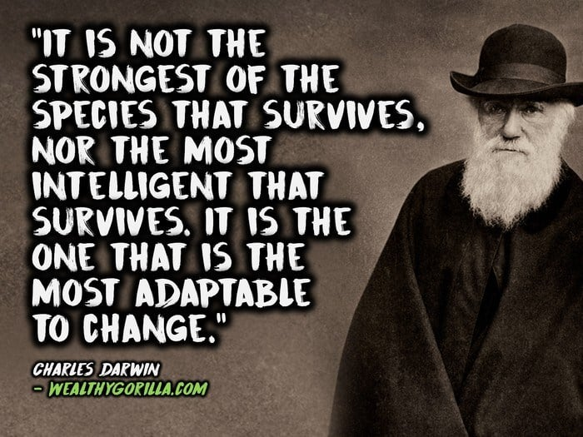
Popular Quotes
ADAPT
TRANSFORM
INNOVATE

Slide 3
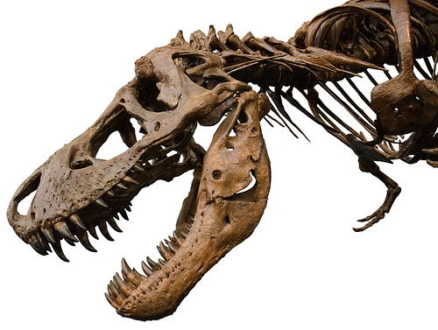
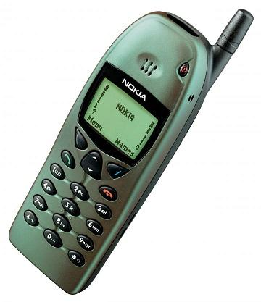
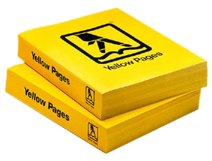
Digital Dinosaurs
All of these have become digital dinosaurs due to their failure to adopt to disruptive technologies.
ADAPT
TRANSFORM
INNOVATE

Slide 4
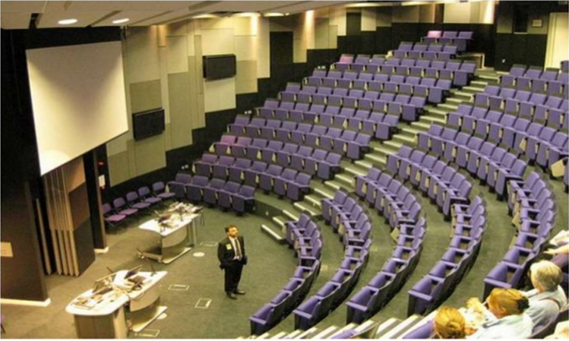
Digital Dinosaurs
SPOT THE DINOSAUR
ADAPT
TRANSFORM
INNOVATE

Slide 5
Digital Titans
A few other popular Digital Disruption which has already happened
Worlds largest taxi company owns no taxi
Worlds largest recruitment agency
Worlds most valuable retailer has no inventory
Largest Phone Co. owns no telco infra
Worlds 7th largest Internet company by revenue
Worlds largest lodging provider with no logistics of its own
Worlds 3rd largest hotel chain
ADAPT
TRANSFORM
INNOVATE

Slide 6
Top 10 Tools to Automate your Office
ADAPT
TRANSFORM
INNOVATE

Slide 7
Communication Tools
For Virtual Meetings:
Skype
(Live Demo)
Zoom
Go To Meeting
ADAPT
TRANSFORM
INNOVATE

Slide 8
Communication Tools
For In-house Staff Communication:
ADAPT
TRANSFORM
INNOVATE

Slide 9
Remote Access Tools
Any Desk
(Live Demo)
Team Viewer
ADAPT
TRANSFORM
INNOVATE

Slide 10
File Sharing Tools
Google Drive
(Live Demo)
Dropbox
We Transfer
One Drive
ADAPT
TRANSFORM
INNOVATE

Slide 11
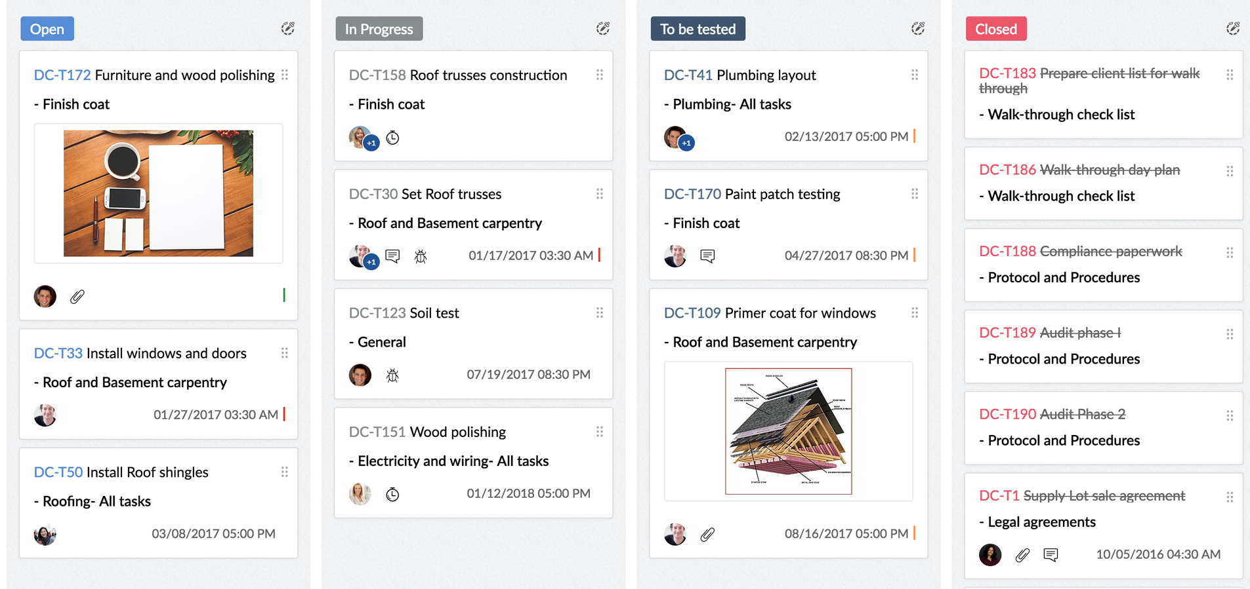
Project Management Tools
Zoho Projects
Trello
Clickup
CCHiFirm
ADAPT
TRANSFORM
INNOVATE

Slide 12
Work Management Tools
ADAPT
TRANSFORM
INNOVATE

Slide 13
Task Management
T Hawk
T Hawk- Best is a CA Practice Managment Sofware. It has a user friendly interface which ensures enhancement in productivity, cost cutting and smooth line overall business operations.
Key Features:
GPS Based Attendance
Reimbursement Approval System
Job Tracking
Leave Management
Time Tracking
Documents Manager

Slide 14
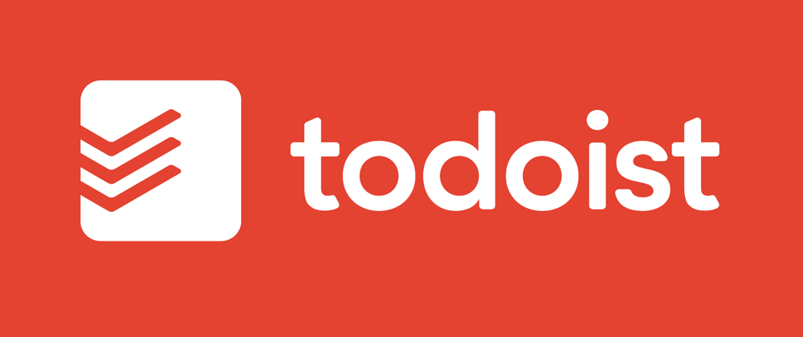
Time Management Tools
Clockify
(Live Demo)
Evernote
ADAPT
TRANSFORM
INNOVATE

Slide 15
Time Manager
Clockify
Clockify is a free time tracking software which allows us to see where our time goes and hence improve productivity per unit time.
Key Features:
Time tracker
Timesheet
Dashboard reports on your time management
Track time on projects, and keep an eye on progress and budget
Clockify works across devices
Invite your team and track time they spend on activities.

Slide 16
Making and organising Notes
Evernote
Evernote is an application designed for taking notes, organizing them, managing and scheduling tasks on a real time basis.
Key Features:
Faster Note-taking
Document Searching
Document Scanning
Real-time Changes
Communication

Slide 17
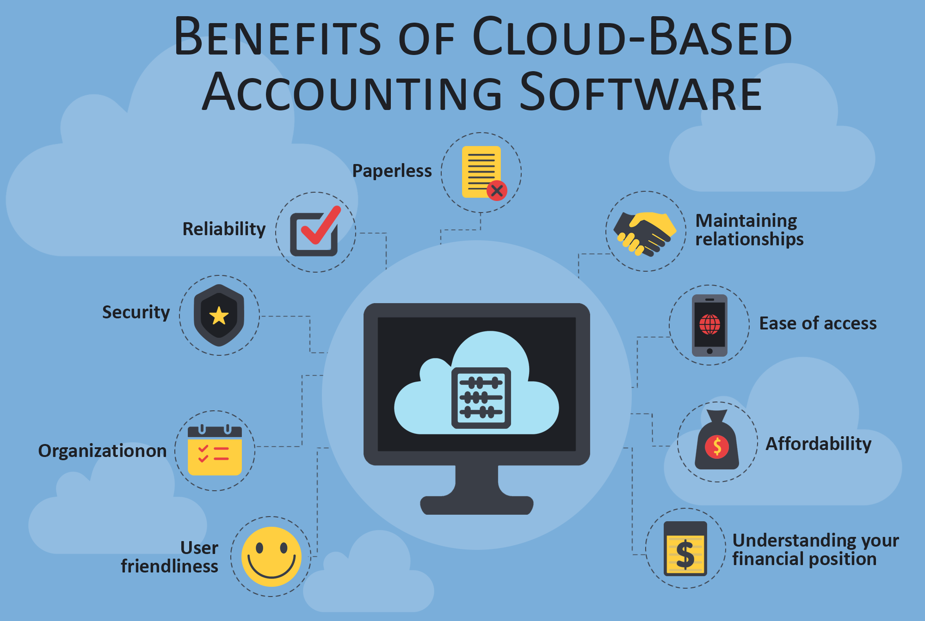
Cloud Accounting Tools
It’s Time to Switch to Cloud Accounting!!
ADAPT
TRANSFORM
INNOVATE

Slide 18
Cloud Accounting Tools
Zoho Books
It is a Smart Cloud-based Accounting Software designed for Digital Accountants.
Key Features:
End-to-end accounting:
Helps in GST Compliance
Integrate with Zoho's 40+ apps and manage every aspect of business
Save time with Auto-email of Invoices / Estimates / Purchase or Sales Orders to customers based on scheduled reminders

Slide 19
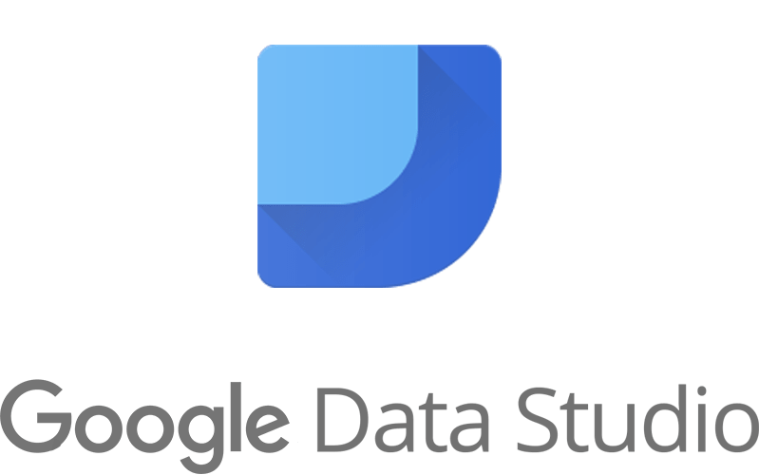
Reporting Tools
Reporting Tools
ADAPT
TRANSFORM
INNOVATE

Slide 20
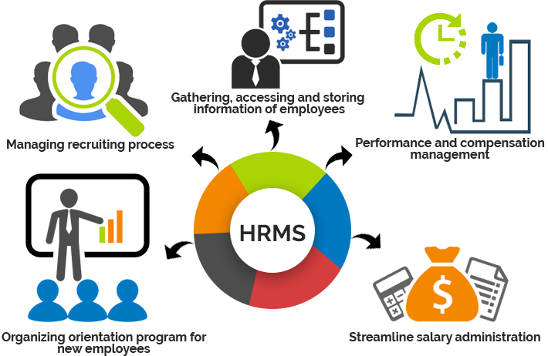
Human Resource Management Tools
ADAPT
TRANSFORM
INNOVATE

Slide 21
Hiring Tools
ADAPT
TRANSFORM
INNOVATE

Slide 22
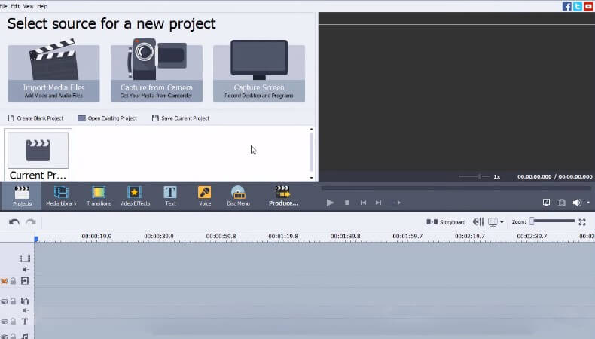
Creating Training video Tools
Camtasia
Open Broadcaster
Adobe Premiere Pro
ADAPT
TRANSFORM
INNOVATE

Slide 23
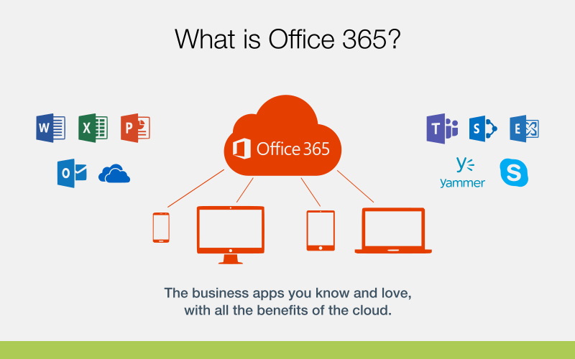
Office365 tools
ADAPT
TRANSFORM
INNOVATE

Slide 24
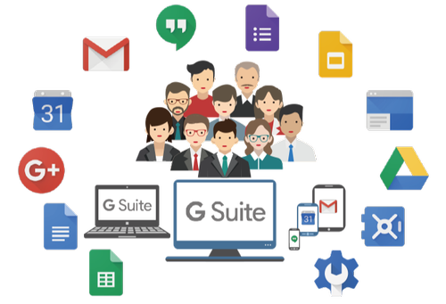
Using G-SUITE to Automate.
ADAPT
TRANSFORM
INNOVATE

Slide 25
Tools from Google we generally use
Search
Gmail
Youtube
Maps
Play Store
Photos
Drive
These does not need any explanation !!
ADAPT
TRANSFORM
INNOVATE

Slide 26
Paperless Office
Gmail
Gmail is a free email service provided by Google. It is intuitive, efficient, and useful with 15 GB of storage, less spam, and mobile access.
Key Features:
Schedule emails
Give yourself a longer time to recover your errors.
Get notifications for certain emails
Mix up your email stars
Create rules to filter your emails
Organize email with sub-labels

Slide 27
Paperless Office
Google Docs
Google Docs brings your documents to life with smart editing and styling tools to help you easily format text and paragraphs.
Key Features:
No more typing: Text to speech
Add Comments & Tag People
Create Your Own Shortcuts
Research information and images online without ever leaving the document.
Translate Your Doc to Another Language
Create a Table of Contents

Slide 28
Paperless Office
Google sheets
Google sheet is an online spreadsheet program. It is available as a mobile application, web application and desktop application.
Key Features:
Helps in creating/editing spreadsheets online.
Use your data anytime, anywhere ,even offline.
Respond to comments added in cells
Save data automatically as we type on cloud.
Google sheets are accessible to more than one person at a time
To prevent other formatting and protect data, cells are auto locked.
Add charts and graphs to visualize data

Slide 29
Paperless Office
Google Calendar
Google calendar is an alternative to ordinary calendars on our phone but with many additional facilities of scheduling events, setting goals and reminders.
Key Features:
Prepare Schedules
New Calendars
Scheduling meetings with groups
Detailing events
Autosave and repeat recurring events
Setting of Goals

Slide 30
Paperless Office
Google Forms
Google Forms is a cloud-based questionnaire and survey software. Forms has many common characteristics such as real-time collaboration and personalization.
Key Features:
Create Unlimited Free Forms With Google Templates
Get Email Notifications for Google Forms Results
Google Forms Is Mobile-Friendly
Automate processes with various addons
Integrate google forms with google sheets

Slide 31
Paperless Office
Outlook
Outlook.com is a web-based suite of webmail, contacts, tasks, and calendaring services from Microsoft.
Key Features:
We can easily switch between Mail, Calendar, People, and more
Type a keyword or phrase into the search box on the ribbon to quickly find the Outlook features
Create Rules to Organize your data
Configure Gmail in outlook
Look up relevant information

Slide 32
Paperless Office
OneDrive
OneDrive is the Microsoft cloud service that connects you to all your files. It lets you store and protect your files, share them with others
Key Features:
Easily add shared files from Teams or SharePoint to OneDrive
Enhance collaboration in Teams
Use visibility and controls for security
Create, view, edit, and share files on the go with the OneDrive
Anywhere access

Slide 33
Paperless Office
Google Drive
Google Drive is a file storage and synchronization service developed by Google.
Key Features:
Create and collaborate with others
15 GB free Storage Facility
Scan all your paper documents with Drive for Android
Hover over an attachment in Gmail and look for the Drive logo

Slide 34
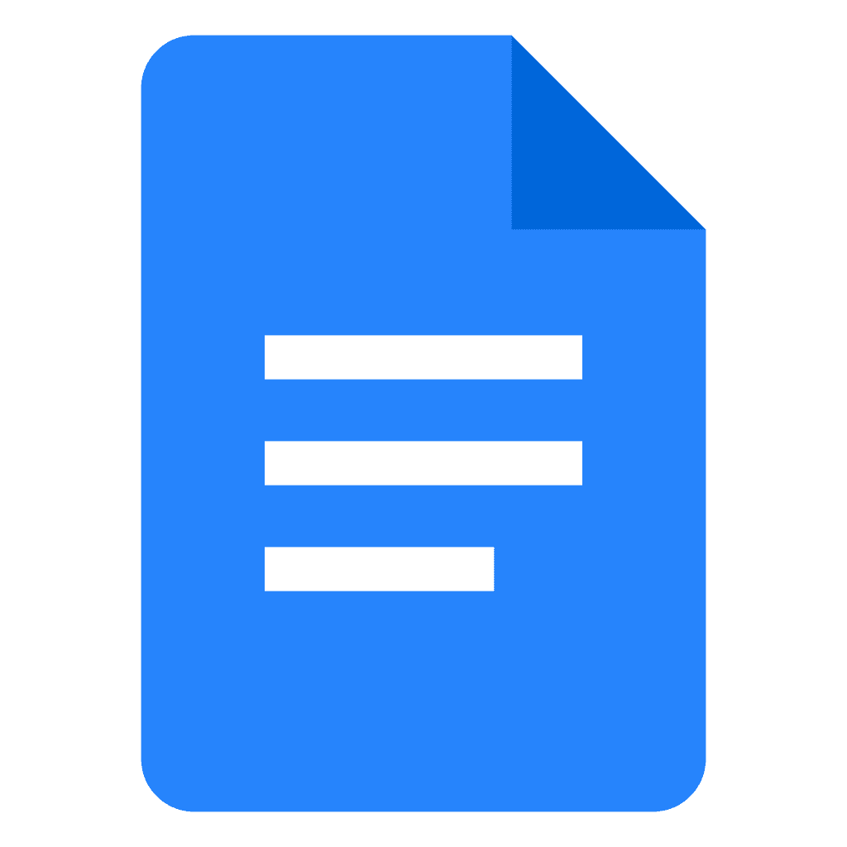
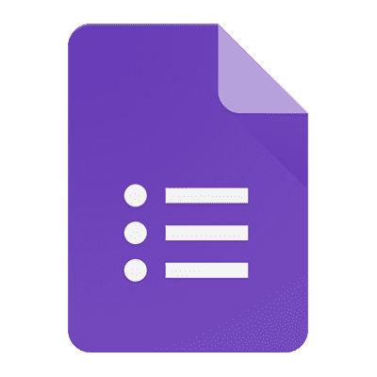
G Suite Applications we should start using
Sheets
Advanced, Fast, Online Spreadsheets.
Endless Automation Possible.
Docs
Get to your Documents anytime, anywhere.
Sharing Controls.
Forms
Collect Data from Laptop/Mobile/Tablets.
Analyze Responses.
Sites
Create Website in a few clicks.
Update website in real time.
ADAPT
TRANSFORM
INNOVATE

Slide 35
G Suite Applications to Connect
Gmail
Schedule emails
Smart Reply
Calendar
Smart Scheduling
Create events directly from Gmail
Hangouts
HD Video Meetings.
Built-in screen sharing.
Contacts
Merge Duplicate Contacts
Restore contacts.
Save any directory contact as a personal contact.
ADAPT
TRANSFORM
INNOVATE

Slide 36
Upskill yourself by e-learning
ADAPT
TRANSFORM
INNOVATE

Slide 37
Tools for Data Security
Password Management
Last Pass
One Pass
Keeper
ADAPT
TRANSFORM
INNOVATE

Slide 38
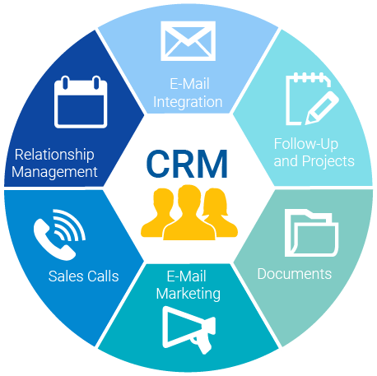
CRM Tools
The final goal of Digital Transformation is enabling the best possible Customer/ Client Experience.
ADAPT
TRANSFORM
INNOVATE

