Slide 1
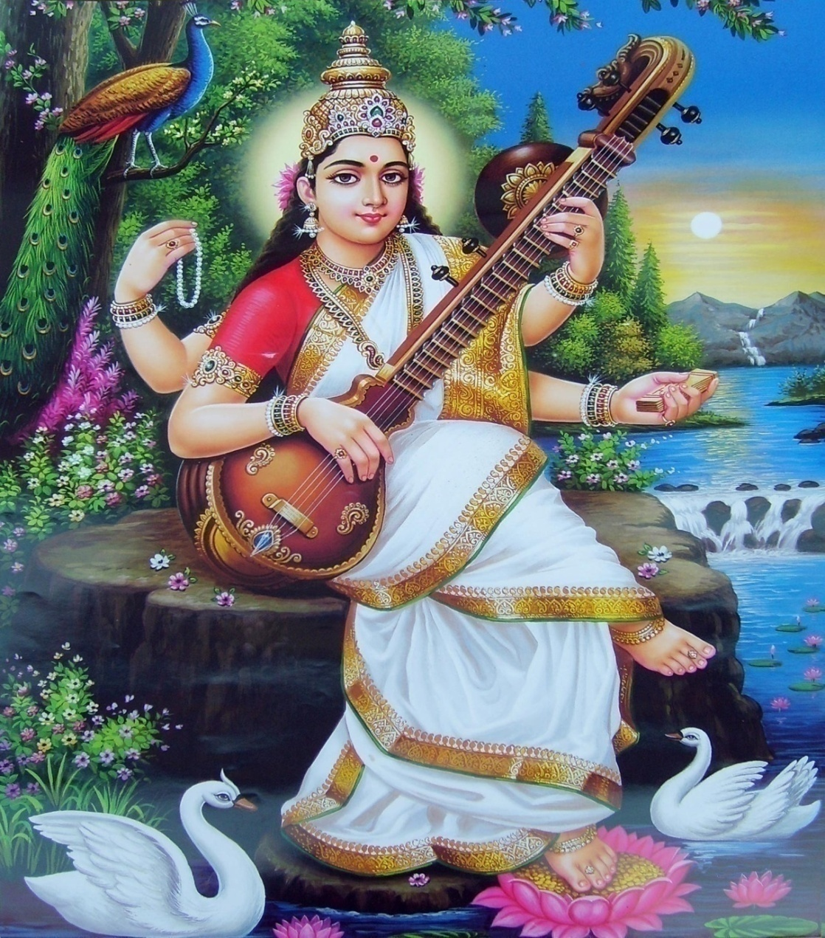
With Blessings of Devi Saraswati

Slide 2
2

Slide 3
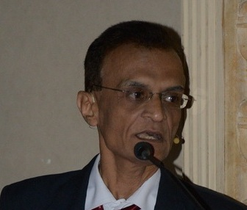
Presentation on “Direct Tax Proposals under Finance Bill in Budget 2020”
By CA Bhupendra Shah

Slide 5
पुष्पं पुष्पं विचिन्वीत मूलच्छेदं न कारयेत् |
मालाकार इवारामे न यथांगारकारकः ||
-महाभरत, उद्योग.
A king must extract tax from his subjects just as painlessly as a bee extracting nectar from a flower. He must act like florist who plucks flowers but takes good care of the plants in return. He must not be like a coal miner who destroys the source of his income day by day.

Slide 6
After Abolition of Art.370A
Humaara watan, khiltey huey shalimaar baag jaisa,
Humaaara watan dal lake mein khiltey huey kamal jaisa,
Navjawaanon key garam khoon jaisa,
Mera Watan, Tera Watan, Humaara Watan, Duniya ka Sabsey Pyaara Watan

Slide 9
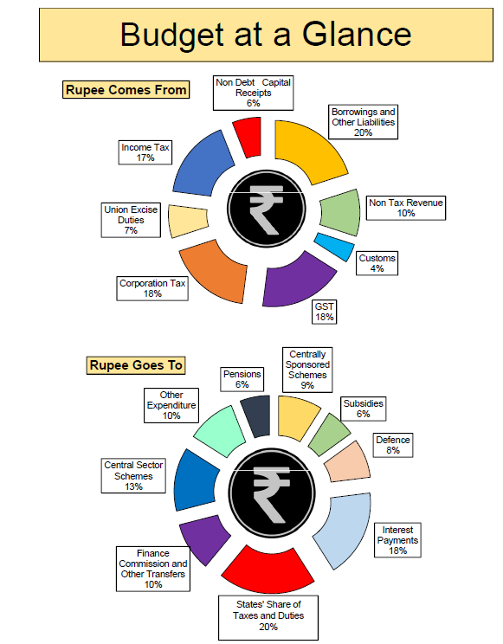

Slide 11
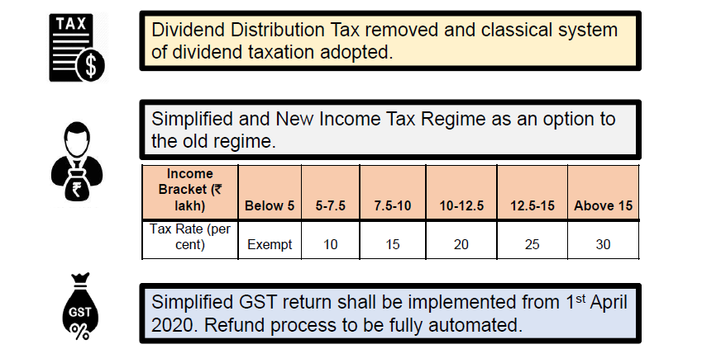

Slide 12
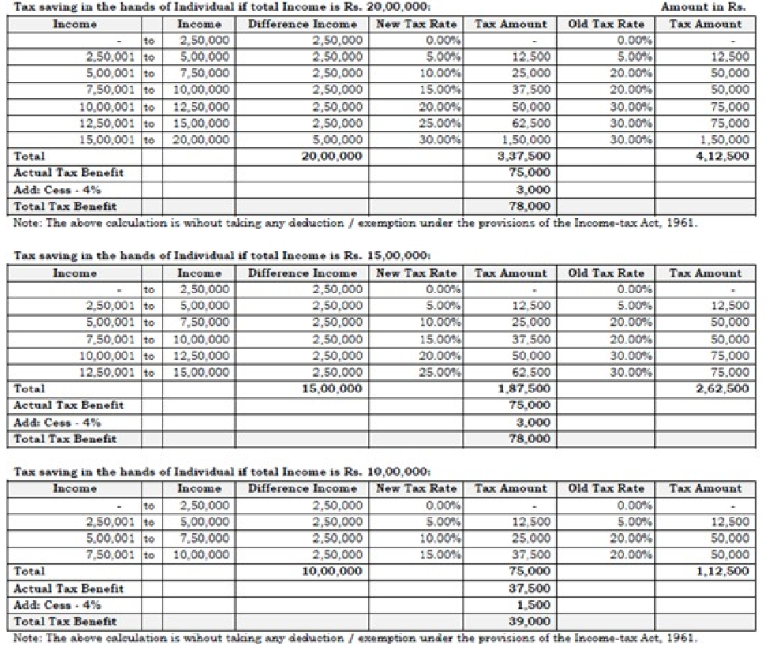

Slide 13
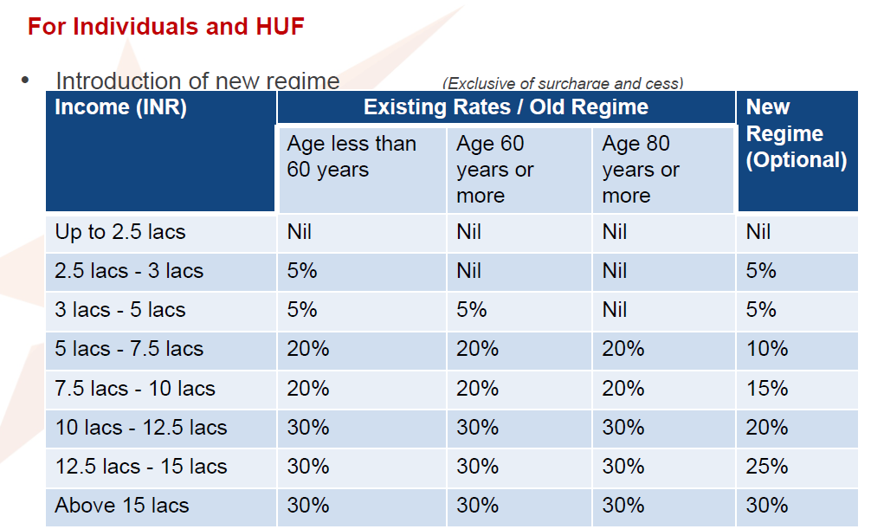

Slide 14
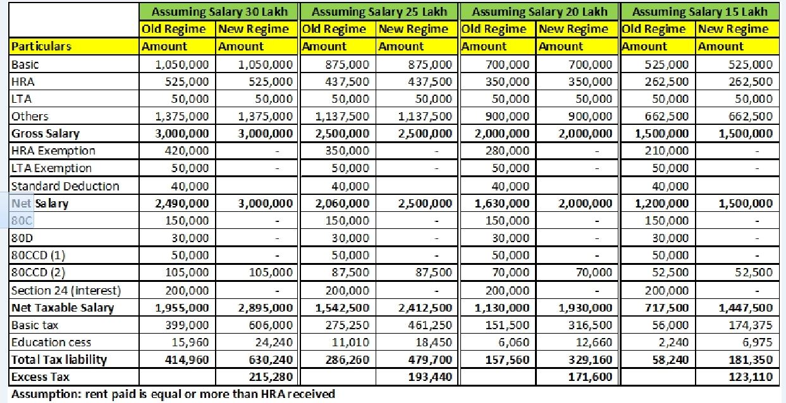

Slide 15
Particulars | New Regime | Old Regime
Gross Total Income (A) | 15,00,000/- | 15,00,000
Deductions under Chapter VIA
80C | N.A | 1,50,000
80D |  | 25,000
Loss from House property |  | 2,00,000
Total Deduction (B) |  | 3,75,000/-
Total Income (A-B) | 15,00,000/- | 11,25,000/-
Total Tax | 1,75,000/- | 1,50,000/-
New tax rate is beneficial only to those 1. who have not taken any housing loan and mediclaim ( mediclaim is taken by one person in a family ) age group 50 and above 2. Person whose income is between 5 to 7 lakh and does not have option to invest and housing loan interest . Age group up to 30 and whole family depends on his income

Slide 16
Incentives to Individual and HUF
No business income->Yearly Option
In other cases->Option valid for all subsequent years as well
If any condition not satisfied, option will be inavlid and other provision will apply.
**********************
No deduction/exemption:
u/s 10 (5)LTC,10(13A)HRA,10(14)Allowance,10(17)MP & MLA allowance and 10(32) Minor.
However, transport allowance between residence to office and conveyance for performance of duty and cost of travel on tour or transfer,daily allowance on account of absence from normal place of duty will be allowed u/s10(14) as amended now.
Rule 3 will be removed and exemption for free food etc through voucher is now abolished
u/s 10AA(SEZ),u/s16(Entertainment allowance & Professional Tax),u/s24(b)(Int.on Loan for SOP or vacant property mentioned u/s23B)
Loss under income from HP no set off and only c/f.
u/s 32(1)(2A) additional depreciation

Slide 17
u/s 32AD,u/s 33AB and u/s 33ABA.
u/s 35(1)(ii)/(iia)/(iii)/(2AA)-Donations.
u/s 35AD/u/s 35CCC
Family pension 57(iia).
Chap.VIA deduction like 80C, 80CCC, 80CCD, 80D, 80DD, 80DDB, 80E, 80EE, 80EEA, 80EEB, 80G, 80GG, 80GGA, 80GGC, 80IA, 80-IAB, 80-IAC, 80-IB, 80-IBA, etc except s.80CCD(2) regarding employer contribution in notified employee pension scheme and s.80JJAA for new employment.
However, depreciation allowed as per the act.
Unabsorbed depreciation to be added to the WDV
No AMT.

Slide 18
ESOP
Budget 2020-21 proposed to amend section 192 of the Act, and insert sub-section (1C) therein to clarify that for the purpose of deducting or paying tax under sub-sections (1) or (1A) thereof, as the case may be, a person, being an eligible start-up referred to in section 80-IAC, responsible for paying any income to the assessee being perquisite of the nature specified in clause (vi) of sub-section (2) of section 17 of the Act, in any previous year relevant to the assessment year 2021-22 or subsequent assessment year, deduct or pay, as the case may be, tax on such income within fourteen days — (i) after the expiry of forty eight months from the end of the relevant assessment year; or (ii) from the date of the sale of such specified security or sweat equity share by the assessee; or (iii) from the date of which the assessee ceases to be the employee of the person; whichever is the earliest on the basis of rates in force of the financial year in which the said specified security or sweat equity share is allotted or transferred.

Slide 19
DDT abolished……….
Dividend income to added in the taxable income of an investor and tax is payable by him under the normal slab rate of taxes.
Claims with respect to expenses under section 57 is now capped to 20% of the dividend income. It is also imperative to note that the amended section 57 allows expense claim only with respect to interest expense and not any other expense like commission paid etc.
Section 194 is amended to cover the TDS applicability on such dividends @ 10%.
The special provision to tax dividend income @ 10% on dividend income in excess of 10 Lakhs under section 115BBDA is amended to drop such levy from 1 st April 2020 as the entire income is taxable in the hands of investors now. This is a welcome move and such investors will have more pay-out in their hands and will get rid of double taxability.
Cascading effect on dividend from one domestic co. to another/s 80M.
No such cascading effect on dividend from foreign company.
Buy back tax retained.

Slide 20
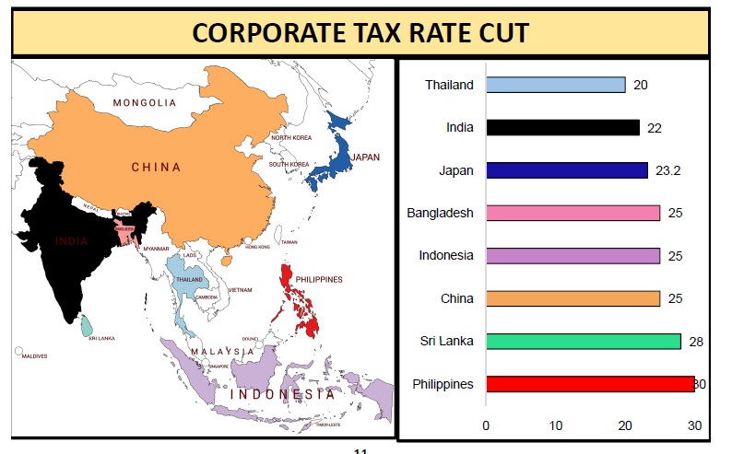

Slide 21
Tax Audit u/s 44AB
Tax audit report to be filed upto 30th September. However, same returns can be filed upto 31st October.
3CEB TP report upto 31/10 and return upto 30-11.
Limit of turnover for tax audit raised to ₹.5 cr for assessee covered under 44AD.

Slide 22
New Category of Tax payer
Indian citizens abroad not paying tax in those regimes are liable to tax here on Global Income - It appears negative provision for people staying in Dubai/GCC who hold Indian citizenship (There could be crashing impact on Dubai).
Bill proposes major amendments to Sec 6 on residential status with respect to individual assessees;
In case of extension of 60 days stay to 182 days in cases where Indian citizens leave India for employment etc., proposed provision reduces 182 days period to 120 days;
Further Indian citizen who is not taxable in any other country by reason of domicile, residence etc. would be deemed to be a resident of India;
In case of resident but not ordinarily resident person (RNOR), amendment replaces earlier conditions with new condition to the effect that such individual or manager of HUF 'has been a non-resident in India in seven out of the ten previous years preceding that year‘.

Slide 24
"Vivad Se Vishwas Scheme“(VVS)
No interest and penalty will be charged if taxpayers pay by March 31, 2020.
scheme would be open till June 30, 2020 with some additional cost.
4,83,000 direct tax cases pending in various appellate forums i.e. Commissioner (Appeals), ITATs, High Courts and the Supreme Court.
Cases u/s 115BBE, 144 and 148 rws 147 etc. and the consequential claims raised through assessments framed in real estate matters are benefited by VVS.

Slide 25
Large Co-op Scociety s.194A
Provisions of Sec 194A extended to large Cooperative Societies also
the total sales, gross receipts or turnover of the co-operative society exceeds fifty crore rupees during the financial year immediately preceding the financial year in which the interest referred to in sub-section (1) is credited or paid; and
(b) the amount of interest, or the aggregate of the amount of such interest, credited or paid, or is likely to be credited or paid, during the financial year is more than fifty thousand rupees in case of payee being a senior citizen and forty thousand rupees, in any other case.
This amendment will take effect from 1st April, 2020.

Slide 27
Faceless Appeal
Faceless appeal to be introduced after faceless assessment in the Income-tax Act.
Empowering Central Government to notify an e-appeal scheme for disposal of appeal so as to impart greater efficiency, transparency and accountability.
Eliminating the interface between the Commissioner (Appeals) and the appellant in the course of appellate proceedings to the extent technologically feasible.
Optimizing utilization of the resources through economies of scale and functional specialisation.
Introducing an appellate system with dynamic jurisdiction in which appeal shall be disposed of by one or more Commissioner (Appeals).
E penalty and ex parte asst also introduced.

Slide 28
Miscellaneous
Pre-fill information of donation will result in hassle-free claims for the individuals claiming tax exemptions.
TDS/TCS above 1 cr for business /50 lacs for professional in case of Ind/huf.
Concessional tax rate of 15% extended to power generation companies.
AMT will not be applicable to co-operative societies if they opt for reduced tax rates of 22%.
Turnover limit for deductions under Section 80-IAC to start-ups has been proposed to be increased to Rs. 100 crore.

Slide 29
Contd………
PAN to now be alloted without application form
'Taxpayers Charter' in the statue is another welcome step which will go a long way in promoting the confidence building measures.
Amendment to section 43CA, 50C and 56 to increase safe harbour vis-a-vis stamp valuation from 5% to 10%.(assessment year 2021-22 and the subsequent years.)
FMV as on 1-4-2001 can’t exceed SDV.
In respect of separate regime for 'business trust' u/s 115A, proposes modification of definition of 'business trust' to do away with the requirement of the units of business trust to be listed on a recognised stock exchange

Slide 30
Contd………
Proposes new Sec 194-O providing for a new levy of TDS at 1% e-commerce operator for sale of goods or provision of service facilitated by it through its digital or electronic facility or platform .
Further, TDS rate for TDS on fees for technical services (other than professional services) u/s 194J to be reduced to 2% from 10%.
Contribution by employer to employee's account for PF, NPS and Superannuation cannot be more than 7.5 lakh a year. Contribution beyond Rs. 7.5 Lakh is taxable.
Proposes amendment to Sec 94B to provide that provisions of interest limitation would not apply to interest paid in respect of a debt issued by a lender which is a PE of a non-resident, being a person engaged in the business of banking in India.
26AS will include all transactions.
Survey only with approval of Pcit unless Jcit gets info from prescribed authority .

Slide 31
Contd…….
Proposes amendment to Sec 206C to levy TCS on overseas remittance and for sale of overseas tour package.
Proposes levy of penalty on a person, if it is found that in the books of accounts maintained by him there is a (i) false entry or (ii) any entry relevant for computation of total income of such person has been omitted to evade tax liability. The penalty payable by such person shall be equal to the aggregate amount of false entries or omitted entry.
Proposes amendments in Sec. 90/90A for alignment with MLI
Finance Bill proposes amendments to curtail ITAT powers to grant stay if 20% tax is paid/provide security.
ITAT cannot grant stay beyond 365 days

Slide 32
Contd.
72AA c/f losses /depreciation on amalgamation now allowed for certain banks/ insurance cos.
80IBA extended upto 31-3-2021 for approval
All NR covered under DRP.
144C will cover any variation prejudicial to ‘A’ even though no variation in returned income/losses.
194C will cover contract even if material supplied by related party of ‘A’
271AAD penalty for false/omitted entry 100% . All hawala covered. CA/ ITP too covered.

Slide 33
Trust
New procedure u/s 12AB
Registration valid for 5 years instead of perpetual.
First time registration valid for 3 years provisionally.
All u/s 10[23C]12AA,35, 80G etc to get registration afresh by applying[ 31-8-20 ]
URN for 80G by donee.
Sec 11 amended ->regn u/s 12AA is inoperative if approved u/s 10[23C]/10[46]-else they have to reapply.

Slide 34
Affordable Housing
Deduction of interest upto ₹.1.50Lakh on loan taken for affordable house is now extended for approval of loan granted upto 31st March,2021.

Slide 39
Issues for consideration

Slide 40
Queries please?????????????
????????????????

