Slide 1
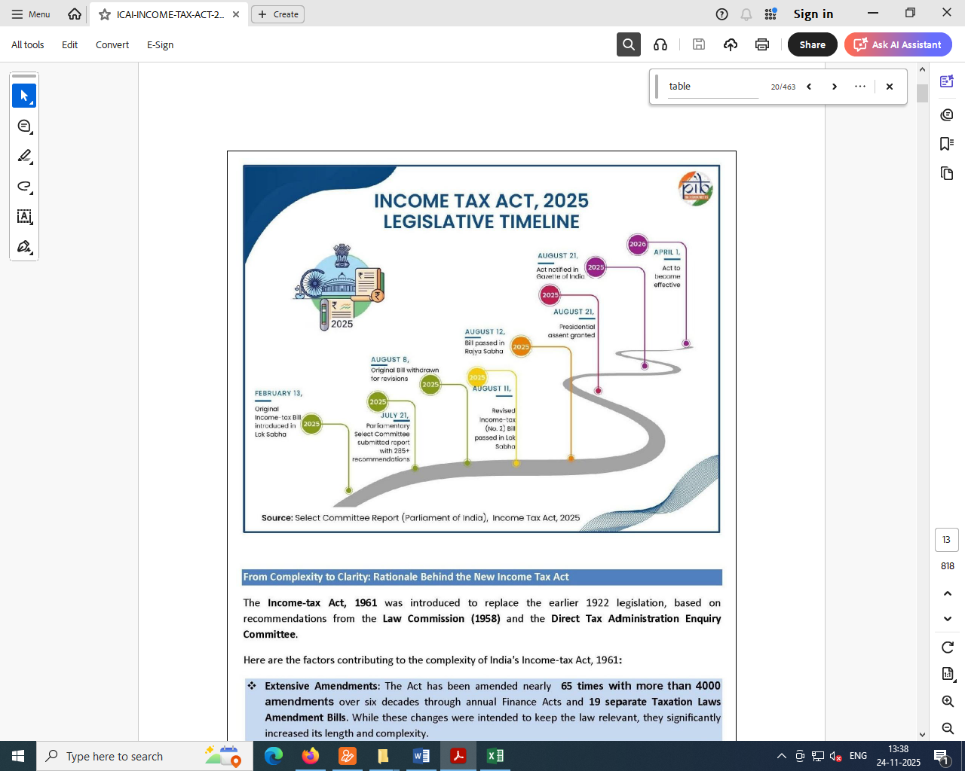
BUDGET 2024 SPEECH BY FINANCE MINISTER: (PAGE 25)
Comprehensive Review of the Income-tax Act, 1961
137. “I am now announcing a comprehensive review of the Income-tax Act, 1961. The purpose is to make the Act concise, lucid, easy to read and understand. This will reduce disputes and litigation, thereby providing tax certainty to the tax payers. It will also bring down the demand embroiled in litigation. It is proposed to be completed in six months.”

Slide 2
The Income Tax Act,1961
Major 65 amendments
4000 individual changes (provisos, explanations, clauses)
The Income Tax Act,2025

Slide 3
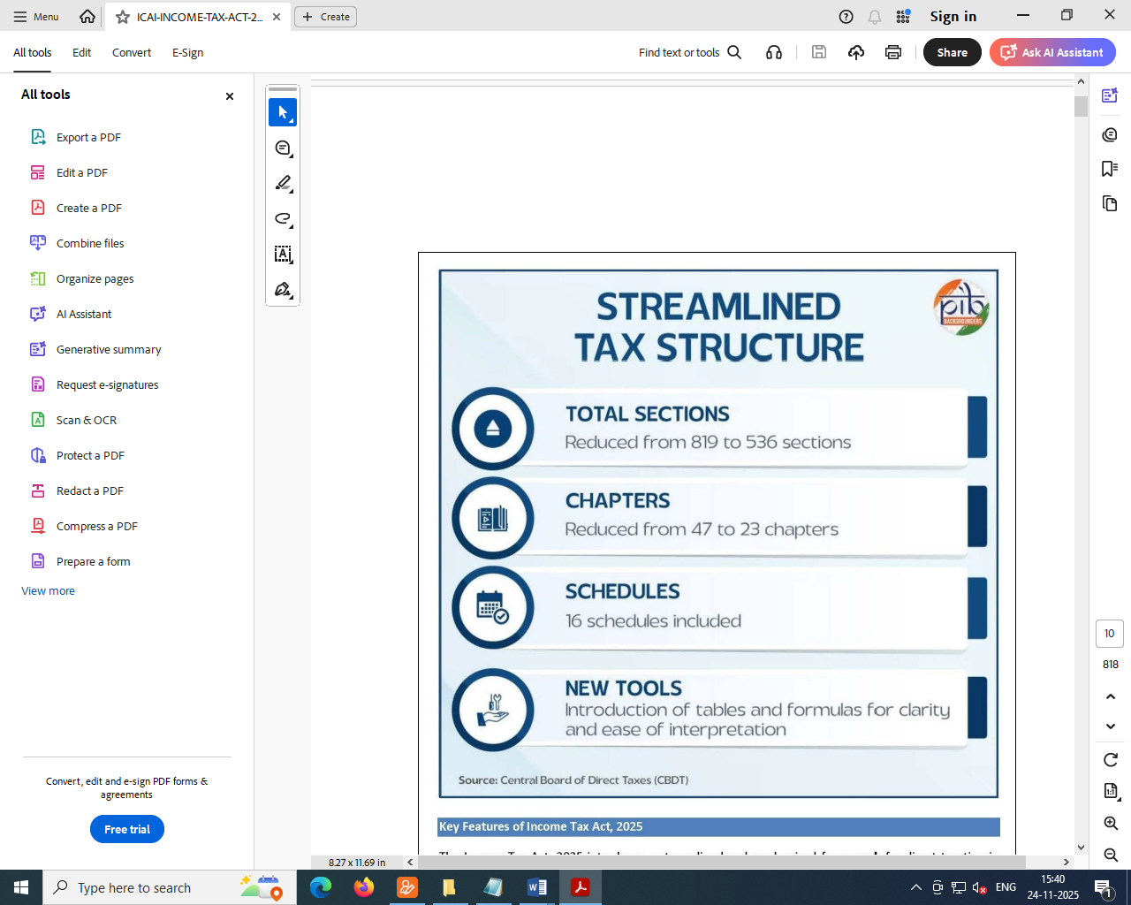
POLICY WISE: NO CHANGE IN THE NEW ACT,2025
Change in language and simplification of language.
Framework intact
Statute is same.
All the capital letters sections e.g. 115BBE or 54F, 54D etc. all are now repealed but it is there in the Act in the form of sections.
Despite simplification, the new Act retains the essence of the 1961 Act: most definitions, income heads, tax rates remain the same.

Slide 4
Income-Tax Act, 1961 | Income-Tax Act, 2025
298 sections in the old IT Act, 1961 but after including all the sections with capital letters like 54B, 54D, 54E, 54EA, 54EB, 54F, 54G, 54H of the Act there are effectively almost 819 sections. | 536 Sections in New IT Act, 2025. No capital sections (unlike 69A, 69B, 69C, 69D, 115BBE, 115BBDA, 115BBF of Old IT Act,1961)
~1,200 “provisos” : Very large number (due to decades of amendment ) For example: 10(23C) has 24 provisos, entire Section 10 (Income not included in Total Income) has 130+ provisos Section 48: Mode of Computation of Capital Gains has 7 Provisos in total. | 0 “provisos”: all the provisos have been removed; their content is reworked into new sub-sections / clauses. Not a single Proviso For example: Section 11 (Income not included in Total Income) has 5 Sub-sections and the exemptions have been specifically categorised in different schedules (Schedules II, III, IV, V, VI and VII). For example: Section 72 : Mode of Computation of Capital Gains has 0 Provisos and 8 Sub-sections in total

Slide 5
Income-Tax Act, 1961 | Income-Tax Act, 2025
Old Act has a large number of “explanations”) — sources say ~ 900+ “explanations” For example: Section 48: Mode of Computation of Capital Gains has 5 Explanations and 3 clauses in total. | 0 “explanations” reasoning moved into clauses/sub-clauses. Not a single explanations. For example: Section 72 : Mode of Computation of Capital Gains has 0 Explanations and 12 clauses
47 chapters | 23 chapters
14 schedules (Schedule I to XIV). | 16 schedules.
~ 5.12 lakh words. | ~ 2.60 lakh words.
250 “Notwithstanding” | Converted to 210 “ Irrespective of”
18 tables : Example: 115BAC Slab rates | 57 tables: Example: Section 58 Presumptive Taxation, Section 63 Tax Audit, Section 73 Cost with reference to certain modes of acquisition.
~ 823 pages (in more recent consolidated versions). | ~ 622 pages.
Definition Section 2 has 48 clauses | Definition Section 2 has 112 clauses

Slide 6
For example: Assessment Year u/s 2(9) of the OLD INCOME TAX ACT, 1961
"assessment year" means the period of twelve months commencing on the 1st day of April every year ;
Previous Year u/s 3 of the OLD INCOME TAX ACT, 1961
For the purposes of this Act, "previous year" means the financial year immediately preceding the assessment year :
Provided that, in the case of a business or profession newly set up, or a source of income newly coming into existence, in the said financial year, the previous year shall be the period beginning with the date of setting up of the business or profession or, as the case may be, the date on which the source of income newly comes into existence and ending with the said financial year.
Definition of “tax year” u/s 3 of the NEW INCOME TAX ACT, 2025
3. (1) For the purposes of this Act, “tax year” means the twelve months period of the financial year commencing on the 1st April.
(2) In the case of a business or profession newly set up, or a source of income newly coming into existence in any financial year, the tax year shall be the period beginning with—
(a) the date of setting up of such business or profession; or
(b) the date on which such source of income newly comes into existence, and ending with the said financial year.

Slide 7
Capital gains: OLD INCOME TAX ACT, 1961
45. (1) Any profits or gains arising from the transfer of a capital asset effected in the previous year shall, save as otherwise provided in sections 54, 54B, 54D, 54E, 54EA, 54EB, 54F , 54G and 54H, be chargeable to income-tax under the head "Capital gains", and shall be deemed to be the income of the previous year in which the transfer took place.
Capital gains: NEW INCOME TAX ACT, 2025
67 (1) Any profits or gains arising from the transfer of a capital asset effected in a tax year shall, save as otherwise provided in sections 82, 83, 84, 85, 86, 87, 88 and 89, be chargeable to income-tax under the head “Capital gains” and shall be deemed to be the income of the tax year in which the transfer took place.
Only sections are changed and “tax year” is substituted with “previous year”.
Capital assets u/s 2(22) of the NEW INCOME TAX ACT, 2025
Property u/s 2(22)(iv)D of the NEW INCOME TAX ACT, 1961
Capital assets u/s 2(14) of the OLD INCOME TAX ACT, 1961
Property u/s 2(14)Explanation 1 of the OLD INCOME TAX ACT, 1961

Slide 8
TRANSFER u/s 2(47) of the OLD ACT), 1961 | TRANSFER u/s 2(109) of the NEW ACT, 2025
“transfer", in relation to a capital asset, includes,— | “transfer” in relation to a capital asset, includes—
(i) the sale, exchange or relinquishment of the asset ; or | (a) the sale, exchange or relinquishment of the asset; or
(ii) the extinguishment of any rights therein ; or | (b) the extinguishment of any rights therein; or
(iii) the compulsory acquisition thereof under any law ; or | (c) the compulsory acquisition thereof under any law in force; or
(iv) in a case where the asset is converted by the owner thereof into, or is treated by him as, stock-in-trade of a business carried on by him, such conversion or treatment | (d) where the asset is converted by the owner into, or is treated by him as, stock-in-trade of a business carried on by him, such conversion or treatment; or
(iva) the maturity or redemption of a zero coupon bond; or | (e) the maturity or redemption of a zero coupon bond; or
(v) any transaction involving the allowing of the possession of any immovable property to be taken or retained in part performance of a contract of the nature referred to in section 53A of the Transfer of Property Act, 1882; or | (g) any transaction involving the allowing of the possession of any immovable property to be taken or retained in part performance of a contract of the nature referred to in section 53A of the Transfer of Property Act, 1882; or
(vi) any transaction (whether by way of becoming a member of, or acquiring shares in, a co-operative society, company or other association of persons or by way of any agreement or any arrangement or in any other manner whatsoever) which has the effect of transferring, or enabling the enjoyment of, any immovable property. | (f) any transaction (whether by way of becoming a member of, or acquiring shares in, a co-operative society, company or other association of persons or by way of any agreement or any arrangement or in any other manner) which has the effect of transferring, or enabling the enjoyment of, any immovable property; or

Slide 9
TRANSFER u/s 2(47) of the OLD ACT), 1961 | TRANSFER u/s 2(109) of the NEW INCOME TAX ACT, 2025
Explanation 1.—For the purposes of sub-clauses (v) and (vi), "immovable property" shall have the same meaning as in clause (d) of section 269UA. Explanation 2.—For the removal of doubts, it is hereby clarified that "transfer" includes and shall be deemed to have always included disposing of or parting with an asset or any interest therein, or creating any interest in any asset in any manner whatsoever, directly or indirectly, absolutely or conditionally, voluntarily or involuntarily, by way of an agreement (whether entered into in India or outside India) or otherwise, notwithstanding that such transfer of rights has been characterised as being effected or dependent upon or flowing from the transfer of a share or shares of a company registered or incorporated outside India; | (h) disposing of, or parting with, an asset or any interest therein, or creating any interest in any asset in any manner, directly or indirectly, absolutely or conditionally, voluntarily or involuntarily, by way of an agreement (whether entered into in India or outside India) or otherwise, irrespective of whether such transfer of rights has been characterised as being effected or dependent upon or flowing from the transfer of a share or shares of a company registered or incorporated outside India, where, the expression “immovable property” means— (i) any land or any building or part of a building, and includes, where any land or any building or part of a building is to be transferred together with any machinery, plant, furniture, fittings or other things, such machinery, plant, furniture, fittings or other things also, such that the land, building, part of a building, machinery, plant, furniture, fittings and other things include any rights therein; (ii) any rights in or with respect to any land or any building or a part of a building (whether or not including any machinery, plant, furniture, fittings or other things therein), which has been constructed or which is to be constructed, accruing or arising from any transaction (whether by way of becoming a member of, or acquiring shares in, a co-operative society, company or other association of persons or by way of any agreement or any arrangement of whatever nature), not being a transaction by way of sale, exchange or lease of such land, building or part of a building;

Slide 10
OLD INCOME TAX ACT, 1961 Transactions not regarded as transfer
47(xiii) any transfer of a capital asset or intangible asset by a firm to a company as a result of succession of the firm by a company in the business carried on by the firm, or any transfer of a capital asset to a company in the course of demutualisation or corporatisation of a recognised stock exchange in India as a result of which an association of persons or body of individuals is succeeded by such company :
Provided that—
(a) all the assets and liabilities of the firm or of the association of persons or body of individuals relating to the business immediately before the succession become the assets and liabilities of the company;
(b) all the partners of the firm immediately before the succession become the shareholders of the company in the same proportion in which their capital accounts stood in the books of the firm on the date of the succession;
(c) the partners of the firm do not receive any consideration or benefit, directly or indirectly, in any form or manner, other than by way of allotment of shares in the company; and
(d) the aggregate of the shareholding in the company of the partners of the firm is not less than fifty per cent of the total voting power in the company and their shareholding continues to be as such for a period of five years from the date of the succession;
(e)the demutualisation or corporatisation of a recognised stock exchange in India is carried out in accordance with a scheme for demutualisation or corporatisation which is approved by the Securities and Exchange Board of India established under section 3 of the Securities and Exchange Board of India Act, 1992 (15 of 1992);
NEW INCOME TAX ACT, 2025
70(zd) of a capital asset or intangible asset by a firm to a company as a result of succession of the firm by a company in the business carried on by the firm, if––
all the assets and liabilities of the firm relating to the business immediately before the succession become the assets and liabilities of the company;
all the partners of the firm, immediately before the succession, become the shareholders of the company in the same proportion in which their capital accounts stood in the books of the firm on the date of the succession;
the partners of the firm do not receive any consideration or benefit, directly or indirectly, in any form or manner, other than by way of allotment of shares in the company; and
the aggregate of the shareholding of the partners in the company is not less than 50% of the total voting power and such shareholding continues to not less than 50% for five years from the date of succession;

Slide 11
Income-Tax Act, 1961 | Income-Tax Act, 2025
2(29(AA)) "long-term capital asset" means a capital asset which is not a short-term capital asset ; | 2(67) “long-term capital asset” means a capital asset which is not a short-term capital asset;
2(29(B)) "long-term capital gain" means capital gain arising from the transfer of a long-term capital asset ; | 2(68) “long-term capital gain” means capital gains arising from the transfer of a long-term capital asset;
2(42(A)) "short-term capital asset" means a capital asset held by an assessee for not more than [twenty-four] months immediately preceding the date of its transfer | 2(101)(a) “short-term capital asset” means a capital asset held by an assessee for not more than twenty-four months immediately preceding the date of its transfer;
2(42(B)) "short-term capital gain" means capital gain arising from the transfer of a short-term capital asset ; | 2(102) “short-term capital gain” means capital gains arising from the transfer of a short-term capital asset;

Slide 12
Section 536 of IT Act,2025: Transitional provisions ensure that existing assessments, appeals, losses, credits, etc., under the 1961 Act are not lost.
“Repeal and savings.
536. (1) The Income-tax Act, 1961 is hereby repealed.
(2) Irrespective of the repeal of the Income-tax Act, 1961 (herein referred to as the repealed Income-tax Act), and subject to sub-section (3)—
(a) nothing shall affect the previous operation of the repealed Income tax Act and orders or anything duly done or suffered thereunder; or
(b) nothing shall affect any right, privilege, obligation or liability acquired, accrued or incurred under the repealed Income-tax Act or orders under such repealed Act;
(c) the provisions of the repealed Income-tax Act shall continue to apply to any proceeding pending on the date of commencement of this Act and to any proceedings initiated on after the 1st April, 2026 (including notices, assessment, re-assessment, re-computation, rectification, penalty, reference, revision and appeals) in respect of any tax year beginning before the 1st April, 2026 and such proceedings shall be carried out as per the procedure specified in the repealed Income-tax Act;..…”
  A one-time relief is introduced u/s 536(2)(n): long-term capital losses (LTCL) incurred up to 31 March 2026 can be set off against short-term capital gains (STCG) from FY 2026-27 onward & carry forward (8 years).
  Under the old 1961 regime, LTCL could typically be set off only against long-term capital gains; this new flexibility is significant.

Slide 13
CAPITAL GAINS
Old Act Capital Gains section 45 to section 55
New Act Capital Gains section 67 to section 91
Sections head | Income Tax Act, 1961 | Income-Tax Act, 2025
Capital gains | 45 | 67
Capital gains on distribution of assets by companies in liquidation | 46 | 68
Capital gains on purchase by company of its own shares or other specified securities | 46A | 69
Transactions not regarded as transfer | 47 | 70
Withdrawal of exemption in certain cases | 47A | 71
Mode of computation of capital gains | 48 | 72
Cost with reference to certain modes of acquisition | 49 | 73
Special provision for computation of capital gains in case of depreciable assets | 50 | 74
Special provision for cost of acquisition in case of depreciable asset | 50A | 75
Special provision for computation of capital gains in case of Market Linked Debenture | 50AA | 76
Special provision for computation of capital gains in case of slump sale | 50B | 77
Special provision for full value of consideration in certain cases | 50C | 78
Special provision for full value of consideration for transfer of share other than quoted share | 50CA | 79
Fair market value deemed to be full value of consideration in certain cases | 50D | 80

Slide 14
Sections head | Income Tax Act, 1961 | Income-Tax Act, 2025
Advance money received | 51 | 81
Consideration for transfer in case of understatement | 52 | Omitted
Exemption of capital gains from as residential house | 53 | Omitted
Profit on sale of property used for residence | 54 | 82
Relief of tax on capital gains in certain cases | 54A | Omitted
Capital gains on transfer of land used for agricultural purposes not to be charged in certain cases | 54B | 83
Capital gain on transfer of jewellery held for personal use not to be charged in certain cases | 54C | Omitted
Capital gains on compulsory acquisition of lands and buildings not to be charged in certain cases | 54D | 84
Capital gain on transfer of capital assets not to be charged in certain cases | 54E | Omitted
Capital gain on transfer of long-term capital assets not to be charged in the case of investment in specified securities | 54EA | Omitted
Capital gain on transfer of long-term capital assets not to be charged in certain cases | 54EB | Omitted
Capital gains not to be charged on investment in certain bonds | 54EC | 85
Capital gain on transfer of certain listed securities or unit not to be charged in certain cases | 54ED | Omitted
Capital gain not to be charged on investment in units of a specified fund | 54EE | Redundant from 01/04/2019* See Note below
Capital gains on transfer of certain capital assets not to be charged in case of investment in residential house | 54F | 86

Slide 15
Sections head | Income Tax Act, 1961 | Income-Tax Act, 2025
Exemption of capital gains on transfer of assets in cases of shifting of industrial undertaking from urban area | 54G | 87
Exemption of capital gains on transfer of assets in cases of shifting of industrial undertaking from urban area to any Special Economic Zone | 54GA | 88
Capital gain on transfer of residential property not to be charged in certain cases | 54GB | Redundant post 31/03/2022
Extension of time for acquiring new asset or depositing or investing amount of capital gains | 54H | 89
Meaning of “adjusted”, “cost of improvement” and “cost of acquisition”. | 55 | 90
Reference to Valuation Officer | 55A | 91
Taxation of Capital Gain
Section 196 Tax on STCG @ 20%
Section 197 Tax on LTCG @ 12.50% on all long term assets (except Equity type long term asset)
Section 198 Tax on LTCG @ 12.50% on Shares / Equity type long term asset
*Section 54EE of the Income Tax Act is not redundant, but its application is currently inactive because it applies only to investments made in specified funds notified by the Central Government before April 1, 2019. No such funds have been notified since that date.
Omitted in New IT Act, 2025
#Section 54GB(5).
Omitted in New IT Act, 2025

Slide 16
INCOME FROM OTHER SOURCES
56. (1) Income of every kind which is not to be excluded from the total income under this Act shall be chargeable to income-tax under the head "Income from other sources", if it is not chargeable to income-tax under any of the heads specified in section 14, items A to E.
(2) In particular, and without prejudice to the generality of the provisions of sub-section (1), the following incomes, shall be chargeable to income-tax under the head "Income from other sources", namely :—
(i) dividends ;
92. (1) Income of every kind which is not to be excluded from the total income under this Act, shall be chargeable to income-tax under the head “Income from other sources”, if it is not chargeable to income-tax under any of the heads specified in section 13(a) to (d).
(2) In particular, and without prejudice to the generality of the provisions of sub-section (1), the following incomes shall be chargeable to income-tax under the head “Income from other sources”:––
(a) any dividend;

Slide 17
INCOME FROM OTHER SOURCES
(ia) income referred to in sub-clause (viii) of clause (24) of section 2;
(ib) income referred to in sub-clause (ix) of clause (24) of section 2;
(ic) income referred to in sub-clause (x) of clause (24) of section 2, if such income is not chargeable to income-tax under the head "Profits and gains of business or profession";
(b) any winning from lotteries, crossword puzzles, races including horse races, card games and other games of any sort or from gambling or betting of any form or nature;
(c) any sum received by the assessee from employees as contributions to any provident fund, superannuation fund, any fund set up under the Employees’ State Insurance Act, 1948, or any other fund for the welfare of such employees, if the income is not chargeable to income-tax under the head “Profits and gains of business or profession”;

Slide 18
INCOME FROM OTHER SOURCES
Old Act Income from other sources section 56 to 59
New Act Income from other sources section 92 to 95
OLD INCOME TAX ACT, 1961 | NEW INCOME TAX ACT,2025
Income from other sources : 56 | Income from other sources :92
56(1) | 92(1)
56(2) | 92(2)
56(2)(i) | 92(2)(a)
56(2)(ia) | Omitted w.e.f. 1-4-1964
56(2)(ib) | 92(2)(b)
56(2)(ic) | 92(2)(c)
56(2)(iv) | 92(2)(d)
56(2)(id) | 92(2)(e)
56(2)(ii) | 92(2)(f)
56(2)(iii) | 92(2)(g)
56(2)(ix) | 92(2)(h)
56(2)(viii) | 92(2)(i)
56(2)(xi) | 92(2)(j)

Slide 19
OLD INCOME TAX ACT, 1961 | NEW INCOME TAX ACT,2025
56(2)(xii) | 92(2)(k)
56(2)(xiii) | 92(2)(l)
56(2)(x)(a)(b)(c) | 92(2)(m)(i)(ii)(iii)
56(2)(x)(c) Proviso XII, XIII | Omitted
56(2)(x)(c) Proviso | 92(3)
56(2)(x)(b) Proviso | 92(4)
56(2)(vii) Proviso- Explanation | 92(2)(5)
Deductions : 57 | Deductions: 93
57(i) | 93(1)(a)
57(ia) | 93(1)(b)
57(ii) | 93(1)(c)
57(iia)+Proviso | 93(1)(d)
57(iii) | 93(1)(e)
57(iv) | 93(1)(f)
 | 93(1)(g)
 | 93(1)(h)
57 Provisos | 93(2)(a) & 93(2)(b)

Slide 20
OLD INCOME TAX ACT, 1961 | NEW INCOME TAX ACT,2025
Amounts not deductible: 58 | Amounts not deductible: 94
58(1)(a)(i)(ii)(iii) | 94(1)(a)(b)(c)
58(1A) or 58(2) | 94(2)
58(3) | 94(3)
58(4) | 94(4)
58(4)Proviso | 94(5) and 94(6)
59: Profits chargeable to tax | 95: Profits chargeable to tax

Slide 21

THANK YOU

