Slide 1
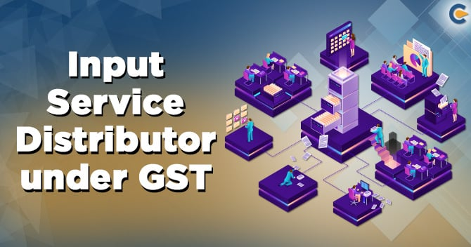
- CA Suruchi Agrawal
Partner, Vimal & Seksaria

Slide 2
DEFINITION OF INPUT SERVICE DISTRIBUTOR (isd)
Section 2 (61) of the CGST Act, 2017
“Input Service Distributor” means an office of the supplier of goods or services or both which receives tax invoices towards the receipt of input services, including invoices in respect of services liable to tax under sub-section (3) or sub-section (4) of section 9 of this Act or under sub-section (3) or sub-section (4) of section 5 of the Integrated Goods and Services Tax Act, 2017 (13 of 2017), for or on behalf of distinct persons referred to in section 25, and liable to distribute the input tax credit in respect of such invoices in the manner provided in section 20;
Old Definition – Prior to 31st March 2025
“Input Service Distributor” means an office of the supplier of goods or services or both which receives tax invoices issued under section 31 towards the receipt of input services and issues a prescribed document for the purposes of distributing the credit of central tax, State tax, integrated tax or Union territory tax paid on the said services to a supplier of taxable goods or services or both having the same Permanent Account Number as that of the said office;

Slide 3
Manner of distribution of credit by ISD
Any office of the supplier of goods or services or both which receives tax invoices towards the receipt of input services, including invoices in respect of services liable to tax under sub-section (3) or sub-section (4) of section 9 of this Act or under sub-section (3) or sub-section (4) of section 5 of the Integrated Goods and Services Tax Act, 2017 (13 of 2017), for or on behalf of distinct persons referred to in section 25, shall be required to be registered as Input Service Distributor under clause (viii) of section 24 and shall distribute the input tax credit in respect of such invoices.
The Input Service Distributor shall distribute the credit of central tax or integrated tax charged on invoices received by him, including the credit of central or integrated tax in respect of services subject to levy of tax under sub-section (3) or sub-section (4) of section 9 of this Act or under sub-section (3) or sub-section (4) of section 5 of the Integrated Goods and Services Tax Act, 2017 (13 of 2017), paid by a distinct person registered in the same State as the said Input Service Distributor, in such manner, within such time and subject to such restrictions and conditions as may be prescribed.
The credit of central tax shall be distributed as central tax or integrated tax and integrated tax as integrated tax or central tax, by way of issue of a document containing the amount of input tax credit, in such manner as may be prescribed.

Slide 4
APPLICABLE LAWS POST AMENDMENT W.E.F. 1ST APRIL 2025
RULE 39 Procedure for distribution of input tax credit by Input Service Distributor
ITC available for distribution in a month shall be distributed in the same month
credit of tax paid on input services attributable to one or more recipient of credit shall be distributed only to that recipient to all such recipients (whether registered or not)
Ineligible credit to be separately distributed
IGST as IGST, CGST as CGST / SGST locally or else as IGST
any ITC required to be reduced vide a credit note shall be apportioned to each recipient in the same ratio in which the input tax credit contained in the original invoice was distributed
RCM credit shall be paid by normal registration in same state and then transferred to ISD for distribution
Relevant period - turnover in the preceding financial year or else the last quarter for which details of such turnover of all the recipients are available, previous to the month during which credit is to be distributed
'turnover'', in relation to any registered person engaged in the supply of taxable goods as well as goods not taxable under this Act
Section 21 and Circular No. 71/45/2018-GST dated 26-10-2018
Manner of recovery of excess credit distributed by an Input Service Distributor (ISD) in contravention of the provisions contained in Section 20 of the CGST Act - the excess credit so distributed shall be recovered from such recipients along with interest and penalty if any. ISD would also be liable to a general penalty under the provisions contained in section 122(1)(ix) of the CGST Act

Slide 5
ISD – VS - CROSS CHARGE
Section 7 – Scope of Supply
(1) For the purposes of this Act, the expression "supply" includes—
(c) the activities specified in Schedule I, made or agreed to be made without a consideration
Schedule I – Activities to be treated as Supply even if made without Consideration
2. Supply of goods or services or both between related persons or between distinct persons as specified in section 25, when made in the course or furtherance of business:
Criteria | ISD | Cross Charge
Type of Expense | Common expenses without actual supply | Services actually provided by one branch to another
When to Use | Centralized procurement of input services | Internal services rendered between GST-registered locations
ITC Distribution | No invoice is raised, ITC is distributed via GSTR-6 | An invoice is raised, and GST is charged
Taxability | No GST on ISD credit transfer | GST must be charged on cross charges
Accounting Treatment | Only credit allocation | Actual revenue recognition between branches

Slide 6
LEGAL POSITION PRIOR TO 31ST MARCH 2025
NOT MANDATORY as per Circular No. 199/11/2023-GST dated 17-07-2023
HO can opt to issue tax invoices to the concerned BOs in respect of common input services procured from third party vendor by HO but attributable to the said BOs as according to the present provisions of the CGST Act and CGST Rules, it is not mandatory for the HO to distribute such input tax credit by ISD mechanism
In cases where full input tax credit is available to a BO, the value declared on the invoice by HO to the said BO in respect of a supply of services shall be deemed to be the open market value of such services. This is irrespective of the fact whether cost of any particular component of such services, like employee cost etc., has been included or not in the value of the services in the invoice.
The cost of salary of employees of the HO, involved in providing is not mandatorily required to be included while computing the taxable value of the supply of such services
Appellate Authority For Advance Ruling, Maharashtra - CUMMINS INDIA LTD., IN RE [2022] 134 taxmann.com 342 (AAAR-MAHARASHTRA)

Slide 7
CHALLENGES IN IMPLEMENTATION OF ISD PROVISIONS
In case of rapid expansion, the formula for distribution will keep changing in the same year
Credit Note to be distributed as per original distribution formula and NOT as per current formula
Distribution formula trumps logic (Eg. Software Expenses not on the basis of no. of users but on the basis of turnover)
There may be accumulation of credit in one registration while other might require cash payment
Additional Compliance burden even if there is one invoice of common credit
Difficulty in segregating common service with consumed service for Cross Charge
Can a taxpayer have multiple ISDs having 2 or more Offices obtaining services common to all? – Yes as per Frequently Asked Questions (FAQ) - 2nd Edition: 31st March, 2017 (Updated as on 1st January, 2018)
Reconciliation of ITC auto-populated in the GST portal

Slide 8
CHALLENGES IN IMPLEMENTATION OF ISD PROVISIONS
Reversal of credit on account of non payment to vendor within 180 days. Whether ITC reversal under the above provision applies at the ISD level or at each recipient level to whom ITC is distributed, or will it not apply to anyone? What about interest paid on the same?
Can ITC be transferred by one unit to ISD?
    Same State transferring unit and ISD – Yes – Refer Rule 54 (1A)
    Different State
While claiming refund on export of goods or services / refund under inverted tax structure by any one of the units, will refund be allowed of credit received from ISD? – various case laws have allowed refund of ITC distributed to eligible unit
Pure Agent

Slide 9

THANK YOU

