Slide 1


S DALMIYA AND ASSOCIATES
MSME and Debt Recovery
Legal Frameworks, Challenges, and Practical Solutions

Slide 2

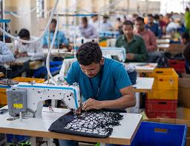


S DALMIYA AND ASSOCIATES
Introduction to MSMEs
Under the Micro, Small & Medium Enterprises Development Act (MSMED Act), 2006, MSMEs are classified based on investment in plant and machinery/equipment and annual turnover.
In the Union Budget 2025, Finance Minister Nirmala Sitharaman announced a major update to the New MSME classification, increasing the investment limit by 2.5 times and doubling the turnover limits.
This move is aimed at fostering growth, encouraging innovation, and creating a more enabling ecosystem for MSMEs to flourish

Slide 3

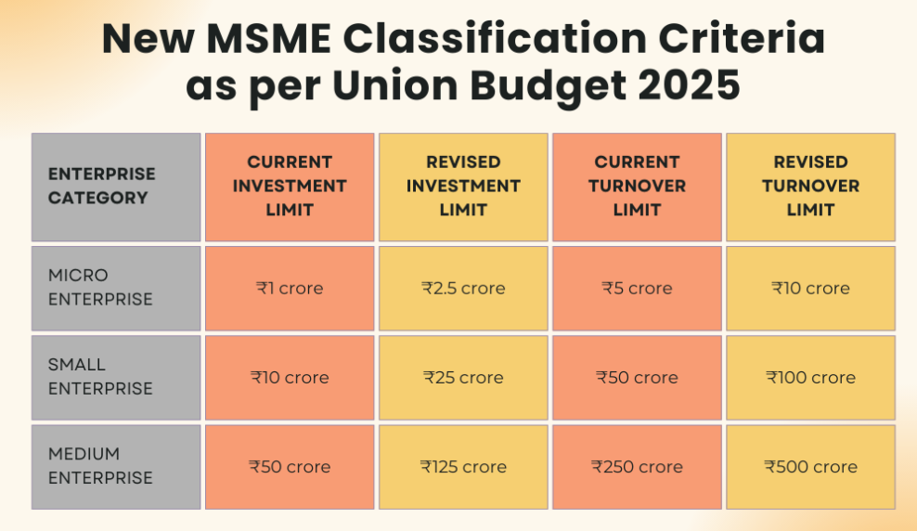

REVISED CLASSIFICATION BASED ON INVESTMENT AND TURNOVER
S DALMIYA AND ASSOCIATES

Slide 4

BENEFITS OF BEING CLASSIFIED AS MSME
  Collateral-Free Loans
  Lower Interest Rates & Priority Lending
  Government Subsidies & Incentives
  Preference in Procurement
  Protection Against Delayed Payments
  Tax & Compliance Benefits
  Credit Rating & Easier Access to Capital Markets
  Skill Development & Training Programs
S DALMIYA AND ASSOCIATES

Slide 5
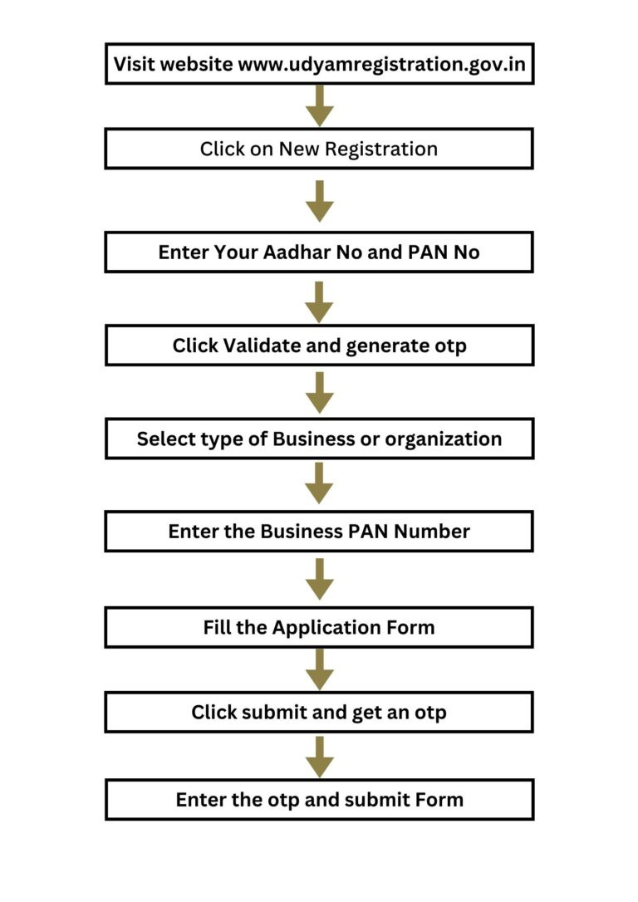
UDYAM
REGISTRATION
PROCESS
S DALMIYA AND ASSOCIATES

Slide 6
CHALLENGES FACED BY MSMES
  Limited Access to Credit
  High Interest Rates
  Delayed payments from large corporates
  Working Capital Crunch
  Lack of Awareness
  Litigation Costs
S DALMIYA AND ASSOCIATES

Slide 7

S DALMIYA AND ASSOCIATES
MSME DEBT RECOVERY
MSMED Act, 2006 (Sections 15–24)
Section 15
Payment to MSMEs must be made within 45 days of acceptance of goods/services.
Section 16
Delay beyond 45 days entitles the MSME to compound interest on the amount due—three times the RBI’s bank rate.
Section 18
Dispute resolution lies with the Micro and Small Enterprises Facilitation Council (MSEFC).
Leverage the power of social media marketing to reach and engage your customers online. Implement data-driven strategies to maximize your digital impact.

Slide 8
OVERVIEW
OF
MSME
DEBT
RECOVERY
S DALMIYA AND ASSOCIATES

Slide 9
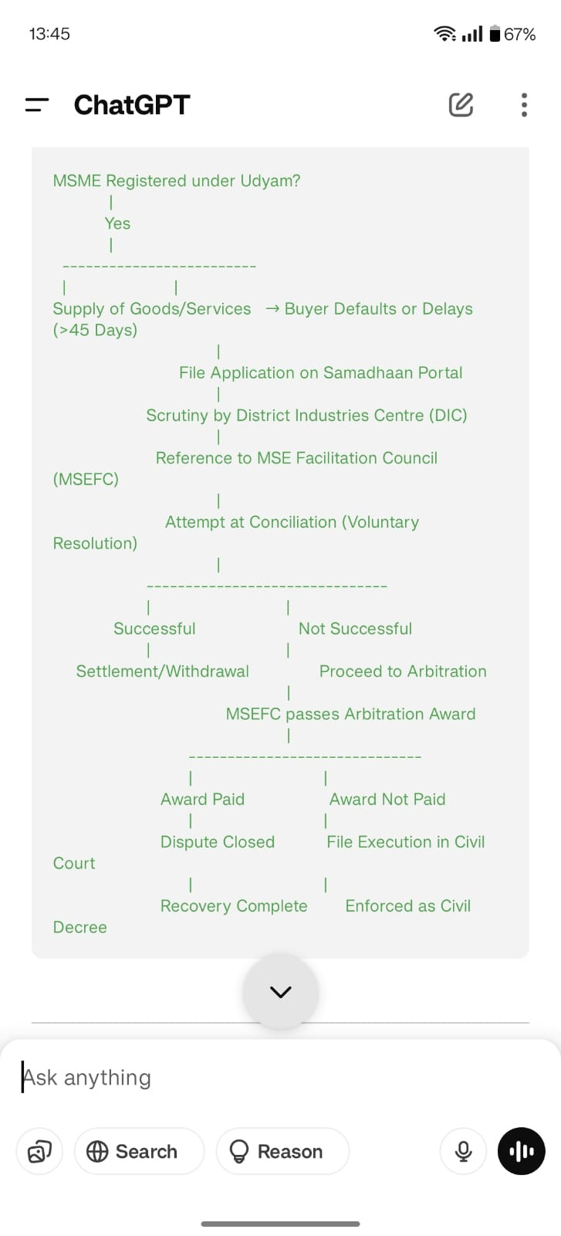
LEGAL FRAMEWORK FOR
RECOVERY
S DALMIYA AND ASSOCIATES

Slide 10
OTHER LEGAL REMEDIES
CIVIL SUIT FOR RECOVERY
NEGOTIATION & MEDIATION
IBC ROUTE
(INSOLVENCY AND BANKRUPTCY CODE)
ARBITRATION
S DALMIYA AND ASSOCIATES

Slide 11
BEST PRACTICES & STRATEGIES
Always have written contracts with clear payment terms.
Keep detailed documentation:
  Signed delivery notes
  Email conversations
  Invoices & receipts
Ensure your Udyam Registration is valid at the time of supply.
Consider offering discounts for early payments to reduce exposure.
Send formal reminders and notices before initiating legal action.
Following up regularly & formally
S DALMIYA AND ASSOCIATES

Slide 12

Q&A
and
Wrap-Up
S DALMIYA AND ASSOCIATES

Slide 13



thank you
CS SHWETA DALMIYA
PRACTISING COMPANY SECRETARY
sdalmiya.associates@gmail.com
+91-9660750519
Room no. 1H, 16, British Indian Street, Kolkata-700069

