Slide 1



International Financial Services Centre in GIFT City:
Global Listings at GIFT IFSC
International Financial Services Centres Authority
Ministry of Finance, Government of India
GIFT City, Gujarat, India
www.ifsca.gov.in

Slide 2
Flow of Presentation
IFSC Jurisdictional Comparison
Tax Regime at IFSC
Brief overview of Capital Market Ecosystem
Direct Listing in IFSC: Journey so far
Regulatory Framework for Listing in IFSC

Slide 3
IFSC Jurisdictional Comparison
Foreign jurisdiction (rest of the world) | GIFT IFSC (India) | Domestic Tariff Area (India)
Offshore Non-Resident | Offshore Non-Resident | Onshore Resident
Respective Int’l Currency | 15 Currencies (INR Not Permitted) | INR denominated
Offshore | 10 yr Corp. Tax Holiday, GST exempted | Taxes as applicable
Resident’s Jurisdiction | Indian Jurisdiction with carveouts under various Laws | Indian Jurisdiction
Different for different jurisdictions | IFSCA – Unified Regulator | RBI, SEBI, IRDAI, PFRDA
Jurisdiction
FEMA
Currency
Tax
Law
Regulators

Slide 4

Competitive tax regime
1
Tax Holiday on Business Income for 10 out of 15 years
2
Minimum Alternate Tax* @ 9%
3
No CTT**/STT**/GST**/Stamp Duty
4
Reduced Withholding Tax of 9% on interest paid on Debt Instruments
5
Competitive Tax Regime for Funds
6
Incentives under Gujarat IT/ITeS Policy (2022-27)
*MAT provisions not applicable for companies opting for concessional tax rate under Sec. 115 BA of Income Tax Act, 1961
**CTT- Commodity Transaction Tax, STT- Securities Transaction Tax, GST- Goods and Service Tax
Notes:
GIFT City – Brief

Slide 5

Capital Markets Ecosystem in IFSC

Slide 6





Capital markets
International Derivates on
Indian Indices
Two Operational International Exchanges
1
NSE IFSC-SGX Connect Migrated
BSE SENSEX Derivatives
Longer Trading Hours
No FX risk as trading in USD
Remote Trading Participants enabled
Two Clearing Corporations
Direct Listing of Indian Stocks
2
Indian/Foreign Cos can list and raise foreign capital
IFSCA (Listing) Regulations, 2024 globally benchmarked
One International Depository
60,000 + Demat Accounts opened

Slide 7
Products available at Exchanges in GIFT IFSC
Products available at IFSC Exchanges
Equity Index Derivatives
Depository Receipts
Currency Derivatives
Commodity Derivatives
Corporate Bonds
Note 1: Products available at India INX: https://www.indiainx.com/static/products.aspx
Note 2: Products available at NSE IX: https://www.nseix.com/markets/products-ifsc

Slide 8
Access to Global Markets
NSE IFSC Receipts
Global Access through IFSC brokers (Global Access Providers)
US Stocks
Unsponsored Depository Receipts
Trading on NSE IX
.
Multiple Jurisdictions
Several exchange traded products
Trading on international exchanges

Slide 9

Direct Listing
Listing in IFSC for Unlisted Companies and Start-ups

Slide 10

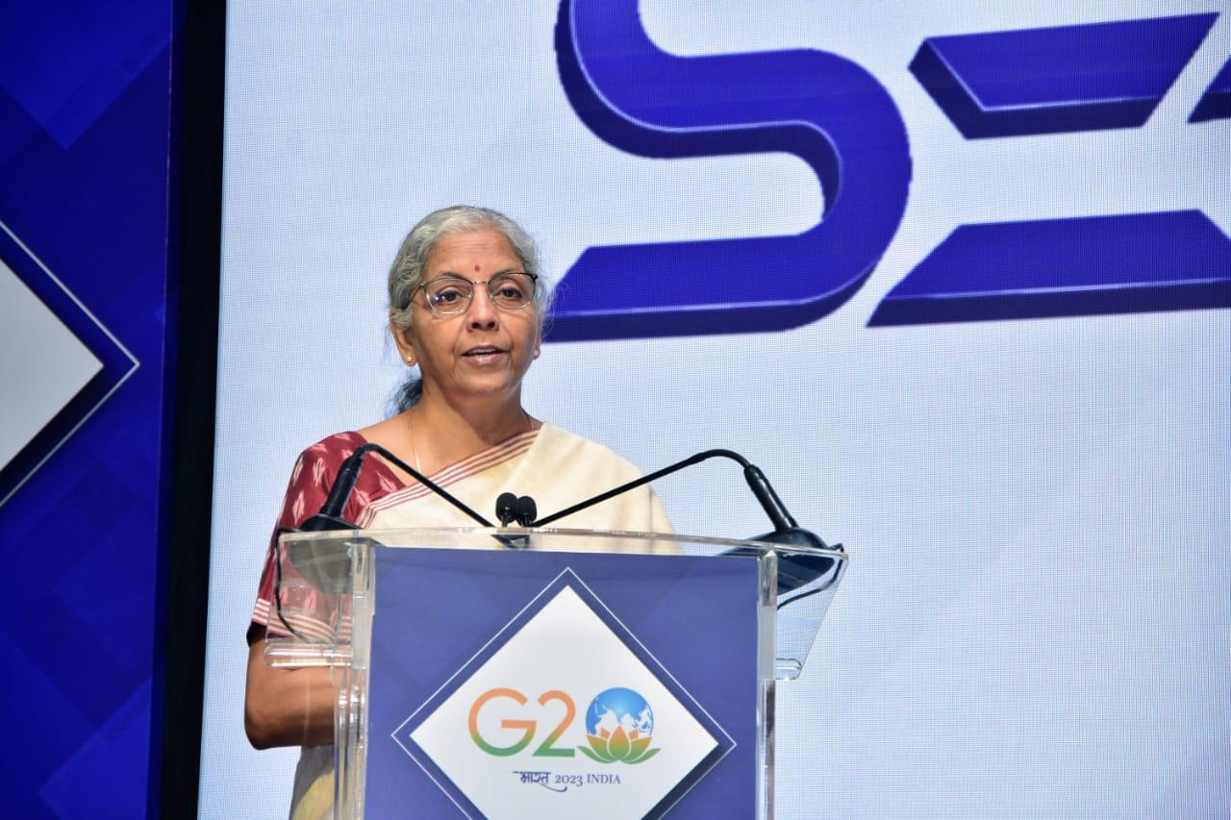
Direct Listing: Announcement
“The Government has taken a decision to enable direct listing of listed/unlisted companies on IFSC exchanges, which will be operationalised shortly enabling start- ups and companies of like nature to access global market through GIFT IFSC. This will also facilitate access to global capital and result in better valuation for Indian companies.”
July 28, 2023

Slide 11
Direct Listing: Background
Dec 2018
Expert Committee Report (constituted by SEBI)
July 2023
Announcement by Hon’ble Union Minister of Finance and Corporate Affairs
Sept 2020
Amendments in Companies Act, 2013: insertion of section 23 (3) and 23 (4)
August 2023
Constitution of a working group under the chairmanship of ED, IFSCA
October 2023
Commencement of Section 23 (3) and 23 (4) of Companies Act, 2013
December 2023
Submission of report by Working Group
January 2024
Notifications issued by DEA and MCA
January 2024
Invited suggestions on ILS Regulations
May 2024 Consultation Paper issued on new IFSCA (Listing) Regulations, 2024
Standing Committee on Primary Markets
August 2024
Notification of New IFSCA Listing Regulations
April 2024
Amendments by RBI in FEMA Regulations

Slide 12



Direct Listing: Notifications in a nutshell
FEMA Non-Debt Rules 2019 is amended to introduce provisions permitting direct listing of equity shares of Indian public companies on international exchanges operating in GIFT-IFSC.
MCA has notified rules for the eligibility criteria and the requirements for listing of equity shares.
Indian public listed or unlisted companies are only permitted for direct listing under this Scheme.
If permissible holder of equity shares is not a person resident in India, such holding shall be regarded as foreign holdings of the Indian public company.
Permissible jurisdiction for overseas listing means GIFT-IFSC.
Permitted international exchanges implies the following exchanges in GIFT-IFSC:
― India International Exchange
― NSE International Exchange

Slide 13
Direct Listing: Regulatory Framework - A Snapshot
Direct Listing Scheme
FEM (NDI) Amendment Rules, 2024
Companies (Listing of Equity shares in Permissible Jurisdictions) Rules, 2024
Provide an overarching regulatory framework to enable public Indian companies to issue and list their shares in permitted international exchanges.
Rules under Section 23(3) of Companies Act, 2013
FAQs on Direct Listing Scheme
(issued by Govt. of India)
IFSCA (Listing) Regulations 2024

Slide 14
Direct Listing @ IFSC
Listing → New Shares + OFS
PUBLIC INDIAN COMPANIES
Unlisted
Listed

Slide 15
Direct Listing
Permissible Holder
Permissible holder (including its beneficial owner) is not a person resident in India
Provided that such a holder who is a citizen of a country which shares land border with India, or an entity incorporated in such a country, or an entity whose beneficial owner is from such a country, shall hold equity shares of such public Indian company only with the approval of the Central Government
NRIs
FPIs
Eligible foreign investors
Other non-residents

Slide 16
Direct Listing
Foreign Investment Limits
Foreign holding shall not exceed limits prescribed under Schedule I to NDI Rules
Subject to limit specified for foreign portfolio investment under these rules
Pricing
Unlisted public company – Issue Price for initial listing of equity shares shall be determined by a book- building process and shall not be less than the fair market value. Subsequent issuance and transfer of equity shares for the purpose of additional listing shall be as per applicable pricing norms of the international exchange and the permissible jurisdiction

Slide 17
IFSCA (Listing) Regulations, 2024
Key Considerations
IOSCO Principles
Global best practices
Ease of Doing Business
Principle based regulations

Slide 18
Direct Listing: New Listing Regulations
IFSCA (Listing) Regulations, 2024
IPOs and FPOs
SPACs
Secondary Listing
Depository Receipts
Debt Securities
Other financial products like Commercial Paper, Certificate of Deposits etc.

Slide 19
IFSCA Listing Regulations
Eligibility Criteria
Revenue Test: | USD 20 million in last financial year or averaged over last three financial years (or)
Profit Test: | Pre-tax profit of USD 1 million in last financial year or averaged over last three financial years (or)
Market Capitalisation Test: | Post issue market capitalisation of USD 25 million
Filing of Offer Document
Issuers required to file offer document with IFSCA for observations
Issuers with issue size of USD 50 million or less exempted.

Slide 20
IFSCA Listing Regulations
Disclosures in Offer Document
Offer document shall contain all material disclosures which are true, correct and adequate to enable the investors to take an informed investment decision
Financial information of the issuers shall not be older than 180 days
Accounting Standards: IFRS or US GAAP or Ind AS or accounting standards as applicable in its jurisdiction of incorporation.
(However, in case an issuer is preparing financial statements as per the accounting standards of its home jurisdiction, it shall be required to reconcile the same with IFRS)
Disclosures shall include: (a) Offer Document Summary (b) Risk factors (c) Introduction of Offer (d) General Information (e) Capital Structure (f) Particulars of the issue (g) underwriting (h) Tax implication for the investors (i) About the Issuer (j) Financial Statements (k) Material related party transactions (l) Legal and other information (m) Details of major group companies (n) Regulatory and other disclosures

Slide 21
Key Features
Offer Timing
Within a period of not more than 12 months from the date of issuance of observations by IFSCA
Offer Period
IPO shall be kept open for at least one working day and not more than ten working day
Pricing
The issuer shall determine pricing in consultation with the lead manager(s) and may be through a fixed price mechanism or through book building mechanism and the same shall be suitably disclosed in the offer document. Provided that in case of listing of equity shares by a public Indian company, the issuer shall also comply with the requirements prescribed under schedule XI of the Foreign Exchange Management (Non-debt Instruments) Rules, 2019.

Slide 22
IFSCA Listing Regulations
Minimum Public Offer
Indian Company: | In accordance with the Securities Contracts (Regulation) Rules, 1957
Foreign Company: | Minimum public offer as well as minimum public shareholding of 10% of the post issue capital
Underwriter
May be underwritten
Adequate disclosures regarding underwriting arrangements shall be made in the offer document
Anchor Investor
Issuer may offer a portion of the issue size for subscription by anchor investors, subject to disclosures made in the offer document

Slide 23
IFSCA Listing Regulations
Monitoring Agency
Issuer may choose to appoint a credit rating agency as a monitoring agency for monitoring the use of proceeds of the issue
Lockup
Pre-issue shareholding of promoters and controlling shareholders of the issuer shall be locked up for a period of 180 days from the date of allotment in the initial public offer
IFSCA Listing Regulations: https://ifsca.gov.in/Viewer?Path=Document%2FLegal%2Fifsca-listing-regulations-202430082024045210.pdf

Slide 24
Direct Listing: Advantages to Issuers
Expanded Investor Base and Valuation
Diversification and Financial Flexibility
Global Visibility and Expansion
Exit Strategy

Slide 25



Direct Listing: Benefits to investors
Investing/Trading in foreign currency (USD)
20+ hours Trading window
Tax benefits
(No Capital Gains tax, No STT, No GST)

Slide 26

Listing of Foreign Companies
Foreign Companies – Additional Benefits
LRS Permitted
(retail Indian investors can participate)
Domestic Mutual Funds
eligible to participate
Estimates suggest that more than 50% of Indian Unicorn startups are domiciled in offshore jurisdictions
United States of America, Singapore and United Kingdom are some of the most popular examples of countries to which Indian entities have ‘flipped’
Opportunity to list such Foreign Companies in GIFT IFSC

Slide 27
Listing Obligations and Disclosure Requirements
Continuous Disclosures
  Shareholding Pattern
  Financial Statements
  Material or price sensitive event information
  Board meetings
  Annual and Extraordinary General Meetings
  Change in directors, KMPs and Compliance Officer
  Resignation of auditors
  Adverse opinions by auditors
  Details of encumbrances, etc.
  Annual report
  Sustainability Reporting
  Whistleblower Mechanism

Slide 28
Listing Checklist
Appointment of Lead Manager and Compliance Officer
File application with recognised stock exchange for seeking in-principle approval
Lead Manager shall submit draft offer document along with Due Diligence Certificate
The draft offer document shall be hosted on website of Authority, recognised stock exchange, issuer and lead manager
The Authority may issue observations, if any, within 21 working days, which shall be incorporated in offer document.
The issuer, in consultation with the lead manager, will determine pricing through either a fixed price or a book-building process.
IPO shall be open for 1 – 10 working days.
The issuer through lead manager shall file a post-issue report with the recognised stock exchange, within 10 working days from the date of closing of the issue.
The issuer shall make the offer within 12 months from the date of issuance of observations by the authority.

Slide 29
Listing of Debt Securities

Slide 30
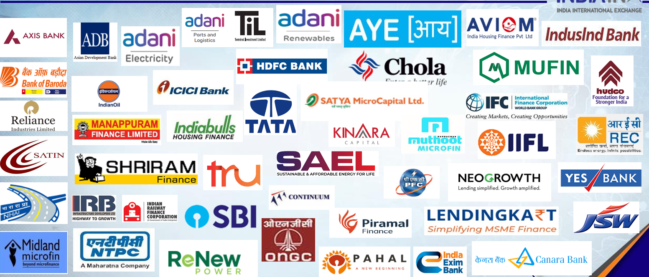
Debt Listing

Slide 31




ESG labelled Bonds
Framework for ESG Labelled Bonds
Recognised Framework
International Capital Market Association (ICMA) Principles / Guidelines
Climate Bonds Standard
ASEAN Standards
European Union Standards
Green Bonds
Social Bonds
Sustainable Bonds
Any framework or methodology specified by IFSCA
Sustainability-linked Bonds

Slide 32
ESG Disclosures and Obligations
Green, Social and Sustainability Bonds
Sustainability-linked bonds
Pre-issuance Disclosures
  ESG objectives of the issue
  Process for evaluation and selection of projects/assets
  Proposed utilization of the proceeds
  Systems and procedures to track the deployment
Annual Disclosures until full allocation
  Utilization Report
  Allocation Report
  Impact Report
Pre-issuance Disclosures
  Rationale for the issuance consistent with issuer’s overall sustainability strategy
  All Pre-issuance obligations in accordance with aligned International standards
Annual Disclosures
  Performance of selected KPIs
  Verification Report by External Reviewer on performance against SPTs and related impact

Slide 33
Debt Listings at IFSC
$ 68+ Bn
Total Debt Listings
$ 16+ Bn
ESG-labelled Debt
https://ifsca.gov.in/Pages/Contents/Listing
Estimates suggest that India will require over USD 15 Tn. to meet its net-zero emission commitment by 2070
Data as on November 30, 2025

Slide 34



Thank You !
International Financial Services Centres Authority (IFSCA)
2nd and 3rd Floor, PRAGYA Tower, Block 15, Zone 1, Road 1C, GIFT SEZ, GIFT City, Gandhinagar,
Gujarat - 382355
+91-79-6180-9800
Info-desk@ifsca.gov.in
www.ifsca.gov.in

